Slide 1
Design and Development of Automated Robotics SystEmS for Inspecting Pipes
By:
Dr. Mehrandezh
University of Regina, Canada

Slide 2
Outline
Problem definition
Background
Solution methodology
Results
Conclusions
Future work

Slide 3
Automated Pipe inspection
What is IT?
Using A Myriad Of Sensor Technology Aboard A Robotic System Moving Inisde Pipes To:
(1) Detect Defects.
(2) Classify Defects.
(3) Size Defects.
(4) Localize Defects.
Why is it needed?
A Consistent Reporting Required (Not Subjected To Human Error And/Or Fatigue).
Robots Doing 3d (Dangerous, Dull, Dirty) Tasks.
Who would be interested?
Pipe Manufacturers (Consistent QC)
Pipeline Users (In-field Inspection).
Sensor Technology Developers.

Slide 4
Background
The pipeline infrastructure is aging.
Proper automated inspection and quality control would make the industry sustainable.
Pipe manufactures and pipeline users strive to make/use the highest quality of pipes.

Slide 5
Background - continued
Dr. mehrandezh and his group collaborated with Evraz Inc. on developing automated image-based pipe inspection technology/methodology.
Evraz is one of the largest steel pipe manufacturers in the world with locations in Portland, Calgary, and Regina, Canada.
Evraz plant in regina makes tubular of 2 To 80-inch Diameters.
Large pipes are inspected manually. Smaller pipes are randomly tested by bursting pressure.
Our system can inspect their small-diameter tubular at 80 ft/min with a 3D spatial resolution of 1 mm.

Slide 6
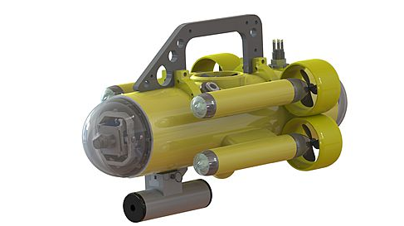
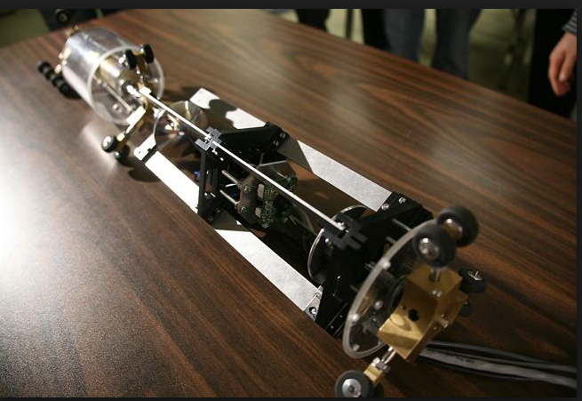
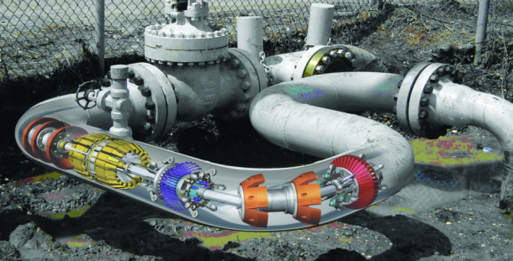
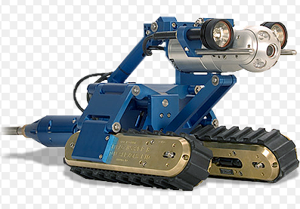
Robotic Pipe Inspection System
Locomotion unit:
  Floating robots.
  PIGS
  Wheeled robots.
    Tracks.
    Straight wheels.
    Angled wheels for spiral motion.
Inspection unit:
  UT.
  Electromagnetic.
  Radiography.
  Vision-based
    Using diffused light.
    Using structured light.

Slide 7
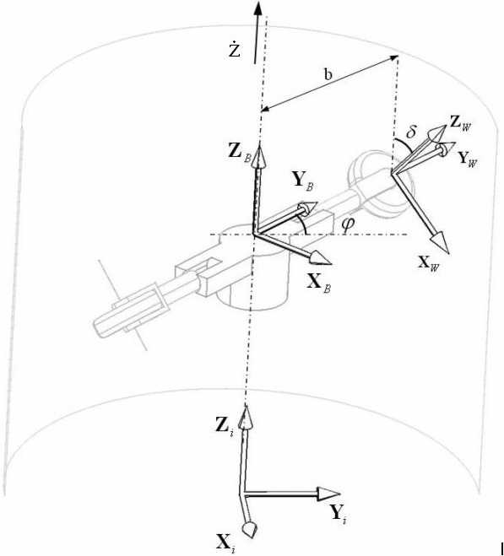
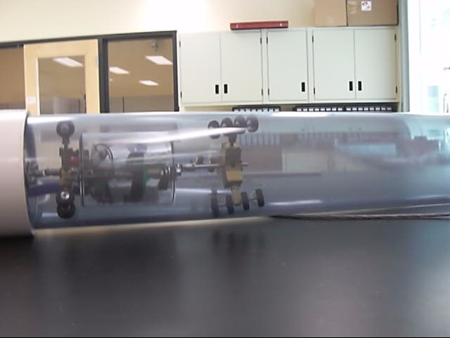
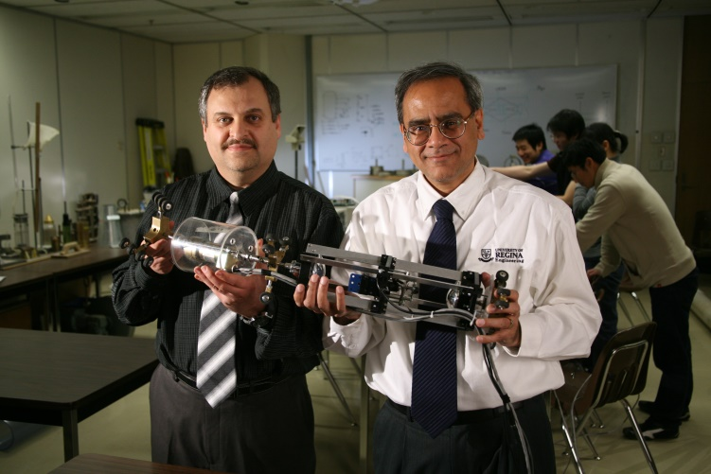
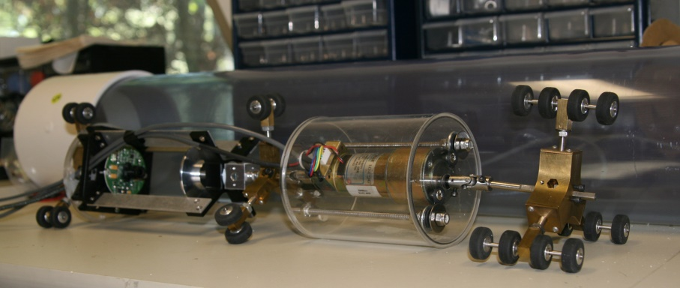
Robotic Pipe Inspection System
Locomotion unit:
  Regina Pipe Crawler (RPC).
  Highlighted as one of the 5 high-tech fixes to infrastructures in “Popular Mechanics”.
Kinematics:

Slide 8
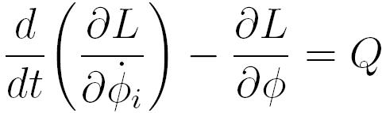

Robotic Pipe Inspection System
Locomotion unit:
  Regina Pipe Crawler (RPC).
  Highlighted as one of the 5 high-tech fixes to infrastructures in “Popular Mechanics”.
Dynamics:
Tm: electro-mechanical torque.
TF: resisting torque due to friction.
TD: resisting torque due to hydrodynamic forces.

Slide 9
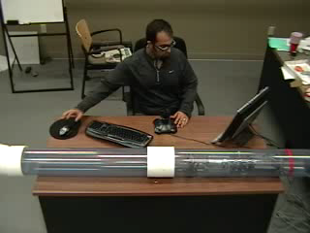
Robotic Pipe Inspection System
Locomotion unit:
  Control:
  Data-driven Adaptive PID control (developed via a human-in-the-loop control environment).
A Human-in-the-Loop (HITL) simulation environment was developed.
A human operator attempts to control the movement of the robot in this HITL based on visual feedback obtained from a Human-Machine Interface (HMI) in real time.
He/she uses an interface (i.e., a joystick or a game pad) to control the robot.
Time-stamped control action of the operator along with robot’s motion are recorded and stored.
The operator repeats the control task till he/she feels comfortable with the whole process (learning curve).
Input/output information gathered from the HITL are stored, filtered and used offline to design an autonomous Neuro-Fuzzy controller.
A human-analogous control strategy using Neuro-Fuzzy systems was proposed.

Slide 10
Robotic Pipe Inspection System
Inspection unit:
  UT.
  Electromagnetic (i.e., Eddy current).
  Radiography (gamma radiation).
  Vision-based (for external defects only)
Image-based Pipe Inspection
Imaging Sensor
Lighting System
Single-View
Multiple-View
Pinhole Perspective Imaging Sensor
Dioptric Imaging Sensor
Catadioptric Imaging Sensor
Diffused Light
Structured Light (laser)
Single-Viewpoint
Non-Single-Viewpoint

Slide 11
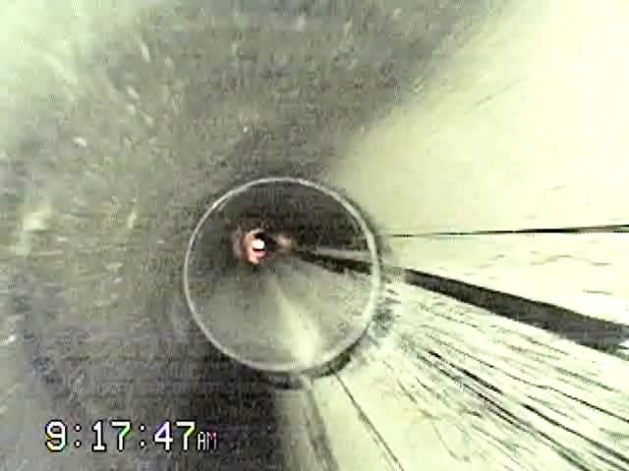
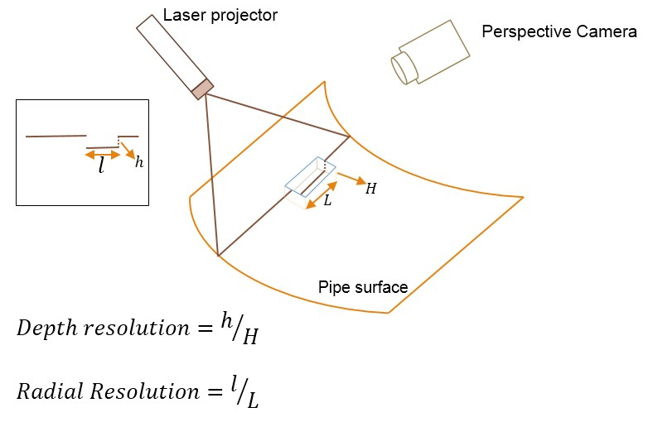
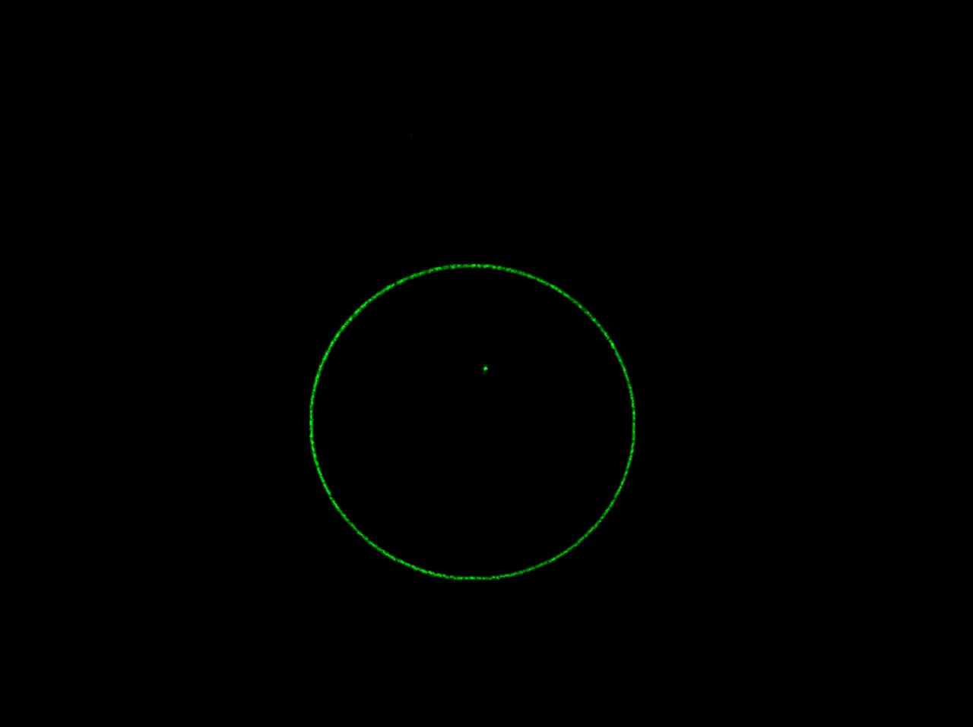
Robotic Pipe Inspection System
Inspection unit:
  Vision-based (for external defects only)
    Using diffused light.
    Using structured light.
LAser-Optics Technology for pipe inspection

Slide 12
LASER-OPTICS TECHNOLOGY
Research problems:
  Optimal configuration for highest resolution.
  Automated defect detection from sequential images.
  Sizing Defects In 3D (Structure From Motion).
  Localizing defects inside the pipe using images (i.e., Visual Odometry).

Slide 13
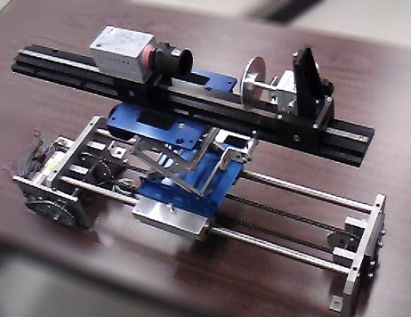
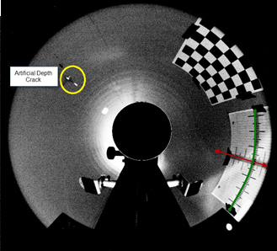
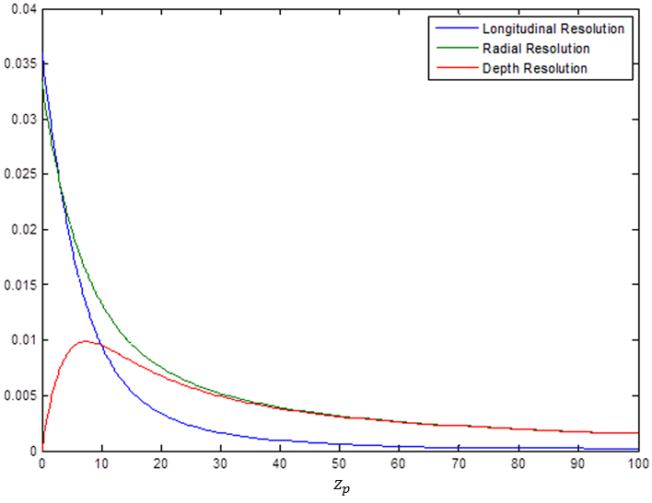
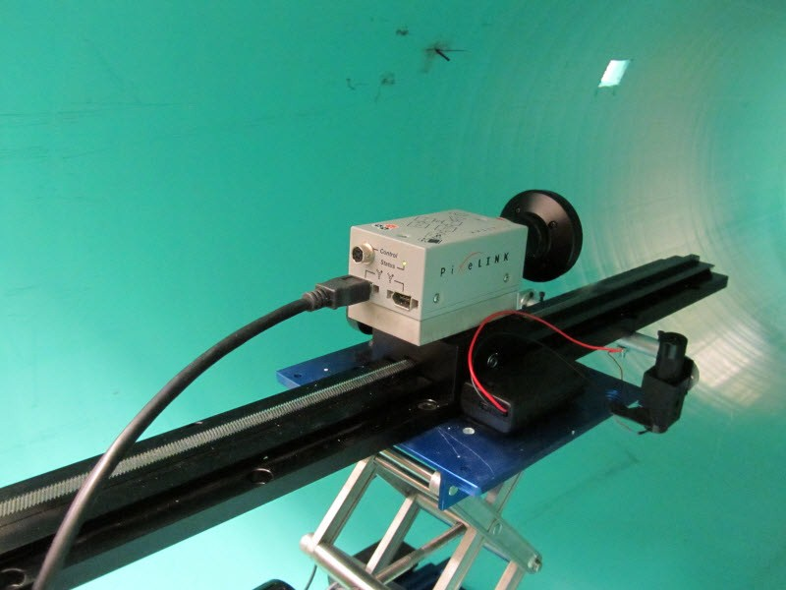
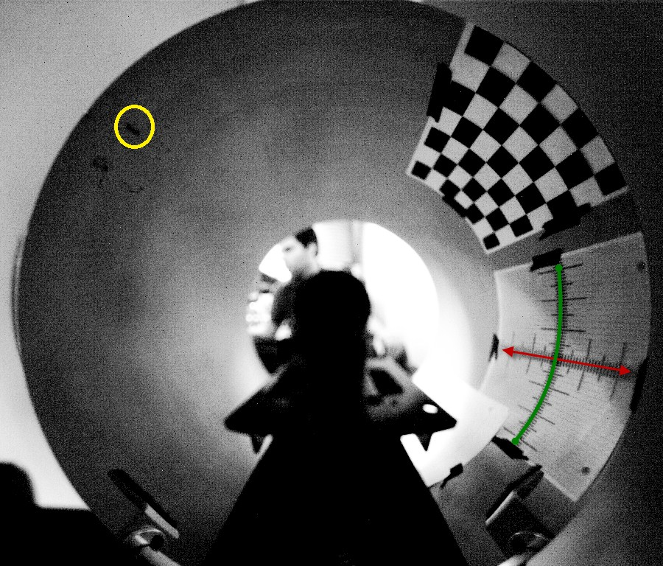
LASER-OPTICS TECHNOLOGY
Research problems:
  Optimal configuration for highest resolution.
  Omni-directional optical systems:
    Catadioptric (a perspective camera + a hyperbolic mirror).
    Dioptric (a perspective camera with a compound fish-eye lens).

Slide 14
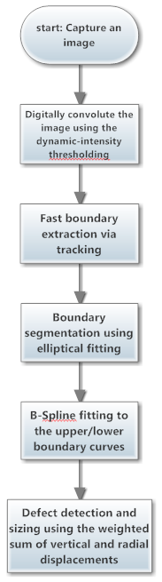
LASER-OPTICS TECHNOLOGY
Research problems:
  Automated defect detection from sequential images.

Slide 15
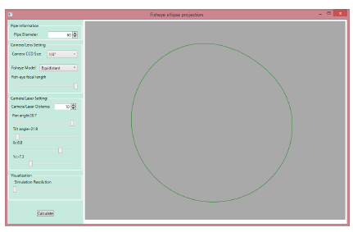
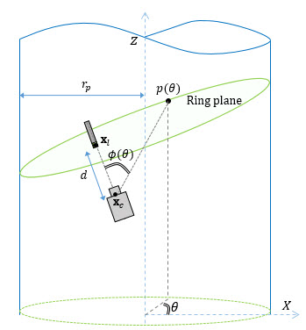
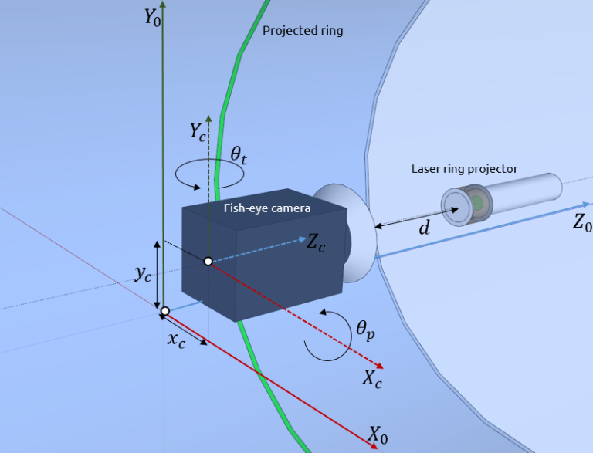
LASER-OPTICS TECHNOLOGY
Research problems:
  SIZING DEFCETC IN 3D (Structure From Motion).

Slide 16
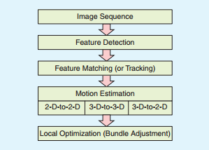
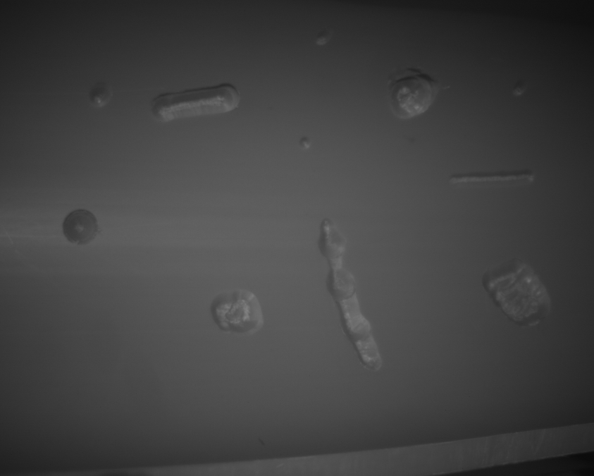
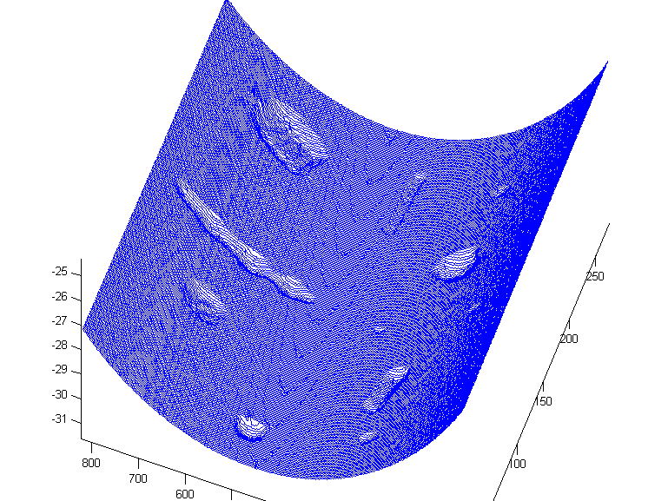
LASER-OPTICS TECHNOLOGY
Research problems:
  Localizing defects inside the pipe using images (i.e., Visual Odometry).
    Stereo Vo vs. mono VO.
    Omni-directional VO.
    Main components of a VO:

Slide 17
Concluding Remarks
  A robotic pipe inspection system was explained.
  The system consists of: (1) the locomotion, and (2) the inspection unit.
  A novel design of a low-DOF locomotion unit was presneted.
  A laser-optics technology for pipe inspection was reviewed.
  This system is used to: (1) detect defects, (2) size them, (3) classify them, and (localize them).
  Automated pipe inspection can provide consistent reports on pipe’s condition.
  It can be used for QC purposes by the pipe manufacturers as well.
  Pro-active and timely inspection of live pipes can make the industry sustainable.

Slide 18
Future work
  Design and development of a robust locomotion unit that can fit into a variety of pipes at different sizes.
  Making the system completely autonomous and wireless.
  Providing live data communication with the ground control via mud pulsating and/or acoustic modems.
  Using intero-ceptive sensors, such as IMUs, for precise odometry and localization.

