Slide 1
Quality-of- life, Body Image and Cosmesis after Single Incision Laparoscopic Cholecystectomy (SILC) Versus Conventional Laparoscopic Cholecystectomy (CLC)
M.D.Huseyin SINAN
M.D. Mehmet SAYDAM*
M.D. M.Tahir OZER
M.D. Sezai DEMIRBAS
Ass.Res.Pervin DEMIR
*Mevki Military Hospital,
Ankara, TURKEY

Slide 2
1.Winslow ER, Brunt LM. Perioperative outcomes of laparoscopic versus open splenectomy:a meta-analysis with an emphasis on complications.Surgery.2003;134:647-653
Conventional Laparoscopic cholecystectomy (CLC) was first performed by Erich Mühe in 1985.
Paradigm shift in the surgical arena (1).
Become the standart surgical procedure for diseases of gallbladder.
Generally four ports are needed
A lot of data are available in the literature for CLC

Slide 3
Seeking new techniques
Less pain
Less scaring
Shorter operative time
Shorter hospital length of stay
High level of satisfaction

Slide 4
2.Pelosi MA, Pelosi MA. Laparoscopic appendectomy using a single umbilical puncture (minilaparoscopy) J Reprod Med 37:588-594 1992 3,Navarra G, Pozza E, Occhionorelli S, CarcoforoP, Donini I. One-wound laparoscopic cholecystectomy.Br J. Surg84:695 1997.
The Conventional Laparoscopic Technique enjoy all these advantages
Single- Access Surgery was described in 1992 (2)
Single Incision Laparoscopic Cholecystectomy (SILC) in 1997 (3)

Slide 5
3. Hirano Y, Watanebe T, Uchida T et al: Single-incision laparoscopic cholecystectomy, single institutionexperience and literature review.World J Gastroenterol 16(2):270-274 2010 4. Lee PC, Lo C, Lai PS et al: Randomized clinical trial of single-incision laparoscopic cholecystectomy versus minilaparoscopic cholecystectomy. Br J Surg 97(7):1007-1012 2010
Reduced postoperative pain (3,4)
Reduced trauma to the abdominal wall (3,4)
Reduced scar (3,4)

Slide 6
5. Sinan H, Demırbas S, Ozer M.T, Sucullu I, Akyol M: Single-incision laparoscopic chılecystectomy versus laparoscopic cholecystectomy: a prospective randomized study Surg Laparosc Endosc Percutan Tech 22:1,2012
Technical problems of SILC
Collision of instruments (5)
Time to learn
Patience for surgeon
Patience for the surgical team

Slide 8
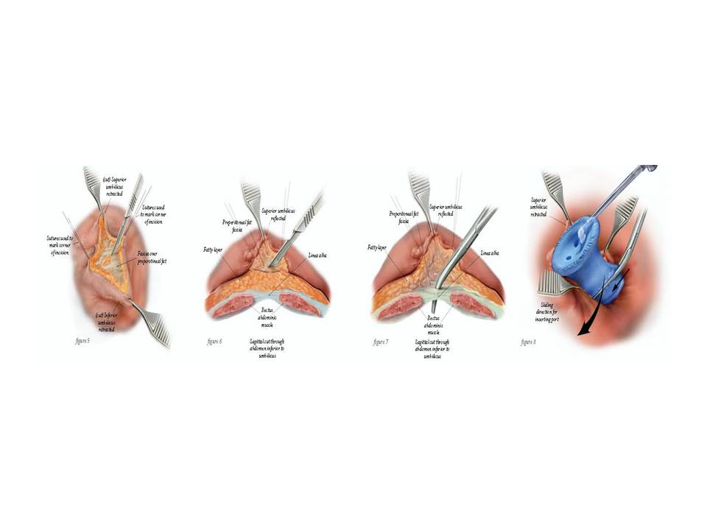

Slide 10
SILC (6 minutes video sample)
33 age male
BMI: 21,9
USG: Cholelitiasis

Slide 11
Relatively less data in the literature
Aim: Comparing outcomes of the SILC with LC in the terms of quality-of-life
measures and cosmesis
Prospective randomized study
January 2011 and March 2013 in Turkey

Slide 12
All operations were performed by the same team.
52 patients in two groups
26 patients were underwent SILC (f/m: 16/10)
26 patients were underwent CLC (f/m: 13/13)

Slide 13
6 months after surgery
EuroQol EQ-5D questionnaire

Slide 14
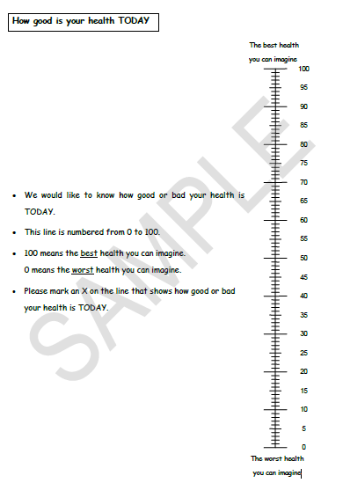

Slide 16
Statistical Analysis
Shapiro –Wilks® test for age variable
Number (n), percentage (%)
Pearson Chi Square® test for gender distribution

Slide 17
Statistical Analysis
Percentage and (n) values for Body Image Questionaire (BIQ) 1 to 5
answers
Mann-Whitney U test® for EQ-5D and BIQ 6 to 10
IBM Corp. Released 2012. IBM SPSS Statistics for Windows, Version 21.0. Armonk, NY: IBM Corp. and MS-Excel 2007
p<0.05

Slide 18
Results
55,8 % female
44,2 % male
Mean age: 46,6
Table 1. The comparison of the specified variables in the groups
 | Group |  |  |  | Test statistic
 | SILC |  | CLC |  |  | p
 | Min; Max | Median | Min; Max | Median
Age | 20.0; 79.0 | 47.5±14.7 | 25.0; 76.0 | 45.7±13.7 |  | 0.641
EQ_5D index | 0.755; 1.000 | 1.000 (0.090) | 0.755; 1.000 | 1.000 (0.090) |  | 0.831
EQ-5D_ self determination of the current health status | 40.0; 100.0 | 85.0 (21.0) | 65.0; 100.0 | 90.0 (11.0) |  | 0.202

Slide 19
Results
Table 2: Distribution of the individuals’ responses to the EQ-5D test
Variables | Group
 | SILC n (%) | CLC n (%)
EQ-5D_1
1 | 21 (48.8) | 22 (51.2)
2 | 5 (55.6) | 4 (44.4)
EQ-5D _2
1 | 23 (51.1) | 22 (48.9)
2 | 3 (42.9) | 4 (57.1)
EQ-5D _3
1 | 23 (51.1) | 22 (48.9)
2 | 3 (42.9) | 4 (57.1)
EQ-5D _4
1 | 18 (52.9) | 16 (47.1)
2 | 8 (44.4) | 10 (55.6)
EQ-5D _5
1 | 21 (48.8) | 22 (51.2)
2 | 5 (55.6) | 4 (44.4)

Slide 20
Results
Table 3: Distribution of the individuals ‘answers to the BIQ’s 1-5 th questions in the groups
Variables | Group
 | SILS n (%) | C LC n (%)
BIQ_1
2 | 1 (100.0) | 0 (0.0)
3 | 7 (77.8) | 2 (22.2)
4 | 18 (42.9) | 24 (57.1)
BIQ _2
2 | 1 (100.0) | 0 (0.0)
3 | 10 (62.5) | 6 (37.5)
4 | 15 (42.9) | 20 (57.1)
BIQ_3
3 | 8 (47.1) | 9 (52.9)
4 | 18 (51.4) | 17 (48.6)
BIQ _4
3 | 5 (41.7) | 7 (58.3)
4 | 21 (52.5) | 19 (47.5)
BIQ _5
3 | 6 (66.7) | 3 (33.3)
4 | 20 (46.5) | 23 (53.5)

Slide 21
Results
Table 4: Answers of the Body Image Quetionnaire's 6-10 questions in the groups
Variables | Group |  | Test statistic
 | SILC Median (min; max) | CLC Median (min; max) |  | p
BIQ _6 | 6.0 (3.0;7.0) | 6.0 (5.0; 7.0) |  | 0.193
BIQ_7 | 6.5 (4.0; 7.0) | 6.0 (4.0; 7.0) |  | 0.007
BIQ _8 | 8.5 (7.0; 10.0) | 8.0 (5.0; 10.0) |  | 0.024
BIQ_9 | 8.0 (6.0; 10.0) | 8.0 (6.0; 9.0) |  | 0.524
BIQ _10 | 9.0 (5.0; 10.0) | 9.0 (7.0; 10.0) |  | 0.938

Slide 22
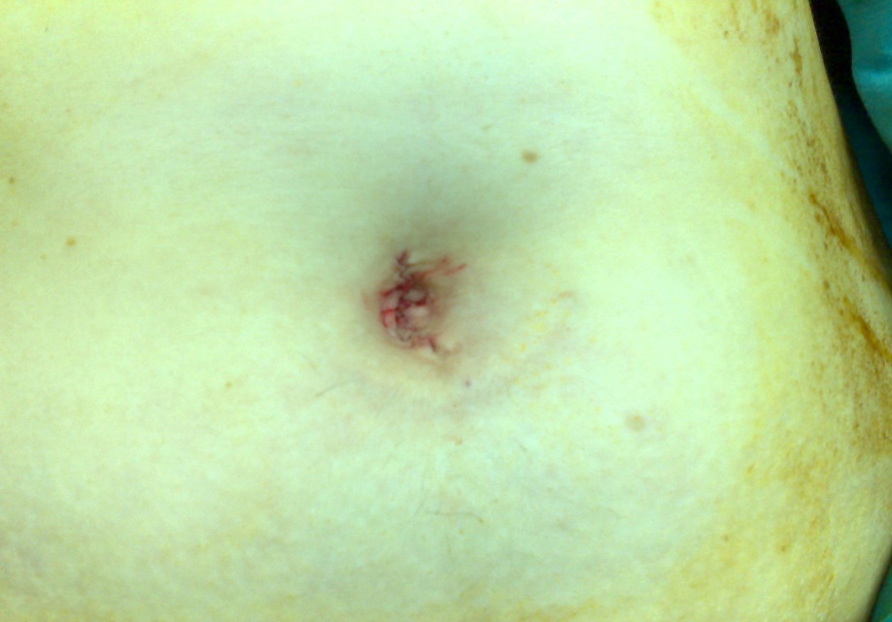
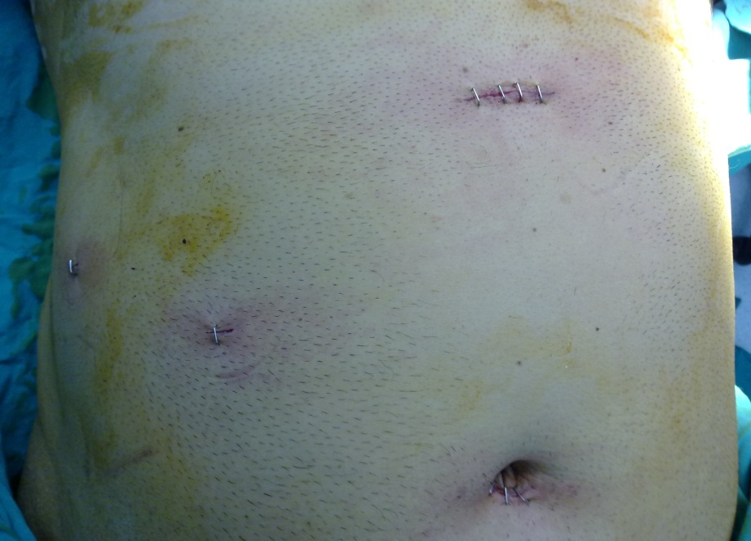
Conclusion
Cosmesis scale was the only statistically significant variable
Patients have better satisfaction of their scar appearance
SILC may be a preferable technique
Further studies are needed for the final assessment

