Slide 1
About OMICS Group
OMICS Group is an amalgamation of Open Access Publications and worldwide international science conferences and events. Established in the year 2007 with the sole aim of making the information on Sciences and technology ‘Open Access’, OMICS Group publishes 500 online open access scholarly journals in all aspects of Science, Engineering, Management and Technology journals. OMICS Group has been instrumental in taking the knowledge on Science & technology to the doorsteps of ordinary men and women. Research Scholars, Students, Libraries, Educational Institutions, Research centers and the industry are main stakeholders that benefitted greatly from this knowledge dissemination. OMICS Group also organizes 500 International conferences annually across the globe, where knowledge transfer takes place through debates, round table discussions, poster presentations, workshops, symposia and exhibitions.

Slide 2
OMICS International Conferences
OMICS International is a pioneer and leading science event organizer, which publishes around 500 open access journals and conducts over 500 Medical, Clinical, Engineering, Life Sciences, Pharma scientific conferences all over the globe annually with the support of more than 1000 scientific associations and 30,000 editorial board members and 3.5 million followers to its credit.
OMICS Group has organized 500 conferences, workshops and national symposiums across the major cities including San Francisco, Las Vegas, San Antonio, Omaha, Orlando, Raleigh, Santa Clara, Chicago, Philadelphia, Baltimore, United Kingdom, Valencia, Dubai, Beijing, Hyderabad, Bengaluru and Mumbai.

Slide 3
PİNEALECTOMY CAUSES OXİDATİVE STRESS İN THE BRAİN TİSSUE OF RATS UNDERWENT TO ABDOMİNAL SURGERY
Assoc. Prof. Mehmet Ozler

Slide 4
Melatonin; the main secreted substance of the pineal gland is a molecule consisting of indole structure which is found in all aerobic living beings from unicellular to mammals.
It is known to be associated with many biological events such as biological rhythms, sexual maturation, reproduction, sleep, mood and immunity.
It has also been shown to have an antioxidant effect in various in vivo and in vitro studies

Slide 5
However, it is a fact that mechanisms of antioxidant enzymes may not depend on just melatonin.
By thinking over these explanations in our study we aimed to investigate levels of oxidant/antioxidant parameters on brain tissue as remote organ effect on rats being applied peritoneal adhesion.

Slide 6
In this study 21 Sprague-Dawley male rats were divided into three groups.
Control
Pnealectomy
Pinealectomy+melatonin

Slide 7
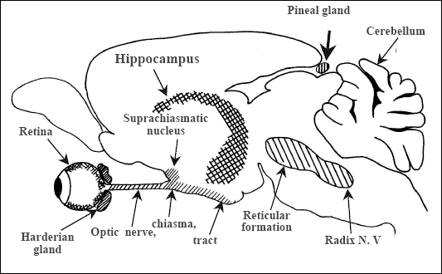
In the first phase of this study pinealectomy procedure was applied on two groups. These groups were left on their own for 15 days.
http://jpp.krakow.pl/journal/archive/11_06_s5/articles/04_article.html

Slide 8
15 days later from pinealectomy, peritoneal adhesion model was prepared by making incision in cecums of rats and suturing them.
One of the groups on which pinealectomy was applied single doze 5mg/kg oral melatonin was applied for 15 days.
This process was begun just after the operation and followed everyday throughout 15 days.

Slide 9
At the end of fifteen days, Apart from evaluation of adhesion lesions, their cranium were opened and their brain tissues were excised.
Malondialdehyde (MDA),
Superoxide dismutase (SOD),
Glutathion peroxidase (GSH-Px)

Slide 10
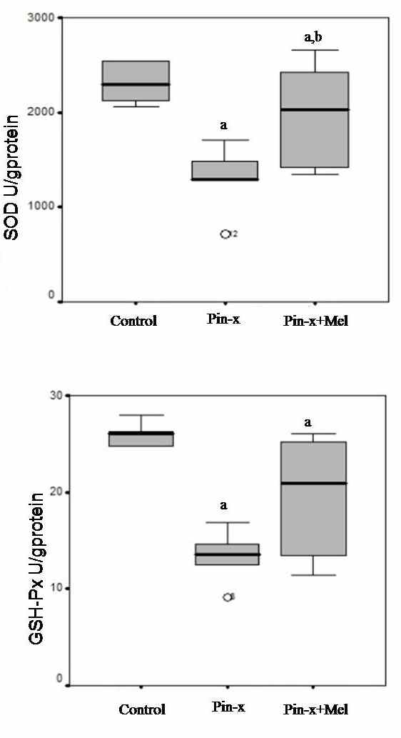
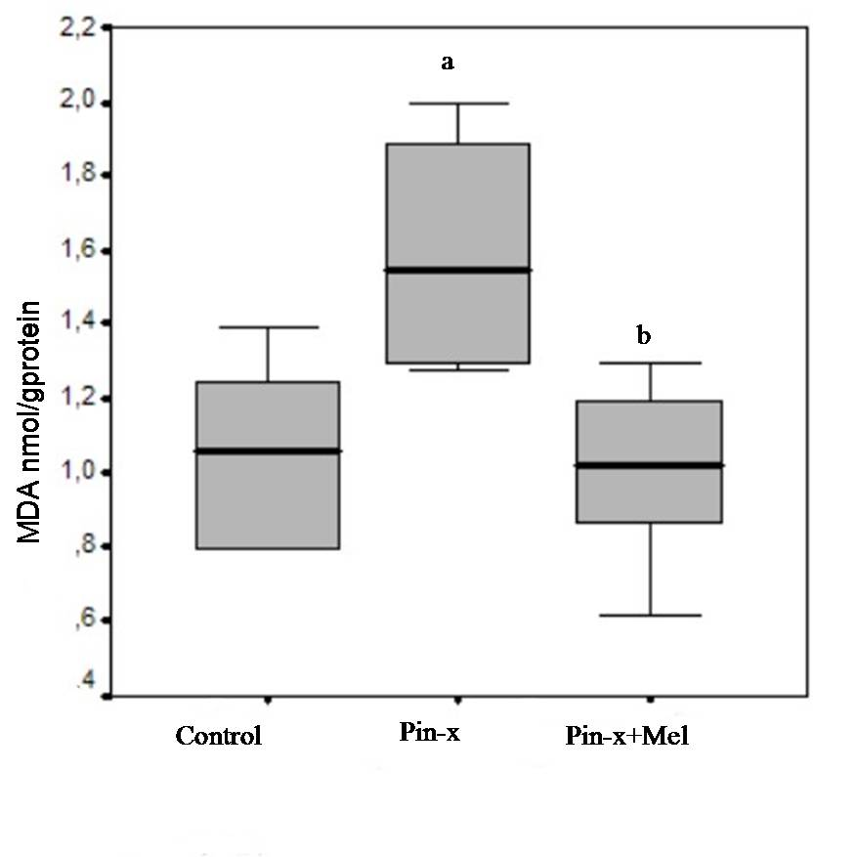

Slide 11
Conclusion
The results of the present study demonstrated clearly that pinealectomy causes oxidative stress and that melatonin administration can relatively ameliorate this effect in the rats brain.

Slide 12
Let us meet again..
We welcome you to our future conferences of OMICS International
2nd International Conference and Expo on
Drug Discovery & Designing
On
October -31 November-02, 2016 at Istanbul, Turkey
http://drug-discovery.pharmaceuticalconferences.com/

