Slide 1
Photonic Generation of Millimeter Wave Signals for Wireless Applications
Mehdi Shadaram
Department of Electrical and Computer Engineering
University of Texas at San Antonio
San Antonio, TX
International Conference and Business Expo on
Wireless Communication & Network
Baltimore, USA, September 21-23, 2015

Slide 2
Outline
Introduction
Utilization of Millimeter Waves
Optical Modulation Scheme
Harmonic Distortion
Performance Analysis
Results
Conclusion

Slide 3
Millimeter Wave RoF
Wireless transmission in the lower microwave band is congested by applications such as Wi-Fi, GSM, etc.
Some other new wireless technologies (e.g. WiMAX) are still handled within the lower microwave regions (2–4 GHz).
In United States, the 60 GHz band can be used for unlicensed short range (1.7 km) data links with data throughputs up to 2.5 Gb/s.
Propagation characteristics of the 60 GHz band like oxygen absorption and rain attenuation limits the range of communication systems using this band.
Geographical consideration is crucial for antenna base stations (BSs) installment.
Because of large number of required BSs and the high throughput of each BS, deployment of an optical fiber backbone is beneficial.

Slide 4
Why 60 GHz Band?
Bandwidth-traffic (57 GHz – 64 GHz)
License-Free Spectrum
Narrow Beam Antennas (Multiple Antennas)
Highly Directional, "pencil-beam" Signal
Easy to Install and Align
Oxygen Absorption and Security (Reduced Interference)

Slide 5
Optical Network for RoF Transmission
Notes:
elimination of the cable connecting video sources and projectors
practical high band-width wireless links to either high capacity or low power computing or storage devices such as hard drives or digital video cameras
delivery of high definition uncompressed baseband audio and video without high definition multimedia interface (HDMI) wires

Slide 6
Methods of Transmitting the mm-wave Wireless Signals over the Optical Fiber
RF over Fiber
IF over Fiber
Baseband over Fiber
Notes:
RF over Fiber
For this method mm-wave signals at the CO are transmitted directly over fiber. This method removes need of frequency translation at BSs. But, the drawback is that high speed optical devices (e.g. optical modulator, photodetector) are required. Also, significant effect of fiber chromatic dispersion on the detected mm-wave wireless signals is necessary to be controlled [9].
IF over Fiber
Intermediate frequency (IF) Signals are transmitted at the CO in this method. Chromatic dispersion effect of fiber on the signal transmission and required speed of optical components are reduced significantly. But in return, the complexity of the antenna BS hardware is added in order to translate the IF signals to mm-waves.
All frequency up-conversion process is done at the Antenna BSs. In this method the fiber chromatic dispersion and the required speed for optical components are the least. But, the drawback is the highest complexity for BSs.

Slide 7
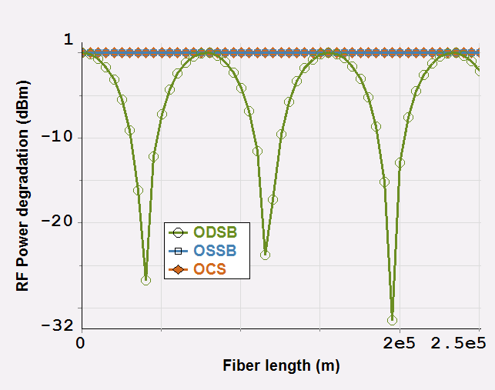

RF Power Degradation Versus Fiber Length for ODSB, OSSB, OCS Modulation Formats
Power Fluctuation
Notes:
This RF power degradation is the difference between RF power detected at the photodetector for fiber length of L km and 0 km. In case of ODSB there are two signal sidebands. So the phase difference due to fiber chromatic dispersion between two beat components at the RF ferequency causes the RF power degradation

Slide 8
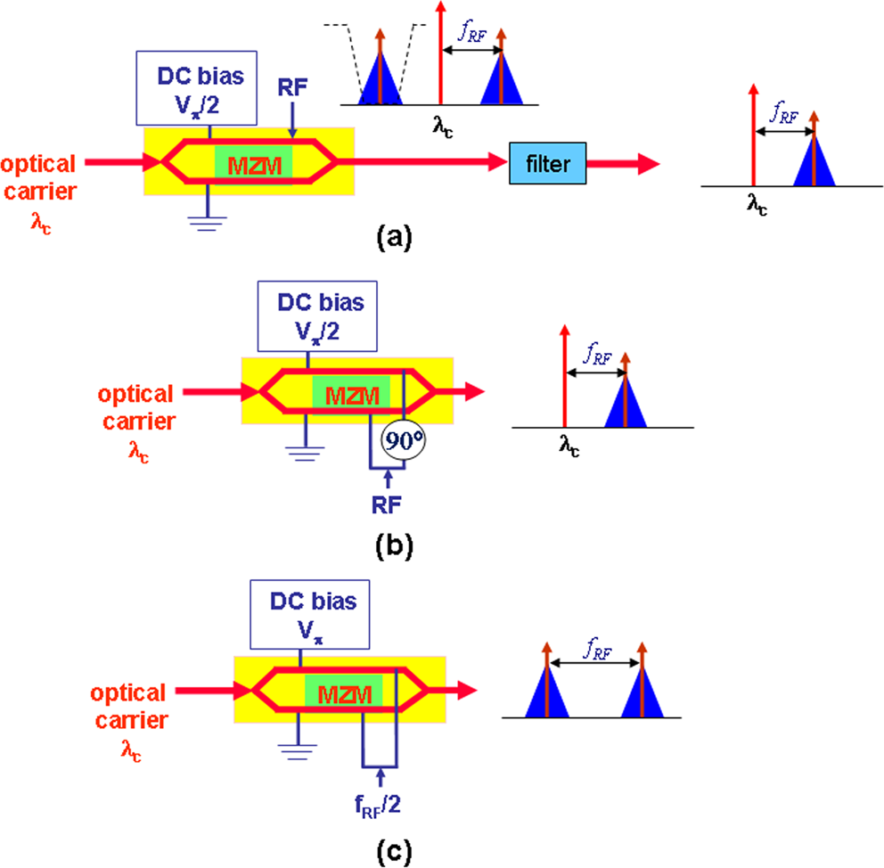
ODSB, OSSB, and OCS
C. Lim, et. al., “Fiber-Wireless Networks and Subsystem Technologies,” Light Tech. J., vol. 28, pp. 390­–405, Feb. 2010

Slide 9
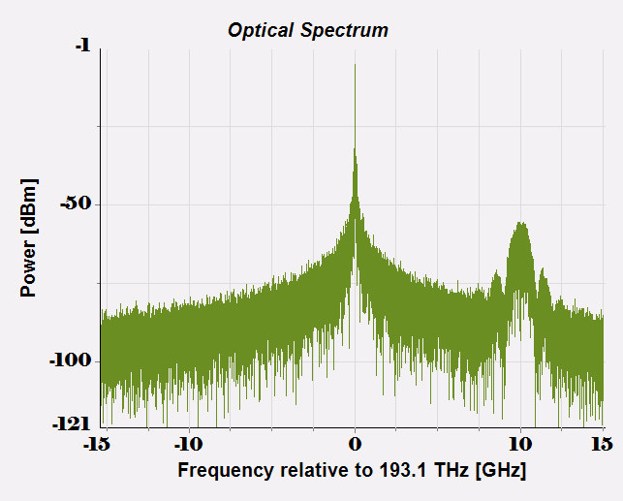
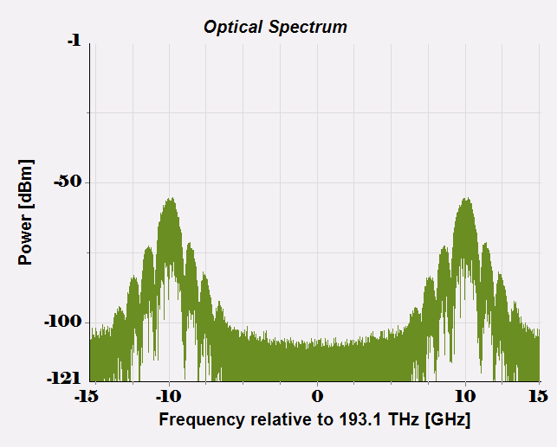

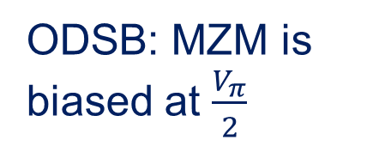

Overcoming Fiber Chromatic Dispersion
The fiber dispersion effect on optically transmitted signals is critical to be controlled specifically for long fiber link. For eliminating this impairment OCS and OSSB techniques can be used
ODSB: MZM is biased at $\frac{V_{π}}{2}$
OSSB; MZM is biased at $\frac{V_{π}}{2}$
OCS; MZM is biased at $V_{π}$
MZM ER=1000, laser linewidth=2MHz

Slide 10
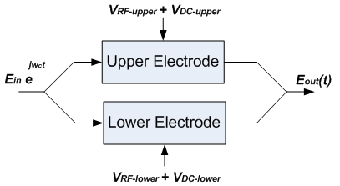
OSSB Modulation
Dual electrode MZM structure

Slide 11


Slide 12
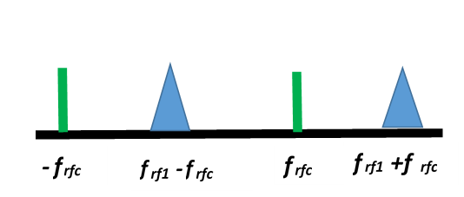
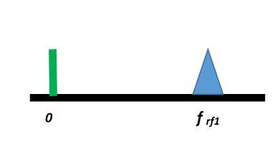
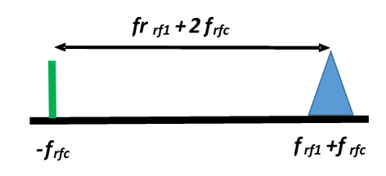
Mm-Wave Generation Procedure
After first MZM
After second MZM
After optical filter: At the photodiode

Slide 13
Second Modulator’s Output
Photodiode’s Output

Slide 14
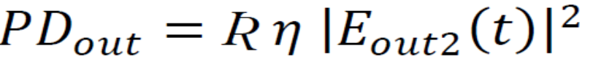
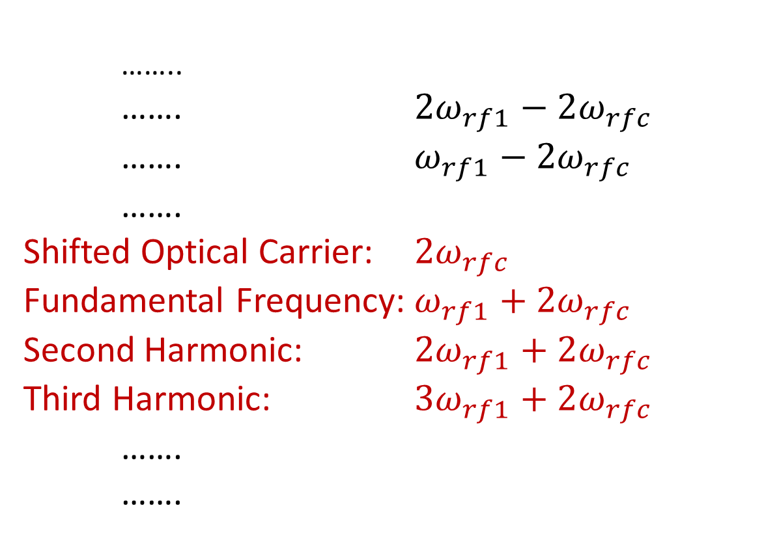
Harmonics after the Photodetection
……..
……. $2ω_{rf1}−2ω_{rfc}$ ……. $ω_{rf1}−2ω_{rfc}$
…….
Shifted Optical Carrier: $2ω_{rfc}$
Fundamental Frequency: $ω_{rf1}+2ω_{rfc}$
Second Harmonic: $2ω_{rf1}+2ω_{rfc}$
Third Harmonic: $3ω_{rf1}+2ω_{rfc}$
…….
…….

Slide 15
2nd and 3rd Order Harmonic Distortions due to Nonlinearities in MZMs

Slide 16
Fundamental Frequency:
𝜔𝑟𝑓₁+2 𝜔_{𝑟𝑓𝑐}
HD2:
2𝜔_{𝑟𝑓1}+2 𝜔_{𝑟𝑓𝑐}
HD3:
3 𝜔_{𝑟𝑓1}+2 𝜔_{𝑟𝑓𝑐}

Slide 17
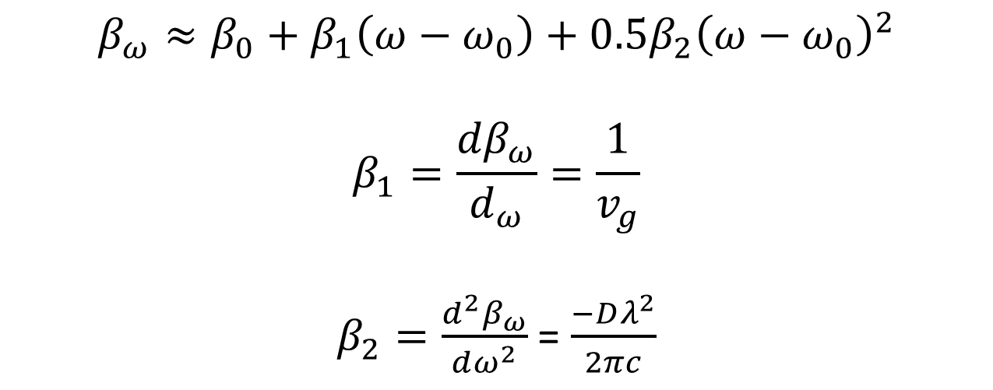
Second and Third order harmonic distortions due to fiber dispersion
$$β_{ω}≈β_{0}+β_{1}\left(ω−ω_{0}\right)+0.5β_{2}{\left(ω−ω_{0}\right)}^{2}$$
$$β_{1}=\frac{{dβ}_{ω}}{d_{ω}}=\frac{1}{v_{g}}$$
$β_{2}=\frac{d^{2}β_{ω}}{dω^{2}}$ = $\frac{−Dλ^{2}}{2πc}$
The propagation constant for each optical subcarrier is different
Source: W.H. Chen, et al, J. LWT, Vol. 22, No. 7, July 2004

Slide 18
Second and Third order harmonic distortions due to fiber dispersion

Slide 19
Second and Third Harmonic Distortion due to Fiber Chromatic Dispersion

Slide 20
Harmonic Distortions with and without Fiber Dispersion

Slide 21
SER for the 4-QAM vs. SNR
L=80km; D=17 ps/(nm.km); Attn: 0.2dB/km; RF=62 GHz, Bit Rate=1 Gb/s

Slide 22
Received Eye Diagrams and Signal Constellations

Slide 23
Generation of Multi Single Side-Band Sub Carriers

Slide 24
Conclusion
RF multiplexed OSSB mm-wave signals generated using cascaded MZMs
Harmonic distortions caused by the MZM and chromatic dispersion are discussed
In order to optimize the suggested system performance, it is required to adjust the RF amplitude properly.
A compromise between high SNR and low nonlinearity effects should be considered to guarantee the system performance.

Slide 25
Thank You
Questions?

