Slide 1
Which germs should be targeted in diabetic foot infection ? a prospective study of 100 patients.
Mehdi Khalfallah, Mohamed Ben Moussa*, Ilhem Boutiba Ben Boubaker*, Dougaz Wejih, Jerraya Hichem, Ramzi Nouira, Amine Slim*, Ibtissem Bouasker, Chadli Dziri.
Surgery Unit B, Charles Nicolle’s Hospital, Tunis, Tunisia
*Laboratory of microbiology, Charles Nicolle’s Hospital, Tunis, Tunisia.
18th European Diabetes Congress July 17-18, 2017 Lisbon, Portugal

Slide 2
Background
Diabetic foot infection: major public health problem both in developed and developing countries [1].
In France: incidence of chronic foot wounds in diabetic patients estimated at 2,5 % per year in 2008 [2].
In Tunisia: diabetic foot accounted for 7,4% of hospital admissions in an endocrinology department in 1997 [3].
[1]: Toumi A, Bernard L, Chakroun M. Antibiothérapie des infections du pied diabétique. Rev Tun Infectiol 2011;5:61-7.
[2]: Ha Van G, Hartemann-Heurtier A, Gautier F et al. Pied diabétique. Encycl Med Chir Endocrinologie-Nutrition 2011; 10:366-9.
[3]: BenKhalifa A. Le pied diabétique: Expérience du service de Diabétologie Hôpital la Rabta. Tunis Med 1997;75:15-22.

Slide 3
Background
History of diabetic foot infection starts with ulceration following a trauma that often goes unnoticed, mainly caused by diabetic neuropathy and incidently by arteriopathy [4].
Ulcerations represent an identified source for infection in 40 to 80 % of cases [5].
[4]: Malgrange D. Physiopathologie du pied diabétique. Rev Med Interne 2008;29:231-7.
[5]: Richard JL, Sotto A, Lavigne JP. New insights in diabetic foot infection.World J Diabetes 2011;2:24-32.

Slide 4
Background
Antibiotic treatment holds an important position in the treatment of diabetic foot infections
This implies a perfect knowledge of the infecting bacteria
In Tunisia, no previous study has been carried out to identify the infecting bacteria.

Slide 5
Aim of the work
To define the clinical and bacteriological profile of the infected diabetic foot in patients admitted in the surgery unit B of Charles Nicolle’s hospital so as to better guide first-line antibiotherapy and identify the prognostic factors of this condition.

Slide 6
Methods
Open prospective study
Extending over 17 months (01/09/2011 – 01/02/2013)
Achieved in collaboration between the general surgery unit B and the microbiological laboratory of Charles-Nicolle’s hospital in Tunis
We decided to include 100 diabetic patients operated on for infected diabetic foot
Each patient had one or several bacteriological samples taken aseptically in the operating room
Clinical data reported according to individual files

Slide 7
Methods
1) Sampling for bacteriological examination:
After preparing the infected wound by surgical debridement, one or several bacteriological samples have been taken for each patient through deep scraping-scrubbing and the samples taken have been preserved in a T.G.V Bio-Rad®transport medium until they reached the bacteriology laboratory.

Slide 8
Methods
2) Bacteriological analysis:
Samples inoculated on plain agar, desoxycholate lactose agar, mannitol salt agar, blood agar and chocolate agar.
For any positive culture, the identification of bacteria has been made by using conventional methods (morphological, cultural and biochemical characteristics).
In case of positive culture for the same bacteria on several samples in the same patient, a single one has been recorded.
The study of antibiotic susceptibility has been carried out according to the MUELLER HINTON agar diffusion technique [6] and interpreted according to the recommendations of the antibiogram committee of the french society of microbiology [6].
[6]: Comité de l’antibiogramme de la Société Française de Microbiologie. Recommandations 2011. Edition 2011:3-55.

Slide 9
Methods
The multiresistance of a bacterium (BMR) has been defined by the isolation of :
enterobacteria resistant to third generation cephalosporin antibiotics (C3G)
Staphylococcus aureus resistant to methicillin (MRSA)
Acinetobacter bauamannii or Pseudomonas aeruginosa resistant to ceftazidime or imipenem.
In case of isolation of enterobacteria resistant to carbapenems, a search for the blaOXA 48 gene has been carried,out through simplex PCR assay.

Slide 10
Methods
3) Clinical analysis: for each patient, we have noted:
demographic characteristics
personal medical history
personal surgical history of the infected foot
risk factors for infection of the diabetic foot
history of the infection
data of the clinical examination of the wound at the time of admission to hospital
grade of the infection according to the international consensus on the diabetic foot classification [2]
kind, doses and duration of the antibiotic treatment received after admission
kind of surgical treatment undergone.
foot X-ray
[2]: Ha Van G, Hartemann-Heurtier A, Gautier F et al. Pied diabétique. Encycl Med Chir Endocrinologie-Nutrition 2011; 10:366-9.

Slide 11
Methods
Diabetes mellitus: defined by a fasting blood glycemia >1,26 g/l or a hyperglycemia > 2g/l.
Neuropathy: defined by a decrease in superficial or deep sensibility and abolition of achille's tendon reflex.
Arteritis: defined by an intermittent claudication, ischemic symptoms or decrease or absence of pulses in lower limbs.
Osteitis: defined by an exposed foot’s bone or radiologic signs as bone lysis, bone sequestrum or periosteal reaction.

Slide 12
Methods
Post-operative monitoring favourable: when post-operative course was uneventful with a non-infected clean wound and systemic signs under control.
Post-operative course unfavourable:
persistence or an extension of the local infection in spite of surgical treatment
and/or worsening of systemic signs in the postoperative course requiring in both cases a return to the operating room.

Slide 13
Methods
4) Statistical analysis:
Data analysed by means of the SPSS® software version 19.0.
Comparison of two means on independent series has been made by means of the Student’s t test and percentages by Pearson’s chi-squared test or the Fisher’s exact bilateral test.
Identification of the prognostic factors has been achieved by means of a multivariate analysis of logistic regression type.
The materiality threshold has been set at 0,05 for all statistical tests.

Slide 14
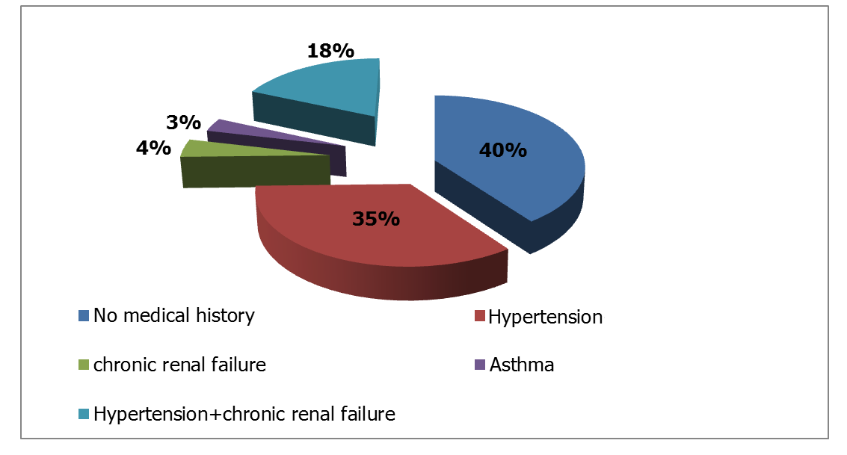
Results
Average age was 59,5 ± 11 years
Sex-ratio of 2,4: 71 men / 29 women
Figure n° 1: medical history

Slide 15
Results
Type 2 diabetes in 85 % , type 1 diabetes in 15% .
Median duration of the progression of diabetes: 15 ± 7,5 years (extremes 1 - 40 years).
Type 1 diabetes: all treated with insulin before their admission.
Type 2 diabetes:
Taking oral anti diabetics (ADO) in30 %
Insulin in 35 %
ADO and insulin in 33 %
No treatment in 2 % of cases.

Slide 16
Results
There was a bad treatment compliance in 62 %.
Peripheral neuropathy: 18 %
Arteritis: 16%
Patients already operated for infected foot at least once: 39% and 15 % had had at least an amputation at the level of the same foot.

Slide 17
Results
Median duration of the progression of the wound or the ulceration ahead of admission to hospital: 58,2 days (extremes : 7 - 360 days)
Rate of chronic wounds (≥ 1month): 80 %
Infection complicating these wounds: 15,1 days (extremes 2 - 45 days ) ahead of admission to hospital
Empirical antibiotic therapy before admission:
63 patients
Combination of fusidic acid + [amoxicillin/clavulanic acid(AMC)] in 57 % of cases.

Slide 18
Results
Clinical examination:
According to the international consensus classification of the diabetic foot, infection:
rated grade 4 in 86 patients
grade 3 in 14 patients
Osteitis: 28 patients

Slide 19
Results
The treatment plan included:
a medical part: antibiotic therapy
a surgical part: excision and/or amputation
Intravenous empirical combination of fusidic acid + AMC : 98 patients.
Ertapenem: 2 patients (infection + septicemia).
Surgical management:
Amputation (toe,foot, leg or thigh): 85 %
Conservative treatment: 15 %

Slide 20
Results
Deep curettage and scraping: 124 samples [ 1,2 samplings per patient (extremes :1 - 3 samples per patient)].
Culture: positive: 91 patients
136 bacteria isolated: average 1 bacteria per patient (extremes : 0 - 3 bacteria ).
monomicrobial infection: 50 patients
polymicrobial infection: 41 patients
2 organisms in 37 cases and 3 organisms in 4 cases.

Slide 21
Results
Germs isolated:
Enterobacteria : 73%
Streptococcus: 10%
Staphylococcus aureus: 9%
Pseudomonas aerugionosa: 8%

Slide 22
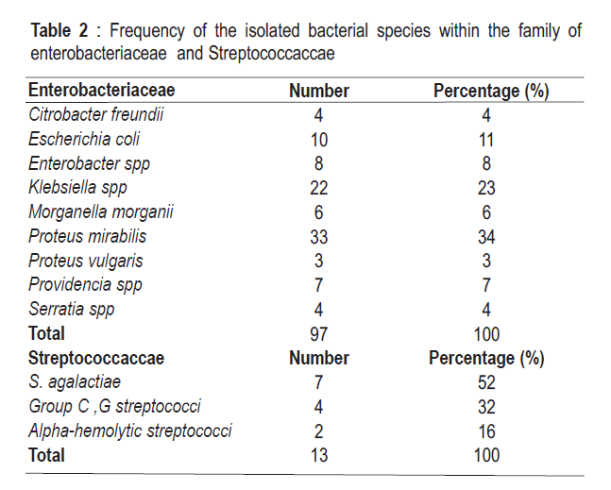
Results

Slide 23
Results
The study of the distribution of the organisms isolated according to the different clinical data:
Gram positive cocci: statistically more often isolated in patients with wounds developing since less than 2 months (p<0,05)
Gram negative bacilli: statistically more frequent in patients with wounds dating back to more than 2 months (p=0,035).
P. aeruginosa was statistically more frequent in patients who had previously undergone foot operation (p=0,02)

Slide 24
Results

Slide 25
Results
Resistance to combination amoxicillin + clavulanic acid(AMC): 48 % of enterobacteriaceae.
Resistance to 3rd generation cephalosporin: 11% of enterobacteriaceae.
Resistance to carbapenems : a strain of K.pneumoniae (resistant to ertapenem, to 3GC and sensitive to imipenem produces carbapenemase and extended-spectrum beta -lactamase (ESBL)).
Resistance to fluoroquinolone: 18 % of enterobacteriaceae

Slide 26
Results
Aminoglycosides: amikacin 3 % of resistance of Enterobacteria
S. aureus:
sensitive to various antibiotics
No meticillin-resistant S. aureus detected
Overall rate of Multi-Drug-Resistance: 9,5 %
Infection by at least one MDRBacteria: 12 patients (2 MDRB in 1 patient).

Slide 27
Results
About 91 % of the isolated bacteria were naturally resistant to fusidic acid
Combination amoxicillin-clavulanic acid(AMC) was inactive in vitro on 44,1 % of the isolated bacteria: empiric antibiotic therapy used for our patients was inadequate in 45 % of cases.

Slide 28
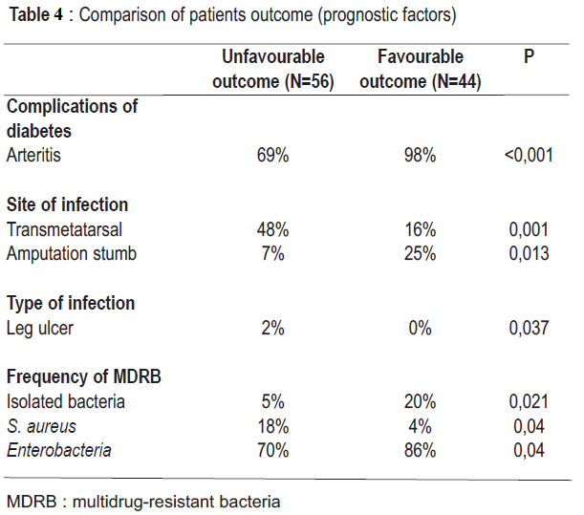
Results
Evolution: favourable 56 %, unfavourable: 44 %.
Univariate analysis:

Slide 29
Results
Multivariate analysis:
Arteritis: p= 0,018, OR =23,7
Multidrug resistant bacteria: p = 0,027, OR = 5,8

Slide 30
Comments
Our study was 1st epidemiological survey which studied bacterial flora causing diabetic foot infection and the prognostic factors of this pathology in surgical environment in Tunisia.
Gram negative bacilli of the enterobacteria family were the main bacteria causing diabetic foot infection in our patients: 73%

Slide 31
Comments
Explained by:
Patients recruited in surgical setting where patients cared for are often suffering from chronic foot wounds that have been treated with one or several antibiotics in ambulatory care
admitted to hospital in almost all cases for severe damage such as wet gangrene , often complicated by osteitis and septicemia.

Slide 32
Comments
Numerous authors have reported the prevalence of gram negative bacilli of the enterobacteria family in recent publications

Slide 33
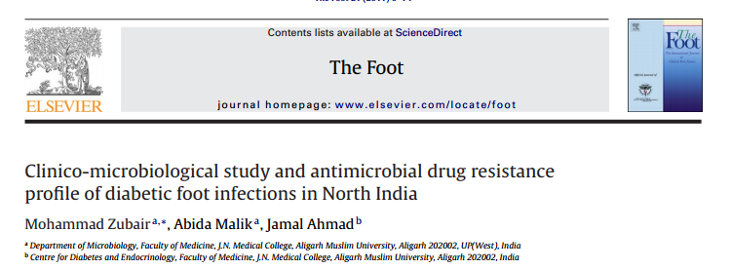
Comments

Slide 34
Comments

Slide 35
Comments
However, data of western literature stressed the prevalence and the pathogenic role of S. aureus

Slide 36
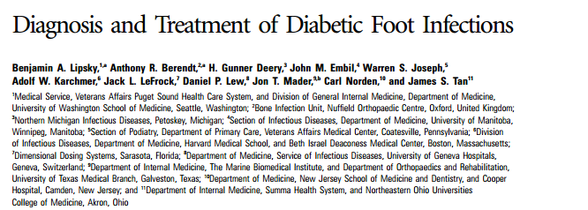
Comments

Slide 37
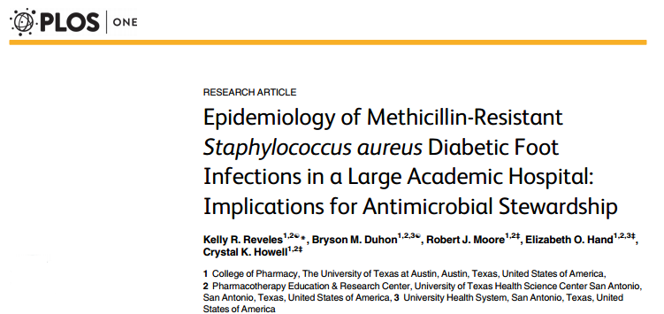
Comments

Slide 38
Comments
Rates of resistance to antibiotics of the bacteria isolated from diabetic foot lesions vary according to studies: due to the different habits in matters of antibiotics prescription despite the existence of recommendations that have tried to standardize prescriptions [7].
[7]: Hartemann-Heurtier A, Robert J, Jacqueminet Set al. Diabetic foot ulcer and multidrug-resistant organisms: risk factors and impact. Diabet Med 2004;21:710-5.

Slide 39
Comments
Resistance of the enterobacteria to 3rd generation cephalosporin: 11 % (production of ESBL)
Frequency of isolation of enterobacteria producing ESBL :between 6 % - 67 %[8].
[8]: Zubair M, Malik A, Ahmad J. Study of Plasmid-Mediated Extended-Spectrum β Lactamase-Producing Strains of Enterobacteriaceae isolated from Diabetic Foot infections in a North Indian Tertiary-Care Hospital. Diabetes TechnolTher 2012;14:315-24.

Slide 40
Comments
Most active antibiotics found in our work:
imipenem
amikacin.
The US infectious pathology society suggested in its last recommendations in 2012, imipenem for the empiric therapy of severe foot infections especially in case of isolation of ESBLs-producing bacteria [9].
Ertapenem: active in vitro against most isolated bacteria except for P. aeruginosa and A. baumannii. The interest of this drug in the treatment of foot suppurations in diabetic patients is well proven in literature [9,10].
[9]: Lipsky BA, Berendt AR, Cornia PB et al. 2012 Infectious Diseases Society of America Clinical Practice Guidelines for the Diagnosis and Treatment of Diabetic Foot Infections. Clin Infect Dis 2012;54:132-73.
[10]: Société de pathologie infectieuse de langue française. Recommandations pour la pratique Clinique : Prise en charge du pied diabétique infecté. Med Mal Infect 2007;37:1-13.

Slide 41
Comments
Limits and shortcomings in our work:
No anaerobic germs isolated: involvement in the diabetic foot infections [11]
No MRSA found during our work: stands at 19,7 % - 60% [12,13]
We have no explanation about the absence of anaerobic germs and MRSA.
Bacterial flora found relates to most cases of severe infections: does not allow to extrapolate our results to the whole diabetic patients with foot infection.
[11]: Ng LS, Kwang LL, Yeow SS, Tan TY. Anaerobic Culture of Diabetic Foot Infections: Organisms and Antimicrobial Susceptibilities. Ann Acad Med Singapore 2008;37:936-9.
[12]: Richard JL, Sotto A, Jourdan N et al. Risk factors and healing impact of multidrug-resistant bacteria in diabetic foot ulcers. DiabetesMetab 2008;34:363-9.
[13]: Cabete J, Martins de Carvalho F, Moniz L et al. Microbiological profile and antibiotic susceptibility patterns of organisms isolated from diabetic foot ulcers in a Portuguese hospital. Rev Cir CardiotoracVasc 2011;18:53-60.

Slide 42
Perspectives
In order to better assess the infecting bacterial flora, multicentric studies should be carried out including:
units of diabetology
internal medicine
infectious disease (less severe infections).
Diabetic foot infection requires multidisciplinary approach: to improve prognosis

Slide 43
Conclusion
Enterobacteria were the main bacteria causing diabetic foot infection in our study: 73%
Germs targeted in diabetic foot infection:
Proteus mirabilis
Klebsiella pp
Escherichia coli
Independent prognostic factors:
Arteritis
Isolation of multidrug-resistant bacteria

Slide 44
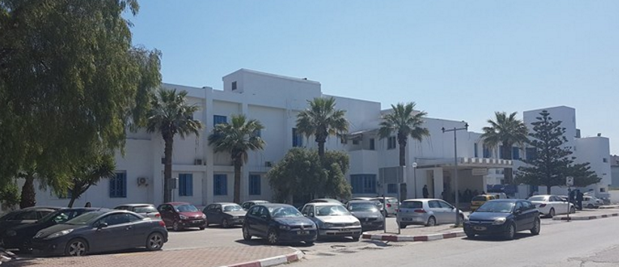
Thank you for your attention
TUNISIA

