Slide 1






Bremen University
Earth System Science
Research School
Climate variability effects on long-term macrofaunal abundance trends in the North Sea
Mehdi Shojaei
The Alfred Wegener Institute, Helmholtz Centre for Polar and Marine Research
Earth System Science
Research School
Prof.Dr. T.Brey Dr. L.Gutow Dr. J.Dannheaim

Slide 2
Outline
Long-term sampling sites
Ecological function, Biological traits analysis (BTA)
and fuzzy coding.
Dynamic factor analysis (DFA)
Results and Conclusion

Slide 3

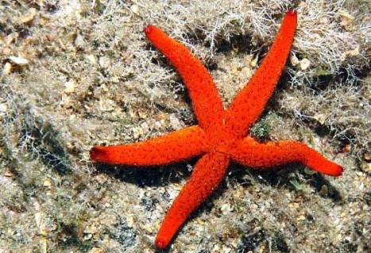
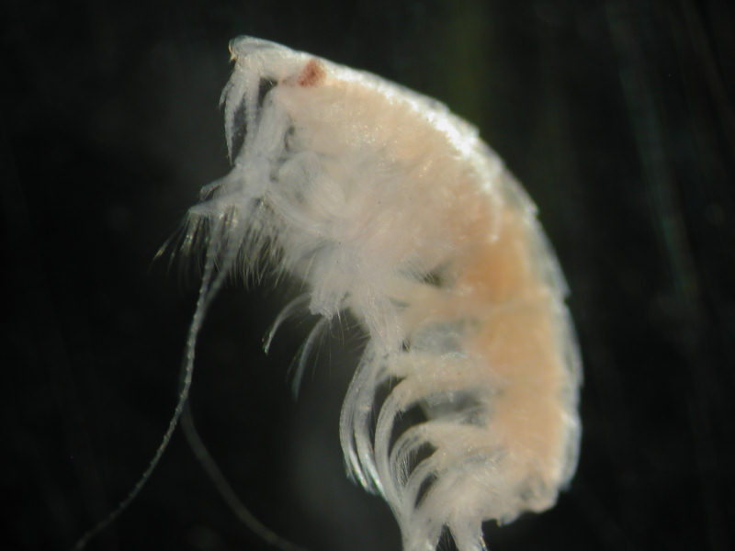
Macrofauna, are invertebrates that live on or in sediment, or attached to hard substrates, in marine, estuarine or freshwater environments.
Thyasira flexuosa
Biopix
OsserMare
MarLIN
Ophiura spp.
Bathyporeia spp.

Slide 4
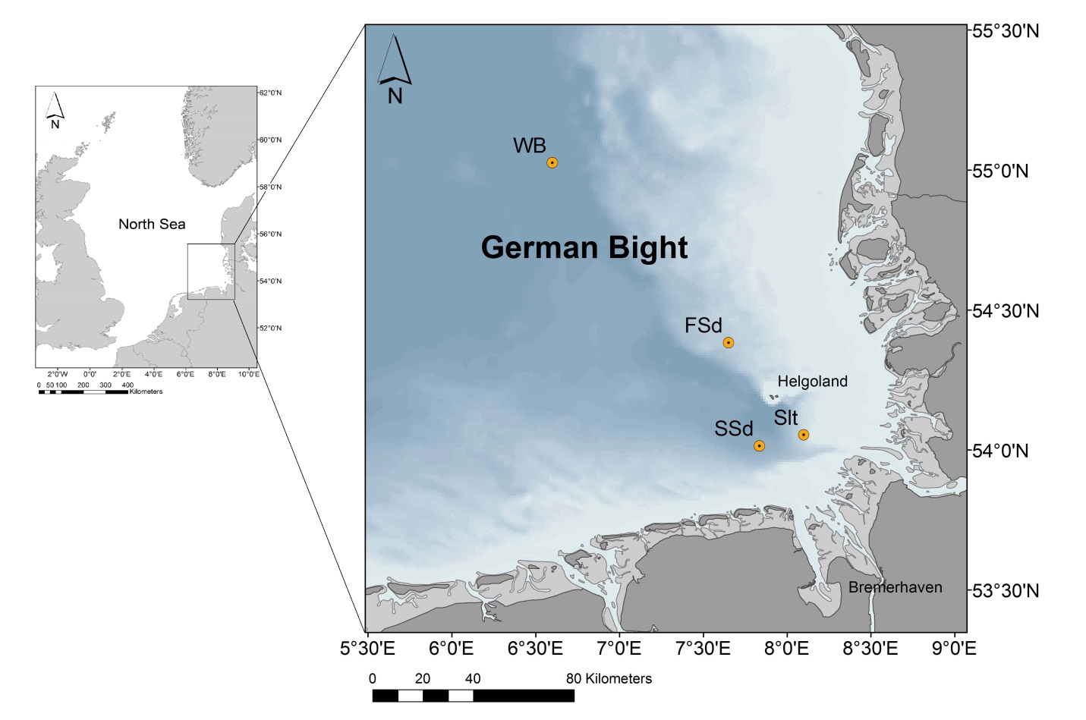
Four sampling sites
Since 1969
∽ 350 TAXA
12 environmental factors

Slide 5
To analyze benthic macrofaunal data set for common temporal patterns
To identify the environmental factors and climate variability affecting these temporal patterns.
To identify traits which contribute most to the observed development of marine macrofaunal community.

Slide 6
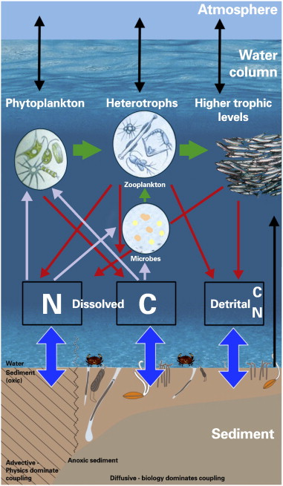
Ecological functioning
“ The activities, processes or properties of ecosystem that influence or are influenced by its biota”
Naeem et al. 2004
Notes:
Ecosystems are composed of different compartments, such as the marine benthos and pelagos and, within these, the physical, chemical and bio logical components that interact in order to maintain functioning. ecosystems are extremely complex and no one variable can describe all of the processes, properties or activities that are involved in their functioning (Giller et al., 2004). In marine ecosystems, at present, it is both conceptuallly and methodologically difficult to address the functioning of the entire ecosystem. Studies often use measures of one aspect of functioning, such as indicators of biogeochemical processes or energy transfer.With regards to these issuues, it may be appropriate to consider a single element of ecosystem functioning, such as benthic functioning. As this approach addresses only one aspect of the whole marine ecosystem, it can be termed ecological functioning.
“The flow of energy and materials through the biotic/abiotic component of ecosystem”

Slide 7
Trophic Group Analysis
Functional Group Analysis
Biological Traits Analysis
Species
Ecosystem processes
Environment
Notes:
Several approaches have been proposed for assessing functional responses, including trophic group analysis (Desrosiers et al. 2000), functional group analysis (Bonsdorff & Pearson, 1999; Pearson, 2001) and integrative indices such as the index of biotic integrity (Borja et al. 2000).
Biological traits analysis is one of the most promising of the recently proposed approaches (Statzner et al., 1994).
BTA was initiated in lentic systems (Statzner et al., 1994) and developed by Bremner, Frid and Rogers for application to marine ecosystems (Frid et al., 2001; Bremner et al., 2003, 2006a, 2006b).
The approach, biological traits analysis (BTA), uses biological traits of benthic taxa as indicators of key aspects of functioning. It focuses on the behaviours and attributes that contribute to the maintenance of ecosystem processes and properties.
It differs from previous trait-based approaches (e.g. trophic or functional groups) as it utilises a wider range of information on organism functional traits. It can be applied to any taxonomic level or organism group and can incorporate indicators of several different aspects of functioning.

Slide 8

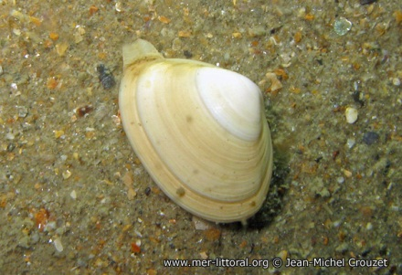
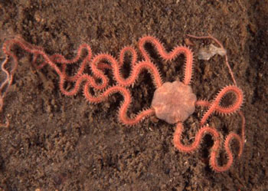
Biological Trait Analysis
Polychaeta
Eteone longa
Abra alba
Amphiura chiajei
Polychaeta
Bivalvia
Ophiuroidea
Taxonomic dissimilarity
Functional similarity
Notes:
BTA is based on the assumption that phylogenetically unrelated organisms might have evolved similar biological adaptation, thus leading to functional similarity, combined with taxonomic dissimilarity (Dolédec and Statzner, 1994).
BTA provides a link among species, environments and ecosystem processes, and is particularly useful for the investigation of anthropogenic impacts on ecological functioning (Bremner, 2005), since species traits are the main properties by which organisms influence ecosystem processes (Petchey and Gaston, 2006).
Nevertheless, organisms that fulfill similar ecological roles may not always respond to stressors in the same way as they are likely to differ in other, more subtle ways although they share some important attributes.

Slide 9
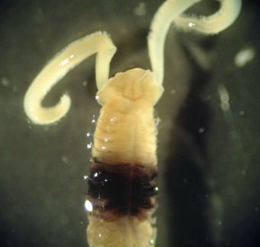
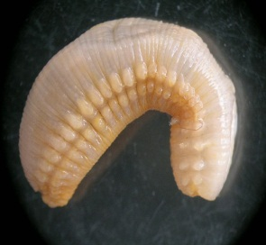
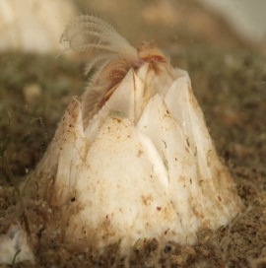
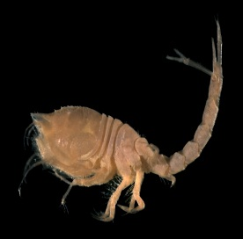
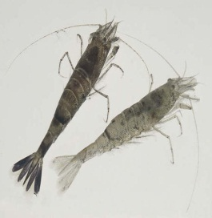
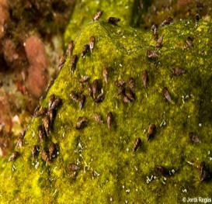
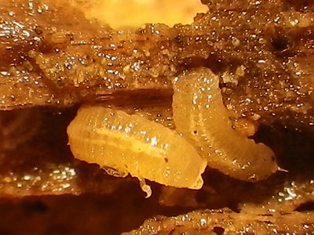
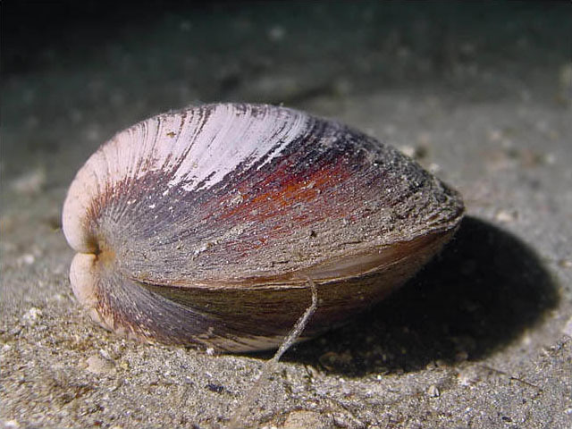
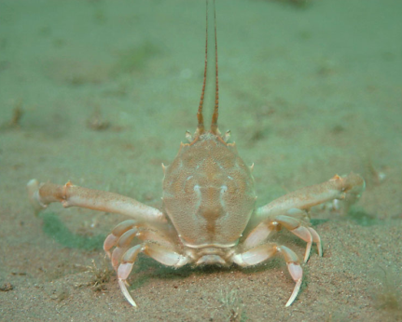
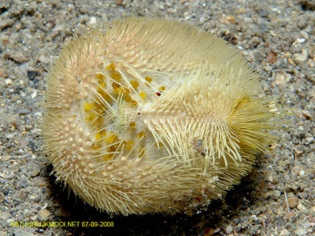
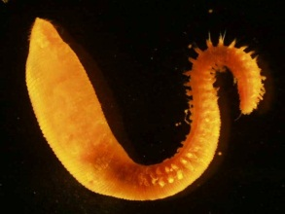
Biological Trait Analysis
Feeding habit
Surface Deposite Feeder
Sub- surface
Deposite Feeder
Suspension Feeder
Interface
Feeder
Prdator /
Scavenger
Grazer
Parasite
Life span
>10
3-10
1-2
<1
Notes:
These traits were broken down into 70 modalities to include the range of possible attributes of individual taxa. For example, the larval development trait was separated into three modalities including planktotrophic, lechitotrophic and direct development (Table 3.1).
1. Magelona mirabilis
2. Polyphysia crassa
4. Eudorella truncatula
5.Crangon crangon
6. Bittium reticulatum
7. Limnoria lignorum
-----------------------------------------------------------------------------------------
Arctica islandica (http://www.seawater.no)
Corystes cassivelaunus (http://www.marlin.ac.uk)
Echinocardium cordatum (http://www.natuurlijkmooi.net)
Scalibregma inflatum (http://www.marlin.ac.uk)

Slide 10
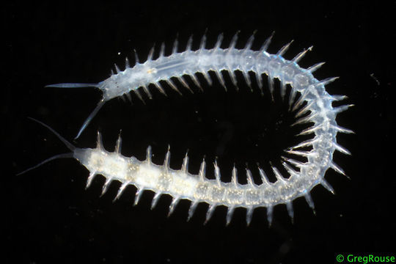
Fuyyz coding
0
1
2
3
Interface feeder
Predator/Scavenger
Sand licker
Grazer
Parasite
Surface
deposite
feeder
Sub-surface
deposite
feeder
Suspention
feeder
1
1
0
0
3
0
0
0
Pisione remota
http://eol.org
Notes:
It is difficult to classify some species and some traits unequivocally to a single modality; many species display multi-faceted behavior, depending on the specific conditions and resources available (Paganelli et al., 2012).Individual taxa (i.e. species or genus) were scored for their affinity to each modality using fuzzy coding (Chevenet et al., 1994).
The scoring range of 0 to 3 was used with an affinity score of zero indicating no association of the taxon with a trait category, whilst a score of three indicates a high affinity for a given trait category. For example Pisione remota are mostly predator/scavenger organisms but may also deposit feed, so they were coded 1 (surface/subsurface deposit feeder), 2 (predator/scavenger) for the trait variable ‘feeding habit’
If the affinity of a species to a particular modality was unknown and there was no information available for the assessment, a score of 0 was given for all the modalities associated with that species so as not to influence the final result. In this way, each species is replaced by the average profile for the corresponding trait and a species with this score will not be taken into account for the rest of the analyses (Chevenet et al., 1994).
Missing data will be supplemented by using information from congener species and from species in the closest taxonomic level.

Slide 11
Energy cycling
Carbon cycling
Temporal variability
Trophic structure
Nitrogen cycling
Transport of carbon from pelagic organisms to benthos
Transport of carbon from benthos to pelagic organisms
Direct carbon fixation
Deep dwelling fauna and burrowers facilitate the transport of carbon from sediment to overlying water
Production of planktonic larvae and vertical migration
Living habit
Larval development
Migration

Slide 12
Biological Trait Analysis
1
Identifying key aspect of functioning (processes and properties)
2
Identifying mechanisms by which the components are facilitated by taxa
Identifying the Biological traits that can be used as indicators of components
3
Carbon cycling
Transport of carbon from benthos to pelagic organisms
Larval development

Slide 13

Carbon cycle
H₂O+CO₂ H₂CO₃ HCO³⁻ + H⁺
HCO³⁻
H⁺
Ca²⁺ +CO₃²⁻
Ca²⁺ +CO₃²⁻
CaCO₃

Slide 14
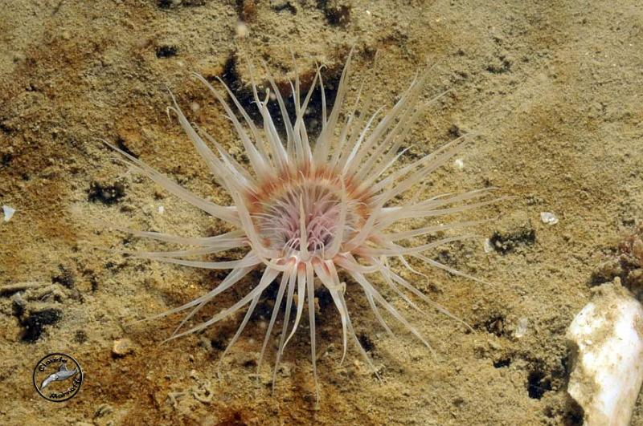
Biological Trait Analysis
Larval Development
Direct
Lecitotrophic
Sexual Differentiation
Gonochric
Syn Hermaphrodite
Planktotrophic
Seq Hermaphrodite
Diet type
Omnivore
Herbivore
Larval stage mobility
Brooded
Short term
Carnivore
Long term
Adult stage mobility
Sessile
Short range
Dispersal potential
Low
Intermediate
Mobile
High
Recoverability
Low
Intermediate
Vulnerability
Vulnerable
Intermediate
High
Robust
Longevity
<1
1-2
Maturity
< 1
1-2
3-10
3-4
> 4
>10
Size of organism
< 1
1-10
Environmental position
Epifauna
Infauna
11-20
Demersal
Epizoic
> 20
Adult movement
Swimmer
Crawler
Burrower
Sessile
Fecundity
1-10
10-100
Reproductive type
AS budding
As parthenogenesis
100-1000
S planktonic
AS fission
S Broadcast spawn
1000-10k
10k-1m
> 1m
S mini adults
Feeding habit
SDF
SSDF
SF
If
Predator
Grazer
http://doi.pangaea.de/10.1594/PANGAEA.813419
Cerianthus lloydi

Slide 15
Larval
Development
Sexual
Differentiation
Diet type
Larval stage
mobility
Adult stage
mobility
Dispersal
Potential
Recoverability
Vulnerability
Feeding habit
Direct
Gonochoric
Omnivore
Brooded
Sessile
Low
Low
Vulnerable
SDF
Lecitotrophic
SYN
Hermaphrodite
Herbivore
Short Term
Short range
Intermediate
Intermediate
Intermediate
SSDF
Plankt-otrophic
SEQ
Hermaphrodite
Carnivore
Long Term
Mobile
High
High
Robust
SF
IF
Adult Longevity
<1
1-2
3-10
>10
Predator
Cerianthus lloydi
Maturity
<1
1-2
3-4
>4
Sand licker
Size of Organism
<1
1-10
11-20
>20
Grazer
Environmental
position
Epifauna
Infauna
Demersal
Epizoic
Parasite
Adult Movement
Swimmer
Crawler
Burrower
Sessile
Fertilization
Fecundity
1-10
10-100
100-1000
1000-10000
10000-1m
>1 m
Internal
Reproductive type
AS
Budding
AS
Parthenogenesis
AS
Fission
S
Broadcast Spawn
S
Planktonic larva
S
Mini adults
External

Slide 16
DFA Model inputs
Response variables
Macro-zoobenthos samples collected at four stations in the North Sea in spring ,1981 to 2011
Explanatory variables
Sea Surface Temperature
Salinity
Inorganic nutrient concentrations (ammonium, nitrite and silicate)
North Atlantic Oscillation winter index (NAO_{WI})

Slide 17
Dynamic factor analysis (DFA)
Common trends
Interactions between response variables
Effects of explanatory variables
N time series = constant + linear combination of M common trends + explanatory variables + noise
It is worth mentioning that a higher number of common trends introduces unexplained information that cannot be interpreted easily in the DFA model. Therefore, DFA should be handled with a model that produces a reasonable ﬁt with the smallest number of common trends (Zuur et al., 2003b).
Based on the information, which is not related to the selected environmental variables of the optimal model.
Notes:
DFA is a multivariate time-series analysis technique to estimate common trends, to study the interactions between response variables and to determine the effects of explanatory variables in a time series data set
DFA describes a set of N observed time series and aims to keep M as small as possible while still producing an optimal model fit (Kisekka et al., 2013). Including explanatory variables partly reduces unexplained variability in the observed time series (Kisekka et al., 2013; Zuur et al., 2003b).

Slide 18
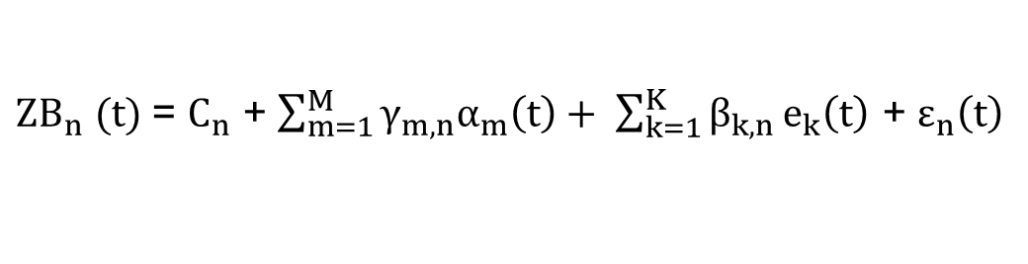
Dynamic factor analysis (DFA)
${ZB}_{n}$ $(t)$= $C_{n}$ + $\sum_{m=1}^{M}{γ_{m,n}α_{m}\left(t\right)+ \sum_{k=1}^{K}{β_{k,n}}}e_{k}\left(t\right)$ + $ε_{n}\left(t\right)$
It is worth mentioning that a higher number of common trends introduces unexplained information that cannot be interpreted easily in the DFA model. Therefore, DFA should be handled with a model that produces a reasonable ﬁt with the smallest number of common trends (Zuur et al., 2003b).
γ_{m,n} : factor loading that indicates the importance of each of the common trends to each response variable.
β_{k,n} : regression coefficient , indicate the relative importance of explanatory variables.
Notes:
Eq. 2 translates into the below equations (3) (Kisekka et al., 2013; Kuo et al., 2011; Ritter and Muñoz-Carpena, 2006; Zuur and Pierce, 2004; Zuur et al., 2007):
(3)
with α_{m}(t) being defined as:
(4)
where ZBn(t) is the value of the nth time series (i.e. the abundance of 11 taxa) at time t (with 1≤n≤N). C_{n} is a constant level parameter as in linear regression model which increases or decreases the linear combination of common trends (Kuo and Lin, 2010). If the time series are standardized, the constant parameters are 0 (Zuur and Pierce, 2004).
is a linear combination of common trends, in which α_{m}(t) is the mth unknown common trend (with 1≤m≤M) at time t and γ_{m,n} is the factor loading that indicates the importance of each of the common trends to each response variable (Kisekka et al., 2013; Kuo et al., 2011). Factor loading was applied to test which common trends are related to the macrofaunal time series (Ligas et al., 2010). A cut-off point of 0.15 was chosen as a criterion for the significance of factor loading; e_{k}(t) is a vector containing explanatory variables, and β_{k,n} stands for regression coefficient for the explanatory variables which indicate the relative importance of explanatory variables to each time series (Zuur and Pierce, 2004). Whether the environmental variables are significantly related to taxa abundance was assessed by using the magnitude of the β_{k,n} coefficients and their associated t-value (t-values larger than 2 in absolute value indicate a strong significant correlation); ε_{n}(t) and ρ_{m}(t) are assumed to be independent and homogeneous for each time series. They are Gaussian distributed noise with zero mean and unknown diagonal or non-diagonal covariance matrix (Ritter and Muñoz-Carpena, 2006; Zuur et al., 2010). The elements in the covariance matrix give the information that cannot be explained either by the common trends or by the explanatory variables (Kisekka et al., 2013). We tested several DFA models by choosing different combinations of numbers of common trends, explanatory variables, and symmetric non-diagonal or diagonal covariance matrix. It is worth mentioning that a higher number of common trends introduces unexplained information that cannot be interpreted easily in the DFA model. Therefore, DFA should be handled with a model that produces a reasonable ﬁt with the smallest number of common trends (Zuur et al., 2003b). The goodness-of-fit of the model can be assessed by visual inspection, the Nash-Sutcliffe coefficient of efficiency (NSE) (Nash and Sutcliffe, 1970) and the Akaike’s Information Criterion (AIC; (Akaike, 1974). NSE provides an estimate of how well the time series of each taxon is represented by the best fitting DFA model, while the AIC is a statistical criterion for model selection with the best model having the lowest AIC (Zuur et al., 2007). Data exploration and analysis were carried out using the software package Brodgar 2.7.2 (http: //www. brodgar.com).

Slide 19
Optimal model
- Three environmental variables (SST, nitrite and silicate)
Two common trends (unexplained variability)
Notes:
Among the 64 DFA models tested, the model consisting of two common trends, three environmental variables (SST, nitrite and silicate) fitted the data best.

Slide 20
North Atlantic Oscillation Index (NAO)
Cold winters
Anomalies in the wind fields
Alteration in the direction of Atlantic inflow, precipitation and riverine input.
Notes:
The first common trend shows a distinct decline from 1981 to 1999 and an increasing tendency thereafter. The second trend shows considerable fluctuations over time with two sharp troughs 1981 - 1986 and 1996 -1999, respectively
The extremely cold winter of 1995/96 is situated within this negative NAO_{WI} phase; hence one might assume that temperature may play the dominant role here, too. However, as SST was contained as environmental variable in the corresponding DFA model (Fig. 6), this trough is not related to temperature. Thus, other regional effects coupled to the NAO_{WI} pattern such as anomalies in the wind fields, alteration in the direction of Atlantic inflow, or precipitation and riverine input should be taken into account in interpreting the observed pattern. Such NAO-coupled features are presumed to affect macrobenthic communities indirectly through primary production/food availability, larval dispersal and related ecological processes
In the 1980s the North Sea benthos was strongly shaped by low SST (e.g., 1984-1987) resulting in reduced abundances of warm-temperate species (e.g. Spiophanes bombyx) and elevated abundances of cold-temperate species (e.g. Urothoe poseidonis), as well as in the occurrence of arctic-boreal species (e.g. Nephtys longosetosa) in the southern part of the North Sea (Kröncke et al., 2001, Wieking and Kröncke, 2001). Additionally, a sharp trough in benthos abundances in the late 1990s coincided with the exceptionally cold winter in 1995/1996 that was the most notable event in the hydro-climate of the German Bight at that time (Reiss et al., 2006a; Schlüter et al., 2008). Our findings confirm the observation of Neumann et al. (2009), too, who report an increase in benthic macrofaunal abundance and species diversity in the southern North Sea between 2003 and 2008.

Slide 21
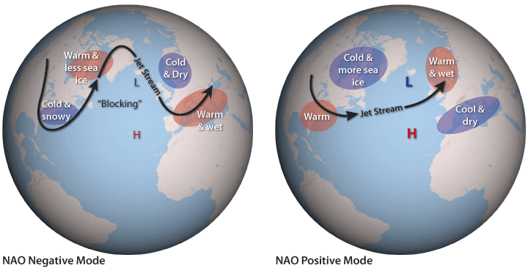
http://www.climatewatch.noaa.gov/
Notes:
The NAO is a pattern of atmospheric variability in the North Atlantic region, and the derived NAO index is a measure of the strength of the sea-level air-pressure gradient between Iceland and the Azores (Birchenough et al., 2011). The NAO index represents an integration of several climatic variables (e.g. water temperature, prevailing wind direction and speed, precipitation) (Birchenough et al., 2011). During a positive NAO the westerly winds are stronger and conditions are colder and drier than average over the Northwest Atlantic (eastern Canada to Greenland) and the Mediterranean region, whereas conditions in northern Europe and the eastern United States are warmer and wetter than average (European Science Foundation, 2007).
Changes in diversity and community structure, and function of benthic systems, directly or indirectly related to variability in the winter NAO index, have been shown from a number of different areas in recent decades (Frid et al., 1996; Kroncke et al., 2001; Schröder, 2005; Neumann et al., 2008).
In the North Sea, severe winters, which are linked to a low NAO index, as occurred in 1978/1979, and 1995/1996, led to a reduction in the abundance of benthic species in nearshore and offshore areas (Kröncke et al., 1998; Armonies et al., 2001; Reiss et al., 2006; Neumann et al., 2009).
Generally, cold winters reduce reproduction and production, resulting in a decrease in species number and biomass.
Occasional events such as severe winters may make the detection of long-term trends more difficult. These events also may cover long-term trends in near-shore areas.

Slide 22
Regression coefficient
the all temperature effects, not only related to extreme events such as cold winters, but also with regard to the long term development.

Slide 23
Factor Loadings
Abra spp. | ABR
Amphiuridae | AMP
Bathyporeia spp. | BAT
Callianassa spp. | CAL
Echinocardium cordatum | ECC
Ophiura spp. | OPH
Spio filicornis | SPF
Spiophanes bombyx | SPB
Spisula spp. | SPI
Thyasira flexuosa | THF
Notes:
factor loading identified those taxa which correlated best with the overall temporal trend of the macrofauna.
These species are relatively small sized, short-lived, fast-growing deposit feeders and their abundance was either positively or negatively related to the MAFA axis and the common trends. The close relationship of these taxa to the MAFA axis and the common trends may reflect the fact that populations consisting of

Slide 24
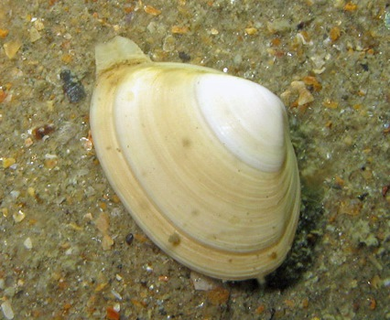
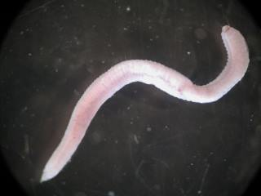
Small sized
Short-lived
Fast-growing
Deposit feeders ©
© MarLIN
© Jean-Michel Crouzet
© MarLIN
Notes:
such “opportunistic” small sized, short-lived, fast-growing species can respond quickly and strongly (in terms of change in abundance) to environmental change (Dorsey, 1982).
These results also reveal the importance and dominance of opportunistic species in the German Bight. A dominance of opportunistic species is often characteristic for disturbed ecosystems (Borja et al., 2003; Thrush et al., 1998). Opportunistic species are characterized by high reproduction rate and rapid development and thus, are capable to proliferate as a result of ecological impact of anthropogenic stressors (Como et al., 2007; Demopoulos and Smith, 2010; Dorsey, 1982).

Slide 25
Homogeneity of benthic assemblages
Widespread anthropogenic and climatic pressures
Harshness of habitat conditions
Stochastic processes in structuring assemblages,
Compositional heterogeneity among sites
Notes:
The test for homogeneity of multivariate dispersions revealed no differences among the three sampling sites (i.e. FSd, SSd and WB; p > 0.05). Several environmental parameters may have contributed to the observed homogenization of benthic assemblages. However theoretical and empirical surveys have demonstrated that increased homogeneity mainly owing to anthropogenic and climatic disturbances (Passy and Blanchet, 2007). Widespread anthropogenic and climatic pressures increase the harshness of habitat conditions and thus, reduce compositional heterogeneity among sites by decreasing the stochastic processes in structuring assemblages (Donohue et al., 2009; Olden and Poff, 2004).
there are several (often infinitely many) directions in which the process may evolve.

Slide 26
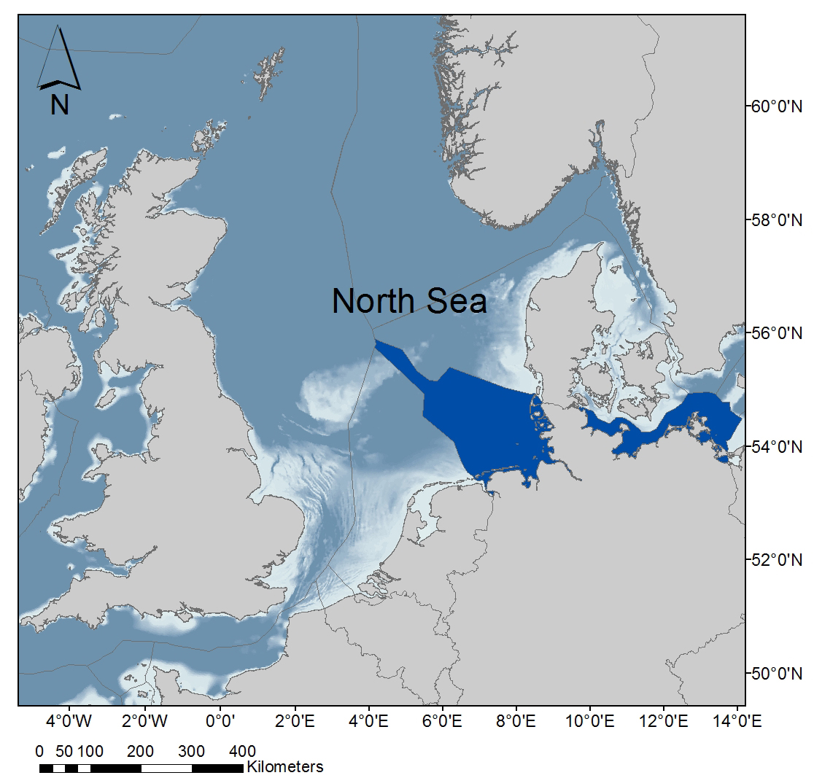
Conclution
In the North Sea various anthropogenic and climatic stressors (e.g. bottom trawling, eutrophication) have modified the benthic communities towards a suppression of large, long-living species, which were replaced by small, opportunistic species.
Our analysis indicates that temperature was the predominant environmental driver of temporal variation in North Sea macrofaunal abundance.
Notes:
In the North Sea various anthropogenic stressors (e.g. bottom trawling, eutrophication) have modified the benthic communities towards a suppression of large, long-living species, which were replaced by small, opportunistic species (Kaiser and Spencer, 1996). For example, continuous physical disturbance of the seafloor by bottom trawling prevents the recovery of benthic species with multi-annual life spans, low recruitment and slow post-recruitment development (Kroger, 2003). These organisms are out-competed by opportunistic taxa with high recruitment rates and are, thus, at high risk of regional extinction (Calabretta and Oviatt, 2008).

Slide 27
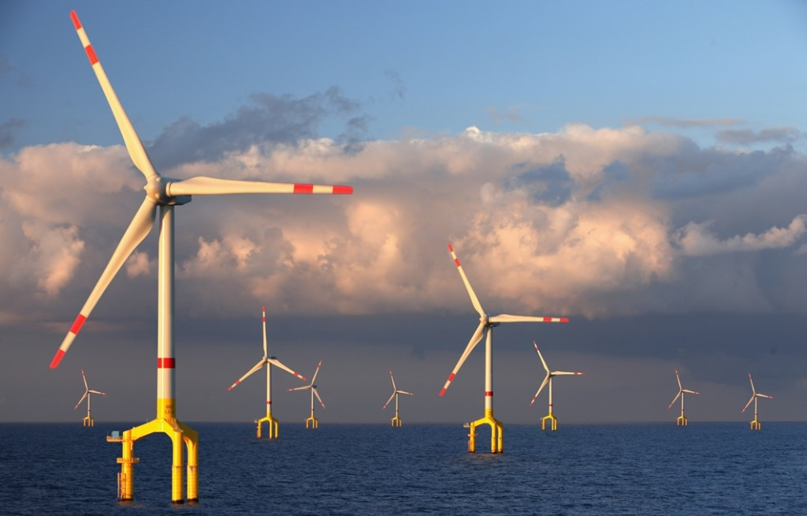
Thanks for your attention

