Slide 1
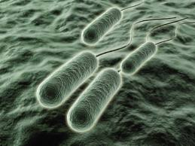
Pseudomonas aeruginosa
Myth or Menace?

Slide 2
Why focus on Pseudomonas aeruginosa?
Well known to environmental microbiologists
Indigenous microbiota of water and soil, plant tissues
Recently found to preferentially aerosolised from those sites into the atmosphere
Well known to clinical microbiologists
Commonly isolated as a opportunistic pathogen in debilitated patients
Catheterised Urinary Tracts
Cystic fibrosis lung colonisation
Burn wounds, particularly large scale
Famously resistant to most antibiotics, very hard to treat
Not well known to food quality microbiologists
Notes:
Pseudomonas aeruginosa is a Gram negative aerobic rod-shaped bacterium that is ubiquitous in the environment, living in the soil, in water and on plant and animal tissues. P. aeruginosa is also an opportunistic human pathogen, causing infections when normal immune defences are disrupted. Burn patients are commonly afflicted with P. aeruginosa infections. Respiratory P. aeruginosa infection is the leading reason for morbidity in cystic fibrosis patients.

Slide 3
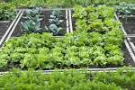
Environmental Microbiology Research Group study
Pilot study regarding Salad Vegetables and Pseudomonas aeruginosa indicated potential of project
Major study of sources of Pseudomonas aeruginosa colonization of CF lungs focussed on two potential sources:
Person to person: human source
Air/water/soil: environmental source
Food-borne micro-organisms are often sourced from their environment, especially fruit and vegetable crops which can be contaminated by the air or water or soil or all three
Notes:
There are many possible ways that vegetables can be contaminated by potentially pathogenic bacteria such as P. aeruginosa. Possible ways of contamination include pre-harvesting contamination by the environment such as soil, fertiliser, pesticides and water; post-harvest by farmers; during transportation by couriers; and food preparation by chefs and food handlers

Slide 4
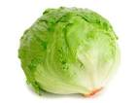
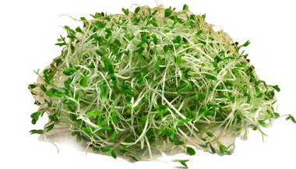
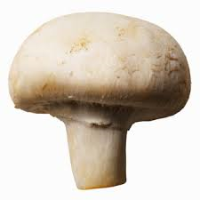
And so to Salad Vegetables
On the premise that:
Salad vegetables are generally eaten raw
Pathogens present in or on food may be aspirated or washed into the lungs
Vegetables are grown in soil or compost and irrigated by sprayed water, or hydroponically (in water)
We tested both the outer surface and inner pulp of the following salad fruit and vegetables:
Lettuce – iceberg type (grown in soil or hydroponically)
Tomatoes
Mushrooms (organic and non-organic)
Alfafa sprouts
Notes:
There are many possible ways that vegetables can be contaminated by potentially pathogenic bacteria such as P. aeruginosa. Possible ways of contamination include pre-harvesting contamination by the environment such as soil, fertiliser, pesticides and water; post-harvest by farmers; during transportation by couriers; and food preparation by chefs and food handlers

Slide 5
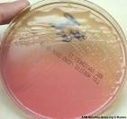
Treatment
Vegetables were sourced from Supermarket, Greengrocer and Farmers’ Market
All samples were collected directly into a sterile stomacher bag using gloved hands, chilled for transport to the laboratory
Outer surfaces were rinsed, rinse water filtered, plated out
Roots of lettuce were removed for separate testing
Flesh of all samples was stomached and plated out in same way as washings
Notes:
The initial methods used to identify potential Ps.a were phenotypic ones, traditional cultural and biochemical characteristics.

Slide 6
Three levels of identification stringency
Level 1: Initial identification of Pseudomonas aeruginosa performed using Phenotypic tests – culture and biochemical characteristics
This gives a presumptive identification
This level would usually be all that was done in food labs
Level 2: Genotyping such as Real-time PCR (RT-PCR)
Pseudomonas aeruginosa duplex RT-PCR reaction assay (PAduplex)
Tests for conserved regions of genome, unique and exclusive to Pseudomonas aeruginosa
Confirms the identity of the organism, while decreasing the probability of misidentification.

Slide 7
Three levels of identification stringency
Level 3: Strain typing using Molecular (DNA) analysis
Within the genome of confirmed Pseudomonas aeruginosa isolates, variation may still be found by this level of analysis
Variants are known as strains
Clones are strains that have been consistently found in a geographical area, in multiple patients
ERIC-PCR is a quick PCR method that is typically used to screen isolates for clonality
The resulting pattern provides a fingerprint of the organism which can be compared to each other to determine if any relationship exists between isolates
Discrimination between isolates was shown to be very high

Slide 8
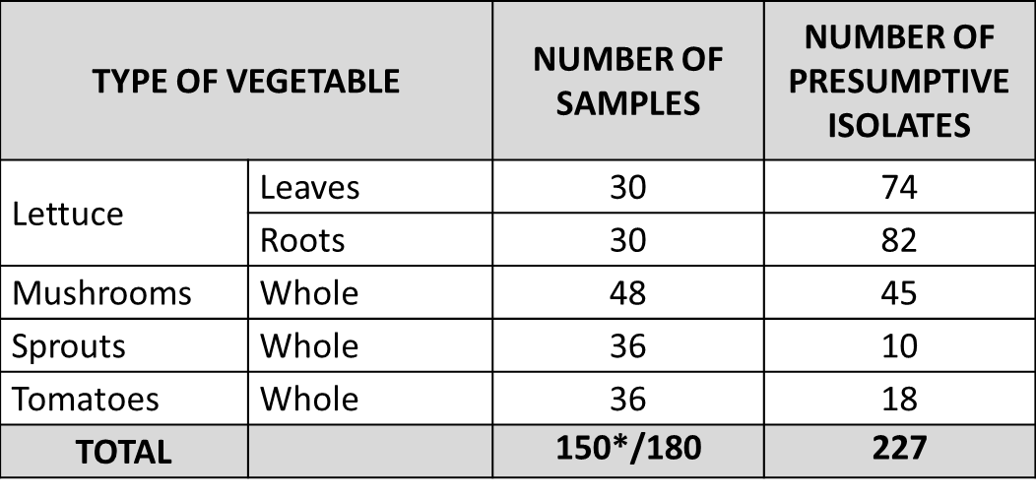
Results – Level 1 Phenotypic ID
Table 1a. Presumptive and confirmatory identification data including number of genotypes of Pseudomonas aeruginosa recovered from sampled vegetables.
* Indicates that lettuce roots were treated as individual samples during analysis, being the additional 30 samples shown in the current table.

Slide 9
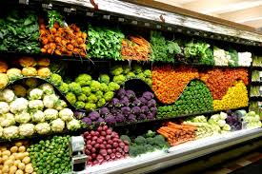
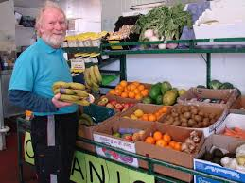
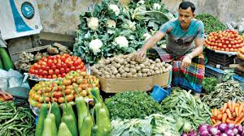
Comments on Table 1a results
All categories of retailers (greengrocer, farmers’ markets, and supermarkets) contributed contaminated vegetables of some type.
Farmers’ markets and supermarkets had contamination in/on all types of vegetables tested
Fruit and vegetable shop’s mushrooms and tomatoes were uncontaminated

Slide 10
Level 2 and 3: Genotyping and strain typing summary

Slide 11
Level 1: Level 2: Level 3 Phenotyping: Genotyping: Strain typing
Phenotypic methods are slow and subject to alterations in biochemistry profiles and phenotype expression
227 isolates were identified by phenotyping as potential Pseudomonas aeruginosa
Genotyping confirms the identity of the Pseudomonas aeruginosa, decreasing probability of misidentification
Of the 227 potential P.aeruginosa isolates, only 74 were confirmed using PA duplex (roughly 2/3 false positives)
ERIC-PCR provides a fingerprint of the organism and compares strains to determine if any relationship exists between them
Of the confirmed 74 Ps. a isolates, 28 different genotypes were identified
Notes:
Phenotyping vs Genotyping
Phenotypic methods have some advantages due to relatively low costs. Disadvantages can include slow bacterial growth time; alterations in biochemistry profiles, phenotype and gene expression; as well as most phenotypic methods’ low discriminatory power (Downes and Itō, 2001; Kapperud et al., 1990).
Real-time PCR (RT-PCR) is a PCR technique which allows quantitation of amplicons in real time. In RT-PCR, the increase in amplicons is monitored using the labeling of primers (Forbes, Sahm and Weissfeld, 2007) by oligoprobes or fluorescent molecules.
A variation on this technique for P. aeruginosa has been validated by Anuj and others (2009). Through the use of two sequences, ecfX and gyrB, Pseudomonas aeruginosa duplex real-time polymerase chain reaction assay (PAduplex) confirms the identity of the organism, while decreasing the probability of misidentification (Anuj et al., 2009).
Strain typing
ERIC-PCR is a quick PCR method that is particularly useful as an epidemiological screening tool. ERIC-PCR is typically used to screen isolates, as there is a faster turnaround for results compared to PFGE (Silbert et al., 2004; Syrmis et al., 2004). This method utilises oligonucleotides in a PCR reaction to target short repetitive sequences in the genome (Versalovic, Koeuth and Lupski, 1991). The fragments are then resolved on a gel, which separates the fragments based on their molecular weight. The resulting pattern provides a fingerprint of the organism which can be compared to each other to determine if any relationship exists between isolates. Discrimination between isolates was shown to be better than other methods, such as ribotyping and serotyping (Silbert et al., 2004; Wolska and Szweda, 2008).

Slide 12
Results of surface vs flesh tests
The great majority of the isolates were found on the outside of all of the vegetables (Table 2).
A very small number of confirmed isolates were found inside a tomato, one sprout package and the roots of the several lettuce.
Table 2: distribution of numbers of confirmed isolates recovered from vegetable tissue and on the external surfaces of various vegetables.

Slide 13
Significance of surface vs flesh results
The finding of a majority of isolates from surfaces of vegetable suggests that the contamination is most likely due to handling, washing or similar
If the growth source of soil or water were found to be contaminated (results not shown here), we might have expected to find more plant tissue contamination
Lack of cross contamination of genotypes between vegetables at any single retailer, indicates that the contamination is unlikely to have occurred there

Slide 14
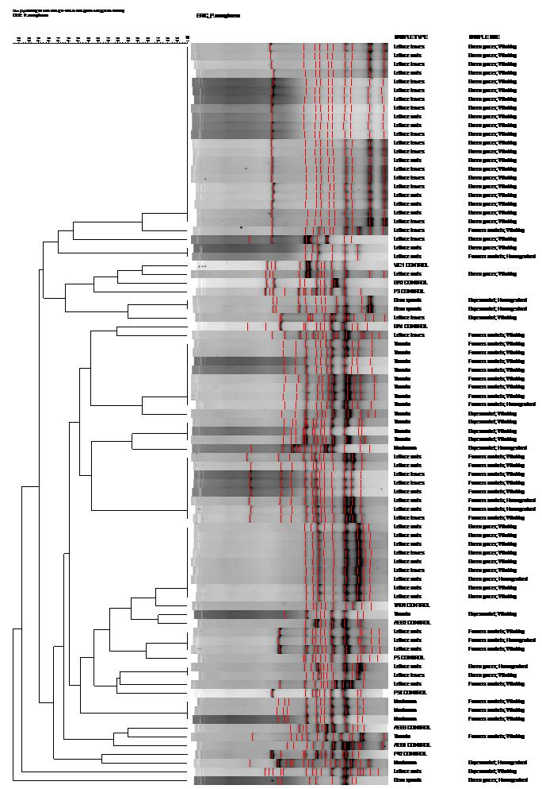
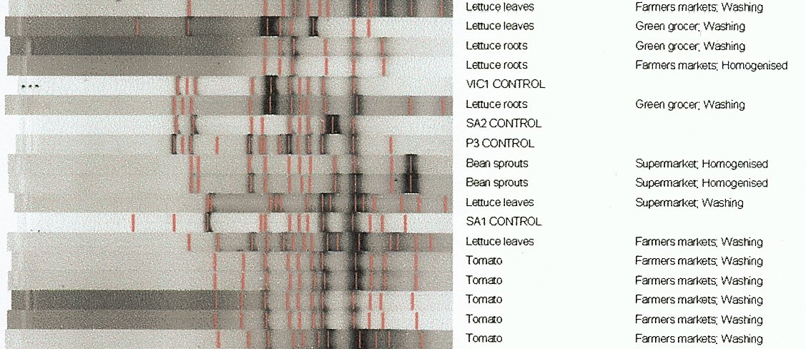
Send in the Clones
Fig. 3. Digitised ERIC-PCR patterns and dendrogram analysis of Pseudomonas aeruginosa isolates from sampled raw salad vegetables including major and minor controls. The similarity index is indicated at the top of the plot.
Px indicates pulsotype number
AES is Australian epidemic strain and number indicates the strain;
VIC1 is Victorian strain 1;
SAx is the South Australian strain and the number is indicative of the strain; and
TAS4 is Tasmanian strain 4

Slide 15
Analysis of Cloning results
No clonal genotypes of P. aeruginosa were found in or on any vegetable tested
However, there has been a possibility suggested that isolated strains may mutate into clonal strains after infection of a human host, similar to the genetic adaptations in CF patients
Recent evidence supports a theory that environmental strains of P. aeruginosa are able to move to other environments, such as the CF lung, and survive because the organism is forced to mutate due to natural selection (Rau et al., 2010)
Therefore, while the isolates recovered in this study may not have 100% correlation to commonly isolated clonal varieties, they may mutate into clonal strains, given favourable conditions.

Slide 16
Take home message
Significance of proportion of isolates identified phenotypically as Pseudomonas aeruginosa that proved to be negative by PA-duplex (roughly 2/3).
This finding has major implications regarding the use of direct PCR methods for food quality testing!
Genotyping results indicated that strains are found more consistently within a type of vegetable, than within a retail outlet.
This indicates that the contamination is more likely to have occurred on the farm, in storage or in transit to the retail outlet

Slide 17
And Finally – Myth or Menace
Certainly not a myth – proved to be present on surface of many vegetables
Degree of menace is yet to be confirmed
Clonal strains were not found in or on vegetables
Level of menace is likely to depend very much on host factors
If salad vegetables are to be eaten by a debilitated or immune-suppressed person, extra care should be taken with washing of the ingredients.

Slide 18
References
Anuj, S. N., D. M. Whiley, T. J. Kidd, S. C. Bell, C. E. Wainwright, M. D. Nissen and T. P. Sloots. 2009. Identification of Pseudomonas aeruginosa by a duplex real-time polymerase chain reaction assay targeting the ecfX and the gyrB genes. Diagnostic Microbiology and Infectious Disease, 63: 127-131.
Curran, B., J. A. W. Morgan and D. Honeybourne. 2005. Commercial mushrooms and bean sprouts are a source of Pseudomonas aeruginosa. Journal of Clinical Microbiology, 43 (11): 5830-5831
Hardalo, C. and S. Edberg. 1997. Pseudomonas aeruginosa: Assessment of risk from drinking water. Critical Reviews in Microbiology, 23 (1): 47-75.
Heijerman, H. 2005. Infection and inflammation in cystic fibrosis: A short review. Journal of Cystic Fibrosis, 4: 3-5.
Kidd, T., K. Ramsay, H. Hu, P. Bye, M. Elkins, K. Grimwood, C. Harbour, et al. 2009. Low rates of Pseudomonas aeruginosa misidentification in isolates from cystic fibrosis patients. Journal of Clinical Microbiology, 47 (5): 1503-1509.
Kominos, S. D., C. E. Copeland, B. Grosiak and B. Postic. 1972. Introduction of Pseudomonas aeruginosa into a hospital via vegetables. Applied Microbiology, 24: 567-570.
Samadpour, M. 2001. Molecular typing of Pseudomonas aeruginosa in distribution systems. Seattle: Awwa Research Foundation and American Water Works Association.
Shooter, R. A., E. M. Cooke, M. C. Faiers, S. M. O'Farrell and A. L. Breaden. 1971. Isolation of Escherichia coli, Pseudomonas aeruginosa, and Klebsiella from food in hospitals, canteens and schools. The Lancet, 2: 390-392.
Stewart, T. 2009. Cystic fibrosis in Australia 2007. North Ryde: Cystic Fibrosis Australia.
Syrmis, M. W., M. R. O'Carroll, T. P. Sloots, C. Coulter, C. E. Wainwright, S. C. Bell and M. D. Nissen. 2004. Rapid genotyping of Pseudomonas aeruginosa isolates harboured by adult and paediatric patients with cystic fibrosis using repetitive-element-based PCR assays. Journal of Medical Microbiology, 53: 1089-1096.
Wright, C., S. D. Kominos and R. B. Yee. 1976. Enterobacteriaceae and Pseudomonas aeruginosa recovered from vegetable salads. Applied and Environmental Microbiology, 31 (3): 453-454.

