Slide 1
“Study of photo catalytic activity and antibacterial activity of Ag/B/N co-doped TiO₂/CNT composites films”
M. Nizam Uddin, PhD
Department of Chemistry
Shahjalal University of Science and Technology
Sylhet, Bangladesh
4th International Conference on
Nanotek & Expo
San Francisco, USA

Slide 2
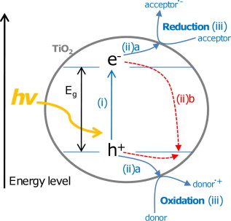
Background
TiO₂ (titania): inexpensive, biocompatible, non-toxic, strong oxidizing and reducing power, and excellent photo-stability
Main processes in semiconductor photo-catalysis:
Photon absorption (UV) and electron–hole pair generation.
Charge separation and migration;
a) to surface reaction sites or
b) to recombination sites.
Surface chemical reaction (oxidation or reduction) at active sites.
Ref.: CA R B O N 4 9 ( 2 0 1 1 ) 7 4 1 – 7 7 2
Notes:
Titanium dioxide, an inexpensive, non-toxic and biocompatible material, is one of the most important and widely investigated photocatalysts [2], because of its potential application in decomposition of various environmentally hazardous compounds (organic, inorganic, and biological materials), which
are found in both gaseous and liquid phases [3].

Slide 3
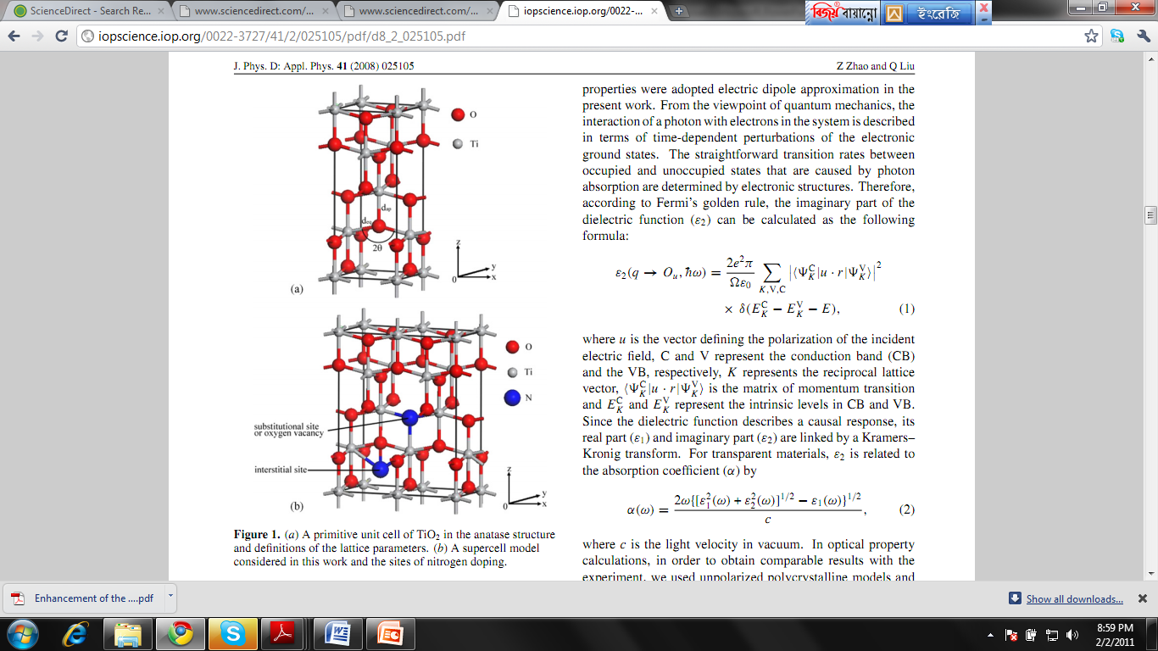
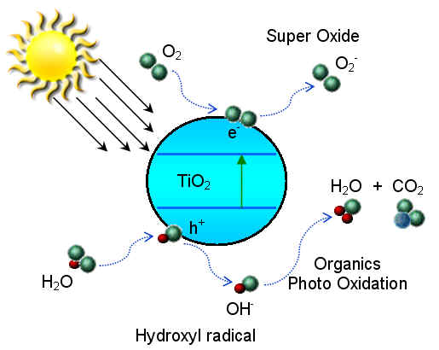
Application of TiO₂ in environmental pollution control
Typical drawbacks
…large band-gap (Eg=3.2 eV ), can not be used as responsive catalysts in visible light.
...difficulties in separation of TiO₂ particles (powder) from the wastes and re-use.
…low rate of electron transfer to oxygen and a high rate of recombination between excited electron–
hole pairs of TiO₂.
n
Solutions
using nano-crystalline TiO₂ thin ﬁlms; no separation required and easy to reuse.
red shift in the optical response of TiO₂ and effect on photocatalytic efficiency due to doping (metal or nonmetal.
a) A primitive unit cell of TiO₂ in the anatase structure
b) A supercell model showing the sites of nitrogen doping
Z. Zhao et al., J. Phys. D: Appl. Phys. 41 (2008) 025105
K. Hashimoto, H. Irie , A. Fujishima, Japan. J. Appl. Phy., 44, 2005, 8269–8285.
Notes:
They only transfer non- biodegradable matter into
sludge(chemically stable) which giving rise to new type of pollution.

Slide 4
Advantages of thin film (schematically)
Anneal at 500˚C
2 h
Reusability is the main advantage of photo-catalysis in the thin film form…

Slide 5
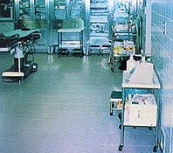
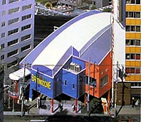
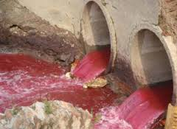
Some interesting applications:
Applications
Pollutant degradation
Decomposition of various environmentally hazardous compounds (organic, inorganic and biological materials), found in both gaseous and liquid phases.
TiO₂ coated tiles in an hospital environment showed that the surface bacteria on the wall surfaces were reduced to zero, plus airborne bacteria counts were reduced.
Titanium Dioxide can be coated on many building materials. These films exhibit a self cleaning effect due to the strong oxidizing properties.
Ref.: C A R B O N 4 9 ( 2 0 1 1 ) 7 4 1 – 7 7 2
http://www.titaniumart.com/photocatalysis-ti02.html
Notes:
Textile industries produce large volume of colored dye effluents which
are toxic and non-biodegradable. These dyes create several environ-mental
pollution problems by releasing toxic and potential carcinogenic substances
into the aqueous phase…

Slide 6
-:Summarizing the Objectives of this project:-
New challenge to use thin film forms of TiO₂ for its comfortable and effective re-use ability.
Modification of TiO₂ by doping with metal and non-metal to extend its spectral response to visible region to promote ‘efficient use of solar energy’ for ‘photodegradation of different dyes’. The aim is to use the modified TiO₂ for the treatment of industrial effluent and to clean polluted water.
Target to use carbon nanotubes (CNT) with large surface area for better adsorption ability of organic dye .
Aiming to decrease the fast recombination rate of photo-generated election-hole pairs in TiO₂ matrix using co-doping and CNT which is supposed to increase photo-catalytic degradation efficiency.

Slide 7
Experimental Details
a) Non-metals co-doped TiO₂ as thin film form

Slide 8
b) Metal/non-metal co-doped TiO₂ -CNT composites as thin film forms

Slide 9
Degradation facilities
2
6
1. Magnetic stirrer
2. Cooling fan
3. Tungsten lamp
3
4. Glass box covered by
Aluminum foil
4
8
5. MB solution
_- - - - - - _ - _ - _ - _ - _ - -
-_ - _ - - - _ - _ - _ - _ - _ - _
6. Thermometer
5
9
- -
7. Circulating Water inlet
7
- -
H₂O
↓
↓
1
8. Circulating Water outlet
H₂O
9. Thin film photo catalyst
Notes:
paper

Slide 10
(a)
An experimental and first-principles study of the effect of
B/N doping in TiO₂thin films for visible light photo-catalysis

Slide 11
SEM images:
Observed significant cracking on the surface of all films.
Raman spectra:
Showed anatase TiO₂ bands
Notes:
Because of doping and particle sizes the raman bands for others are different

Slide 12
XRD:
Anatase phase of TiO₂
No B- and N- derived peaks due to other oxides and nitrides:
Indication of B and N as dopant in TiO₂ ; no tendency to segregate and/or precipitate in different phases during the synthetic process
Notes:
The B and N in the matrix are assumed to be either interstitial or systematically substitute Ti or O without changing the host TiO₂ matrix. Considering peak of (101) planes in account, the average crystalline sizes of the sample ‘a’, ‘b’, ‘c’ and ‘d’ are 13.43, 11.67, 12.99 and 13.43 nm, respectively. It suggested that the change in particle size with respect to B/N content is not significant. For our samples the average lattice parameters are as follows: a = 3.78 Å, c = 9.44 Å and unit cell volume = 134.52 Å³.

Slide 13
XPS
Ti-O-B or Ti-B-O or O-Ti-B
Ti-O-N or Ti-N-O
O-Ti-N linkages might be responsible for visible light photo-catalysis…
O-Ti-N
B1s XPS spectrum with the highest atomic percentage of B
N1s XPS spectrum with the highest atomic percentage of N
Notes:
XPS studies using mono-chromated Al-Kα X-ray source were performed to check the atomic percentage of different doping elements. Atomic percentages of different elements were calculated from the XPS narrow scan peak intensity considering the relative sensitivity factor of each element. The atomic ratios of boron to nitrogen (B/N) for different samples are as follows; 0.27 (a), 3.83 (b) and 20.89 (c)
Referring to the standard BE of B1s in B₂O₃ (193.1 eV, B-O bond) [75] and TiB₂ (187.5 eV, B-Ti bond), [76] it is speculated that boron atom might probably be incorporated into TiO₂ matrix and form Ti-O-B or Ti-B-O or O-Ti-B bond [52,77]. Hence peak at 192.1 eV have been assigned to Ti-O-B or Ti-B-O or O-Ti-B bond. Fig. 7(ii) shows the N1s XPS spectrum for the sample ‘a’ which contains highest atomic percentage of N. Considering significant asymmetry, N1s peak has been deconvoluted with in two peaks at 398.5 and 400.0 eV. The peak at 398.5 eV may be because of anionic N incorporated in TiO₂ in O-Ti-N linkages [22,78], which might be responsible for visible light photo-catalysis. The higher binding energy peak at 400.0 eV are attributed to oxidized nitrogen in the form of Ti-O-N or Ti-N-O linkages [22,78]. The absence of a peak at or near 396 eV for the N 1s core level implied that the TiN phase or chemisorbed nitrogen is not formed in the nano materials [79].

Slide 14
UV-Vis:
Clear red-shift in UV-Vis spectra; revealing the visible light absorption with B/N co-doped TiO₂
Percentage of degradation efficiency ; (i) 1° cycle, (ii) 2° cycle and (iii) 3° cycle
Notes:
One of the main problems in the use of TiO₂-based photo-catalysts is the deactivation; mostly attributed to blockage of the active sites on the surface, loss of coating material from the surface due to erosion or etc. [84,85]. To evaluate the possibility of catalyst recovery and re-use, successive photo-catalytic MB degradation was performed for all of the doped and bare- films. After each cycle, films were annealed for 1 hr at 500 °C and then re-used. Fig. 9 (ii) shows that successive utilization for 2° cycle induced even better performance for all the films (a), (b), (c) and (d). For 2° and 3° cycles the efficiency increased to 62-69 % for co-doped films whereas that increased to 32-34 % for bare- films. The increasing of efficiency for 2° and 3° cycles might be i) due to the surface chemistry changing at each time heat treatment after each degradation study and/or ii) the nitrogen concentration within the structure might be increased for the MB solution adsorption on the film. It is still in great debate of the synergy effects on photoactivities and the importance of the relative ratios on photoactivities [17,50]. Further work is ongoing to understand this behavior.

Slide 15
Density functional theory calculation (single doping)
Mid-gap energy states
Relaxed structures and partial density of states (PDOS) of a) pure anatase, b) B- doped O-, c) N- doped O- and d) N interstitial models. Energies are shifted such that Fermi levels are matched with zero of energy. The bond lengths between doped atoms and first neighbors are indicated. Solid lines, gray shaded, green shaded and blue shaded areas represent the total DOS, PDOS of Ti3d, O2p and N2p states, respectively.
Notes:
Our recent displays the structural models and the total (DOS) and partial density of states (PDOS) of pure TiO₂, single doped B- or N- to O- site and interstitial N. The band gap of anatase is 2.04 eV, lower than experimental value; 3.2 eV [87] but consistent with the previous theoretical studies [39,88] underestimation of band gap is a well-known deficiency of DFT calculations. A correction can be made using hybrid functional, self-interaction correction or ‘DFT+U’ methods, but in this study our primary purpose is to understand the changes induced by the dopants on the electronic structures of bulk anatase, not the exact value of the band gap. PDOS analysis shows that the top most valence bands are formed mainly from O2p states while the conduction bands minimum are formed from Ti3d states. For the case of B substituting O atom (Fig. 10(b)), the hybridization of B2p, Ti3d and O2p orbitals gives rise to gap states appearing at 0.27 eV below the conduction band for B- doped O- model. In this structure, B atom makes a strong bonding with one of the neighbor O atoms with bond length as 1.36 Å. B-Ti bond distance is 2.11 Å which is even larger than Ti-O bond distance of pure anatase (1.95 Å). work

Slide 16
Density functional theory calculation (co-doping)
Mid-gap energy states
Co-doping of anatase: a) B atom replaced with Ti and N atom replaced with O and b) N atom replaced with Ti, and B atom replaced with O. Solid lines, gray shaded, green shaded and blue shaded areas represent the total DOS, PDOS of Ti3d, O2p and N2p states, respectively.
Summary
i. band gap narrowing leads to the red shift of the absorbance spectra to the visible light region. Ii. the appearance of midgap states could be responsible for the enhancement of the photo-catalytic activity either by improving the absorbance or avoiding the recombination of electron-hole pairs.
Notes:
In summary, band gap narrowing leads to the red shift of the absorbance spectra to the visible light region. Meanwhile, the appearance of midgap states could be responsible for the enhancement of the photo-catalytic activity either by improving the absorbance or avoiding the recombination of electron-hole pairs [89].

Slide 17
(b)
SYNTHESIS, CHARACTERIZATION, PHOTO CATALYTIC AND ANTIBACTERIAL ACTIVITY OF Ag/B/N CO-DOPED TiO₂ / CNT COMPOSITE FILMS

Slide 18
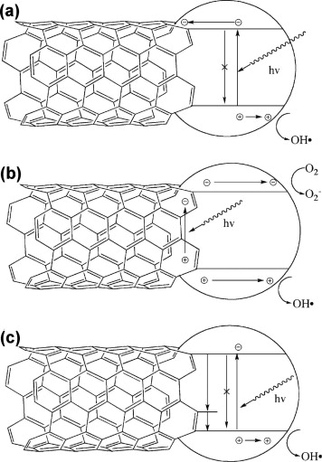
Effect of CNT on photo-catalytic activity of TiO₂ as Sensitizer…..
i. high-surface area and high quality active sites
ii. retardation of electron–hole recombination (a)
iii. UV to visible light catalysis by moadification of band-gap and / or sensitization(b)
iv. C-O-Ti bond formation like carbon doped TiO₂; enhanced UV to VIS absorption (c)
Proposed mechanisms of synergistic enhancement in TiO₂–CNT composites. (a) CNTs inhibit recombination by acting as sinks for photogenerated electrons in TiO₂. (b) Photosensitizing mechanism based on electron–hole pair generation in the CNT. Depending on the relevant positions of the bands, the electron or hole may be transfered into the TiO_{2,} from CNT generating O2- or OH species . (c) CNTs act as impurities through the Ti–O–C bonds .
Ref.: Woan et al., Adv Mater 2009;21(21):2233–9.
R. Leary, A. Westwood, Carbon, 49, 2011, 741–772.
Notes:
(b) In this scheme,
the photogenerated electron in the CNT is transferred into
the conduction band of the TiO2, permitting a reduction process,
such as the formation of superoxide radicals by adsorbed
molecular oxygen. The positively charged CNTs then remove
an electron from the valence band of the TiO2, leaving a hole.
The positively charged TiO2 can then take part in an oxidation
process; for example, with water to form hydroxyl radicals.
These two mechanisms (Fig. 8a and b) are now widely cited,
although there are conflicting views as to whether simplemixing [51,170,173] or intimate contact [51,52,69,107,176] is
sufficient to enable such effects; or whether chemical bonding
is required [39,79
© Alternatively, it has been suggested
that CNT–TiO2 systems may be more complex, consisting of
two distinct effects leading to enhanced photocatalytic activity
(Fig. 8c) [39,211]. The first is the presence of the C-O-Ti
bond, similar to the case for carbon-doped TiO2, which
extends light absorption to longer wavelengths. The second
effect is proposed to result from the electronic configuration
of the CNTs, with greater numbers of mid band-gap states
introduced by defects resulting in higher photocatalytic
activity.

Slide 19
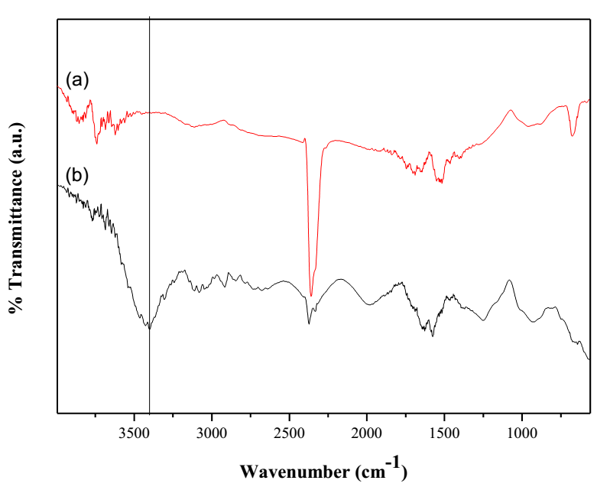
FTIR spectra of (a) Pure and (b) Functionalized MWCNTs
Pure
≈3400 cm⁻¹
(O-H stretching)
Functionalized MWCNTs

Slide 20
XRD spectra of (a) TiO₂, (b) CNT-TiO₂ (c) 2%Ag-TiO₂,
(d) 2%B 5%N 2%Ag -CNT-TiO₂ and (e) 2%B 5%N-CNT-TiO₂
composite thin films calcinated at 500°C.

Slide 21
UV-Visible absorption spectra of (a) TiO₂, (b) CNT-TiO₂ (c) 2%Ag-TiO₂, (d) 2%B 5%N 2%Ag -CNT-TiO₂ and (e) 2%B 5%N-CNT-TiO₂ composite thin films calcinated at 500° C.

Slide 22
Percentage of degradation efﬁciency of (a) TiO₂, (b) CNT-TiO₂ (c) 2%Ag-TiO₂, (d) 2%B 5%N 2%Ag -CNT-TiO₂ and (e) 2%B 5%N-CNT-TiO₂ ﬁlms (i) in cycle number 1 (1°cycle), (ii) in cycle number 2 (2° cycle).

Slide 23
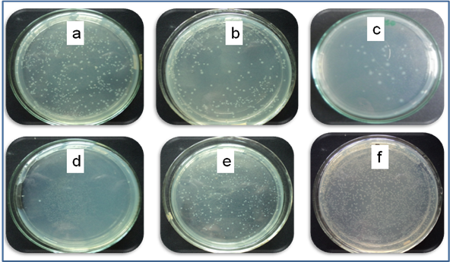
Antibacterial efficiency of (a) TiO₂, (b) CNT-TiO₂ (c) 2%Ag-TiO₂, (d) 2%B 5%N 2%Ag -CNT-TiO₂ (e) 2%B 5%N-CNT-TiO₂ composite thin films and (f) without film (control).
Antibacterial activity :
Against the E. coli bacteria based on the so-called antibacterial drop-test in the laminar air flow chamber
Colony forming unit (CFU) of E-coli after
visible light irradiation for 60 min in presence of (a) TiO₂, (b) CNT-TiO₂ (c) 2%Ag-TiO₂, (d) 2%B 5%N 2%Ag -CNT-TiO₂ and (e) 2%B 5%N-CNT-TiO₂ and without film (control ) in 1°cycle and 2°cycle.
Notes:
The antibacterial activity of the Ag/B/N co-doped TiO₂ and CNT composite thin films against the E. coli bacteria have been investigated based on the so-called antibacterial drop-test in the laminar air flow chamber. Sizes of all the samples used in this experiment were 25 mm / 25 mm. Before the microbiological experiment, all glass wares and samples were sterilized by heat treating at 180°C for 60 min. The microorganisms were cultured on a nutrient agar plate at 37° C for 24 h. The cultured bacteria were added in 10 ml saline solution to reach the concentration of bacteria to 10¹⁰ colony forming units per milliliter (CFU ml⁻¹ ) corresponding to McFarland scale. A portion of the saline solution containing the bacteria was diluted to 10⁸ CFU ml⁻¹. For the antibacterial drop-test, each film was placed into a sterilized Petri dish. Then 100 µl of the diluted saline solution containing E. coli were spread on surface of the film. Then it was irradiated by a tungsten lamp at room temperature. After 60 min, the bacteria were washed from surface of the film using 10 ml saline solution (NaCl) in the sterilized conical flask. Then 25 µl of each bacteria containing suspension were spread on a nutrient agar plate and incubated at 37° C for 24 h for counting the surviving bacterial colonies. The reported data were the average value of three separate similar runs.

Slide 24
Conclusions
First Phase
Co-doped TiO₂ thin films with B and N have been successfully synthesized by simple sol-gel dip coating method.
The B/N co-doped TiO₂ films demonstrated up to 40% higher photo-catalytic activities than bare-TiO₂ films under visible light irradiation.
The absorption edges for the doped films were found to be shifted toward the visible region.
The film with the B/N atomic ratio of 0.27 displayed the highest degradation rate among all doped films.
The doped films retained their superior catalytic activity for extended periods (Re-usability).
Computational calculation findings supported experimental data by indicating the possible routes that can be responsible for the improvement of the photo-catalytic activity in TiO₂ due to B and N doping.
It is revealed that B/N doped TiO₂ films could be a potential candidate for scaling up for industrial applications.
Notes:
₂₄

Slide 25
Second Phase
Co-doped TiO₂ and CNT composite thin films with silver, boron and nitrogen have been successfully synthesized by newly developed simple sol-gel drop coating method.
The 2%B 5%N-CNT-TiO₂ composite film demonstrated 58% photo-catalytic efficiency and 2%B 5%N 2%Ag -CNT-TiO₂ composite film showed 99% bacteria killing efficiency under visible light irradiation.
The absorption edges for the doped films were found to be shifted toward the visible region, while the overall absorption remarkably increased.
The doped composite films retained their superior catalytic activity for extended periods. It can also be concluded that silver acted as a very effective metal antibacterial agent as well as a kind of doping metal with boron, nitrogen in TiO₂ composite films.

Slide 26
Acknowledgement E. Bengu, Rasim Ovali, Oguz Gulseren : Bilkent University, Turkey M. M. R. Mazumder, M. S. Islam , Sayed Ul Alam Shibly , Saiful Islam , Md. Motiur Rahaman Mazumder , Md. Saidul Islam, M. Jasim Uddin , D. R. Sarker, Z. Rahman, M. A. Hossain, and M. Elias,: Shahjalal University of Science and Technology, Bangladesh
Recent related journal publications of my research group
Md. Nizam. Uddin* et al J. Photochem. Photobiol. A: Chem., 254 (2013) 25-34.
M. J. Uddin, Md. Nizam Uddin et al, International Nano Letter, 3 (2013) 16.
Submitted: M. N. Uddin* et al under review at J. Crystal Growth, 2014.
M. N. Uddin* et al under review at J. Appl. Surface Science, 2014.

Slide 27
This research was funded by the following projects
i. The world Academy of Sciences, Italy (Undertaken by UNESCO)
ii. University Grant Commission of Bangladesh,
iii. Research Center, Shahjalal University of Science and Technology,
iv. Ministry of Science and Technology, Bangladesh, and
v. Bilkent University via Ministry of Defense, Turkey.

Slide 28
Thank you very much for your attention!
National Parliament House of Bangladesh
Notes:
Construction started
1961
Completed
1982
Architect
Louis Kahn

Slide 29
SUST, my job place with Photo
Mascots made by the Architecture students of SUST for a national festival
Liberation War Memorial
'71 at SUST
Entrance way to SUST campus
Students' Hall
Academic building of SUST
University Central Library

