Slide 1
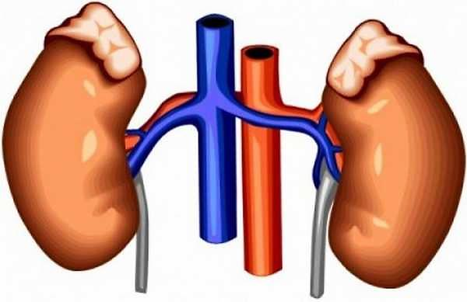
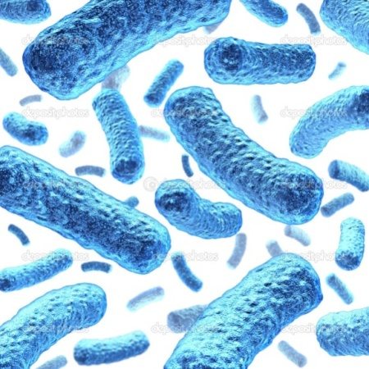
BACTERIOLOGY & ANTIBIOTIC SENSITIVITY PATTERNS OF URINARY TRACT INFECTION IN A TERTIARY HOSPITAL IN BANGLADESH
Professor Md. Mahabubul Islam Majumder
Department of Medicine
Comilla Medical College, Comilla
Bangladesh

Slide 2
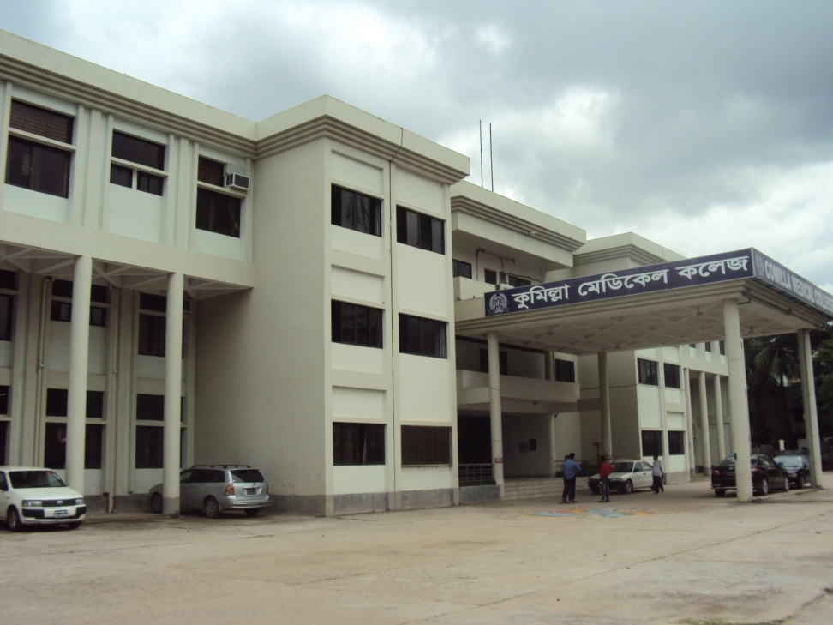
Comilla Medical College

Slide 3
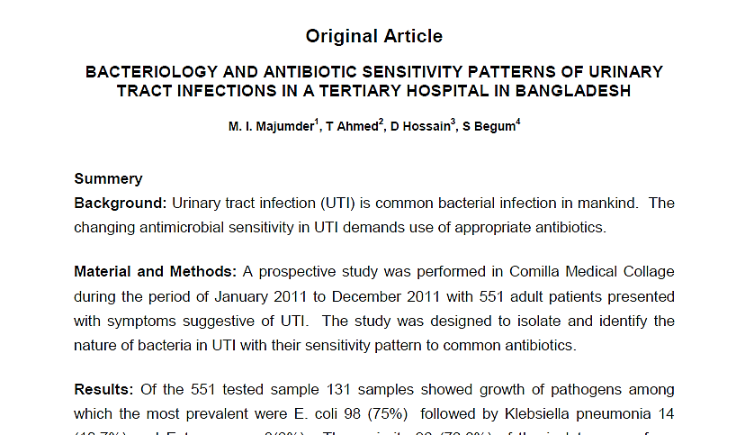
Ref: Mymensingh Med J. 2014 Jan;23(1):99-104.
Index with PubMed, MEDLINE Research gate

Slide 4
Urinary tract infection (UTI) is the common bacterial infection in mankind.¹
Cystitis - .70 episodes / person / year.²
Worldwide, about 150 million people are suffer from UTI / year, costing 6 billion US dollars.³
Females are more affected than males except at the extremes of life.⁴
Emerg Infect Dis, 2005,11(10):1503-6.
NEJM 2012; 366:1028-37.
J. Cell Tissue Res., 2005, 5(2), 445-448.
BMJ 2000, 321:1368-1369.
Notes:
Ref:
Gonzalez CM, Schaeffer AJ: Treatment of urinary tract infection: what's old, what's new, and what works. World J Urol. 1999; 6:372-382.
Akram M, Shahid M, Khan AU. Etiology and antibiotic resistance patterns of community-acquired urinary tract infections in J N M C Hospital Aligarh, India Annals of Clinical Microbiology and Antimicrobials. 2007; 6:4
Akinkugbe FM, Familusi FB, Akinkugbe O. Urinary tract infection in infancy and early childhood. East Afri Med. 1973; 50 (9): 514-52

Slide 5
Uncomplicated UTI are common in adult women across the entire age spectrum, with mean annual incidence of 15% and 10% in those aged 15-39 and 40-79 years, respectively.⁵
5. J Pak Med Assoc. vol 60, no1, 2010
Notes:
Ref:
Gonzalez CM, Schaeffer AJ: Treatment of urinary tract infection: what's old, what's new, and what works. World J Urol. 1999; 6:372-382.
Akram M, Shahid M, Khan AU. Etiology and antibiotic resistance patterns of community-acquired urinary tract infections in J N M C Hospital Aligarh, India Annals of Clinical Microbiology and Antimicrobials. 2007; 6:4
Akinkugbe FM, Familusi FB, Akinkugbe O. Urinary tract infection in infancy and early childhood. East Afri Med. 1973; 50 (9): 514-52

Slide 6
Almost 95% of cases of UTI are caused by bacteria that typically multiply at the opening of the urethra and travel up to the bladder.⁴
Pyelonephritis usally blood borne infection.
4. BMJ 2000, 321:1368-1369

Slide 7
Usually 10⁵ cfu/ml colony count is considered significant in urine C/S.
But in 30-50% cystitis colony count is10² -10⁴cfu/ml.⁶
Upto 2/3rd cases of recurrent infections – are recurrences of initial infection.
6. NEJM 2012; 366:1028-37.

Slide 8
E.coli is responsible in 75-95% cases.
Staphylococcous ranks 2nd, than Proteus,Klebsiella and others.
Recurrence – 25% within 6 months of 1st episode.⁶
6. NEJM 2012; 366:1028-37.

Slide 9
Globally – first line sensitive drugs are:
Nitrofurantoin, Fosfomycin, Cotrimoxazole & Pivmecillinum⁶
Prevalence of resistance – if >20% with Cotrimoxazole & > 10% with Flouroquinolones.
6. NEJM 2012; 366:1028-37.

Slide 10
Background of the study
The changing antimicrobial resistance caused a demand for new microbial agents.¹
The irrational use of antibiotics has an influence in the spread of antimicrobial resistance among bacteria.^{2,4}
1. Emerg Infect Dis, 2005,11(10):1503-6.
2. J. Cell Tissue Res., 2005, 5(2), 445-448.
4. BMJ 2000, 321:1368-1369.
Notes:
References:
CourvalinP.Antimicrobial drug resistance: Predection is very difficult ,specially about the future.Emerg Infect Dis, 2005,11(10):1503-6.
Ebrahimzadeh, M.A.; Mahdavee, M.R.; Vahedi, M. Antibiotic resistance in E. coli isolated from urine: A 2-years study isolated from patient with urinary tract infections in Iran. J. Cell Tissue Res., 2005, 5(2), 445-448.
Udur G: Drug resistant cholera in India attributed to antibiotic misuse. BMJ 2000, 321:1368-1369.
Moland E.S,N,D,. Hanson J.A. Banik, A.Hossain. Strong W, Thomas K. S. Prevalance of newer 5-lactamase in Gram-negative clinical isolates collected in United States from 2001 to 2002. J. Clin. Microbiol. 2006, 44:3318-3324.

Slide 11
Background of the study
The widespread use of broad spectrum antibiotics has led to the emergence of nosocominal infection caused by drug resistant microbes.⁷
The local data about the antimicrobial sensitivity should be available for proper therapeutic interventions of UTI.
7. J. Clin. Microbiol. 2006, 44:3318-3324.
Notes:
References:
CourvalinP.Antimicrobial drug resistance: Predection is very difficult ,specially about the future.Emerg Infect Dis, 2005,11(10):1503-6.
Ebrahimzadeh, M.A.; Mahdavee, M.R.; Vahedi, M. Antibiotic resistance in E. coli isolated from urine: A 2-years study isolated from patient with urinary tract infections in Iran. J. Cell Tissue Res., 2005, 5(2), 445-448.
Udur G: Drug resistant cholera in India attributed to antibiotic misuse. BMJ 2000, 321:1368-1369.
Moland E.S,N,D,. Hanson J.A. Banik, A.Hossain. Strong W, Thomas K. S. Prevalance of newer 5-lactamase in Gram-negative clinical isolates collected in United States from 2001 to 2002. J. Clin. Microbiol. 2006, 44:3318-3324.

Slide 12
Basic Study Objective/ Aim
The aim and objective of this study was to detect culture and sensitivity pattern of bacteria implicated in UTI which will help to adopt more effective strategies in treatment of UTI.

Slide 13
Study Design
551 patients
Selected from History & clinical findings
Screened for Growth of the organism
Screened for Antibiotics Sensitivity
Study Time period: Jan. 2011 to Dec. 2011
Baseline
Week 52

Slide 14
Baseline Patient Characteristics
Male, N (%) | 221 (40.10)
Female, N (%) | 330 ( 59.90)
Age | Over 12 Years
Type | Asian, Bangladeshi

Slide 15
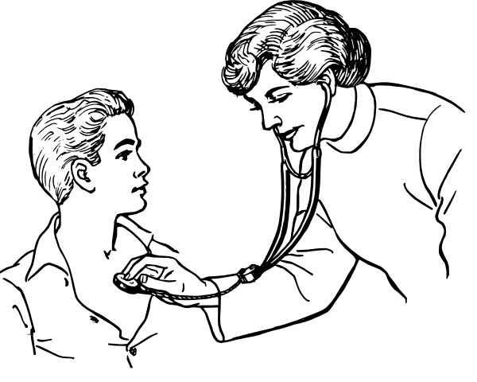
Materials & Methods
Inclusion criteria:
Patients above 12 years of age.
Presented with the complains of dysuria, frequency, urgency and fever with pain in suprapubic area / lion with or without tenderness.
Those patients are on antibiotic advised to stop drug for 48 hours and included in this study.

Slide 16
Materials & Methods
Exclusion Criteria:
Patients presented with active menstruation PID, tuboovarian, disease, appendicitis, colitis, epididymitis and orchitis diagnosed either clinically or by investigations were excluded from this study.

Slide 17
Materials & Methods
Prospective study in Comilla Medical Collage including 551 adult patients presented with symptoms suggestive of UTI.
Study period was in between January 2011 to December 2011.
Urine samples were collected both from the out patients and inpatients dept. of Medicine.

Slide 18
Materials & Methods
The mid-stream urine specimens were collected and cultured within hour of collection.
The samples were incubated aerobically overnight at 37ºc after plated out on MacConkey and Blood agar media.
The characteristic bacteria on the culture media were isolated.

Slide 19
Materials & Methods
Antimicrobial sensitivity tests were carried out by disc diffusion technique Kirby- Bauer disc diffusion technique as recommendation of CLSI (Clinical and Laboratory Standard Institute)
The plates were then incubated at 37°C for 18-24 hours.

Slide 20
Materials & Methods
Growth of >10⁵ cfu/ml was considered as significant growth.
Interpretation of results was expressed in sensitive, moderate sensitive and resistant

Slide 21
Materials & Methods
The Antibiotics used for susceptibility testing in our study were
amoxycillin,
amoxyclav,
cefotaxime,
ceftriaxone,
cephalexin,
nalidexic acid,
nitrofurantoin,
mecillinum,
amikacin,
cefixime,
ceftazidime
cefuroxime,
cephradine
ciprofloxacin
cotrimoxazole,
gentamycin,
meropenem,
and imipenem.

Slide 22
Results

Slide 23
Results
Overall prevalence of growth and there sex distribution.

Slide 24
Frequency of Isolation of organism in relation to sex of pts.
z/p values( affected total females vs males): 5.36/<.001

Slide 25
In vitro antibiotics sensitivity and resistance pattern of organism.
No. | Name of antibiotics | Sensitivity pattern |  |  | Resistance pattern
 |  | Sensitive (%) | Moderately Sensitive (%) | Total (%)
01 | Imipenem | 129 (98.5) | 2(1.5) | 131(100) | 0(0)
02 | Meropenem | 127 (97) | 1(1) | 128(98) | 3 (2)
03 | Amikacin | 127 (97) | 1(1) | 128(98) | 3 (2)
04 | Nitrofurantoin | 115 (88) | 4(3) | 119(91) | 12 (9)
05 | Gentamycin | 112(85) | 1(1) | 113(86) | 18(14)
06 | Mecillinum | 109(83) | 4(3) | 113(86) | 18(14)
07 | Amoxyclav | 74 (56) | 26 (20) | 100(76) | 31 (24)
08 | Ceftriaxone | 47 (36) | 6(4) | 53(40) | 78 (60)
09 | Cefotaxime | 41 (32) | 10(7) | 51(39) | 80 (61)

Slide 26
In vitro antibiotics sensitivity and resistance pattern of organism.
Cont....
No. | Name of antibiotics | Sensitivity pattern |  |  | Resistance pattern
 |  | Sensitive (%) | Moderately Sensitive (%) | Total (%)
10 | Cotrimoxazole | 44 (34) | 6(4) | 50(38) | 81 (62)
11 | Cefuroxime | 47 (36) | 2(1) | 49(37) | 82(63)
12 | Cephradine | 31 (24) | 17(13) | 48(37) | 83(63)
13 | Cephalexin | 35 (27) | 11(8) | 46(35) | 85 (65)
14 | Ciprofloxacin | 36 (27) | 9(7) | 45(34) | 86 (66)
15 | Cefixime | 38 (29) | 2(1) | 40(30) | 91 (70)
16 | Nalidexic acid | 28 (22) | 5 (3) | 33(25) | 98 (75)
17 | Amoxycillin | 17 (13) | 0 (0) | 17(13) | 114 (87)

Slide 27
Overall Discussion
131 (23.77%) urine samples gave significant growth and no bacterial growth was recorded in 420 (76.23%) samples.
Cause of failure to growth in 76.23% samples possibly due to irregular intake of long acting antibiotics by our patients.
Research on UTI by ICDDRB observed growth only in 24.14% samples which was consistent with our study.
Notes:
Findings in our study is consistent with the findings of previous studies in ICDDR,B where E. coli and Klebsiella pneumoniae was isolated in 66.92%and13.45% cases respectively¹¹ from the patient with UTI.
But previous study in ICDDR, B in the year 2007 demonstrated sensitivity to cotrimoxazole was near 67%.

Slide 28
Overall Discussion
The most predominant organisms isolated were Echeriachia coli (75%) and Klebsiella (10.7%).
UTI was found more in females than males.
New Findings: cotrimoxazole was found to be useful only in 44% cases.
Notes:
Findings in our study is consistent with the findings of previous studies in ICDDR,B where E. coli and Klebsiella pneumoniae was isolated in 66.92%and13.45% cases respectively¹¹ from the patient with UTI.
But previous study in ICDDR, B in the year 2007 demonstrated sensitivity to cotrimoxazole was near 67%.

Slide 29
Overall Discussion
Study shows cephalosporin and fluoroquinolones are no more useful against uropathogens,
only 30-40 % found sensitive to different members of cephalosporins.
& only 34% were sensitive to ciprofloxacin.
Notes:
Ref:
Frshad, S. Ranjbar R. Anvarinejad M, Shahidi M,A, Hosseini, M. Emergence of multi drug resistant strains of Eschetichia coli isolated from urinary tract infection. The Open Conferance Procedings Journal,2010,1:192-96.

Slide 30
Overall Discussion
The most powerful parentral antibiotics in this study were imipenem, meropenem and amikacin as they shows efficacy against 98-100% of the isolates which was supported by data from other similar studies.¹
The Open Conferance Procedings Journal,2010,1:192-96.
Notes:
Ref:
Frshad, S. Ranjbar R. Anvarinejad M, Shahidi M,A, Hosseini, M. Emergence of multi drug resistant strains of Eschetichia coli isolated from urinary tract infection. The Open Conferance Procedings Journal,2010,1:192-96.

Slide 31
Conclusion
This study concludes that urinary isolates were more sensitive to imipenem, meropenem, amikacin and nitrofurantoin in comparison to the other antibiotics in this region.

Slide 32
Contd…
There is every need to -
constantly monitor culture and sensitivity pattern of specific pathogens in different health care centre.
Guidelines for appropriate use of antibiotics in tertiary care hospitals in our country needs updating by large scale prospective study.

Slide 33
Say bye to UTI
T
H
A
N
K
Y
O
U

