Slide 1
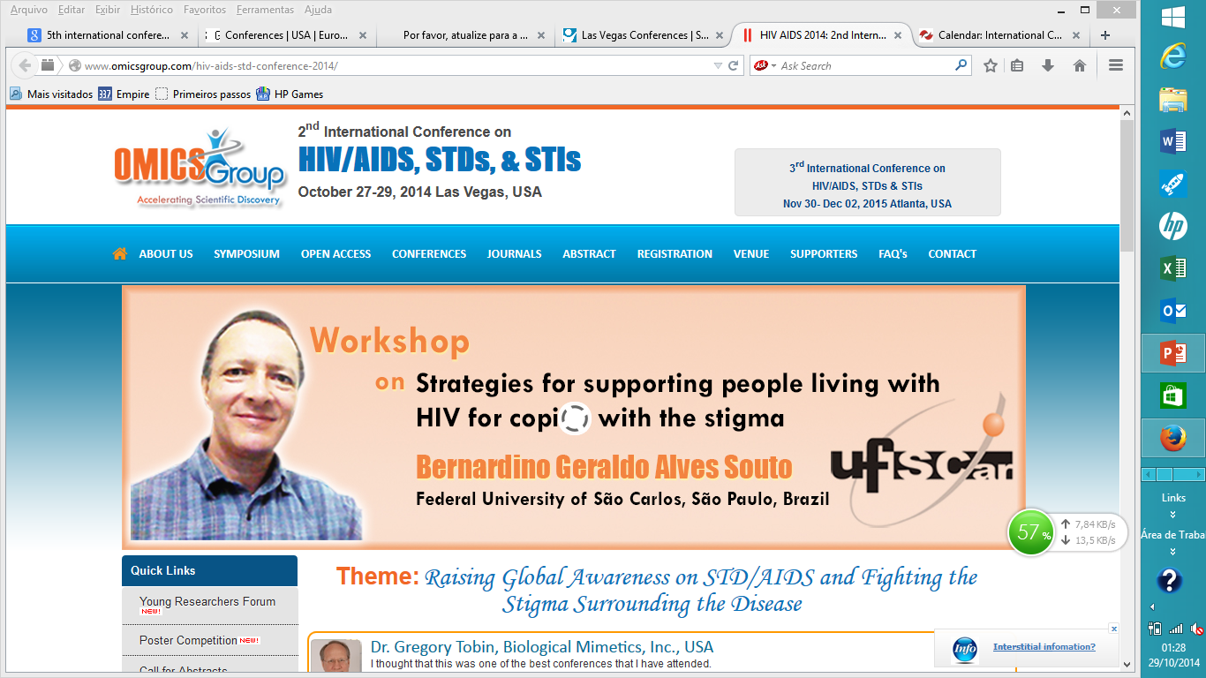

Slide 2
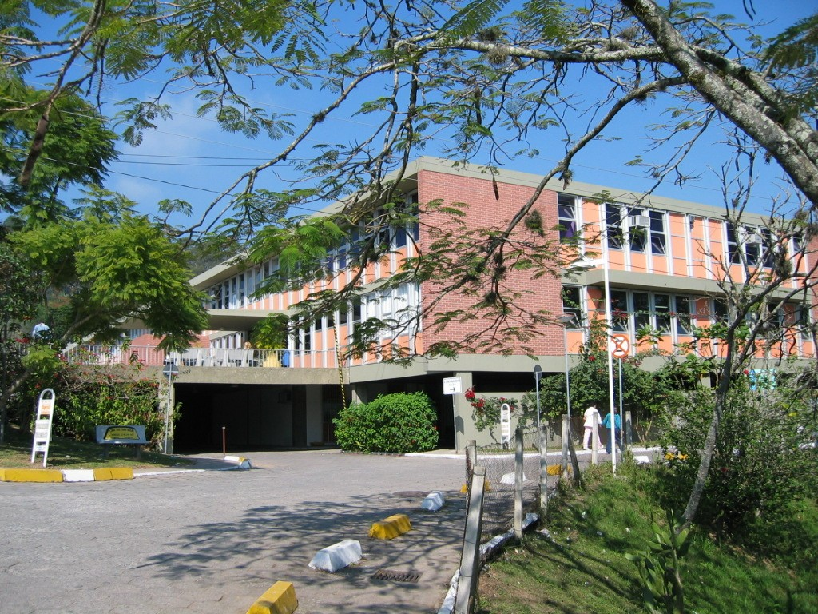
JOANA DE GUSMÃO CHILDREN’S HOSPITAL/UNIVERSITY HOSPITAL
FLORIANÓPOLIS-SC-BRAZIL

Slide 3
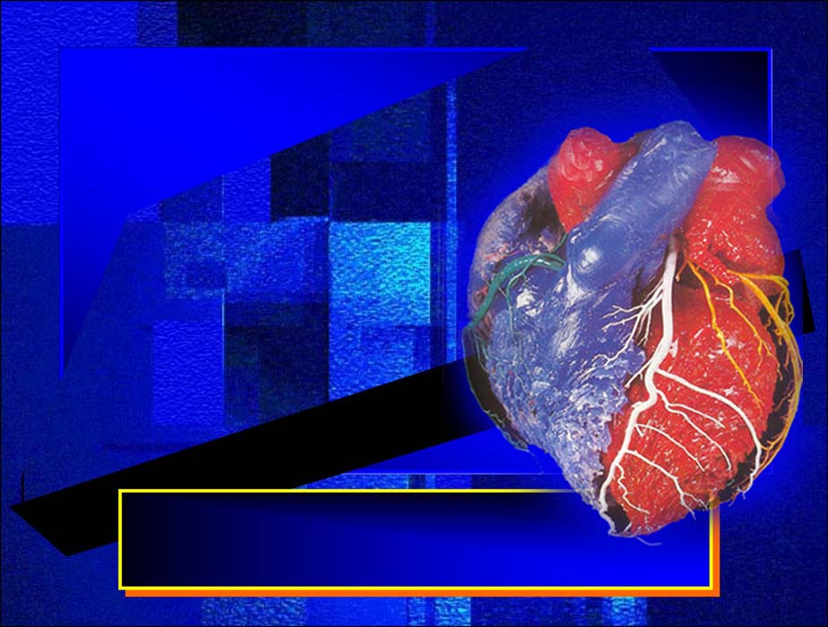
CARDIAC DIASTOLIC FUNCTION IN PEDIATRIC AIDS/HIV-CARRIERS:
ASSESSMENT, TREATMENT AND PREVENTION
OF FUTURE CARDIOVASCULAR DISEASES
MAURICIO LAERTE SILVA,MD

Slide 4
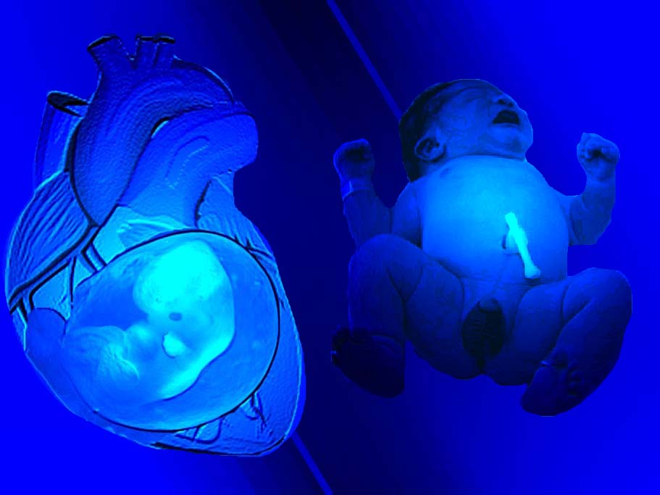
C
A
R
E
B
E
F
O
R
E
A
F
T
E
R

Slide 5
Cardiovascular manifestations occur frequently in children
with human immunodeficiency virus (HIV) vertical infection.
The prevalence of HIV infection among children is still high
as advances in therapy and management of the disease
improve life expectancy.
J Pediatr 2002;141(3):327-34.;Pediatrics 2001;107:328-38.

Slide 6
In a prospective study, the 5-year cumulative incidence of
cardiac dysfunction in children ranged from 18% to 39%.
underlying cause of HIV-related death
in 11.8% of them.
The exact pathogenesis of the cardiac manifestations
remains unclear.
most likely multifactorial.
Pediatrics 2001;107:328-38; J Pediatr 2002;141(3):327-34;Circ Heart Fail 2010;3(1):132-9.

Slide 7
The cardiac abnormality most commonly seen
is dilated cardiomyopathy.
ranging from asymptomatic cardiac
dilation to severe chronic heart failure.
Mild depression of left ventricle (LV) and LV mass
were risk factors for death, independent of age,
duration of illness, CD₄⁺ count, HIV-1 viral load,
neurologic disease or malnutrition.
J Pediatr 2002;141(3):327-34; Pediatrics 2001;107:328-38;AIDS 2003;17(Suppl. 1):S46–S50; Circulation 2000;102:1542-8;
Pediatr Infect Dis J 2004;23(6):559-63.

Slide 8
Subclinical cardiac abnormalities develop
early in HIV-infected children, even among
those with asymptomatic HIV disease
or for cardiac dysfunction.
J Pediatr 2002;141(3):327-34; Circulation 2000;102:1542-8;Indian Pediatr 2005 ;42(2):146-9; Afr Health Sci 2005;5(3):219-26;
Cardiovasc J S Afr 2005;16(4):206-10.

Slide 9
After beginning highly active antiretroviral
therapy (HAART), there are reports of
reductions in the incidence of left ventricular
dysfunction and more favourable outcomes
of cardiac alterations.
It was reported the resolution of dilated cardiomyopathy
in vertically-infected HIV affected children who received
a combination of drugs.
Pediatr Infect Dis J 2004;23(6):559-63; Arq Bras Cardiol 2008;90(1):11-7;Arq Bras Cardiol 2003;80(3):316-20;
Arq Bras Cardiol 2005;85(4):233-40.

Slide 10
It is possible that an alteration in
diastolic function precedes
systolic dysfunction, as seen
in other clinical conditions
Heart 2000;84(6):620-4; AIDS Patient Care STDS 2009 ;23(4):231-8; Circ Heart Fail 2010;3(1):132-9.

Slide 11
An observational, cross-sectional study was conducted
at the Joana de Gusmao Children's Hospital, Santa Catarina
Health State Secretary, Brazil.
Convenience and not probabilistic sample.*
*Silva,ML et al. Biventricular diastolic function assessed by Doppler echocardiogram in children vertically infected with human immunodeficiency vírus. J Pediatr (Rio J). 2014;90(4);403-407

Slide 12
94 symptomatic (CDC classes A, B or C) vertically
HIV-infected children.
Age: 20.3 to 170.6 months
(mean 69.7 months).
Sex: 52 (55.0%) males.
J Pediatr (Rio J). 2014;90(4):403-407

Slide 13
Two diastolic cardiac function variables were
evaluated:
Left and right ventricular filling,
represented by the E/A ratio of the
mitral and tricuspid Doppler waveforms.
E
A
A
E
E/A ratio > 1,0
E/A ratio < 1,0
NORMAL
ABNORMAL
J Pediatr (Rio J). 2014;90(4):403-407

Slide 14
In the left heart side, there was a predominance
of the myocardial compliance impairment
(28.0% and 95%CI, 18.9% to 37.1%)
versus
the abnormal relaxation
(10.7% and 95% Cl, 4.4% to 17.0%).
J Pediatr (Rio J). 2014;90(4):403-407

Slide 15
In the right heart side, the situation was reversed,
and was evidente a slight predominance of
the abnormal relaxation
(16.3% and 95% Cl, 8.7% to 23.7%)
in comparison to the
myocardial compliance impairment
(13.1% and 95% CI, 6.2% to 20.0%)
J Pediatr (Rio J). 2014;90(4):403-407

Slide 16
From the physiopathologic standpoint,
the abnormal relaxation represents an impairment
of myocardial relaxation and/or filling dynamics
of ventricles and is an early and reversible
stage in the scope of the diastolic dysfunction.
However, the myocardial compliance impairment is due
to a more aggressive injury of the myocardium, sometimes
with fibrosis, and may not be reversible in some instances.
J Pediatr (Rio J). 2014;90(4):403-407

Slide 17
Why differences in the type of diastolic dysfunction
between the left and right ventricles exist is a question
that remains to be clarified.
Therefore, it appears that the left myocardium is more
susceptible to the aggression, regardless the causal agent,
or it is affected early during the disease progression.
J Pediatr (Rio J). 2014;90(4):403-407

Slide 18
The exploratory procedures (factorial analysis and
multiple correspondence analysis) to evaluate correlations
between variables did not show evidence of any association,
despite some suggestions from the table
of frequency analysis.
J Pediatr (Rio J). 2014;90(4):403-407

Slide 19
Thus, the findings of biventricular diastolic dysfunction
may be an expression of an isolated direct or indirect
action of the HIV with no influence of any
other factor, as has been suggested by other authors.
J Pediatr (Rio J). 2014;90(4):403-407

Slide 20
The fact that the immunologic status did not show a
relationship with cardiac dysfunction is important
clinically and indicates that the CD₄⁺ percentage count
cannot be considered an indicator of cardiac involvement.
J Pediatr (Rio J). 2014;90(4):403-407

Slide 21
Thus, HIV-infected children should have a
Doppler-echocardiographic study performed as
a part of their evaluation, even when they are
asymptomatic from the cardiovascular point of view.
J Pediatr (Rio J). 2014;90(4):403-407

Slide 22
SUMMARIZING

Slide 23
EVOLUTION AND PATHOGENESIS OF THE INVOLVEMENT OF THE CARDIOVASCULAR SYSTEM IN HIV INFECTION
PHASE I
Phase of diastolic dysfunction
(inversion of the E/A ratio and prolongation
of the isovolumetric relaxation time) with
normal systolic parameter
(Fractional Shortening > 27% (EF >50%)
Potentially reversible
Need chocardiographic
follow-up every six months
Adapted from: Cardiovascular disease in AIDS.Springer Milan.2009, pp 181-189

Slide 24
Potentially reversible but duration
unpredictable.
Improvement of the
echocardiographic parameters with
ACE-1 inhibitors.
Immunomodulant therapy
(eg. iv immunoglobulin) may
be helpful in case of myocarditis and
viral myocardial infection.
In this phase the use of AZT may worsen the
clinical evolution of cardiomyopathy
(possibly for impairment of the Krebs cycle).
Need echocardiographic folow-up every six
months.
PHASE II
Phase of reversible systolic dysfunction
(increase of thickness of interventricular
septum, increase of end-diastolic diameter,
optimal thickness/radium ratio), with
a Fractional Shortening > 27% (EF >50%)
Adapted from:Cardiovascular disease in AIDS.Springer Milan.2009, pp 181-189

Slide 25
PHASE III
Non reversible.
In this phase individual
variables (including HAART) may
accelerate the negative outcome of
cardiomyiopathy.
The state of immunodeficiency may enhance
the negative inotropic effects of
local cytokines, justifying the reduced
response to inotropic agents.
Phase of irreversible systolic dysfunction
(increase of both end-diastolic and
end-systolic diameter, flattening of
the interventricular septum without
systolic increase, difuse left ventricular
hypokinesia) with a
Fractional Shortening < 27% (EF <40%)
Adapted from:Cardiovascular disease in AIDS.Springer Milan.2009, pp 181-189

Slide 26
Prevention!
= screening

Slide 27
THANK YOU
SO
MUCH
FOR YOUR
ATTENTION!
+55-48-9972-3439
mauricio.laerte@unisul.br

