Slide 1
About OMICS Group
OMICS Group International is an amalgamation of Open Access publications and worldwide international science conferences and events. Established in the year 2007 with the sole aim of making the information on Sciences and technology ‘Open Access’, OMICS Group publishes 400 online open access scholarly journals in all aspects of Science, Engineering, Management and Technology journals. OMICS Group has been instrumental in taking the knowledge on Science & technology to the doorsteps of ordinary men and women. Research Scholars, Students, Libraries, Educational Institutions, Research centers and the industry are main stakeholders that benefitted greatly from this knowledge dissemination. OMICS Group also organizes 300 International conferences annually across the globe, where knowledge transfer takes place through debates, round table discussions, poster presentations, workshops, symposia and exhibitions.

Slide 2
About OMICS Group Conferences
OMICS Group International is a pioneer and leading science event organizer, which publishes around 400 open access journals and conducts over 300 Medical, Clinical, Engineering, Life Sciences, Phrama scientific conferences all over the globe annually with the support of more than 1000 scientific associations and 30,000 editorial board members and 3.5 million followers to its credit.
OMICS Group has organized 500 conferences, workshops and national symposiums across the major cities including San Francisco, Las Vegas, San Antonio, Omaha, Orlando, Raleigh, Santa Clara, Chicago, Philadelphia, Baltimore, United Kingdom, Valencia, Dubai, Beijing, Hyderabad, Bengaluru and Mumbai.

Slide 3
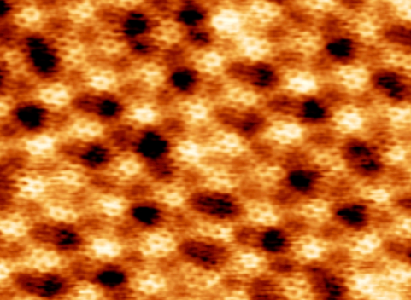



Interfaces between graphene and MoS₂ probed by STM and ARPES
Matthias Batzill
University of South Florida, Tampa
At USF:
Horacio Coy-Diaz
Dr. Rafik Addou
Antares beamline at SOLEIL:
Dr. José Avila
Dr. Chaoyu Chen
Prof. Maria C. Asensio
DOE
NSF

Slide 4
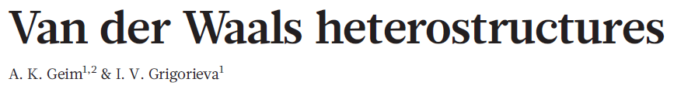
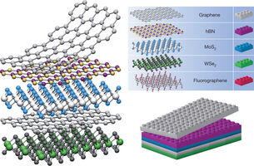
Artificial crystals or device-structures made of 2D-materials
DOE
NSF

Slide 5
How do interactions between layers modify properties?
Kuc, Zibouche, Heine PRB 83, 245213 (2011)
DOE
NSF

Slide 6
If interlayer interactions are important for the electronic structure of van der Waals materials, how do interlayer interactions affect heterostructures of van der Waals materials?
Here we study graphene/MoS₂ interfaces.
DOE
NSF

Slide 7
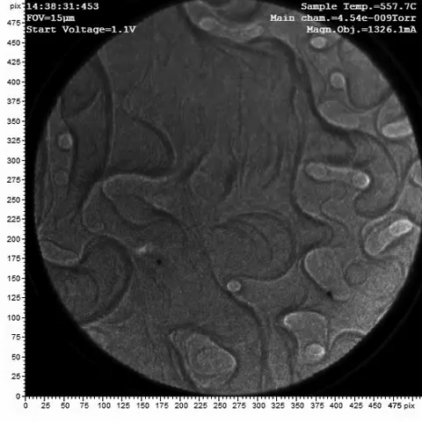
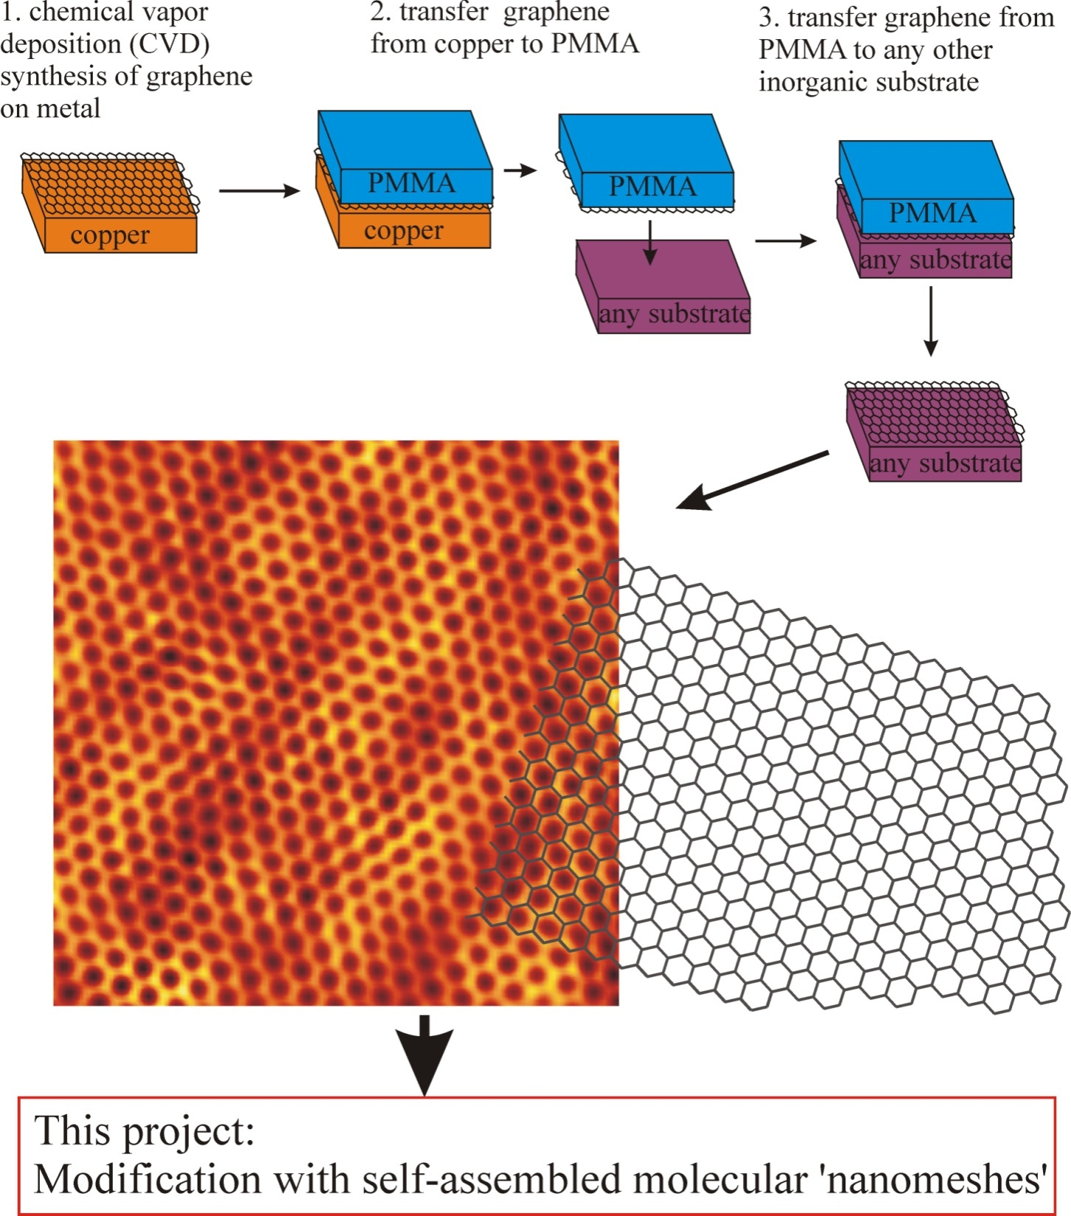
Preparation of graphene/MoS₂ samples
DOE
NSF

Slide 8
Characterization of transferred graphene on MoS₂
Trapped water-layer after transfer (ambient AFM)
DOE
NSF

Slide 9
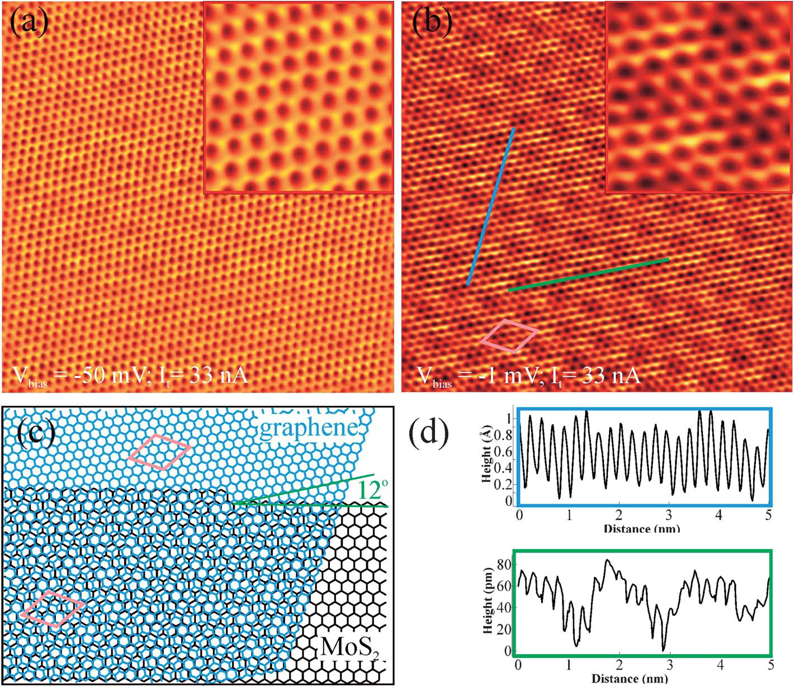
Characterization of transferred graphene on MoS₂
After annealing in UHV at 300 C:
Atomically sharp interface => moire pattern.
DOE
NSF

Slide 10
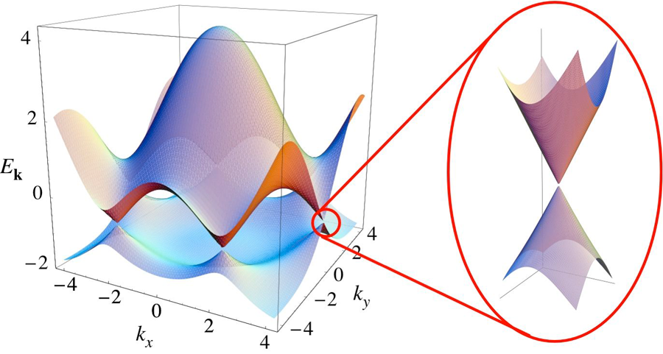
Electronic structure of transferred graphene on MoS₂
Γ
Μ
Κ
graphene
MoS₂
E_{Fermi}
1.12 eV
1.23 eV
DOE
NSF

Slide 11
Intact Dirac-cone with no charge transfer doping
ARPES (30 eV)
NanoARPES (100 eV)
=> The Dirac cone of graphene is very close to that expected for free-standing graphene, i.e. linear dispersion and no doping (Fermi-level at the Dirac point).
DOE
NSF

Slide 12
Band-gaps in graphene π-band
NanoARPES 100 eV
30 eV ARPES
Same gaps in graphene for same substrate-direction=> substrate induces gaps
DOE
NSF

Slide 13
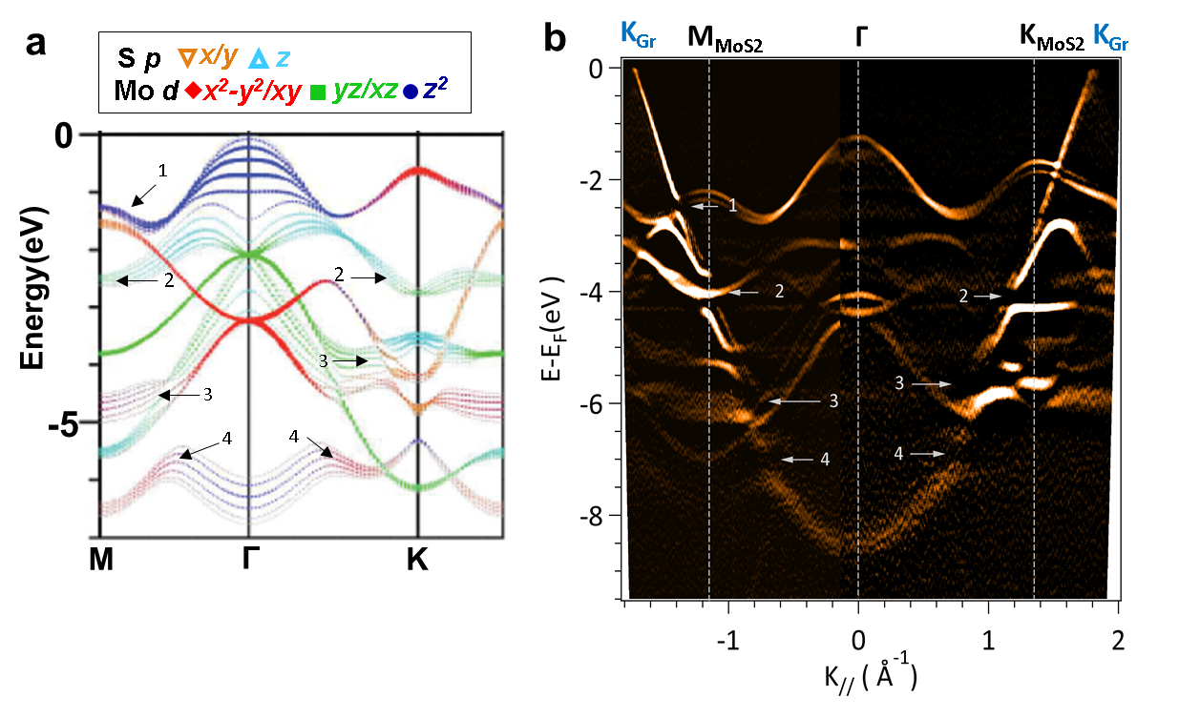
Correlation of band-gaps in graphene with MoS₂ ‘out-of-plane’ orbitals
=> Band gaps open in graphene due to hybridization of π-states with ‘out-of plane’ MoS₂ molecular orbitals.
DOE
NSF

Slide 14
Conclusions: graphene/MoS2 ‘van der Waals’ interfaces
Macroscopic (tens of mm-sized) CVD-grown graphene can be transferred with excellent quality to MoS₂ with atomically sharp and clean interfaces.
The interface band alignment between graphene and MoS₂ suggests a close to barrier-less electron injection from graphene into MoS₂.
A close to ideal Dirac-cone of graphene is observed.
Overlap of out-of-plane molecular orbitals of MoS₂ with graphene π-band causes hybridization and opening of band-gaps in graphene.
DOE
NSF

Slide 15
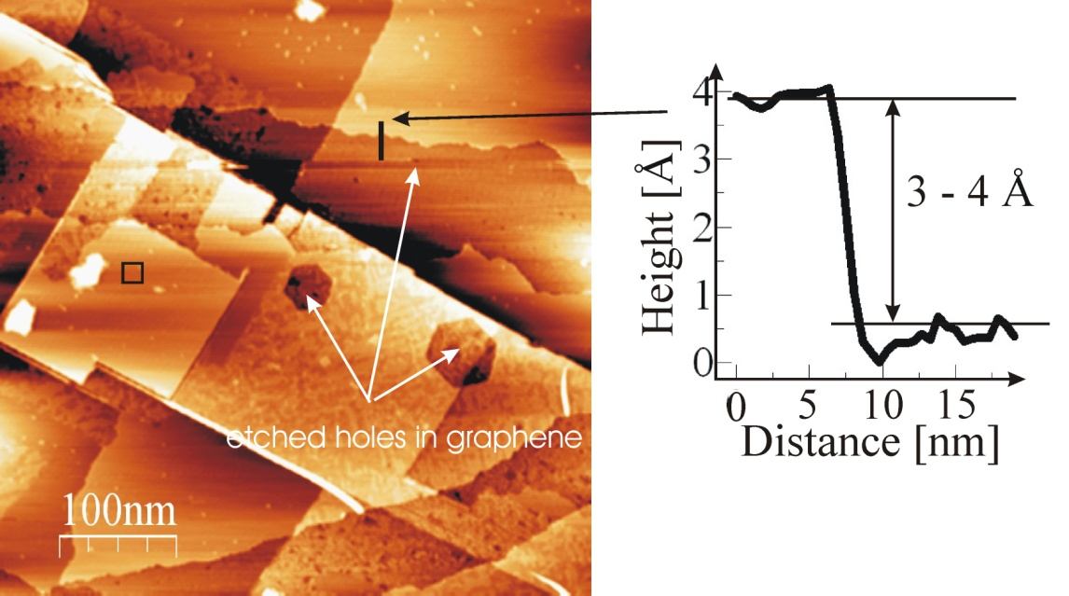
Graphene transfer to other materials: e.g. SrTiO₃(001)
DOE
NSF

Slide 16
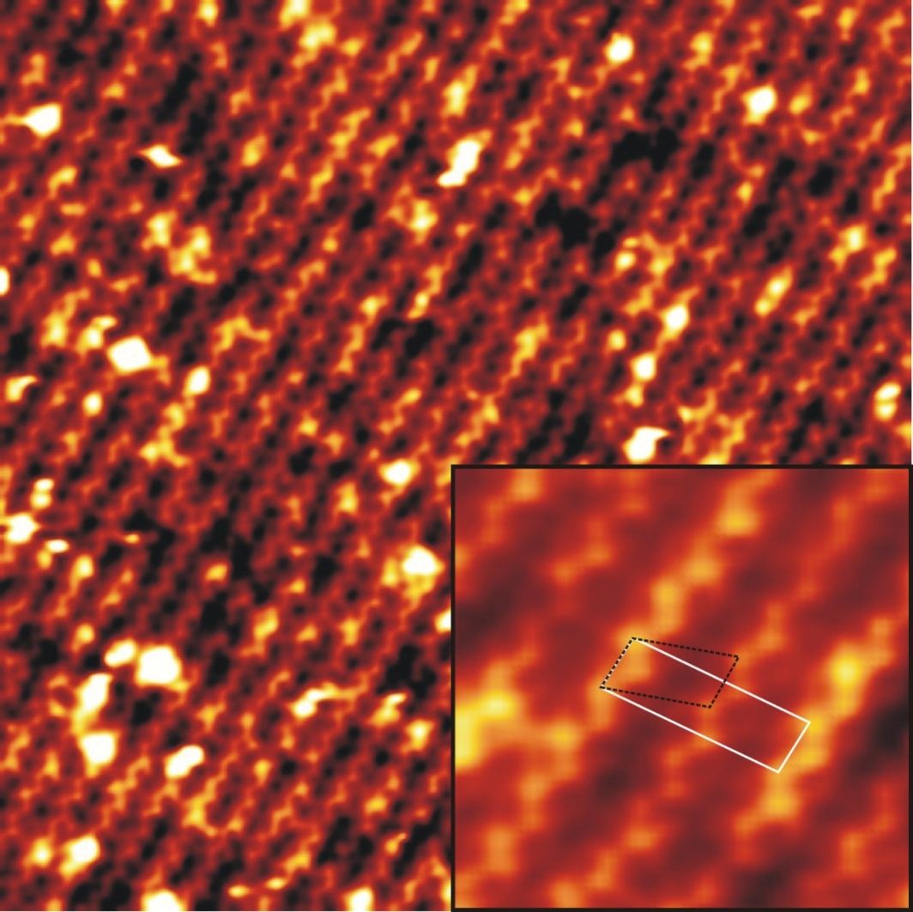
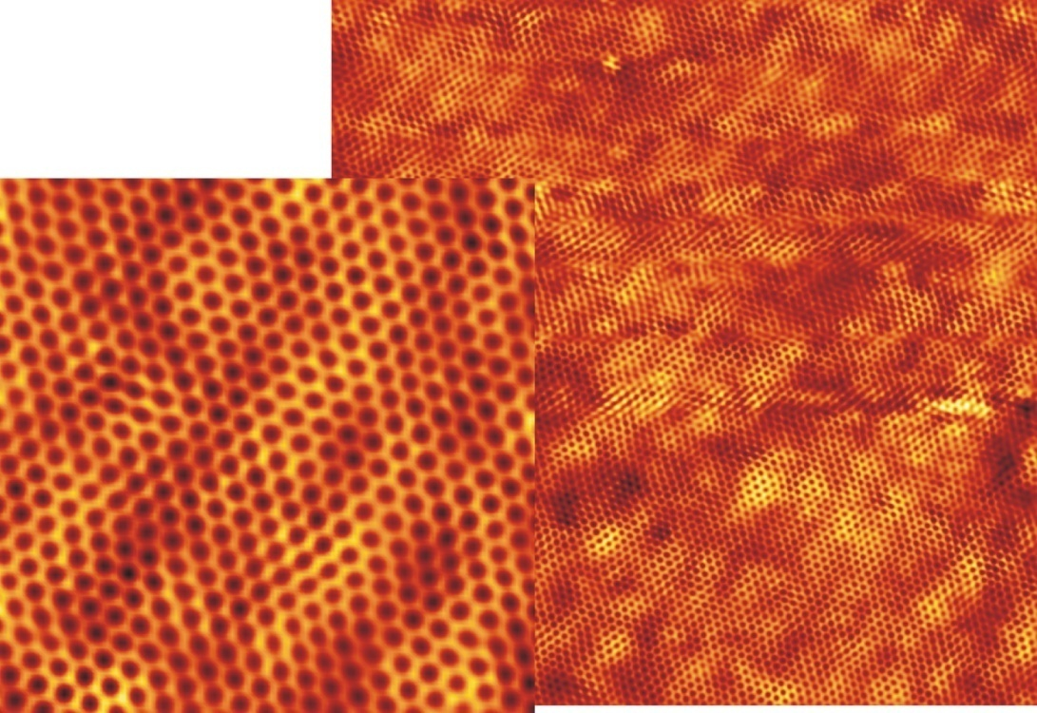
Graphene transfer to other materials: e.g. SrTiO₃(001)
Interface structure of graphene/SrTiO₃(001)
Reconstructed bare SrTiO₃ surface.
Graphene covered STO
=>This suggest an atomically sharp interface between graphene and the oxide substrate!
H. Coy-Diaz, R. Addou, M.B J. Phys. Chem. C 117, 21006 (2013)
DOE
NSF

Slide 17
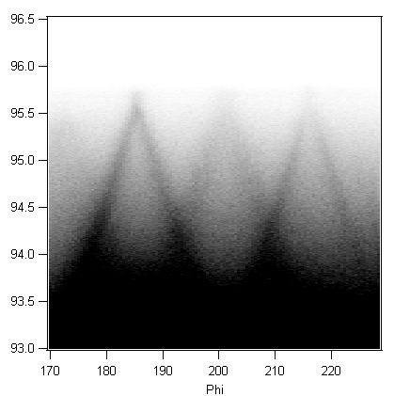
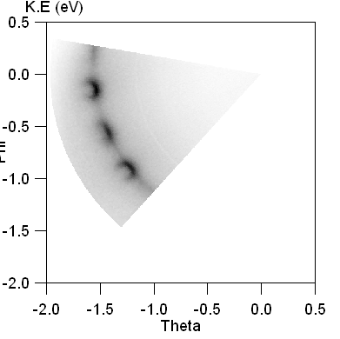
Graphene transfer to other materials: e.g. SrTiO₃(001)
Fermi level
Dirac point
=>Dirac cone of graphene is maintained: Interface charge transfer results in n-type doping
DOE
NSF

Slide 18
Let Us Meet Again
We welcome you all to our future conferences of OMICS Group International
Please Visit:
http://materialsscience.conferenceseries.com/
Contact us at
materialsscience.conference@omicsgroup.us
materialsscience@omicsgroup.com

