Slide 1
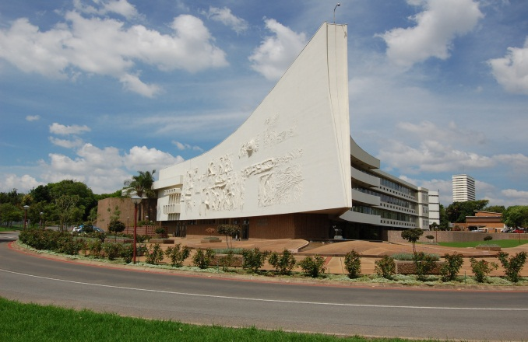
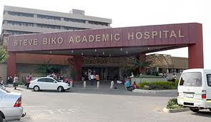

INSTITUTIONAL REVIEW:COMPLICATED SINUSITIS-
MASHUDU TSHIFULARO
Professor/HOD
ENT DEPT.UP.
SOUTH AFRICA
PT,UP

Slide 2
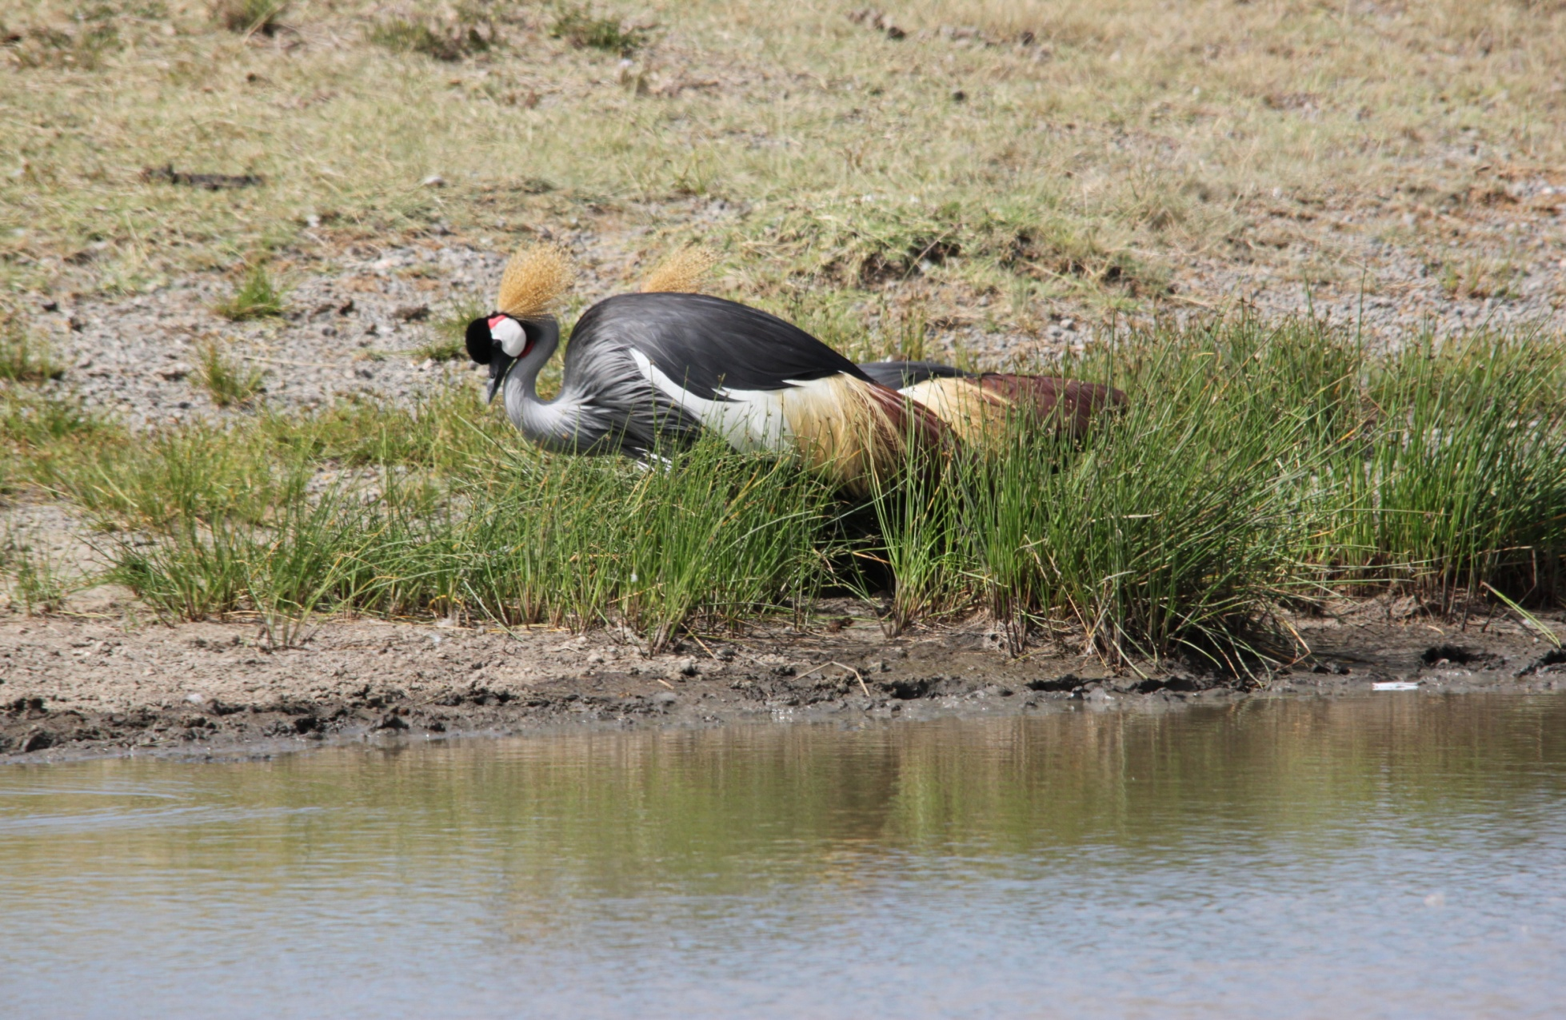

Slide 3
Middle East and Africa: penicillin-resistant S. pneumoniae
Tunisia
24.0% 11.0%
Lebanon
38.0% 18.0%
Turkey
26.8% 18.3%
Israel
16.9% 29.7%
Kuwait
1.6% 45.6%
Algeria
11.4% 5.7%
Ghana
17.0% 0.0%
Saudi Arabia
39.8% 21.7%
Egypt
29.1% 0.0%
Nigeria
36.0%
Kenya
41.2% 1.8%
South Africa
20.9% 51.0%
Penicillin-intermediate (MIC 0.12–1 µg/mL)
Penicillin-resistant (MIC ≥ 2 µg/mL)
Data from various sources and various years

Slide 4
outline
Introduction
Aim
Methods
Results
Conclusion
Acknowledgement

Slide 5
INTRODUCTION
Complications of acute bacterial sinusitis into orbital and intracranial sepsis is a common problem in pediatrics age group. (Pendas,2003)
Between 0.5% and 24% of patients admitted to hospital with acute bacterial sinusitis develop intracranial and orbital complications.(Walker,2002).
A delay in making a diagnosis of complicated bacterial sinusitis has a serious morbidity and mortality (Tshifularo,2006).

Slide 6
AIM
To do an epidemiological study on all patients admitted with complicated sinusitis
To update and modify treatment protocol evidence based approach.
To review referral pattern by primary care doctors-knowledge and education.

Slide 7
METHODOLOGY
TERTIARY INSITUTION
PROSPECTIVE CASE SERIES .
SAMPLE:ALL PATIENTS ADMITTED 2001-2006(PHASE I) ,2010-2014(PHASE II) 2015(PHASE III).
EPI INFO v3/SPSS (statistical),CI 95%,p<0.05%.
ETHICAL ISSUES/REPC:Approval certificate.

Slide 8
RESULTS
DEMOGRAPHY
REFERAL DEPARTMENT
CLINICAL PRESENTATION
COMPLICATION SITES
MICROBIOLOGY
TREATMENT

Slide 9
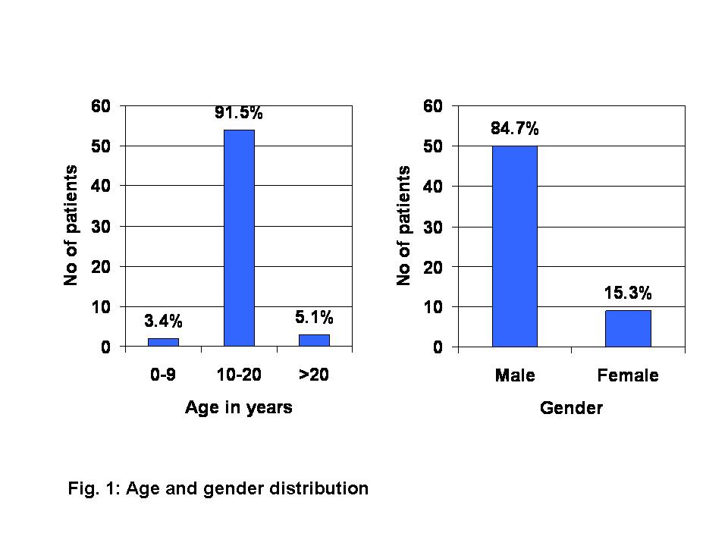

Slide 10
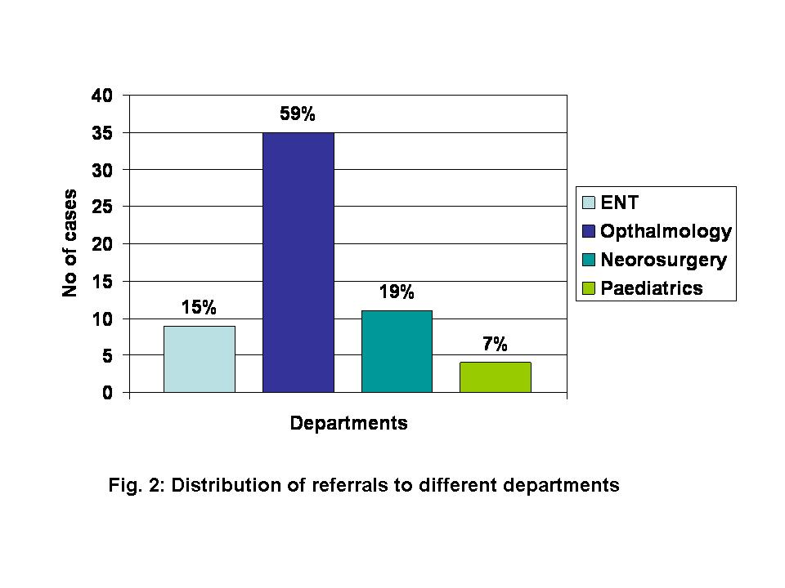

Slide 11
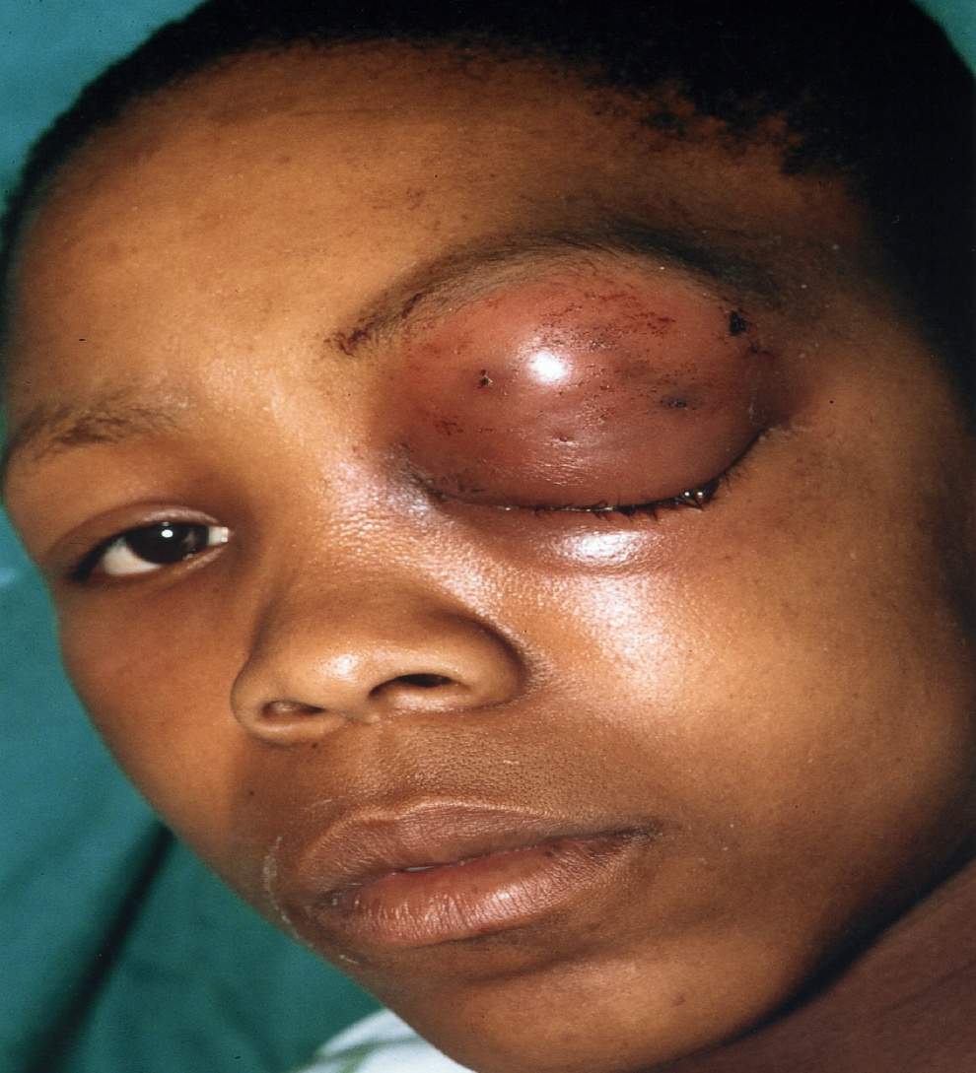
Clinical presentation
Fever
Facial swelling
Headache Persistent
Proptosis,diplopia
Fits, paralysis
Nasal Blockage,
Mental status changes,
Coma

Slide 12
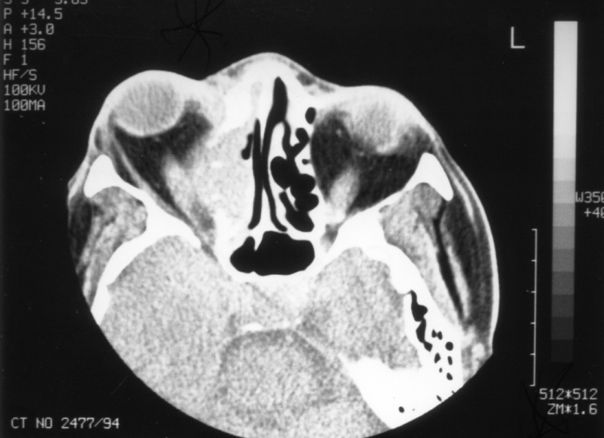
Diagnosis and Radiology
Complications occurred mainly in winter cold months April-August yearly.
Contrasted CT Scan of the sinuses and brain confirmed the diagnosis.

Slide 13
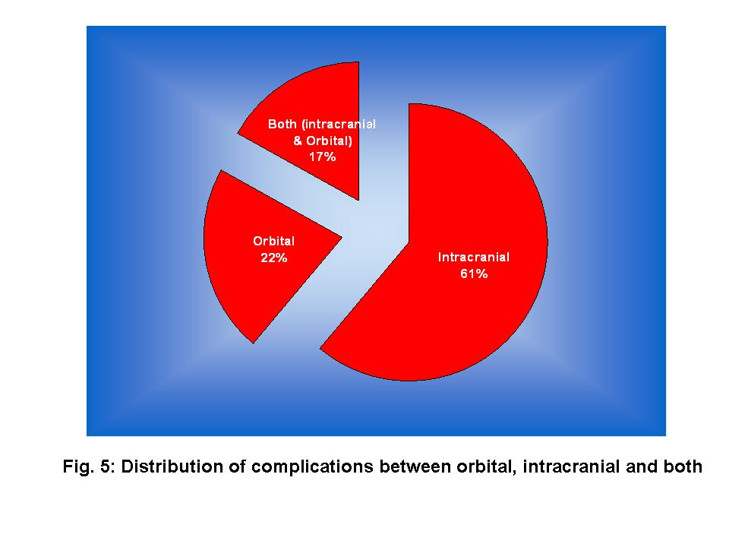

Slide 14
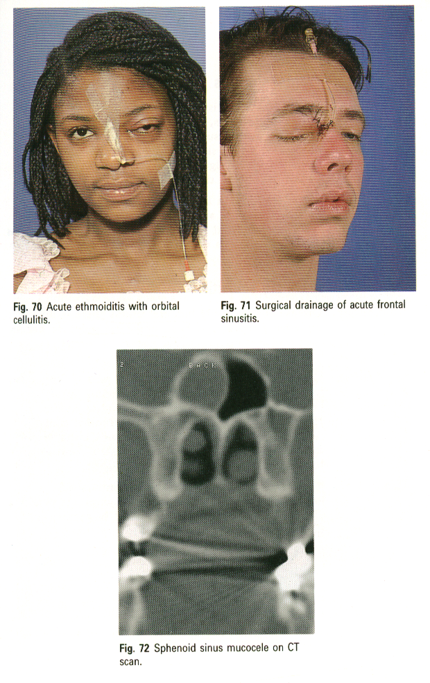

Slide 15
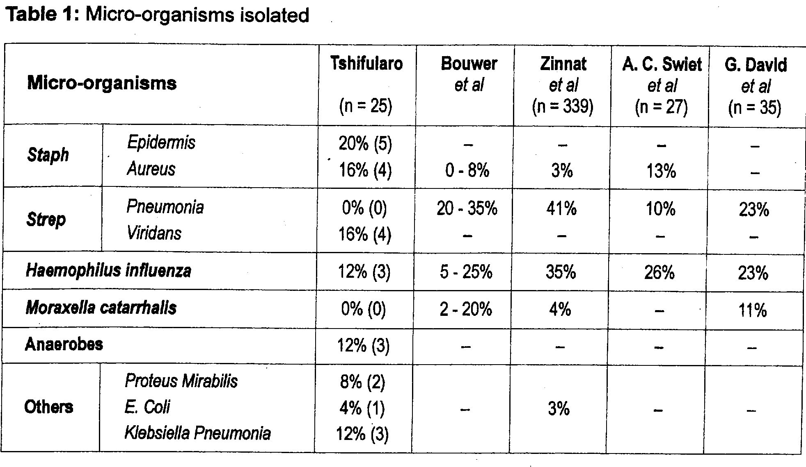

Slide 16
discussion
.SURGERY COMBINED WITH MEDICAL TREATMENT WITH(AMPICILLIN,FLAGYL,AUGMENTIN/CEFORIXIME/CHLORAMPHENICOL )WERE THE TREATMENT OF CHOICE. According to microbiology
STAPH EPIDEMIS/MELLERIE WERE COMMONEST CULTURED BACTERIAS WITH 50% CULTURE NEGATIVE
(EXTERNAL ETHMOIDECTOMY / FESS,BURR HOLES)-multidisciplinary approach-neurosurgeon,otorrhinolaryngologist and ophthalmologist
FEMALES HAD HIGHER MORTALITY RATE THAN MALES IN OUR STUDY.(3 FEMALES DIED) NO MALE DEATH.

Slide 17
Conclusions
NEW DEPT PROTOCOL:
Any young pediatric patient who present with headache and facial swelling must be assumed to be having a complicated bacterial sinusitis until proved otherwise, a CT scan of sinusitis/brain must be done .
Combined surgery and Medical treatment according to MCS results(resistance level).

Slide 18
ACKNOWLEDGEMENT
Patients
ENT Department
Disclaimer: None
No financial benefit

Slide 19


