Slide 1
Innate immune regulation of
T-helper (Th) cell homeostasis in the intestine
Masayuki Fukata, MD, Ph.D.
Research Scientist II
Division of Gastroenterology,
Department of Medicine, F. Widjaja Foundation,
Inflammatory Bowel and Immunology Research Institute,
Cedars-Sinai Medical Center,
Assistant Professor, Step III
UCLA Department of Medicine,
David Geffen School of Medicine
University of California Los Angeles

Slide 2
Two arms of immunity
Innate immunity
Adaptive immunity
Timing
Rapid (hours) Slow (days)
Target
Broad Specific
Main cells
APCs, PMN, NK, ILCs, T cells, B cells
Location
Interface (mucosa, skin) Internal (lymphoid organs)
.
Notes:
I would like to start with the general comparison between innate and adaptive immunity.
Compared to adaptive immunity, innate immunity is rapidly established, has antigen-non-specific broad effect, handled by many types of cells not just only antigen-presenting cells but also neutrophils NK cells innate lymphoid cells and epithelial cells, and mainly works at the mucosal interface and skin where are continuously exposed to microorganisms.
The major task of innate immunity is to recognize invading microorganisms and initiate primary response to them while establishing an antigen-specific adaptive immunity.

Slide 3
Pattern recognition receptors (PRRs) recognize microorganisms
G-bacteria
G+bacteria
flagella
TLR4
TLR5
TLR9
Bacterial
DNA
TLR2, 1or 6
TLR3
dsRNA
ssRNA
peptidoglycan
endosome
NOD1,2
TLR7,8
G+bacteria
NLRs
C-type lectins
fungi
Notes:
So, how are microorganisms recognized?
It is mainly mediated by groups of receptors, called pattern recognition receptors, that detect pathogen associated molecular patterns.
The pattern recognition receptors include TLRs, NLRs, and C-type lectins. There are other types of pattern recognition receptors that detect viruses which I am not going to talk about today.
Each PRR detects different parts of microorganisms and induces unique signaling pathways in the cells.
Among these PRRs, TLR is the major PRR in intestinal mucosa.

Slide 4
TLR signaling
Other TLRs
TLR4
TLR3
MyD88
MyD88
TRIF
TRAM
TRIF
TRAF6
NF-κB
MAPKs
IRF3
IRF3
IFN-β
NF-κB
AP-1
Notes:
Most TLRs interact with MyD88 to initiate signal transduction that results in activations of NF-kB and MAP kinases.
Only TLR3 and TLR4 use an adaptor molecule, TRIF, although TLR4 also uses MyD88. TRIF induces a unique signaling pathway that results in IRF3 activation and type I IFN induction. It also induces NF-kB activation in late kinetics.
TLR3 recognizes dsRNA, and TLR4 recognizes Gram-negative bacterial component, LPS.
It is still unknown why only TLR3 and TLR4 use the TRIF pathway and we have studied the role of TRIF-dependent TLR signaling in the intestine.

Slide 5
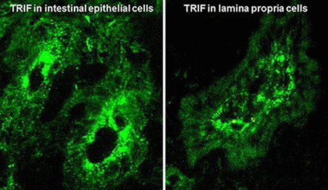
Innate immune cells in the intestine
(mouse colon)
CD11c
F4/80
TRIF
Notes:
The distribution of innate immune cells in intestinal mucosa is unique per cell type. Dendritic cells are located throughout the crypt just behind the epithelial cells.
Macrophages are, on the other hand, mainly located at the bottom of the crypt.
The expression of TRIF is found in epithelial cells and lamina propria cells.

Slide 6
CD4+ cells in the intestine
(normal human colon)
CD4
Notes:
The human intestine is the largest mass of lymphoid tissue in our body, containing over 10^6 lymphocytes/g tissue.
Among them, CD4+ Th cells are relatively abundant in intestinal lamina propria suggesting an importance of intestinal mucosa in Th cell homeostasis.

Slide 7
The interplay between innate and adaptive Th cell immunity
suppress
Antigen presenting cells
encounter microorganisms
activate
ET
or
Reg
Phagocytosed
Degraded
DCs
Innate
Immune
recognition
Differentiate
Cytokine
naïve
Chemokine
Mφs
Co-stimulatory molecules
Notes:
So, how do these two arms of immunity cooperate? Innate immunity is initiated by antigen presenting cells like DCs or macrophages when they encounter microorganisms. The target microorganisms are phagocytosed and degraded in phagosomes.
Multiple innate immune sensors recognize the target molecules during this process, and induce cytokines and chemokines, and prepare antigen presentation to T cells by the induction of co-stimulatory molecules on the cell surface.
Secreted cytokines and chemokines call for T cells and differentiate them to either effector or regulatory cells that provide antigen specific immune responses. The fate of T cell differentiation depends on the cytokines by APCs and the transcription factors activated in T cells. Activated T cells secrete type-specific cytokines which further activate or suppress innate immune cells.

Slide 8
Th cell differentiation
Th1
IL-12
APCs
Th2
IL-4
TCR
MHC
IL-10
+
Treg
CD28
CD80/86
TGF-β
Naïve CD4+
T cells
+
IL-6
Th17
IL-23
IFN-γ
IL-1β
Notes:
The Th cell differentiation is directed to four specific types, Th1, Th2, Th17 and regulatory T cells.
Due to its biological complexity, we have focused on innate regulation of Th17 cell differentiation.
Th17 cell differentiation involves IL-23, IL-6, IL-1b and TGF-b. Among these cytokines, TGF-b is normally abundant in intestinal mucosa and shared by Treg generation.

Slide 9
Distribution difference in Th cell types
Th1
Th17
Peripheral
intestine
Peripheral
intestine
Sathaliyawala et al. Immunity 2013
Notes:
So the question is, are the different types of Th cells distributed equally in intestinal mucosa?
There is an interesting paper showing memory Th cells in human body.
Th1 cells were relatively equally distributed throughout the body, but Th17 cells were mainly located in the intestine.

Slide 10
Intestinal commensal bacteria maintain mucosal Th cells especially Th17 type
SFB
Macpherson et al., Nature Reviews Immunology 2004
Ivanov et al., Cell 2009
.
Notes:
It is likely that the distribution of Th cells in intestinal mucosa is maintained by the existence of commensal microorganisims as germ-free mice have significantly reduced number of lamina pripria Th cells.
In addition, Th17 cells can be generated in intestinal mucosa by colonization of a specific group of bacteria called Segmented Filamentous Bacteria.
Therefore, unlike Th1 cells, the proportion of Th17 cells in intestinal mucosal CD4+ T cells is maintained by host-microbial interactions.

Slide 11
Function of Th17 cells
Anti-fungal (filamentous fungi, candida, aspergillus)
Anti-bacterial (especially extracellular bacteria)
Induce chemotaxis (neutrophils, macrophages)
Cell growth (in some tumor)
Induce autoimmune diseases (MS, RA, etc)
Induce cytokines (IL-17A, IL-17F, IL-22, IL-21, GM-CSF, CCL20, TNF)
Lineage flexibility (plasticity)
Notes:
So, what are Th17 cells? The features of Th17 cells include anti-fungal, anti-bacterial, chemotaxis, and cell growth.
Th17 cells are known to play central role in many autoimmune diseases such as multiple sclerosis and rheumatoid arthritis.
Therefore, they are generally considered as pro-inflammatory cells, but many reports have shown immuno regulatory functions of Th17 cells.

Slide 12
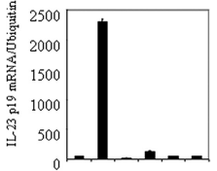
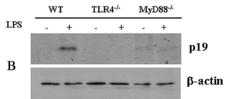

MyD88-dependent TLR4 signaling induces IL-23p19 in APCs
IL-6
IL-23
TGF-β
IL-1β
IFN-γ
IL-12
TNF-α
TLR4
BMDC
Peritoneal macrophages
TCR
MyD88
MHC
CD28
CD80/86
CD4+
T cells
APCs
JBC 284: 24006–24016, 2009
Notes:
Given the importance of host-microbial interactions in the maintenance of intestinal Th17 cells, I would like to discuss how TLR4 signaling contribute to the Th17 cell differentiation.
TLR4 signaling may induce most of the key cytokines that induce Th17 cell differentiation, although it also induces other cytokines that induce Th1 cell differentiation.
Many previous reports including ours have demonstrated significant contribution of MyD88-dependent TLR4 signaling to the key cytokine expression for Th17 cell differentiation.
However, little is known about TRIF-dependent regulation of Th17 cell differentiation.

Slide 13
Does TRIF-dependent TLR4 signaling induce Th17 cell differentiation?
TLR4
MyD88
IL-6
IL-23
TGF-β
IL-1β
TRAM
TRIF
TLR4
TCR
TRIF
TRAF6
MHC
IRF3
IRF3
IFN-β
CD28
CD80/86
NF-κB
MAPKs
CD4+
T cells
APCs
NF-κB
AP-1
Notes:
TRIF-dependent TLR4 signaling has also shown its ability to induce IL-6, IL-23, TGF-b, and IL-1b in many different cell types.

Slide 14
TRIF-dependent TLR4 signaling likely suppress Th17 cell differentiation
.
Infect immun 83: 4404-15, 2015
Notes:
So, we did in vitro Th cell differentiation assay. Peritoneal macrophages isolated from WT and TRIF-deficient mice were co-cultured with either OT-II T cells or WT naïve T cells.
In the presence of LPS, the TLR4 ligand, more Th17 cells and less Th1 cells were generated from OT-II cells in response to OVA when they were co-cultured with TRIF-deficient macrophages compared to T cells co-cultured with WT macrophages.
A similar difference in Th cell differentiation was found between naïve T cells co-cultured with WT macrophages and naïve T cells co-cultured with TRIF-deficient macrophages in response to Yersinia and Salmonella.
These results suggest that TRIF signaling in antigen presenting cells may suppress Th17 cell differentiation and facilitate Th1 cell differentiation, respectively.

Slide 15
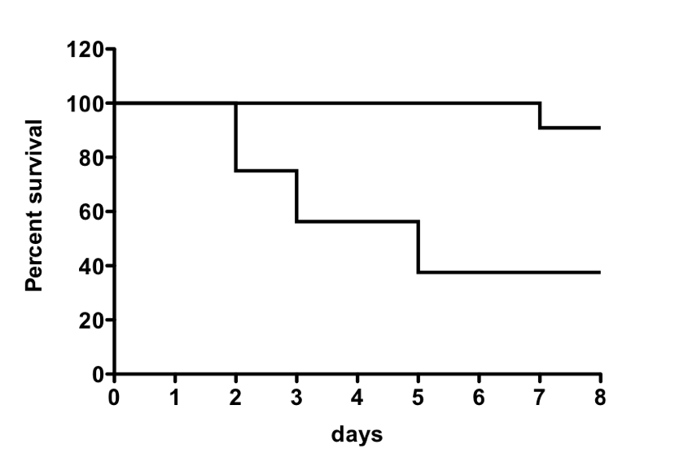
The role of TRIF signaling in the regulation of Th17 cells in the intestine
LPS
① In host defense mechanism
(Y. enterocolitica infection model)
IECs
DCs
Mφs
WT
Trif ^{LPS2}
differentiation
*
P = 0.0051
Th17 cell
J Exp Med 208: 2705-16, 2011
Notes:
We then tested if TRIF signaling regulates Th17 cell differentiation in vivo. We used a mouse model of enteric Y. enterocolitica infection to assess Th17 cell function in host defense mechanism.
We have shown that TRIF-deficient mice are susceptible to this model. They succumbed to the infection within 5 days mainly due to defective phagocytosis.

Slide 16
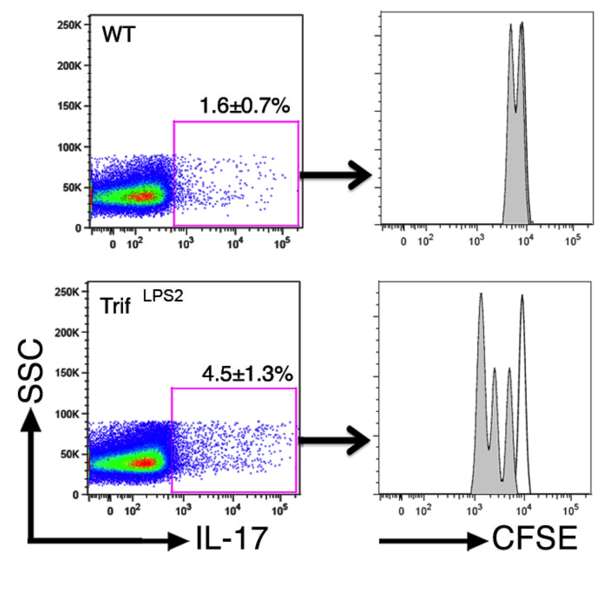
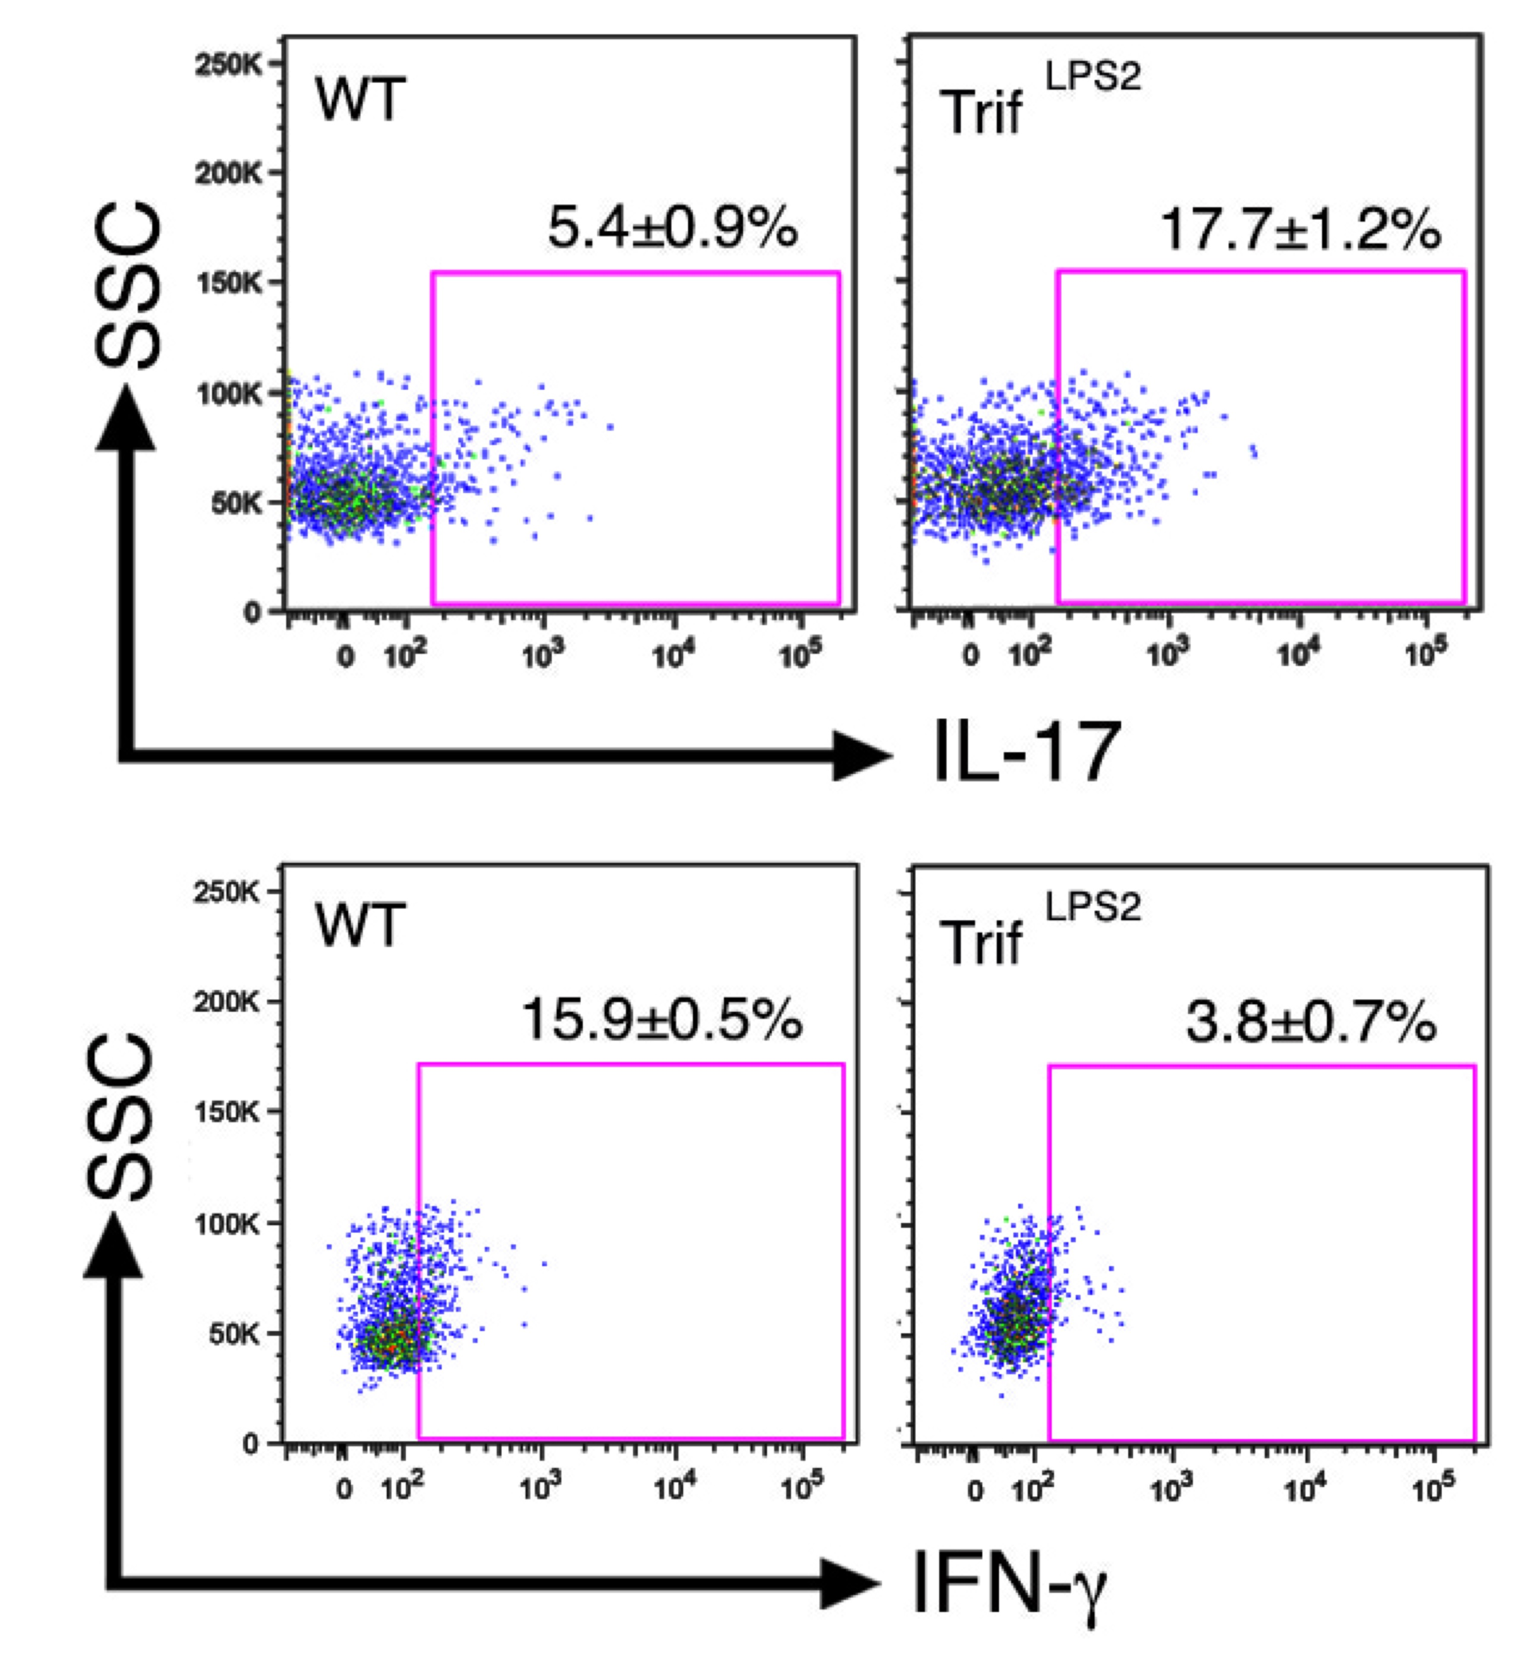
TRIF-deficient (Trif^{LPS2}) mice generate more Th17 cells and less Th1 cells in response to Y. enterocolitica infection (day 9)
MLN
MLN CD4+ T cells
WT CD4+ T
Trif^{LPS2} CD4+ T
WT
Trif^{LPS2}
Infect immun 83: 4404-15, 2015
Notes:
To examine T cell differentiation in this model, we adjusted the infection dose to half and analyzed Th cell populations in the MLN 9 days post infection.
Consistent with in vitro data, TRIF-deficient mice showed more Th17 cells and less Th1 cells in the MLN.
We confirmed the expansion of Th17 cells in TRIF-deficient mice by CFSE division assay by giving CFSE-labeled naïve WT T cells to WT and TRIF-deficient mice prior to infection.

Slide 17
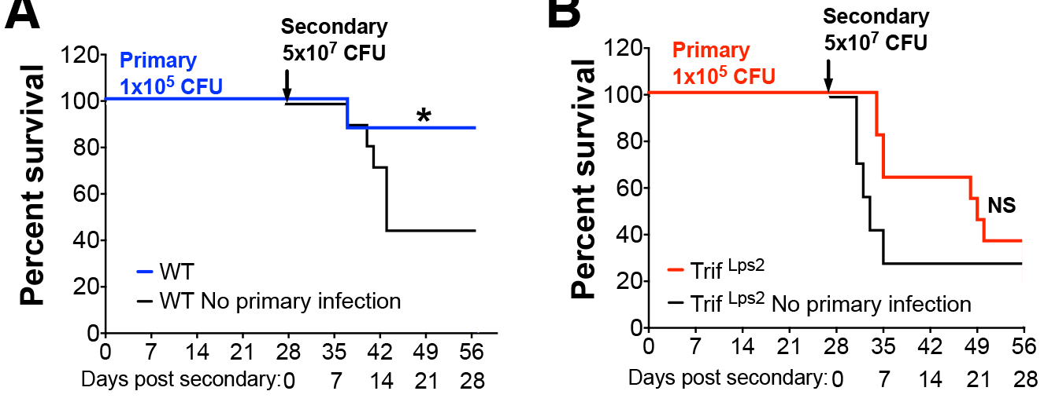
TRIF-deficient mice fail to establish effective immunological memory in the intestine
Y. enterocolitica re-infection model
WT
Trif^{LPS2}
Infect immun 83: 4404-15, 2015
Notes:
We next sought to determine whether the development and function of Th cells were affected by performing re-infection. WT and Trif^{LPS2} mice were infected first with low dose Y. enterocolitica (1x10⁵ CFU), followed by reinfection with high dose (5x10⁷ CFU) in 28 days.
The black line shows the mortality of primary infection.
WT mice significantly improved survival during re-infection, indicating establishment of effective immunological memory.
However, the improved resistance to re-infection was not observed in Trif^{LPS2} mice.

Slide 18
Absence of TRIF skews memory T cells towards Th17 response
(7 days post secondary infection)
WT
Trif^{LPS2}
MLN cells
WT
Trif^{LPS2}
Infect immun 83: 4404-15, 2015
Notes:
The partial resistance seen in the Trif^{LPS2} mice led us to compare the proportion of memory cells in the MLN between WT and Trif^{LPS2} mice 7 days after re-infection.
FCM revealed almost equal generation of CD4+CD44+ memory cells but an increased proportion of TCM cells in the MLNs of Trif^{LPS2} mice compared to WT mice.
The proportion of Th17 cells was greater in these memory T cells in Trif^{LPS2} mice compared to WT memory T cells in the MLN. In contrast, the proportion of Th1 cells in these memory T cells was lower in Trif^{LPS2} mice than WT mice.

Slide 19

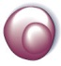

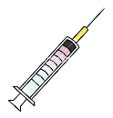
Transferring primed Th cells
(role of TRIF in T cells or non T cells?)
Trif^{LPS2} mice
CFSE
label
Transfer 6X10⁶
Trif^{LPS2}
28 days
1X10⁵ CFU Y. enterocolitica
WT
High dose infection
(5X10⁷ CFU)
WT mice
CFSE
label
Transfer 6X10⁶
28 days
1X10⁵ CFU Y. enterocolitica
WT CD4+ T cells
from the MLN,
and the spleen
Trif^{LPS2}
Notes:
To understand why increased generation of memory Th17 cells did not promote resistance to re-infection in Trif^{LPS2} mice, WT and Trif^{LPS2} mice were infected with Y. enterocolitica after receiving primed Th cells isolated from WT and Trif^{LPS2} mice that had been pre-exposed to Y. enterocolitica.

Slide 20
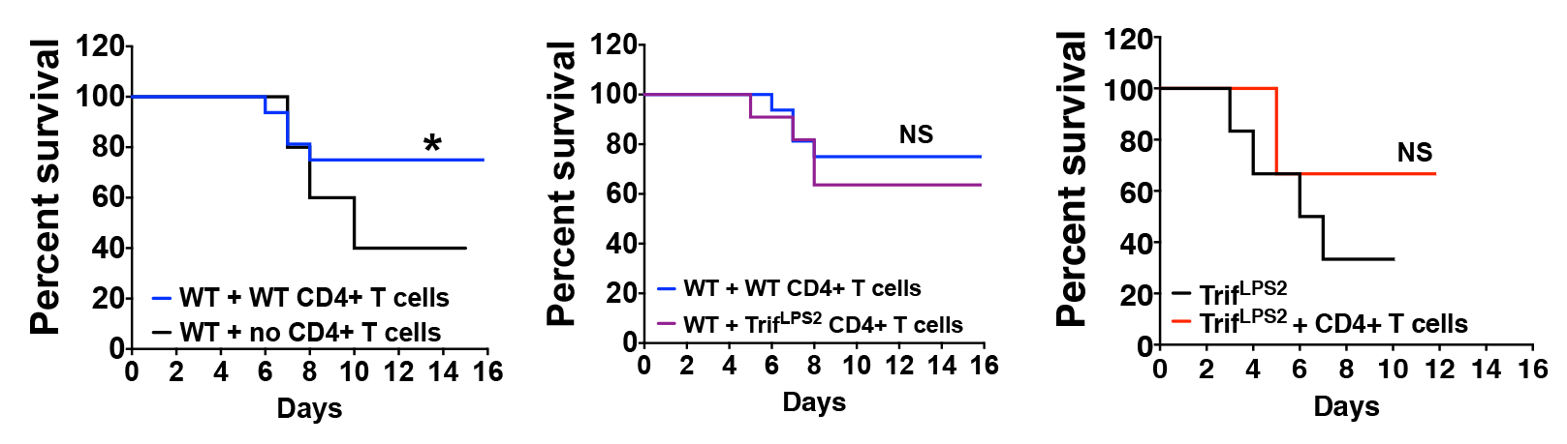
Primed T cells do not confer protective immunity without TRIF signaling during bacterial infection
5x10⁷ CFU infection after primed T cell transfer
7 days post infection
14 days post infection
Infect immun 83: 4404-15, 2015
Notes:
Increased resistance to Y. enterocolitica infection was observed in WT mice by transferring primed WT Th cells.
Similar improvement in mortality resulted from transferring primed Th cells from Trif^{LPS2} mice. However, no survival improvement was observed in Trif^{LPS2} mice receiving WT primed Th cells.
We confirmed that transferred Th cells had been equally distributed to the MLN in WT and Trif^{LPS2} mice by using CFSE labeling. After 7 days of infection, the percentage
of CFSE+ cells in the MLN was approximately 4% in both WT and Trif^{LPS2} mice. The majority of CFSE+ cells were memory cells, as they expressed high levels of CD44.
However, within 14 days post-infection, these transferred WT Th cells began to express more IL-17 and less IFN-g in Trif^{LPS2} mice than the transferred cells in WT mice.

Slide 21
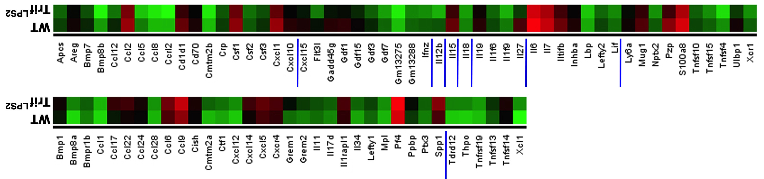
Trif^{LPS2} Mfs had an unique cytokine profile that supports Th17 cell differentiation
52 downregulated in Trif^{LPS2}
Trif^{LPS2}
WT
Trif^{LPS2}
WT
35 upregulated in Trif^{LPS2}
Infect immun 83: 4404-15, 2015
Notes:
For the mechanism, WT and TRIF-deficient macrophages were stimulated with Yersinia lysate and subjected to RNA-seq analysis.
Based on the clustering, 35 upregulated and 52 downregulated genes were found to be cytokines or chemokines and we found 8 genes that have been associated with Th17 cell polarization.

Slide 22
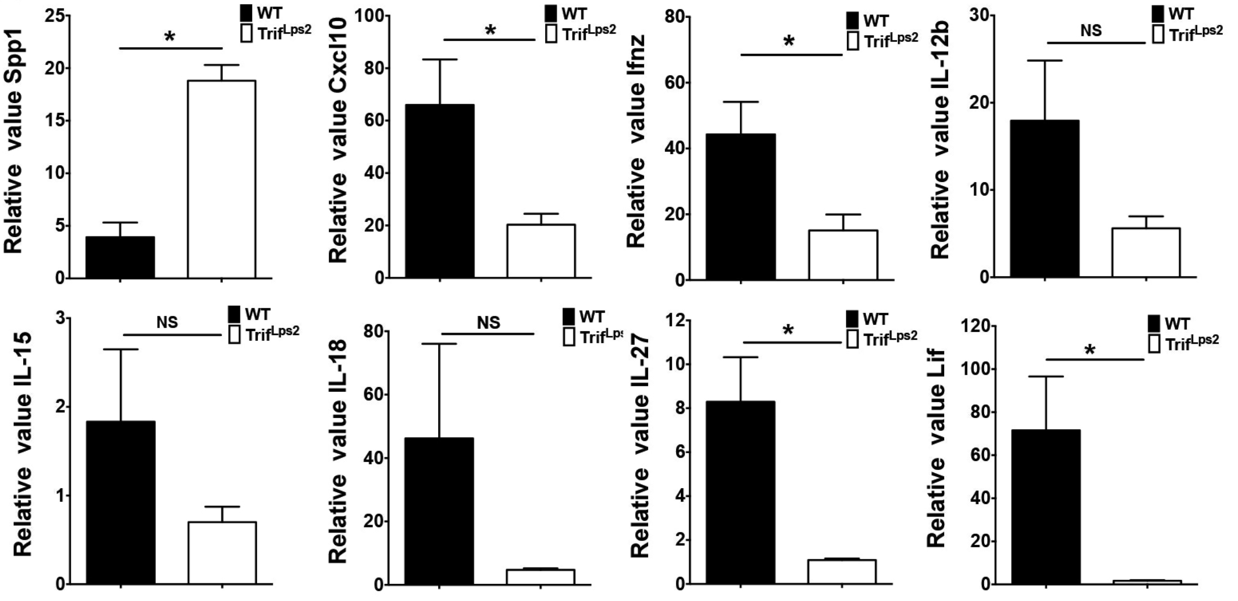
Consistent alteration of gene expression in the MLN during Y. enterocolitica infection
Infect immun 83: 4404-15, 2015
Notes:
We then confirmed the expression of these 8 genes in the MLN of the WT and TRIF-deficient mice after infection with Yersinia, and found that four genes, Spp1, Cxcl10, IFNz, IL-27, and Llf were consistently up and down regulated in TRIF-deficient mice.
These 5 genes are type I IFN associated genes.

Slide 23
TRIF-dependent regulation of Th17 cell response involves type I IFN signaling
WT M⍉s + T cells
+ anti-IFNAR
Western blot analysis
of Th cells
Infect immun 83: 4404-15, 2015
Notes:
To confirm the involvement of type I IFN signaling in the regulation of TRIF-dependent Th17 cells, we performed in vitro Th cell differentiation using WT and TRIF-deficient macrophages with WT naïve T cells together with Yersinia lysate.
After three days co-culture, T cells were subjected to western blot analysis for transcription factors. T cells that were co-cultured with TRIF-deficient macrophages demonstrated increased RORgt expression and decreased phosphorylation of STAT1.
In the presence of blocking antibody for type I IFN receptor, WT T cells showed similar pattern of the activation in transcription factors as T cells that were co-cultured with TRIF-deficient macrophages.

Slide 24
The role of TRIF signaling in the regulation of Th17 cells in the intestine
LPS
Summary
IECs
① In host defense mechanism
(Y. enterocolitica infection model)
DCs
Mφs
TRIF suppresses Th17 cell generation and balances Th1 and Th17 cell responses against Gram-negative bacteria, Y. enterocolitica.
The maintenance of Th1 and Th17 cell balance also requires TRIF signaling and is involved in host resistance to Y. enterocolitica.
TRIF-dependent suppression of Th17 cell generation may be mediated by type I IFN signaling.
differentiation
T cell

Slide 25
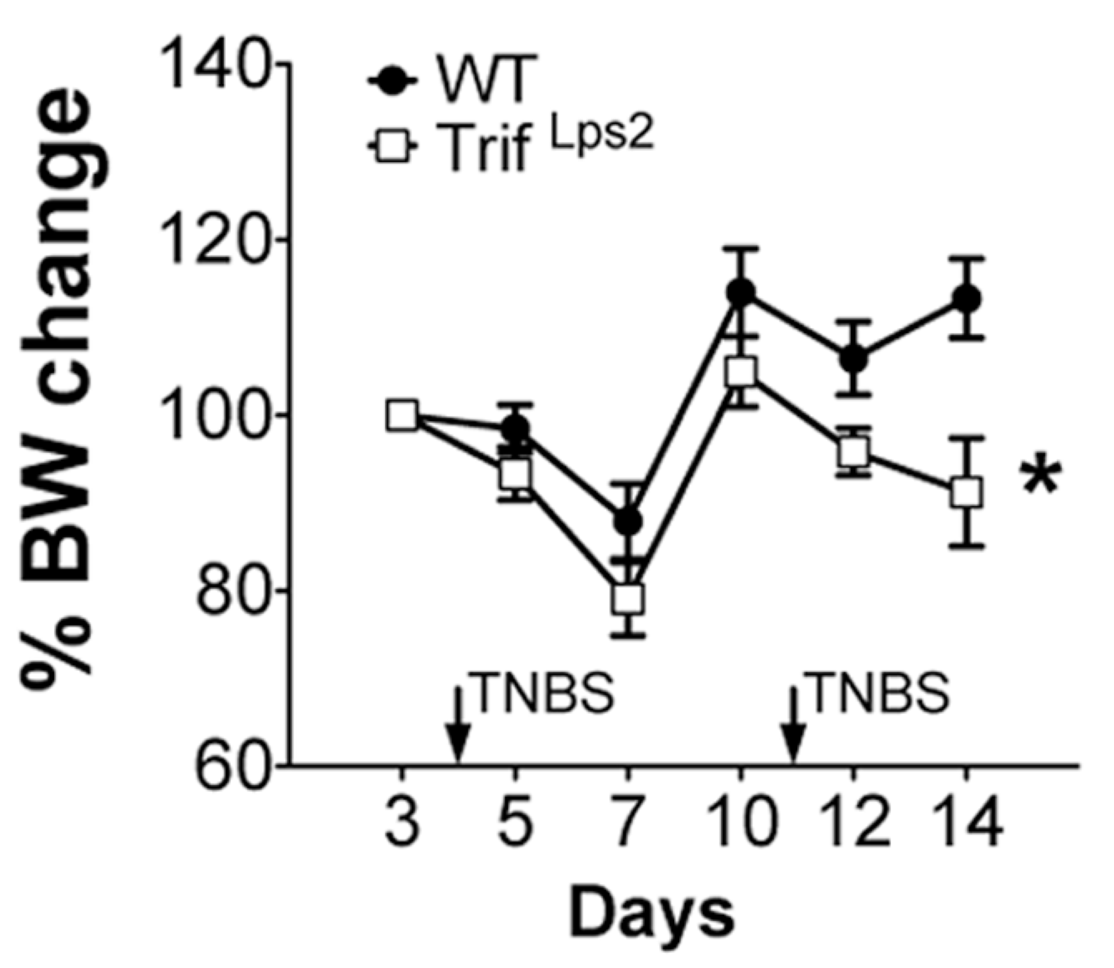
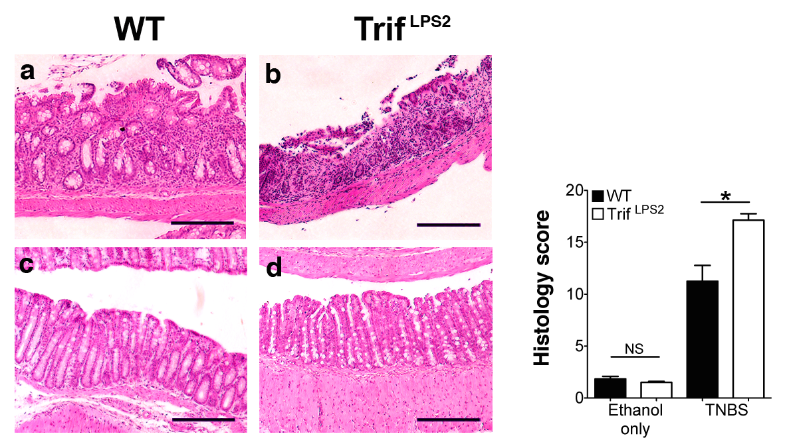
The role of TRIF signaling in the regulation of Th17 cells in the intestine
② In intestinal inflammation
(TNBS colitis model)
LPS
IECs
DCs
Mφs
differentiation
Th17 cell
Mucosal Immunol 8: 296-306, 2015
Notes:
Next we used a mouse model of TNBS colitis to assess Th17 cell function in intestinal inflammation in vivo.
We have shown that TRIF-deficient mice are susceptible to this model.
TRIF deficient mice generated more Th17 cells than WT mice associated with increased severity of TNBS colitis.

Slide 26

Pathogenesis of inflammatory bowel disease (IBD) involves host Th cell responses to commensal bacteria
In patients with IBD
Increased number of Th17 cells have been found in inflammed mucosa.
Attempts have made blocking IL-17, a signature cytokine of Th17 cells in patients with CD; however, it failed to meet efficacy criteria.
Animal studies have demonstrated inconsistent results with regard to pathogenic and regulatory phenotypes of Th17 cells in the intestine.
The existence of IFN-γ(+) and Foxp3(+) Th17 cells in human and animal models of IBD suggests the fluctuant phenotype of Th17 cells in the intestine.
IFN-γ(+)Th17 cells have been implicated in severity of colitis in human and animal models of IBD.
Genetic
predisposition
Mucosal Immune
Abnormality
IBD
Environmental
Triggers
(dysbiosis,
infection)
Aggressive T cell response to commensal bacteria
Notes:
Let me give you some background for the involvement of Th17 cells in the pathogenesis of inflammatory bowel disease.
The pathogenesis of IBD has been implicated in a combination of genetic predisposition, mucosal immune abnormality, and environmental trrigers including infection or dysbiosis.
The consequence of the combination is an aggressive T cell response to commensal bacteria.
In patients with IBD, …..

Slide 27
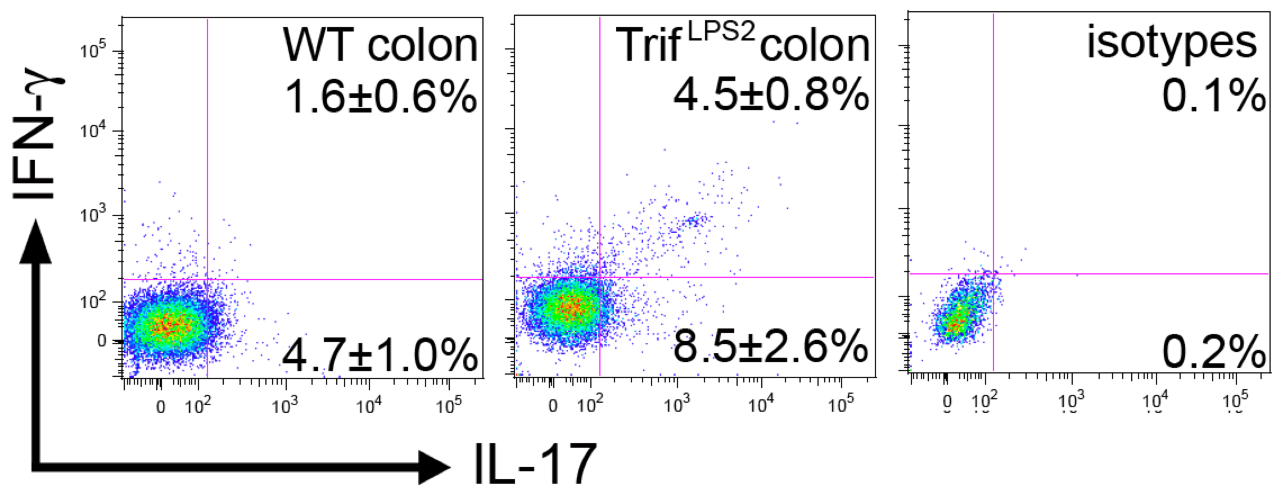
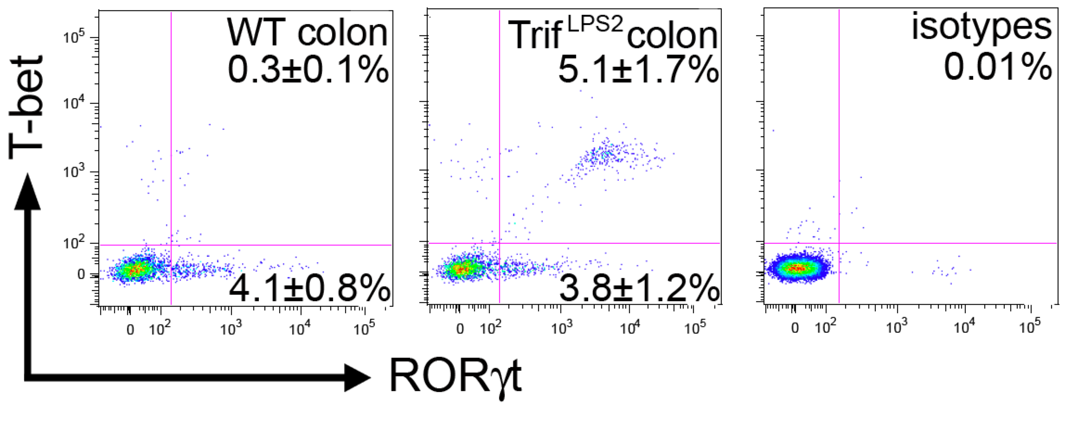
Trif^{LPS2} mice carry IFN-γ expressing Th17 cells in the intestine during TNBS colitis
WT
Trif^{LPS2}
WT
Trif^{LPS2}
WT
Trif^{LPS2}
Mucosal Immunol 8: 296-306, 2015
Notes:
During TNBS colitis, a substantial number of CD4+ T cells in the lamina propria in Trif^{LPS2} mice is found to be expressing both IL-17 and IFNg. Such CD4+ T cells are rare in WT mice.
Consistently, we found a subset of CD4+ T cells in the lamina propria in Trif^{LPS2} mice are expressing both RORgt and T-bet, which subset is not found in WT mice.
We did not see a difference in the number of Foxp3 and IL-17 double positive cells in the colon between WT and Trif^{LPS2} mice.

Slide 28
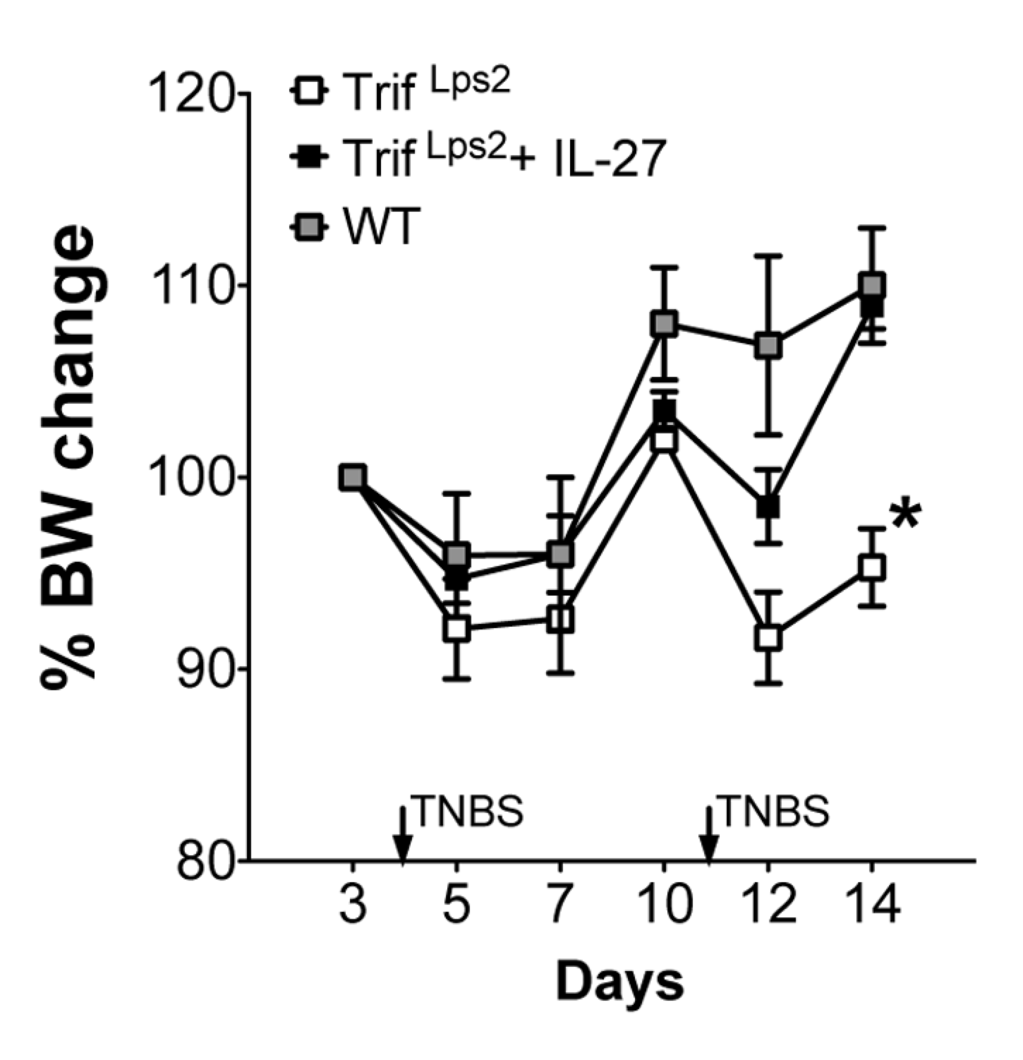
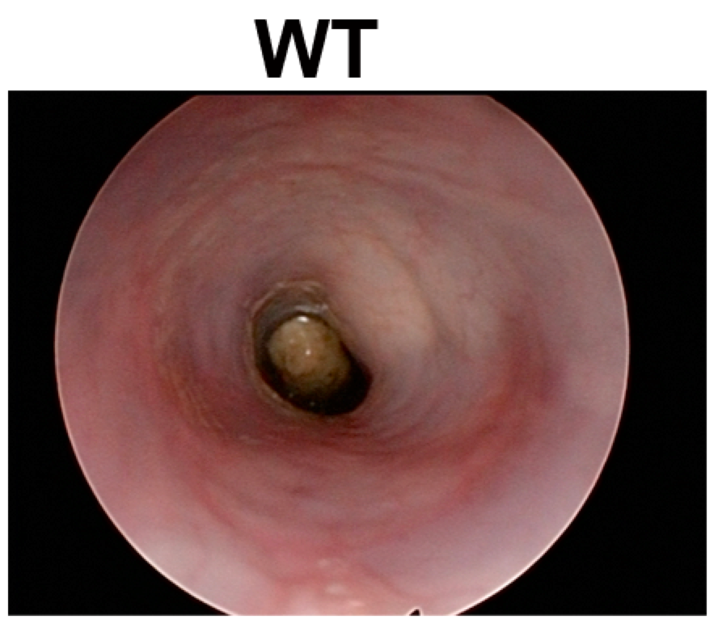
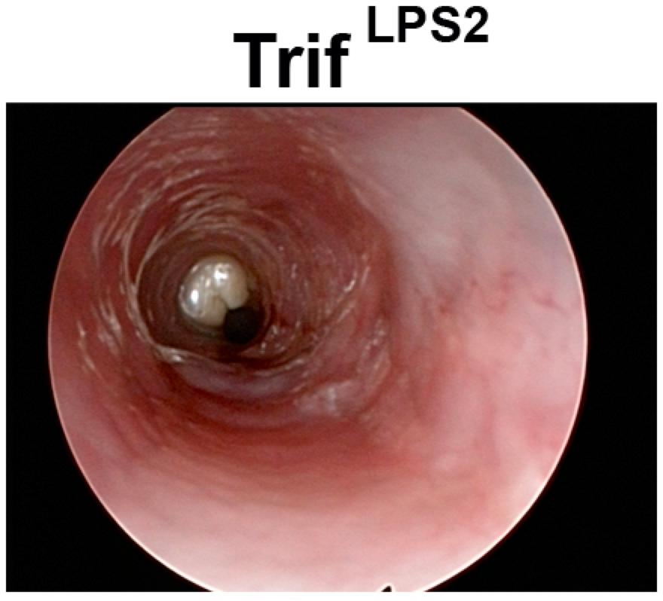
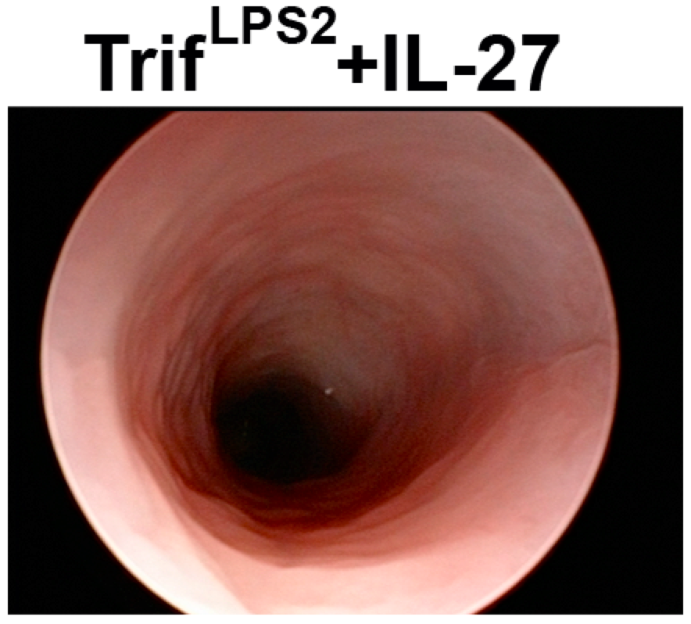
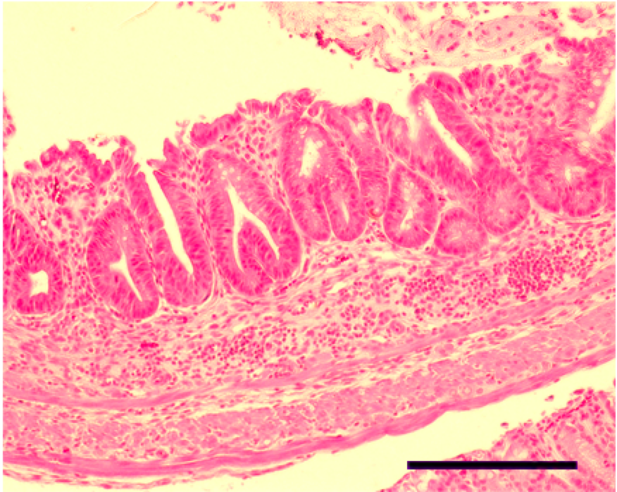
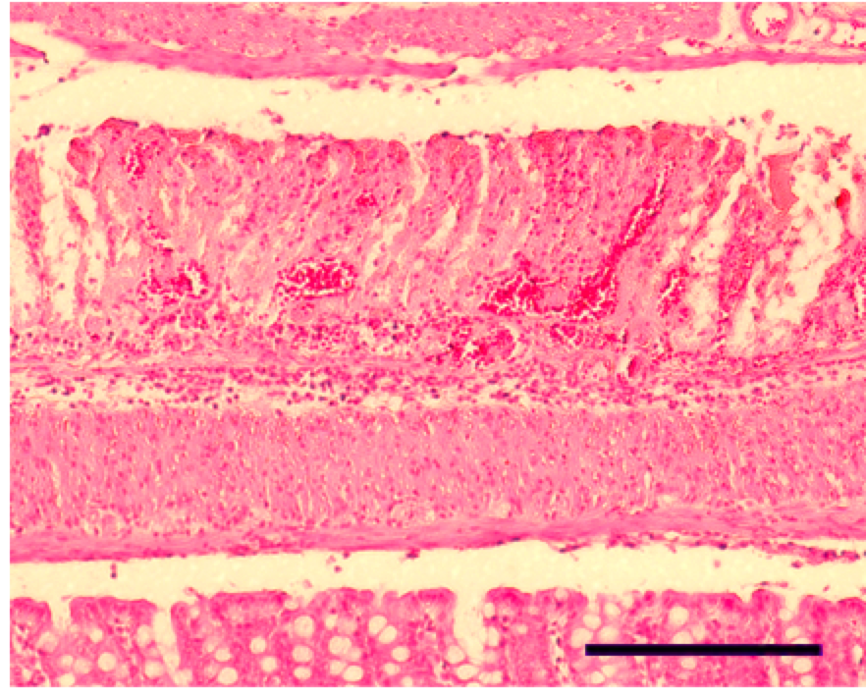
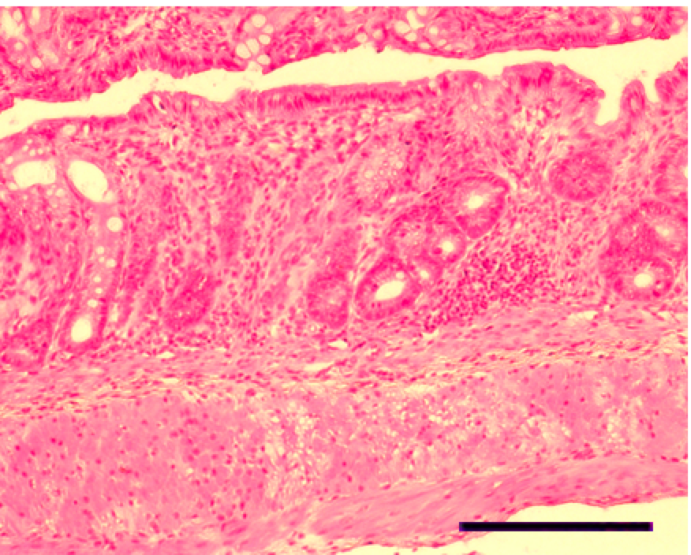
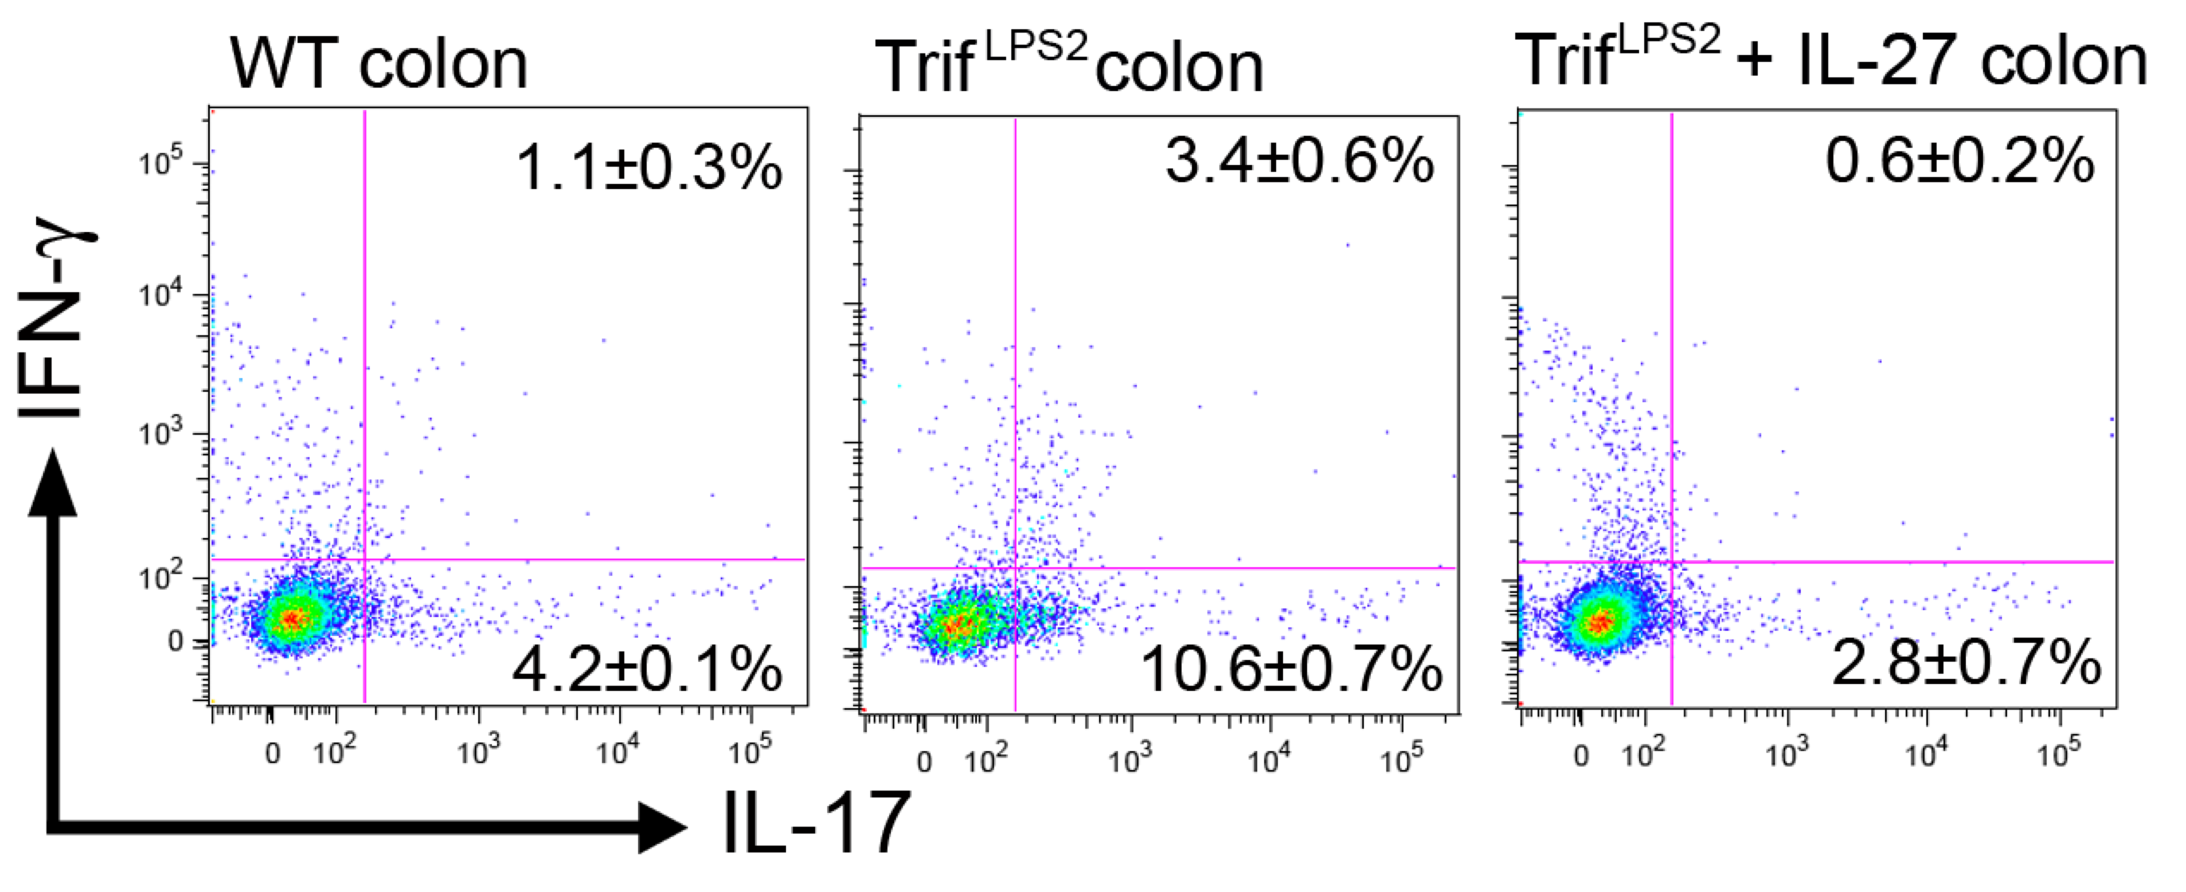
IL-27 treatment reduces severity of TNBS colitis in Trif^{LPS2} mice along with suppression of IFN-γ expressing Th17 cells in the lamina propria
rIL-27 daily injection
(s.c, 0.25μg)
.
Mucosal Immunol 8: 296-306, 2015
Notes:
In this model, we found that an impaired expression of IL-27 contributed to the abnormal expression of IFN-g in Th17 cells in the colon and the increased severity of colitis in Trif^{LPS2} mice.
Treatment of Trif^{LPS2} mice with recombinant IL-27 preserved body weight of Trif^{LPS2} mice during colitis. Colonoscopy demonstrates that IL-27 treatment heals mucosal damage in Trif^{LPS2} mice. Histology shows consistent results with colonoscopy.
When we examined lamina propria CD4+ T cells, IL-27 treated mice did not show IFNg expressing Th17 cells in the lamina propria.
These results suggest that IL-27 regulates abnormal generation of IFNg expressing Th17 cells in the colon which may be responsible for the severity of mucosal inflammation.

Slide 29
Th17 cell plasticity in Crohn’s disease
Gene | SNP ID | Alleles | Allele frequency | P value
IL27 | rs26528 | G/A | 45.1 | 9.7*10E-22
IFNAR | rs2284553 | G/A | 59.9 | 2.1*10E-16
STAT1 | rs1517352 | C/A | 60.0 | 1.9*10E-10
Commensal
Bacteria
TRIF
IFN-γ(+)
ex-Th17
IL-17(+)
IFN-β
APC
IL-27
Plasticity
IFNAR
STAT1
IFN-γ(-)
Naïve
STAT3
Th17
IL-10
.
Notes:
In the mouse model, the underlying mechanism involves impaired expression of IL-27 by macrophages and defective type I IFN signaling and following activation of STAT1 in T cells.
We tried to determine whether any of these pathways are also defective in human IBD. In our GWAS analysis, TRIF variants themselves were not associated with IBD susceptibility, but identified three SNPs associated with CD susceptibility that encoded IL27, IFNAR, and STAT1 genes, all of which are within TRIF-mediated regulatory pathways of Th17 cells.
TRIF induces ① IL27 and ② type I IFNs in APCs in response to commensal bacteria. Both IL27 and type I IFNs induce ③ STAT1 activation in T cells.
IL27 directly blocks Th17 cell plasticity through transcriptional regulation and indirectly through STAT1 activation. In the presence of STAT3 (also induced by IL27) in Th17 cells, IL27 and IFNAR individually induce IL10. Therefore, Impairment of TRIF signaling amplifies Th17 cell generation and plasticity in patients with CD.

Slide 30
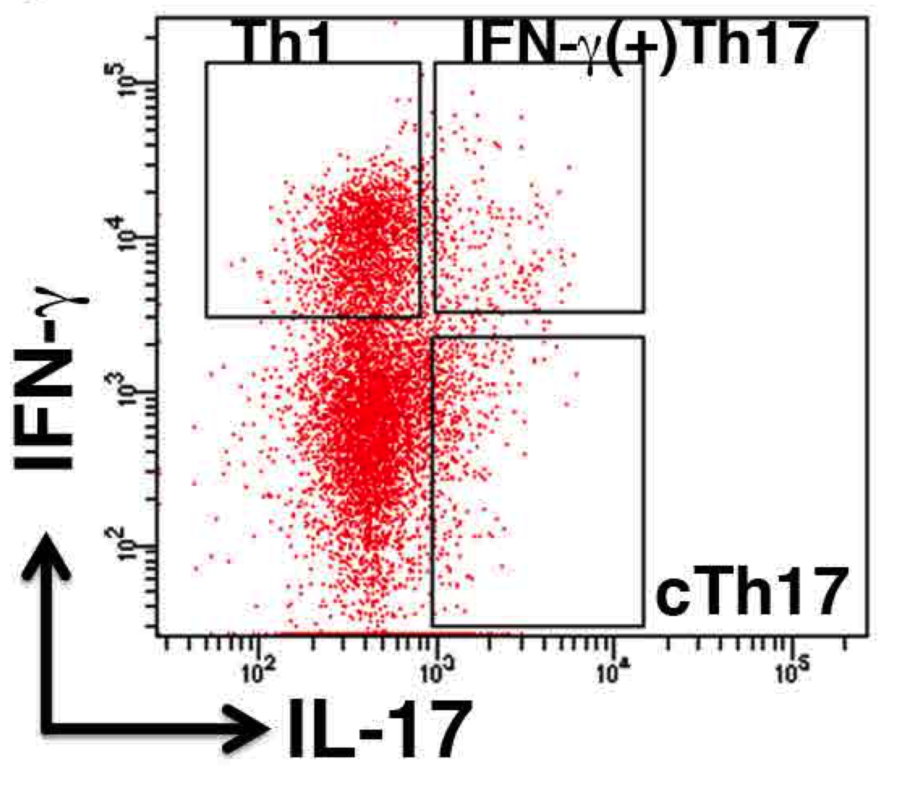
The altered expression of cytokine receptors in IFN-γ(+)Th17 cells
IFN-γ/IL-17A reporter mouse
Microarray analysis
sorting
Notes:
So, what are the IFN-g(+)Th17 cells? How they differ from conventional Th17 cells? To answer this question, we used IFN-g/IL-17A double reporter mice. Peritoneal macrophages from WT mice were co-cultured with native T cells from IFN-g/IL-17A double reporter mice in the presence of Cecal bacterial antigen.
After three days, T cells were separated into Th1, IFN-g(+)Th17 cells, and conventional Th17 cells by sorting. These Th cell subsets were subjected to microarray analysis.
Based on the clustering, 16 altered genes in IFN-g(+)Th17 cells were found to be cytokine or chemokine receptors that include upregulation of Ccr9 and downregulation of Ifnar2 and IL-10r.
Expression of Ccr9 is associated with infiltration into the small intestine. Ifnar2 is one of the key components of TRIF-dependent Th17 cell regulation.
And the expression of IL-10r is associated with self regulatory mechanism of inflammation.

Slide 31
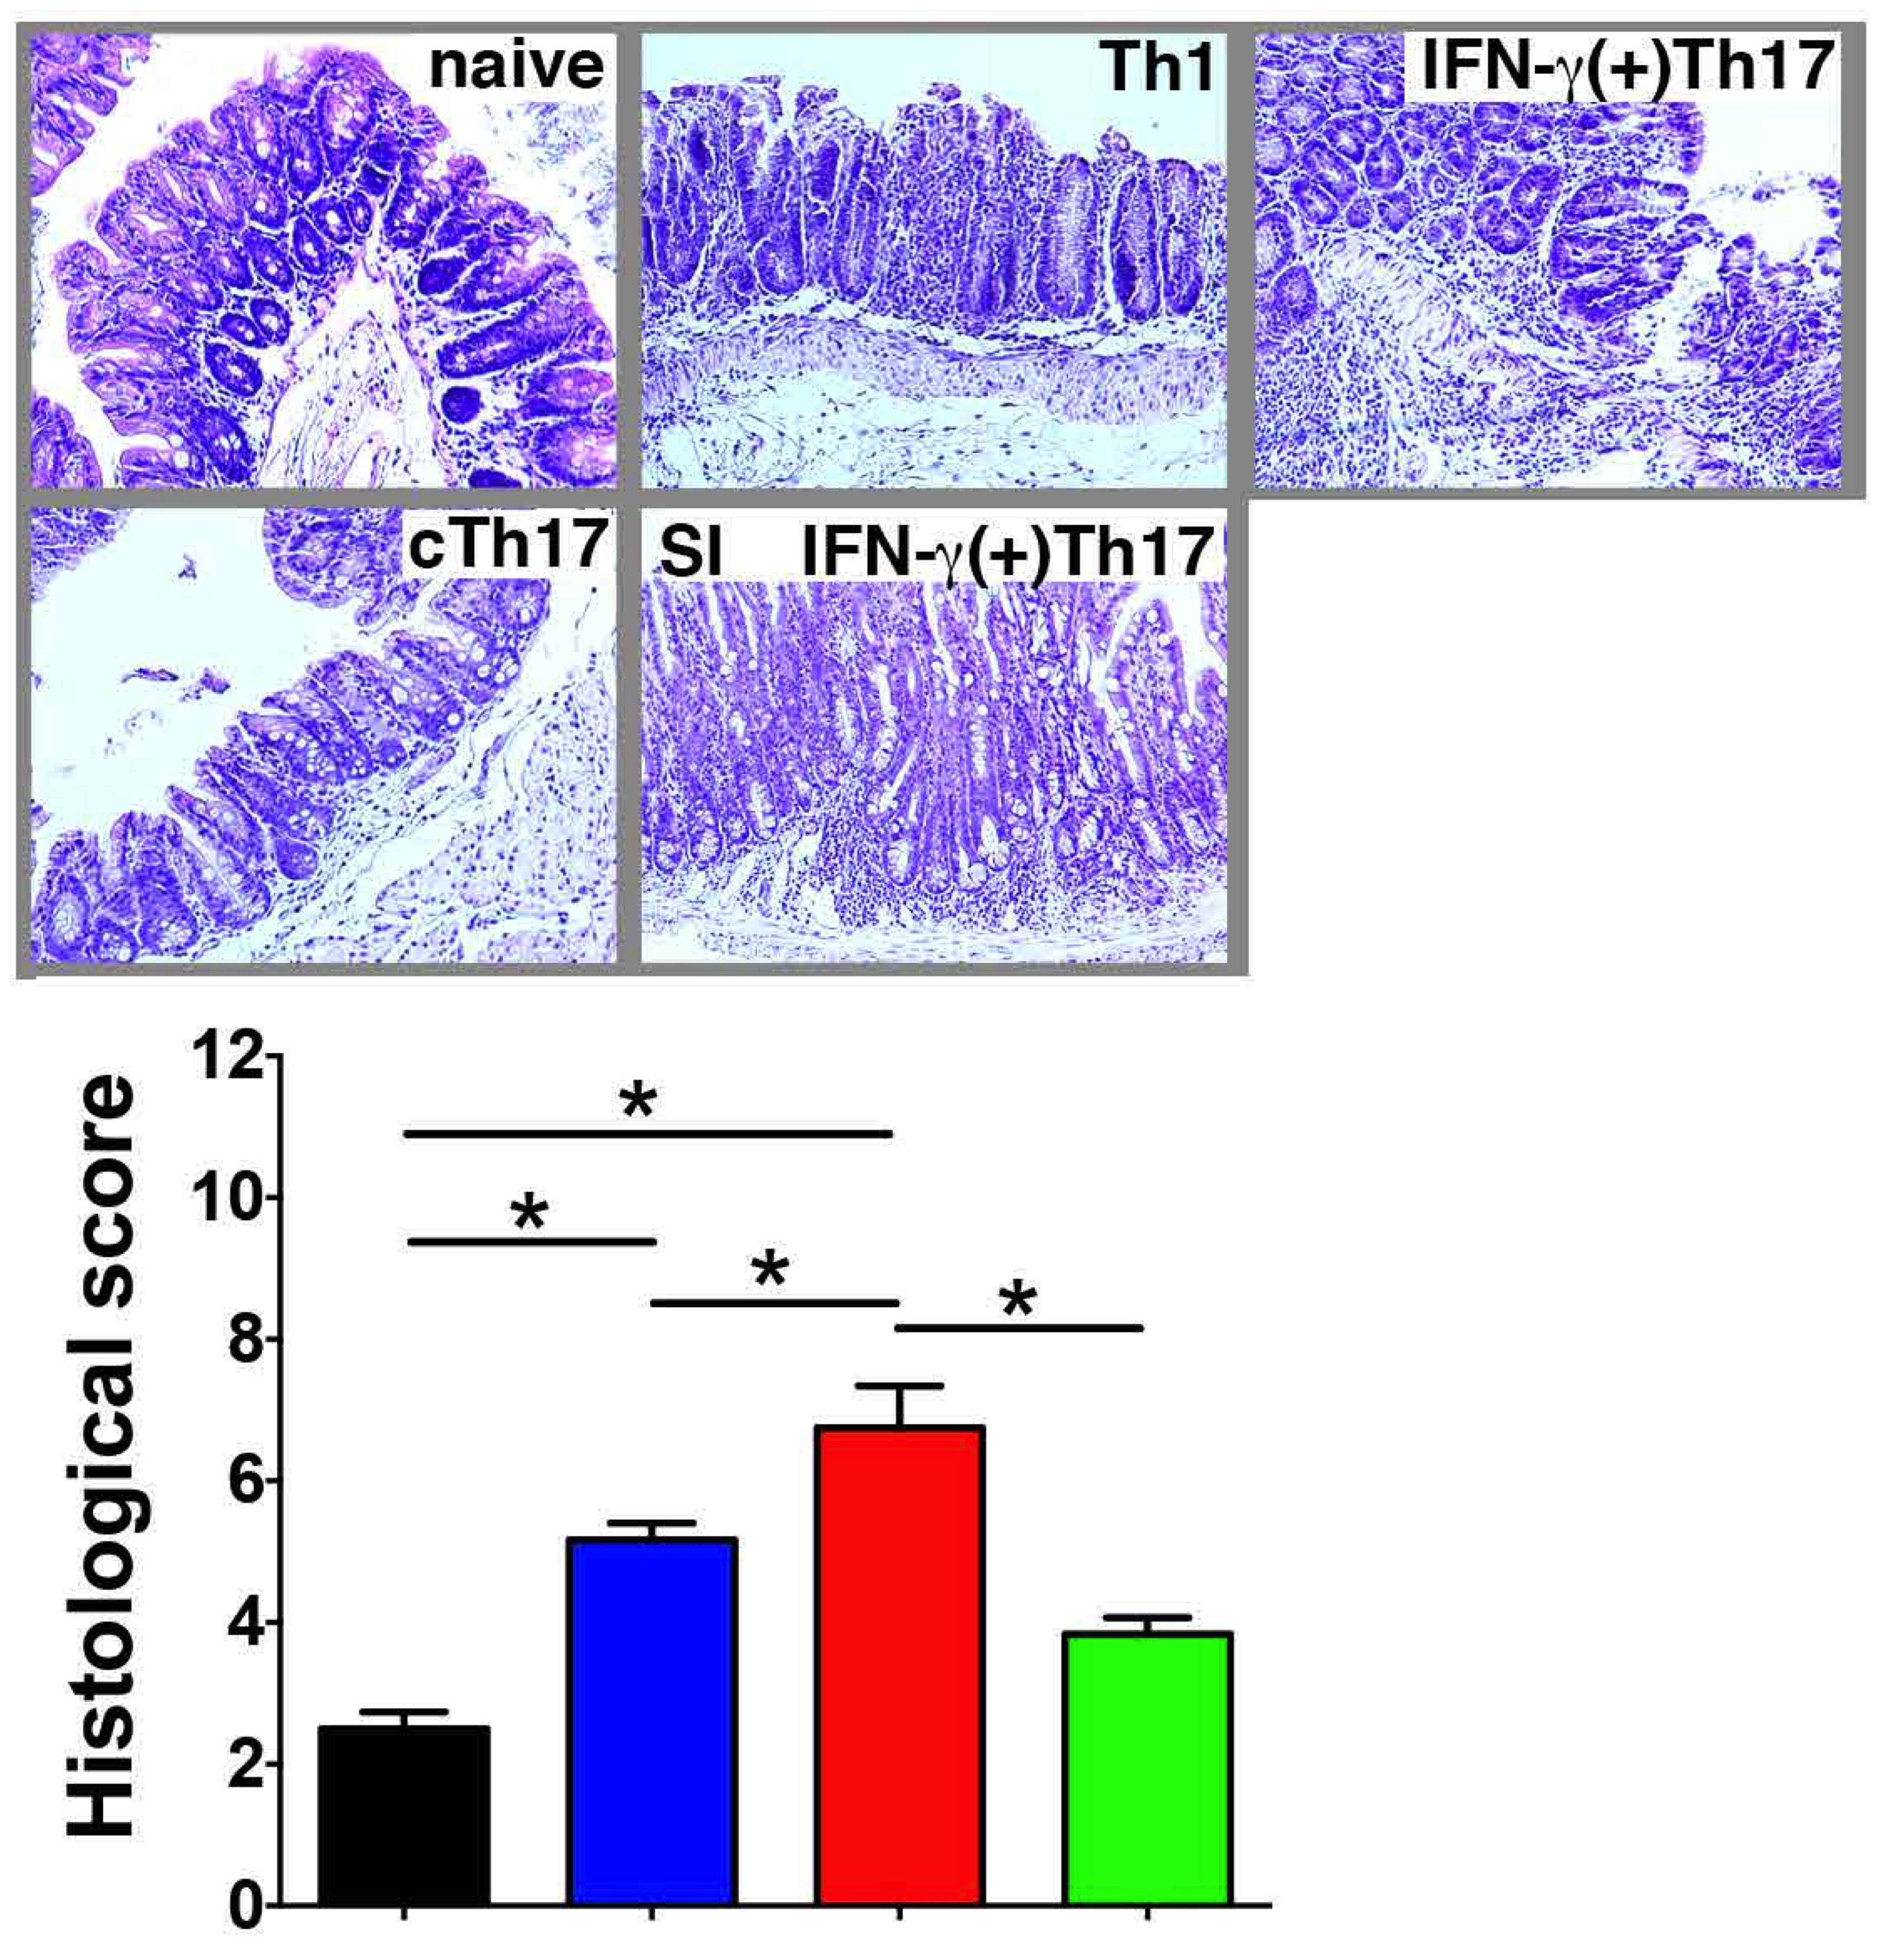
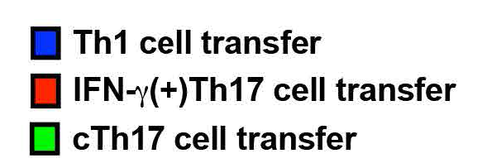
IFN-γ(+)Th17 cells (ex-Th17 cells) are more potent to induce colitis than
IFN-γ(-)Th17 cells
.
Notes:
Next we addressed inflammatory capacity of these Th subsets by transferring these cells to RAG1-/- mice.
After four weeks, mice that received IFN-g(+)Th17 cells developed most severe colitis compared to mice that received other types of cells.
Interestingly, IFN-g(+)Th17 cells induced severe inflammation in the ileum which was not seen in mice that received other types of cells.
Therefore, IFN-g(+)Th17 cells may have strong inflammatory capacity especially in the ileum.

Slide 32
The role of TRIF signaling in the regulation of Th17 cells
in the intestine
LPS
Summary
IECs
② In intestinal inflammation
(TNBS colitis model)
DCs
Mφs
TRIF suppresses Th17 cell generation and plasticity with Th1 cells in response to commensal bacteria (CBA).
The suppression of Th17 cell generation and plasticity by TRIF signaling involves IL-27, IFNAR, and STAT1.
SNPs of IL-27, IFNAR, and STAT1 were individually associated with human Crohn’s disease.
IFN-γ(+)Th17 cells have strong inflammatory capacity especially in the ileum.
differentiation
T cell

Slide 33
Summary
TRIF
mediated
Type I IFN
signaling
Th1 / Th17 imbalance
Mφs
Th17
Th17
Impairs host resistance to infection
Exacerbates colitis
Th17
DCs
Plasticity
Naïve
Th1
Notes:
To further summarize today’s talk.
Upon recognition of bacteria, either pathogens or commensals, TRIF signaling is induced by TLR4 activation in antigen-presenting cells.
This leads to multiple gene induction that is mainly regulated by Type I IFNs, which balances generation of Th1 and Th17 cells by suppressing Th17 cell differentiation.
Without proper TRIF signaling, more Th17 cells are generated due to the lack of type I IFN-mediated regulation of Th cell differentiation. This may cause an imbalance of Th1 and Th17 cells which results in impaired host resistance to infection and exacerbation of inflammation.

