Slide 1
About OMICS Group
OMICS Group International is an amalgamation of Open Access publications and worldwide international science conferences and events. Established in the year 2007 with the sole aim of making the information on Sciences and technology ‘Open Access’, OMICS Group publishes 400 online open access scholarly journals in all aspects of Science, Engineering, Management and Technology journals. OMICS Group has been instrumental in taking the knowledge on Science & technology to the doorsteps of ordinary men and women. Research Scholars, Students, Libraries, Educational Institutions, Research centers and the industry are main stakeholders that benefitted greatly from this knowledge dissemination. OMICS Group also organizes 300 International conferences annually across the globe, where knowledge transfer takes place through debates, round table discussions, poster presentations, workshops, symposia and exhibitions.

Slide 2
About OMICS Group Conferences
OMICS Group International is a pioneer and leading science event organizer, which publishes around 400 open access journals and conducts over 300 Medical, Clinical, Engineering, Life Sciences, Pharma scientific conferences all over the globe annually with the support of more than 1000 scientific associations and 30,000 editorial board members and 3.5 million followers to its credit.
OMICS Group has organized 500 conferences, workshops and national symposiums across the major cities including San Francisco, Las Vegas, San Antonio, Omaha, Orlando, Raleigh, Santa Clara, Chicago, Philadelphia, Baltimore, United Kingdom, Valencia, Dubai, Beijing, Hyderabad, Bengaluru and Mumbai.

Slide 3


2nd International Summit on “Integrative Biology”
Aug.4-5 2014, Hilton Chicago Northblook, USA
Novel Approach to Integrate Biocompatible MEMS
by Electrodeposition Using Supercritical Carbon Dioxide
Masato Sone
Precision & Intelligence Laboratory,
Tokyo Institute of Technology

Slide 4
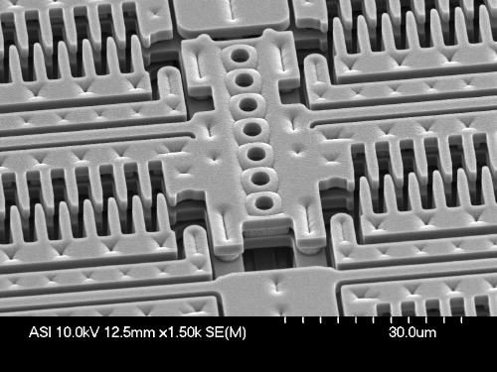
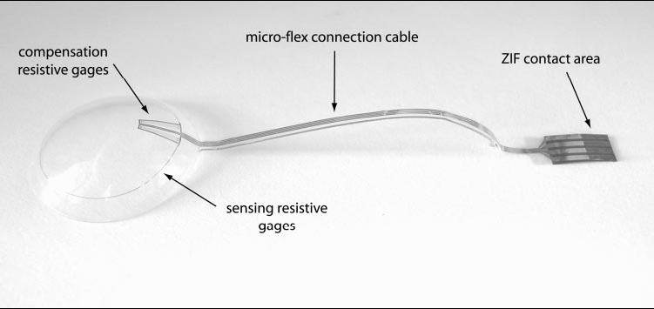
Introduction
Micro Electro Mechanical system(MEMS)
Actuator and sensor component
Silicon Substrate (semiconductor)
Next generation
Polymer based MEMS
Flexible, biologically compatible
Bio-Medical Micro-Devices
Neuro-prosthetics
Hybrid structure of
Electro-devise and biosensor on polymer
Compensation
resistive gages
Micro-flex connection cable
ZIF contact area
sensing
resistive gages
Sensing contact lens
P.Renaud et al, J.Acta Ophthalmologica 87, 433-437 (2009)
Notes:
Recently application area is MEMS devices.
그것은 Actuator sensor component is focused MEMS is developed. from Semiconductor technique. Thus silicon substrate is easily used. However in next generation, polymer MEMS is a promising candidate. Due to flexible, and biologically compatible properties. Application area is bio-medical micro devices such as neutral device or blood checker device.

Slide 5
To realize Neuro-prosthetics
1. Artificial hand or leg: robotics & MEMS
2. Artificial skin : biosensor & circuit on rubber
3. Artificial neurons: circuit on polymer
4. Wearable electrodevice : circuit on textile
New method to metalize on polymer;
especially on textile

Slide 6
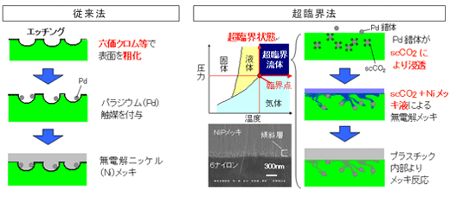
Metalizing on Polymer
Novel method
Catalyzation in Sc-CO₂ and Electroless plating in Sc-CO₂ emulsion (ELP-SCE)
Conventional electroless plating
Etching
Pd*
Surface etching with Chromate
Pd complex penetration with Sc-CO₂
Pd
Sc-CO₂
Sc-CO₂
as media
Ni electroless
plating in Sc-CO₂ emulsion
Catalyzation with
palladium
Electroless plating reaction with polymer inside
Ni electroless plating
Pd* =Pd bis-acetylacetonate
Notes:
Conventional electroless plating were performed with this step.
Etching with performed with chromate
Pd catalyzation were performed
Ni-electroless plating were performed
In novel method concept is that
Novel technique consisting of two processes:
1. catalyzation in supercritical CO₂ with Pd bis-acetylacetonate is performed
2. Then Ni electroless emulsion plating with Sc-CO2 is performed
Then electroless plating reaction is perforemd
In catalyzation procedure, Pd complex were deposited on polyimide substrate because of chemical affinity of Sc-CO2
Secondly, In electroless plating procedure, Ni-P thin film are fabricated in Ni electrolss plating emulsion with sc-CO2

Slide 7
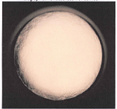
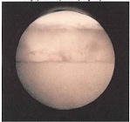
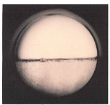
Supercritical carbon dioxide(Sc-CO₂)
Phase diagram for CO₂
SOLID
20
LIQUID
Supercritical state
Pressure [MPa]
Critical point
10
Tc=302K Pc=7.38MPa
Triple point
GAS
０
１００
２００
３００
４００
Temperature [K]
7
Notes:
7
This figure is carbon dioxide diagram horizontal line is temperature and vertical line is pressure. This line is boiling lines
Stated at the critical point is defined as supercritical carbon dioxide , when its temperature and pressure exceed the critical temperature (Tc) and pressure (Pc). interface between gas and liquid disappears. Characteristic points were introduced after slide
7

Slide 8
2. Electrodeposition on Polymers by Electrodeposition Using Supercritical Carbon Dioxide

Slide 9

Catalyzation in Sc-CO₂
ELP-SCE
Supercritical CO₂ (20ml)
353K,15MPa
Pd Bis 2,4-pentanedionato 1.219 x 10⁻⁶ mol/L
in Sc-CO2
Electroless Ni-P plating solution (30 ml) ＋ Surfactant (300μl)

Slide 10
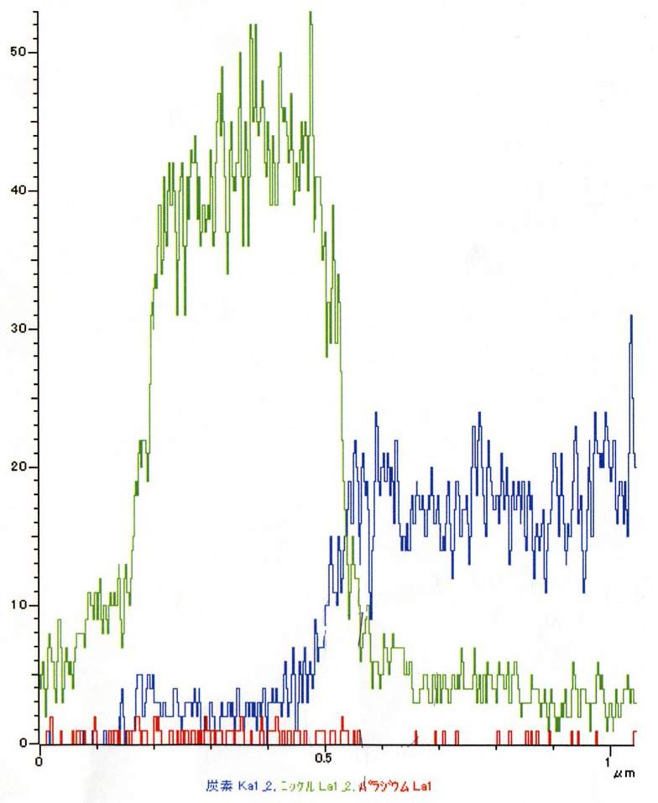
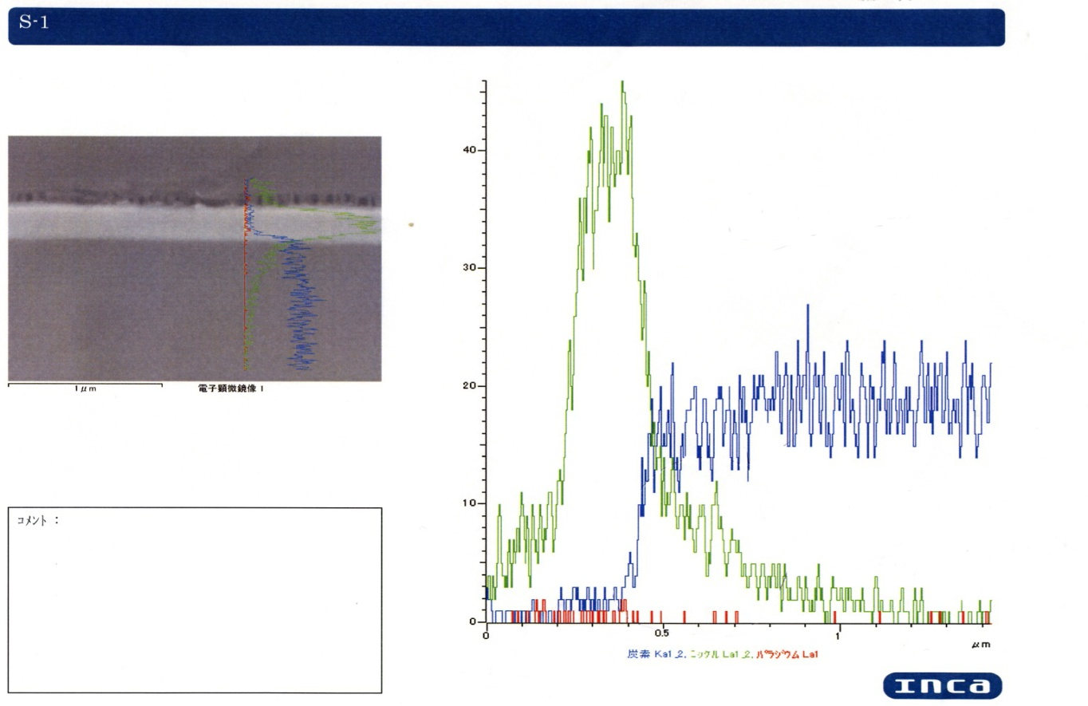
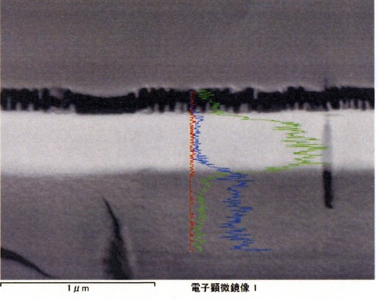
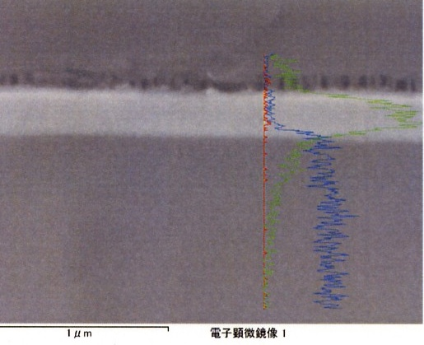
Cross-sectional atomic composition along the depth
Interface
Interface
Atomic Intensity
Atomic Intensity
Ni
Ni
Ni
Ni-P thin film
C
Ni-P thin film
C
Polyimide
substrate
Polyimide
substrate
um
150-200nm
Pd
Pd
1μm
1μm
0
0.5
Depth
1.0
μm
0
0.5
um
1
1.0
μm
Conventional electroless plating.
ELP-SCE
Penetrated Ni ions inside of polyimide (200nm depth)
Notes:
Moreover I founded new finding
This result is cross sectional atomic composition along the depth result..
Please show the supercritical electroless plating , An Ni atom can be observed at a depth
of 200 nm inside the polyimide in supercritical nano-electroless plating.
This indicates that Ni-P grew from inside of polymer (200nm depth) due to the high transport property of the Sc-CO₂.
According to EDX result,

Slide 11

Diffusion of Sc-CO₂
C* = critical Pd concentration for Ni-P electroless plating reaction
Pd catalyst
1.219 x 10⁻⁶ mol/L
C*
Concentration of Carbon dioxide
● : 30min
▲ : 20min of Sc-CO₂
■ : 5min
0 0.2 0.4 0.6 μm
d₁
d₂
d₃
Penetration depth
Notes:
Figures shows calculation result. Horizontal line is depth, vertical line is concentration of media. Left result shows sc-co2 media diffusion with various time. With this result, sc-co2 make penetrate Pd catalyst into PI substrate. Using this result we can plot catalyzation reaction time.
C* is critical Pd concentration for Ni-P electroless plating reaction. With line in C* 계산결과 직선의 diffusion형태를 보여주었다.

Slide 12
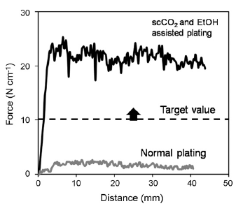
Adhesiveness of the metal film to polymer treated by the developed method
Ref) H. Adachi, K. Taki, S. Nagamine, A. Yusa, and M. Ohshima, The Journal of Supercritical Fluids. In Press, Corrected Proof(2009).

Slide 13
2. Summary
The depth of Ni impregnation is linearly related the square root of catalyzation reaction time in Sc-CO₂ and thus to be in conformance with Fick’s second law.
(We can infinitely penetrate metal inside polymer!!)
2. High transport properties is essential for the impregnation of Ni-P into polymer and for the suppression of defects in metal on polymer.

Slide 14
3. Metalization on Textiles by Electrodeposition Using Supercritical Carbon Dioxide

Slide 15
Metalization on Textile
Novel method
Catalyzation in Sc-CO₂ and Electroless plating in Sc-CO₂ emulsion (ELP-SCE)
Cross section of Nylon 6,6 fibre
Pd*
Pd complex penetration with Sc-CO₂
Sc-CO₂
Catalyzed fibre by Pd complex
Sc-CO₂
as media
Ni electroless
plating in Sc-CO₂ emulsion
Electroless plating reaction with polymer inside
Metalized fibre plated by Ni-P
Pd* =Pd bis-acetylacetonate
Notes:
Conventional electroless plating were performed with this step.
Etching with performed with chromate
Pd catalyzation were performed
Ni-electroless plating were performed
In novel method concept is that
Novel technique consisting of two processes:
1. catalyzation in supercritical CO₂ with Pd bis-acetylacetonate is performed
2. Then Ni electroless emulsion plating with Sc-CO2 is performed
Then electroless plating reaction is perforemd
In catalyzation procedure, Pd complex were deposited on polyimide substrate because of chemical affinity of Sc-CO2
Secondly, In electroless plating procedure, Ni-P thin film are fabricated in Ni electrolss plating emulsion with sc-CO2

Slide 16
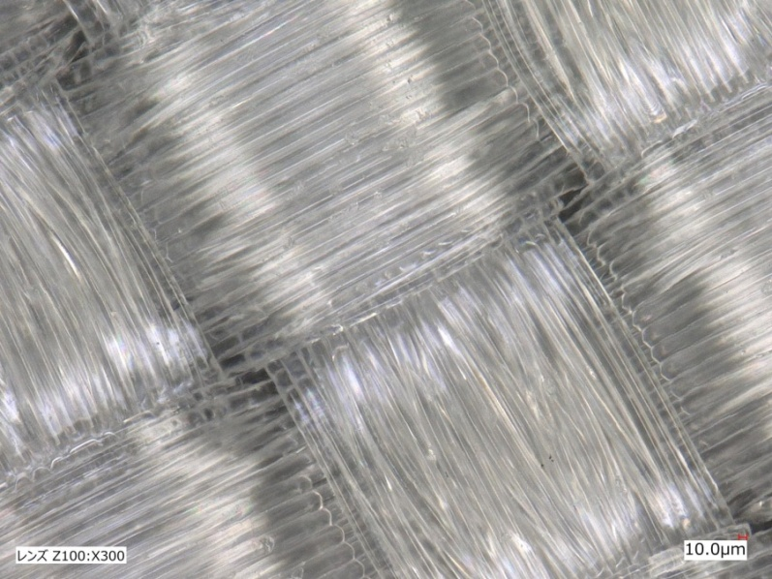
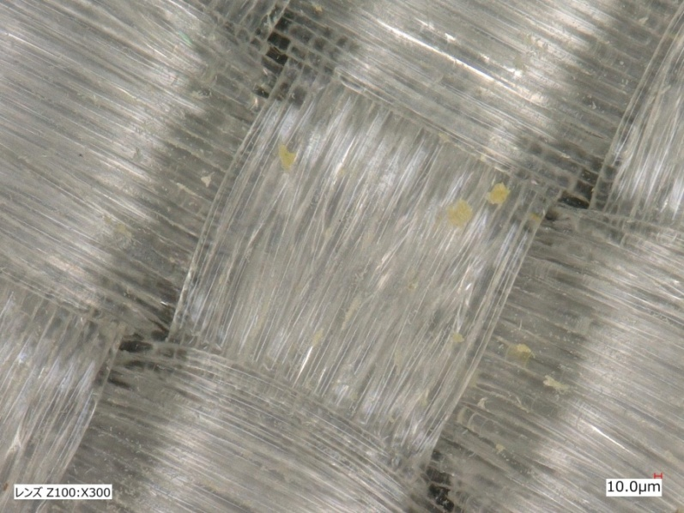
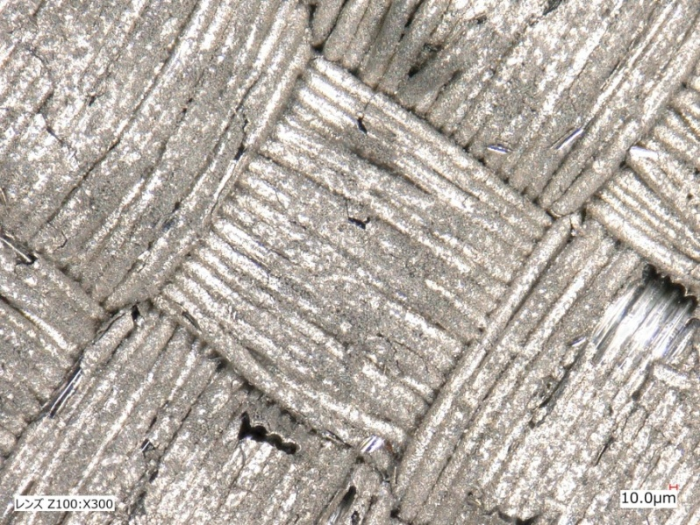
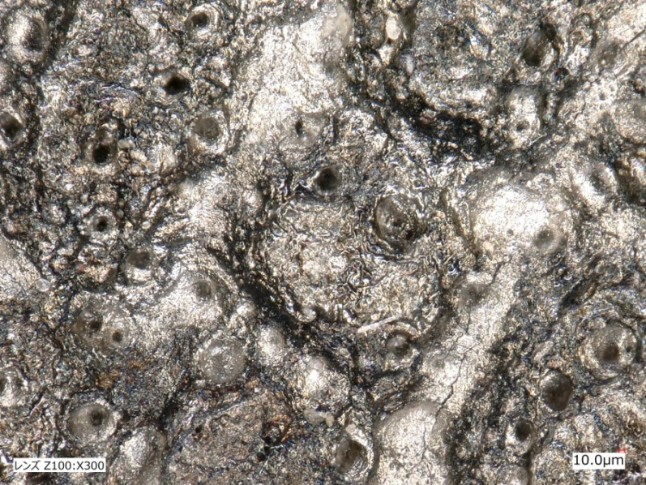
Metallization on Nylon 6,6 fibril
(a) Nylon 6,6
(b) Nylon 6,6 catalyzed in Sc-CO₂
(c) Nylon 6,6 electroplated in Sc-CO₂
(d) Nylon 6,6 electroplated in CONV

Slide 17
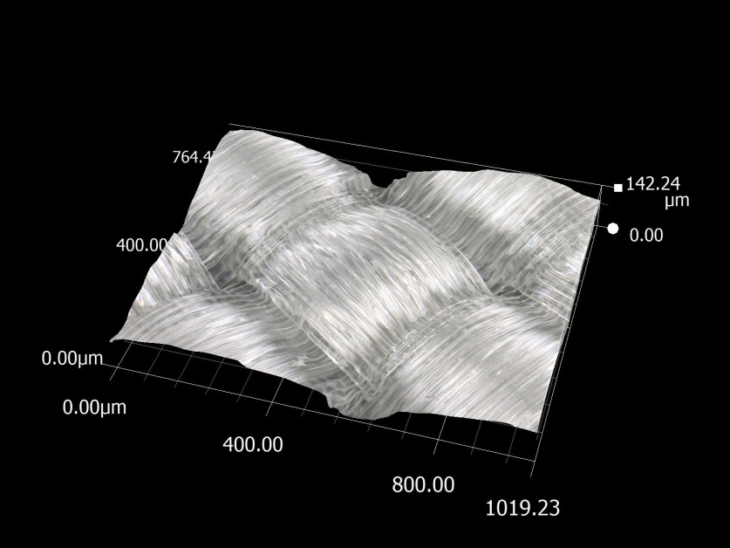
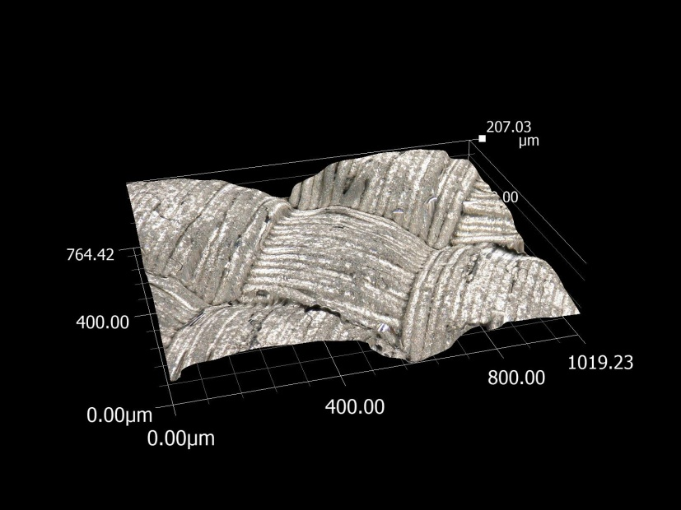
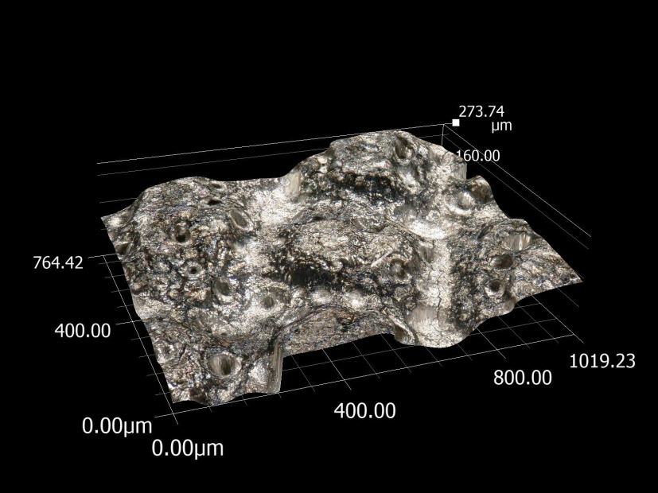
3D images of Metalized Nylon 6,6 fibril
Roughness: 45μm
(a) Nylon 6,6
Roughness: 33 μm
Roughness: 55μm
(b) Nylon 6,6 electroplated in Sc-CO₂
(c) Nylon 6,6 electroplated in CONV

Slide 18
4. Conclusions
Successful metallization on Nylon 6,6 textiles by using supercritical CO₂ catalyzation with Pd Bis 2,4-pentanedionato
2. Metalized fibrils via supercritical CO₂ catalyzation show the original modification of Nylon 6,6 fibrils

Slide 19
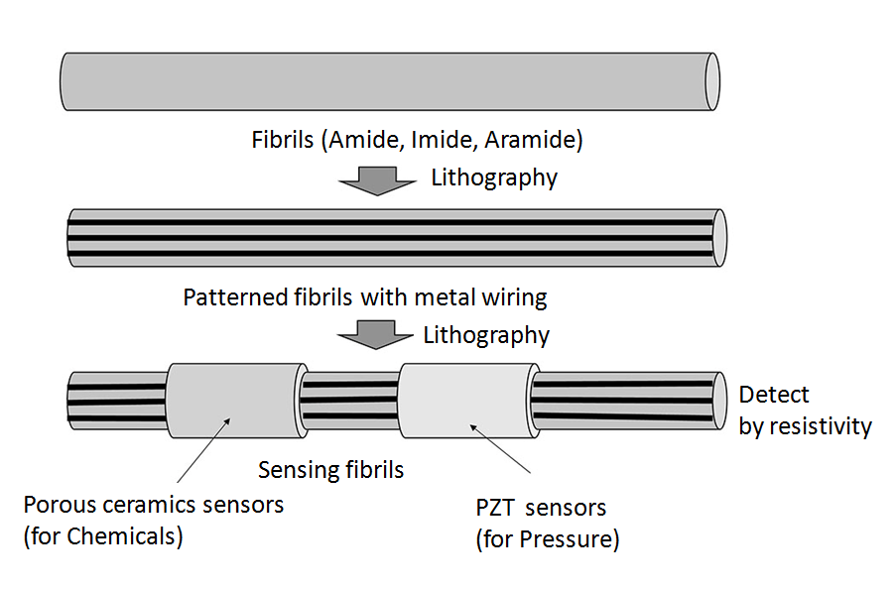
5. In future
1. Plating of Pt or Au
on polyimide fibrils
2. Patterning of noble metal on textile
3. 3D integration of circuit
on textile
Acknowledgement: Funding Program for The Murata Science Foundation and NEXT Program GN037, 2011-2014, Cabinet Office (CAO), Japan.

Slide 20
Let Us Meet Again
We welcome you all to our future conferences of OMICS Group International
Please Visit:
www.omicsgroup.com
www.conferenceseries.com
www.pharmaceuticalconferences.com

