Slide 1
About OMICS Group
OMICS Group is an amalgamation of Open Access Publications and worldwide international science conferences and events. Established in the year 2007 with the sole aim of making the information on Sciences and technology ‘Open Access’, OMICS Group publishes 500 online open access scholarly journals in all aspects of Science, Engineering, Management and Technology journals. OMICS Group has been instrumental in taking the knowledge on Science & technology to the doorsteps of ordinary men and women. Research Scholars, Students, Libraries, Educational Institutions, Research centers and the industry are main stakeholders that benefitted greatly from this knowledge dissemination. OMICS Group also organizes 500 International conferences annually across the globe, where knowledge transfer takes place through debates, round table discussions, poster presentations, workshops, symposia and exhibitions.

Slide 2
OMICS International Conferences
OMICS International is a pioneer and leading science event organizer, which publishes around 500 open access journals and conducts over 500 Medical, Clinical, Engineering, Life Sciences, Pharma scientific conferences all over the globe annually with the support of more than 1000 scientific associations and 30,000 editorial board members and 3.5 million followers to its credit.
OMICS Group has organized 500 conferences, workshops and national symposiums across the major cities including San Francisco, Las Vegas, San Antonio, Omaha, Orlando, Raleigh, Santa Clara, Chicago, Philadelphia, Baltimore, United Kingdom, Valencia, Dubai, Beijing, Hyderabad, Bengaluru and Mumbai.

Slide 3
Serum total bilirubin concentration is negatively associated with increasing severity in patients with type 2 diabetes mellitus
Masami Tanaka, Takeshi Nishimura, Risa Sekioka, Hiroshi Itoh Department of Internal Medicine, School of Medicine, Keio University Tokyo, Japan

Slide 4
Aims
Serum bilirubin concentration is associated with diabetic retinopathy in patients with type 2 diabetes.
This study investigated the relationships between serum bilirubin concentration and the severity of diabetic retinopathy.
The importance of bilirubin was compared with the factors which were previously shown to be associated with the incidence of diabetic retinopathy (duration of diabetes, body mass index, systolic blood pressure, and HbA1c).

Slide 5
Methods
A total of 674 patients with type 2 diabetes are investigated in this cross-sectional study.
Serum total bilirubin concentrations are compared between patients with and without diabetic retinopathy, and according to the severity of the retinopathy.
Multivariate analyses are performed to evaluate the association of retinopathy with total bilirubin concentration, duration of diabetes, body mass index, systolic blood pressure, and HbA1c.

Slide 6
Patient demographic and laboratory data
N 674
Age (years) 64.7 ± 13.9
Sex (men/women) 446/228
Duration of diabetes (years) 13.9 ± 10.9
BMI (kg/m²) 25.5 ± 6.3
HbA1c (%) 9.13 ± 2.16
Total bilirubin (mg/dL) 0.74 ± 0.36
AST (IU/L) 26.8 ± 17.0
ALT (IU/L) 26.8 ± 20.1
eGFR (mL min ⁻¹ 1.73 m ⁻²) 61.7 ± 31.6
Smoking, n (%) 324 (48.1)
Hypertension, n (%) 498 (73.9)
Dyslipidaemia, n (%) 520 (77.2)
Diabetic retinopathy, n (%) 279 (41.4)
NDR/SDR/PPDR/PDR, n (%) 395 (58.6)/132 (19.6)/43 (6.4)/104 (21.8)
Diabetic nephropathy, n (%) 323 (47.9)
Cerebrovascular disease, n (%) 101 (15.0)
Cardiovascular disease, n (%) 128 (19.0)
NDR, no diabetic retinopathy
SDR, simple DR
PPDR, preproliferative DR
PDR, proliferative DR

Slide 7
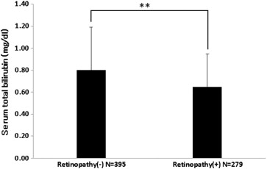
Result 1: Serum total bilirubin concentration of patients with and without retinopathy
** p < 0.001
Sekioka R, Tanaka, M, et al.
Serum total bilirubin concentration is negatively associated with increasing severity of retinopathy in patients with type 2 diabetes mellitus
Journal of Diabetes and its Complications, Volume 29, Issue 2, 2015, 218–221

Slide 8
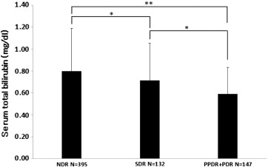
Result 2:
Serum total bilirubin concentration of patients with NDR, SDR, and PPDR + PDR
** p < 0.001, * p < 0.05
NDR, no diabetic retinopathy;
SDR, simple diabetic retinopathy;
PPDR, preproliferative diabetic retinopathy
PDR, proliferative diabetic retinopathy
Sekioka R, Tanaka, M, et al.
Serum total bilirubin concentration is negatively associated with increasing severity of retinopathy in patients with type 2 diabetes mellitus
Journal of Diabetes and its Complications, Volume 29, Issue 2, 2015, 218–221

Slide 9
Result 3:
Multivariate logistic regression analysis of diabetic retinopathy
 | Wald | Odds ratio | 95%CI | p
Sex (Female = 1, Male = 0) | 2.620 | 1.419 | 0.929–2.168 | 0.106
Age | 0.327 | 0.995 | 0.980–1.011 | 0.568
BMI | 0.295 | 0.992 | 0.962–1.022 | 0.587
Duration of diabetes | 57.419 | 1.079 | 1.058–1.100 | 0.000
Systolic blood pressure | 8.100 | 1.012 | 1.004–1.021 | 0.004
HbA1c | 0.002 | 1.002 | 0.917–1.095 | 0.961
Total bilirubin | 18.112 | 0.262 | 0.142–0.486 | 0.000
Smoking | 1.005 | 1.225 | 0.824–1.822 | 0.316
CI : confidence interval

Slide 10
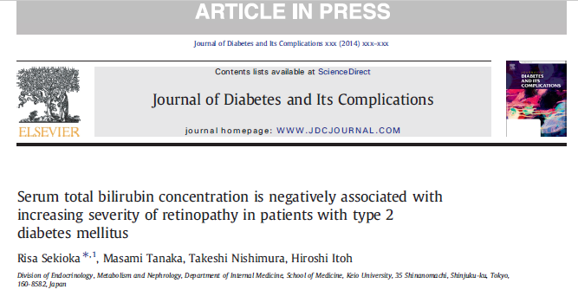
Summary of results ▶Total bilirubin concentration is lower in type 2 diabetic patients with retinopathy. ▶Total bilirubin concentration decreases with increasing severity of diabetic retinopathy. ▶Patients with retinopathy have high blood pressure and long diabetes duration.

Slide 11
ADA2015 Boston
Discussion
It is already shown that bilirubin concentration is lower in patients with type 1 and 2 diabetes with vascular complications.
Low serum total bilirubin concentration in patients with type 1 or type 2 diabetes mellitus complicated by vascular complication
Masami Tanaka, Takeshi Nishimura, Risa Sekioka, Hiroshi Itoh

Slide 12
1) 131 patients with type 1 DM
serum TBC is compared between patients with and without retinopathy/nephropathy, and among groups stratified according to the severity of retinopathy/nephropathy.
2) 293 patients with type 2 DM
TBC is compared between patients with and without diabetic microangiopathy, and between patients with and without macroangiopathy (cerebral infarction, coronary artery disease, and peripheral arterial disease).

Slide 13
Comparison of serum total bilirubin concentration according to severity of diabetic retinopathy and nephropathy
Results: T1DM-1
MA | Severity | n | Total bilirubin (mg/dl) | J-T, p value
R | NDR | 82 | 0.8 (0.6-1.0) | <0.001
 | SDR | 24 | 0.6 (0.5-0.775)
 | PPDR+PDR | 25 | 0.5 (0.4-0.75)
N | Without nephropathy | 88 | 0.8 (0.6-1.0) | <0.001
 | Microalbuminuria | 12 | 0.75 (0.525-1.0)
 | Macroalbuminuria and/or renal failure including dialysis | 31 | 0.5 (0.4-0.7)
Values are expressed as number or median (interquartile range).
Abbreviation: MA, Microangiopathy; R, Retinopathy; N, Nephropathy; J-T, Jonckheere-Terpstra test; NDR, no diabetic retinopathy; SDR, simple DR; PPDR, preproliferative DR; PDR, proliferative DR.

Slide 14
Logistic-regression analysis of diabetic retinopathy and nephropathy
Results: T1DM-2
Retinopathy
 | Odds ratio | 95%CI | p value
Gender (Female = 1, Male = 0) | 0.879 | 0.347-2.228 | 0.786
Age | 1.007 | 0.976-1.038 | 0.672
Duration of diabetes | 1.067 | 1.022-1.114 | 0.003
HbA1c | 1.064 | 0.813-1.394 | 0.650
Systolic blood pressure | 1.025 | 0.998-1.053 | 0.067
Total bilirubin | 0.047 | 0.007-0.310 | 0.001
Smoking | 0.538 | 0.209-1.380 | 0.197
Nephropathy
 | Odds ratio | 95%CI | p value
Gender (Female = 1, Male = 0) | 0.474 | 0.176-1.278 | 0.140
Age | 1.061 | 1.025-1.099 | 0.001
Duration of diabetes | 1.011 | 0.972-1.051 | 0.593
HbA1c | 1.074 | 0.813-1.418 | 0.616
Systolic blood pressure | 1.020 | 0.993-1.048 | 0.142
Total bilirubin | 0.017 | 0.002-0.158 | 0.000
Smoking | 0.818 | 0.316-2.118 | 0.679

Slide 15
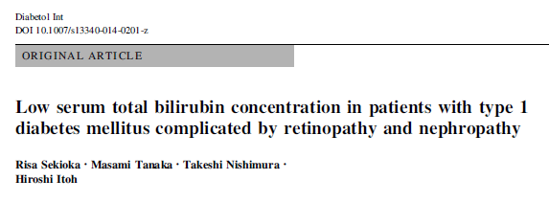

Slide 16
Results: T2DM-1
Diabetic micro/macro angiopathy and serum total bilirubin concentration
p=0.0029
p=0.0140
p=0.033
1.2
1.0
0.8
0.6
0.4
0.2
0
0.79
±0.32
0.69
±0.24
0.78
±0.29
0.70
±0.28
0.80
±0.28
0.72
±0.29
Total bilirubin concentration （mg/dL）
n=167
n=124
n=174
n=119
n=87
n=204
Retinopathy （－）
（＋）
Nephropathy （－）
（＋）
Neuropathy （－）
（＋）
p<0.0001
p=0.0010
p<0.0001
1.2
1.0
0.8
0.6
0.4
0.2
0
Total bilirubin concentration （mg/dL）
0.77
±0.30
0.65
±0.24
0.77
±0.30
0.78
±0.30
0.59
±0.20
0.56
±0.16
n=251
n=41
n=236
n=56
n=266
n=26
Stroke （－）
（＋）
CAD （－）
（＋）
PAD （－）
（＋）
CAD: Coronary artery disease, PAD: Peripheral artery disease

Slide 17
Logistic regression analysis examining the effect of various factors on micro/macro angiopathy
Results: T2DM-2
Microangiopathy
Macroangiopathy
Characteristics | Odds ratio | P
TBC | 0.652 | 0.49
BMI | 1.05 | 0.24
Age | 1.02 | 0.35
Gender | 0.788 | 0.57
Duration of diabetes | 1.18 | 0.0000
HbA1c | 1.01 | 0.94
Smoking | 1.60 | 0.29
Alcohol | 1.06 | 0.90
LDL-C | 0.999 | 0.88
HDL-C | 0.993 | 0.59
TG | 1.00 | 0.32
SBP | 1.01 | 0.63
Characteristics | Odds ratio | P
TBC | 0.1051 | 0.0004
BMI | 1.0567 | 0.0851
Age | 1.0512 | 0.0022
Gender | 1.1601 | 0.6896
Duration of diabetes | 1.0359 | 0.0482
HbA1c | 0.8849 | 0.2088
Smoking | 1.5366 | 0.2523
Alcohol | 1.6685 | 0.1799
LDL-C | 0.9906 | 0.0297
HDL-C | 0.9978 | 0.8419
TG | 1.0010 | 0.1597
SBP | 1.0049 | 0.5311
TBC: total bilirubin concentration, SBP: systolic blood pressure

Slide 18
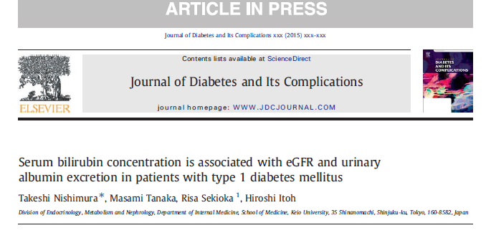

Slide 19
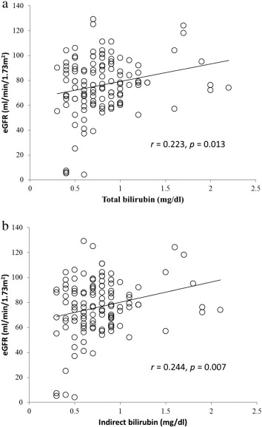
Correlation between serum bilirubin concentration and estimated glomerular filtration rate (eGFR) in patients with type 1 diabetes
(a) Total bilirubin
(b) Indirect bilirubin
Nishimura T, Tanaka M, et al
Serum bilirubin concentration is associated with eGFR and urinary albumin excretion in patients with type 1 diabetes mellitus
Journal of Diabetes and its Complications, 2015, Available online 9 July 2015
http://dx.doi.org/10.1016/j.jdiacomp.2015.07.007

Slide 20
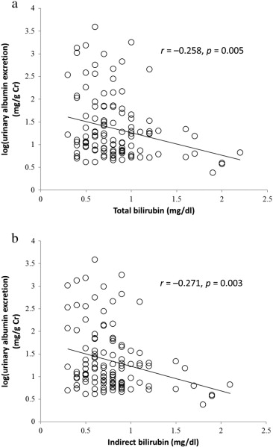
Correlation between serum bilirubin concentration and log(urinary albumin excretion) in patients with type 1 diabetes
(a) Total bilirubin
(b) Indirect bilirubin
Nishimura T, Tanaka M, et al
Serum bilirubin concentration is associated with eGFR and urinary albumin excretion in patients with type 1 diabetes mellitus
Journal of Diabetes and its Complications, 2015, Available online 9 July 2015
http://dx.doi.org/10.1016/j.jdiacomp.2015.07.007

Slide 21
Factors contributing to the estimated glomerular filtration rate
 | Estimated | SE | t value | p value
Total bilirubin
Total bilirubin level (mg/dL) | 0.160 | 5.490 | 1.837 | 0.069
Duration of diabetes (years) | –0.110 | 0.176 | –1.252 | 0.213
BMI (kg/m²) | –0.116 | 0.592 | –1.318 | 0.190
HbA1c (%) | 0.099 | 1.332 | 1.122 | 0.264
Use of ARB or ACEI (yes = 1, no = 0) | –0.290 | 4.611 | –3.285 | 0.001
Systolic blood pressure (mmHg) | –0.006 | 0.105 | –0.069 | 0.945
Indirect bilirubin
Indirect bilirubin level (mg/dL) | 0.174 | 5.752 | 2.012 | 0.047
Duration of diabetes (years) | –0.108 | 0.175 | –1.234 | 0.220
BMI (kg/m2) | –0.113 | 0.591 | –1.280 | 0.203
HbA1c (%) | 0.095 | 1.324 | 1.085 | 0.280
Use of ARB or ACEI (yes = 1, no = 0) | –0.288 | 4.599 | –3.279 | 0.001
Systolic blood pressure (mmHg) | –0.004 | 0.104 | –0.041 | 0.968
“Estimated” refers to the estimated value of the standardized regression coefficient.
Abbreviations: SE, standard error; BMI; body mass index; HbA1c, haemoglobin A1c; ACEI, angiotensin-converting enzyme inhibitor; ARB, angiotensin receptor blocker
Nishimura T, Tanaka M, et al
Serum bilirubin concentration is associated with eGFR and urinary albumin excretion in patients with type 1 diabetes mellitus
Journal of Diabetes and its Complications, 2015, Available online 9 July 2015
http://dx.doi.org/10.1016/j.jdiacomp.2015.07.007

Slide 22
Factors contributing to urinary albumin excretion
 | Estimated | SE | t value | p value
Total bilirubin
Total bilirubin level (mg/dL) | –0.186 | 0.169 | –2.095 | 0.038
Sex (male = 1, female = 0) | 0.052 | 0.123 | 0.586 | 0.559
Age (years) | 0.233 | 0.004 | 2.699 | 0.009
Duration of diabetes (years) | 0.111 | 0.005 | 1.271 | 0.206
BMI (kg/m²) | 0.009 | 0.017 | 0.107 | 0.915
HbA1c (%) | 0.222 | 0.039 | 2.617 | 0.010
Use of ARB or ACEI (yes = 1, no = 0) | 0.230 | 0.137 | 2.661 | 0.009
Systolic blood pressure (mmHg) | 0.110 | 0.003 | 1.223 | 0.224
Indirect bilirubin
Indirect bilirubin level (mg/dL) | –0.196 | 0.177 | –2.242 | 0.027
Sex (male = 1, female = 0) | 0.050 | 0.121 | 0.576 | 0.566
Age (years) | 0.231 | 0.004 | 2.651 | 0.009
Duration of diabetes (years) | 0.110 | 0.005 | 1.260 | 0.210
BMI (kg/m²) | 0.006 | 0.017 | 0.068 | 0.946
HbA1c (%) | 0.226 | 0.039 | 2.682 | 0.008
Use of ARB or ACEI (yes = 1, no = 0) | 0.230 | 0.137 | 2.668 | 0.009
Systolic blood pressure (mmHg) | 0.107 | 0.003 | 1.199 | 0.233
“Estimated” refers to the estimated value of the standardized regression coefficient.
Abbreviations: SE, standard error; BMI, body mass index; HbA1c, haemoglobin A1c; ACEI, angiotensin-converting enzyme inhibitor; ARB, angiotensin receptor blocker
Nishimura T, Tanaka M, et al
Journal of Diabetes and its Complications, 2015, Available online 9 July 2015
http://dx.doi.org/10.1016/j.jdiacomp.2015.07.007

Slide 23
Serum bilirubin concentration is negatively associated with micro/macro vascular complications in both type 1 and type 2 diabetes.

Slide 24
Bilirubin
1) Antioxidant properties by scavenging reactive oxygen species,
2) Anti-inflammatory properties by inhibiting the TNFα-related induction of endothelial adhesion molecules (E-selectin, VCAM-1, ICAM-1)

Slide 25
Conclusion
Bilirubin might function protectively against vascular complications in both type 1 and type 2 DM patients.

Slide 26
Let us meet again..
We welcome you all to our future conferences of OMICS International
4th Annual Conference on European Pharma Congress
June 18-20,2016, Berlin, Germany.
http://europe.pharmaceuticalconferences.com/

