Slide 1
About OMICS Group
OMICS Group International is an amalgamation of Open Access publications and worldwide international science conferences and events. Established in the year 2007 with the sole aim of making the information on Sciences and technology ‘Open Access’, OMICS Group publishes 400 online open access scholarly journals in all aspects of Science, Engineering, Management and Technology journals. OMICS Group has been instrumental in taking the knowledge on Science & technology to the doorsteps of ordinary men and women. Research Scholars, Students, Libraries, Educational Institutions, Research centers and the industry are main stakeholders that benefitted greatly from this knowledge dissemination. OMICS Group also organizes 300 International conferences annually across the globe, where knowledge transfer takes place through debates, round table discussions, poster presentations, workshops, symposia and exhibitions.

Slide 2
About OMICS Group Conferences
OMICS Group International is a pioneer and leading science event organizer, which publishes around 400 open access journals and conducts over 300 Medical, Clinical, Engineering, Life Sciences, Phrama scientific conferences all over the globe annually with the support of more than 1000 scientific associations and 30,000 editorial board members and 3.5 million followers to its credit.
OMICS Group has organized 500 conferences, workshops and national symposiums across the major cities including San Francisco, Las Vegas, San Antonio, Omaha, Orlando, Raleigh, Santa Clara, Chicago, Philadelphia, Baltimore, United Kingdom, Valencia, Dubai, Beijing, Hyderabad, Bengaluru and Mumbai.

Slide 3
Proton conduction in tin phosphates and their application to electrochemical devices
Nagoya University
Graduate School of Environmental Studies
Masahiro Nagao

Slide 4
Contents
１． Development of proton conductor
２ ． Application to the fuel cell
３ ． Application to the NOx reduction reactor
４ ． Application to the sensor
５ ． Application to the capacitor

Slide 5
１．Development of proton conductor
H⁺

Slide 6
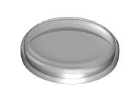
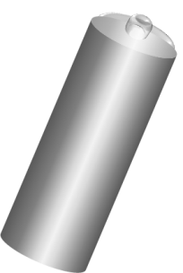
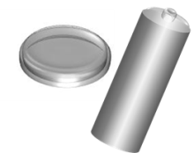
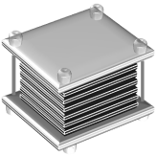
Applications using ionic conductors
Electrical charges are transported as the form of ions.
Fuel Cell
Battery
Membrane reactor
Gas sensor
A
H2
AH
H⁺， OH⁻， CO³⁻，O²⁻
Li⁺
H⁺，O²⁻
(ºC)
0
200
400
600
1000
Ionic conductive liquids, Polymers, Ionic-liquids
B L A N K
Molten salts
Ionic conductive ceramics

Slide 7
Ionic conductors
SnP₂O₇
Solid electrolyte
Conductive under unhumidified conditions
Stable under reducing conditions

Slide 8
Conductivity of In³⁺ doped SnP₂O₇
0.2 Scm⁻¹ @200°C

Slide 9
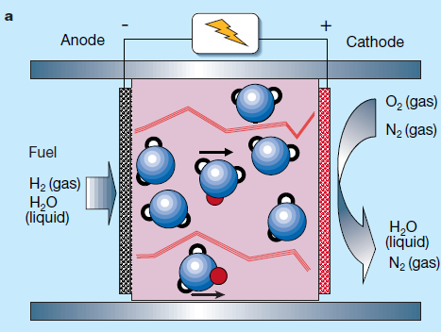
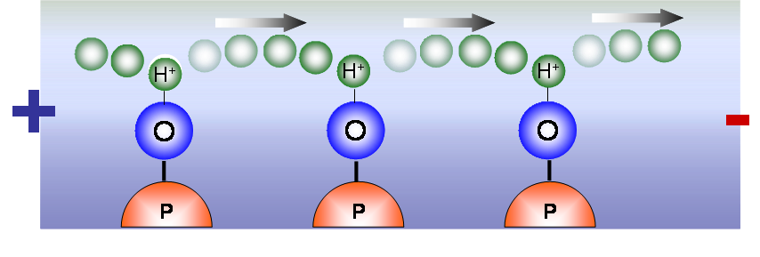

Charge carrier
Conductivity ratio
σH2O+ / σD2O+ = 1.32
(nearly $\sqrt{2}$)
H₂O atmosphere
Conducting ions → H₃O⁺, H⁺
D₂O atmosphere
Mass ratio
MH3O+ ：MD3O+ = 19：22
MH+ ：MD+ = 1：2
× vehicle mechanism
○ Grotthuss mechanism

Slide 10
ionic transport number
at 250ºC
OCV / mV
------ theoretical
--■-- measured OCV
P H₂ / atm
H2 (1 atm), Pt/C Sn0.9In0.1P2O7 Pt/C, H2+Ar (x atm)
Ionic transport number : 0.97 → pure ionic conductor in H₂ atmosphere

Slide 11
introduction of protons
Increase of proton concentration by the doping
Sn⁴⁺ <= In³⁺ + H⁺
Sn⁴⁺→In³⁺
Interaction with
water vapor
Sn⁴⁺
Sn⁴⁺
In³⁺
In³⁺
H⁺
Sn⁴⁺
＋
＋
H⁺
Sn⁴⁺
In³⁺
Sn⁴⁺
＋
H⁺
H⁺
Sn⁴⁺
Sn⁴⁺
H⁺
H⁺
In³⁺
＋
Point defection
(1) Substitution of In³⁺ for Sn⁴⁺ increase the h･ concentration
Sn⁴⁺ → In³⁺ + h･
(2) H⁺ is introduced according to the interaction of H2O with h･
H2O (g)+ h･ → H_{i}⁺ + ½ O₂(g)

Slide 12
２ ．Application to the fuel cell
H2

Slide 13

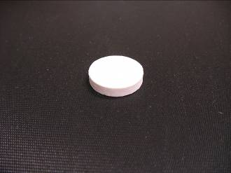
In³⁺ doping into Sn⁴⁺
SnO2 + In2O3 + H3PO4 + H2O
stirred and heated at 300°C
Slurry with high viscosity
solid state reaction at 650°C for 2.5 hours
In³⁺ doped SnP2O7 powder
*P / (Sn + In) ratio = 2.0 (determined by XRF)
uniaxial hydrostatic press at 2,000kgcm⁻²
pressed pellet

Slide 14
application to the fuel cell
0°C
100°C
200°C
600°C
1000°C
Ionic conductor
NafionTM
H3PO4
GAP
Y-stabilized ZrO2
Intermediate
temperature
v.s. PEFC
Platinum catalyst
CO poisoning
Smooth electrode reaction
Highly purified and high-pressured H2 storage
Extreme humidification
Variety of fuels (hydrocarbons, alcohols, ethers)
v.s. SOFC
Transition-metal(oxide) catalyst
Cheap structural materials
Extreme humidification
Suitable for large size
Careful start--stop operation

Slide 15
Fuel cell performance (temperature dependence)
Electrolyte thickness: 1.0 mm
Fuel: Hydrogen (30cc)

Slide 16
Fuel cell performance (dependence of electrolyte thickness)
Temperature: 250°C
Fuel: Hydrogen (30cc)
Thickness = 0.35 mm
= 0.6 mm
= 1.0 mm

Slide 17
Stability test
700 mV

Slide 18
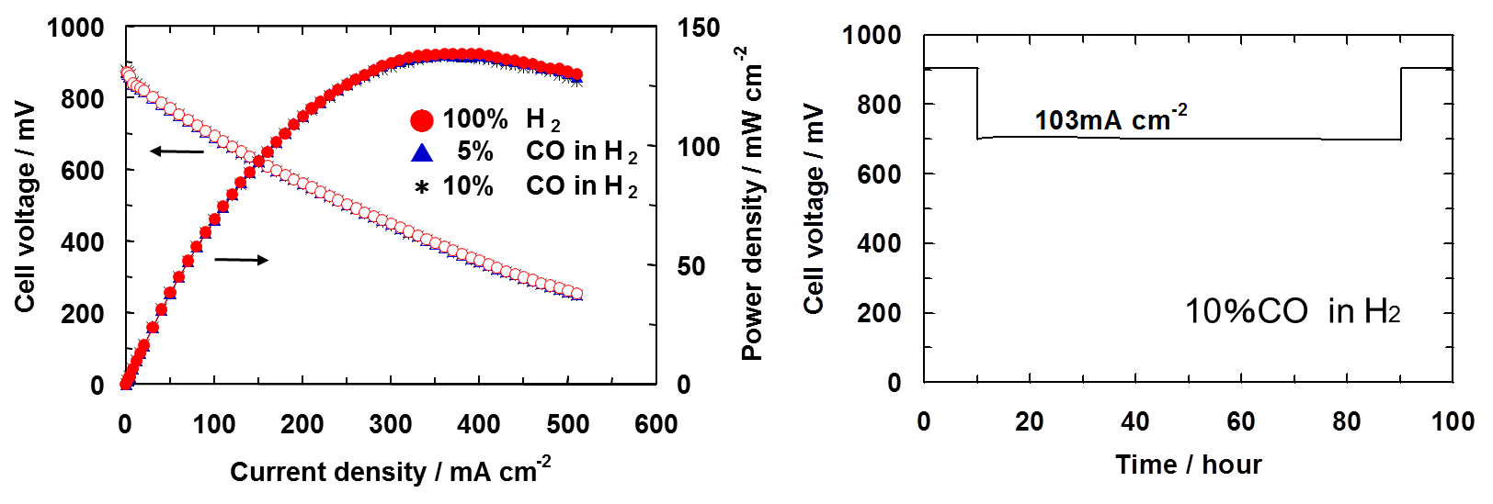
CO tolerance on fuel cell performance
High tolerance and good stability toward CO

Slide 19
Other works
PAPERS
FUEL CELLS 10, 798-803, 2010
ELECTROCHEM. SOLID-STATE LETT. 12, B1-B4, 2009
SOLID STATE IONICS 179, 1446-1449, 2008
J. ELECTROCHEM. SOC. 154, B53-B56, 2007
JOURNAL OF POWER SOURCES 196, 6042-6047, 2011
ELECTROCHIMICA ACTA 55 8371-8375, 2010
ELECTROCHEM. SOLID-STATE LETT. 13, B8-B10, 2010
CHEM. COMMUN. 47, 5292-5294, 2011
Angew. Chem. Int. Ed. 47, 7841-7844, 2008
J. ELECTROCHEM SOC. 155, B92-B95, 2008
Cathode (ORR: 1/2O₂ + 2H⁺ + 2e⁻ → H₂O)
Activation of ORR
  Increase of TPB by the composite of electrolyte and catalyst
  High dispersion of catalyst
  Anode（HOR: H₂ → 2H⁺ + 2e⁻）
  non-platinum catalyst
    Mo₂C catalyst
    Electrolyte
    decrease of resistance
      Thin film by using binder
      Fuel（Variety）
      Electrochemically active gas or liquid
        methane, ethane, propane, butane, dimethyl ether
        methanol, (ethanol)

Slide 20
３ ． Application to a NOx reactor
N2

Slide 21
Other electrochemical devices
Application 1: Fuel cell
Application 2: Reactor
Application 3: Gas sensor
1. Three-way catalyst
2. Urea SCR（selective catalytic reduction by urea）
CO2
HC
CO
H2O
(NH2)2CO + H2O
Urea storage tank, infrastructure for urea supply, ammonia slip
NO
N2
CO2
NO2
H2O
catalyst
NO
N2
Catalyst support
NH3
Catalyst support
Urea SCR
(NH₂)₂CO + H₂O → 2NH₃ +CO₂
4NO + 4NH₃ + O₂ → 4N₂ + 6H₂O
*only for stoichiometric ratio

Slide 22
New concept for NOx Reduction
Fuel cell
Reactor
H₂
H₂O
galvanostat
galvanostat
H₂O
N₂
O₂
NO
Electrochemical reduction
2H2O → 4H⁺ + 2O2 + 4e⁻
2NO + 4H⁺ + 4e⁻ → N₂ + 2H₂O

Slide 23
NOx reduction by current（NOx conc. changes in outlet）
Temperature = 250°C
O2 concentration = 5%
Counter
Working
H₂O → 2H⁺ + 1/2O₂ + 2e⁻
NO + 2H⁺ + 2e⁻ → 1/2N₂ + H₂O

Slide 24
Current efficiency
Temperature = 250°C
O2 concentration = 5%
30
6
◆ 2% O2
▲ 3%
■ 5%
● 7%
× 9%
25
5
● Ba：Pt=4：1
◆ Pt/C
%
20
4
15
3
Conversion / %
Current efficiency /
10
2
5
1
0
0
0
10
20
30
0%
2%
4%
6%
8%
10%
Current / mA
O2 concentration / %

Slide 25
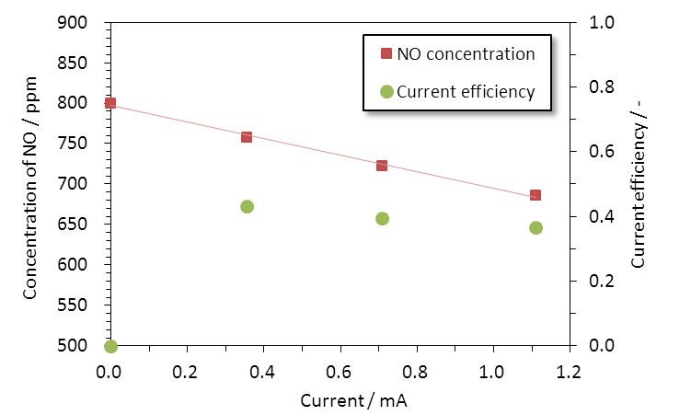
NOx reduction by alternating current（NOx conc. changes in outlet）
Temperature = 150°C
Frequency = 0.01 Hz

Slide 26
Conclusion
Sn_{0.9}In_{0.1}P₂O₇ showed high conductivity of 0.2 S cm⁻¹ at 200--250℃ in unhumidified conditions.
A fuel cell using Sn_{0.9}In_{0.1}P₂O₇ as the electrolyte (0.35 mm thick) showed high power density of 264 mW cm⁻² at 250℃ in unhumidified conditions and had good stability for discharge properties below 350℃.
The NOx reactor using Sn_{0.9}In_{0.1}P₂O₇ as the electrolyte showed a high conversion of NOx to nitrogen.
The NOx were reduced by using alternating current at 0.01 Hz.
Partial of this work was supported by JSPS KAKENHI Grant Number 25870308.
Thank you for your attention.

Slide 27
Let Us Meet Again
We welcome you all to our future conferences of OMICS Group International
Please Visit:
http://materialsscience.conferenceseries.com/
Contact us at
materialsscience.conference@omicsgroup.us
materialsscience@omicsgroup.com

