Slide 1
Duel Fuel Technology in Biomass CHP-Systems
̶
Prof. Dr.-Ing. Markus Brautsch
Center of Excellence for Combined Heat and Power of the Technical University of Applied Sciences Amberg-Weiden
University of Birmingham, School of Chemical Engineering
Jiangsu University of Science and Technology

Slide 2
Index
Introduction
The experimental setup and procedure
Measurement results
Outook

Slide 3
Introduction
Global warming will become a huge challenge in the next decades
IPCC: Temperature increase from 1.7 °C to 10 °C
Sustainable energy solutions: efficient, cost effective and environment friendly (1)
Biomass can be converted in solid, liquid and gaseous fuels through different conversion processes
The use of biomass can be highly efficient through cogeneration processes
The use of renewable energies is combined with high-efficiency technologies
In combination with fluctuating energy systems cogeneration units can work as base-load units
The Dual Fuel Technology can improve the economy in CHP systems and combine with CO₂ savings

Slide 4
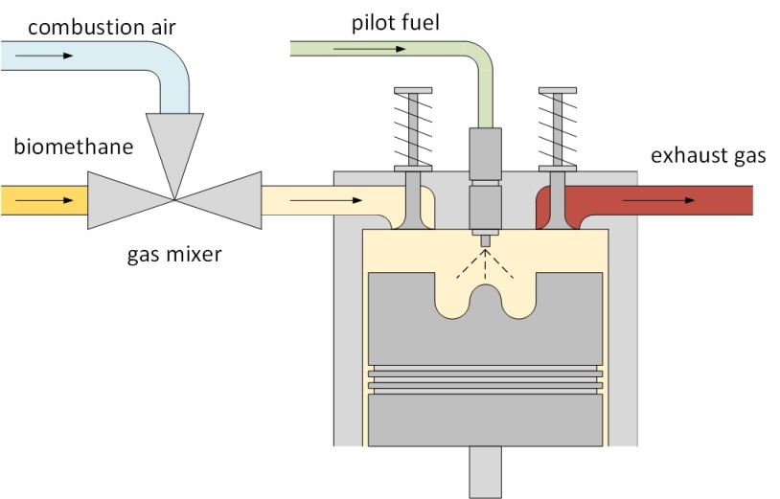
Introduction
Mode of operation of a dual fuel process with exterior fuel-mixture generation (2)

Slide 5
Introduction
Different conversion routes of biomass and combustion procedures are analysed in 4 procedures

Slide 6
Introduction
Technical and mechanical data of the investigated CHP systems (3)

Slide 7
Index
Introduction
The experimental setup and procedure
Measurement results
Outook

Slide 8
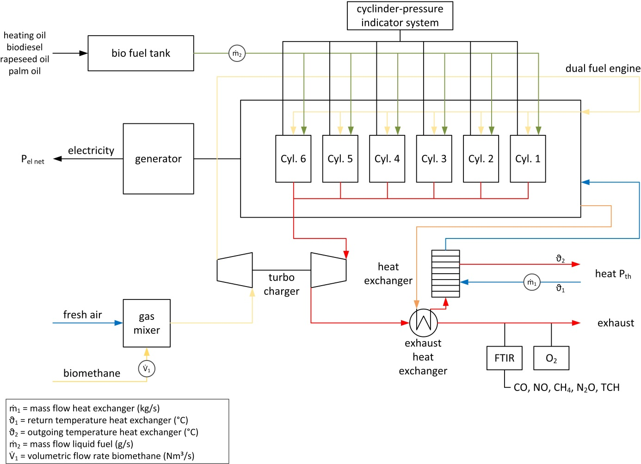
2. The experimental set up
The installation of the test bed for the experimental procedure (2)

Slide 9
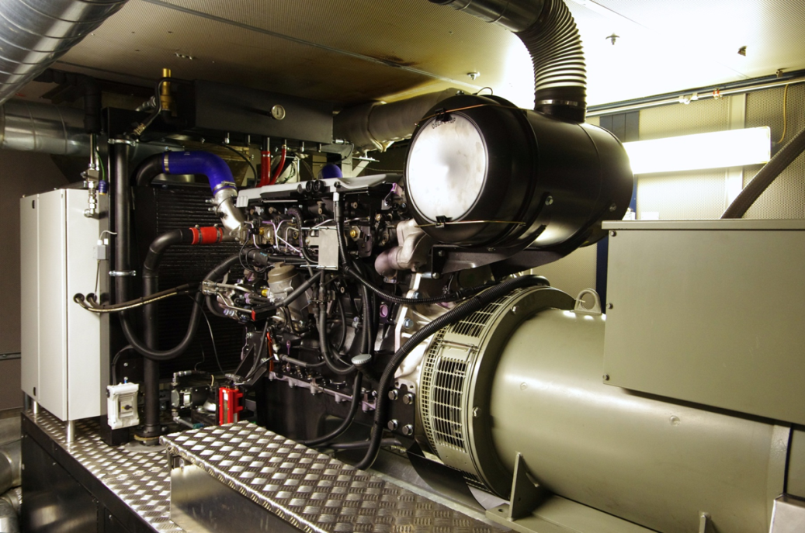
2. The experimental set up
The MAN D 26 Diesel engine connected to the Leroy Somer LSA 47.2 M8 synchronous generator at the test bench

Slide 10
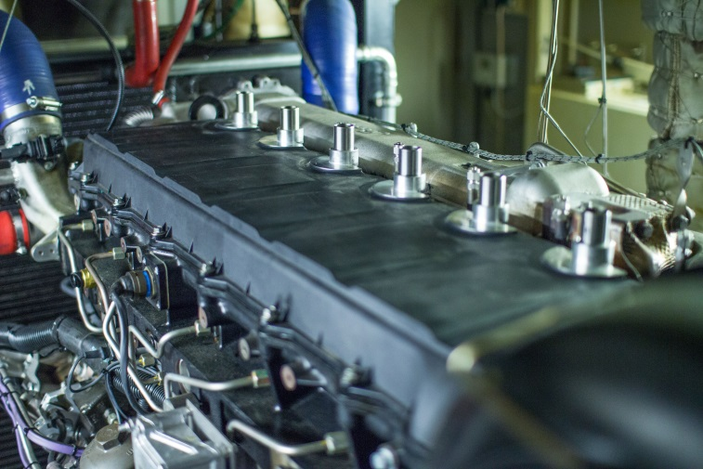
2. The experimental set-up
Cylinder indicating pressure measurement system at the cylinder head for the analysis of the cylinder pressure profile as function of the crank angle
Optimisation of different gas/fuel ratios and avoidance of engine knock

Slide 11
Index
Introduction
The experimental setup and procedure
Measurement results
Outook

Slide 12
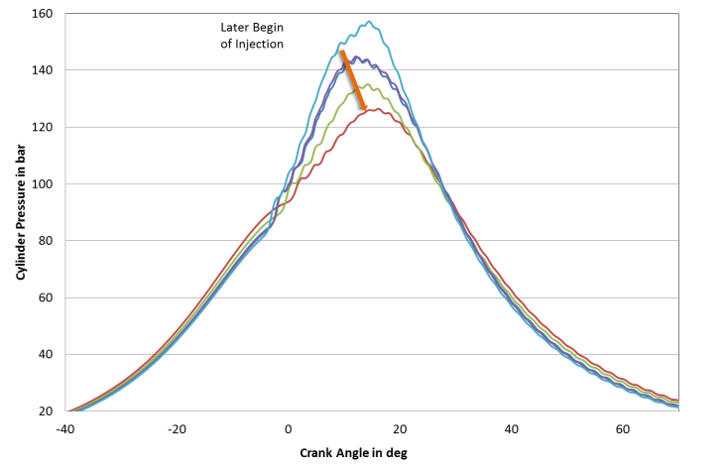
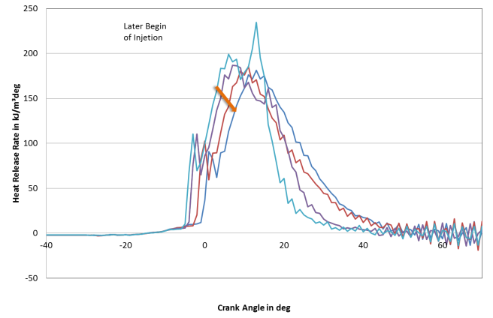
3. Measurement results
The earlier pilot fuel has been injected: (2)
the earlier was the beginning of the combustion
the higher were the peak pressures
the higher is the pressure gradient referable to an abrupt ignition of the gas
The later the pilot fuel has been injected: (2)
the combustion was shifted to the engines expansion phase
increasing exhaust fume temperatures and decreasing efficiencies

Slide 13
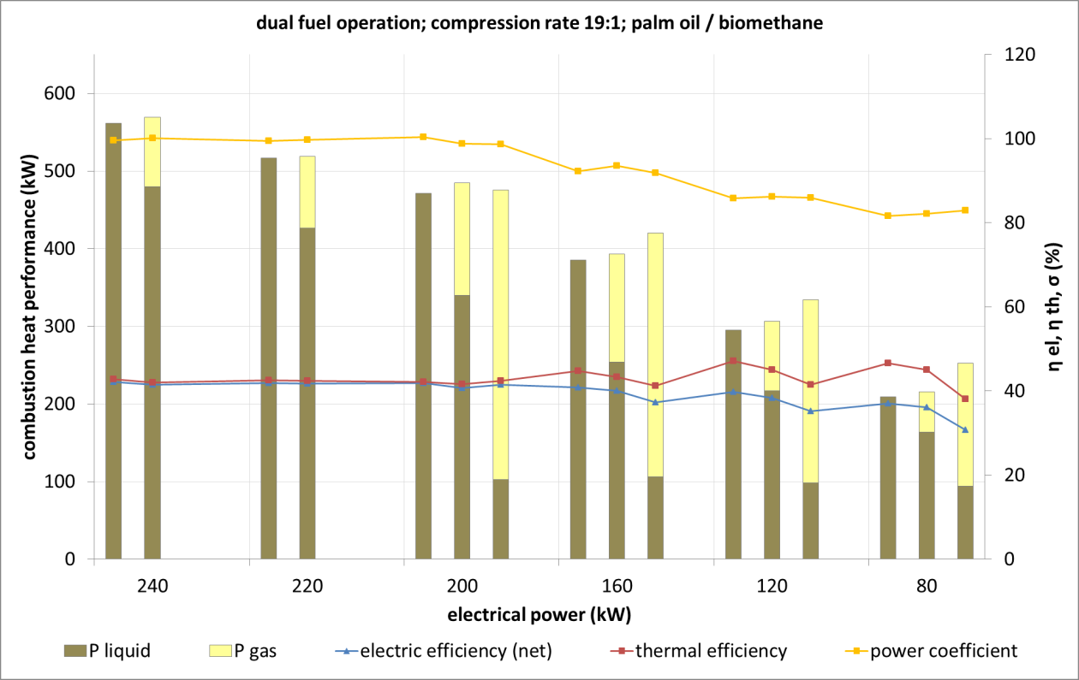
3. Measurement results
MAN D 26 common rail CHP system (compression rate 19:1) with palm oil and palm oil/biomethane dual fuel operation – procedure 1 “flexible dual-fuel mode”

Slide 14
The cylinder pressure as function of the crank angle (cylinder 4) at 240 kW electrical load, heating oil/biomethane dual fuel operation, compression rate 19:1
Maximum valve position (65 %) corresponds to P_{gas} = 141 kW and P_{liquid} = 431 kW
Fuel injection timing of 8 ° crank angle before top dead centre
Increasing gas ratios:
- higher pressure gradients
- peak pressures increase to 180 bar
- accretive fluctuations between the different single cycles
- pressure variations in the expansion stroke, which indicates knocking tendencies

Slide 15
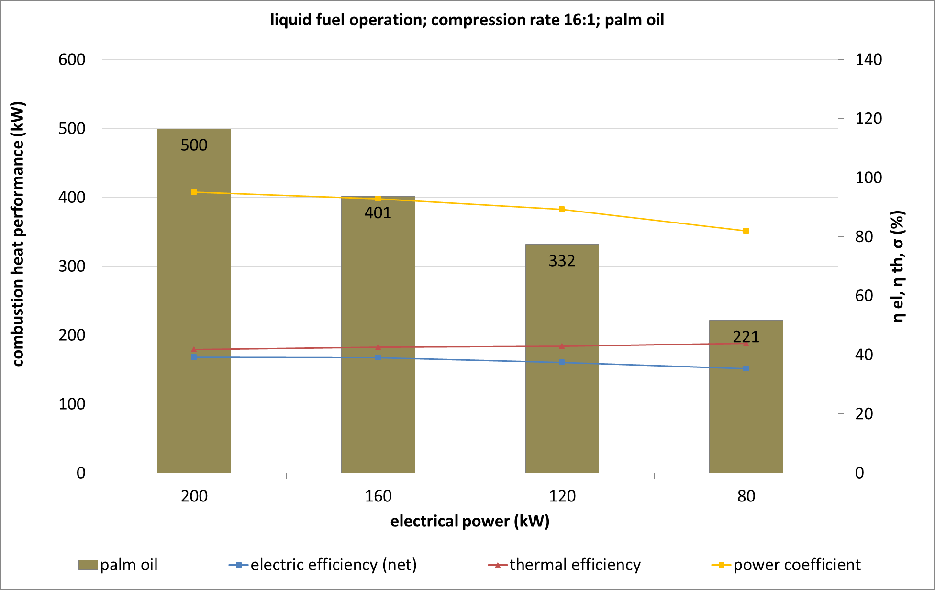
3. Measurement results
MAN D 26 common rail CHP system (compression rate 16:1) with palm oil/biomethane dual fuel operation – procedure 2 “pilot ignition mode”

Slide 16
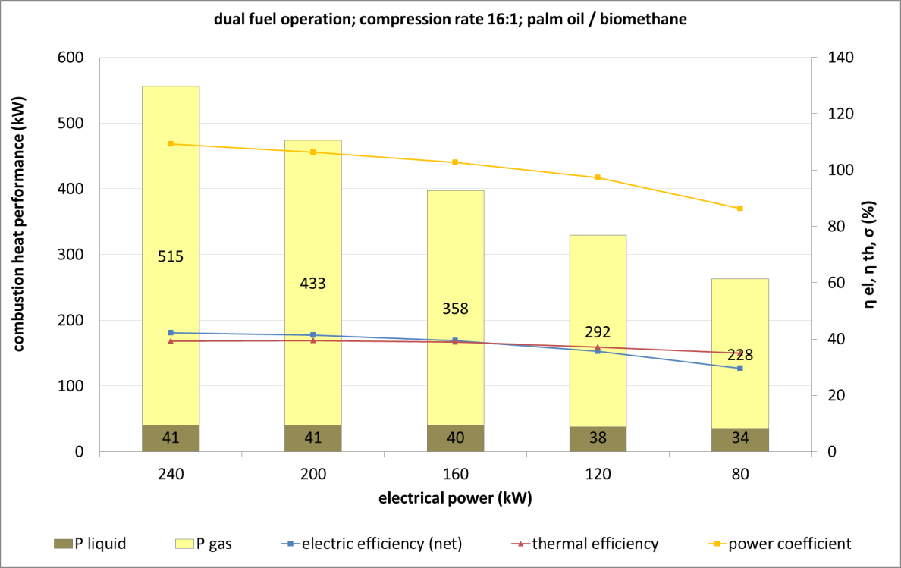
3. Measurement results
MAN D 26 common rail CHP system (compression rate 16:1) with palm oil/biomethane dual fuel operation – procedure 2 “pilot ignition mode”

Slide 17
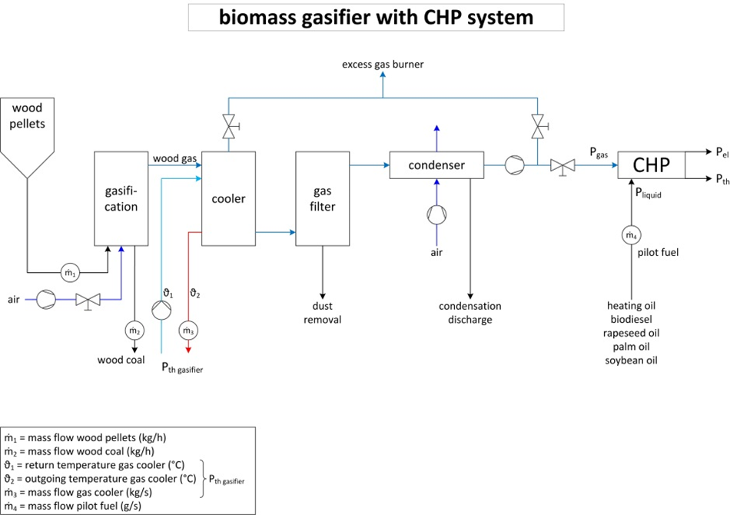
3. Measurement results
MAN D 26 common rail CHP system (compression rate 14:1) dual fuel operation – procedure 3

Slide 18
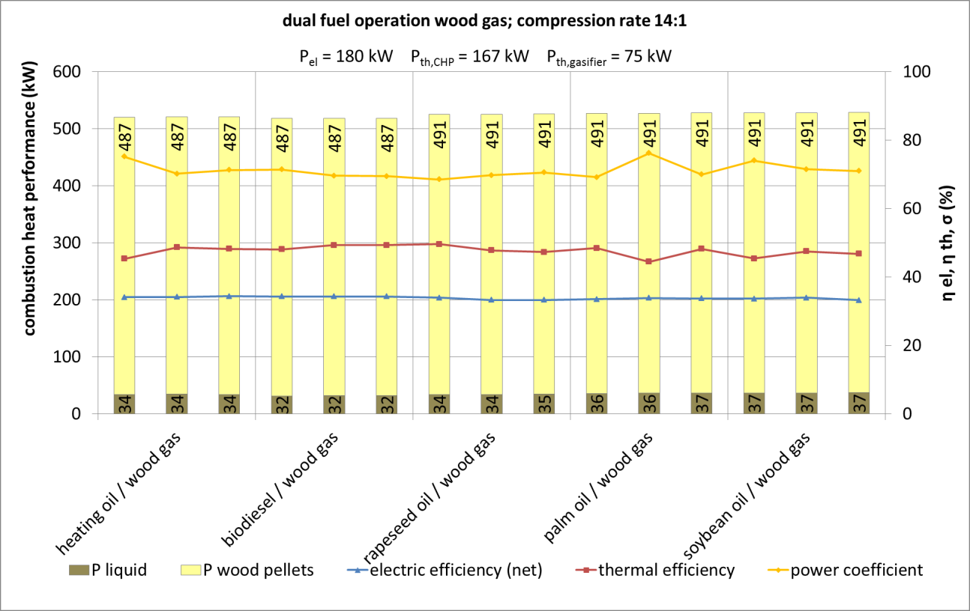
3. Measurement results
MAN D 26 common rail CHP system (compression rate 14:1) dual fuel operation – procedure 3

Slide 19
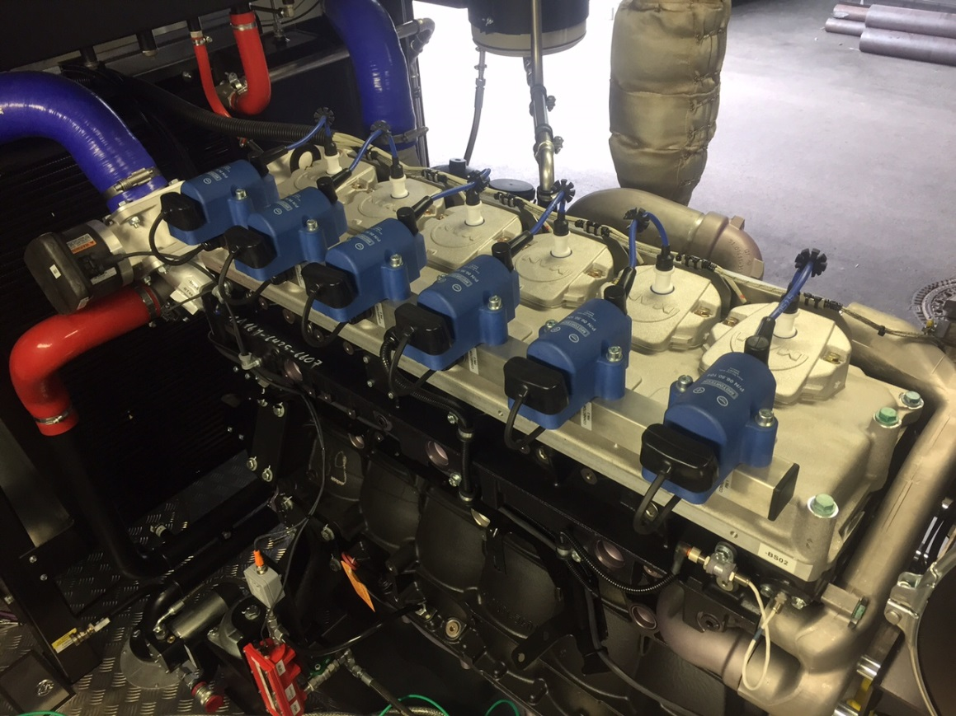
3. Measurement results
The modified cylinder head of the MAN D-26 engine with ignition coils and spark plugs in procedure 4
reduced compression rate of 12.6:1 because of 100 % woodgas operation

Slide 20
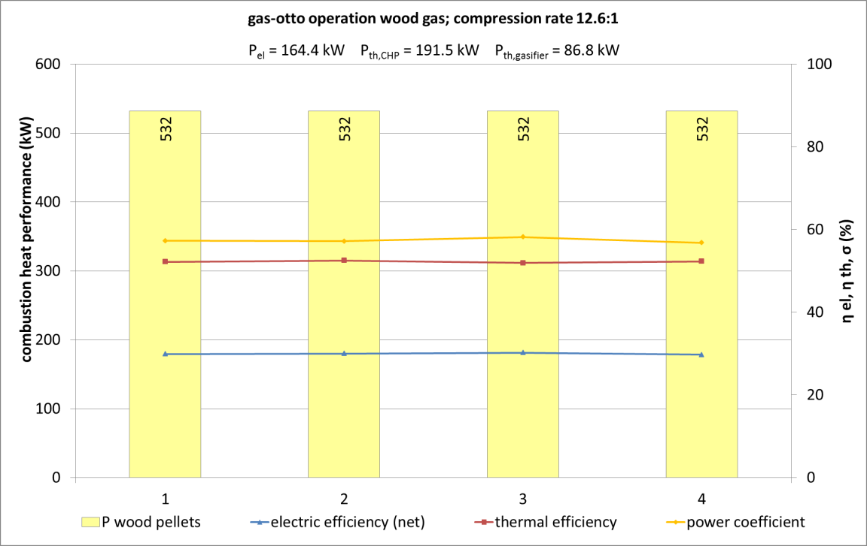
3. Measurement results
MAN D 26 common rail CHP system (compression rate 12.6:1) gas Otto operation – procedure 4

Slide 21
Index
Introduction
The experimental setup and procedure
Measurement results
Summary

Slide 22
4. Summary
Procedure 1, “flexible dual-fuel mode”, compression rate 19:1:
  Optimized for diesel combustion
  Suitable for variable ratios of gaseous and liquid fuels
  Wide range of fuel/gas ratios
  Suitable for flexible operation when liquid fuels are the primary fuel source
Procedure 2, “pilot ignition mode”, compression rate 16:1:
  Optimized for gas combustion
  Pre defined liquid fuel ratios of 40 kW
  Significant higher gas ratios
  No significant efficiency disadvantage under full load operation, although reduced compression rates

Slide 23
4. Summary
Procedure 3 , “woodgas dual fuel operation”, compression rate 14:1:
  Optimized dual fuel operation for woodgas combustion
  Pre defined fuel ratios of 40 kW
  34 % electrical efficiency based on wood pellet feedstock
Procedure 4 , “spark ignition woodgas combustion”, compression rate 12.6:1:
  Replaced cylinder head
  30 % electrical efficiency based on wood pellet feedstock

Slide 24
References
(1) Dinçer, I., Zamfirescu, C., Advanced power generation systems, Elsevier, Amsterdam, Netherlands, 2014.
(2) Lechner R., O'Connell N., Brautsch M. Identifikation von Einsatzmöglichkeiten und Potentialen der Zündstrahltechnologie zur Verbesserung der Anlageneffizienz und Wirtschaftlichkeit von BHKW-Anlagen mit experimenteller Überprüfung der Vorteile an einer Pilotanlage unter realen Bedingungen im Praxisbetrieb. Stuttgart: Fraunhofer-IRB-Verlag; 2015.
(3) Burkhardt GmbH, Energy and Building Technology, Kreutweg 2, 92360 Mühlhausen

