Slide 1
Biotechnological potential of the microflora associated with the brown alga Ascophyllum nodosum
Marjolaine Martin
Microbiology and Genomics Unit
Gembloux Agro-Bio Tech, University of Liège, Belgium
Frankfurt, Wednesday 19th of August 2015
World Congress and Expo on Applied Microbiology

Slide 2
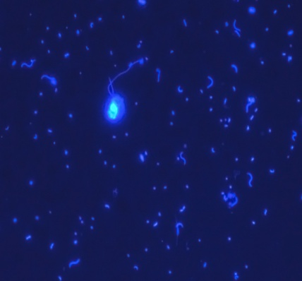
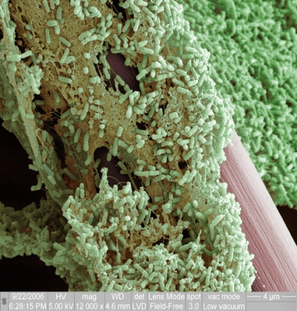
Marine Microorganisms
Planktonic
Biofilms
Hostile environment
→ Molecules with strong bioactivity

Slide 3
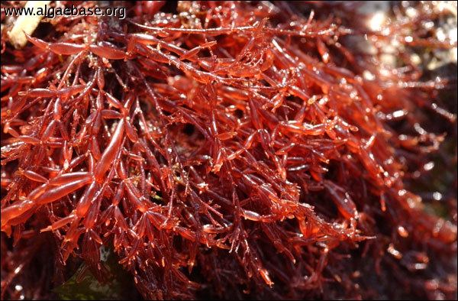
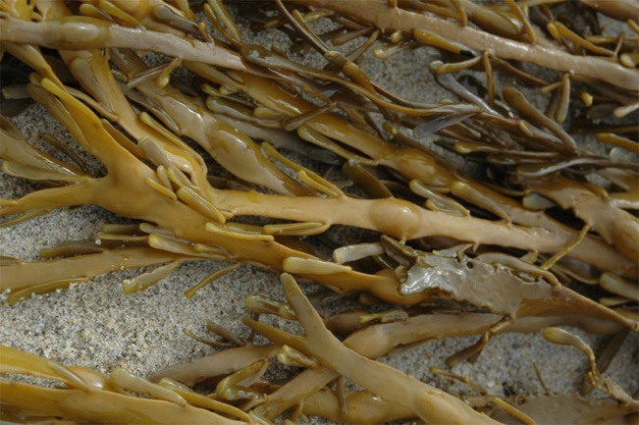
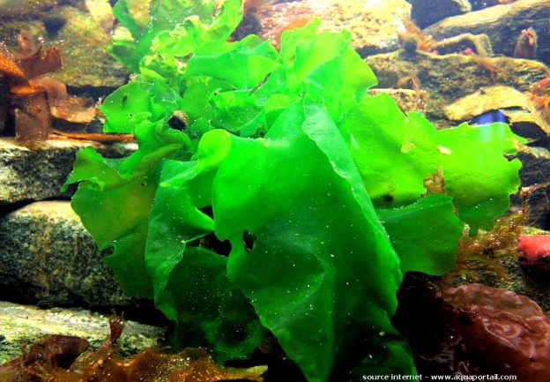
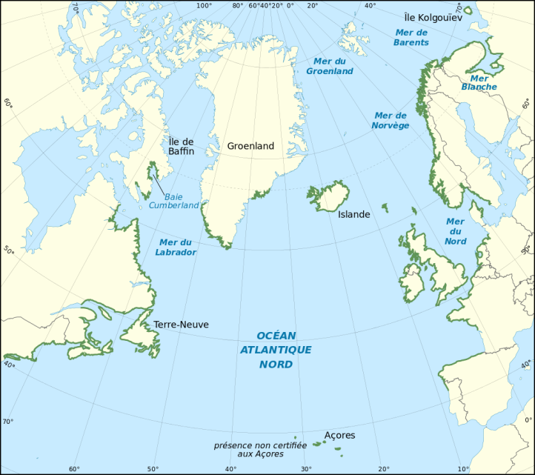
Marine Macroalgae
Rhodophyta
Phaeophyta
Chlorophyta
Ascophyllum nodosum

Slide 4
Bacteria-seaweed interactions
Anti-microbials
Growth factors & vitamines
Hydrolases
Review Martin et al, AMAB., 2014

Slide 5
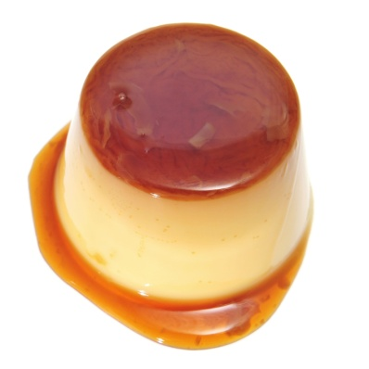
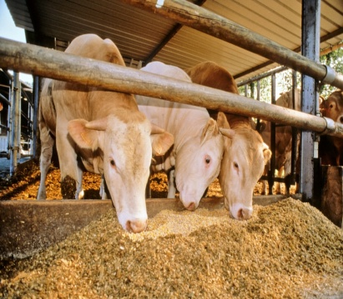
Halotolerance
Robustness
Amylases
Agarases
Xylanases
Kappa-carrageenases
Beta-glucosidases
Iota-carrageenases
Arabinanases
pH-stable
Activity
Cellulases
Alginate lyases
Estérases/Lipases
Sulfatases
Cold-active
Piezotolerant
Notes:
These enzymes with those properties find a great interest in biotechnologies and diverse sectors
So this was the part, where I tried to convince you that marine bacteria associated with algae represent a great potential to identify new microbial enzymes

Slide 6
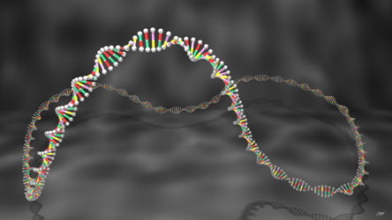
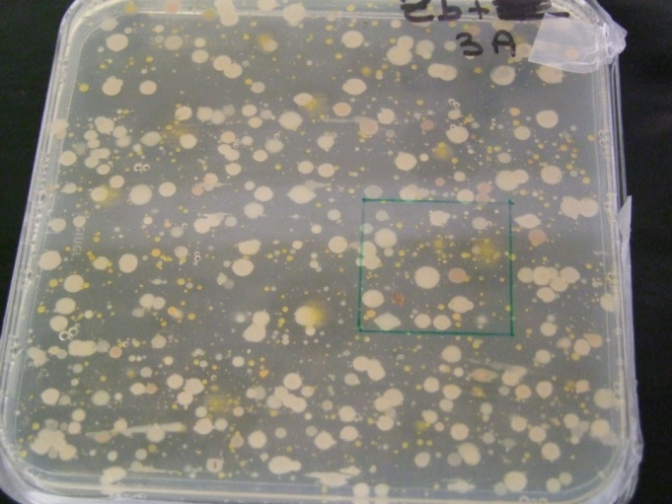
Seeking for bacterial enzymes
Functional metagenomics
→ Total bacterial DNA
Culturing
→ Cultivable microorganisms

Slide 7
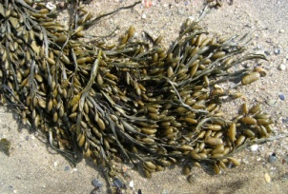
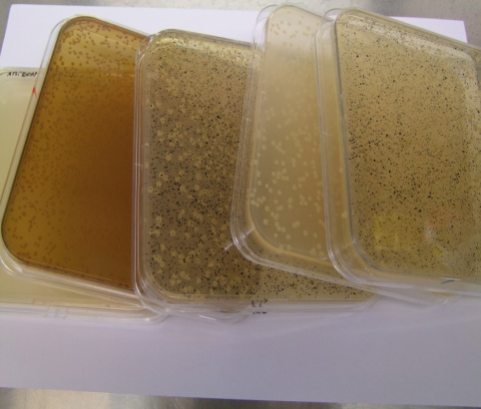
Functional Metagenomics
Ascophyllum nodosum
Functional Screening
Metagenomic library
from algal biofilms

Slide 8
Results functional metagenomics
Winter library
Summer library
First metagenomic functional screening on alga-associated bacteria
180 Mb screened
100 Mb screened
> 10 carboxyesterases
1 beta-glucosidase
1 endo-β1,4-glucanase
6 carboxyesterases
Martin et al, Appl. Env. Microbiol., 2014

Slide 9
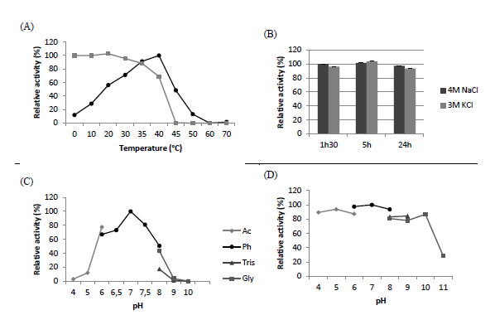
FIRST cellulase identified by marine functional metagenomics !
Cold-active
Halotolerant
pH-stable
Martin et al, Appl. Env. Microbiol., 2014

Slide 10
functional metagenomics on alga-associated bacteria...
Is a good way to identify novel marine bacterial enzymes
Is a great ressource of enzymes with biotechnological potential
Is very fastidious when not automated
Can be problematic for the expression of some genes
Didn’t allow us the identification of algal-polysaccharidases

Slide 11
Seeking for bacterial enzymes
Functional metagenomics
→ Total bacterial DNA
Culturing
→ Cultivable microorganisms

Slide 12
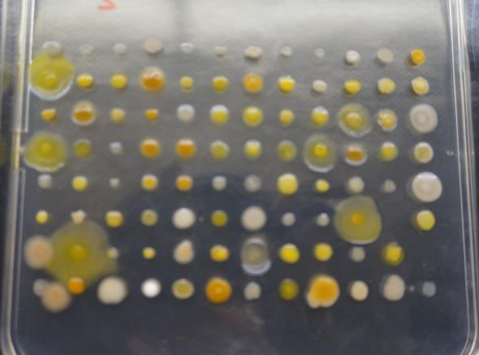
Screening cultivable microorganisms
324 bacteria were isolated from Ascophylum nodosum triplicates
These 324 bacteria were screened for algal-polysaccharidases
Liquefaction of the surrounded jellified medium
Medium is jellified with agar, iota- or kappa-carrageenan, or alginate salts

Slide 13
Isolated polysaccharolytic strains
Flavobacteria (41) | Gammaproteobacteria (37)
Flavobacteria | 7 Families
Algibacter, Cellulophaga, Maribacter, Zobellia spp. | Cobetia, Colwellia, Marinomonas, Paraglaciecola, Pseudoalteromonas, Shewanella, Vibrio spp.
41 acting on agars/carrageenans | 23 acting on agars/carrageenans
26 acting on alginates | 35 acting on alginates
11 strains <97% 16S rRNA identities | 2 strains < 97% 16S rRNA identities
78
polysaccharolytic strains
Novel polysaccharolytic genera
Multiple putative novel species

Slide 14
PCoA of the genera found on the three algae samples
Hydrogenophaga
Sample 1
0.2
Salmonella
Ruegeria
A common core of polysaccharolytic genera
Tenacibaculum
Loktanella
0.1
Vibrio
Winogradskyella
Neptunomonas
Colwellia
Marinomonas
Polaribacter
PCoA- 44%
Cobetia
Zobellia
Algibacter
Psychromonas
0.0
Pseudoalteromonas
Sample 2
Amphritea
Formosa
Sulfitobacter
Cellulophaga
Octadecabacter
Maribacter
Glaciecola
Dokdonia
Granulosicoccus
Psychroserpens
Shewanella
-0.1
Leucothrix
Psychrobacter
Marinobacter
Phenylobacterium
Roseobacter
Photobacterium
-0.2
Pseudomonas
Sample 3
Bacillus
-0.3
-0.2
-0.1
0.0
0.1
0.2
PCoA- 56%

Slide 15
Culturing polysaccharolytic alga-associated bacteria...
Shows that polysaccharolytic strains are abundant in the cultivable alga-associated microflora (25%)
Allow the identification of multiple novel polysaccharolytic species
Allow the identification of novel polysaccharolytic genera
Suggests that cultivable polysaccharolytic strains are essential for the seaweed holobiont

Slide 16
Ascophyllum nodosum associated microflora...
Has been underexplored yet
Is a great resource of novel enzymes with particular properties
Is a great resource of novel bacterial strains with biotechnological potential

Slide 17
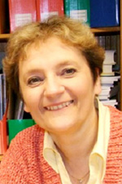
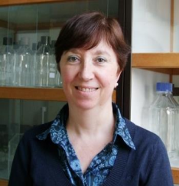
Acknowledgments
Micheline Vandenbol
Promoter
Renée Martin
Michèle Nuttinck
Gurvan Michel
Tristan Barbeyron
Murielle Jam
Thank YOU for your attention !
marjolaine.martin@ulg.ac.be

