Slide 1
MIMO Systems and Applications
Mário Marques da Silva
marques.silva@ieee.org

Slide 2
Outline
Introduction
System Characterization for MIMO types
Space-Time Block Coding (open loop)
Selective Transmit Diversity (closed loop)
Multi-Layer Transmission
Space Division Multiple Access (SDMA)
Beamforming
Multi-User MIMO vs Single-User MIMO
Coordinated Multi-Point Tx
Multihop Relay
MISO System specified for Directivity
Conclusions

Slide 3
Introduction
4G systems is demanding high data rates, improved performance and improved spectral efficiency
Multi-antenna systems are used in order to push the performance or capacity/throughput limits as high as possible without an increase of the spectrum bandwidth, although at the cost of an obvious increase of complexity
Multi-antenna systems are regarded as:
SISO (Single Input Single Output)
SIMO (Single Input Multiple Output)
MISO
MIMO

Slide 4
System Characterization for MIMO Types
Types of MIMO systems:
Space-Time Block Coding (STBC)
Selective Transmit Diversity (STD)
Multi-layer Transmission
Space Division Multiple Access (SDMA)
Beamforming
Single-User MIMO vs Multi-User MIMO

Slide 5
Space-Time Block Coding (STBC)
Initially proposed by Alamouti in 1998
Although STBC is essentially a MISO system, the use of receiver diversity makes it a MIMO
This is an open loop system (CSI is not required at the Tx side)
The transmitted signal is
The frequency domain received signal is
Ant. 1
a₂ a₁
a₂ a₁
Ant. 2
STC Encoder
a₁* -a₂*
2T T 0
2T T 0

Slide 6
Space-Time Block Coding (STBC)
The Alamouti’s post-processing for two antennas comes
Defining and
the post-processing comes
Finally, the decoded symbols come

Slide 7
Multi-Layer Transmission
STBC aims to improve performance
Nevertheless, 4G systems aims to provide 1 Gb/s (nomadic) and 100 Mbps (mobile), which requires schemes able to increase throughput
This is normally achieved by Multi-Layer Transmission (also achieves improved spectral efficiency)
The throughput is increased by a factor M (number of Tx antennas)
The number of Rx antennas must be equal to or higher than the number of Tx antennas
The detection consists of “steering” the receive antennas to each one (separately) of the transmit antennas, in order to receive the corresponding data stream. This can be achieved through the use of the nulling algorithm

Slide 8
Multi-Layer Transmission
Typically used in the uplink of cellular network (BS has more antennas than MS)
The lowpass equivalent of the transmitted signals at the M antennas are respectively given by
Multi-layer MIMO Detectors: MLSE, MMSE, ZF, SIC, V-BLAST (Vertical – Bell Laboratories Layerd Space-Time), Lattice, etc.
V-BLAST:
The symbol of the Tx antenna with the highest SNR is first detected using a linear nulling algorithm such as Zero Forcing (ZF) or MMSE detector.
The detected symbol is regenerated, and the corresponding signal portion is subtracted from the received signal vector using typically a SIC detector.
This cancellation process results in a modified received signal vector with fewer interfering signal components left. This process is repeated, until all symbols are detected.

Slide 9
Space Division Multiple Access (SDMA)
SDMA allows multiple users exploiting spatial diversity as a multiple access technique, while using the same spectrum
Typically employed in the uplink of cellular network
Similar to multi-layer transmission, this belongs to the spatial multiplexing group, allowing the use of the V-BLAST detector (nulling w/ ZF/MMSE + SIC)

Slide 10
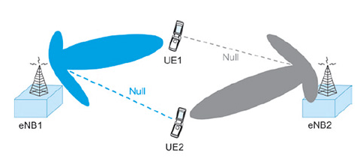
Beamforming
Implemented by antenna array with array elements at the transmitter or receiver being closely located to form a beam
Effective solution to maximize the SNIR, as it steers the transmit (or receive) beam towards the receive (or transmit) antenna, while reducing the interference generated to other users

Slide 11
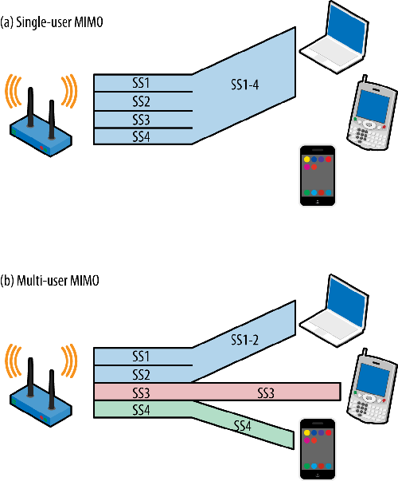
Multi-User MIMO
SU-MIMO considers data being transmitted from a single user into another individual user (widely used in the uplink)
An alternative concept is the MU-MIMO, where multiple streams of data sent by a single transmitter (typically a BS) are simultaneously allocated to a certain user to increase throughput (or to multiple users to increase capacity), using the same frequency bands (and the Tx supports more antennas than the Rx)
When the aim is improved performance, instead of different streams of data, STBC or STD is employed
The approach behind MU-MIMO is similar to SU-MIMO multi-layer transmission. Nevertheless, while multi-layer Tx (or SDMA) is typically employed in the uplink, the MU-MIMO is widely implemented in the downlink
This allows sending different streams of data to a certain User Equipment (UE), increasing the throughput (this is performed simultaneously for many UEs)
In this case, instead of performing the nulling algorithm at the receiver side, the nulling algorithm needs to be performed using a pre-processing approach at the transmitter side (BS)
This occurs because the BS can accommodate a high number of transmit antennas and the UE can only accommodate a single or reduced number (lower) of receive antennas
Use pre-coding such as ZF, MMSE, dirty paper, etc.
This typically requires downlink CSI at the Tx side (in FDD)
Similar concept can be employed in Base Station Cooperation (Coordinated Multi-Point Transmission) and in Multihop Relaying to improve SNR or throughput at the cell edge

Slide 12
Coordinated Multi-Point Transmission (CoMP)
CoMP Transmission is an important technique that can mitigate inter-cell interference, improve the throughput, exploit diversity and, therefore, improve the spectrum efficiency.
Mitigates shadowing, path loss and inter-cell interference, at the Cell Edge.
In case each BS uses the MIMO scheme, the resulting MIMO can be viewed as a "giant MIMO", consisting of a combination of independent antenna elements from different BSs
Coordinated Multi-Point transmission (CoMP) comprises the coordinated transmission of signals from adjacent base stations (BS), and the corresponding reception from UE. The signal received at the UE side consists of the sum of independent signals sent by different BSs.

Slide 13
Coordinated Multi-Point Transmission (CoMP)
Three approaches for CoMP:
Based on SU-MIMO (ex: using STBC or multi-layer transmission) – multi-layer Tx requires that the number of Rx antennas be equal to or higher than number of BS’s
Based on MU-MIMO (requires pre-processing but simple receiver)
Based on a scheduling algorithm to coordinate BS Tx’s

Slide 14
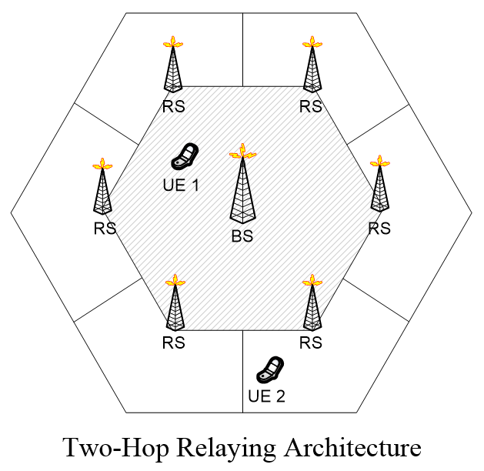
Multihop Relay
Multihop relay is a technique that can improve the coverage and capacity by providing a homogenous service, regardless the users' positions, allowing high data rates for UE even at the cell edge.
This is achieved by installing a number of Relay Stations (RS) that act as repeaters, between the BS and the UEs.
UEs at the cell edge suffer from high propagation loss and high inter-cell interference from neighbor cells. Other UE reside in areas that suffer from strong shadowing effects or require indoor coverage from outdoor BS.
These impairments originate a degradation of the SNR, which translates in a reduced service quality.
Thus, the overall goal of multihop relay is to bring more power to the cell edge and into shadowed areas, while inducing minimal additional interference for neighbor cells.

Slide 15
MISO System specified for Directivity
Transmitters with directivity introduced at information level where the transmitted constellation is only optimized in the desired direction can be used for security purposes
Severely time-dispersive channels in broadband wireless systems => Use MIMO to improve spectral efficiency
The use of multilevel modulations in modern wireless standards leads to high peak-to-average power ratios and further drives the costs of power amplifiers while reducing their efficiency.

Slide 16
MISO System specified for Directivity
Power efficiency on Amplification can be improved, due to the fact that constellations are decomposed into several BPSK (Bi Phase Shift Keying) or QPSK components (Quadri-Phase Shift Keying), being each one separately amplified and transmitted independently by an antenna
Several users can coexist since each user must know the configuration parameters associated to the constellation configuration, i.e., the direction in which the constellation is optimized, otherwise receives a degenerated constellation with useless data

Slide 17
MISO System specified for Directivity
FDE (Frequency-Domain Equalization) techniques are suitable for time-dispersive channels, namely the SC-FDE (Single Carrier – Frequency Domain Equalization) with multilevel modulations.
This leads to lower envelope fluctuations => efficient power amplification (OFDM signals present high envelope fluctuations)
IB-DFE receiver (Iterative Block Decision Feedback Equalization) are suitable for SC-FDE with multilevel modulations

Slide 18
Multilevel constellations
The constellation symbols can be expressed as a function of the corresponding bits as follows:
for each .
is the binary representation of i
In matrix format we have
where

Slide 19
Multilevel constellations
Examples:
optimal 16-Voronoi constellation (linear)
16-OQAM can be decomposed as a sum of four BPSK signals with the mapping rule defined by the set of non null complex coefficients

Slide 20
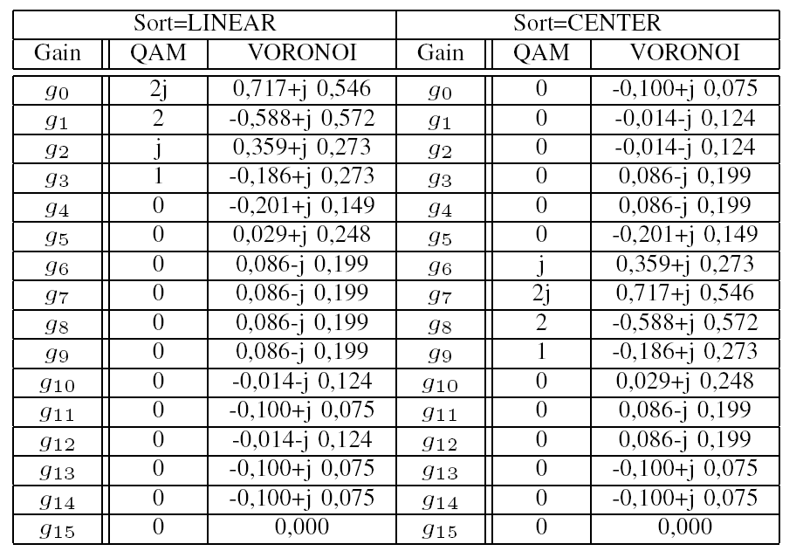
Transmitter
Linear and Centered arrangements of sub-constellations in transmitter’s antennas for 16-QAM and 16 Voronoi

Slide 21
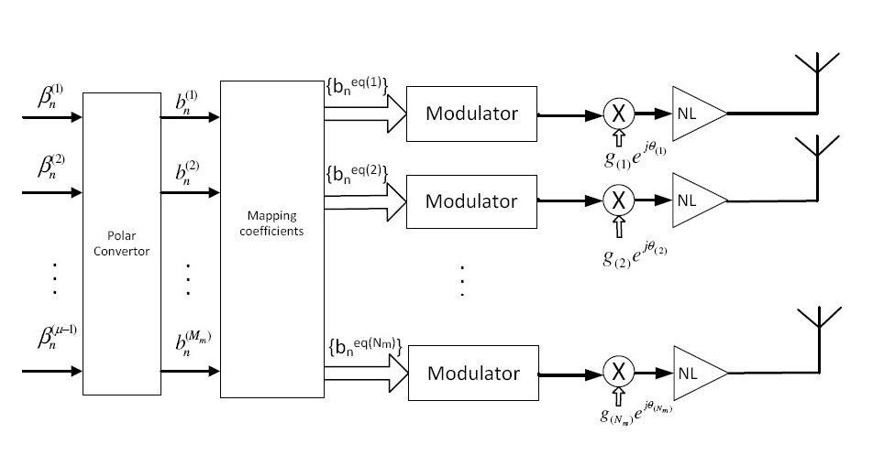
Transmitter
MISO System specified for Directivity

Slide 22
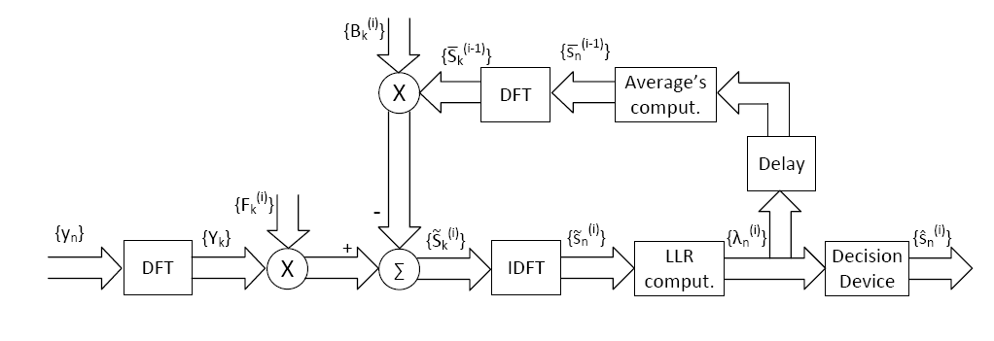
Receiver design
MISO System specified for Directivity
The receiver does not require any processing, as the multiple components of the modulation are summed over-the-air, and combined in terms of phase, as long as the receiver is in the desired DoA (alternatively, regular receive diversity can be employed).

Slide 23
Simulation Environment
MISO System specified for Directivity
SC-FDE systems with multilevel modulations.
We considered 16-QAM, 64-QAM or Voronoi constellations, decomposed as as a sum of N_{m} BPSK components.
Antennas are equally spaced by d=λ/4 and the constellations are optimized for θ=75º (under these conditions the directivity in the transmitted constellation is assured by phase rotations of the BPSK components).
AWGN channel and a severely time-dispersive channel are considered
Channel is modeled as a frequency selective fading Rayleigh channel characterized by an uniform PDP (Power Delay Profile), with 32 equal-power taps, with uncorrelated Rayleigh fading on each tap.

Slide 24
Simulation results
MISO System specified for Directivity
The symbols s_{n} are selected with equal probability from a M-QAM constellation (dimensions of M=16 and M=64 are considered).
The transmitter based on 16-QAM with gray mapping is characterized by the set of non null coefficients 2j, 1, 2 and j, associated to the antennas 1, 2, 3 and 4, respectively. 64-QAM uses 6 non-null coefficients with values 2j, 1, 2, j, 4 and 4j associated to the antennas 1, 2, 3, 4, 5 and 6, respectively.

Slide 25
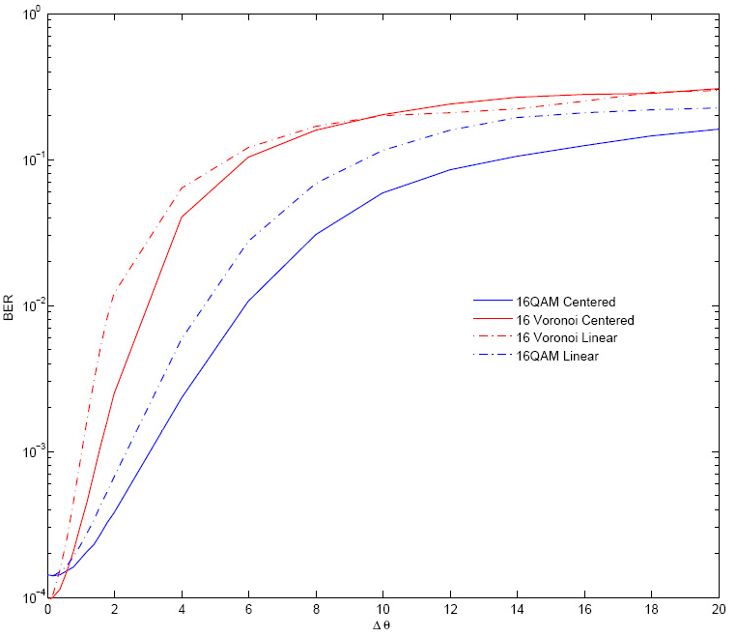
MISO System specified for Directivity
Impact of an angle error regarding the transmission direction θ in BER performance of size-16 constellations using linear and centered arrangements.

Slide 26
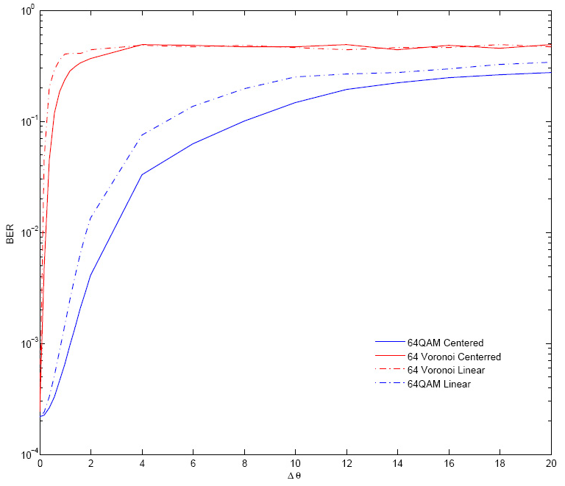
MISO System specified for Directivity
Impact of an angle error regarding the transmission direction θ in BER performance of size-64 constellations using linear and centered arrangements

Slide 27
Analysis of Simulation Results
MISO System specified for Directivity
The impact of constellation's directivity on system's performance increases with the constellation’s size.
Higher directivity is assured by Voronoi constellations with a linear arrangement (uses 16 antennas, instead of 4 [16-QAM] or 6 [64-QAM]).
Increasing system’s spectral efficiency / higher modulation orders assures a better separation of the data streams transmitted for the different users.
Higher impact of angle errors for constellations that are decomposed in a higher number of sub-constellations (i.e. the case of Voronoi constellations).

Slide 28
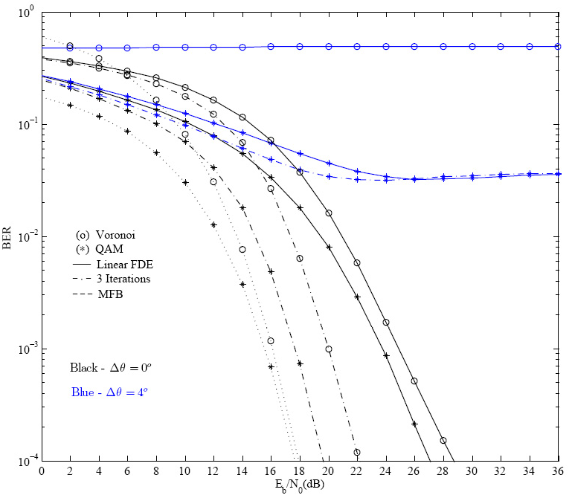
MISO System specified for Directivity
Linear array: BER performance for size-64 constellations with a frequency selective channel and an angle error against to transmission direction θ.

Slide 29
Analysis of Simulation Results
MISO System specified for Directivity
When the angle error is null for 3 iterations of IB-DFE the performance is close to the Matched Filter Bound (MFB).
Due directivity errors (see 4º of error) other users are unable to decode efficiently the transmitted data (the constellation symbol is degenerated)
Voronoi constellations are the best choice.
Voronoi constellations achieves higher directivity but worse performance.

Slide 30
Conclusions
Results show that the proposed MIMO / MISO system achieves directivity, while degenerating the constellation signals in the other directions.
Directivity can increase with higher spectral efficiencies / higher order modulations.
Constellation shaping implemented by a MISO transmission structure achieves physical layer security.
Besides the aspects already mentioned, this approach also improves the power efficiency given the decomposition of multilevel constellations into constant envelope signals.
This facilitates the use of simplified non-linear amplifiers.

Slide 31
Acknowledgements
This work was supported by FCT pluri-anual project IT UID/EEA/50008/2013

