Slide 1
Araraquara Dental School – UNESP-Univ. Estadual Paulista, Araraquara, Sao Paulo, Brazil
Department of Oral Diagnosis and Surgery
Academich Centrum Tandheelkunde Amsterdam, Nederland
Orale Celbiologie
The influence of magnesium deficiency on bone remodeling cells
Marina Belluci* ; Teun de Vries; Ton Schoemaker; Carlos Rossa Junior; Silvana Orrico; Vincent Everts
Financial Suports: Capes, CNPq, FUNDUNESP, FAPESP

Slide 2
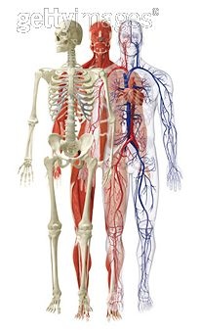
Magnesium is the forth most abundant cation and the most abundant intracellular cation in vertebrates.
Maguire & Cowan, 2002; Rude et al., 2009
Primary functions include the maintenance of muscle and nerve functions, normal cardiac rhythm, nucleotide synthesis, sodium potassium – ATPase activity and bone strenght.
Bergman et al., 2009
The total amount of magnesium in human body is 25g:
50 - 60% - Bone
27% - Muscles
19% - Soft tissue
0.5% - Erythrocytes
0.3% - Serum
Maguire & Cowan, 2002; Tucker et al., 1999

Slide 3
It is estimated that from 2.5% to 15% of the world population suffers from some form of hypomagnesemia.
Sabbagh et al. 2008
Mg dietary deficiency is more common in industrialized countries, as reported in the United States and European countries.
Boylan et al., 2009; Briefel & Johnson, 2004; Marx & Neutra 1997; Schimatschek et al. 2001; Touvier et al. 2006
Epidemiologic studies have demonstrated a positive correlation between dietary Mg intake and bone density and/or increased rate of bone loss with low dietary Mg intake (Osteoporosis).
New et al., 1997; Tucker et al., 1999; Wang et al., 1999

Slide 4
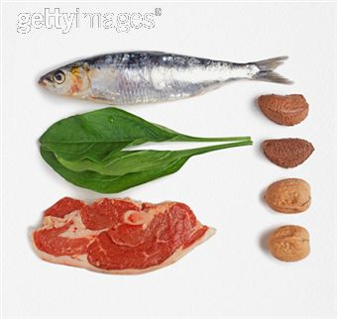
The Recommended Daily Allowance (RDA) for Mg is 420mg/day for adult men and 320mg/day for adult women, however the usual dietary Magnesium intake falls bellow recommendation from adolescence to old age.
Rude et al., 2003; Rude et al., 2003; Rude et al., 2004; Rude et al., 2005; Rude et al., 2006
Organic food have 29% more Mg than non-organic food.
Crinnion et al., 2010
Ingestion of certain substances, such as alcohol, tea, sodas may cause excessive loss of Mg by the kidney. Cyclosporin, Antibiotics and diuretics also increase renal excretion of Mg.
Johnson, 2001; Bergman et al., 2009
Systemic diseases that results in malabsorption of Mg (Diabetes Mellitus)
Bergman et al., 2009

Slide 5
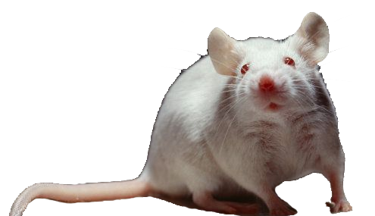
Magnesium deficiency
Pro-inflammatory cytokines (TNF-α, iL1-β, iL-6)
Neutrophils, eosinophils e macrophages
leukocytes inside the tissues
PTH
Osteoblasts
Osteoclasts
Mineralization process
Imbalance on bone metabolism
Abed & Moreau, 2007; Creedon et al., 1999; Bussiere et al., 2002; Rude et al., 2004; Manzur et al., 2007

Slide 6
Aim:
In vitro study:
To evaluate the effect of magnesium restriction on osteoclastogenesis by precursors obtained from marrow of long bone and further influence on osteoclast activity.
In vivo study:
To evaluate the relevant role played by magnesium in the inflamatory process and bone metabolism.
(Belluci et al. 2013)

Slide 7
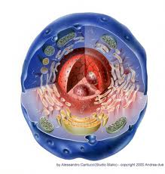
In Vitro study

Slide 8
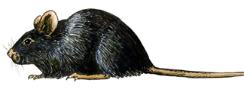
Materials and methods
Study design
Isolating Bone marrow cells
Groups:
100% Mg: 0.8mM
50% Mg: 0.4mM
10% Mg: 0.08mM
0% Mg: 0mM
Long bone
Cells were seeded on plastic and on bone
C57BL/6
0
3
Day
Procedure
Isolated mice (n=6) bone marrow cells from long bone in a Mg free medium and seeded in 4 different groups
PCR
Proliferation assay (DNA)
Viability
(Belluci et al. 2013)

Slide 9
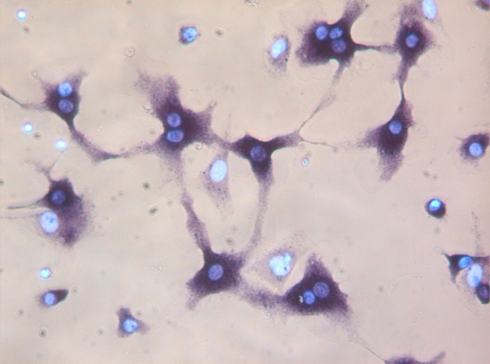
Materials and methods
Study design
Groups:
100% Mg: 0.8mM
50% Mg: 0.4mM
10% Mg: 0.08mM
0% Mg: 0mM
100 μm
0
3
6
Day
Procedure
Isolated mice (n=4) bone marrow cells from long bone in a Mg free medium and seeded in 3 different groups
PCR
Proliferation assay (DNA)
Viability
Osteoclastogenesis
TRAP (enzymatic)
(Belluci et al. 2013)

Slide 10
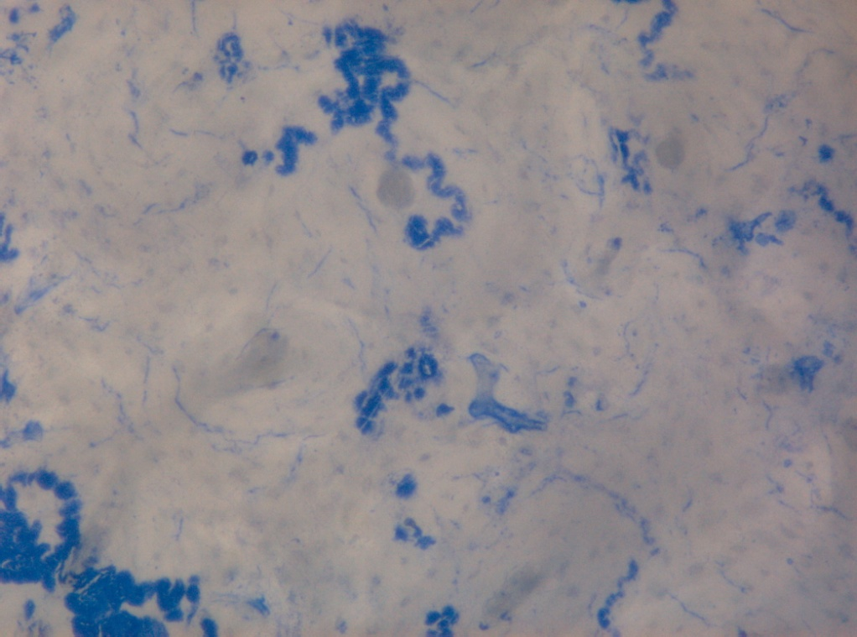
Materials and methods
Study design
Groups:
100% Mg: 0.8mM
50% Mg: 0.4mM
10% Mg: 0.08mM
0% Mg: 0mM
0
3
6
8
Day
Procedure
Isolated mice (n=4) bone marrow cells from long bone in a Mg free medium and seeded in 3 different groups
PCR
Proliferation assay (DNA)
Viability
Osteoclastogenesis
TRAP (enzymatic)
Resorption pit
(Belluci et al. 2013)

Slide 11
Results

Slide 12
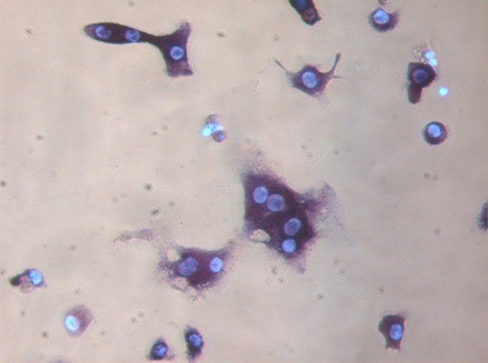
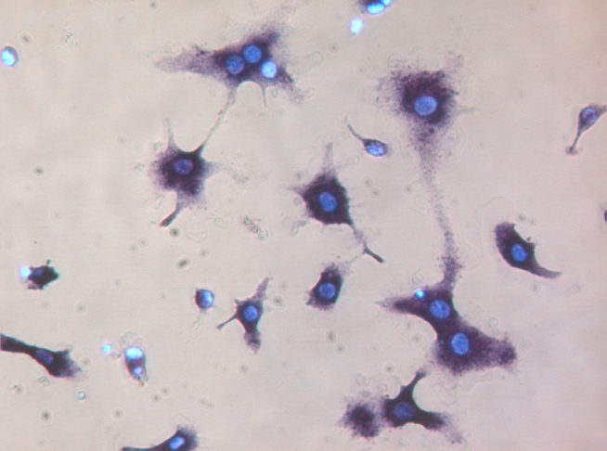
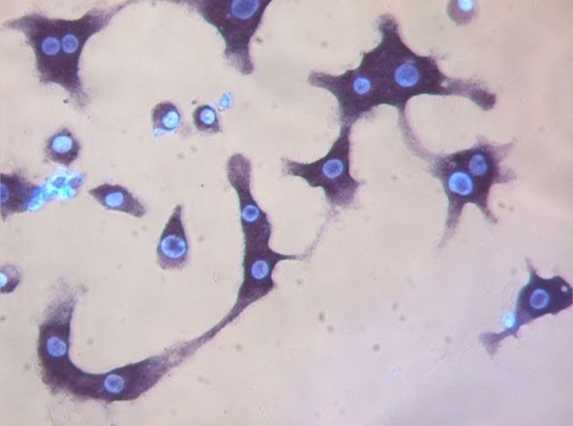
0.8 mM
0.4 mM
100 μm
100 μm
0.08 mM
0 mM
100 μm
100 μm
(Belluci et al. 2013)

Slide 13
***P<0.001
**p≤0.01
***P<0.001
**p≤0.01
**p≤0.01
***P<0.001
*p<0.05
(Belluci et al. 2013)

Slide 14
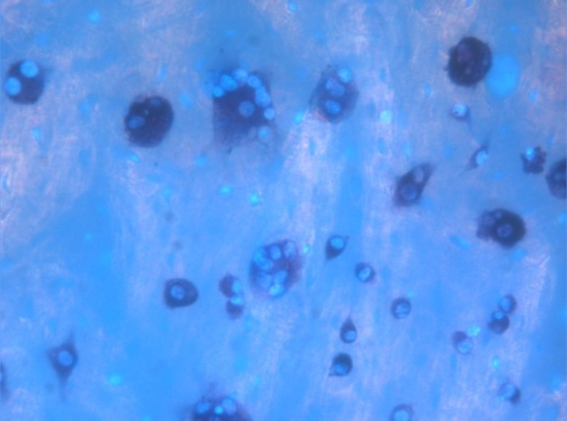
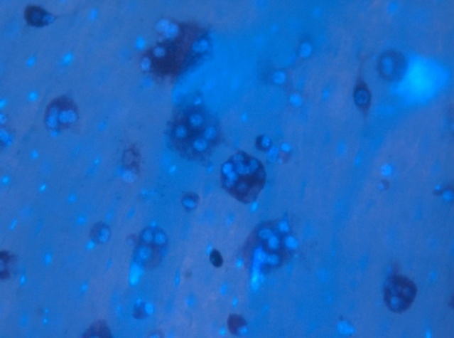
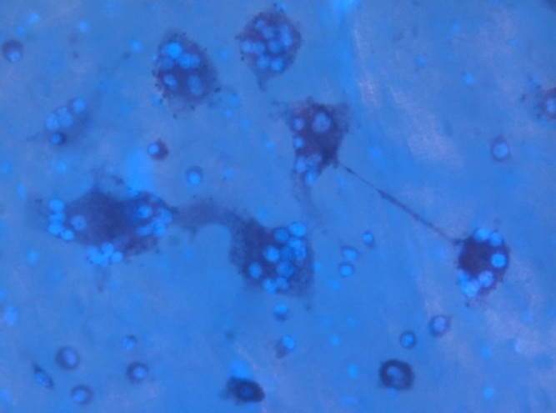
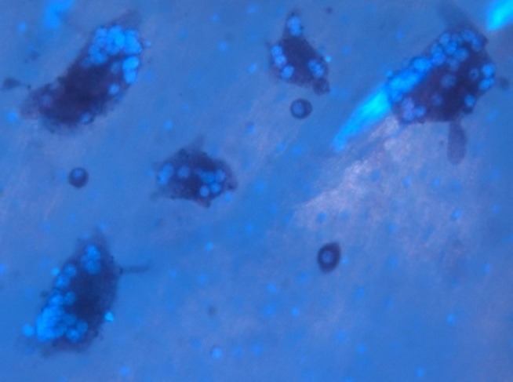
A)
0.8 mM
0.4 mM
100 μm
100 μm
0.08 mM
0 mM
100 μm
100 μm
(Belluci et al. 2013)

Slide 15
**P<0.01
*p≤0.05
*P<0.05
*p≤0.05
**P<0.01
(Belluci et al. 2013)

Slide 16
*
(Belluci et al. 2013)

Slide 17
Viability
Proliferation
(Belluci et al. 2013)

Slide 18
Cells cultured on Plastic
Cells cultured on bone
(Belluci et al. 2013)

Slide 19
PCR
(Belluci et al. 2013)

Slide 20
Resorption Pit Assay
A)
B)
TRAP Enzymatic Assay
C)
D)
(Belluci et al. 2013)

Slide 21
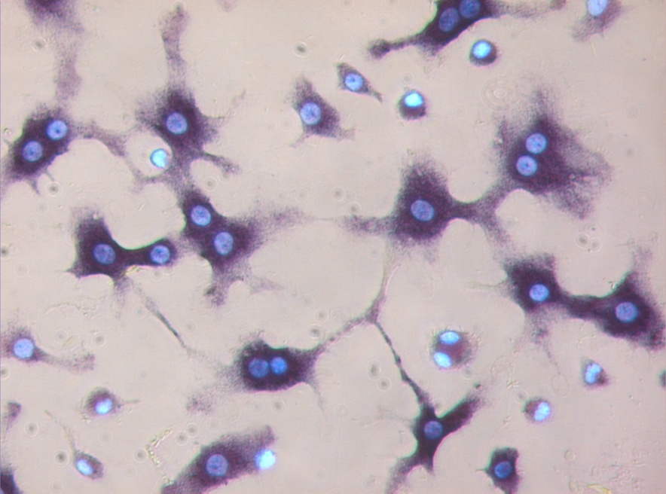
Conclusion:
Mg deficiency promotes osteoclastogenesis
Magnesium deficiency did not interfere on the viability and the proliferation rate of the precursors cells
During Mg deficiency the number of osteoclast is higher but they are less active.

Slide 22
In Vivo study
Aim:
To evaluate the relevant role played by magnesium in the inflamatory process and bone metabolism.

Slide 23
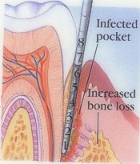
Periodontal disease
Definition
Periodontitis is a multifactorial inflammatory disease initiated and maintained by microorganisms of the dental biofilm, which affects the supporting structures of the teeth. In spite of its infectiuos nature, behavioral, genetic and host-related factors ultimately determine the severity, suceptibility and progression of the disease.
Kinane et al., 2007; Meisel et al., 2005
In industrialized countries, it is estimated that from 30 to 50% of adult population suffers from some form of periodontal disease.
Meisel et al., 2005

Slide 24
CEEA – 20/2006
Holtzman rats
180g
(n=30)
CTL: Standard Mg content (n=15)
Mg: 90% of Mg reduction (n=15)
Diet
INGREDIENTS | AIN – 93 M (g/kg diet)
Cornstarch | 465.69
Casein (>85% protein) | 140.00
Dexistrinized cornstarch(90-94% tetrasaccharides) | 155.00
Sucrose | 100.00
Soybean oil (no additives) | 40.00
Fiber | 50.00
Mineral Mix (AIN-93G-MX) | 35.00
Vitamin Mix(AIN-93-VX) | 10.00
L-Cystine | 1.80
Choline Bitartrate(41.1% choline) | 2.50
Tert-butylhydroquinone | 0.014
Reeves, 1997

Slide 25
Tabela 2: Mineral mix (AIN – 93M – MX)
INGREDIENT (g ou mg/kg) | CONTROL | Mg 1 | Mg 2
Carbonato de cálcio anidro (40.04% Ca) | 357.00 | 357.00 | 357.00
Fosfato de potássio monobásico (22.76% P, 28.73% K) | 250.00 | 250.00 | 250.00
Citrato de potássio, tripotássico monohidratado (36.16% K) | 28.00 | 28.00 | 28.00
Cloreto de sódio (39.34% Na, 60.66% CI) | 74.00 | 74.00 | 74.00
Sulfato de potássio (44.87% K, 18.39% S) | 46.60 | 46.60 | 46.60
Oxido de magnésio (60.32% Mg) | 24.00 | 6.00 | 2.40
Citrato férrico (16.5% Fe) | 6.06 | 6.06 | 6.06
Carbonato de Zinco (52.14% Zn) | 1.65 | 1.65 | 1.65
Metassilicato de sódio 9H₂O (9.88% Si) | 1.45 | 1.45 | 1.45
Carbonato de manganês (47.79% Mn) | 0.63 | 0.63 | 0.63
Carbonato cúprico (57.47% Cu) | 0.30 | 0.30 | 0.30
Sulfato de cromo potássio 12H₂O (10.42% Cr) | 0.275 | 0.275 | 0.275
Ácido Bórico (17.5% B), mg | 81.5 | 81.5 | 81.5
Fluoreto de sódio (45.24% F), mg | 63.5 | 63.5 | 63.5
Carbonato de níquel (45% Ni), mg | 31.8 | 31.8 | 31.8
Cloreto de lítio (16.38% Li), mg | 17.4 | 17.4 | 17.4
Selenato de sódio anidro (41.79% Se), mg | 10.25 | 10.25 | 10.25
Iodato de potássio (59.3% I), mg | 10.0 | 10.0 | 10.0
Paramolibdato de amônio 4H₂O (54.34% Mo), mg | 7.95 | 7.95 | 7.95
Vanadato de amônio (43.55% V), mg | 6.6 | 6.6 | 6.6
Sacarose | 209.806 | 209.806 | 209.806
Reeves, 1997

Slide 26
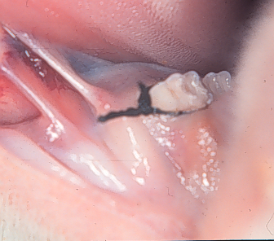
Study design
Analyzed Parameters
Groups:
CTL
10% Mg
Serum levels
MicroCT
Immunohistochemistry
Magnesium
Calcium
Lower left first molar (DP)
Lower right first molar (CTL)
Lumbar Vertebra
Mandible
Split mouth
study design
0
60
90
Day
Procedure
Diet with reduction of Mg
Placement of ligature (Periodontitis)
Sacrifice
(Belluci et al. 2010)

Slide 27
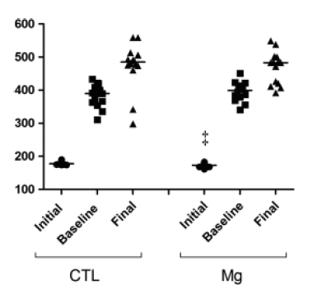
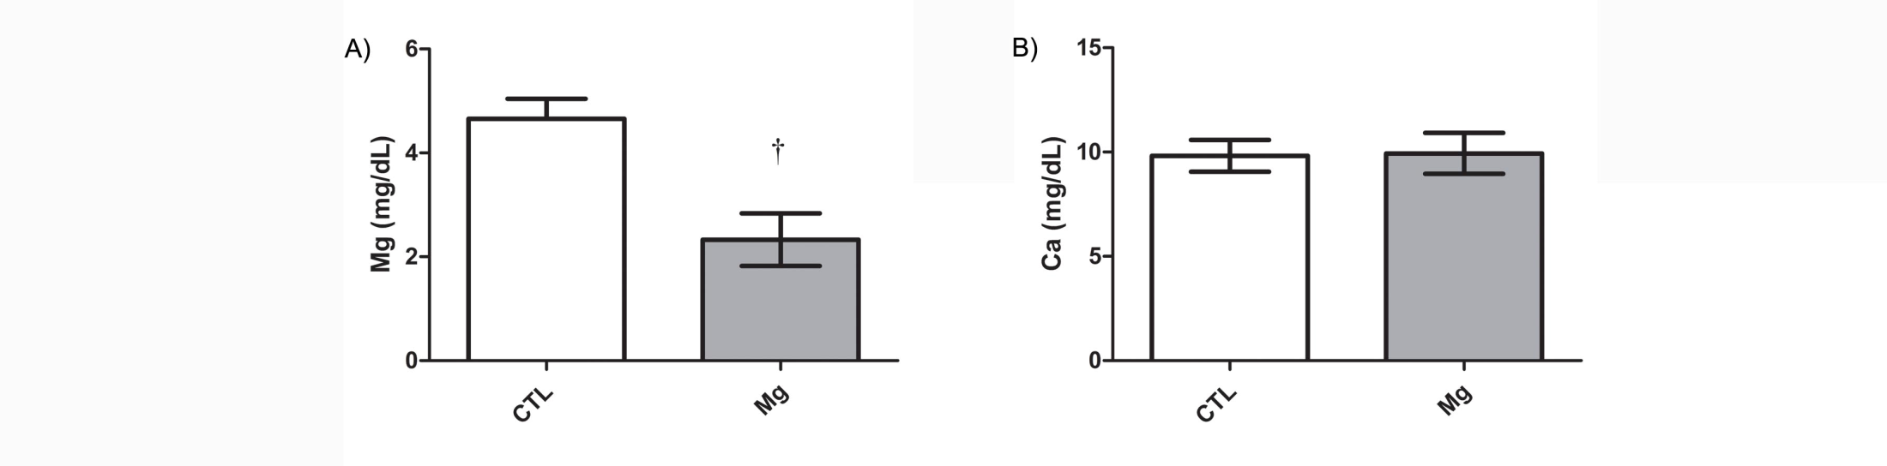
Animal weight
Initial
Initial
Final
Final
Serum levels
Belluci et al. 2010

Slide 28
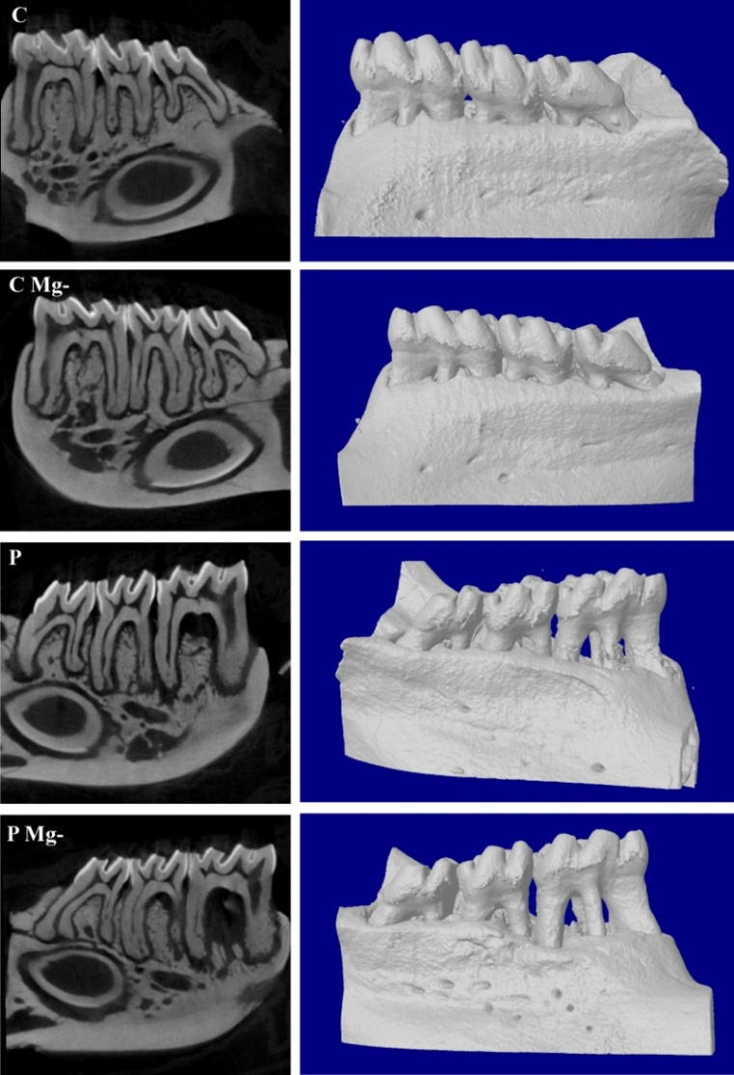
MicroCT - mandible
CTL
CTL – Mg-
PD
PD – Mg-

Slide 29
MicroCT
Femur

Slide 30
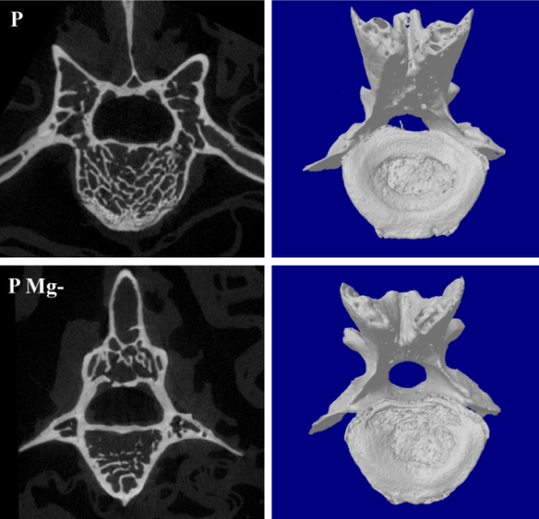
MicroCT – Lumbar vertebra

Slide 31
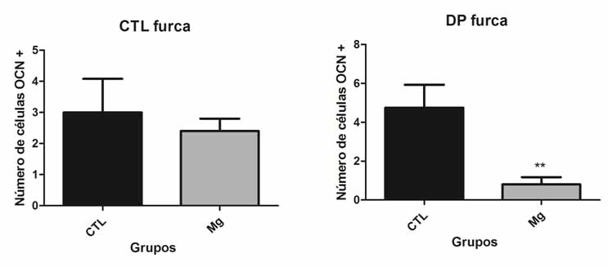
Immunohistochemistry
Health site
Periodontal disease site

Slide 32
Conclusion:
Mg deficiency increases the severity of alveolar bone loss induced by experimental periodontal disease, suggesting that magnesium plays a role not only in bone homeostasis but also in the modulation of bone turn over associated with immunoinflammatory process

Slide 33
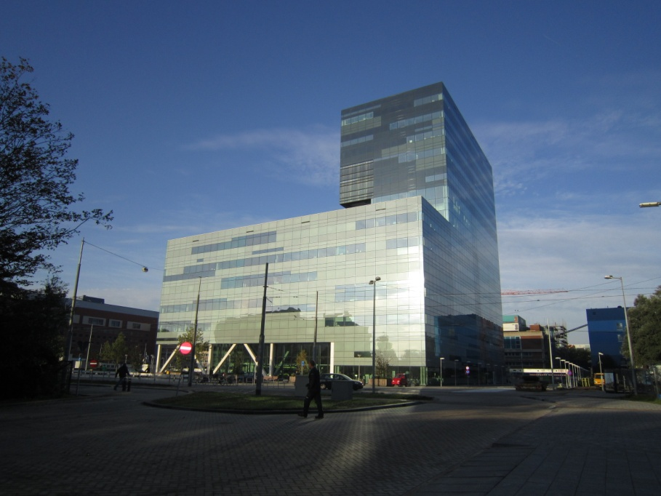
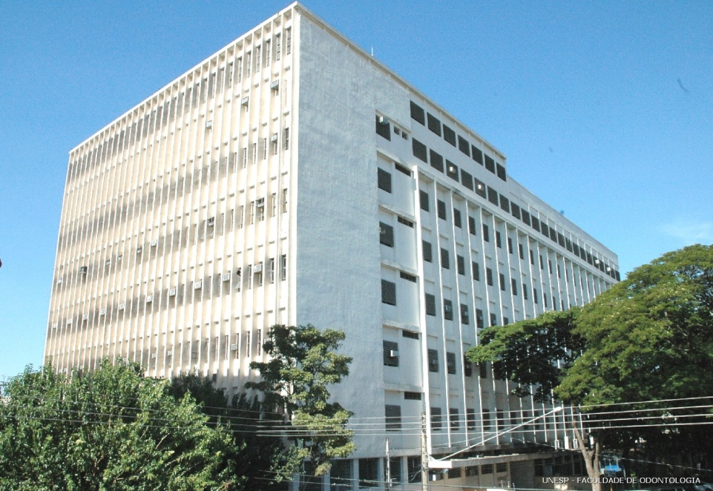
Acknowledgments
Oral Cell Biology Department - ACTA
Department of Diagnosis and Surgery - UNESP
Silvana Regina Perez Orrico
Carlos Rossa Junior
Elcio Marcantonio Junior
Paulo Cerri
Vincent Everts
Teun de Vries
Ton Schoenmaker
bellucimarina@hotmail.com

