Slide 1
“TOTAL PANCREATECTOMY FOR THE TREATMENT OF PANCREATIC NEOPLASM, WHEN IS INDICATED?”
Prof. Flavio Antonio de Sá Ribeiro
flavioasribeiro@bol.com.br

Slide 2
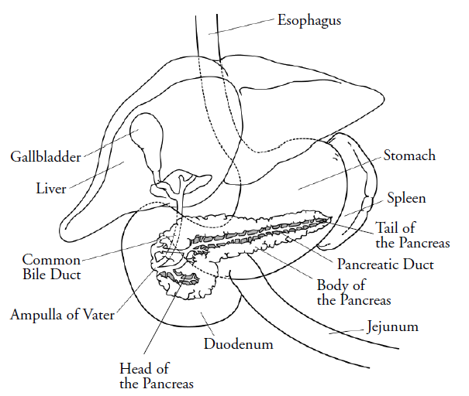

Slide 3
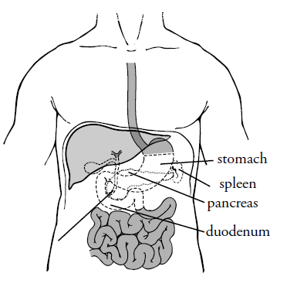
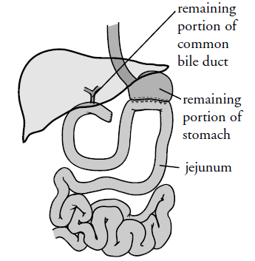

Slide 4
Total Pancreatectomy
Key Points
Poor outcomes in pancreatic cancer;
Has long been associated with high morbity and mortality;
Associated with difficulties in diabetes management.

Slide 5
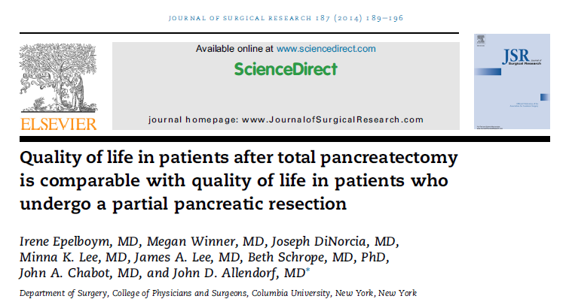
Total Pancreatectomy

Slide 6
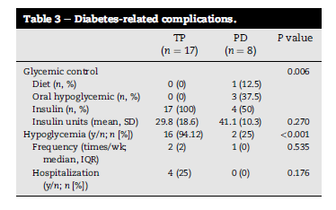
Total Pancreatectomy

Slide 7
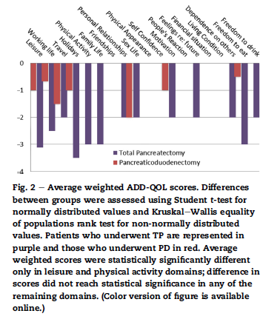

Slide 8
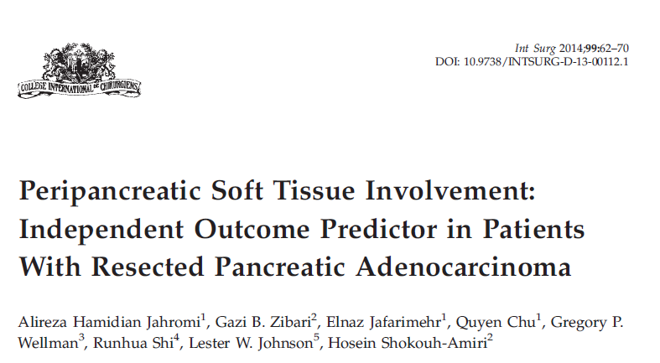
Total Pancreatectomy

Slide 9
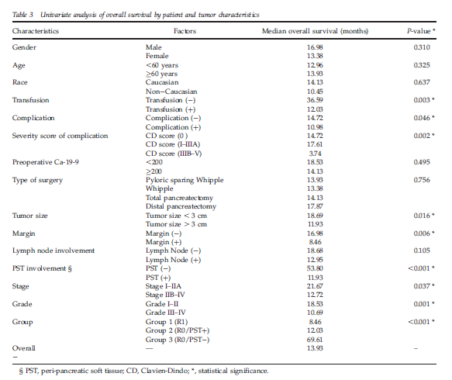

Slide 10
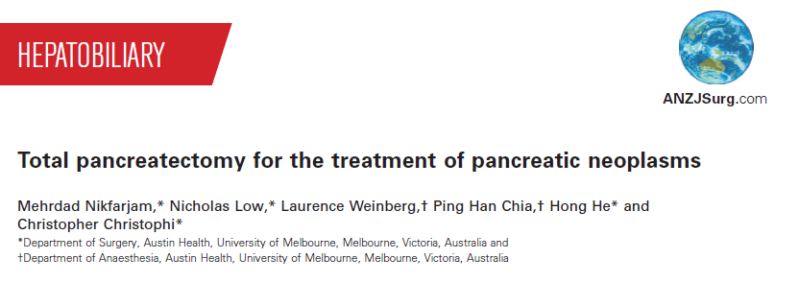

Slide 11
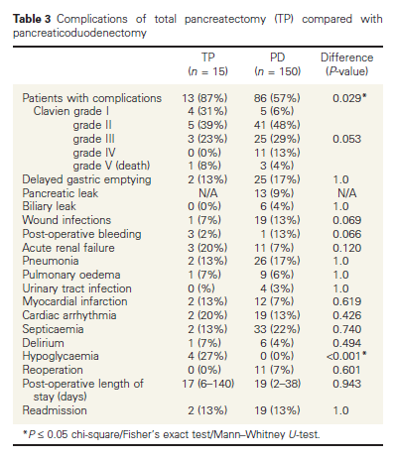

Slide 12
Total Pancreatectomy
Bahra e Neuhaus, em Nature Rewiews / Gastroenterology & Hepatology, volume 7, 2010.
“Is There Still a role for total Pancreatectomy?”
19,9% (WP) e 18,5% (TP).
No pancreatic leak.
No risk for multicentre disease in pancreas.

Slide 13
Total Pancreatectomy
Microscope disease can be found in the section margin or in peripancreatic (fat) tissue.
R1 resection – worst prognoses.
Margin < or = 1mm – R1.
R0 – R1 (79 a 44%).
N related to prognoses.

Slide 14
Total Pancreatectomy
Indications of TP:
Margin compromising.
Fragility of pancreatic tissue.
Cystic Tumours.
IPMNs

Slide 15
Total Pancreatectomy
Bhayani and cols., J.Gastrointest. Surg.(2014) 18:549-554.
“Perioperative Outcomes of Pancreaticoduodenectomy to Total Pancreatectomy for Neoplasia”

Slide 16
Total Pancreatectomy
TP no risck to pancreatic leak.
TP more morbity with endocrino and exocrino insuficience.
High mortality – 6,1% (TP) x 3,1% (WP) (p=0,02).

Slide 17
Total Pancreatectomy
High morbility 38% (TP) x 30% (WP) (p=0,02).
Transfusion 16% (TP) x 10% (WP) (p=0,01).
Infection and sepse are equal.
Pos op morbility is associated a HIPOGLICEMIA.

Slide 18
Total Pancreatectomy
When associated pancreatectomy with other visceral resection we have the double mortality.
Do TP is quite similar to do pancreatectomy with other visceral resection.
In TP we have a decrease of inflamatory response compare WP.

Slide 19
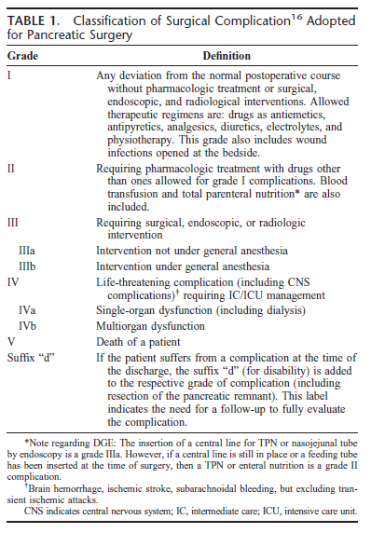

Slide 20
Total Pancreatectomy
Key points:
Continuous infusion of insulin begun in per op.
Regular use of NPH and regular insulin .
Hypoglycemia isn’t usual.
No regular use of pancreatic enzymes.

Slide 21
Total Pancreatectomy
Indications:
Microscopy margin invasion or margin equal or inferior a 1mm.
Multicentre tumors or IPMN.
Pancreas fragility.
Pos op complications associated to remain pancreatic tissue.

Slide 22
Total Pancreatectomy
Surgical considerations:
Spleen is important to move the tail and the body of the pancreas.
In TP the excision of the pancreas begun in the tail to the head.
Remove al peripancreatic tissue – lateral margin.
Section the spleen vein 1 a 0,5 cm before portal junction.
Remove the entire uncinato process.

Slide 23
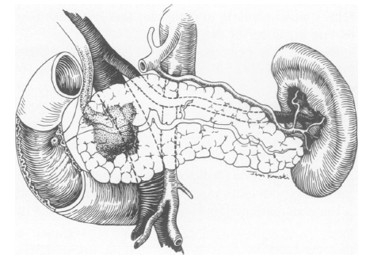

Slide 24
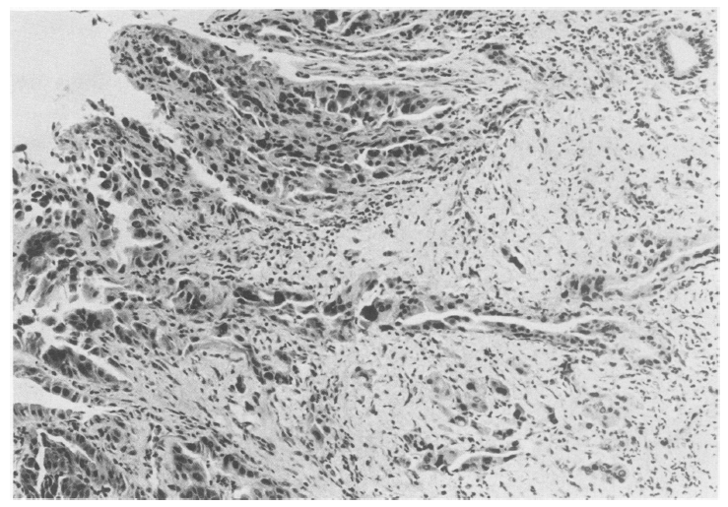

Slide 25
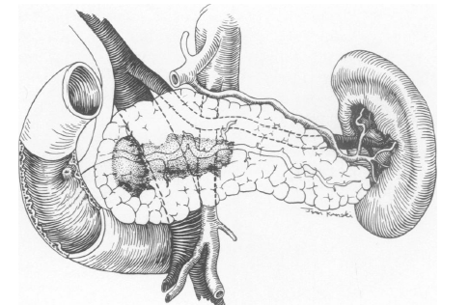

Slide 26
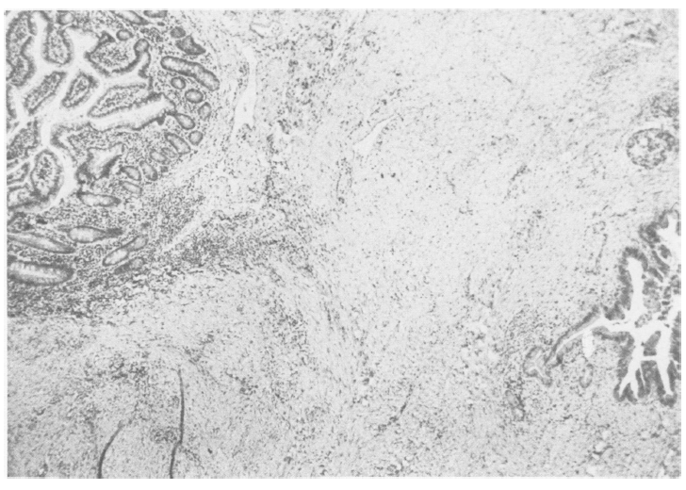

Slide 27
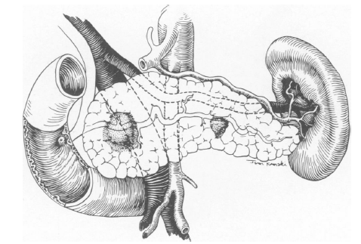

Slide 28
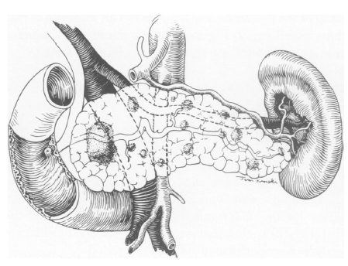

Slide 29
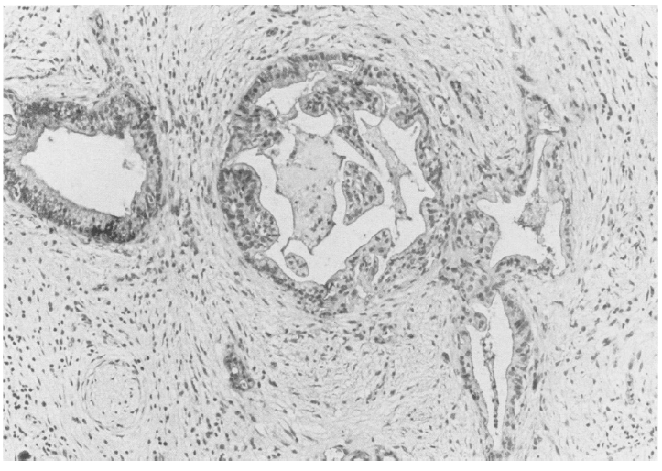

Slide 31
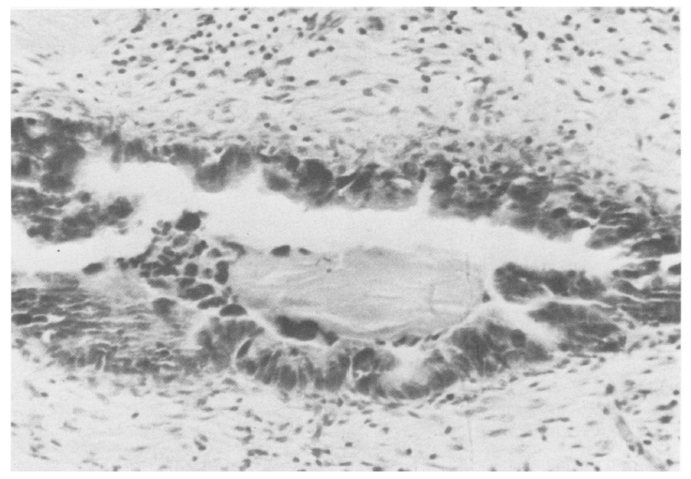

Slide 32
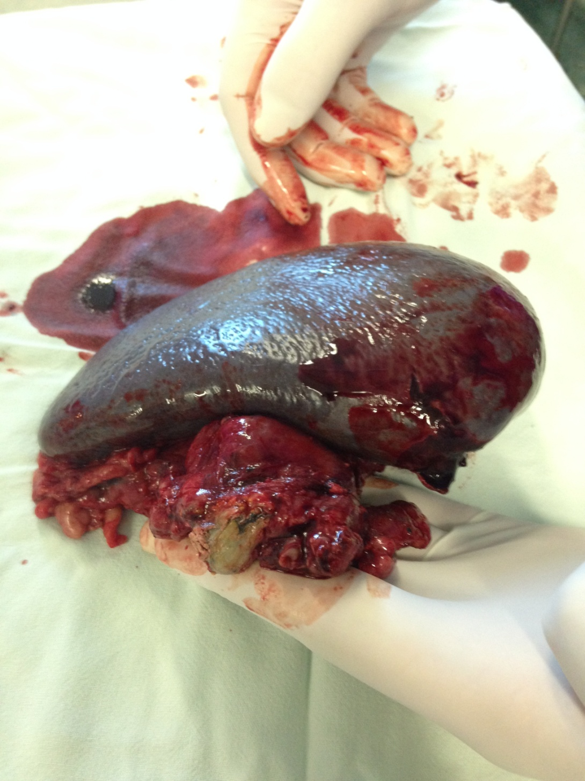
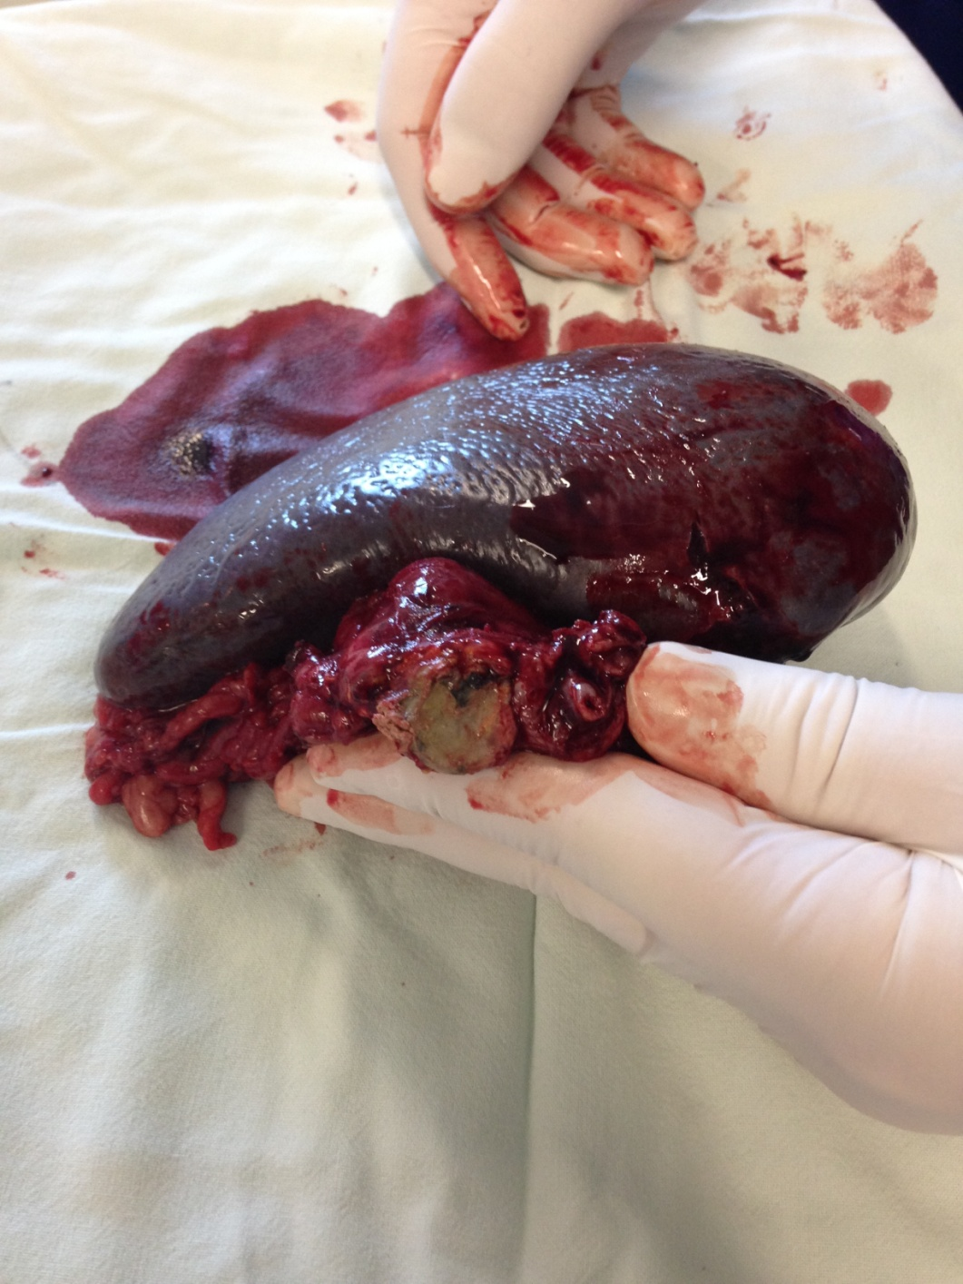

Slide 33
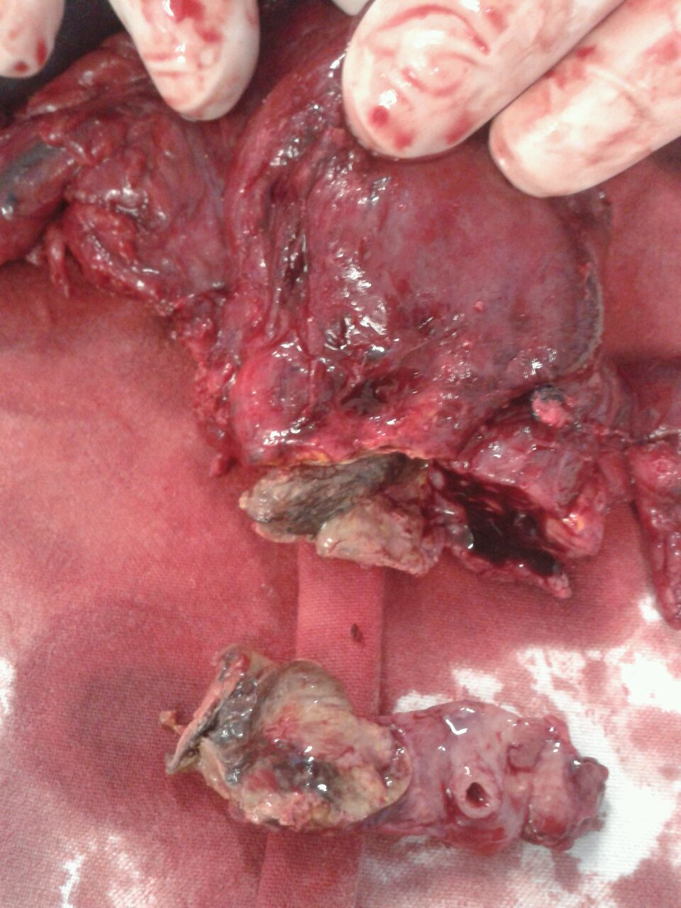

Slide 34
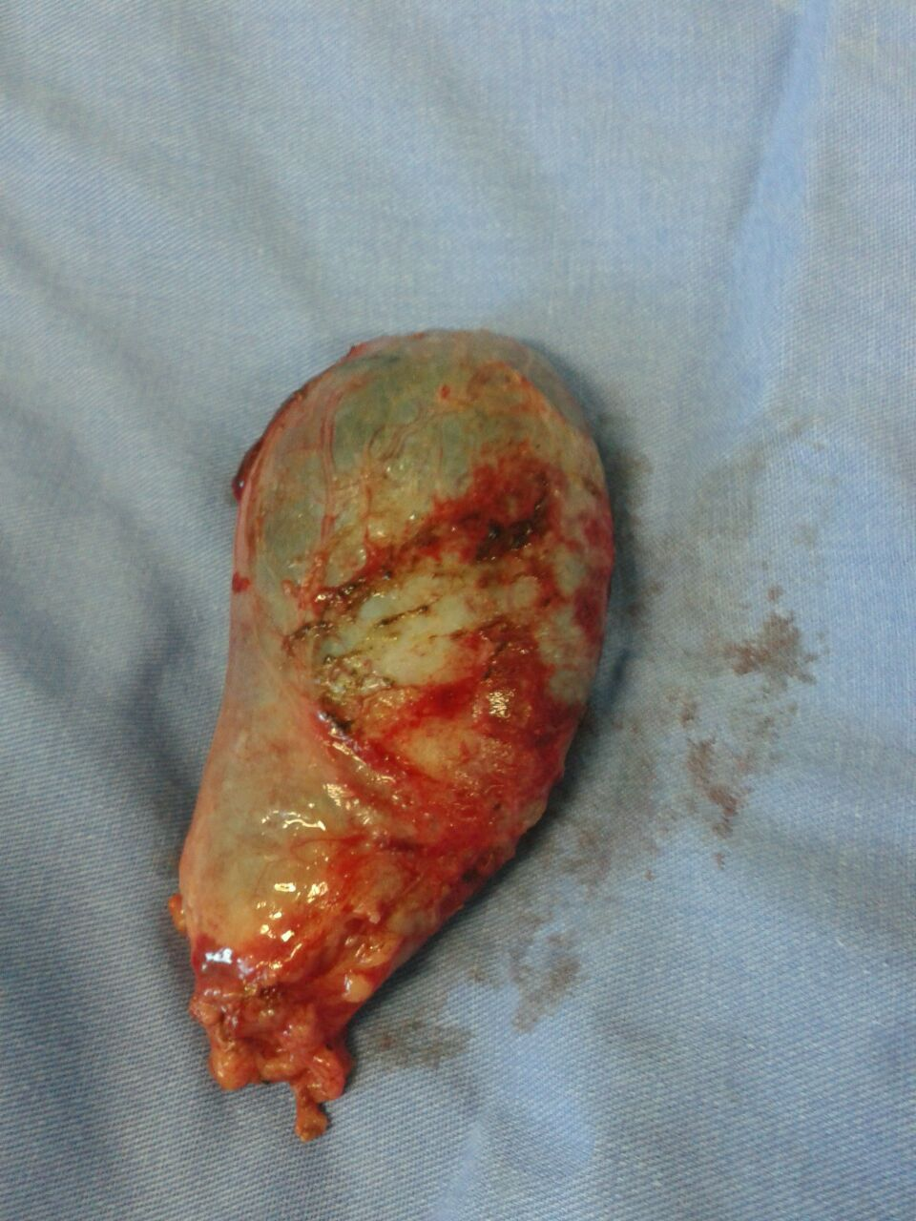
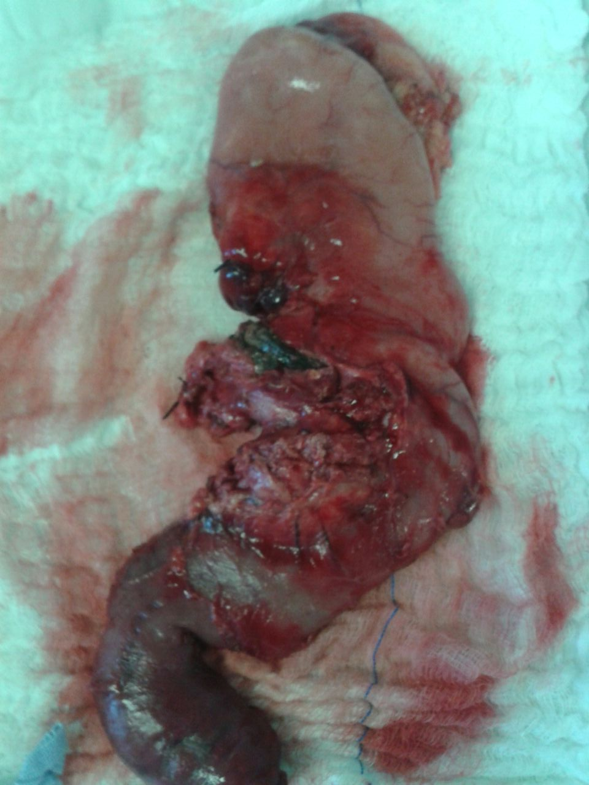

Slide 35
