Slide 1
A PRELIMINARY STUDY of the EFFECT of RUBUS sp. EXTRACTS on THE EXCITATORY and INHIBITORY AMINO ACIDS LEVELS in HIPPOCAMPUS and CEREBRAL CORTEX in RATS.
Maria Rosana Ramirez, PhD, Prof.
¹ Faculty of Pharmacy, Federal University of Rio Grande do Sul, (PoA, RS, Brazil).
^{2.} National Council of Scientific and Technical Research (CONICET-Argentina).

Slide 2
INTRODUCTION
Blackberries (Rubus sp), and are very complex in terms of genetic background, growth characteristics, and number of species.
Blackberries are rich sources of phytochemicals which may impact positively on human health.
However, studies to elucidate the potential therapeutic properties of blackberries have been limited.

Slide 3
INTRODUCTION
Therefore, the present research was focused both on preparation and characterization of polyphenolic extracts from blackberry cultivars grown in Brazil and on investigation of their biological properties.

Slide 4
INTRODUCTION
The total phenolic and anthocyanin content, and total antioxidant capacity were compared.
The major types of flavonoids and anthocyanins were determined.
Furthermore, the whole extract was fractionated and the bioactivity of anthocyanin fraction and whole extract was compared.

Slide 5
INTRODUCTION
These studies can be divided into two parts:
Investigation of possible anti-inflammatory activity in vitro and in vivo.
Evaluation of the effects of extracts on the levels of excitatory and inhibitory amino acids in the brain of rodents subjected to chronic treatment (HPLC, Waters pico tag®) .

Slide 6
Material & Methods
Fruits Rubus sp.
Brazilian Corporation of Agricultural Research
Compositional analyses
Methods Spectrophotometrics
(mg per 100 g of fruit lyophilized)
HPLC Analyses
Biological activities
(in vitro & in vivo)
Paw edema in rats
Amino acids levels in brain of rats
Antichemotactic Assay
Antioxidant activity
Flavonoids Profile
Anthocyanins Profile
Total polyphenolics (Folin-Ciocalteu)
Total Flavonoids
Total anthocyanins (Brazilian Pharmacopoeia, 2003).

Slide 7
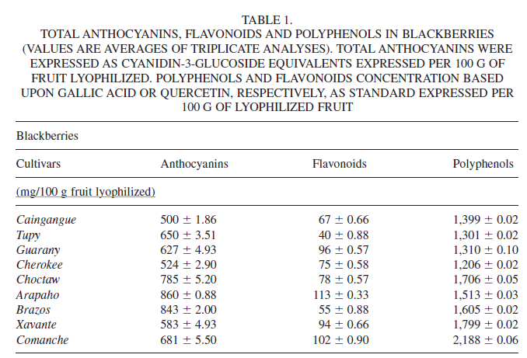
Compositional Analysis

Slide 8
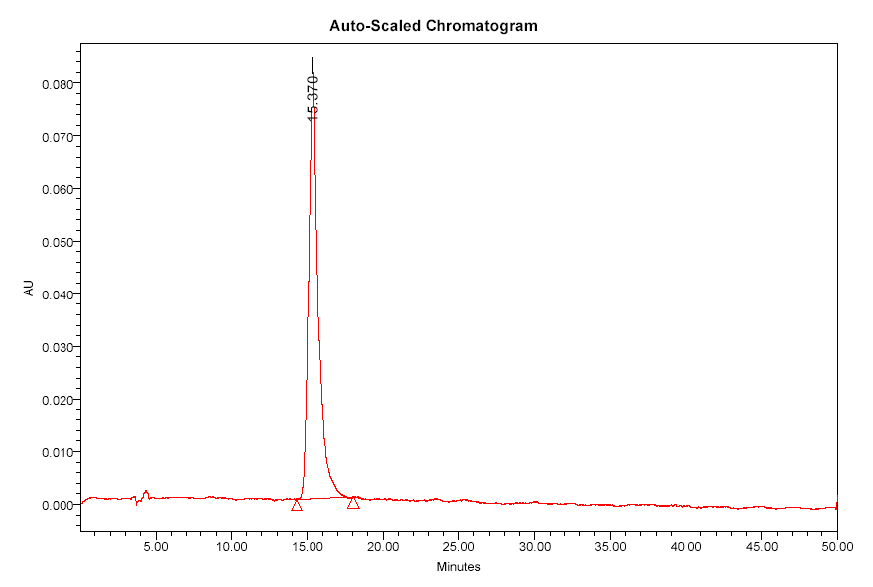
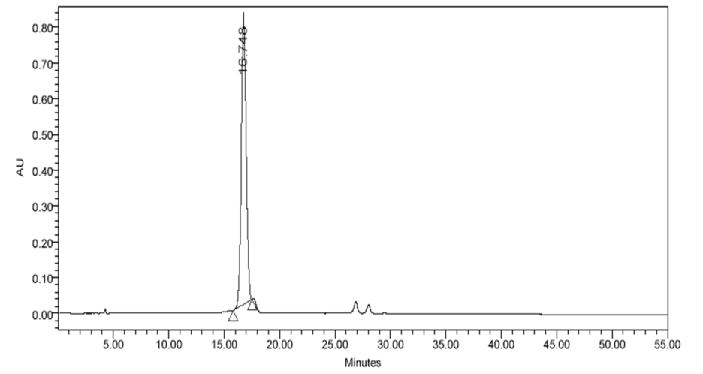
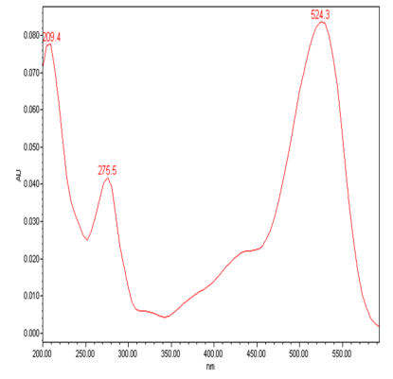
RESULTS
A
B

Slide 9
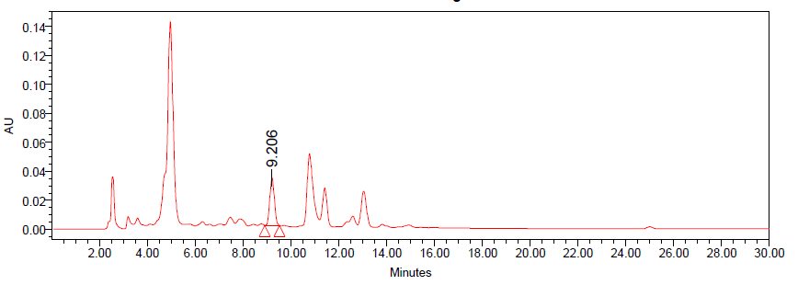
RESULTS
Figure 2. Flavonoids profile

Slide 10
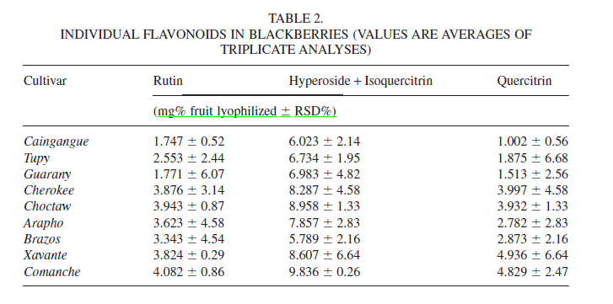
RESULTS

Slide 11
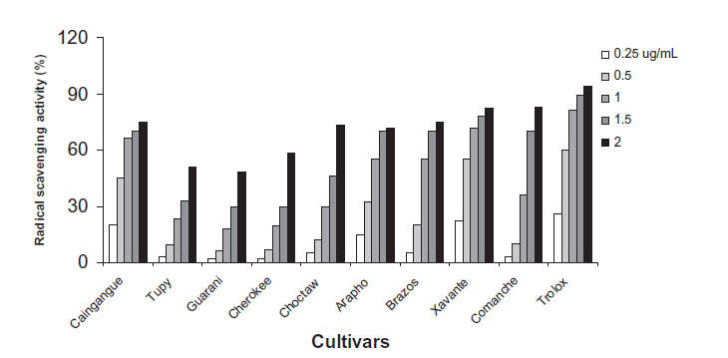
RESULTS

Slide 12
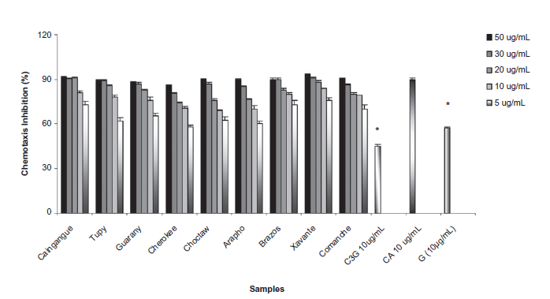
RESULTS

Slide 13
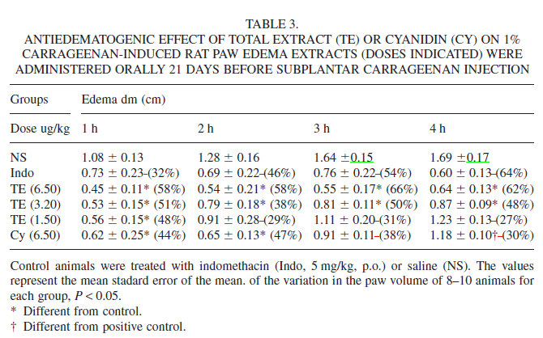
RESULTS

Slide 14
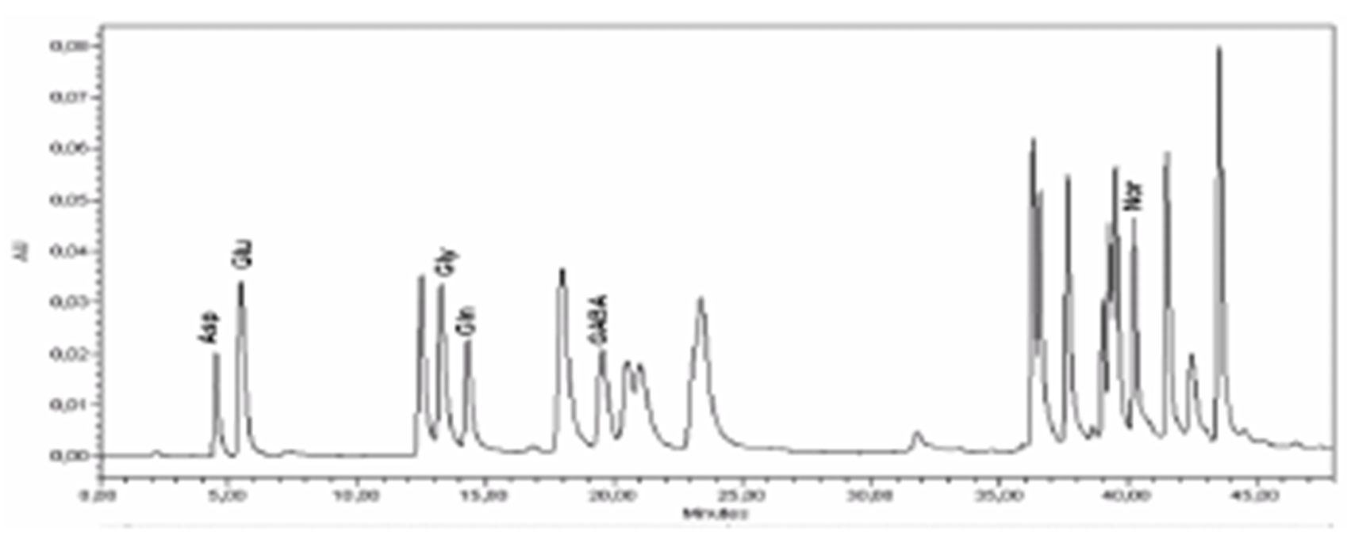
RESULTS

Slide 15
RESULTS
Treatment:
Cyanidin 3 glucoside
Total extract
Hippocampus & Cerebral cortex

Slide 16
CONCLUSION
Extracts were prepared from blackberries grown in Brazil and were shown to possess significant antioxidant, antichemotactic and anti-inflammatory properties.
The anthocyanin fractions were separated and were found to have antichemotactic and antiinflamatory activities.

Slide 17
CONCLUSION
We found that, animals submitted to the treatment with total extract presented an increase of glutamate levels.
However significant decrease on the glutamate levels was observed in both structures of animals treated with cyanidin 3 glucoside isolated.

Slide 18
CONCLUSION
The results suggest that both extracts presents effects on the central nervous system, since the treatment caused alterations on the amino acids levels in the hippocampus and cerebral cortex in rats.
In addition, we gain more knowledge on tissue disposition of phytochemical polyphenolics.

Slide 19
Thanks
for your interest in my work!
ACKNOWLEDGMENTS: This study was supported by CNPq-UFRGS, Brazil.

