Slide 1
DNA vaccination against drug resistance in chronic viral infections, example of HIV-1
Isaguliants Maria
Department of Microbiology, Tumor and Cell Biology, Karolinska Institutet, Stockholm, Sweden;
A. Kirhenstein Institute of Microbiology and Virology, Riga Stradins University, Riga, Latvia

Slide 2
BACKGROUND
Highly Active Antiretroviral Therapy (HAART) dramatic change Death from AIDS-related diseases reduced significantly
How long clinical benefit will last? the emergence of multiple drug-resistant viral strains (drHIV) primary infections with drHIV failures on HAART regimens
Immune response limits HIV-1 replication. Elite controllers! Under HAART – no antigen stimulation - loss of anti-HIV immune response
Urgent task – to exert an additonal non-drug pressure on HIV-1 to reduce its capacity to develop resistance CREATE A ”BOTTLE NECK” EFFECT
long term non-progressors. Both elite controllers and non-progressors purtain strong cellular response to HIV which limits viral replication
CONCEPT - complement HAART with an immune pressure!

Slide 3
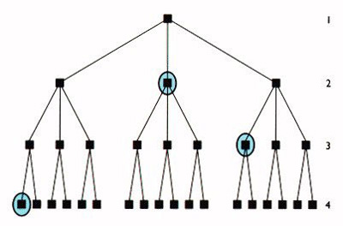
AIM
Prevent or hinder development of drug resistance in HIV-infection by therapeutic vaccination
preceding or parallel to HAART
Immune prevention of primary DR mutations to
hamper the whole process of drug resistance development

Slide 4
TASKS:
Selection of antigens responsible for resistance – HIV enzymes, gp41.
Selection of genetic background – HIV1 FSU-A
Consensus approach to design of antigens
Genetic engineering of plasmid vectors
Modification of antigens by introduction of primary drug resistance mutations
Efficient protocols for DNA delivery for preclinical trials
Preclinical trials, also on the background of treatment with antiretroviral drugs

Slide 5
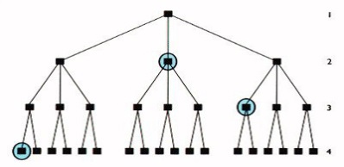
DESIGN OF IMMUNOTHERAPEUTICALS
Choice of components
Antigens involved in HIV resistance – primarily HIV ENZYMES
Design principles:
consensus sequence
primary DR mutations
enzyme inactivation for safety
HIV-1 subtype A prevalent in Russia and FSU
Block appearance of early mutations – hamper the whole process
Introduce mutations abrogated enzymatic activity

Slide 6
DESIGN OF IMMUNOTHERAPEUTICALS
Choice of vaccine vehicle - naked DNA
PLASMID BACKBONE
pVax 1 (Invitrogen)
HIV ENZYME GENES
Consensus HIV-1 subtype A
Codon-optimized to increase expression
ENZYME GENE
MULTI-GENE SET GENERATED: RTPRIN-A
- Reverse Transcriptase;
- Protease;
- Integrase HIV subtype A
Notes:
Genetic vaccine based on plasmid DNA
Plasmid encodes viral antigen of choice
Antigen is expressed in the vaccine recipient; correctly processed and folded. No need in expression/purification
Elicites B and T cell response as attenuated viral vaccine, but totally safe /not virulent
Standard plasmid manufacture from bacteria
Highly stable over long period of time
No cold chain in storage /distribution
Effective methods of vaccination

Slide 7
DESIGN OF IMMUNOTHERAPEUTICALS: example of protease
HIV-1 Protease
Cleaves Gag and Pol polyproteins into mature forms
Major target of antiretroviral therapy
Protease inhibitors (PIs) bind active site
Long-term effectiveness limited due rapid viral evolution, leading to proteases with drastically lower affinity to the drugs
Louis et al. 2011
Notes:
Red circles are drug resistance mutations

Slide 8
DESIGN OF IMMUNOTHERAPEUTICALS: sequence selection
HIV-1 FSU-A Protease amino acid sequences from treatment-naïve patients were selected from databases (Los Alamos, Genbank).
Athina Kilpeläinen, HOV Nordic 2014

Slide 9
DESIGN OF IMMUNOTHERAPEUTICALS: creation of consensus
Consensus protein sequence
Consensus sequences built on 1996-2003 and 2000-2011 selections were 100% identical
Consensus adequately represent FSU-A PR in (some) years to come
PR_A consensus
PR_B consensus
PR_B (HXB2)
Notes:
http://hivdb.stanford.edu/DR/asi/releaseNotes/index.html for consensus B seq

Slide 10
DESIGN OF IMMUNOTHERAPEUTICALS: selection of DR mutations
Selection of drug resistance mutations:
A set of primary DR mutations 46I, 54V and 82
http://hivdb.stanford.edu/cgi-bin/PositionPhenoSummary.cgi

Slide 11
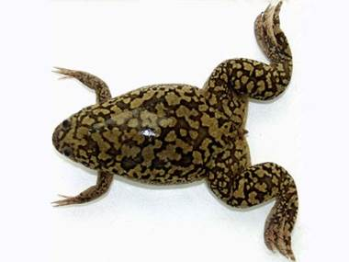
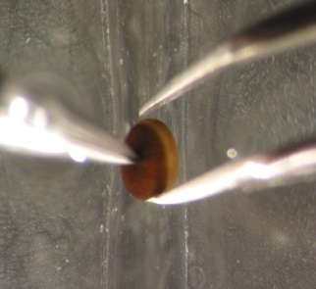
Immunogens: In vitro, cell line tests
PR_A and PR_Ai are expressed in oocytes of X laevis
Notes:
Homogenized by pipetting and separated by centrifugation pbs. Put in amounts loaded. Draw a slide about 14C and oocytes.

Slide 12
Immunogens: Evolution of RT-based immunogens
Modification of HIV-1 reverse transcriptase gene
Modification | Codon Optimization | Enzyme inactivation | Drug Resistance
RT wt | - | - | -
RT wt opt | + | - | -
RT wt opt-in | + | + | -
RT 1.14 | - | - | +
RT 1.14 opt | + | - | +
RT 1.14 opt-in | + | + | +

Slide 13
PRECLINICAL PERFORMANCE OF VACCINE COMPONENTS
DNA-immunization protocol
GENE Injection + Electroporation
Say those are BALB/c mice, but we have also data for C57BL/6
DAY -4
DAY 0
DAY 21
COLLECTION OF PREIMMUNE SAMPLES
COLLECTION OF HYPERIMMUNE SAMPLES (SERA, splenocytes)
SAMPLE ANALYSIS: ELISA, ELISpot, FLUOROSpot, FACS

Slide 14
DELIVERY
Optimized protocol of vaccine delivery
Needle injection
Electroporation over the injection site
most commonly used
1000-times enhanced gene delivery & expression
100-times enhanced immune response
widely used in clinical trials

Slide 15
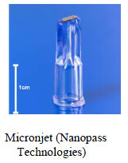
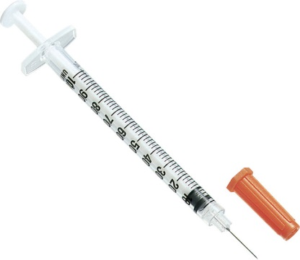
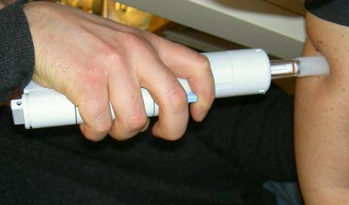
DELIVERY
Optimization of gene delivery – vaccine inoculation
29G needles OR
Microneedles
Biojector
(delivery by gas pressure)
Optimization of gene delivery - electroporation
Petkov SP, Heuts F, Krotova OA, Kilpelainen A, Engström G, Starodubova ES, Isaguliants MG. Hum Vaccin Immunother. 2013 Jul 3;9(10). Evaluation of immunogen delivery by DNA immunization using non-invasive bioluminescence imaging
Notes:
15

Slide 16
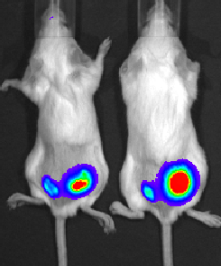
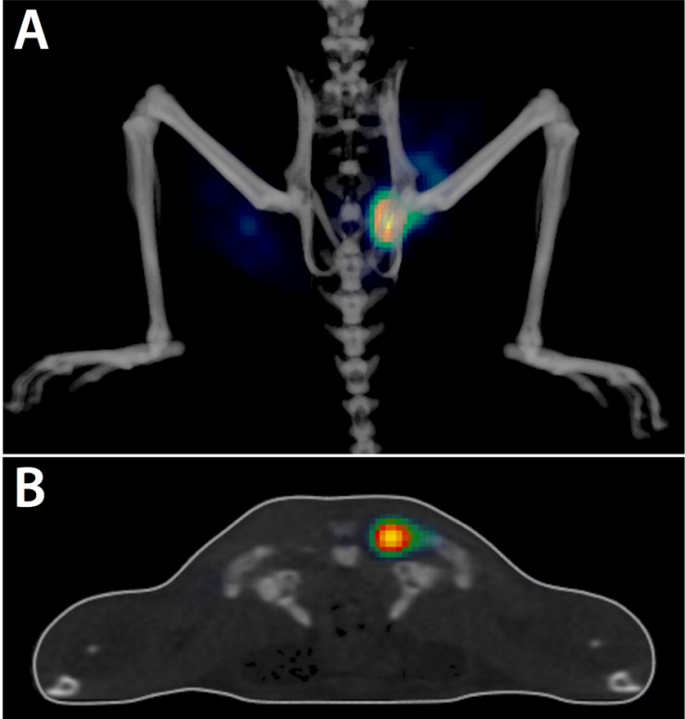
DELIVERY IN PRECLINCALS
Optimization of plasmid delivery
Immunization of BALB/c mice with viral DNA mixed with DNA encoding Luciferase followed by in vivo imaging
2D- and 3D-imaging quantifies gene delivery with each injection

Slide 17
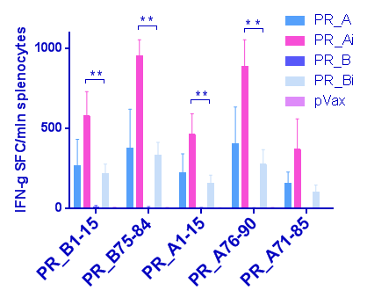
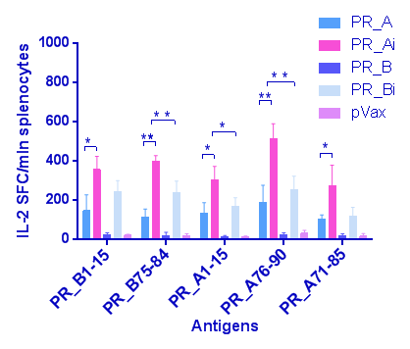
Immunogenicity of candidate immunotherapeuticals in mice
Inactive consensus protease of HIV FSU-A was highly immunogenic in BALB/c mice
PR-specific secretion of IFN-γ/IL-2 by splenocytes of PR_Ai gene immunized mice. DR variants of PR_Ai are under trial
IFN-γmln splenocytes
IL-2mln splenocytes
Notes:
The first 2 peptides are PR_B peptides and the three remaining PR_A
PR_Ai induced significantly higher responses than PR_Bi.
PR_A induced specific immune responses comparable to PR_Bi.

Slide 18
PRECLINICAL PERFORMANCE OF VACCINE COMPONENTS
Immune response in BALB/C mice after one immunization
FOR T-cells:
Add parental non-mutated genes:
RT – no dual spots; PR – show what David has shown (no matter that it was after 2 injections; IN – show for IN_in MAKE THEM LIGHT-GREY
T-cell response
Dual IFN-g/IL-2 production
(Fluorospot)
Humoral response
IgG and IgA titers
(ELISA)
Starodubova E. Et al Mol Imaging 2012; Isaguliants M et al, Human Vaccines & Immunotherapeuticals 2013; Hallengärd D et al, Vaccine 2011; Krotova OA et al, PLoS One 2013

Slide 19
SUMMARY ON WHAT WE OFFER TO DEVELOP FOR THERAPEUTIC USE
PROTOTYPE VACCINE COMPONENTS
Plasmids encoding HIV enzymes
reverse transcriptase, protease and integrase that are:
contain primary mutations of drug resistance;
no enzymatic activity;
consensus sequence of subtype A and B (region specific).
Plasmids tested for expression in cell culture and mouse tissues
DELIVERY METHOD
Effective protocols of needle injections followed by electroporation
STRONG IMMUNOGENIC PERFORMANCE IN PRECLINICALS
All components induce strong polyfunctional immune response in rodents; Rabbit experiments are on-going.

Slide 20
Only one study with a success in a prevention trial – LEARN BY HEAR THE NAME AND WHICH VACCINE THEY USED!
More and more effort into therapeutic trials. HIV looked upon as a chronic disease which needs to be treated! Ours – in lines with others.
BUT - Many therapeutic HIV vaccine trials aimed at induction of immune response which would limit overall viral replication – but this can be demonstrated ONLY IN THE ABSENCE OF HAART (when HIV can openly replicate)
TO PERFORM OUR TRIAL/REACH DESIRED OUTCOME we do not need to stop treatment
SUMMARY ON WHAT WE OFFER TO DEVELOP FOR THERAPEUTIC USE
OUTLINE FOR A CLINICAL TRIAL:
Standard in therapeutic HIV-1 vaccine trials:
Immunization → Drug treatment off → Measure viral loads
Structured Therapy Interruption (STI) can be harmful!
We suggest: No unsafe procedures
Therapeutic immunization + HAART, NO STIs → Measure frequency of drug-resistance conferring mutations
Notes:
Recrutiment: HIV patients naive to therapy with no/low antibody and cellular response to HIV enzymes
Trial: 2-3 rounds of immunization; on-start of HAART (combination of 3 inhibitors targeting 2 of 3 HIV enzymes); booster; regular blood (serum, PBMC) sampling, sequencing of mutation-prone regions in HIV enzyme genes.
Primary objective: Safety
Primary outcome: proof of safity/absence of adverse side-effects
Secondary objective #1: Immunogenicity
Secondary outcome #1: Induction of cellular and antibody immune response against HIV enzymes
Secondary objective #2: Decrease the incidence of DR mutations in HIV enzymes targeted by HAART.
Secondary outcome #2: Decreased incidence of HAART-induced drug-resistance conferring mutations in HIV enzymes targeted by a 3-drug combination (RT and PR/no IN; or RT and IN/no PR) in immunized compared to mock-immunized patients on the same regimen.
Could be an increased incidence of other mutations (all increased incidence of allover mutations) due to immune pressure. To delineate this, compare the rate of mutations in 3rd HIV enzyme targeted by vaccine but not by HAART (immune-controlled mutations) in vaccinated versus control groups.

Slide 21
ACKNOWLEDGMENTS
Engelhardt Institute of Molecular biology, Moscow, Russia
Elizaveta Starodubova
Anastasia Latanova
Vadim L Karpov
Yulia Kuzmenko
Ivanovsky Institute of Virology,
Moscow, Russia
Olga Krotova
Oleg Latyshev
Olesya Eliseeva
Karolinska Institutet,
Stockholm, Sweden
Stefan Petkov
Athina Kilpeläinen
David Hallengärd
Per Warholm
Britta Wahren
Grants of the Swedish Research Fund 2012-2015; Thematic partnership grant of the Swedish Institute 2013-2016; EU project BALTINFECT 2013-2016; Russian Fund for Basic Research 2013-2015.

Slide 22
THANK YOU FOR YOUR ATTENTION!

