Slide 1



THE ROLE OF MAST CELL PROTEASES IN TUMOR ANGIOGENESIS
Dr. Maria Célia Jamur
University of São Paulo
Ribeirão Preto Medical School
Department of Cell and Molecular Biology

Slide 2
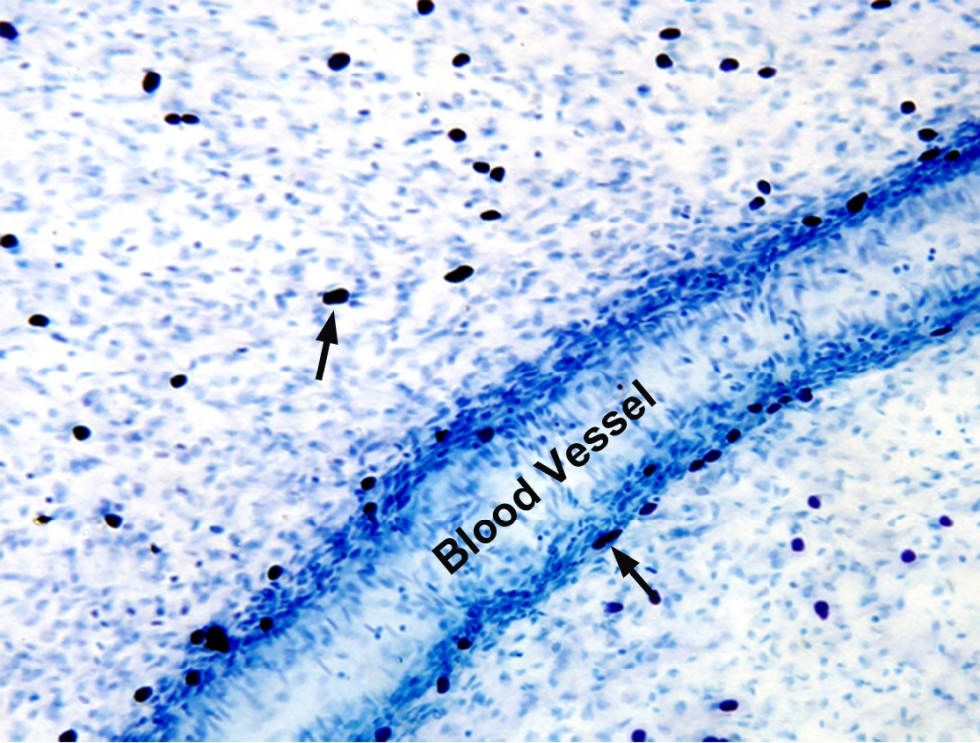
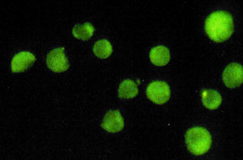
MAST CELLS
Local effector cells of the immune system that participate in :
Defense of the host organism
Inflammatory reactions
Elimination of parasites
Innate immunity against bacterial and viral infections
Allergic reactions
Diseases
Asthma
Diseases of the central nervous system: Alzheimer’s disease
Diseases of the cardiovascular system: Atherosclerosis
Tumor Progression
IgE
EM

Slide 3
MAST CELL FUNCTION IS RELATED TO THE RELEASE OF MAST CELL MEDIATORS
Newly Formed Mediators
Phospholipase A₂ Activation
Chemotactic leukotrienes
Prostaglandins
Thromboxanes
Activating Factors, PAF
FcεRI
Antigen
Preformed Mediators
Granule Release
Histamine
Heparin
Enzymes
Chemotactic factors
Mast cell specific proteases
Newly Synthesized Mediators
Transcription Factor Activation
Growth Factors
Cytokines

Slide 4
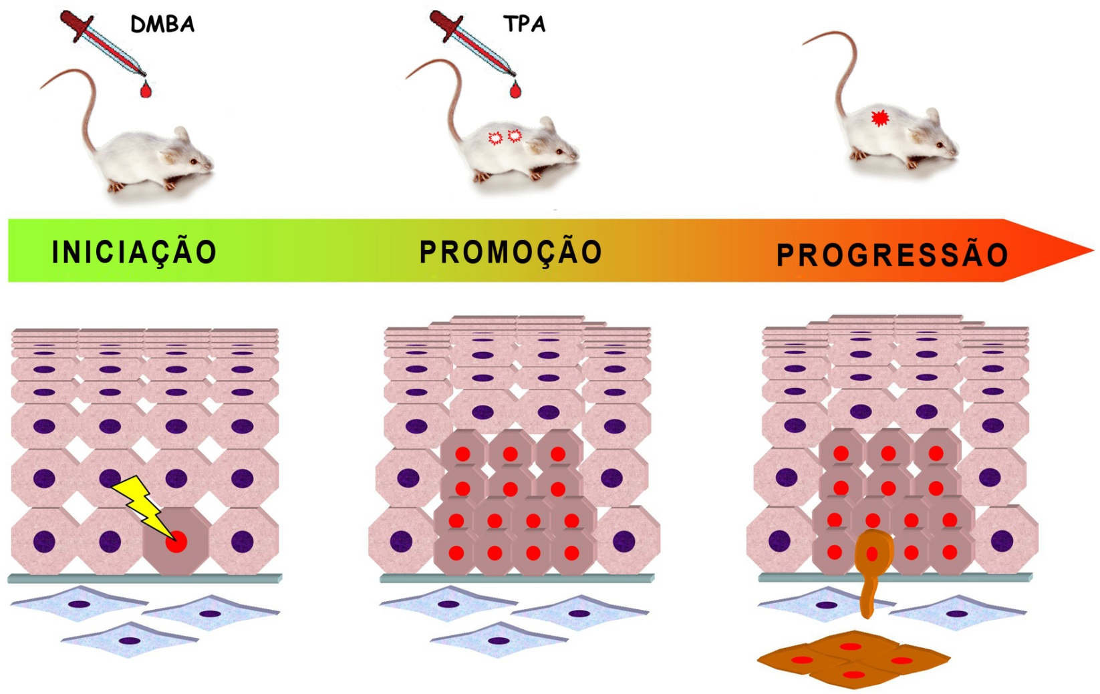
TUMOR INDUCTION
DMBA
TPA
1 week
BALB/c mice
INITIATION
PROMOTION
PROGRESSION
DMBA (7,12-Dimethylbenz(a)anthracene)
TPA (12-O-Tetradecanoylphorbol-13-acetate)
Diagram Modified from the German Cancer Research Center

Slide 5
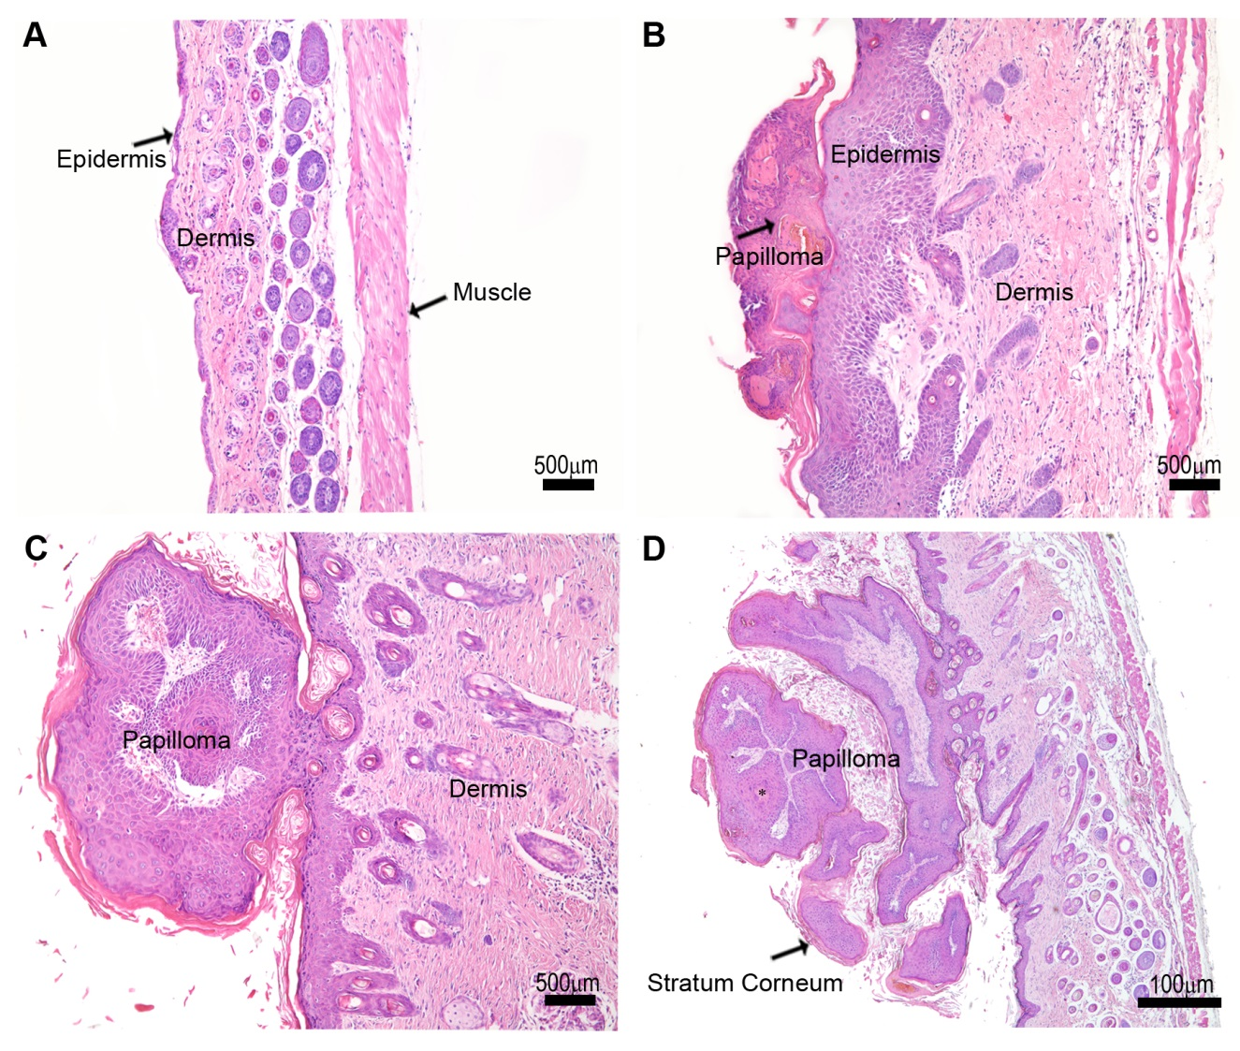
TUMOR MORPHOLOGY CHANGES WITH TUMOR PROGRESSION
Phase I
Control
Phase II
Phase III
Keratin
cyst
H&E
The division into morphological phases facilitates the analysis of mast cells during tumor progression.
Sundberg, JP, et al., Mol. Carcinog., 1997
de Souza, Jr., et al., PLoS One, 2012

Slide 6
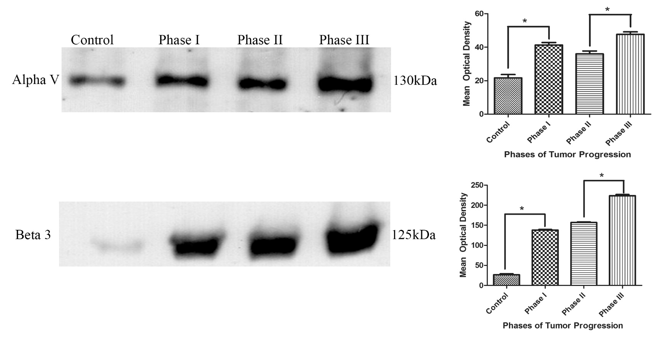
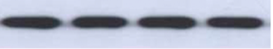
MARKERS OF TUMOR PROGRESSION INCREASE WITH TIME
PLC Gama
Alpha Actina
Expression of αV and β3 integrin subunits
de Souza, Jr., et al., PLoS One, 2012

Slide 7
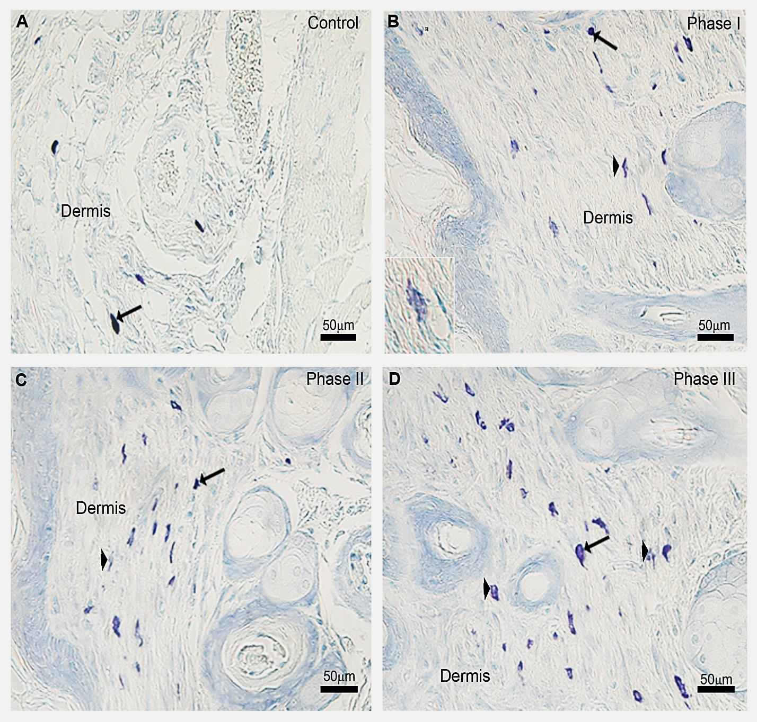
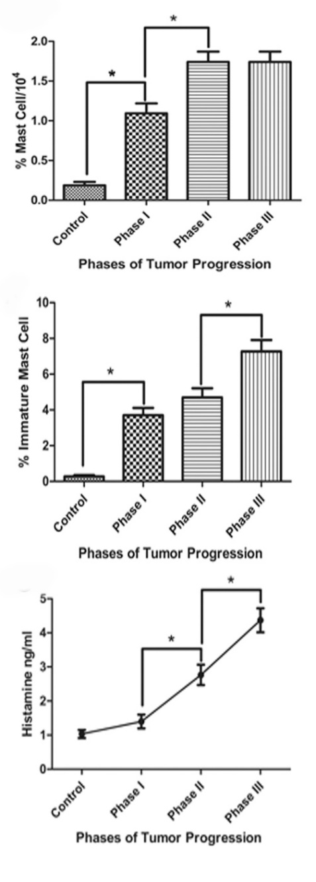
MAST CELL NUMBERS INCREASE IN THE DERMIS
DURING TUMOR PROGRESSION
de Souza, Jr., et. al, PLoS One, 2012

Slide 8
MAST CELL SPECIFIC PROTEASES
Exclusively expressed by mast cells and include chymases, tryptases and carboxypeptidase A
These proteases constitute ~25% of the granule content
Stored as active enzymes
Implicated in several pathological conditions:
Arthritis
Allergic airway inflammation
Glomerulonephritis
Aortic aneurism
Tumor angiogenesis
Caughey, Immunol. Reviews, 2007
Pejiler et al., Blood 2010
da Silva et al., J.Histochem. Cytochem, 2014

Slide 9
MOUSE MAST CELL SPECIFIC PROTEASES
PROTEASE | MW | CLASS | TYPE | ACTIVITY
Chymase | ~36 kDa | Serine protease | mMCP-1, 2, 4 mMCP-5 | Chymotrypsin-like Elastase
Tryptase | ~36 kDa | Serine protease | mMCP-6, 7 | Trypsin-like
Carboxypeptidase A | ~50 kDa | Metalloprotease | mMCP-CPA | Carboxypeptidase
Pejiler et al., Adv. Immunol. 2007

Slide 10
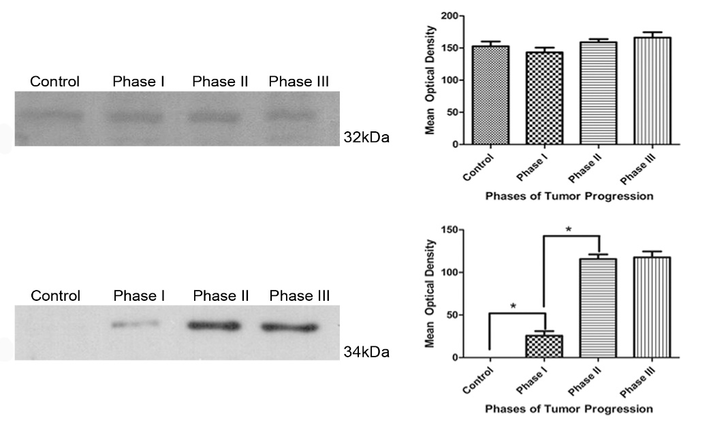
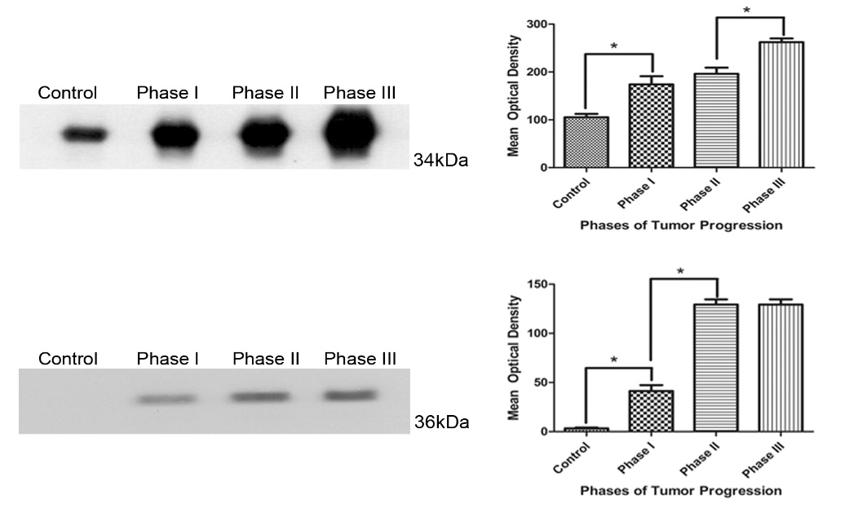
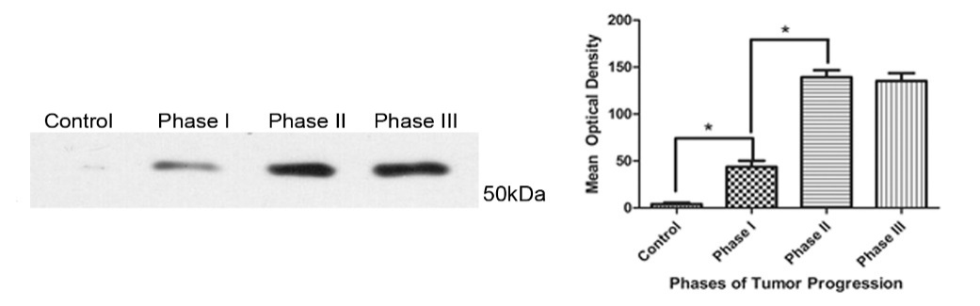
EXPRESSION OF MAST CELL SPECIFIC PROTEASES IS ALTERED DURING TUMOR PROGRESSION
Chymases
Tryptases
mMCP-4
mMCP-6
mMCP-5
mMCP-7
Carboxypeptidase A
CPA
de Souza, Jr. et al.,PLoS One, 2012

Slide 11
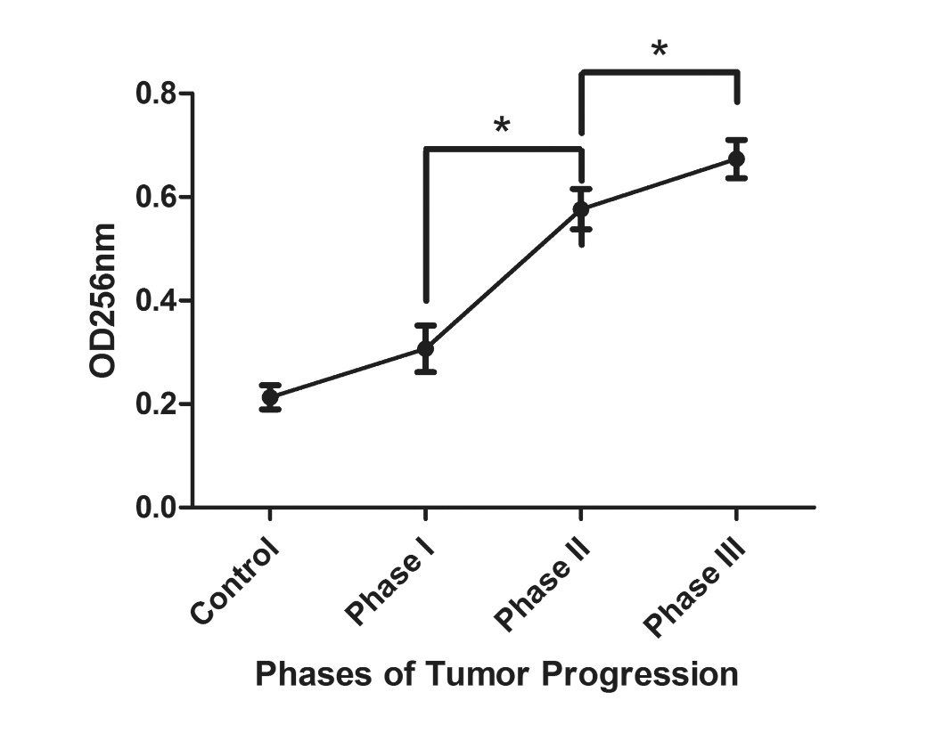
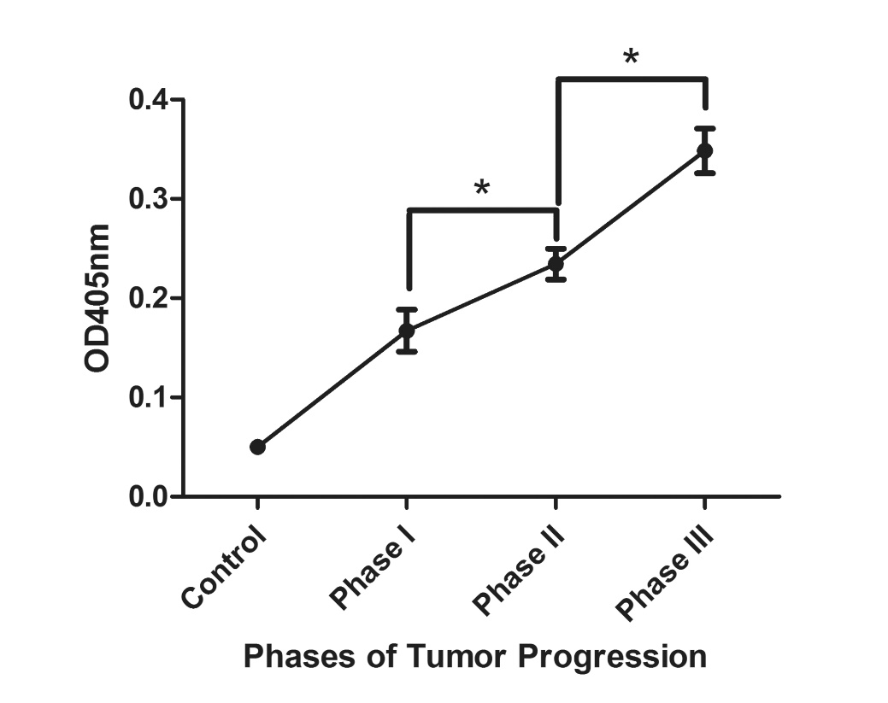
ENZYMATIC ACTIVITY OF CHYMASE AND TRYPTASE INCREASE WITH TUMOR PROGRESSION
Chymase
Tryptase
de Souza, Jr., et al., PLoS One, 2012

Slide 12
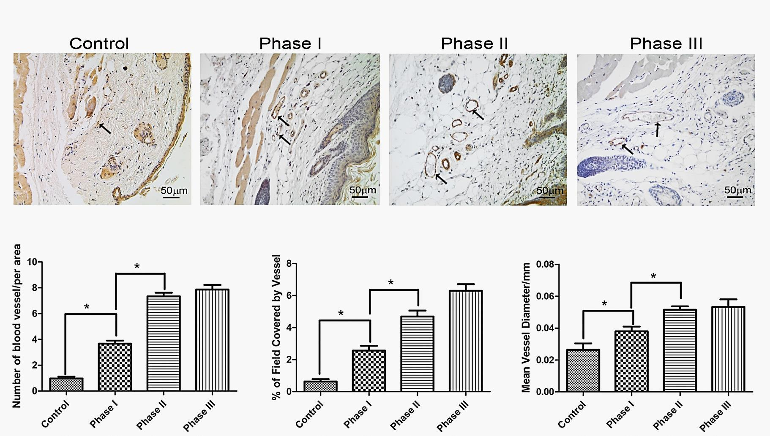
BLOOD VESSEL NUMBER AND DIAMETER INCREASE DURING TUMOR PROGRESSION
Blood vessels immunolabeled with anti-vonWillebrand factor
Blood Vessels/Area
% Field Covered
Mean Vessel Diameter
Area = 1.9 mm²
de Souza, Jr., et al., PLoS One, 2012

Slide 13
THERE IS A POSITIVE CORRELATION BETWEEN BLOOD VESSELS AND MAST CELLS NUMBER AND PROTEASE EXPRESSION
 | Number of Vessels/Field* |  | % of Field* Covered by Vessels
 | Correlation coefficient (r) | Significance (p) | Correlation coefficient (r) | Significance (p)
Number of Mast Cells | 0,98 | 0,018 | 0,94 | 0,05
Protease Expression | (r) | (P) | (r) | (P)
mMCP-5 | 0,98 | 0,016 | 0,95 | 0,04
mMCP-6 | 0,92 | 0,07 | 0,97 | 0,02
mMCP-7 | 0,99 | 0,007 | 0,96 | 0,03
mMC-CPA | 0,99 | 0,009 | 0,95 | 0,04
*Field = 1.9mm²

Slide 14
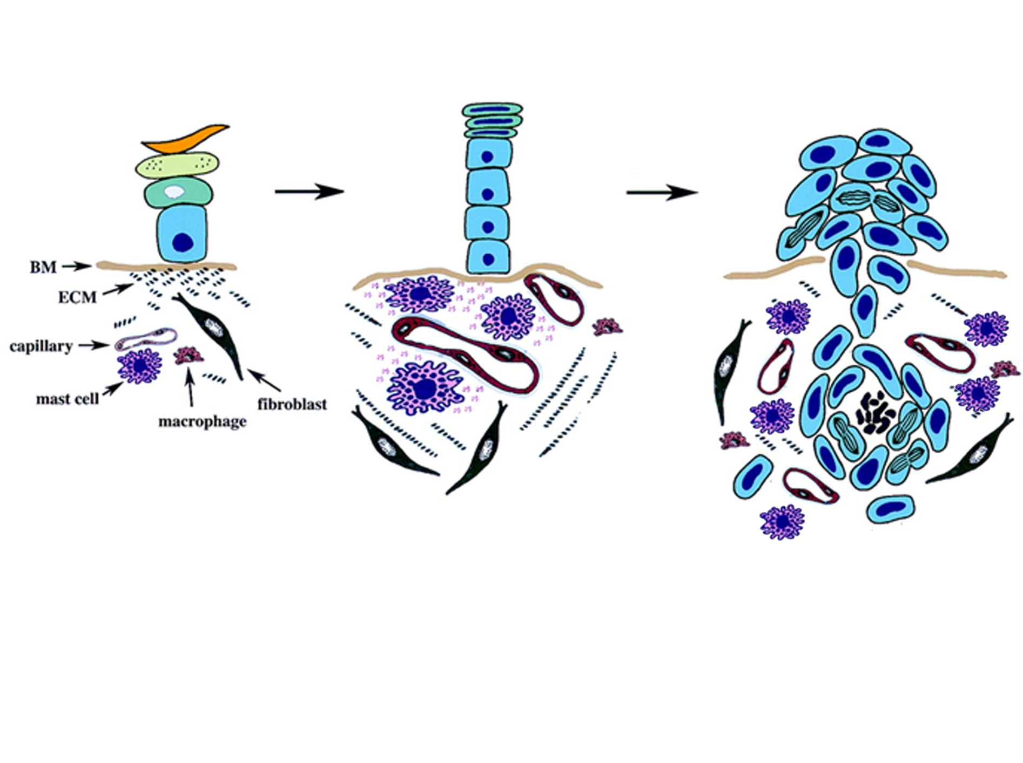
Tumor Progression
Mast Cell Proteases
Blood Vessels
Modified from Coussens L M et al. Genes Dev. 1999;13:1382-1397

Slide 15
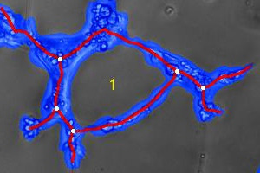
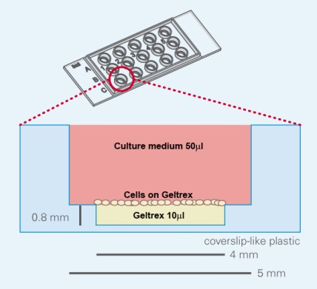

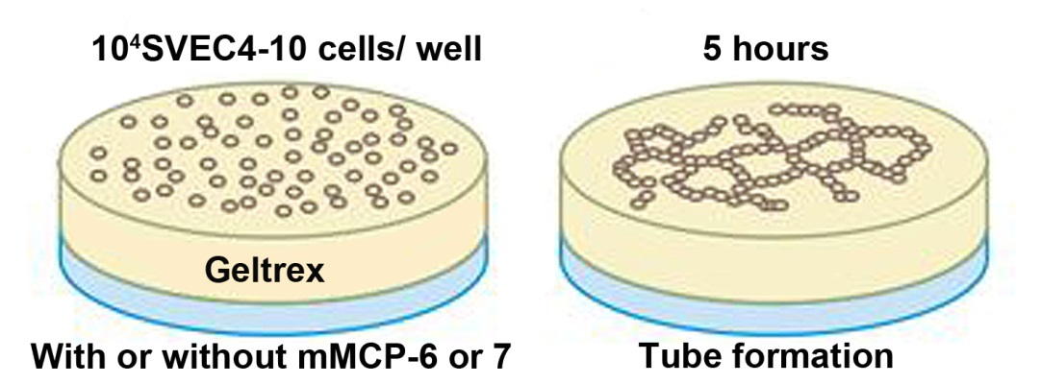
IN VITRO ANGIOGENESIS
TUBE FORMATION ASSAY
Tubes
L
Branch points
Wimasis WimTube
Ibidi µ-Slide
Angiogenesis®

Slide 16
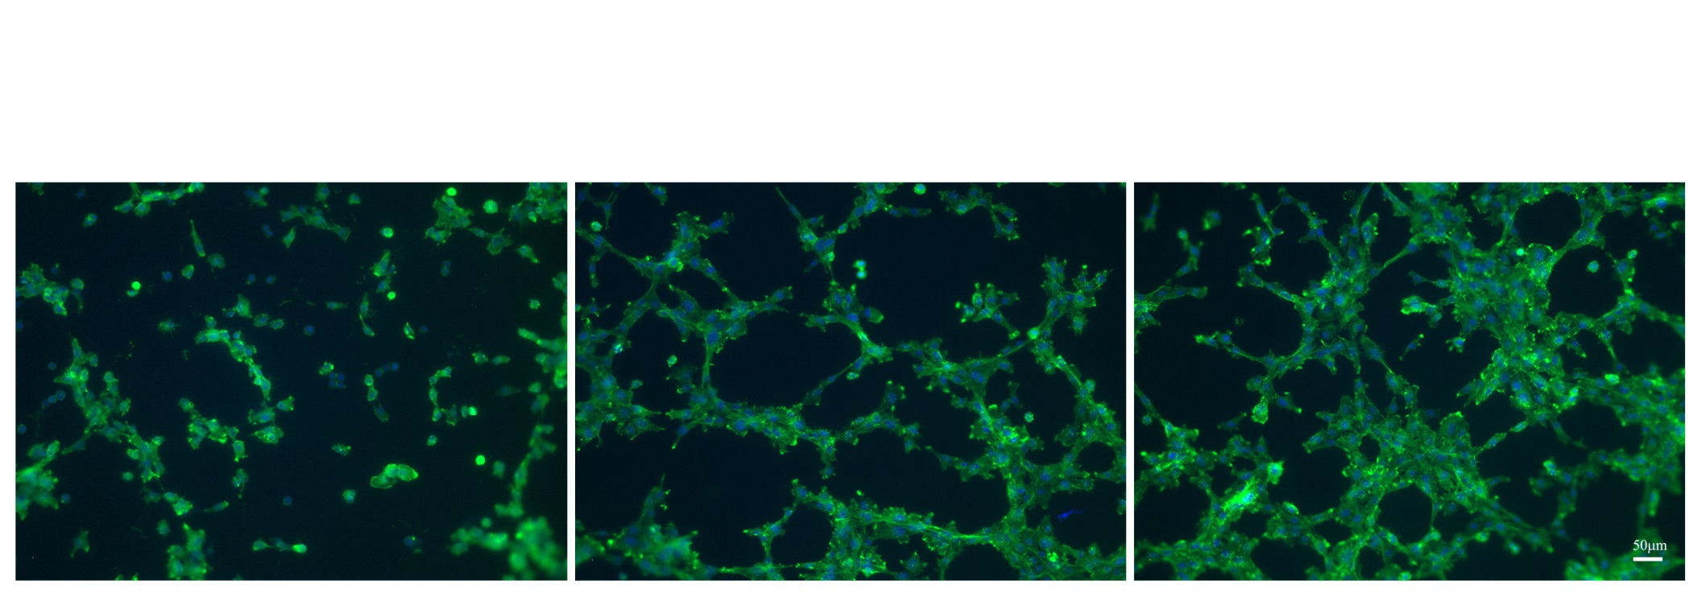
rMMCP-6 AND -7 ACCELERATED TUBE FORMATION BY ENDOTHELIAL CELLS
SVEC4-10 CELLS
without proteases
SVEC4-10 CELLS
rmMCP-6
SVEC4-10 CELLS
rmMCP-7
L
L
L
L
L
A few cells are spread and occasional tubes are seen
Cells are spread and tubes and loops are present
Tubes and loops are more prevalent
Tube
L =
Loop
Cells were cultured for 5 hours at 37°C on Geltrex, fixed, stained with phalloidin conjugated to Alexa 488 and counterstained with DAPI .

Slide 17
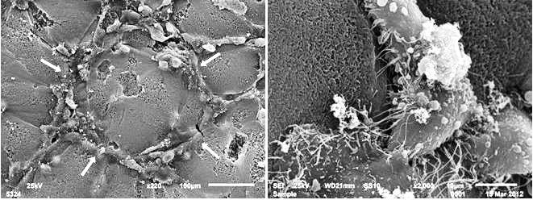
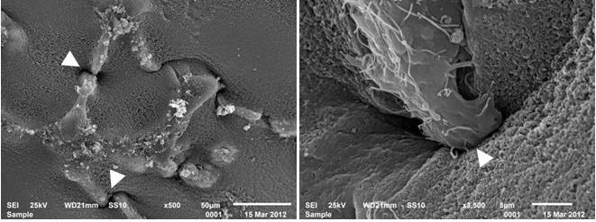
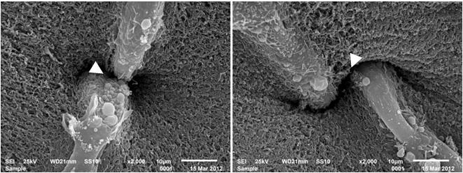
rMMCP-6 AND -7 ACCELERATE TUBE FORMATION AND MATRIX PENETRATION
Control
rmMCP-6
rmMCP-7
Cells were cultured for 5 hours at 37°C on Geltrex
Scanning Electron Microscopy

Slide 18
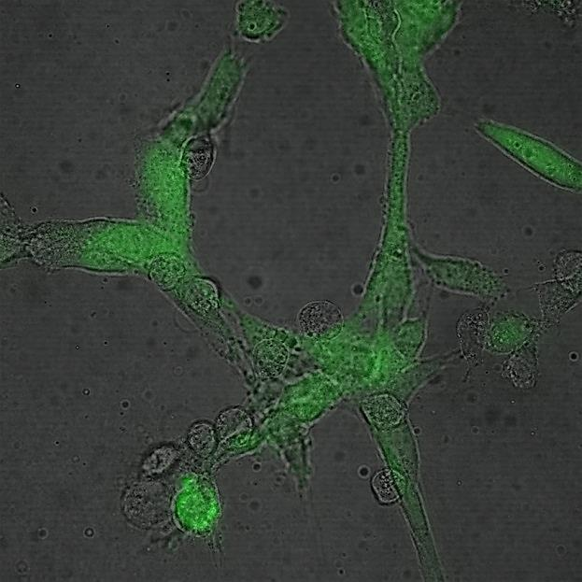
CO-CULTURE OF SVEC4-10 ENDOTHELIAL CELLS WITH P815 MAST CELLS INDUCES FORMATION OF TUBES AND LOOPS
Phalloidin-Alexa 488 and DAPI
L
There are fewer tubes and loops than when the SEVEC4-10 cells are cultured with proteases
Cells were cultured for 5 hours at 37°C on Geltrex
GFP-SVEC4-10 cells
P815 Mast Cells
Tube
L =
Loop

Slide 19
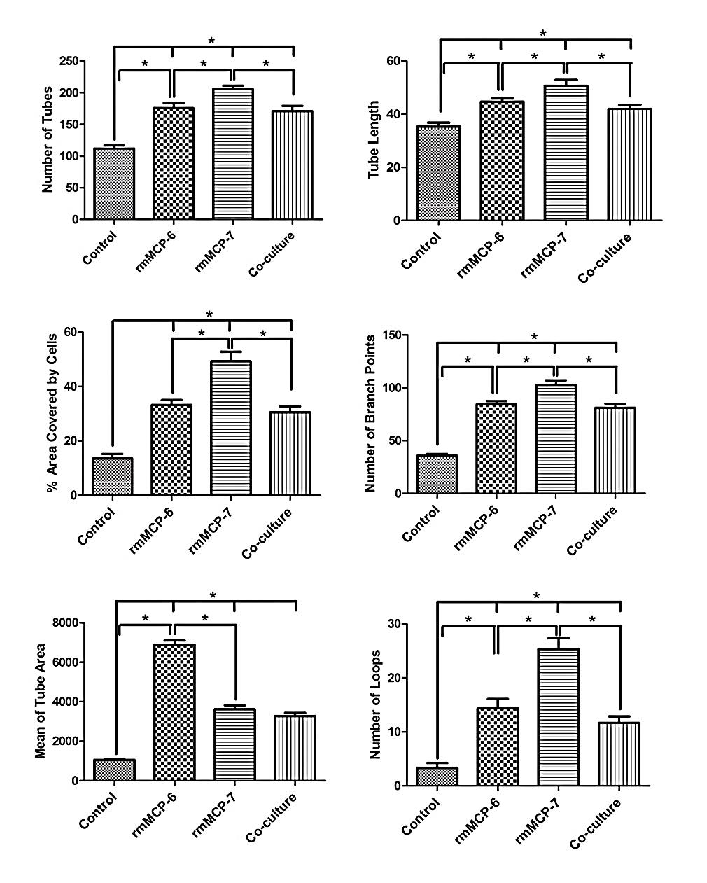
rmMCP-7 IS MORE EFFECTIVE IN INDUCING TUBE FORMATION
Number of Tubes
Tube Length
Number of tubes, area covered by tubes, tube length, branching points and loops are higher when the SVEC4-10 cells are incubated with rmMCP-7
The average area occupied by the tubes was higher when cells were cultured with rmMCP-6
% Area Covered
Branch Points
Mean Tube Area
Loops
Wimasis WimTube

Slide 20
ANTI-mMCP-6 AND ANTI-mMCP-7 REDUCE TUBE FORMATION
Control cells were cultured in absence of antibodies or proteases
Antibodies were a gift from Dr. Michael Gurish, Brigham and Women´s Hospital, Harvard University

Slide 21
rmMC TRYPTASES INDUCE THE RELEASE OF ANGIOGENIC FACTORS
rmMCP-6
rmMCP-7
Control
Proteome Profiler Mouse Angiogenesis Array
Mean Optical Density

Slide 22
CONCLUSIONS
Mast cells are involved in the induction of angiogenesis in the early stages of tumor development
Mast cells modulate blood vessel growth in the later stages of tumor progression
Mast cell specific proteases play a critical role in angiogenesis by inducing release of angiogenic factors

Slide 23
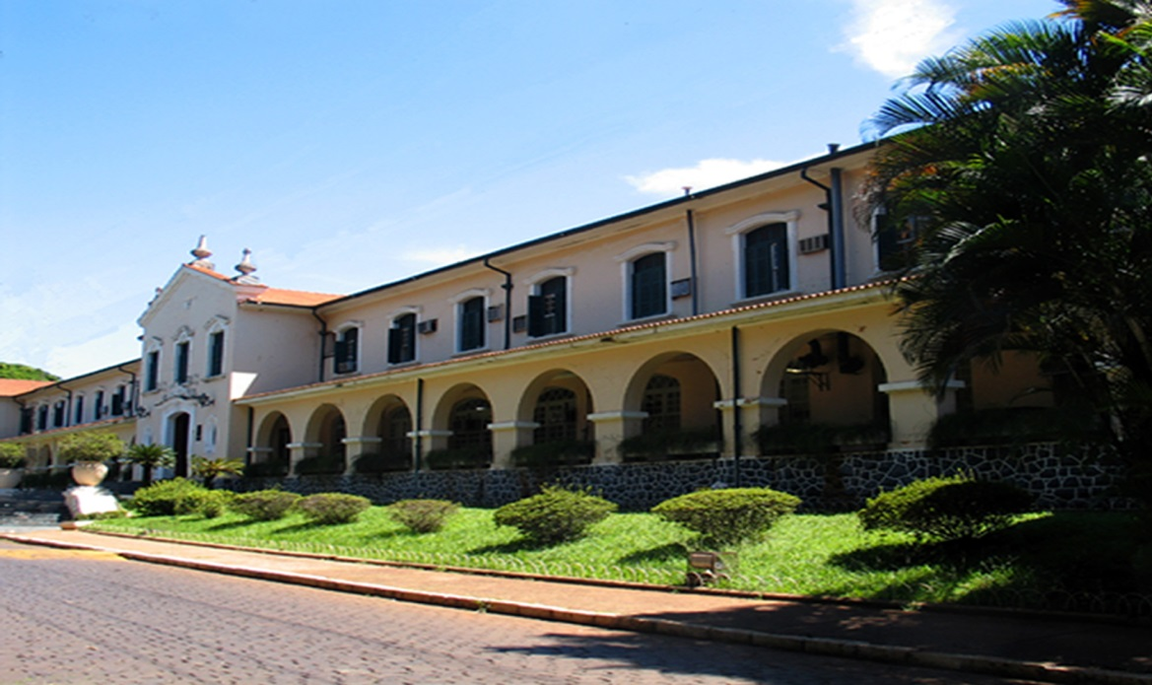
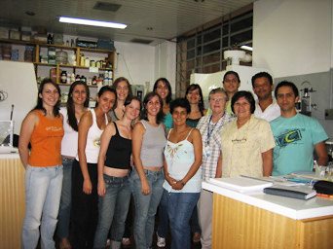

Collaborators:
Devandir Antonio de Souza, Jr.
Maria Rita de Cassia Campos
Vanina Danusa Toso
Ana Carolina Santana
Antonio Carlos Borges
Constance Oliver
FMRP
Financial Support

Slide 24


