Slide 1
UNIVERSITY OF PRETORIA
In vitro antagonistic effects of listeria adhesion protein (LAP)- expressing Lactobacillus casei against Listeria monocytogenes and Salmonella Typhimurium var Copenhagen
Mapitsi S. Thantsha

Slide 2
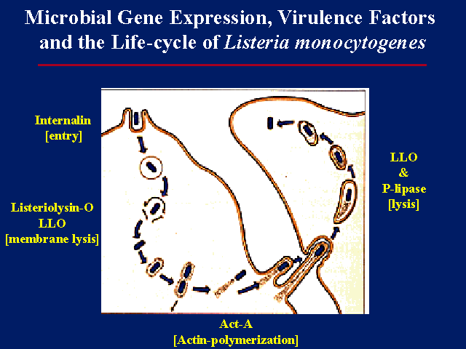
Listeria mononocytogenes
Characteristics
Gram positive coccoid to rod shaped, facultative anaerobe, non-spore former with peritrichous flagella for tumbling.
Growth temp range from 0-42ºC, with an opt btw 30 and 35ºC, salt tolerant.
Association with foods
Raw vegetables, pork sausages, turkey frankfurters, cook-chill chicken and chicken nuggets, salami, ham corned beef ,milk
Pathogenesis and clinical features
Pregnant women, very young or elderly and the immunocompromised more susceptible.
In pregnant women it causes influenza like illness with fever, headache and occasional gastrointestinal symptoms, and result in abortion, stillbirths or premature labour in severe cases.
In non-pregnant adults listerosis is characterized by septicaemia, meningitis and meningioencephalitis

Slide 3
Salmonella
Characteristics
Gram negative, facultative anaerobic, non-spore forming rods, motile with peritrichous flagella
Temperature growth range from below 5ºC to 47ºC, optimum 37ºC
Salmonellae infect a range of animals, but a few are host adapted: S. typhimurium and S. paratyphi in humans.
Association with foods
Zoonotic infection, transmitted by faecal oral route
Cross contamination directly or indirectly through kitchen equipment and utensils.
Human transmission, faecally contaminated hands touching food
.
Pathogenesis and clinical features
Entiriditis: vomiting, diarrhoea, fever
Systemic disease (typhi, paratyphi): resist phagocyte killing, 2 stage illness: 1 in blood, 2 in gall bladder

Slide 4
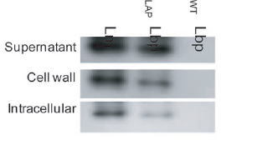
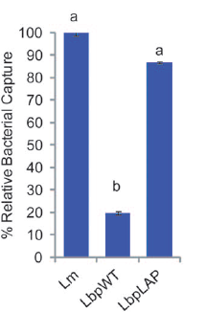
Western blot showing expression of LAP in different fractions
Adhesion of recombinant Lb. paracasei to Caco-2 cells
Binding of recombinant Lb. paracasei to magnetic beads coated with Hsp60 relative to L. monocytogenes
Comparison of wild type and recombinant Lb. paracasei adhered to Caco-2 cell monolayer.

Slide 5
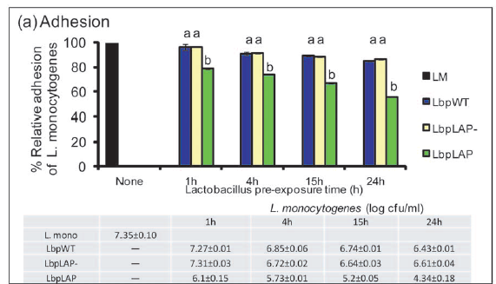
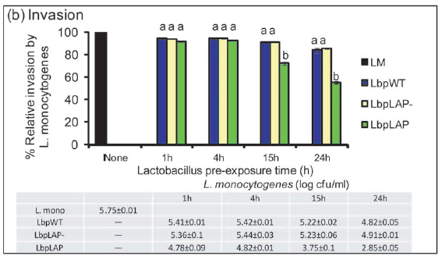
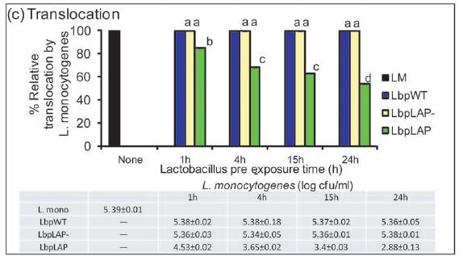
Inhibition of L. monocytogenes adhesion, invasion and transepithelial translocation to Caco-2 cells pre-treated with recombinant Lb. paracasei

Slide 6
Do recombinant Lb. casei expressing LAP provide enhanced protection against S. Typhimurium

Slide 7
Adhesion assay
Grow mammalian cells in 24 well plate up to confluency
Wash cells 3 x with cell-PBS
Add different probiotics suspended in I10F medium/ SIF (MOE of 100:1), incubate at 37 ºC for xh in anaerobic jar with gaspak
Remove excess I10F/SIF and replace with 100 μL of L. monocytogenes suspended in I10F medium (MOI=10:1)
Incubate for 1 h at 37 ºC in an anaerobic jar with gaspak
Wash cells 2 x with cell-PBS
Remove excess SIF, analyze for LDH activity (Piersen cytotoxicity kit)
Treat with 100 μl 0.1% Triton X100 at room temperature for 10 min
Serially dilute in cell-PBS and plate out on MRS , XLT-4 and MOX agar plates for Lactobacilli, S. Typhimurium and L. monocytogenes, respectively
7

Slide 8
Invasion assay
Grow mammalian cells in 24 well plate up to confluency
Wash cells 3 x with cell-PBS
Add different probiotics suspended in I10F/ SIF (MOE of 100:1), incubate at 37 ºC for xh in anaerobic jar with gaspak
Remove excess I10F/ SIF and replace with 100 μL of L. monocytogenes suspended in SIF (MOI=10:1)
Incubate for 1 h at 37 ºC in an anaerobic jar with gaspak
Remove excess SIF and replace with 100 μL of L. monocytogenes suspended in SIF (MOI=10:1), treat cells with I10F medium with 100 μg/ml gentamycin for 1hr at 37ºC
Wash cells 2 x with cell-PBS
Treat with 100 μl 0.1% Triton X100 at room temperature for 10 min
Serially dilute in cell-PBS and plate out on MRS and MOX agar plates for Lactobacilli and L. monocytogenes, respectively
8

Slide 9
Probiotics | Bacterial counts (Log cfu/ml )
 | HCT-8 cells | Caco-2 cells
Lb. casei WT | 5.48 ± 0 | 5.49 ± 1.39
Lb. casei with empty pL401 | 5.52 ± 0.1 | 5.51 ± 0.93
Lb. caseiLAP^{Lm} | 5.80 ± 0 | 5.49 ± 0.90
Lb. caseiLAP^{Lin} | 5.53 ± 0 | 5.70 ± 1.25

Slide 10
Probiotics | Bacterial counts (Log cfu/ml )
 | Co-inoculated with L. monocytogenes | Co-inoculated with S. Typhimurium
Lb. casei (wild type) | 8.25 ± 0.91 | 8.21 ± 0.67
Lb. caseiLAP^{Lm} | 7.79 ± 0.44 | 8.66 ± 0.21
Lb. rhamnosus GG | 8.36 ± 0.49 | 8.63 ± 0.48

Slide 11
Table 1: Number of probiotics adhered to Caco-2 cells after 3h
Probiotic | Counts (Log cfu/ml )
Lb. casei (wild type) | 5.39 ± 0.3
Lb. rhamnosus GG | 5.62 ± 0.3
Lb. caseiLAP^{Lm} | 5.90 ± 0.32
Lb. caseiLAP^{Lin} | 5.93 ± 0.27
11
All data presented is means of duplicate from three independent experiments

Slide 12
Effect of recombinant Lb. casei expressing LAP on adhesion and invasion of L. monocytogenes to Caco-2 cells in SIF and anaerobic conditions

Slide 13
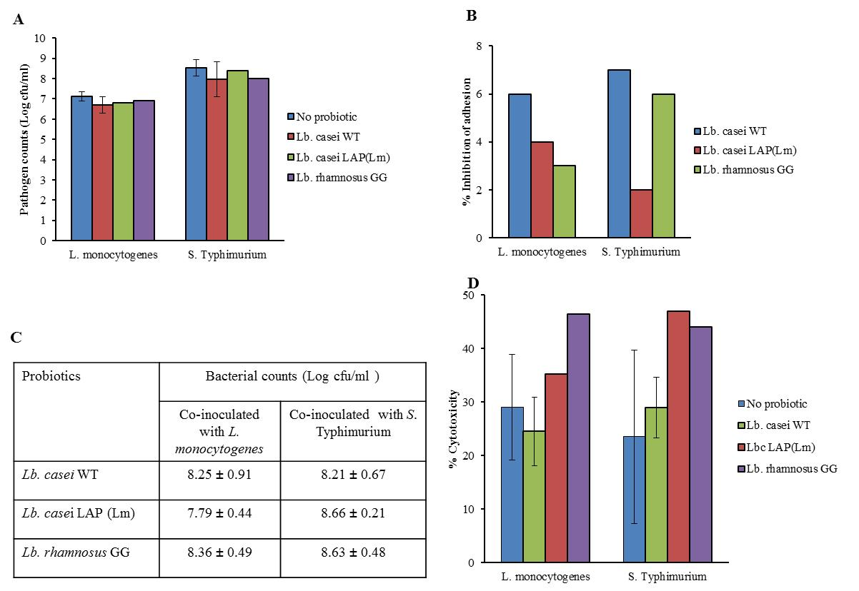
Adhesion characteristics and cytotoxicity of Salmonella Typhimurium and L. monocytogenes to Caco-2 cell monolayer under anaerobic conditions in the presence of recombinant Lactobacillus casei. (A) Pathogen adhesion to cell monolayers. (B) Reduction of pathogen adhesion by probiotics. (C) Probiotics adhered to mammalian cells after overnight incubation. (D) Cytotoxicity induced by pathogens to Caco-2 monolayer. Data are averages of three independent experiments run in triplicate.

Slide 14
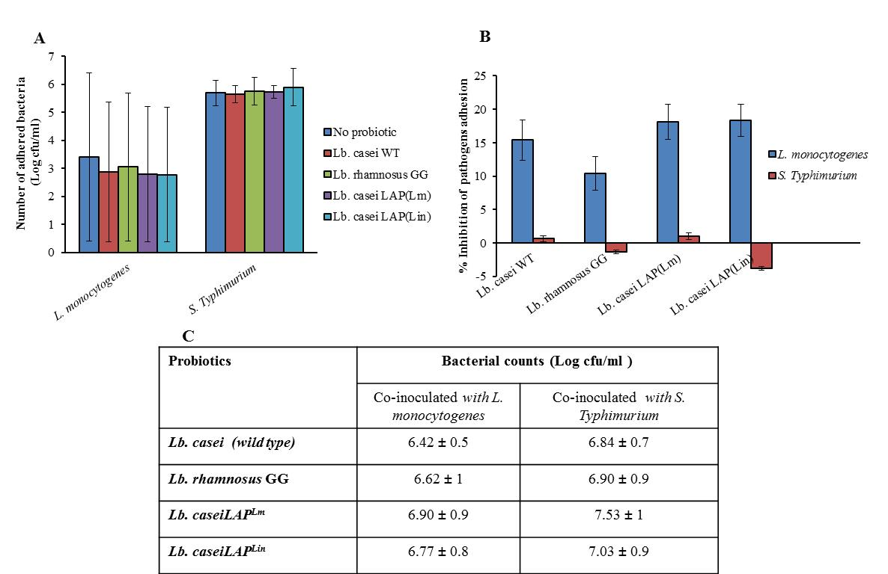
Adhesion characteristics and cytotoxicity of Salmonella Typhimurium and L. monocytogenes to HCT-8 cell monolayer under anaerobic conditions in the presence of recombinant Lactobacillus casei. (A) Pathogen adhesion to cell monolayers. (B) Reduction of pathogen adhesion by probiotics. (C) Probiotics adhered to HCT-8 cell monolayer after overnight incubation. (D) Cytotoxicity induced by pathogens to HCT-8 monolayer. Data are averages of three independent experiments run in triplicate.

Slide 15
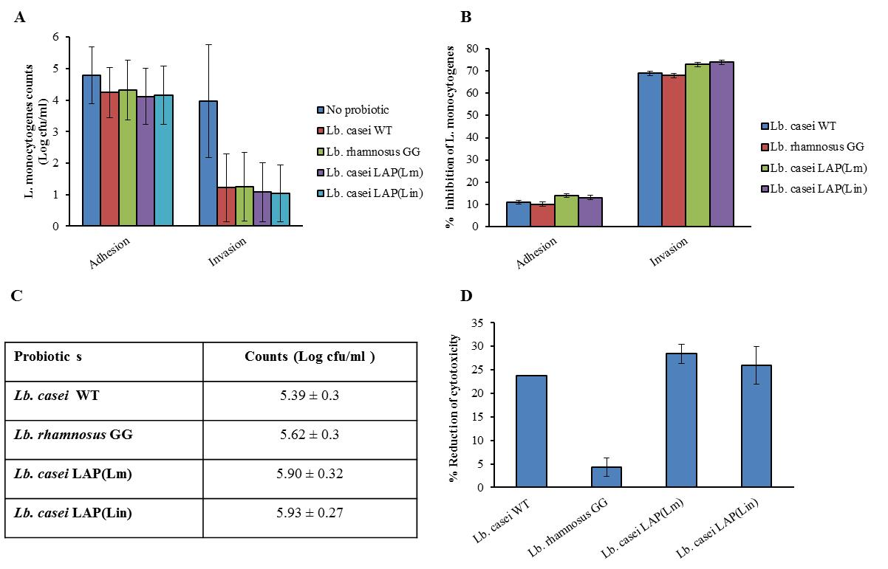
Adhesion, invasion characteristics and cytotoxicity of L. monocytogenes to Cao-2 cell monolayer in SIF under anaerobic conditions in the presence of recombinant Lactobacillus casei. (A) Adhesion and invasion experiments. (B) Reduction of L. monocytogenes adhesion and invasion by probiotics. (C) Probiotics adhered to Caco-2 cell monolayer after 1 h. (D) Cytotoxicity induced by L. monocytogenes to Caco-2 cells. Data are averages of three independent experiments run in triplicate.

Slide 16
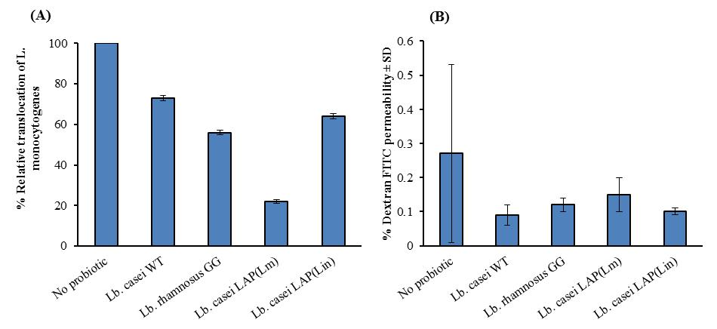
Transepithelial translocation characteristics of L. monocytogenes. (A) Transepithelial translocation characteristics of L. monocytogenes through Caco-2 cell monolayer by trans-well assay. (B) Dextran^{FITC} permeability through Caco-2 cell monolayer in trans-well assays. Caco-2 cell monolayers were grown in trans-well inserts to confluency and then treated with wild type L. casei, recombinant L. casei strains expressing Listeria adhesion proteins from L. monocytogenes and L. innocua, Lb. casei LAP(Lm) or Lb. casei LAP(Lin), respectively or L. rhamnosus GG for 1h, then treated with L. monocytogenes for 1h.

Slide 17
Probiotic | TEER (Mean Ω/cm² ± SD)ª |  | TEER reduction
 | Before exposure to L. monocytogenes | After exposure to L. monocytogenes
Lb. casei | 16.0 ± 15 | -4.17 ± 1.26 | 20.17
Lb. rhamnosus GG | 33.5 ± 18 | -1.50 ± 2.78 | 35
Lb. casei LAP(Lm) | 12.0 ± 10.9 | -0.50 ± 2.65 | 12.5
Lb. casei LAP(Lin) | 16.0 ± 14 | -1.17 ± 2.84 | 17
ªCaco-2 cell monolayers were grown in transwell inserts to confluency and then treated with wild type L. casei, recombinant L. casei strains expressing LAP from L. monocytogenes and L. innocua, Lb. casei LAP(Lm) or Lb. casei LAP(Lin), respectively or L. rhamnosus GG for 1h, then treated with L. monocytogenes for 1h. TEER measurements before and after L. monocytogenes treatment alone were 17.5 ± 15.6 and 5.17 ± 14.2, respectively. Values are averages of three experiments analysed in duplicates. TEER reduction was calculated as TEER_{before} - TEER_{after}

Slide 18
CONCLUSIONS
Recombinant Lb. casei expressing LAP inhibited adhesion and invasion of L. monocytogenes to intestinal cells under simulated intestinal conditions.
Recombinant Lb. casei expressing LAP did not offer enhanced protection against other enteric pathogens, specifically S. Typhimurium var Copenhagen.
Recombinant Lb. casei strains expressing LAP show specificity for protection of intestinal cells against L. monocytogenes.

Slide 19
Acknowledgements
Prof Arun Bhunia
19

Slide 20
THANK YOU!
mapitsi.thantsha@up.ac.za

