Slide 1
OMICS GROUP
SURGERY ANESTHESIA
CONFERENCE
November 2014
CHICAGO
U.S.A

Slide 2
“THE REAL CAUSE OF A PATIENT WITH ABDOMINAL PAIN“
Original case report
Manuela Stoicescu, Consultant MD, PhD, Assistant Professor University of Oradea Faculty of Medicine and Pharmacy Medical Disciplines Department, Romania

Slide 3
MOTTO
“The abdomen is full of the misters and a patient with diffuses abdominal pain is possible to offer us many surprises of diagnosis.”

Slide 4
OBJECTIVES
The main objective of this clinical case presentation was to found the real cause of a patient who came at the Emergency Service for diffuses abdominal pain. The most important information of this clinical case report is that this symptom appeared in context of trauma.

Slide 5
MATERIAL AND METHODS
I present the clinical case of a women 58 years old, hypertensive, with diabetes mellitus tip2 (NIN) who followed therapy with oral anti diabetes drugs. She came at the Emergency Department because with one day before she had an accident, she felled from the cart and the horse passes on her. After this incident she feels diffuses abdominal pain and also pain in the back (thoracic and lumbar areas).

Slide 6
MATERIAL AND METHODS
The objective examination relieved: BP=160/90mmHg, heart sounds rhythmic HR=82 bates/min, dullness at the left base of the lung and silent at the auscultation of the lung at this level. The patient feels pain after the palpation of the abdomen. She feels diffuses abdominal pain with medium intensity after superficial and deep palpation, but the abdomen was soft, participate at the respiratory movements and without rebound tenderness.

Slide 7
INVESTIGATIONS
An EKG was performed and relieved sinus rhythm, HR=82bates/min and QS wave in leads V1, V2 and V3 significant an old anterior-septum myocardial infarction was showed, without ischemic lesion changes. The patient don’t know about this myocardial infarction from the past history and I suppose that was an un painful (silent) myocardial infarction how appeared at the diabetes patients in context of vegetative neuropathy).The image of the EKG follow to see in the next slide:

Slide 8
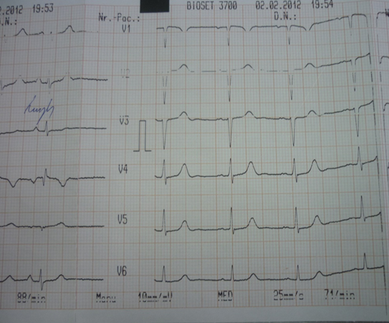
THE EKG

Slide 9
THE CHEST X-RAY
The Chest X-ray was performed and showed opacity with concavity up, homogenous at the base of the left lung. The X rays of the thoracic, lumbar colonna and basin was normal without fracture lines. So was excluded fracture of the ribs , thoracic and lumbar colonna and also in the area of the basin.

Slide 10
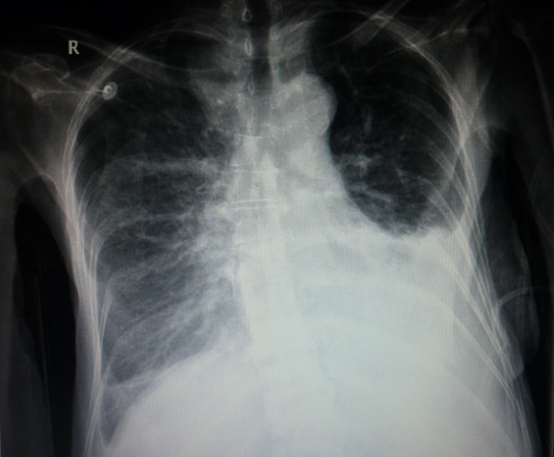
THE CHEST X RAY
Opacity at the left base of the lung

Slide 11
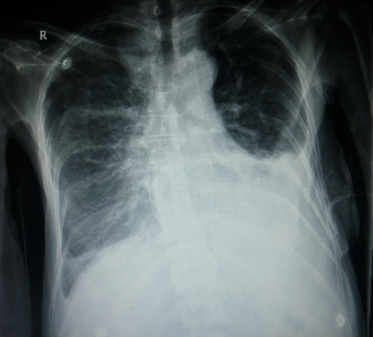
Opacity at the left base of the lung
Opacity at the left base of the lung

Slide 12
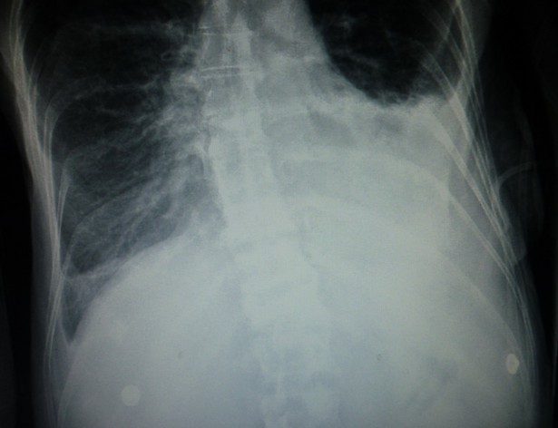
Opacity at the left base of the lung with concavity up.
Opacity at the left base of the lung with concavity up

Slide 13
THE X ray of the thoracic and lumbar colonna-anterior incidence
The lumbar colonna–anterior incidence-without fracture lines

Slide 14
THE X ray of the lumbar colonna lateral incidence
The lumbar colonna –lateral incidence- without fracture lines

Slide 15
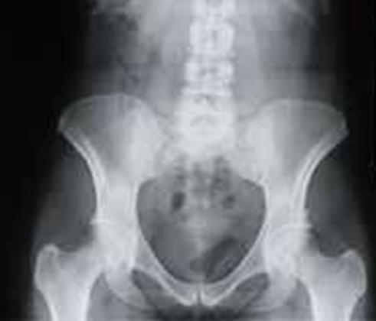
THE X ray of the basin
The basin without fracture lines

Slide 16
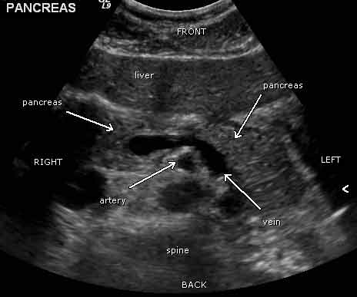
THE ABDOMINAL ECHO
The abdominal echo relieved all the organs normal without hematomas

Slide 17
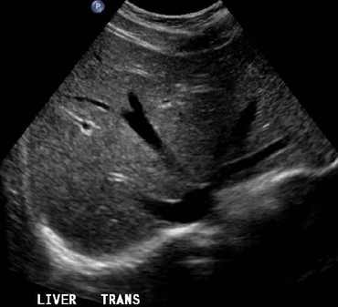
THE LIVER ECO NORMAL
The liver without hematomas

Slide 18
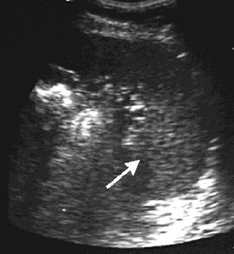
THE SPLEEN ECO NORMAL
The spleen without hematomas

Slide 19
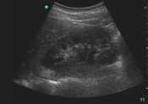
THE RIGHT KIDNEY ECO NORMAL
The right kidney without hematomas

Slide 20
THE LEFT KIDNEY ECO NORMAL
The left kidney without hematomas

Slide 21
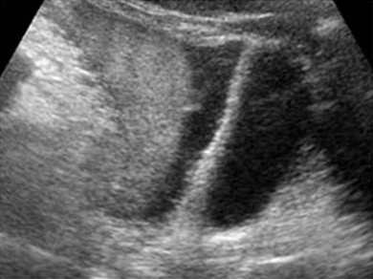
COLLECTION IN THE LEFT DOUGLAS POUCH - ECO
The presence of a fluid collection in the left Douglas pouch, medium quantity, hyperecogenic
The fluid collection in the left Douglas pouch

Slide 22
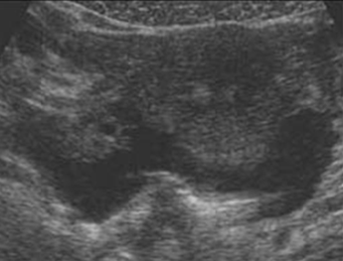
THE ABDOMINAL CT
An abdominal CT was performed and relieved the same collection in medium quantity in the left Douglas pouch, without lesions of the organs insides of the abdominal cavity.
The fluid collection in the left Douglas pouch

Slide 23
THE LABORATORY TESTS
Laboratory tests showed:
ESR=10-20mmh, fibrinogen=282mg%,
glycemia=200mg/dl, WBC=5000/mm³, Platelets=200 000/mm³, Hb=10g/dl,
Ht=42%, Red blood cell = 3 millions / mm³, cholesterol=215mg/dl, HDL cholesterol =30,
LDL cholesterol=40, triglycerides=300mg /dl
and other lab tests was in normal range.

Slide 24
PARACENTESIS
Because this fluid collection existed inside of the abdomen a paracentesis was performed in the left lateral position of the patient and appeared fresh blood so a haemoperitoneum was presented. Of course the presence of the haemoperitoneum was after trauma because she had an accident, she felled from the cart and the horse passes on her.

Slide 25
QUESTION?
The main question was which is the cause of the haemoperitoneum because all the organs inside of the abdomen were intact, without hematomas after the abdominal eco and CT was performed. Where is the source of bleeding?

Slide 26
SURGERY DEPARTMENT
The patient was referred urgently to the Surgery Department for immediately laparatomy after 1UI iso group iso Rh blood transfusion was started to administrate.

Slide 27
EMERGENTLY LAPAROTOMY
After the emergently surgical abdominal intervention was performed was discovered unexpected: break of the mesentery with haemoperitoneum and was solved. So the cause of the haemoperitoneum was break of the mesentery this was the reason that not a hematomas of the organs was the cause. All the organs were normal at the abdominal echo examination. The patient had a good evolution after the surgery intervention.

Slide 28
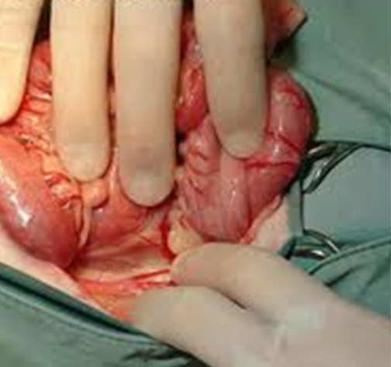
BREAK OF THE MESENTERY HAEMOPERITONEUM
Break of the mesentery

Slide 29
THE OPACITY OF THE LEFT BASE OF THE LUNG
Because she presented also the opacity of the left base of the lung with concavity up this could be: pneumonia in phase of consolidation, a solid mass with atelectasis or pleural effusion. Because the opacity is with concavity up this is a sign to suggest a pleural effusion.

Slide 30
THE PLEURAL EFFUSION
A pleural puncture and thoracocentesis was performed and unexpected showed fresh blood. So an haemothorax was also presented after trauma at the left base of the lung in the pleural cavity and was solved, was evacuated and stopped after haemostatic therapy.

Slide 31
THE FINAL DIAGNOSIS
The final diagnosis of the patient was: •Trauma of the abdomen - Hemoperitoneum •Break of mesentery •Haemothorax after trauma •Post bleeding anemic syndrome •Diabetes mellitus type2 •High Blood Pressure •Dislipidemia, silent ischemic heart disease - •Silent old anterior-septum myocardial infarction.

Slide 32
RESULTS AND DISCUSSIONS
The particularity of this clinical case presentation is that after trauma the real cause of the diffuses abdominal pain was a break of mesentery, haemoperitoneum and unexpected the opacity of the left base of the lung was in reality a haemothorax also in the context of trauma.

Slide 33
CONCLUSIONS
1.The most important conclusion of this clinical case presentation is that when after trauma appear diffuses abdominal pain and a haemoperitoneum is present in condition that all the abdominal organs (liver, spleen, kidney, others) are normal without hematomas at the abdominal eco and CT, the real cause could be the break of mesentery.

Slide 34
CONCLUSIONS
2. Because the patient was hypertensive the value of blood pressure wasn’t low, more than that high with medium value and this situation disturb our clinical thinking, because in acute bleeding we expect to found the low value of the blood pressure. So, the normal or high value of the blood pressure not excluded bleeding inside of the abdomen in the first moment.

Slide 35
CONCLUSIONS
3. In the context of the abdominal trauma, some times the real cause of the diffuses abdominal pain could be break of mesentery with haemoperitoneum and also other organs of the body could be affected like lung and pleura and a opacity of the lung could be unexpected a pleural effusion with fresh blood so an haemothorax and we must to take into account this possibility.

Slide 36
THANK YOU

