Slide 1
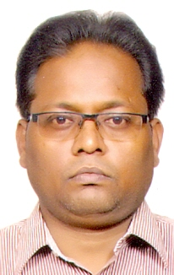
God DOESN’T PLAY DICE
AN ORAL PRESENTATION
BY
DR MANISH KUMAR
DEPARTMENT OF ELECTRICAL ENGINEERING,
INDIAN INSTITUTE OF TECHNOLOGY(BANARAS HINDU UNIVERSITY), VARANASI-221005,
UTTAR PRADESH, INDIA
For
PHYSICS 2016
JUNE 27-29, 2016 IN NEW ORLEANS, USA
HIGHLIGHTING INNOVATIONS AND CHALLENGES IN THE FIELD OF PHYSICS

Slide 2
Heisenberg introduced the uncertainty principal, according to which position and momentum cannot be described simultaneously, i.e. ΔxΔp ≥ ℏ/2. This is true for all the physical quantity known to us. So that even energy when considered as particle in terms of photon its position and momentum is uncertain. Here comes the famous statement made by the genius Albert Einstein “GOD doesn’t play dice”. The inference obtained from here is that there is no uncertainty with GOD i.e. uncertainty fails here but how to prove? It is as simple as it follows:
Let us hypothesize for GOD that there is no uncertainty,
i.e. ΔxΔp = 0. ∵ Δp = mΔv, Δv = Δx/ Δt,
also E = mc² → m = E / c2 , where m, c are mass of GOD, velocity of light which according to Albert Einstein is absolute and is a constant in any frame of reference respectively and so E is the corresponding energy associated with the GOD.
∴ E(Δx)²/Δt = 0.
This implies either of the three conditions which are as follows:
(i) E = 0 or
(ii) Δx = 0 or
(iii) Δ = ∞
If E = 0 then there is no discussion, so we can rule out this possibility or this also implies that when there is nothing still there is GOD i.e. everything in the universe/multiverse is originated from “Zero” which also describes GOD’s characteristics.
If Δx = 0, then it implies GOD’s position does not change or it can be said that GOD is everywhere in the universe/multiverse so this is also true for GOD.
Third possibility is Δt = ∞ i.e. time period is infinite, then also our hypothesis is justified. It is what GOD is, whose time period is infinite, rest all the quantities in the universe/multiverse are having finite time period.
It is the justification for GOD doesn’t play dice.

Slide 3
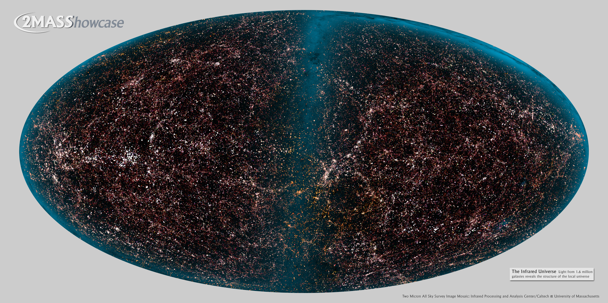
THANK YOU

