Slide 1
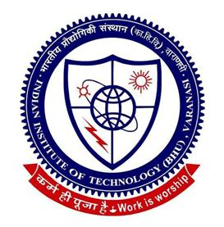
God's diagnostic tool is the mathematics and prescription is physics
AN ORAL PRESENTATION
BY
DR MANISH KUMAR
DEPARTMENT OF ELECTRICAL ENGINEERING,
INDIAN INSTITUTE OF TECHNOLOGY(BANARAS HINDU UNIVERSITY), VARANASI-221005,
UTTAR PRADESH, INDIA
MISS SHAGUN SINGH
BANASTHALI VIDYAPEETH, JAIPUR, RAJASTHAN, INDIA
For
PHYSICS 2016
JUNE 27-29, 2016 IN NEW ORLEANS, USA
HIGHLIGHTING INNOVATIONS AND CHALLENGES IN THE FIELD OF PHYSICS

Slide 2
INTRODUCTION
“Necessity is the mother of invention” is the famous proverb which originates from the inquisitive mind of human beings.
From paleotheolic age to modern world the fight for survival is the necessity that lead to the consequential development of modern civilisation.
The most revolutionary theories came from those who has undettered faith in GOD.
The only proof of GOD was the undettered faith of human beings which was being challenged by many athiest those who deny His complete existence and hence the debate leads to many war and bloodshed.
GOD’s physical existence and his interaction with the matter (living/non-living) is beyond the realm of physics as the boundary of physics is
Different potential ideas in physics has utilized the mathematics as the diagnostic tool and various prescription came from sectors like Classical Physics, Modern Physics, Computational Physics, Theoretical Physics, Applied Physics, Meta Physics, Solar Physics, Bio Physics, Astro Physics etc. for creation, invention and discovery as the Physics is the study of science that deals with energy and matter and their interactive nature with each other.

Slide 3
Proof from Astrophysics
Consider the atomic model an electron circulating the nucleus containing proton i.e. Hydrogen atom model. There are two attractive forces i.e. gravitational attraction because of masses of proton, electron and the coloumb attraction because of opposite charges of the two particles. These forces are balanced by the centrifugal force because of the revolution of electron around the proton viz.
Substituting all this into force equation one obtains

Slide 4
Where H is the magnetic field intensity. The above two equations show that H is not only the consequence of current but also the mass of the two particles play role. Now using similarity of above model for the universe replacing the mass of proton with the mass of GOD at the centre of Universe and mass of electron as mass of the Universe circulating around it having single positive and negative charge respectively one obtains
Since Astrophysics has proved the existence of constant magnetic field in the Universe and has also measured to be about 10⁻¹³ Tesla. So by knowing the masses we can determine the distance of GOD from the Universe.

Slide 5
PROOF FROM QUANTUM PHYSICS
The mathematical diagnosis says that when positive energy is in exact phase matching with the negative energy then net energy is zero.
The prescription means the physics is that absence of energy does not means nothing is there instead the two energies actually balance each other and hence it represents that GOD is in perfect harmony.
So whenever the two energies differ in phase there is creation of Universe.
Reference:
“GOD doesn’t play dice”, Manish Kumar, International Journal of Scientific & Engineering Research, Volume 7, Issue 1, January 2016 Edition.

Slide 6
PROOF FROM META PHYSICS
Meta Physics is that branch of physics which deal with the spritiual part of life. Here we would like to quote few verses from Shri MadBhagwad Gita, a holy book of Hindu mythology which is supposed to give all the guidelines for humanity and is accepted across whole the globe viz.
Chapter 2: Contents of the Gītā Summarized
TEXT 22
vasamsi jirnani yatha vihaya navani grhnati naro 'parani tatha sarirani vihaya jirnany anyani samyati navani dehi TRANSLATION
As a person puts on new garments, giving up old ones, similarly, the soul accepts new material bodies, giving up the old and useless ones.
PURPORT
Change of body by the atomic individual soul is an accepted fact. Even some of the modern scientists who do not believe in the existence of the soul, but at the same time cannot explain the source of energy from the heart, have to accept continuous changes of body which appear from childhood to boyhood and from boyhood to youth and again from youth to old age. From old age, the change is transferred to another body. This has already been explained in the previous verse.
Transference of the atomic individual soul to another body is made possible by the grace of the Supersoul.The Supersoul fulfills the desire of the atomic soul as one friend fulfills the desire of another.

Slide 7
The verse is— कर्मण्येवाधिकारस्ते मा फलेषु कदाचन। मा कर्मफलहेतुर्भूर्मा ते सङ्गोऽस्त्वकर्मणि॥ २-४७ In Roman scripts— Karmanye vadhikaraste Ma Phaleshu Kadachana, Ma Karmaphalaheturbhurma Te Sangostvakarmani The meaning of the verse is— You have the right to work only but never to its fruits. Let not the fruits of action be your motive, nor let your attachment be to inaction.

Slide 8
Electrical force can accelerate or decelerate the charge particles
Magnetic force is to only change the direction of charge particle, also note that it is the Electrical field that is the cause of Magnetic field.
We relate the Karma as the Electric force and the luck as the magnetic force which is the result of karma or Electrical force.
We have only right to work and hence not in the result because result or luck is the consequence of it.
The soul changes body as we change clothes so the karma done in previous life is converted into luck in its new life.
One can be expressed into complex number hence the person will have magnitude and phase. So the magnitude represent the maximum work one can carry out then the phase of that number is basically the desires of a person or we can righteously say this “as conciousness of person”.
One has to control over one’s conciouness via the five sense organs but both the work or the amplitude and the phase are functions of time and space. This is the reason every person is affected by the whole universal phenomenon consciously or unconsciously.
Internal force is the driving force that causes action, this is universal fact accepeted by theist or atheist .
Two needs that drive the life firstly the biological and secondly psychological.
One’s action is purely a reflection of these needs.
The limit of this conciousness is Salvation or Moksh. Understanding this by more methodological and scientific approach will put a final stamp on End of Physics.

Slide 9
With this goal again we comeback on person being represented by a complex function in which one amplitude as well as phase is function of space and time, since we are assumed to be a journey hence frequency and the propogation constant is also evolving with the time and space assumed to be complex i.e.
From here we come to conclusion that indeed that speed of light is not real but a complex quantity which instantly reveals that indeed understanding GOD is beyond the realm of Physics.

Slide 10
proof from Bio-physics
Bio Physics has emerged as a major filed in modern world by our great founder of Quantum Physics Erwin Schrodinger who Said What is Life? It is now playing great role in the concept of soul-body i.e. energy-matter interaction
Through this one can determine the gender of new born
There is two types of energy as explained previously:
Positive energy or male soul
Negative energy or female soul
Gender of child is determined by the chromosome pair i.e XX and XY
XX is for female and XY is for male.
Triggering is basically the moment of soul entering the body i.e. interaction of matter and energy in case of life.
In reproduction it is actually mating of male and female leads to formation of another life depending upon the following chart:

Slide 11
Basic Triggering Process:
Female soul triggering
X
X
Female
X
X
Male soul triggering
X
Y
Male
Female soul triggering
X
Y
Third Gender
X
Y
Male soul triggering
X
X
Third Gender

Slide 12
In this triggering mechanism the pictorial represents how new soul enters into body.
The information carried in soul from past lives i.e. from one’s work in the past lifes then directs the behaviour and development of embryo in the mother’s womb .
There can be 4 possibilities :
If there occurs female soul triggering then it will lead to XX formation.
If there occurs male soul triggering then it will lead XY to formation.
If the female soul triggers the XY formation then it results to third gender.
If the male soul triggers the XX formation then it results to third gender.
Which is quite evident from the all three genders found on the globe. Now variety in the physiological appearance of human race is the sole result of their geographical locations and their habitat which is responsible for different cultures prevailing across the globe.
Hence the ultimate goal of human race is salvation
It is only possible when the positive soul meets the exact negative soul leading to their salvation with a result in the form of their off springs for their souls to achieve salvation. Hence this is the reason of creation of universe by GOD.

Slide 13
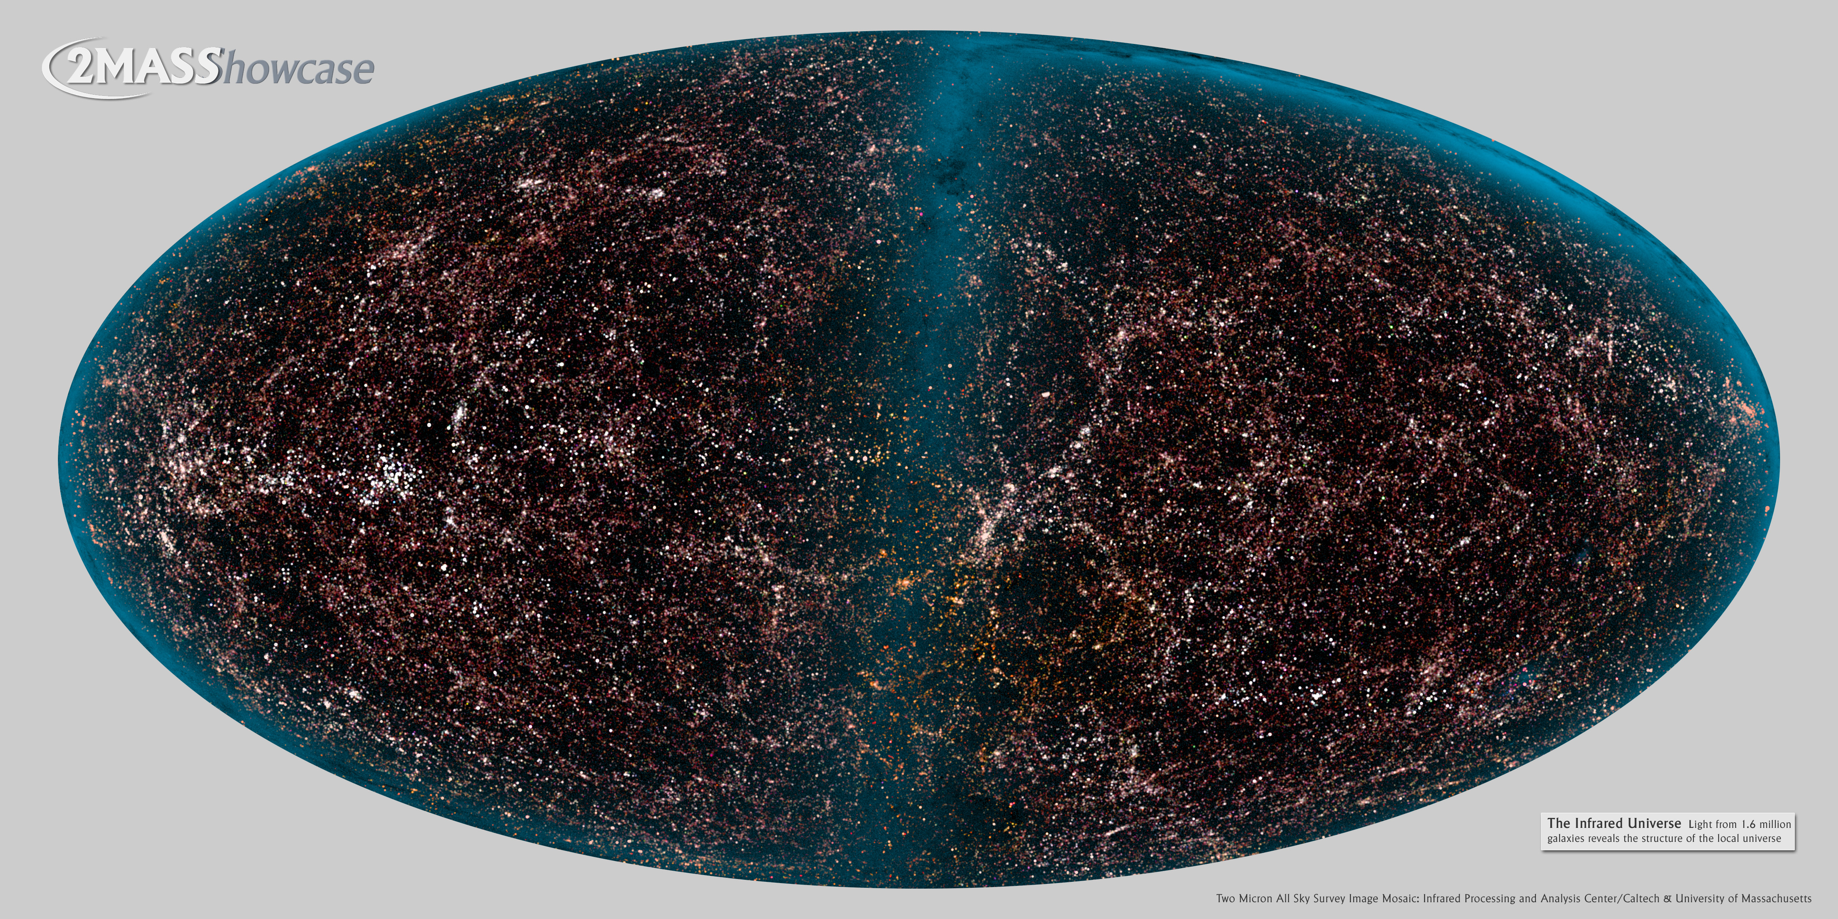
THANK YOU

