Slide 1
Study of metabolic syndrome profil in gardinnage company of the university
Of Yaoundé I
presented
by
Dr. Mandob Enyegue Damaris

Slide 2
PLAN
Introduction
Material and Proceduris
Results and Discussions
Conclusion and perspectives

Slide 3
Introduction
The metabolic syndrome is actually a major problem to public healt
The theme metabolic syndrome refers to a group of abnormatities which can be carbohydrates, lipids and associated vascular risk factors that can lead to diabetes type II and cardiovascular diseases linked to atherosclerose in most individuals.
The history of metabolic syndrome is illustrated by the evolution of it’s name: Plurimetabalic syndrome, X syndrome, mortal quartor, insulino-resistant syndrome and dysmetabolic syndrome

Slide 4
Introduction
It is characterised in an individual by the simultanous presence of the following factors:
Obesity
Dyslipidemia
Arterial hypertension
The high waistline
Hyperglycemia
Several studies have proven that individuals having all above characteristies are exposed to high cardiovascular abnormatities ( Empara and al.,2004)

Slide 5
Introduction
There exist several definitions of metabolic syndrome which complicates a son diagnostic,proposed by international organisations and group of experts such as;
OMS (1998 )
EGIR (1999)
The NCEP-ATP III (2001)
AACE (2001)
AHA/NHLBI (2004)
FID (2005)
FID/AHA/NHLBI (2009)
But those proposed by the NCEP are easily applicable clinically.

Slide 6
Introduction
The definition of the NCEP does not any criteria
Fasting blood sugar 6.1 mmol/L
Arterial pressure 130/80 mmHg
Dyslipidemia TG 1.7 mmol/L
HDL 1mmol/L in men and
1.3 mmol/L in the women
Klaist size 102 cm in men et 88 in woman

Slide 7
Introduction
Studies show the prevalence of metabolic syndrome and a components varis ethnicity, dietany behaviors, physical activity,age,sex, the genetic difference(Cameron and al.,2004
The choice is between campus police base on their daily activities ( duration at work, stationang station to station,stress, the daily feeding etc.)

Slide 8
Introduction
The mastery of risk factors associated wich metabolic syndrome , has brought us to set awselves the general objectives.
The metabolic syndrome in individuals of the company baby sitting (garding) the university of yaoundé I
Specific objectives :
The prevalence of individual components of the metabolic syndrome,
The prevalence of the metabolic syndrome,
The characteristics of metabolic syndrome in the company

Slide 9
Material and procedures
This study was sponsored by the Education and prevention of non communicable diseare programm of the medical foundation Andre Fouda and authoriced by the rector of the university of yaoundé I.
The levy and biochimical examination were made by frained personnel of the medical foundation Andre Fouda
Investigation:
Interrogation;
A survery sheet enabled us to identyfy the demographie data of patients.

Slide 10
Material and procedures
Taking anthropometric measurements ;
the following materials (equipments) permitted us to take the anthropometric measuerements .
A measuring rod , which was used to measure the size;
A weigh-person (balance), which was used to measure the weight;
A meter tape , which measured the waist circumference;
A sphygmomanometer, whivh was used to measure blood pressure

Slide 11
Material and procedures
Blood sample and evaluated of biochimical parameters:
Blood samples were leviel fasting by veripimeture on heparin;
The test tubes with anticoagulant were used to collect the blood to dose (titrate) for glycimia;
The test tubes withait anti-coagulant were used to collect the blood ta titrate (dose) for lipid parameters
Plasma glycemia
Serum lipid properties (parameters): TG, Chol-t,
Chol-HDL

Slide 12
Material and procedures
Statistical data analysis
The qualitatives variables were expremed by their averaye +- standard deviation which the qualitatives were expremed by their percentage of the work force;
The SPSS ( statistical package for social sciences) version 16.0 for window was used for the analysis of results;
The significance level used was of 0.05

Slide 13
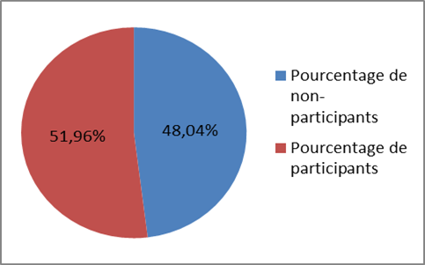
Results and discussion
Individuals 53 in number responded favorable to the study
Figure 1 : Turn out of particiption and non participation

Slide 14
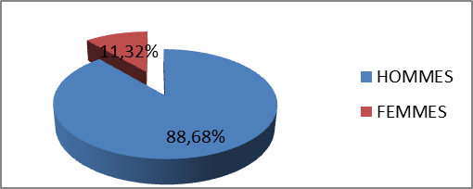
Results and Discussion
Figure 2: Distribution of population of study by sex of the person individual

Slide 15
RESULTS AND DISCUSSION
The participetion rate of 51.96 % was obtained thanks to the agreement of the president who motivates participants and also the awareness that we had conducted with the chief of campus police.
Nearly72 % of participation have a degree GCE E-Leve.
However 48.04 % of the rate of non-participation of the fear of screening for STDS and also the degree of understanding based on the importance of the study of non-communicable diseases at high risk.
We find that this population is in majority of human or 88.68 %. The met the natural conditions in the genre and are more physically.
The low proportion of the woman 11.32 % is due to the lack of substantial recrutment of woman in this body metier (type of job). The security requires certain physical competence

Slide 16
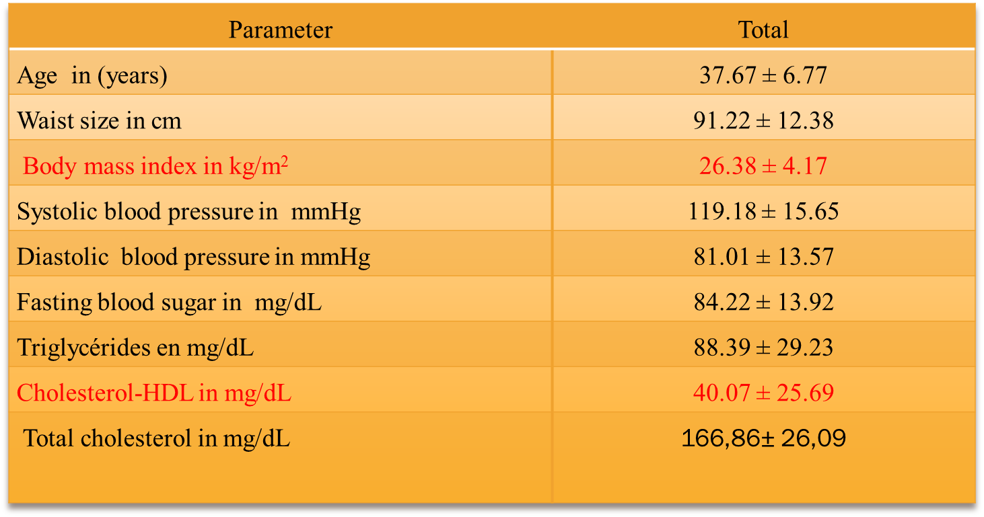
RESULTS AND DISCUSSION
Biographic and demographic characteristics
T able I: Representation of biographical and demographical characteristics

Slide 17
RESULTS ET DISCUSSION
The average of 26.38 +-4.7 25 BMI which corresponds to the maximum normal value and the cholesterol-HDL whose average is 40.07+- 25.69 characterizes the minimum threshold hypocholesterolemia.
Other parameters values were within normal rangs
The high rates of overweight, high blood pressure and HDL-hypocholesterolemia observed can be explained by the high alcohol consomption including energy promotes the storage of energy from food.

Slide 18
RESULTS AND DISCUSSION
The overweight wchich will lead to obesity is also responsible for the genesis of dyslipidemia with results, by the decrease in HDL-cholesterol levels and observed non-dimination of total cholesterol.
The HDL-cholesterol deficit causes an accumulation of total cholesterol in tissues with consequence the genesis of atherosclerosis which is the main determinant of VDC

Slide 19
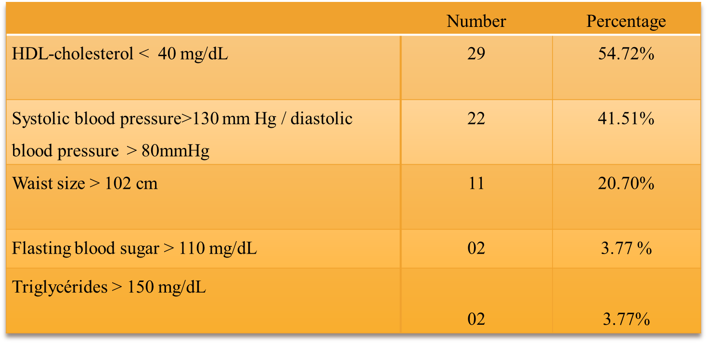
RESULTS AND DISCUSSION
Prevalence of metabolic syndrome and as individual components.
Table II : Prevalence of metabolic syndrome and as individual companents

Slide 20
RESULTS AND DISCUSSION
HDL-cholesterol (54.72 %) blood pressure (41.51%) and waist circumference (20.75%) are the most frequence individual components.
Glycemia and fasting triglycerides are less frequent components witheach 3.77 %.
Alcoholism and smoking are strongly associated to the occurrence of metabolic syndrome components (Tolstrup and al., 2006; Csiszar and al., 2009).
Alcohol prevalence was high 100 % in people who consumed at least once a day , wich explains the high rate of hypercholesterolemia- HDL, blood pressure and waist circumference.

Slide 21
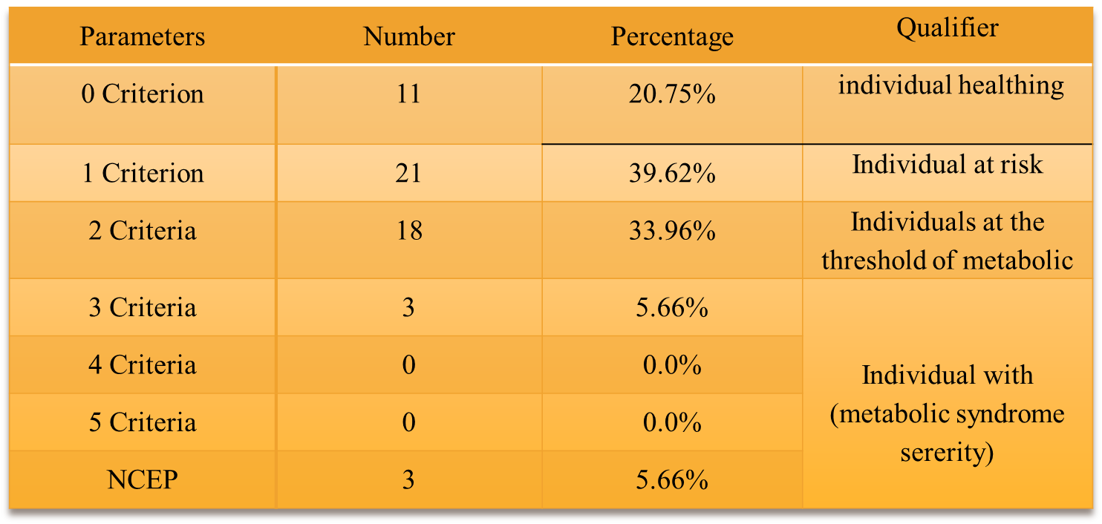
RESULTS AND DISCUSSION
According to NCEP, to be a bearer of metabolic syndrome , one should have at least 3 of the 5 criterria that characterize the metabolic syndrome
Table III : Evolution and sevrety of metabolic syndrome components

Slide 22
RESULTS AND DISCUSSION
These various cardimetabolic risk factors helped determine the prevalence of metabolic syndrome in our study population.
We got a low prevalence of metabolic syndrame in the rangs of 5.66 %.
This low prevalence of the matabolic syndrome many be explained by the level of physical activity of the regular traning that has suffered this population .
However 33.96 % of people are on the threshold of metabolic syndrome.
This is explained in part by the presence of hypocholesterolemia and blood pressure elevation and partly by their physical activaty which improves insulin sensitivity ( Pater and al., 1995) and reduces some complications of obesity for example and therefore the aggregation of many components of metabolic syndrome in the population.

Slide 23
Conclusion
In the course of this study whose general objective was :
The metabolic syndrome in the individuals of the campus police .
More specificly:
The prevalence of the metabolic syndrome individual components;
The prevalence of the metabolic syndrome;
The characteristies of the metabolic syndrome.
The prevalence of individual components such as blood glycose, HDL-Cholesterol, TG, hypertension were respectively 3.77 %, 54.72 %, 3.77 %, and 41.51 %.
The prevalence of the metabolic syndrome among this company is 5.66 %

Slide 24
PERSPECTIVE AND RECOMMENDATION
The evolution of CVD and stoke being very dynamic in Cameroun, we will extend our study to other gardinnage companus as DAK services, G4S etc and also in the army
As a recommendation
A change in lifestyle ( diet, physical activity, smoking and alcoholism) should be made;
Daily physical activity of moderne intensity for at least 30 minutes.

