Slide 1
Endothelium as a part of septic Multiple Organ Dysfunction Syndrome (MODS)-is endocan an answer ?
Małgorzata Lipinska-Gediga
Department of Anaesthesiology and Intensive Therapy
Medical University Wroclaw, Poland

Slide 2
Sepsis is a systemic, deleterious host response to infection leading to severe sepsis (acute organ dysfunction secondary to documented or suspected infection) and septic shock (severe sepsis plus hypotension not reversed with fluid resuscitation)
Intensive Care Med (2013) 39:165–228
DOI 10.1007/s00134-012-2769-8

Slide 3
Under resting conditions, endothelial cells exhibit a number of important physiological functions :
regulate blood pressure and blood flow by modulating the tone of arterioles
inhibit blood coagulation
express thrombomodulin, which binds thrombin and Activated protein C (APC), with its cofactor protein S, blocks the cofactors VIIIa and Va of the clotting system.
release small amount of tissue-type plasminogen activator and inhibit platelet aggregation by producing prostacyclin and nitric oxide
regulate the transmigration of leukocytes by controlling the expression of adhesion molecules and the production of chemoattractants

Slide 4
As one of the largest “organs”, the endothelial and capillary system occupies a central role in the homeostasis of organ functions. However, one of the largest and most important organs, is not routinely tracked in the daily clinical routine
In sepsis, endothelial activation and dysfunction are critical determinants of the host response and represent an explanation for the complex sepsis pathophysiology
( Iba et al. 2005; Shapiro et al. 2010,Paulus 2011).Given this central place of the endothelium, there is a strong biologic rationale for targeting markers of endothelial activation as biomarkers of sepsis. (Pierrakos and Vincent 2010, Paulus 2011, Xing 2012, De Backer 2014).

Slide 6
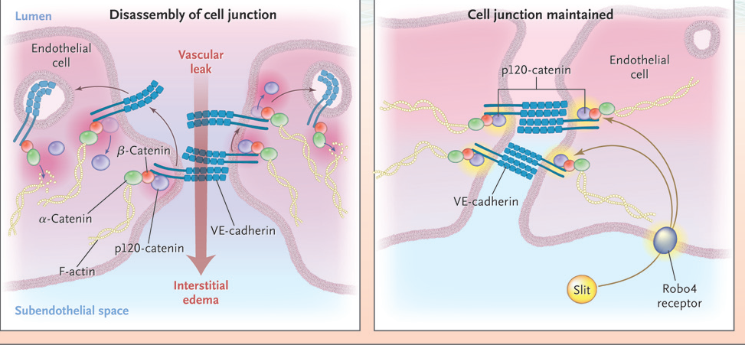
N Engl J Med 363;7 nejm.org August 12, 2010

Slide 7
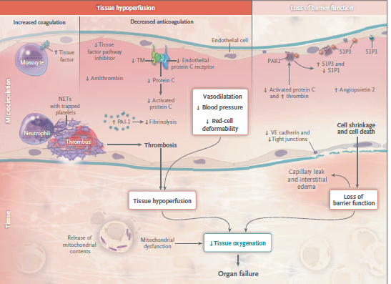

Slide 8
Endocan, also called endothelial cell-specific molecule-1, is a soluble 50 kDa dermatan sulfate proteoglycan that is secreted from pulmonary and kidney vascular endothelial cells [Bechard et al. 2001, Lassalle et al.1996]. Endocan is stable at low levels in the blood and was detected in the serum of healthy subjects at an average concentration of 1.08 ng/ml. ESM-1 mRNA is regulated by the cytokines, TNFα induced accumulation of ESM-1 mRNA early;(Berchard et al. 2000), it was detectable at the second hour and peaked at the 18th hour of TNF incubation. The spontaneous as well as TNFα-induced secretion of ESM-1 is strongly inhibited by IFNγ. Endocan was shown to inhibit the interaction between intercellular adhesion molecule-1 (ICAM-1) and the integrin (lymphocyte function-associated antigen-1) LFA-1 on leukocytes, and can modulate LFA-1 mediated leukocyte functions, such as the firm adhesion of leukocytes to the endothelium and the leukocytes transmigration (Bechard et al. 2000)

Slide 9
Study group comprised twenty two patients with septic shock, admitted to the Department of Anesthesiology and Intensive Therapy of Wroclaw Medical University, Poland. Patients with cardiogenic shock and other acute circulatory failure not induced by infection were excluded from the study. The study group patients were retrospectively divided into the survivors (n = 15) and non-survivors (n = 7) subgroups. The diagnosis of septic shock was performed according to the 2001 Consensus Conference Criteria .This study is observational and prospective. The status of clinical patients was assessed with the Acute Physiology and Chronic Health Evaluation II (APACHE II) score [Knaus et al. 1985] on admission to the ICU, and the extent of multiple organ failure was evaluated using the Sequential Organ Failure Assessment (SOFA) score [Vincent et al.1996] on admission, and on the 2nd, 3rd, and 5th days. Blood was drawn on admission, and on the 2nd, 3rd, and 5th days.

Slide 10
The data were analyzed with non-parametric test (Mann–Whitney U-test) to compare the two groups. The APACHE II and SOFA score values are presented as the mean ± standard deviation (SD). A P value $≤$ 0.05 was considered to be statistically significant.
Correlation analysis with continuous data was conducted using Pearson’s correlation test (r). All analyses were performed using the STATISTICA data analysis software system, version 10. StatSoft, Inc. (2011). www.statsoft.com

Slide 11
Control group-adult patients undergoing valve replacement or coronary artery bypass grafting under cardiopulmonary bypass (ECC) were consecutively included in the study. Endocan levels were measured before and directly after surgery, next on the 1st and 2nd postoperative day at the ICU. The control group consisted of 19 patients (12 men, 7 women, mean age 67 years), this group presented no multiple organ failure in postoperative period and the ICU stay didn’t exceed 2 days.
 | Cardio (ECC) group n=19 | Septic group n=22 | P value
Endocan _{1st} | 2,10 (0,64÷7,9) | 5,25 (0,58÷13,0) | 0,0009
Endocan _{2nd} | 5,06 (0,97÷6,9) | 5,09 (0,58÷12,0) | 0,24
Endocan _{3rd} | 4,80 (1,09÷11,0) | 2,36 (0,65÷10,0) | 0,08
Endocan _{4th} | 3,1 (1,0÷10,7) | 2,01 (0,58÷12,0) | 0,68

Slide 12
APACHE II and SOFA score in septic shock group
 | Survivors N=15 | Non-survivors N=7 | P value
APACHE II _{1st day} | 21,5 ± 5,41 | 28,66± 7,36 | 0,025
SOFA _{1st day} | 10,85 ± 2,53 | 13,66 ± 3,07 | 0,048
SOFA _{2nd day} | 8,14 ± 1,87 | 12,16 ± 3,18 | 0,002
SOFA _{3rd day} | 6,07 ±3 ,19 | 11,00 ± 6,27 | 0,04
SOFA _{5th day} | 4,33 ± 3,04 | 12,00 ± 5,29 | 0,009
Endocan (ng/ml) in septic shock group
 | Survivors N=15 | Non-survivors N=7 | P value
Endocan _{1st day} | 4,46 (0,58÷9,57) | 7,15 (2,8÷13,0) | 0,13
Endocan _{2nd day} | 5,34 (0,58÷10,8) | 4,85 (2,6÷12,0) | 0,52
Endocan _{3rd day} | 2,26 (0,65÷10,0) | 4,0 (2,34÷10,0) | 0,19
Endocan _{5th day} | 1,76 (0,58÷8,00) | 10,8 (1,56÷12,0) | 0,03

Slide 13
 | Cardio (ECC) group n=19 | Septic survivors n=15 | P value
Endocan _{1st} | 2,10 (0,64÷7,9) | 4,46 (0,58÷9,57) | 0,006
Endocan _{2nd} | 5,06 (0,97÷6,9) | 5,34 (0,58÷10,8) | 0,6
Endocan _{3rd} | 4,80 (1,09÷11,0) | 2,26 (0,65÷10,0) | 0,005
Endocan _{4th} | 3,1 (1,0÷10,7) | 1,76 (0,58÷8,00) | 0,25
 | Cardio (ECC) group n=19 | Septic non-survivors n=7 | P value
Endocan _{1st} | 2,10 (0,64÷7,9) | 7,15 (2,8÷13,0) | 0,002
Endocan _{2nd} | 5,06 (0,97÷6,9) | 4,85 (2,6÷12,0) | 0,38
Endocan _{3rd} | 4,80 (1,09÷11,0) | 4,0 (2,34÷10,0) | 0,88
Endocan _{4th} | 3,1 (1,0÷10,7) | 10,8 (1,56÷12,0) | 0,20

Slide 14
Procalcitonin (PCT) is a prohormone of calcitonin consisting of 114 to 116 amino acid, PCT originates from the calcitonin-I (CALC-I) gene on chromosome 11.Under physiological conditions serum levels are below 0.5 ng/ml. A microbial infection induces an ubiquitous increase in CALC-I gene expression and a significant release of CTpr from all tissues and cell types (Müller, 2001 ) . Whang and et. al considers that PCT is a secondary mediator intensifying, rather than initiating, the septic response (Whang, 2000). According to SSCIG 2013 (Dellinger 2013) PCT is used as a diagnostic marker of sepsis, monitoring its course and therapeutical efficacy.

Slide 17
Based on the preliminary results, the serum endocan is usually only slightly induced in the course of the time-limited inflammatory response (cardiac surgery)
The highest values of endocan were observed in non-survivors (n=7) and was directly associated with the highest APACHE II and SOFA score results, reflecting the clinical status and progress of multiple organ failure in this group
Prognostic value ?
Correlations?
The research is ongoing

