Slide 1
Interparticle interactions between water molecules
M. Yasutomi
University of the Ryukyus, Japan

Slide 2
I. Introduction
In a very cold winter, ice covers a surface of a lake, but water below the ice doesn’t freeze into ice and all creatures in liquid water can be alive. They owe their lives to the thermodynamic property of liquid water that
It has a density maximum at 4℃.
Liquid water has also a compressibility minimum at 46.5℃.
Solid water has polymorphic structures.

Slide 3
In this way, liquid water has a number of anomalies.
Although these have been long studied by many different authors up to now, it is not still cleared what thermodynamic mechanisms induce these phenomena.
I’m going to elucidate the physics underlying them.

Slide 4
II. Summary
First, I summarize our results.
We discovered a new simple technique of mimicking any function by Yukawa terms.
It reduces greatly the computation time to a few minutes from a few months or a few years.
We estimated many functional representations of interparticle interactions between water molecules.
Selected potentials are shown in Figs. 1 and 2.

Slide 5
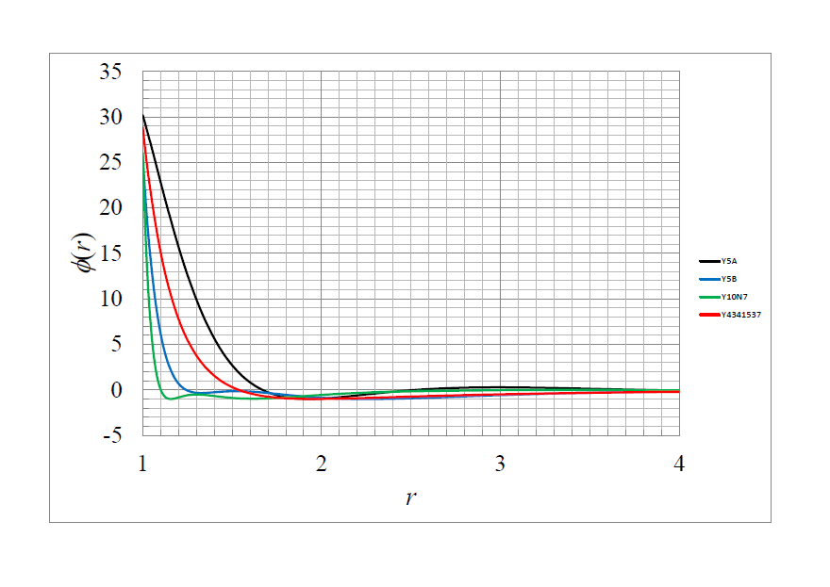
Fig.2.
Fig. 1.

Slide 6
X
All of the potentials reproduce the experimentally measured density-temperature relation at 1 bar with an accuracy better than obtained by previous models.

Slide 7
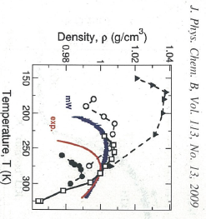
Fig.4.
Fig.3.

Slide 8
X
It is clear that our results are better compared with those by other models available in the literature.

Slide 9
X
Next, I show isothermal compressibility as a function of temperature at 1 bar in Fig.5 which are obtained by using the potentials shown in Fig. 2.
Dashed line shows experimentally measured data.
Figures 2 and 5 show that liquid with steeper repulsion has smaller compressibility.
We will be able to obtain more optimum potential model in a few months.

Slide 10
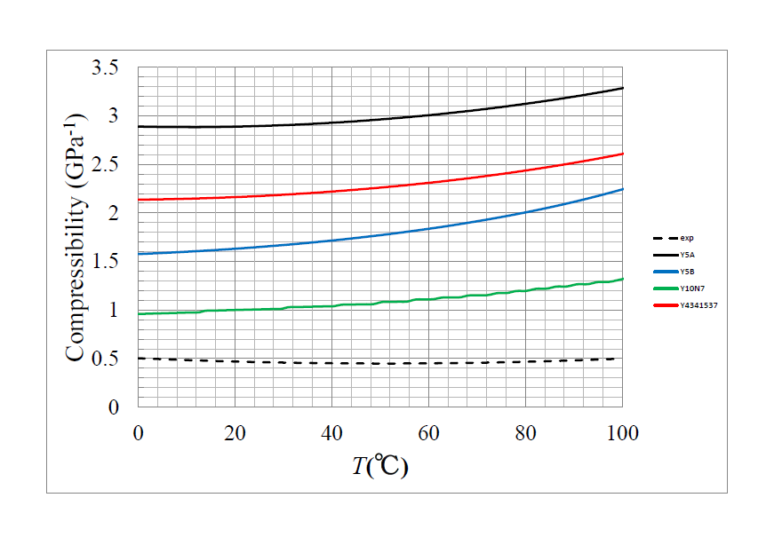
Fig.2.
Fig.5.

Slide 11
X
Later, I will show that density anomaly is caused by the soft-repulsion near the hard-core contact depending on the atraction.
In the following sections, I will present our theory, a new simple technique of fitting by Yukawa terms, and physics underlying the density anomaly.

Slide 12
III. Self-Consistent Ornstein-Zernike Approximation (SCOZA)
OZ relation
Closure
Consistency
(1)
(2)
(3)

Slide 13
Excess internal energy per unit volume
Pair interaction between water molecules
Hard-core repulsion + Multi-Yukawa tails
(4)
(5)

Slide 14
IV. A new simple fitting technique
The conventional fit:
It takes a few months or a few years to mimic any smooth potential by six or seven Yukawa terms, respectively.
2. A new simple fit:
z_{n} =(n-1) z₂ (n>2). (6)
It takes only a few minutes to attain the same accuracy as that mentioned above.

Slide 15
X
V. A great number of pair potentials between water molecules
Thermodynamic properties of liquid water can be obtained from u.
There would be infinite number of combinations of φ and g which give the same u because it is determined by the product φ g.
This will help us to understand why solid water has polymorphic structures and why liquid water has a large number of anomalies.

Slide 16
VI. Physics underlying the density anomaly
When α>0, pressure decreases with reducing temperature.
When α<0, pressure increases with reducing temperature (pressure anomaly).
The behavior of u determines the sigh of α.
(7)

Slide 17
Liquid water model: Case 1
usual liquid model: Case 2
Fig. 6

Slide 18
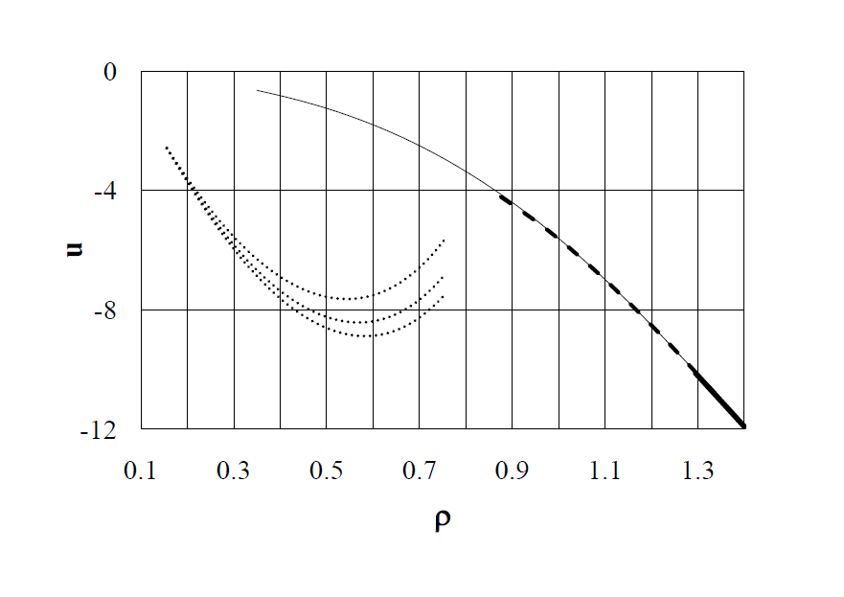
Higher T
Case 2
Case 1
Lower T
Higher T
Lower T
Fig.7

Slide 19
Lower T
Case 1
Case 2
Higher T
Fig.8

Slide 20
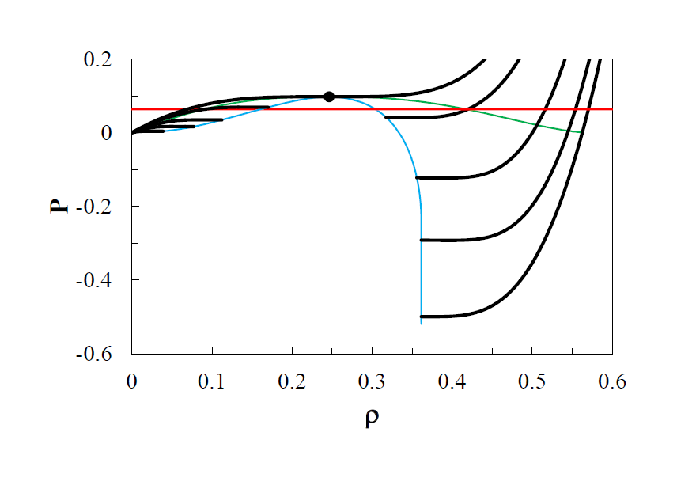
α>0
higher T
higher T
lower T
lower T
Fig.9

Slide 21
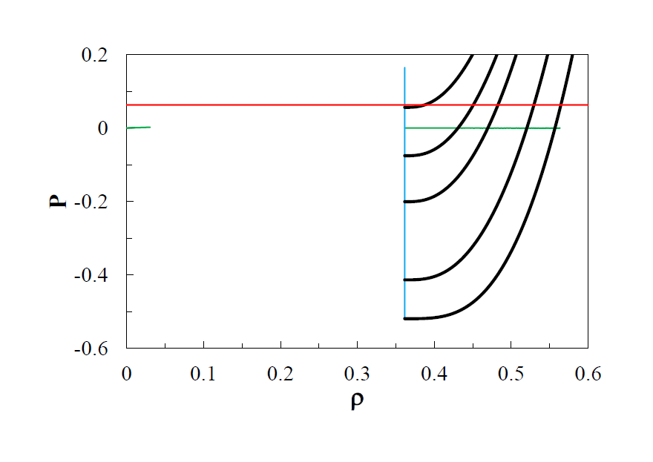
α<0
lower T
higher T
Fig.10

Slide 22
The integrand f which determines u.
(4)
(8)
Δf: the difference of f(r,ρ,T) from that at 20ºC
(9)

Slide 23
Fig.11

Slide 24
X
Δf increases greatly near the hard-core contact with reducing temperature.
Now we can conclude that the behavior of u is determined by the soft-repulsion near the hard-core contact and the behavior causes density anomaly of liquid water.

Slide 25
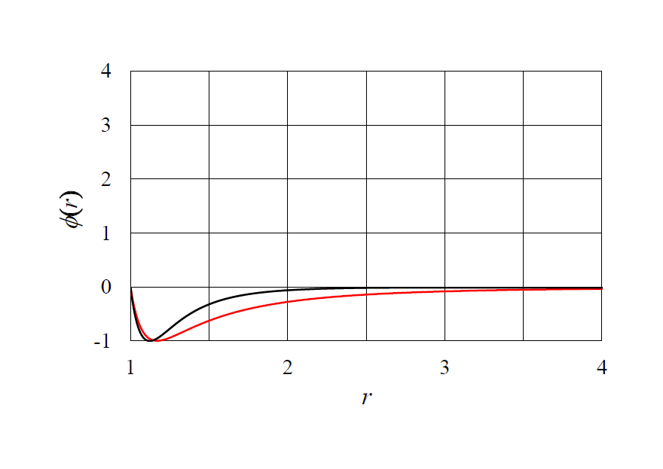
Conditions for a tail to cause density anomaly
Fig.13.
Fig.12

Slide 26
We can conclude that negative thermal expansion is caused when the value of the potential tail at the hard-core contact is in some proper range which depends on the shape of the attraction.

Slide 27
VIII. Summary
We presented a new simple technique of fitting by multi-Yukawa terms which reduces drastically the computation time.
There would be infinite number of combinations of φ and g which help us to understand why liquid water has many anomalies and ice has polymorphic structures.
Density anomaly is caused by the behavior of u which is determined by the soft-repulsion near the hard-core contact.

Slide 28
The compressibility is determined by the degree of steepness of the soft-repulsion.
Almost all of the ideas put forward up to now tell us nothing about what induces negative thermal expansion of liquid water.
Reference
Frontiers in physics: Condens. Matter, 2014,
“Interparticle interactions between water molecules’’

Slide 29
Thank you so much.

Slide 30
Finally we discuss what thermodynamic mechanism induces the density anomaly, which has been long studied by different authors with numerous ideas put forward.
However, it has also been long pointed out that these ideas tell us nothing about what causes the negative thermal expansion at temperatures below 4ºC .
For example, one claim is that the tetrahedral structure of ice causes the density anomaly, but there is no evidence for this.

Slide 31
As a counter analogy, consider a folding umbrella. To open or close it, one pushes or pulls the base of the frame with hand power. The frame itself has no power to open or close itself without human intervention.
In the case of the umbrella, the direct cause of its expansion and contraction is human hand power and not the frame itself.
To clarify the thermodynamic mechanism that causes the density anomaly, it is necessary to find the power that acts as an attractive force to condense water at temperatures above 4ºC, but acts as a repulsive force to expand water below 4ºC with reducing temperature.

Slide 32
Such a force (hereafter referred to for simplicity as the “anomaly force’’) is the immediate cause of the density anomaly of liquid water.
It is difficult to imagine how the tetrahedral structure could have an “anomaly force’’ analogous with the case of the folding umbrella.

Slide 33
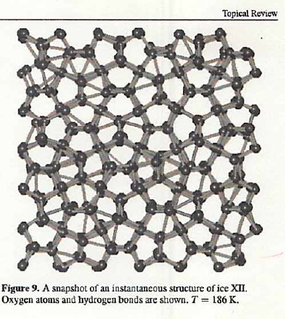

Slide 34
