Slide 1
Biosorption of zinc by living and lyophilized biomass of Bacillus cereus DAA54 and Pseudomonas aeruginosa DAA86
Presented by:
Abugharbia M. A.

Slide 2
Introduction

Slide 3
Heavy metals as pollutants
Heavy metals are:
1- Able to form complex compounds.
2- Pollutants for water.
3- Not biodegradable and accumulate in living cells causing diseases.

Slide 4
Metal removal
Biological removal processes:
Removing heavy metals from aqueous wastes using some bacteria.
Bacterial removal by biosorption of heavy metals is low cost, rapid and minimizing secondary problems.

Slide 5
Biosorption as example of bioremediation
Bioremediation based on living or non-living bacteria.
Biosorption is an energy independent.
Bioremediation technology based on binding of metals to cell wall of bacteria to remove pollutants.

Slide 6
Zinc and microorganisms
Zinc is an essential trace element for growth and enzyme activities of heterotrophic bacteria. However, excess load of Zn shows toxicity and inhibition to bacterial processes.

Slide 7
Therefore we design this research to solve water –Zinc pollution problem as follows:
This research aim to assess the efficiency and ability of the most resistant bacterial strains Bacillus cereus DAA54 and Pseudomonas aeruginosa DAA86 on bioremediation of water polluted by Zinc.

Slide 8
To solve this problem, We have done this steps:
1st step: Isolation of the most resistant bacterial isolates to zinc from different polluted water resources, Agricultural, Domestic and Industrial waste water at Sohag, Egypt. Isolation according to standard bacteriological methods .
2nd step: 102 Isolates were isolated and tested for Zn²⁺ toxicity under different concentrations from 50 up to 800 ppm.

Slide 9
3rd step: We chose the most two resistant isolates to zinc for further investigations.
Fig. Reveal that only 6.67 % of isolates could survive Zn ²⁺ toxicity at concentration of 700 ppm, whereas 100% of isolates could survive at 50 and 100 ppm.
Among 102 isolates detected, we found that isolate no. 37 (Gram positive) survive at 300 ppm and isolate no. 56 (Gram negative) survive at 700 ppm were the most resistant.

Slide 10
4th step: Identification of the two isolates (37 and 56) using morphological and biochemical tests and genetically by 16SrRNA analysis according to Bergey’s Manual (1984; 1994; 2005).

Slide 11
Results of biochemical tests for isolate no. 37 and 56:
Test | Isolate 37 | Isolate 56
Gram staining | + | -
Motility | + | +
Shape | Rod-shape | Rods
Spore forming | + | -
Starch hydrolysis | + | -
Casien hydrolysis | + | +
Reduction of nitrate | + | +
Urease test | - | +
Gelatin hydrolysis | + | +
Lipase test | + | -
Growth at 4° C | ND | -
Test | Isolate 37 | Isolate 56
Acid and gas from glucose | - | +
Growth on 7% NaCl | + | +
Anaerobic Growth | + | -
V-P reaction | - | -
MR test | + | +
Catalase test | + | +
Oxidase test | - | +
Citrate test | + | +
King A | ND | +
King B | ND | +
The bacterial isolates were tentatively identified on the basis of classification schemes (isolate no. 37 as Bacillus cereus 37 and isolate no. 56 as Pseudomonas aeruginosa 56) .

Slide 12
Identification of isolates 37 and 56 using 16S rRNA analysis
Isolate 37 indicated greatest similarity to members of the Bacillus sp. group. As illustrated, the 16S rRNA sequences of isolate 37 was most closely related to Bacillus cereus. These results suggest that the isolates are new isolates of the bacterium Bacillus cereus. The 16S rRNA gene sequences of the bacterial isolate number 37 reported in this research were deposited in the DDBJ/ EMBL /GenBank nucleotide sequence databases with the accession number: AB831654 (Bacillus cereus DAA54).
Isolate 56 indicated greatest similarity to members of the Pseudomonas sp. group. The 16S rRNA sequences of isolate 56 was most closely related to Pseudomonas aeruginosa. These results suggest that the isolates are new isolates of the bacterium Pseudomonas aeruginosa. The 16S rRNA gene sequences of the bacterial isolate number 56 reported in this research were deposited in the DDBJ/ EMBL /GenBank nucleotide sequence databases with the accession number: AB831653 (Pseudomonas aeruginosa DAA86).
We got these results by Macrogen Korea lab.

Slide 13
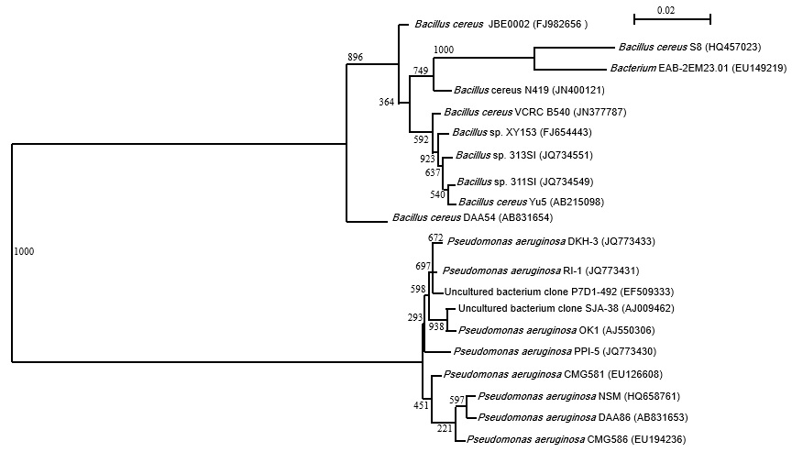
Phylogenetic tree of Bacillus cereus DAA54 and Pseudomonas aeruginosa DAA86 isolates and related bacteria based on 16S rRNA gene sequences. Boot values were based on 1000 replicates. Scale shows percentage of substitutions per nucleotide position

Slide 14
5th step: Study of the effect of different concentrations of Zn²⁺ on growth and protein banding pattern
A. Growth curves of Bacillus cereus DAA54 and Pseudomonas aeruginosa DAA86.
Both isolates were grown in tris minimal broth (Mergeay, 1995) amended with 20, 60 and 100 ppm Zn ²⁺ for Bacillus cereus DAA54 and with 40, 80 and 120 ppm Zn ²⁺ for Pseudomonas aeruginosa DAA86. Cultures without heavy metals were used as control. All cultures were incubated at 37 °C for 12 h and at 150 rpm. Cultural samples were taken at regular intervals for measuring optical density at λ = 600 nm (OD 600nm) of each culture using Atomic absorption spectrophotometer (AAS) (Model 210 VGP Buck Scientific) spectrophotometer.

Slide 15
A. Bacillus cereus DAA54
B. Pseudomonas aeruginosa DAA86
Figs. (A and B) : Showed that growth curves of (A) Bacillus cereus DAA54 and (B) Pseudomonas aeruginosa DAA86 grown in tris minimal medium containing (0, 20, 60 and 100) and (0, 40, 80 and 120) ppm Zn²⁺ , respectively.
Fig. (A) Showed that the growth not affected up to 100 ppm Zn²⁺.
Fig. (B) Showed that the growth affected up to 120 ppm Zn²⁺ and lag phases exhibited prolongation up to 4 hours at concentrations (40 and 80) ppm Zn²⁺, where it was 6 hours at 120 ppm Zn⁺² compare to the control (2 hours). Generally, higher concentrations of metals caused inhibition in the maximum growth compared to control

Slide 16
B. Protein banding patterns of Bacillus cereus DAA54 and Pseudomonas aeruginosa DAA86.
The protein patterns were analyzed using SDS-PAGE (Sodium Dodecyl Sulphate- Poly Acrylamide Gel Electrophoreses) according to Laemmli, (1970) in the first dimension.

Slide 17
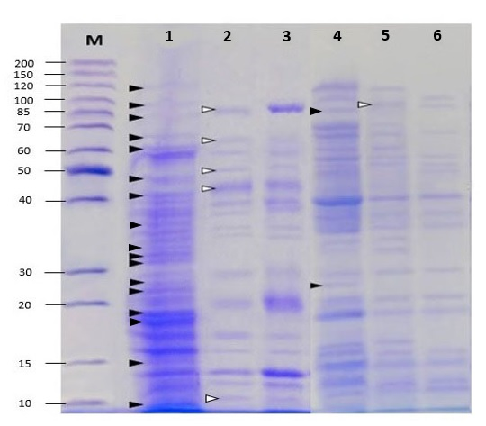
Protein analysis for B. cereus DAA54 and P. aeruginosa DAA86 under zinc stress
B. cereus DAA54
P. aeruginosa DAA86
Fig. Protein patterns of Bacillus cereus DAA54 and Pseudomonas aeruginosa DAA86 growing in tris minimal broth medium enriched with different concentrations of Zinc. M = marker, Lane 1: control of Bacillus cereus DAA54, Lane 4: control of Pseudomonas aeruginosa DAA86 , Lane 2 & 5: represent protein pattern of 50 ppm Zinc treatment, Lane 3 & 6: represent protein pattern of 150 ppm Zinc treatment. ( refer to disappeared bands, refer to the new bands after treatments).
KDa

Slide 18
Bacillus cereus DAA 54 lost proteins with a molecular weight ( 116, 93, 79, 64, 60, 48, 42, 37, 34, 33, 32, 26, 24, 18, 17, 14 and 10) kDa under zinc stress while proteins with molecular weights ( 89, 63, 50, 44 and 11 ) kDa were induced.
Pseudomonas aeruginosa DAA 86 lost under zinc stress proteins with molecular weights ( 119, 100, 88, 72, 60, 50, 35, 34, 26 and 16 ) kDa while induced new protein with a molecular weight (96) kDa.

Slide 19
6th step: Qualitative analysis for assessing the ability of the two strains in biosorption of zinc using Infrared analysis (IR) for free biomass and Zinc-loaded biomass.
Preparation of bacterial biosorbents was performed according to Aksu & DÖnmez (2001) and Puranik & Paknikar (1999). Raw samples and biomass loaded with 40 ppm Zn²⁺ were analyzed by an Infrared spectrophotometer (IR) Model 470 Shimadzu corporation adopting KBr disk technique, which was performed to give a qualitative and preliminary characterization of the main chemical groups present on the cell wall that are responsible for heavy metal biosorption. (Selatnia et al., 2004).

Slide 20
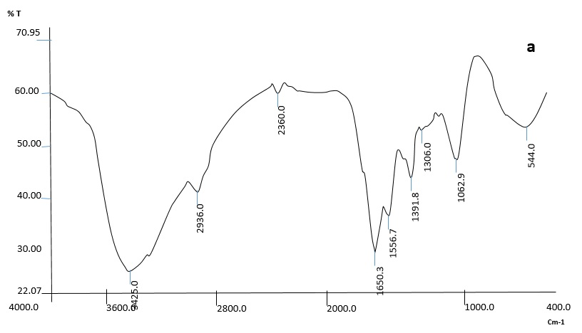
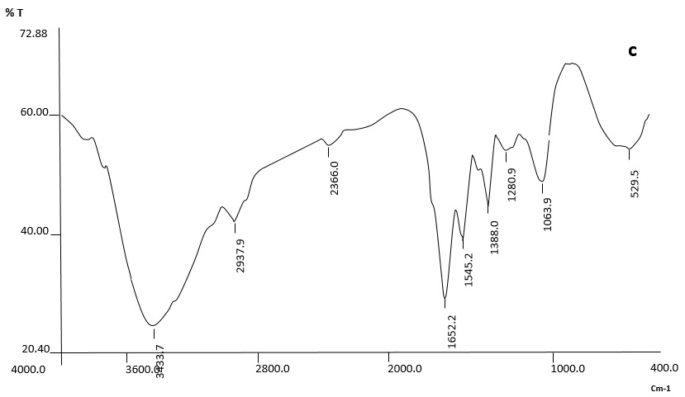
Bacillus cereus DAA54
b
IR analysis for Bacillus cereus DAA54 the bacterial metal free biomass (a), and biomass after 40 ppm of zinc loaded (b).

Slide 21
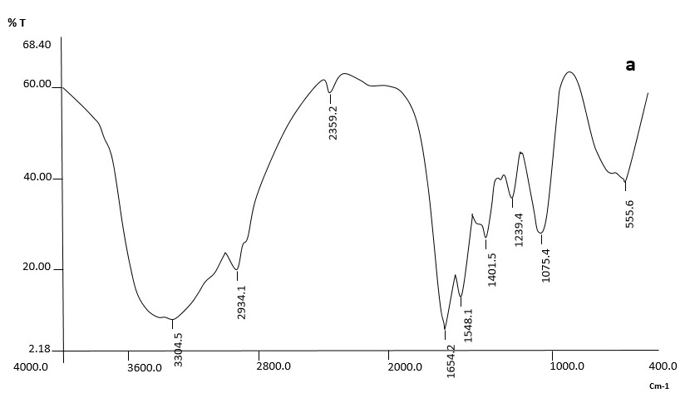
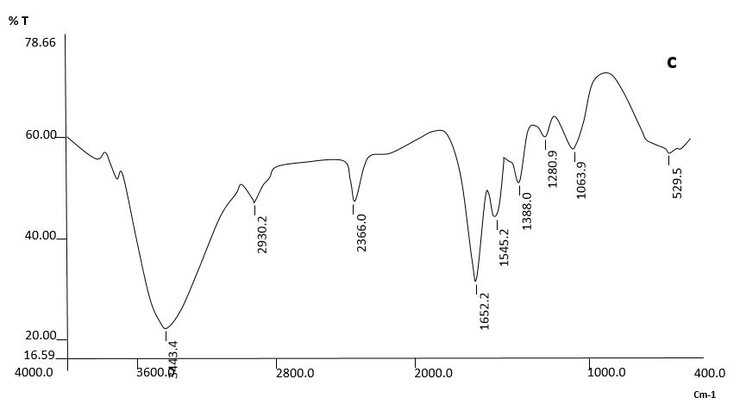
Pseudomonas aeruginosa DAA86
b
IR analysis for Pseudomonas aeruginosa DAA86 the bacterial metal free biomass (a), and biomass after 40 ppm of zinc loaded (b).

Slide 22
Infrared spectra showed that B. cereus DAA54 and P. aeruginosa DAA86 biomass possesses different chemicals groups (R–NH₂ , OH, NH, C=O, S–S and P-OH).
Biosorption of zinc caused shift in the vibration bands in the zinc-loaded biomass suggesting the role of these groups in the adsorption of zinc.

Slide 23
7th step: Optimization of factors affecting bisorption
A. Effect of pH
The impact of the solution pH on the metal biosorption was investigated in the biomass of Bacillus cereus DAA54 and Pseudomonas aeruginosa DAA86 and conditioned to different pH environments (ranging between 2.0 and 8.0) containing 20 ml of metal solution. The pH adjustment was done with the addition of either 0.1M NaOH or 0.1M HCl. Sodium nitrate (0.1M) was used as a supporting electrolyte for all experiments. The method was carried out according to Seki et al., (1998).
B. Effect of contact time
Experiments for determining the kinetics of the process were carried out using 40 mg l⁻¹ from the initial metal concentrations of Zn 2+ ions, in 20 ml of metal solution.

Slide 24
A. Effect of pH on biosorption
Bacillus cereus DAA 54
Pseudomonas aeruginosa DAA 86
Effect of different pH’s on Zn²⁺ biosorption by living and lyophilized cells of (a) B. cereus DAA54 and (b) P. aeruginosa DAA86.
Data showed that the optimum pH values for adsorption of zinc on living and lyophilized biomass of Bacillus cereus DAA54 and Pseudomonas aeruginosa DAA86 were found to be 7 and 6, respectively.

Slide 25
B. Effect of contact time on biosorption
Bacillus cereus DAA 54
Pseudomonas aeruginosa DAA 86
Effect of time on Zn²⁺ biosorption by living and lyophilized cells of (a) B. cereus DAA54 and (b) P. aeruginosa DAA86
The rate of metal uptake increases rapidly in the first part within 20 min of contact after which the rate decreases till we reach a constant value of metal concentration after 30 min. Therefore, one can conclude that the appropriate equilibrium time for measurements was taken at 30 min in case of Bacillus cereus DAA 54 and Pseudomonas aeruginosa DAA 86

Slide 26
8th step: Quantitative analysis for assessing the ability of the two strains in biosorption of zinc by using AAS and calculating Biosorption isotherms according to (Langmuir and Freundlich ) were obtained at optimum pH’s and time in case of living and lyophilized biomass of Bacillus cereus DAA54 and Pseudomonas aeruginosa DAA86.
The sorption experiments were carried out using 20 mg of the untreated cells (living) or lyophilized cells in conjunction with concentrations of Zn ²⁺ starting from 0 to 160 ppm and 20 ml of 0.1M NaNO₃ as supporting electrolyte solution with shaking at 200 rpm for 30 min to attain equilibrium. Experiments were conducted at room temperature (30°C). Then the samples were centrifuged at 10,000 rpm for 5 min and the heavy metal concentration in supernatants was measured by Atomic absorption spectrophotometric (AAS) Model 210 VGP Buck Scientific.

Slide 27
Adsorption isotherms of Bacillus cereus DAA 54 and Pseudomonas aeruginosa DAA 86
Zinc biosorption by living and lyophilized cells of (a) B. cereus DAA54 and (b) P. aeruginosa DAA86
Data indicate that the sorption capacity increased with increasing the initial metal-ion concentration for metal ions on the biomass surface

Slide 28
The linear form of Langmuir adsorption isotherm of Zn²⁺ biosorption by living and lyophilized cells of (a) B. cereus DAA54 and (b) P. aeruginosa DAA86

Slide 29
Langmuir adsorption isotherms of Zn²⁺
Biosorbents | B. cereus DAA54 |  |  | P. aeruginosa DAA86
 | b (l/mg) | q_{max} (mg/g) | R² | b (l/mg) | q_{max} (mg/g) | R²
living cells | 0.092311 | 166.67 | 0.9792 | 0.058 | 144.93 | 0.87
lyophilized cells | 0.4783 | 181.81 | 0.9921 | 0.72 | 153.85 | 0.97
Langmuir adsorption constants obtained from the Langmuir adsorption isotherms of Zn²⁺ by living and lyophilized biomass of B. cereus DAA54 and P. aeruginosa DAA86.

Slide 30
Freundlich adsorption isotherms of Zn²⁺
The linear form of Freundlich adsorption isotherm of Zn²⁺ biosorption by living and lyophilized cells of (a) B. cereus DAA54 and (b) P. aeruginosa DAA86.

Slide 31
Biosorbents | B. cereus DAA54 |  |  | P. aeruginosa DAA86
 | Kf | n | ²R | Kf | n | ²R
living cells | 23.023 | 2.11 | 0.8233 | 9.86 | 1.77 | 0.7459
lyophilized cells | 65.89 | 3.48 | 0.572 | 65.5 | 4.3 | 0.5207
Freundlich adsorption isotherms of Zn²⁺ by living and lyophilized biomass of B. cereus DAA54 and P. aeruginosa DAA86.
Our data results indicate that the sorption capacity increased with increasing the initial metal-ion concentration for metal ions on the biomass surface

Slide 32
According to our data, B. cereus DAA54 found to be more efficient as a biosorbent than P. aeruginosa DAA86, which may a result of :
1. In case of lyophilized biomass: the structure of the wall of this gram positive bacteria has essentially two chemical components, peptidoglycan and teiochoic acid, which can make approximately 50% of the cell dry weight, they play a major rule in precipitation of heavy metals (Hossain and Anantharaman, 2006).
2. In case of living biomass: the process of biosorption is supported by synthesis of low molecular weight proteins metallothioneins, which are rich in thiol groups (from eg. cysteine), binding them in the form which is not active biologically and thus is excluded from metabolical reactions (Martin-Gonzalez et al., 2006) and our results showed that B. cereus DAA54 induced new proteins more than that in case of P. aeruginosa DAA86 under stress of Zinc.

Slide 33
Our results demonstrate that the bacterial isolates Bacillus cereus DAA54 and Pseudomonas aeruginosa DAA86 could be used as a promising biosorbents for the removal of Zn(II) ions from polluted water resources.

Slide 34
ACKNOWLEDGEMENTS

Slide 35
Thanks

