Slide 1
Structural Steel Connection Design
between
the Structural Consultant
&
the Steel Fabricator
Dr. Magdi A. Khalifa
Abu Dhabi - United Arab Emirates

Slide 2
Introduction
In steel construction,
the Structural Consultant or the Engineer of Record (EOR), analyzes the structure using the applicable load combinations and then size up the members for strength and serviceability.
Generally, design of connections is done in a later step.

Slide 3
Introduction
The Structural Consultant or the EOR has three options on how to produce the connection design.
As in Section 3.1.2 of the 2010 American Institute of Steel Construction (AISC) Code of Standard Practice, the summary of these options are:
The EOR design and show all connection details on the structural drawings
The EOR provides the basics and delegate the work to a steel detailer who completes the details
The EOR chooses to provide the forces and the design requirements to the fabricator so that the design engineer working with/for the fabricator perform the design of the connections
In general, the steel fabricator, who might as well be the erector of the structure, would prefer to have this third option setting.

Slide 4
Introduction
The apparent benefit of this setting is that the fabricator is the best entity to know its own capability of how to produce and fabricate any type of a connection. This for sure involves:
Practicality
Quality control
Material availability
Cost
Transportation
Type of available cranes
Erection sequence

Slide 5
Selected Topics:
Steel Construction Process
The Fabricator/Erector Role
Loads for Connection Design
Design for the Best Results
Design Changes and Modifications
Erection

Slide 6
Steel Construction Process
Steel Construction Process
Understanding the fabrication and the erection processes of the structure will allow the development of a structural system that can be fabricated and erected smoothly.
- System analysis and member sizing is done by the EOR.
- Member sizes, forces, and moments in addition to the desired types of connections is passed to the selected fabricator.
- Connection design is done by the fabricator and submitted back to the EOR for approval.

Slide 7
Steel Construction Process
- Based on the approved connection designs, the detailer (working with/for steel fabricator) must also obtain the EOR approval of the shop drawings.

Slide 8
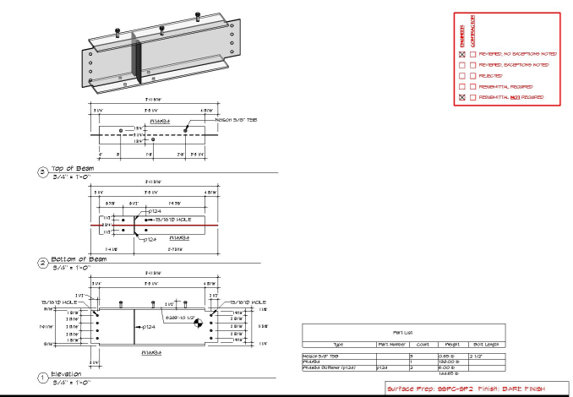
Shop drawings are the detailed drawings created for all steel members and assemblies and they contain all the information required for the fabrication of the members including all dimensions, sizes, steel grade, and number of units to be produced.

Slide 9
Steel Construction Process
- Based on the approved connection designs, the detailer (working with/for steel fabricator) must also obtain the EOR approval of the shop drawings.
- The actual fabrication of members can start after receiving shop drawings approval.
- After obtaining the EOR approval for the Erection drawings ( made to illustrate the erection sequence and how assemblies are put together) the final structure can be erected.

Slide 10
Fabricator/Erector Role
The Fabricator/Erector Role
It is customarily that fabricators and erectors work as subs to the main contractor.
They will not be decided upon until the time of signing the contract between the client and the winning main contractor.
However, a list of few fabricators/erectors can be named as possible candidates and it is not unusual for the EOR to consult and collaborate with them.
It is always a good idea to consult with the anticipated fabricator/erector at early stages of the structural design to tune the design to the available capabilities and ideas of the fabricator/erector.

Slide 11
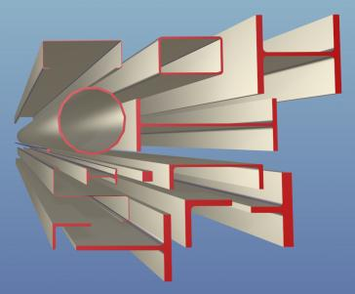
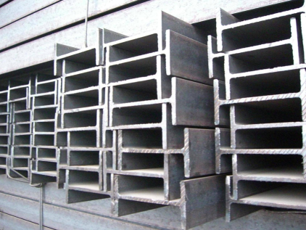
At the member sizing stage, the EOR can always seek the advice of the fabricator on the availability of certain types of steels or shapes saving valuable time and cost.
Based on fabricator/erector collaboration and feedback, the EOR along with client will be able to take better decisions on the final requirements of the structure.

Slide 12
Loads for Connection Design
Loads for Connection Design
Member and connection forces are usually conveyed using structural drawings, load tables, and specifications.
It always recommended that information to be given at the tendering stage of the project so the fabricator will make the proper allowance when he submits his quotation.
Load tables may include all applicable loading cases or they can be the ones that create the critical loading envelope.
It must be clearly identified if these loads or envelopes are based on the Allowable Strength Design (ASD) or they are based on the Load and Resistance Factor Design (LRFD).

Slide 13
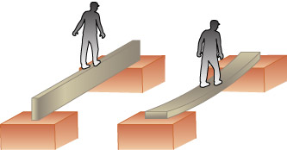
Loads for Connection Design
Some consultants tend to convey the design loads in terms of a percentage of the steel member capacity. This might sounds like a quick shortcut for a long tedious process but it holds within it a huge waste of material and of connection design, fabrication, and erection hours.
The connection designer has to satisfy the percentage requirement and if the size of steel member is large due serviceability requirement, for example, then the connections at the joints will be over designed for no logical reason.

Slide 14
Loads for Connection Design
Similarly, at a beam-to-column connection the actual moments are much smaller than the full moment capacity of the beam, thus specifying connection design with a high percentage of the full capacity of the beam would be a huge waste.
On the contrary, if hefty concentrated forces are placed near the end of the member, then such connection designed on the percentage of the full capacity of the beam might prove to be inadequate.
End forces of different load cases should be compatible at the joints where members meet. The forces for the connection design will not be analyzed properly if the forces in each member are not in equilibrium.

Slide 15
Loads for Connection Design
Connection design can be achieved by using specialized computer programs or could be done by hand.
The use of spreadsheets help significantly in reducing the effort and time required.
However, in many cases the connection design engineer may find it necessary to perform hand calculation because no software is applicable to all possible types and details of connections.

Slide 16
Design for the Best Results
Design for the Best Results
The fabricator always tries to convey to the structural design consultant that the cost of connections may far exceed the cost of reduced weight of a steel member.
Depending on the type of the structure, the cost of connections fabrication and erection is estimated anywhere between 10% to 20% of the cost of steel weight.
Thus by including the cost of connections, the lightest structural steel section might not necessarily be the cheapest.

Slide 17
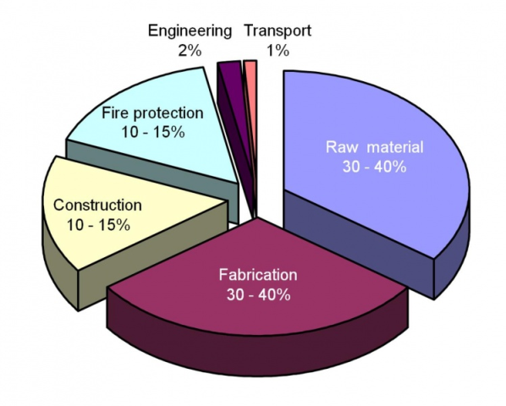

Slide 18
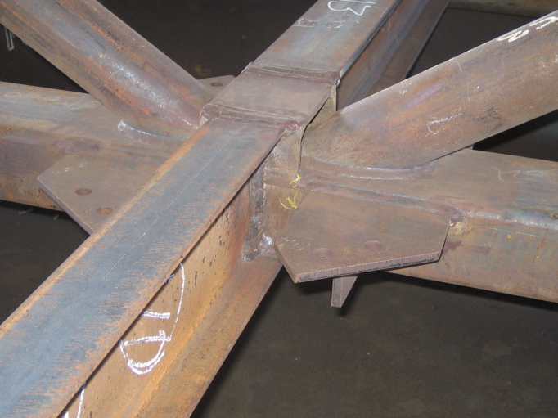
Design for the Best Results
Also, in many cases, fabricators find that the size of members as shown on the structural drawings is too small to accommodate easy connections. This simply will add significantly to the cost of connections and the cost of the finished structure.

Slide 19
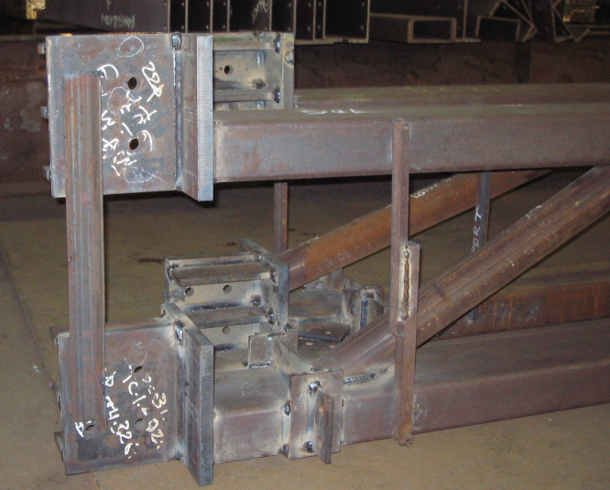

Slide 20
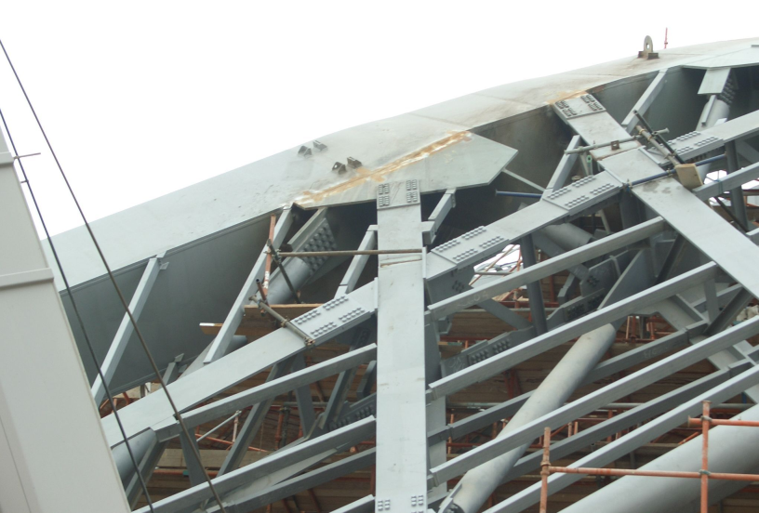
Design for the Best Results
Complicated connections increase the time and the cost of the fabrication as well as the erection process.

Slide 21
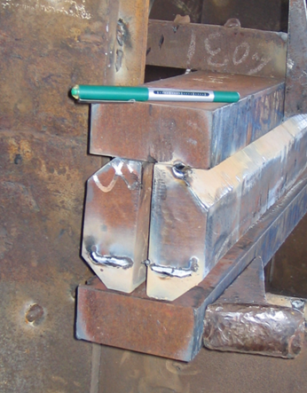

Slide 22
Design for the Best Results
Repeated member sizes, connection types, steel types are recommended and, in general, reduce the cost of each step on the production cycle as well as the overall cost of the structure.
For a better quality control and speed of erection, reduce the number of connections involve site welding.
It is always a good practice that sample details of complicated or special connections to be shown on the structural drawings as guidelines for the fabricator's engineer to minimize any misunderstanding right from the beginning.
Simplicity in design makes it more economical. A project with fewer members will translate to less number of connections and thus becoming less labor intensive and more cost competitive and have better constructability.

Slide 23
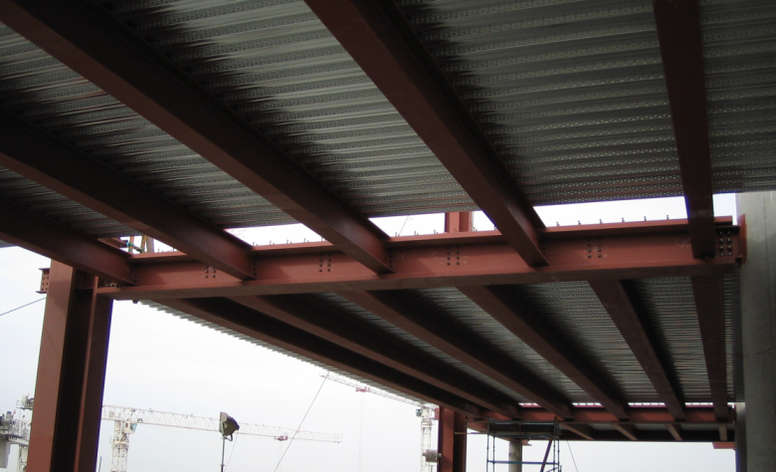

Slide 24
Design for the Best Results
Model connections can be used in large projects to reduce the approval burden on EOR.
In this process, a connection model is designed and fully detailed by the fabricator's team and all associated approvals will be obtained from EOR.
In the end, the fabricator must certify that all similar connections were designed and detailed the same way, this without the need to submit every single connection for approval.
However, this will not alleviate or reduce the final responsibility off the EOR who has, at least, to spot check some of them.

Slide 25
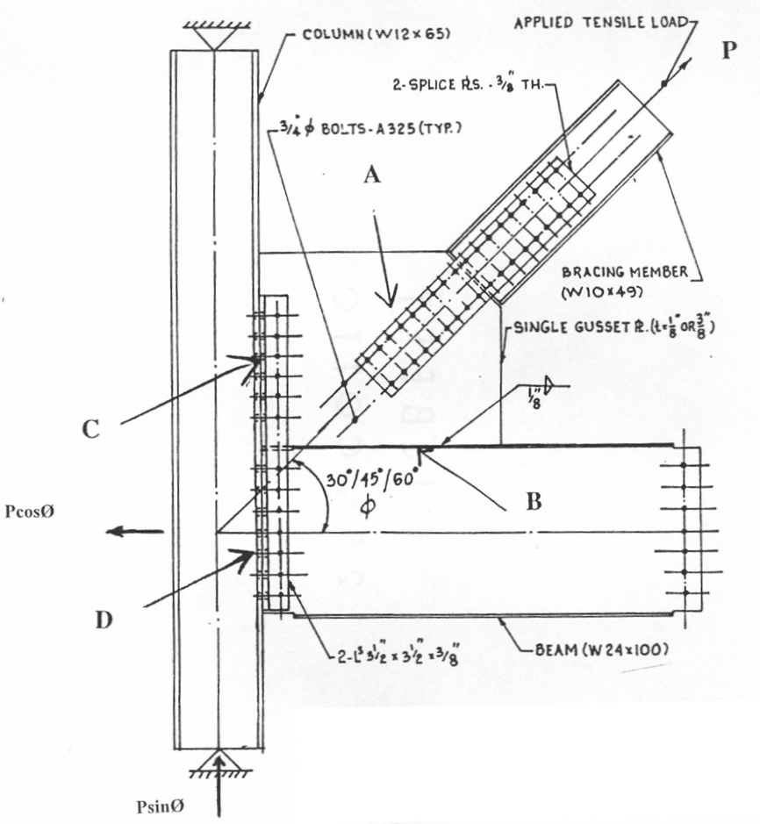
It is always a good practice that sample details of complicated or special connections to be shown on the structural drawings as guidelines for the fabricator's engineer to minimize any misunderstanding right from the beginning.
It is always a good practice that sample details of complicated or special connections to be shown on the structural drawings as guidelines for the fabricator's engineer to minimize any misunderstanding right from the beginning.

Slide 26
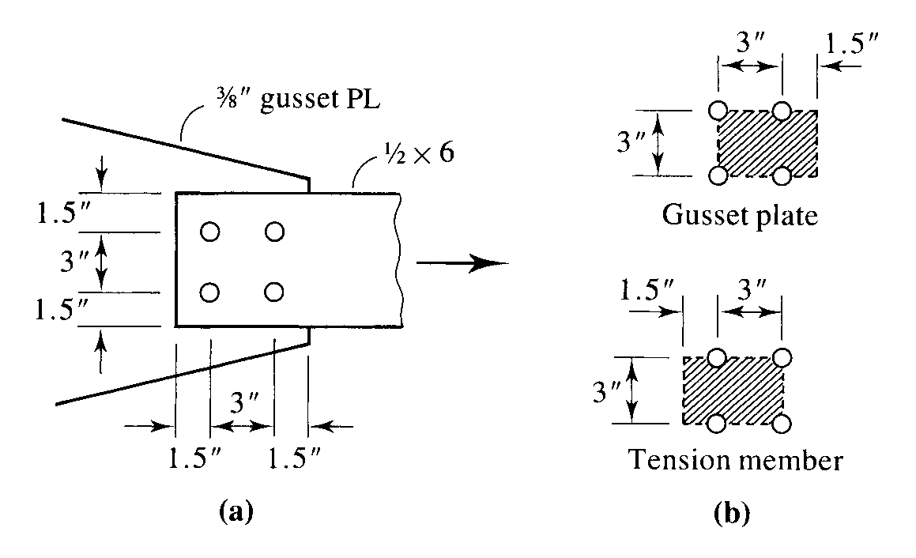
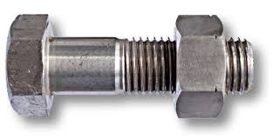
Design for the Best Results
Imposing generalized certain criteria or a requirement by EOR for all connections to be a certain type, such as slip-critical connection, as an example, could be a waste if it is not mandated by a code.

Slide 27
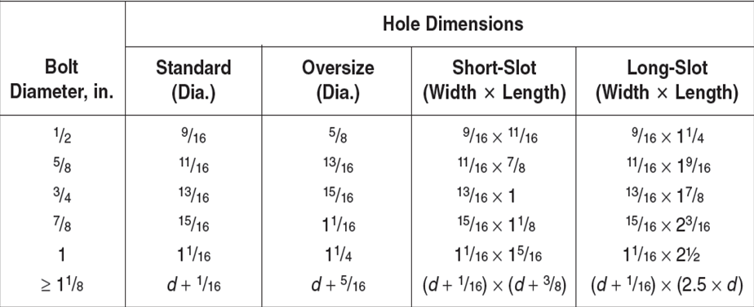
Design for the Best Results
Similarly, a requirement of using standard size holes in all connections would put a heavy restriction on the fabricator and the erector for no apparent gain.

Slide 28
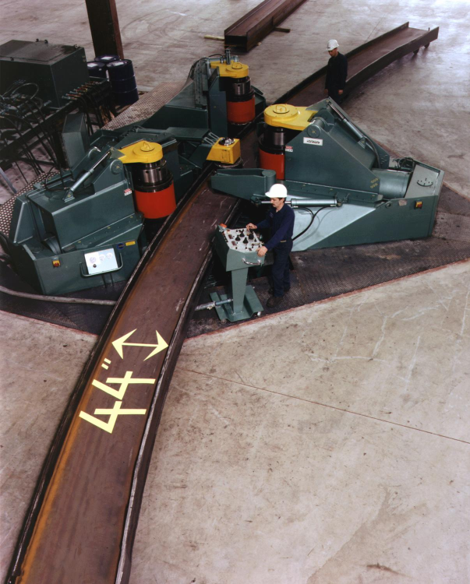
EOR needs to clearly specify that the holes in flanges should be done after finishing the required member cambering. This is to avoid macro cracks that may affect fatigue resistance.

Slide 29
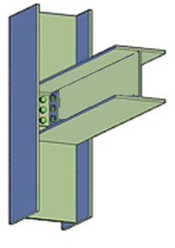
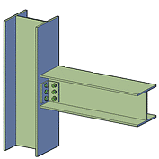
Design for the Best Results
The fabricator, as well as, the erector may prefer certain orientation of some steel members over other possibilities. If this can be conveyed to the structural consultant at the member design stage the project will tend to be easier and cheaper.

Slide 30
Design for the Best Results
Most failures of steel structures due to connection failure
Steel Members are connected by: Bolting or Welding
Bolting: Does not require skilled workers
Could be complicated and requires space
Makes erection easier and faster
Welding: Elegant
Requires skilled workers
Requires inspection
Not recommended on site

Slide 31
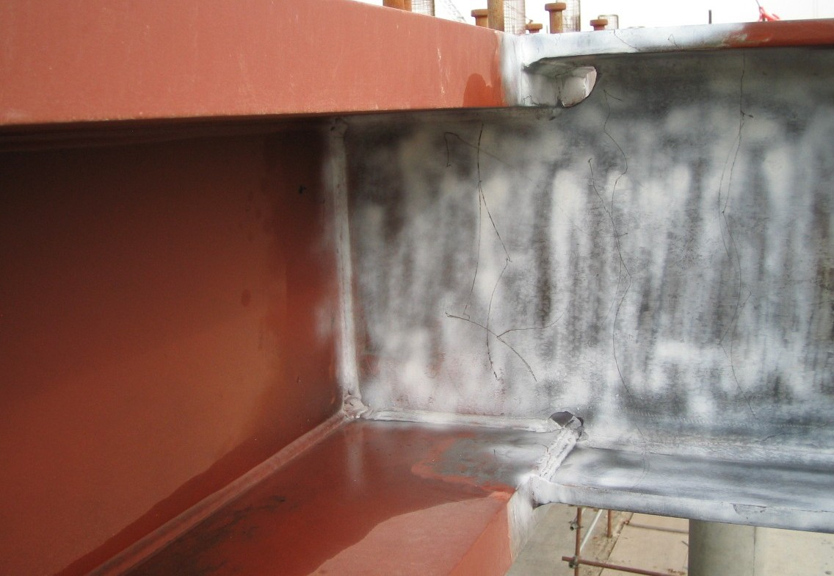

Slide 32
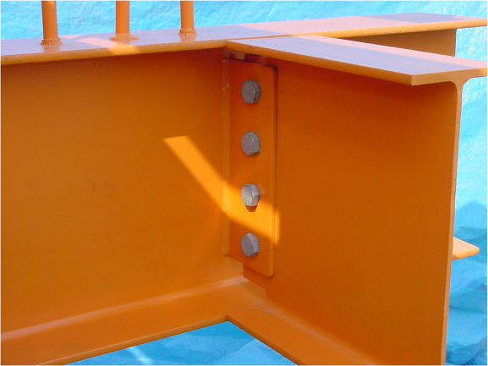
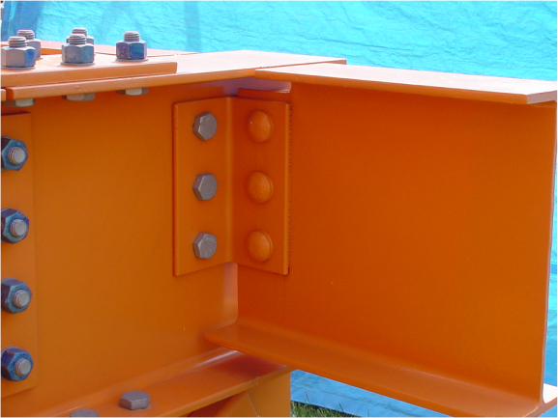
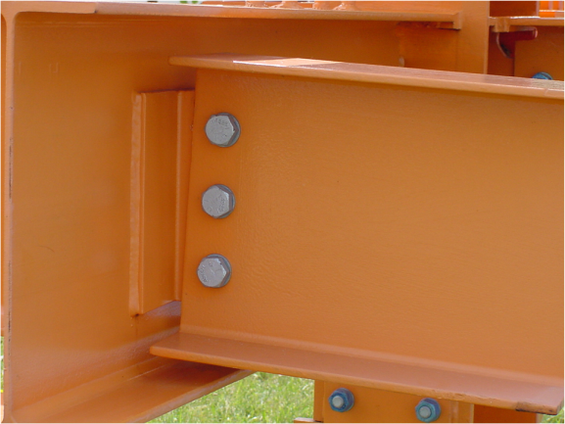
Design for the Best Results
A bolted angle cleat connection rather than welded plate may allow for automated processing which can result in a faster fabrication and easier transportation.
Single Angle
Tee Connection
Shear Tab

Slide 33
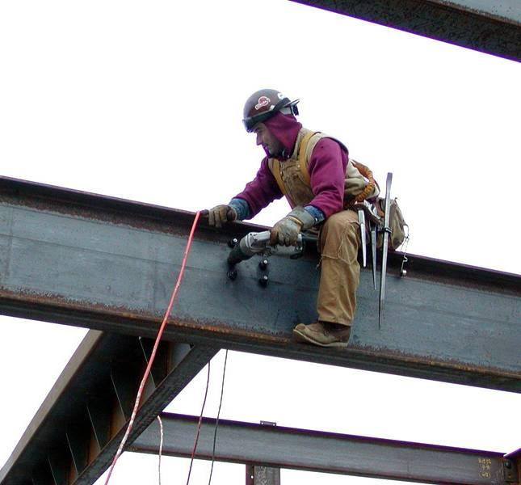
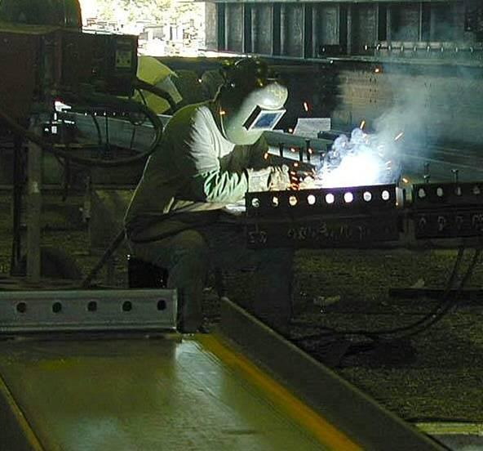
An agreement on recommended and non-recommended types of connections among all parties can be achieved before design starts to save valuable design time.

Slide 34
Design Changes
Design Changes and Modifications
When negotiating the contract, all parties should agree to the proposed mechanism of approvals and schedules of delivery.
This will pave the way for smooth design and smooth approval process and reduce causes of project delaying.
Freezing of design is an important milestone in the engineering-fabrication-erection process.
It reduces disruption and rework of steel elements which might turn to be much more expensive than originally thought.

Slide 35
Design Changes
Even small changes by the client/EOR of original design after approving shop drawings could have drastic effects on the scheduled time of completion as well as the fabrication and the erection costs.
The whole cycle of the process has to repeat and start all over again from the beginning. This might include material sourcing, connection design, detailing, approvals, fabrication, and transportation in addition to disposing of already fabricated parts.

Slide 36
Design Changes
Depending on the complexity of the actual change and depending on the accumulated cost and the extra time required an agreement on compensation should be reached out early enough otherwise this might lead to a formal dispute between the fabricator and the main contractor/EOR.
For unavoidable changes, if the fabrication and erection are to be done by the same company, then adjusting schedules is required to tune for these changes.

Slide 37
Erection
Erection
If the structural design is complete, the fabricator may decide which parts of the structure can be assembled together in the fabrication yard.
This depends on the size of the structure, its location, the available type of cranes, transportation cost, along with the required erection sequence.
Thus, erection drawings must be produced early enough to allow for design and fabrication of field or site connections.

Slide 38
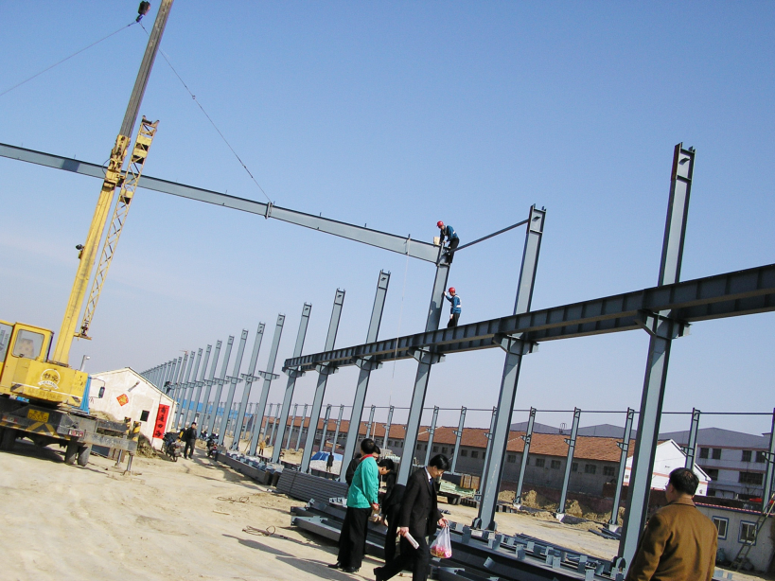

Slide 39
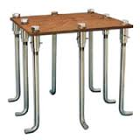
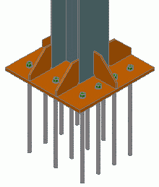
Erection
Sometimes the fabricator might find that the base plate design is difficult to fabricate, or the materials specified by EOR is not available or do not exist in certain sizes or hard to acquire.
This might lead to delays in the erection process. Also, it is always economical to use thicker base plates rather than using stiffeners with thinner plates which require more labor work.

Slide 40
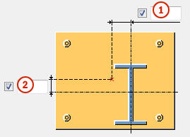
Erection
Also, the erector sometimes complains that anchor bolts are not correctly set and the erector has to exercise costly remedial work in order to erect the column.
If the weld is used, fillet welds are much preferred than partial or complete penetrating welds.

Slide 41
Erection
Several types of cranes can be used simultaneously to erect a part of the structure. The hiring of cranes is very expensive, thus a well planned fabrication and erection scheme is a must to make use of equipment time and in the same time provide the needed access to the site for the ease of handling material which is very important.
Any disruption to the program execution will be very costly. If the process of erection can be planned to follow the same sequence of fabrication huge savings can be made in terms of construction time and crane usage.

Slide 42
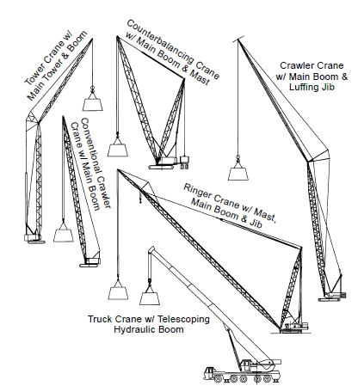

Slide 43
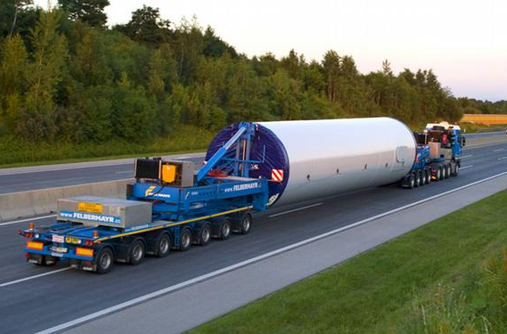
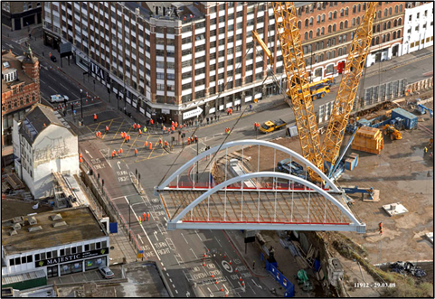
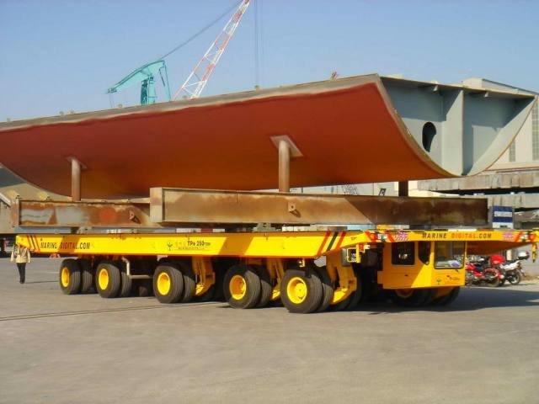

Slide 44
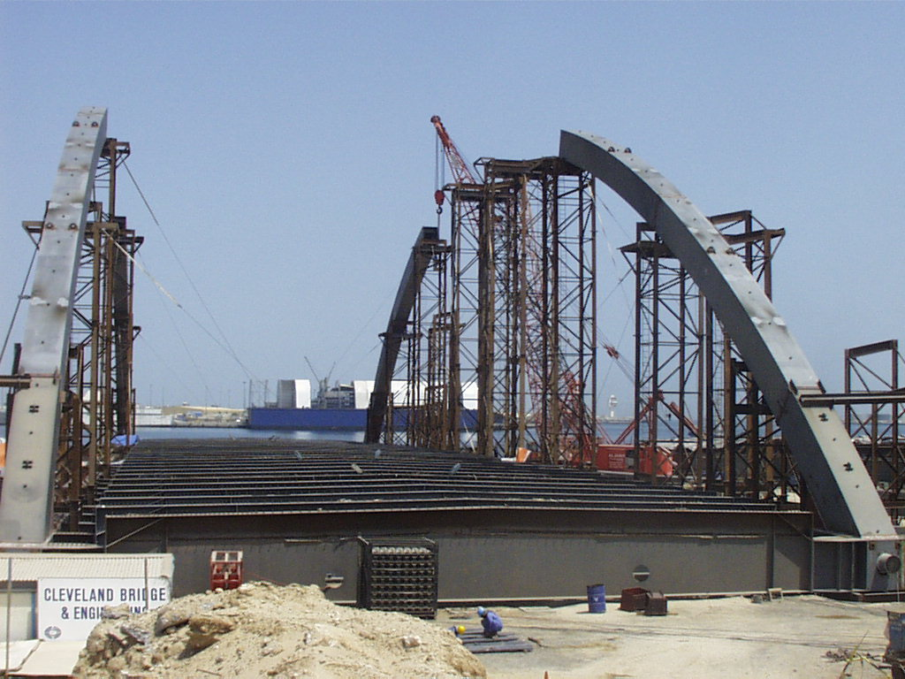

Slide 45
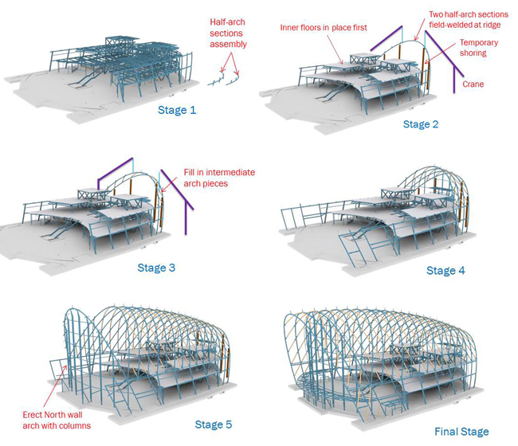

Slide 46
Conclusion
To have an economical and efficient steel structure the structural consultant need to keep in mind the fabrication and the erection processes during the member sizing of the structure.
Collaborating with the fabricator and the erector right from the start will immediately show its benefits.
For extra savings on cost and time, delegate the connection design to the fabricator to allow for design flexibility and to make use of the capability of the fabricator’s facility.
This action can be enhanced if the erector and the fabricator is the same company so the effect of design changes can be reduced.

Slide 47
Thank You

