Slide 1
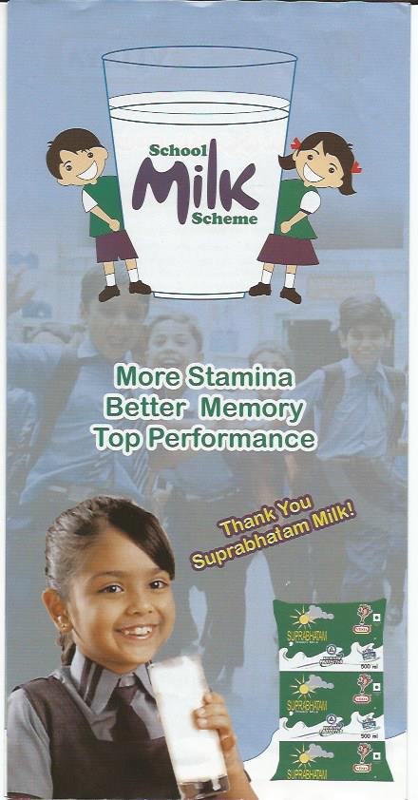
COMBATING MALNUTRITION THROUGH SCHOOL MILK PROGRAM BY APDDCF IN ANDHRA PRADESH,INDIA
MADHUSUDANA RAO
M.Sc.DT.,MBA(HRM).,PG Dip.in RD
Deputy Director, APDDCF/
Assistant Project Director, DWMA

Slide 2
Dairying in India is of importance to meet the requirement of hungry budding millions; adopting or promoting any Technology undermining their welfare will have no future.
Dr.Verghese Kurien

Slide 3
Introduction:
Childhood malnutrition is an important public health and development challenge in India.
Under nourished children have significantly higher risk of mortality and morbidity.
Besides increasing the risk of death and disease, under nutrition also leads to growth retardation and impaired psychological and cognitive development.
Ensuring nutritional security of the teaming millions of Indians, more so the children, is one of the major challenges envisaged under the 12th FYP of GoI.
The Ministry of Statistics and program implementation in its report published indicated that, 48% children under the age of 5 in India are stunted, indicating alarming proportion of chronically malnourished children. Proper nutrition is most critical early in life as this may have far reaching effects later during the productive adult life.

Slide 4
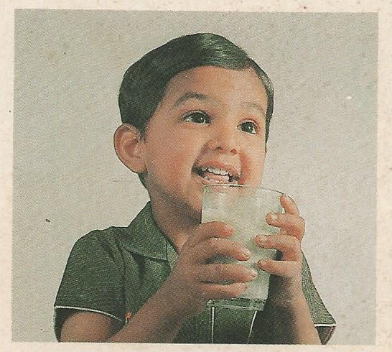
Milk is one of the food commodities that can catalyze a change as it has accessibility in the remotest parts of the country.
Milk and its products are endowed with properties that make them potential carriers of many deficient micro nutrients.
Furthermore, scientific and epidemiological evidences suggest how important mother’s milk is in ensuring nutritional well being of neonates.

Slide 5
Status of malnutrition in India:
In 2011, under-5 mortality in India was 53 per 1000 live births, one of the highest in world.
British based nonprofit NGO, SAVE THE CHILDREN, reported that, 1.83 million Indian children die even year before they turn five and pinned malnutrition as the key reason for the deaths.
Census 2011, AP has 86, 42,686 children of the state population of 8,45,80,777.
The latest findings by NIN note that, 38.8% children in AP in the age group of 1-5 years are under nourished and 48.1% have stunted growth.
AP has the highest infant mortality rate amongst state at 43 per 1000 live births and rates are particularly high in rural areas.
Only 46% of children below the age of 2 years have received all immunizations.
One fifth .21.6%. of girls in rural AP becomes mothers by 19 years of age.
According to NFHS data (2005-06), over a third of all children in AP are stunted (34%) and under weight (37%).

Slide 6
AP facts…..
AP ranks ninth in the country in terms of 6-13 years children’s school attendance.
Only 76.2% of girls and 82.4% boys from the total children population in that age group attend school.
Not a single mandal in Hyderabad city could achieve the distinction of retaining all the students at a single school till the end of five-year elementary education, latest figures from the RVM reveal.
A total of 114 mandals out of 1104 mandals in AP have 100% retention.
In the Telangana state comprising of 10 districts, at present, 104 ICDS projects are being in operation covering 112624 malnourished children.

Slide 7
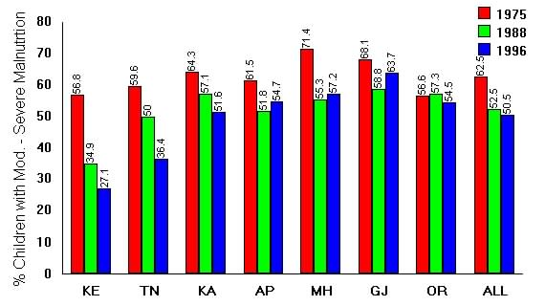
Malnutrition among preschool children in AP and other states.

Slide 8
School Based Milk Programs:-

Slide 9
SCHOOL BASED MILK PROGRAMS
School based milk programs are common in many countries around the world. Support for these programs is often built on the assumption and public perception that milk is a nutritionally advantageous food for children.
Studies at the beginning of the twentieth century in Scotland were among the first to show that milk delivered to school aged children increased height. Later studies show that, the greatest height increase was realized if milk were targeted to under nourished children ;
the event World Milk Day which started in 2000 is celebrated every year on sept.1st, is now held in over 30 countries, bringing attention to school based milk programs and promoting milk among the students.
Some of the festivities from 2009 included the launching of School Milk Clubs in various schools in Gujarat, India; milk is perceived to be nutritious for school aged children and thus more widely promoted than other beverages;

Slide 10
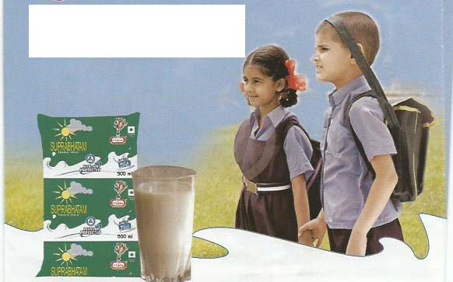
Suprabhatam-tetrapacked milk in school milk program by APDDCF….

Slide 11
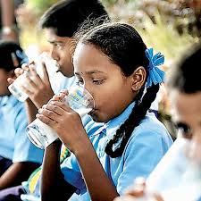
Programs for children…..
Balika Samriddhi Yojana
Kishori Shakti Yojana
Nutrition Program for adolescent Girls
Integrated program for street children
Child line services
Central adoption Resource Agency
Program for juvenile justice
Mid Day Meal scheme
National crèche Fund

Slide 12
MID DAY MEALS PROGRAM….
A mean of providing free and compulsory universal primary education of satisfactory quality to all children below the age of 14 years.
Way back in 1925 Madras Corporation has launched mid day meals for the under privileged children as a public welfare concept in India.
As a program, started in 1995, it aims at improving enrolment, attendance and retention, while simultaneously improving the nutritional status of children in primary classes.
The coverage of more than 14 crores children in rural and urban areas under the scheme makes the mid day program one of the largest nutrition support schemes in world.
A model for public private partnership also evolved in Hyderabad where NAANDI FOUNDATION manages a central kitchen to provide cooked meals and whereas as in Karnataka, Akshaya Patra Foundation of ISKCON has been engaged in providing the services.

Slide 13
Models……
In Gujarat, the program is running from 60s as Government sponsored program.
Women empowerment models of Tamilnadu are also examples of excellence in implementation of the program.
Milk and milk products hold huge potential to improve nutrition and livelihoods for hundreds of millions of poor people across the world; as part of a balanced diet, milk and dairy products can be an important source of dietary energy, protein and fat.
They are also rich in micronutrients critical for fighting malnutrition in developing countries where the diets of poor people are often starch or cereal based and lack diversity.

Slide 14
Why milk????
It’s a matter of pride and satisfaction that moved from a state of dependency to that of self sufficiency.
The success of operation flood established India’s ability to implement the program of milk production enhancement.
Milk is a near perfect food source packed with vital vitamins and minerals that keep our bodies healthy and strong.
Due to the importance of milk for babies, teens and adults, milk is being considered as a prominent food source with 9 essential nutrients that immediately benefit our health in following ways;
Calcium- builds healthy bones and teeth, maintains bone mass
Protein-serves as a source of energy, builds repairs muscle tissues.
Phosphorous-strengthens bones and generates energy
Vitamin-D-maintain bones and enhances calcium absorption
Vitamin-A-helps maintain healthy RBC and nerve tissues
B2-converts food into energy
Niacin-metabolizes sugars and fatty acids.

Slide 15
Milk is the elixir of life…..
It contains as much protein as an egg, as many carbohydrates as a quarter cup of rice and the same calcium as in 16 cups of spinach.
Milk products such as cheese help protect against dental caries. Containing all the 9 important essential AAs, there is no denying that milk is an excellent source of protein. In fact, Tryptophan- one of the 9 essential AAs can actually help induce sleep.
As part of a balanced diet, milk and milk products can be an important source of dietary energy, protein and fat.

Slide 16
Programs to combat malnutrition in AP:
A program in the name of Indiramma Amrutha Hastham was launched in 103 high risk integrated child development services with an outlay of Rs.100 Crores to reduce the incidence of low birth babies, malnutrition among children.
Milk is included as one of the dietary item in the scheme and the APDDCF was requested to provide Double Toned Milk to the Anganwadi Centers, for onward supply of 200 ml. DTM to children and lactating mothers under each institution.

Slide 17
Initiative of APDDCF:

Slide 18
In Andhra Pradesh, 29 tribal blocks and 20 fluoride affected areas are selected for the milk scheme and about 99,736 children are being provided Vijaya milk.
The APDDCF which is supplying fortified milk in the name of Vita milk, fortified with Vitamin A to most of the tribal institutions/Anganwadi centers/KGBVs across the state to the tune of about 3,00,000 liters per month need to be supported by way of central assistance in strong institution building, good cooperative base, policies to control the private dairies and value based milk collection at farmer level.
Even, Tetra packed milk in the name of Suprabhatam is being supplied to Tribal Schools in Khammam District, as the institutions are far away and there is no proper road connectivity.Vijaya Skimmed milk powder, as per monthly requirement is also being supplied to the remotest anganwadi institutions in the state.

Slide 19
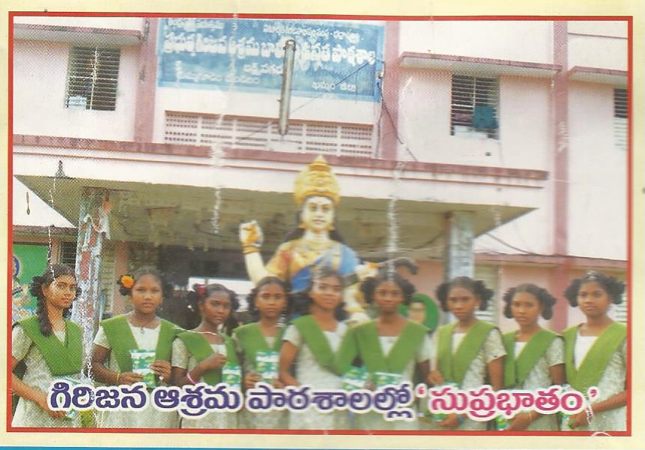
Tetrapack milk in tribal schools through APDDCF……

Slide 20
Conclusion:
Government needs to address the issue of malnutrition by making nutrition a specific objective in dairy sector development and by investing in programs that help poor families keep small dairy livestock.
Small scale dairy farming especially with local breeds is beneficial to poor households as it helps in providing nutrient food and also regular income.
Dairy consumption in developing countries is expected to increase by 25% by 2025 as a result of population growth and rising incomes, but still milk and milk products will likely still be out of reach for the most vulnerable households.

Slide 21
Vitamin-A deficiency…..
India has the largest percentage as well as the largest absolute numbers of vitamin A deficient children in the world.
In 1990, the country had about 60 percent of children in the age group of 0-72 months with sub-clinical vitamin A deficiency.
According to estimates available from the M. S. Swaminathan Research Foundation, a large proportion of the Indian population receives less than 50 percent of the recommended dietary intake of vitamin A from dietary sources.
An investigation of the dietary intake of vitamin A of preschool children in southern India reported significantly lower intakes for case of girls compared to boys. A positive association was found with the socio-economic status of the family as well as level of maternal education.

Slide 22
Attention of Government……
WHO has classified vitamin A deficiency as a public health problem affecting over 250 million children in over half of all countries worldwide.
Effective vitamin A supplementation coverage has been achieved in many countries with high child mortality rates.
The tribal children who remained malnourished, deprived, need more attention in extending nutritious milk as attention is required from both policy and implementation perspectives.
Government should make milk fortification mandatory in order to tackle the pressing problem of malnutrition by meeting the cost of Vitamin A, with which, dairies should not feel it as a burden.

Slide 23
Lets be careful……
In the wake of news regarding injecting Oxytosin to cattle for more milk production, there is dire necessity of supply of packed milk to children obtained from cooperative dairies.
There is also the need of developing and making available the fortified milks with Vitamin-A, Folic Acid or Iron to meet the requirement of specific segments.
Government should take steps to bring down the cost of milk production by way of incentives to feed/veterinary medicines and insurance of the cattle.

Slide 24
Milk is must…….
Milk from some of the other underutilized dairy species also has particular nutritional benefits.
For instance, the protein profiles of mare and donkey milk may make them more suitable for the 2-6 % of the population allergic to cow milk.
Even its clinically proved that, milk from Breed such as GIR is able to cure diabetes if consumed regularly.
In nutshell, pure milk should be made available to the teaming millions for the hopeful future of the country as a whole to make available all the nutrients required for the growth of the child.

Slide 25
Thank you

