Slide 1
Evaluation of Condensate Stabilization Plant through Static and Dynamic Process Simulation
Authors: Machado, R.; Marangoni, C.;
Miotto, F.; Querino, M.

Slide 2
Today’s Agenda:
Introduction
Objective
Methodology
Results and Disscussion
Conclusion
References
Acknowledgements

Slide 3
Introduction
Condensate is the liquid formed by the condensation of a gas, specifically, the hydrocarbon liquid separate from natural gas because of changes in temperature and pressure when the gas from the reservoir was delivered to the surface separators. Such condensate remains a liquid at atmospheric temperature and pressure.
Condensate stabilization is the removal of light components from hydrocarbon liquid to lower its vapour pressure to a desired level. Stabilization may be used to meet a required pipeline sales contract specification or to minimize the vaporization of the hydrocarbon.

Slide 4
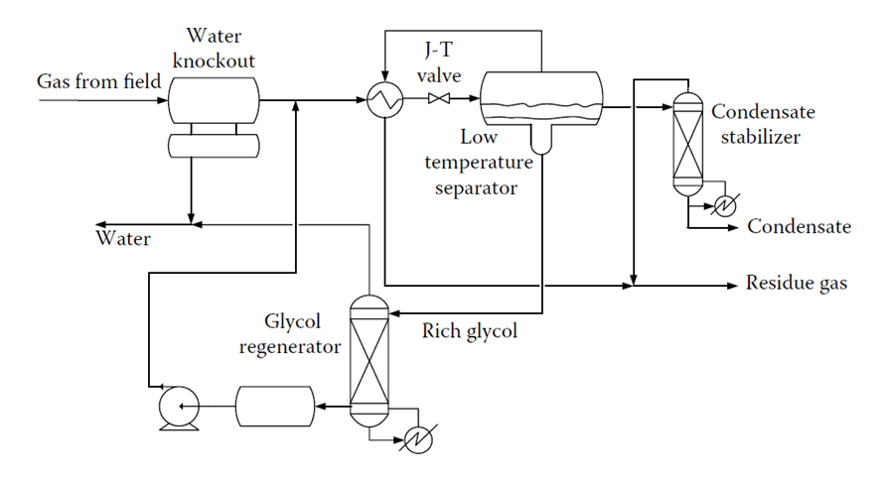
Introduction
How can this be done?

Slide 5
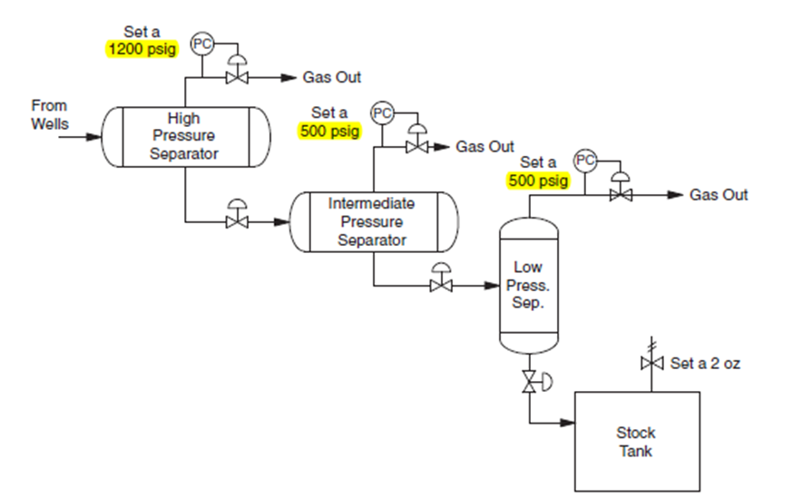
Introduction
Three Stage Separation
600 psi
300 psi
65psi
Source: Mokhatab, Poe and Speight (2006)

Slide 6
Objectives
Based on actual plant data in the literature, it carried out a simulation using Aspen HYSYS® software to predict the opposite process behavior on some proposed amendments (Rahmanian, Ilias and Nasrifar, 2015).
In the static software module, changes in temperature, pressure and flow of plant behavior were evaluated.
In the dynamic software module, a control system was tested and configured to stabilize disturbances in the model.

Slide 7
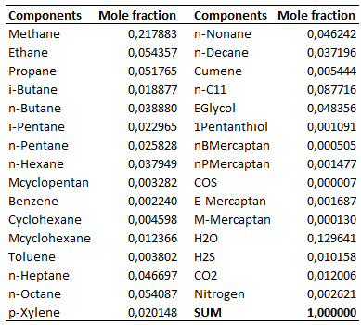
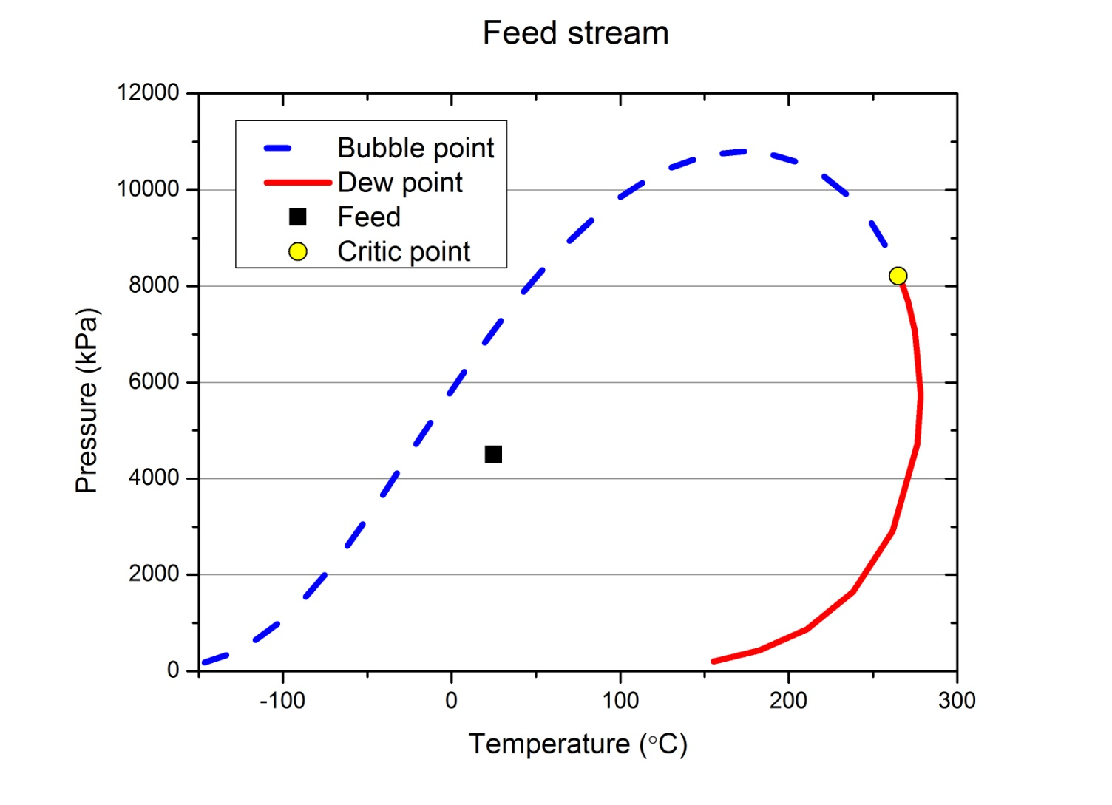
Methodology
In this work we use the software Aspen Hysys® version 8.6
Fluid-package: Peng-Robinson
Feed condition

Slide 8
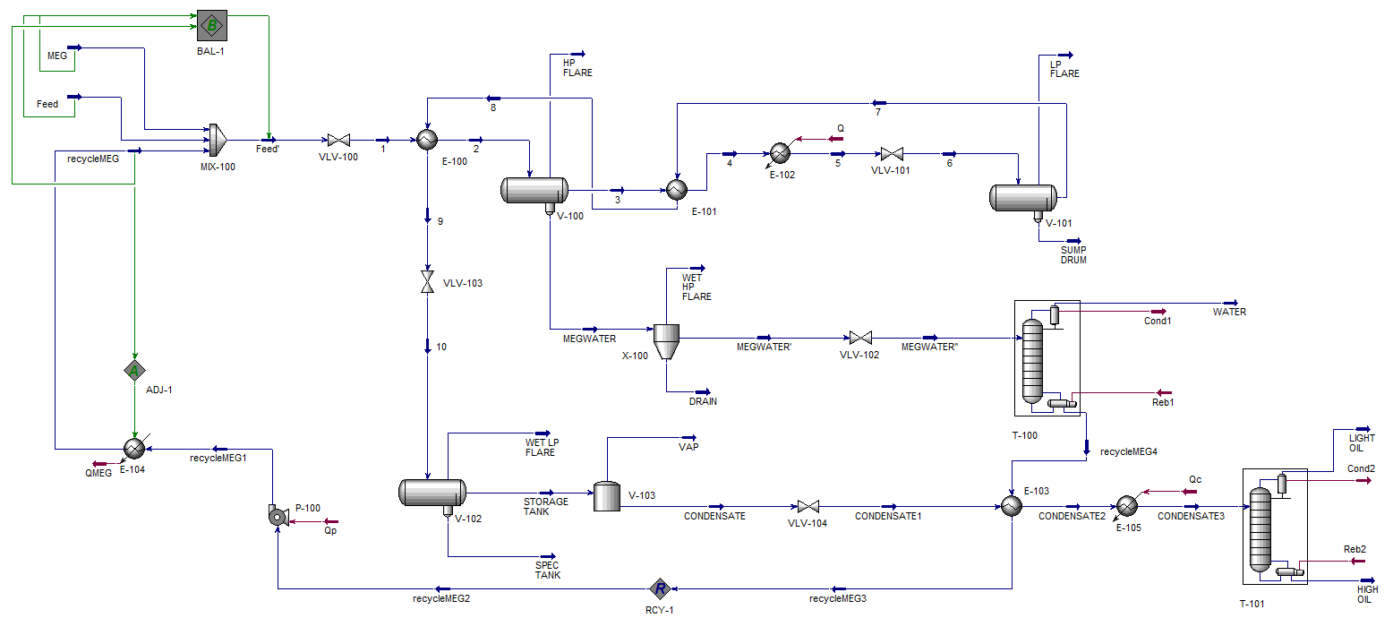
Methodology
Process Flow Diagram for the Condensate Stabilization

Slide 9
Results and Discussion
For the Static Process Simulation

Slide 10
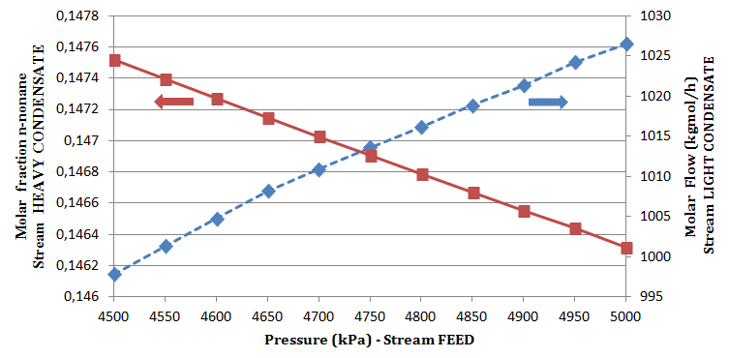
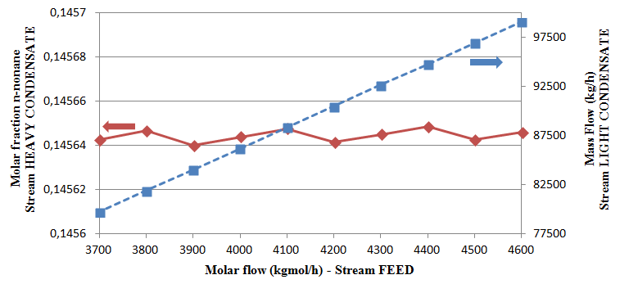
Results and Discussion

Slide 11
Results and Discussion

Slide 12
Results and Discussion

Slide 13
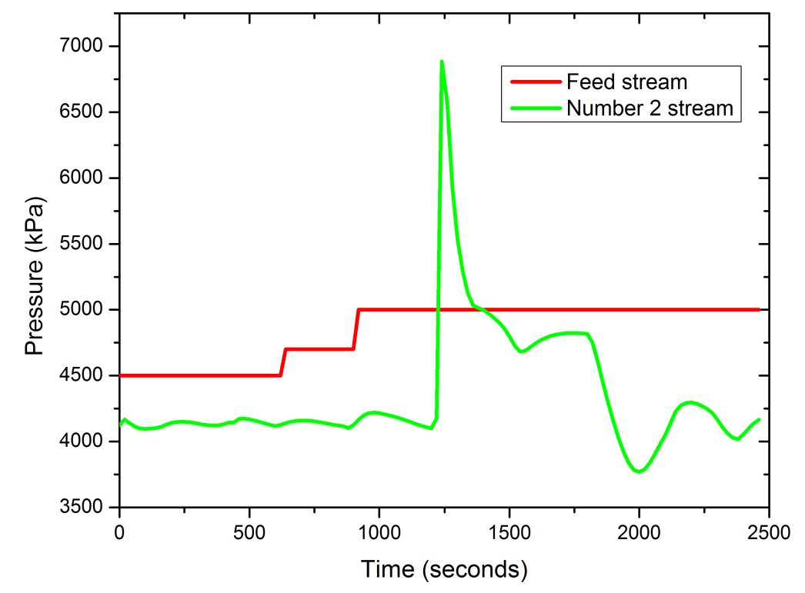
Results and Discussion

Slide 14
Conclusions
The simulation performed for the condensate stabilization provided specification of the products like the RVP criteria, were presented in this work similarly to all changes programmed into the system.
The changes in the feed stream (temperature, pressure and flow) influenced product quality.
It is necessary to set other process specifications to simulate the conditions of condensate stabilization.
It was possible to develop dynamic models for the process with added columns for regeneration of MEG and for separating the final product.
The adjustment of the controllers is essential to the stabilization of the dynamic models.

Slide 15
References
Peng D. and Robinson D. A new two-constant equation of state. Industrial and Engineering Chemistry 15, 59-64, 1976.
Mohaktab, S.; Poe, W.; Speight, J. Handbook of Natural Gas Transmission and Processing. Gulf Professional Publishing 672, 2006.
Rahmanian, N.; Ilias, I.; Nasrifar, K. Process simulation and assessment of a back-up condensate stabilization unit. Journal of Natural Gas Science and Engineering 26, 730-736, 2015.
Rahmanian, N. et al. Simultation and optimization of a condensate stabilization process. Journal of Natural Gas Science and Engineering 32, 453-464, 2016.

Slide 16
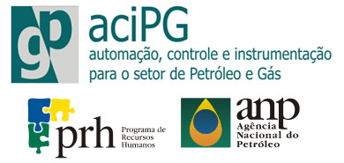
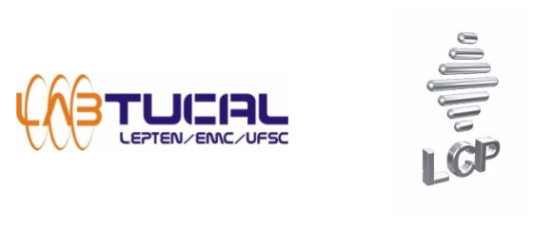
Acknowledgements

