Slide 1
Abstract presentation Medical research- Scorpion as a model
Dr. M.V.Raghavendra Rao,
Professor of Medical Microbiology, Immunology and Parasitology,
Dean (Students Affairs)
Avalon University School of Medicine
Sta. Rosaweg 122-124
Willemstad, Curaçao
C: +5999 691-0461
T: +5999 788-8008
F: +5999 788-8102
E: reachdrmvrrao@gmail.com
E: dr.raghavendra@avalonu.org
www.avalonu.org,
Editor-In Chief-Anatomy and Physiology current research (USA)
Editor Bio Technology and Microbiology current research International journal (USA)

Slide 2
Thalidomide
Dr. Raghavendra Rao

Slide 3
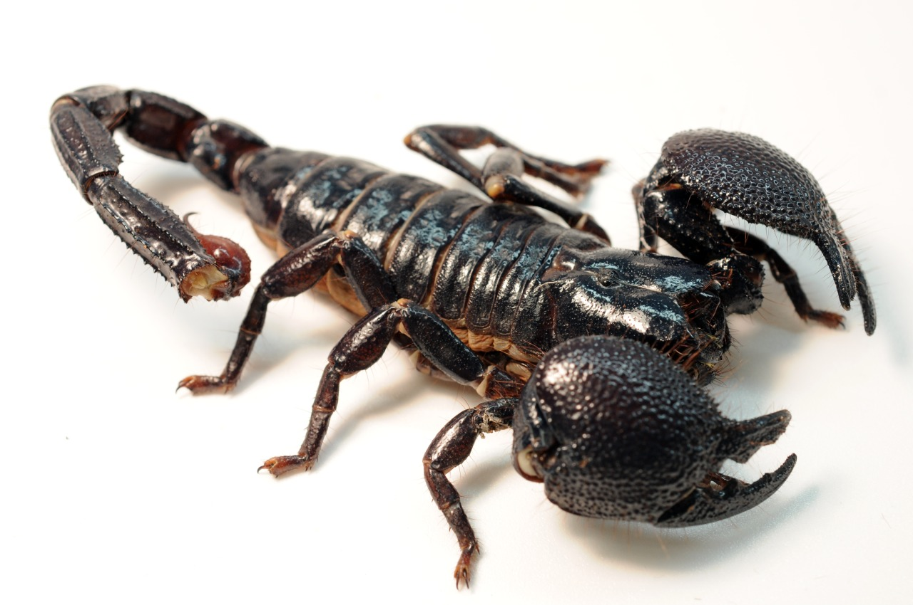

Slide 5
A drug formerly used as a sedative, but withdrawn in the early 1960s after it was found to cause congenital malformation or absence of limbs in children whose mothers took the drug during early pregnancy.

Slide 6
Thalidomide is a sedative that used to be prescribed to treat anxiety, tension, gastritis and insomnia.
It was also used to relieve morning sickness in pregnant women.
However, thalidomide was found to cause deformity in children born to mothers who took the drug and it was withdrawn in the UK during the early 1960s.

Slide 7
Thalidomide caused birth defects across more than 46 nations and affected over 10,000 babies.
These babies were born with missing or abnormal limbs, feet or hands.
Other defects included abnormal or absent ears, heart and kidney problems, cleft palate, spinal cord defects and digestive system disorders.

Slide 8
Today, thalidomide is sold and prescribed as an anti-cancer therapy and as a treatment for patients with leprosy, HIV/AIDS, rheumatoid arthritis, sarcoidosis, Chron’s disease, various skin conditions and graft-versus-host disease.

Slide 9
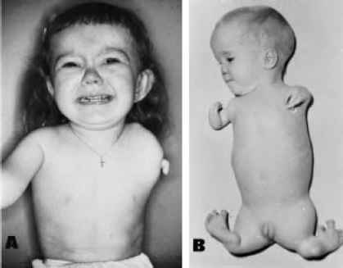

Slide 10
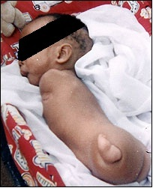

Slide 12
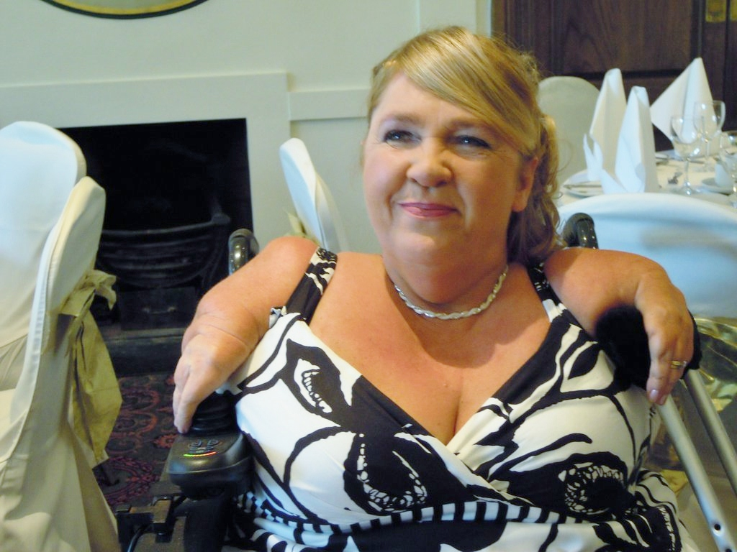

Slide 14
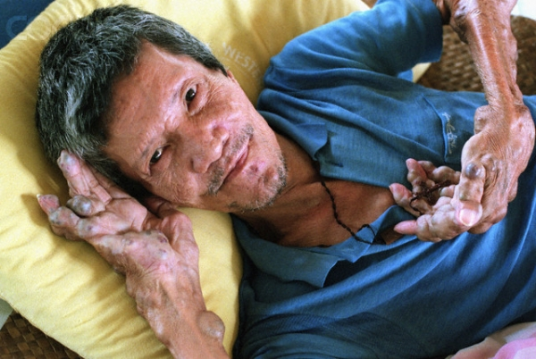

Slide 15
Thalidomide is used to treat a complication of leprosy referred to as erythema nodosum leprosum (ENL).
The main effect of this drug in the treatment of ENL is its fever reducing property and it has only been shown to have a limited effect in the control of neuritis, the main cause of disability in people with leprosy.

Slide 16
Thalidomide is given in combination with prednisolone and melphalan to treat myeloma in patients aged 65 or older who are not suitable for stem cell treatment.
Researchers are still trying to elucidate the mechanism of this drug in treating myeloma but studies have shown that thalidomide can prevent the development of new blood vessels required to provide oxygen and nutrients to tumors.

