Slide 1
Graphene Oxide@Gold Nanorods Conjugate for Controlled Release of Doxorubicin in tumor
M Shahanawaz Khan
Surpervisor : Prof Hui Fen Wu
Date and time : 3.55pm, 22nd Sep 2015
Department of Marine Biotechnology
National Sun Yat-Sen University, Kaohsiung, Taiwan

Slide 2
“There’s Plenty of Room at the Bottom
Richard Feynman

Slide 3
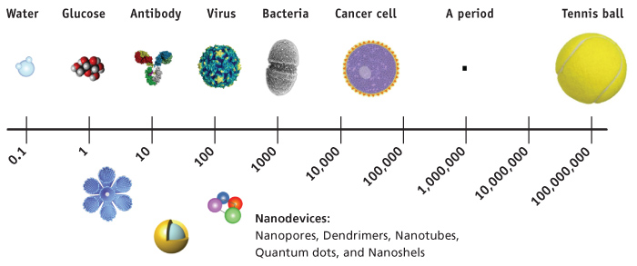
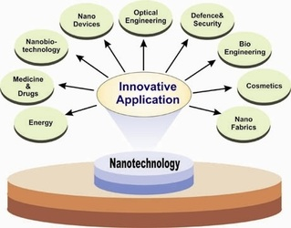
http://www.nanorev.in/uploads/1/5/6/0/15608714/3132245.jpg

Slide 4
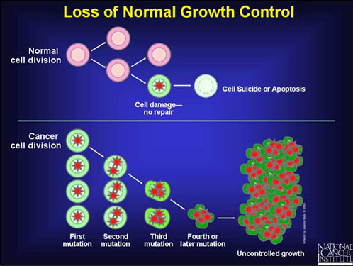
Cancer ?

Slide 5
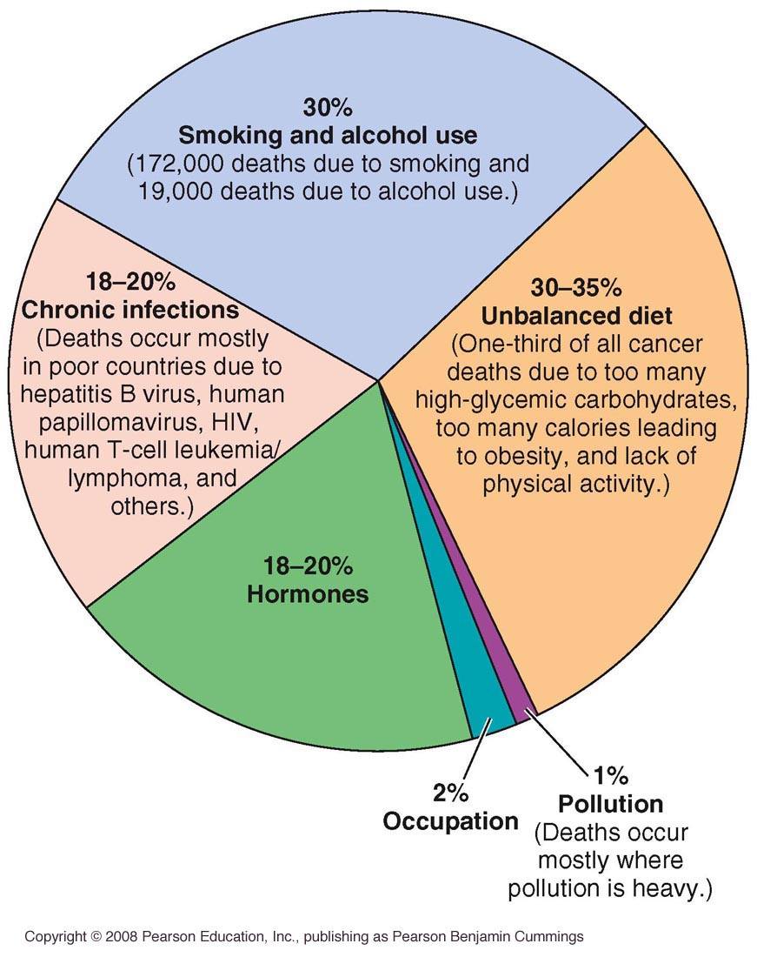
Factors Believed to Contribute to Global Causes of Cancer

Slide 6
The flow…
Synthesis of Graphene Oxide and Gold nanorods
Characterization
Photothermal property
Application

Slide 7
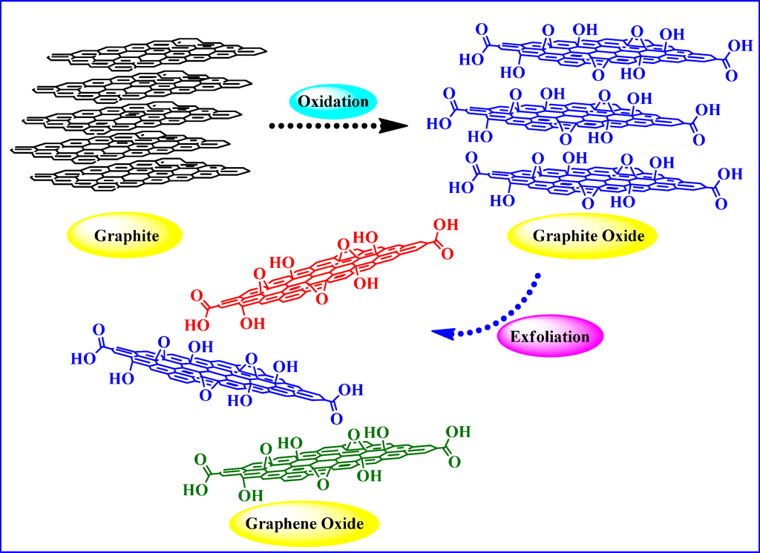
Synthesis of Graphene oxide
Functionalisation with Arabica acacia

Slide 8
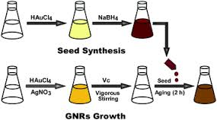
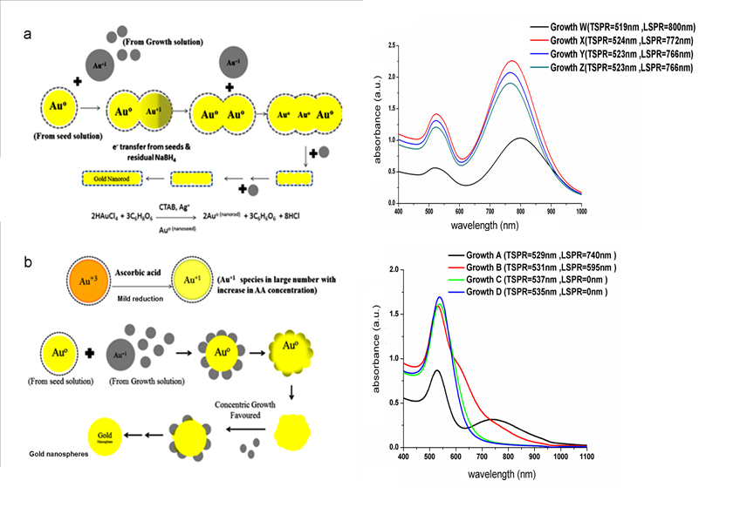
Synthesis Gold Nanorod

Slide 9
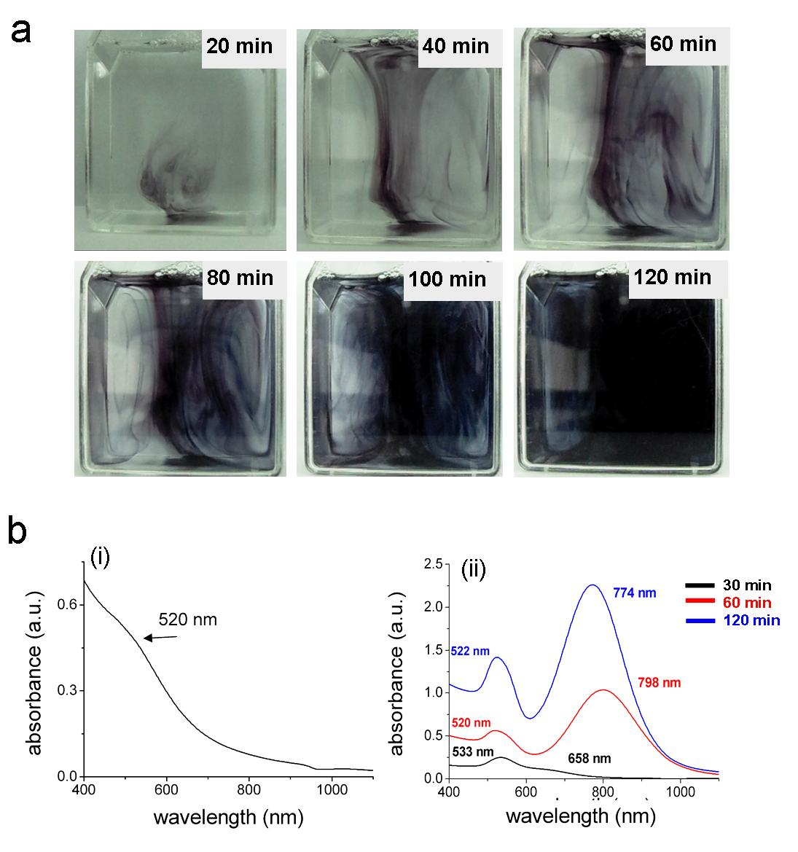
Formation of Gold Nanorod

Slide 10
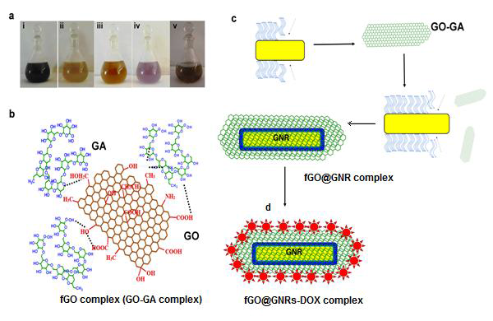
Schematic representation of the important steps involved in synthesis of the drug delivery vehicle based on graphene oxide and gold nanorods (a) Colors of the solution at various stages of reactions to form final conjugate viz i-GO, ii-GA, iii-fGO, iv-fGO@GNRs and v-fGO@GNR-DOX (b) fGO conjugate (GO-GA) synthesis after reaction of GO with GA (c) Incorporation of fGO in the GNRs (fGO@GNRs) during zipping mechanism (d) Loading of anti-cancer drug DOX on fGO@GNRs complex.

Slide 11
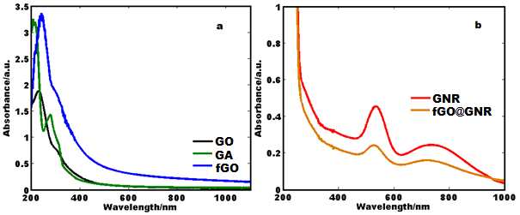
UV-Vis spectra of (a) Graphene Oxide, Gum arabic and their complex and (b) Gold nanorods and its conjugation with fGO.

Slide 12
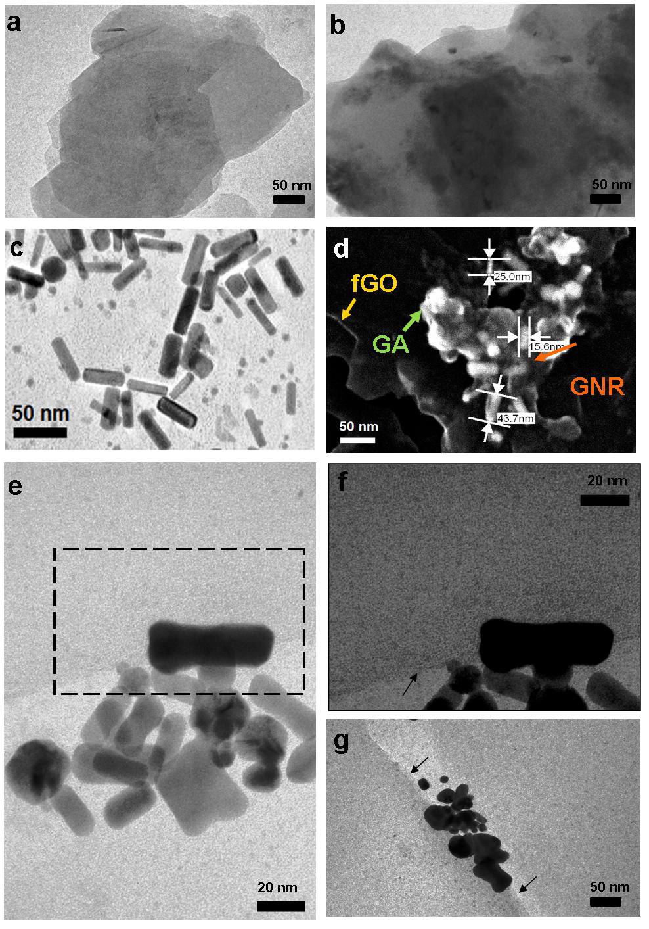
Electron micrograph showing (a) TEM image of graphene oxide (GO), (b) fGO (c) bare GNRs, (d) FE-SEM image of fGO@GNRs, (e) TEM image of fGO@GNRs displaying magnified view of interactions, (f) enlarged contrasted view of highlighted area of (e) showing clear view of dog-bone shaped GNR on a thin layer of fGO and (g) another TEM image showing dog-bone shaped GNR with other anisotropic nanostructures on a thin sheet of fGO.

Slide 13
TGA of fGO@GNR and final complex and (b) Zeta potential values various components involved in formation of final complex where A: fGO, B: Pure GNRs, C: fGO@GNR & D: fGO@GNR-DOX.

Slide 14
Effect of irradiation time on photothermal temperature of different components in vitro and (b) Infrared image showing increase in temperature of final complex fGO@GNR after 15 min. B. Temp enhancement IR images of PBS, GO, GNR , GO@GNR by using FLIR camera.

Slide 15
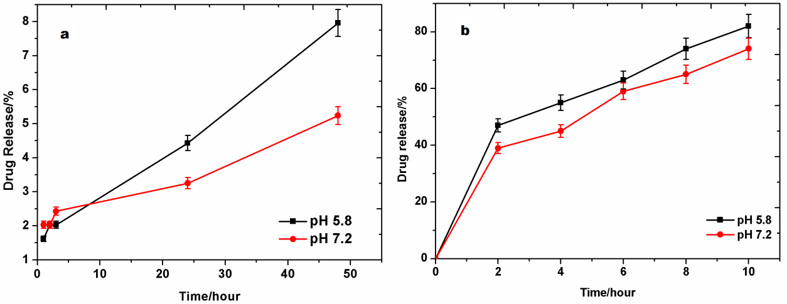
Percentage Drug Release with respect to time (a) without NIR and (b) with NIR irradiation.

Slide 16
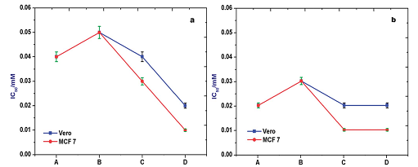
IC50 values on in vitro cell lines (a) without NIR irradiation and (b) with NIR irradiation where A: GNRs, B: fGO@GNR, C: fGO@GNR-DOX & D: Free DOX.

Slide 17
Trypan blue treatment of A549 cancer cells by GO@GNR and laser
Control cells
Dox-treated
Laser-treated
Laser-fGO@GNR

Slide 18
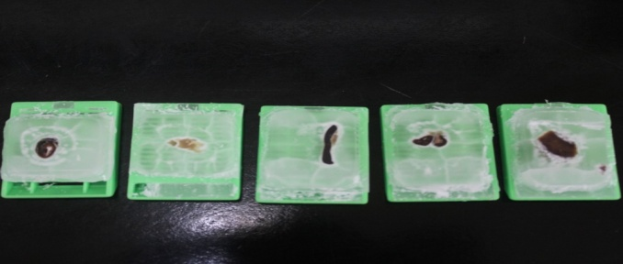
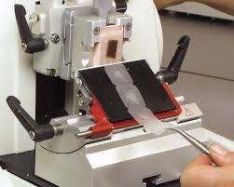
Microtomy
Tissue Fixation
Organ dissection
Formalin
50 mint
70% Ethanol
50 mint
80% Ethanol
50 mint
90% Ethanol
50 mint
95% Ethanol
50 mint
100% Ethanol
50 mint
100% Ethanol
Xylene
Paraffin/ 65degree for 1hour
50 mint
50 mint

Slide 19
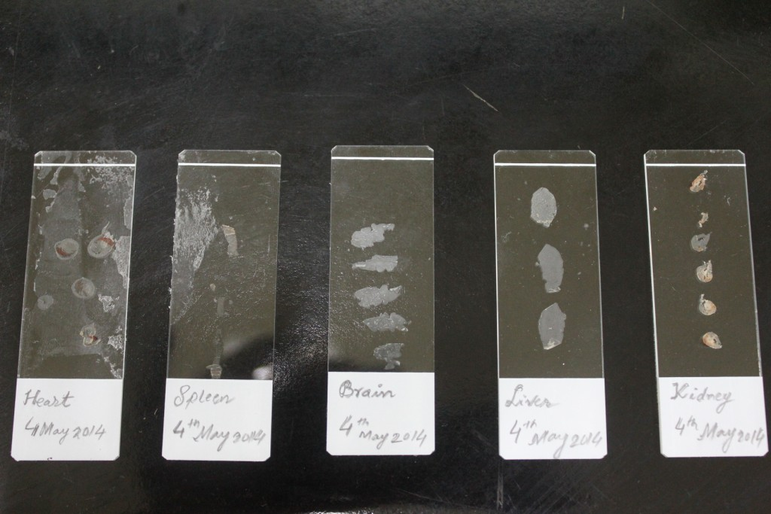
Deparaffinisation of tissue section
Incubate the slide for 65⁰ for 30 mint.
Incubate the slide for 2 times in Xylene for 30 mint.
Incubate the slide for 2 times in 100% ethanol for 10 mint.
Incubate the slide for 2 times in 95% ethanol for 10 mint.
Incubate the slide for 2 times in 70% ethanol for 10 mint.
Incubate the slide for 2 times in 50% ethanol for 10 mint.
Incubate the slide for 2 times in 30% ethanol for 10 mint.
Incubate the slide in PBS for 5 mint.

Slide 20
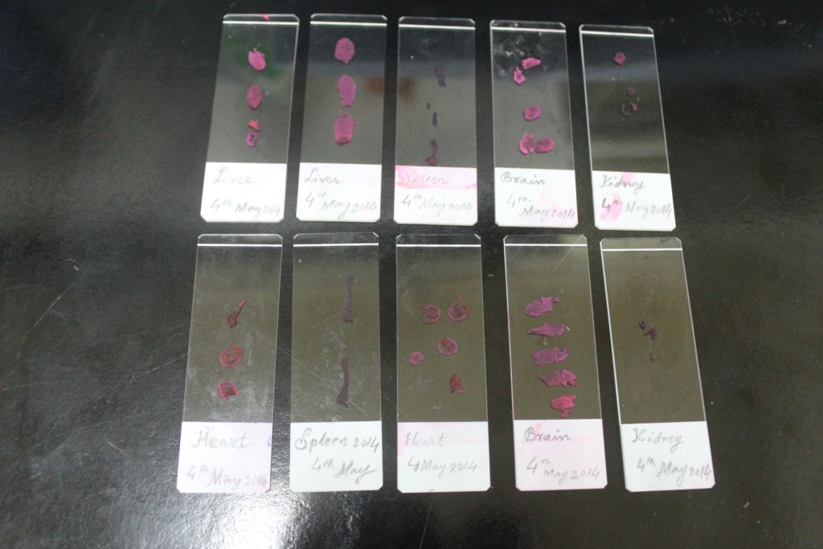
Deparaffinisation of tissue section
9. Then add 200uL of Haemotoxylin for 5 mint.
Wash the slide on opposite side by running tap water.
11. Incubate the slide in PBS for 5 mint.
12. 400uL of EOSIN dye on slide
13. Wash the slide on opposite side by running tap water.
Incubate the slide in PBS for 5 mint.
Incubate the slide for 2 times in 100% ethanol for 2 mint.
Incubate the slide for 2 times in Xylene for 10 mint.

Slide 21
Microtomy of (A) Tumor with different condition, i. Control ii. Dox treatment iii. fGO@GNR-DOX
(i)
(ii)
(iii)

Slide 22
Microtomy of tumor with different section of organs treated by Dox and fGO-GNR-Dox.

Slide 23
.
http://www.cancer.gov/PublishedContent/Images/images/documents/59f950a6-9b9d-43ad-80a4-776cefdd17ce/cancer17.jpg

Slide 24
References [1] J.P. Gillet, M.M. Gottesman, Mechanisms of multidrug resistance in cancer, Methods Mol. Biol. 596 (2010) 47-76. [2] K. Greish, Enhanced permeability and retention (EPR) effect for anticancer nanomedicine drug targeting, Methods Mol. Biol. 624 (2010) 25-37. [3] A.H. Calvert, D.R. Newell, L.A. Gumbrell, S. O’Reilly, M. Burnell, F.E. Boxall, Z.H. Siddik, I.R. Judson, M.E. Gore, E. Wiltshaw, Carboplatin dosage: prospective evaluation of a simple formula based on renal function, J. Clin. Oncol. 7 (1989) 1748-1756. [4] P.E. Kintzel, R.T. Dorr, Anticancer drug renal toxicity and elimination: dosing guidelines for altered renal function, Cancer Treat. Rev. 21 (1995) 33-64. [5] S. Jaracz, J. Chen, L.V. Kuznetsova, I. Ojima, Recent advances in tumor-targeting anticancer drug conjugates, Bioorg. Med. Chem. 13 (2005) 5043-54. [6] A.S. Narang, S. Varia, Role of tumor vascular architecture in drug delivery, Adv. Drug Deliv. Rev. 63 (2011) 640-58. [7] R. Abou-Jawde, T. Choueiri, C. Alemany, T. Mekhail, An overview of targeted treatments in cancer, Clin. Ther. 25 (2003) 2121-37. [8] M. Saad, O.B. Garbuzenko, T. Minko, Co-delivery of siRNA and an anticancer drug for treatment of multidrug-resistant cancer, Nanomedicine 3 (2008) 761-76. [9] J.Z. Zhang, Biomedical Applications of Shape-Controlled Plasmonic Nanostructures: A Case Study of Hollow Gold Nanospheres for Photothermal Ablation Therapy of Cancer, J. Phys. Chem. Lett. 1 (2010) 686-695. [10] R. Marches, C. Mikoryak, R.H. Wang, P. Pantano, R.K. Draper, E.S. Vitetta, The importance of cellular internalization of antibody-targeted carbon nanotubes in the photothermal ablation of breast cancer cells, Nanotechnology, 22 (2011) 095101. [11] M. Shahnawaz Khan, Sunil Pande, Abou Talib, Mukesh Lavkush Bhaisare, Hui-Fen Wu. Controlled delivery of dopamine hydrochloride using surface modified carbon dots for Neuro diseases. Colloids Surf B Biointerfaces. 2015 Jun 19;134:140-146. [12] K.S. Novoselov, A.K. Geim, S.V. Morozov, D. Jiang, Y. Zhang, S.V. Dubonos, I.V. Grigorieva, A.A. Firsov, Electric field effect in atomically thin carbon films, Science 306 (2004) 666-9. [13] V. Singh, D. Joung, L. Zhai, S. Das, S.I. Khondaker, S. Seal, Graphene based materials: Past, present and future, Prog. Mater. Sci., 56 (2011) 1178-1271. [14] A.K. Geim, K.S. Novoselov, The rise of graphene, Nat. Mater. 6 (2007) 183-191.

Slide 25
Conclusion
GNRs reduced inherent toxicity of associated with CTAB as well as enhanced photo thermal properties of the conjugate with respect to individual ones (GNRs and GO).
Due to shape and size related properties GNRs; they are one of the best nano-materials for efficient delivery of the drugs. In short, we have combined the excellent hemodynamics of GNRs as well as high drug carrying capacity of GO for delivery of doxorubicin.
Drug release was found to be more at pH 5.8 which is mandatory for drug delivery to most of the solid tumors.
Need more study…..
Future Plan
Synthesize nanomaterial which can control pH, magnetic and photothermal property

Slide 26
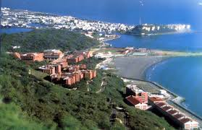
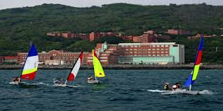
ACKWLODGEMENT

Slide 28
FTIR

