Slide 1
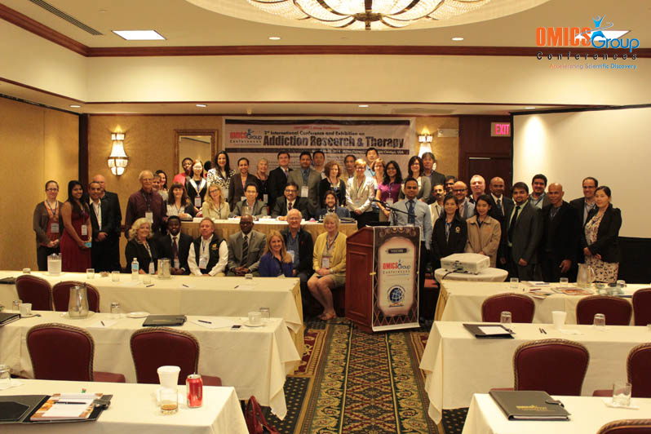
Addiction Therapy-2014 Chicago, USA August 4 - 6, 2014
Lynda Sharrett-Field

Slide 2
Preclinical Studies of Glucocorticoid Receptor Antagonists in the Treatment of Alcohol Dependence
Lynda Sharrett-Field¹, Hilary J. Little² , Mark Prendergast¹
¹Department of Psychology, University of Kentucky,
²Division of Addictions, Institute of Psychiatry, University of London

Slide 3
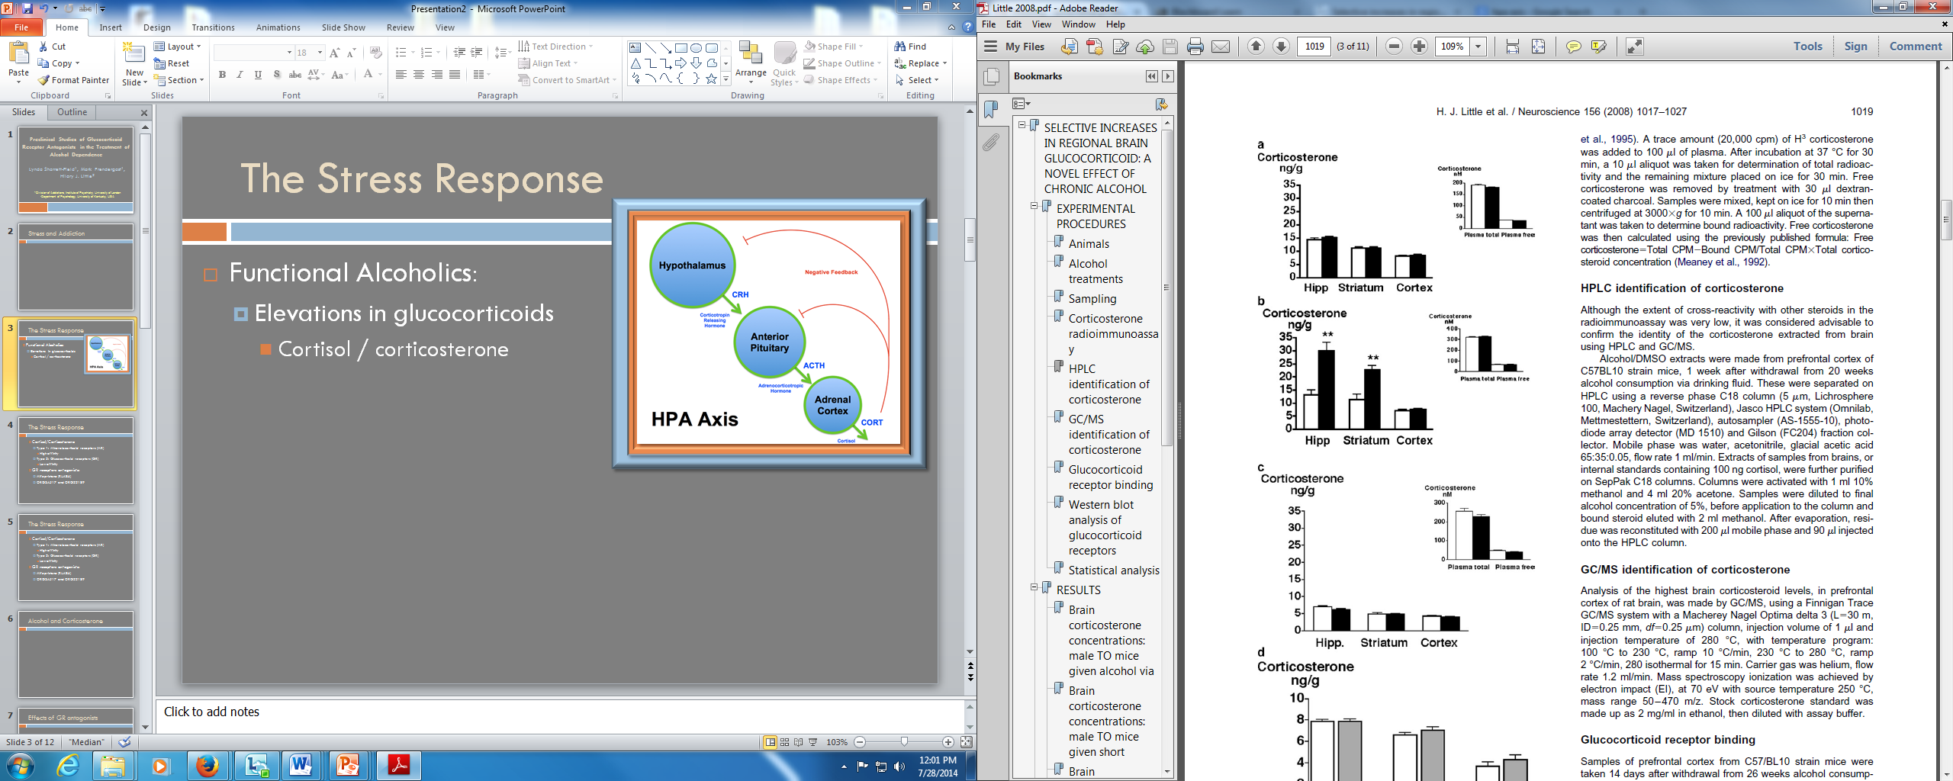
Current FDA Approved Treatments for Alcohol Dependence
Antabuse
Naltrexone
Vivitrol
Acamprosate
Alcohol Withdrawal
Benzodiazepines

Slide 4
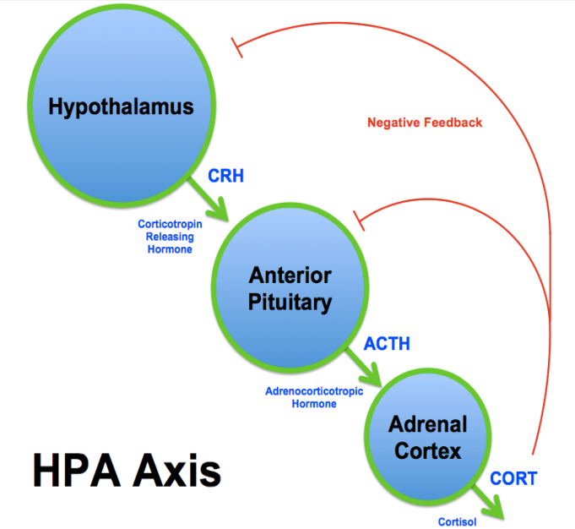
Stress and Addiction
HPA Axis and Addiction:
Cortisol / Corticosterone
Type 1: Mineralocorticoid receptors (MR)
High affinity
Type 2: Glucocorticoid receptors (GR)
Low affinity

Slide 5
Stress and Addiction
Preclinical Studies:
Rats will self-administer CORT to physiological levels achieved with the presentation of stress.
(Piazza et al, 1993)
Administration of CORT increases self-administration of psychostimulants
(Goeders, 1996)
Administration of CORT or presentation of stressor increases self-administration of alcohol
(Faulke et al, 1994)

Slide 6
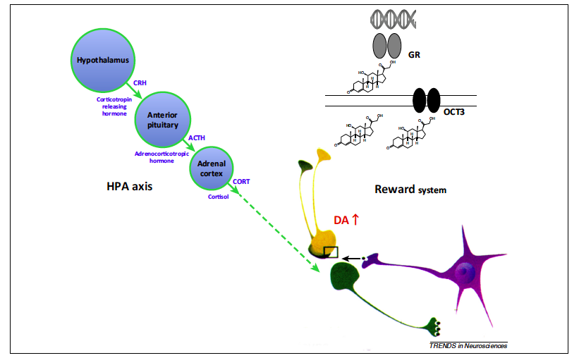
Potential Mechanism of CORT/DA Interaction
Spanagel, Noori, Heilig, 2014

Slide 7
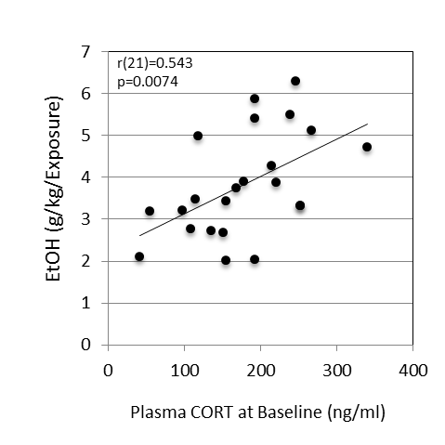
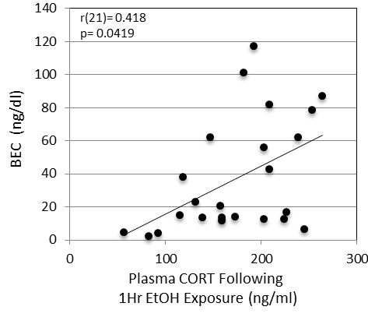
Voluntary Intermittent Ethanol Consumption and CORT
BELs and plasma CORT levels following 1hr of EtOH exposure are positively correlated
Basal plasma CORT levels are associated with voluntary EtOH Consumption
Sharrett-Field et al., unpublished data

Slide 8
Forced Continuous Ethanol Consumption and Corticosterone
Elevations in corticosterone differ across brain regions and are affected by abstinence.
3 week exposure ethanol via liquid diet
3 weeks ethanol via liquid diet
6 days of abstinence
Corticosterone
Control
Corticosterone
Control
ng/g
7% EtOH
ng/g
7% EtOH
35
**
30
35
25
30
**
20
25
15
20
15
10
10
5
5
0
0
Hipp Striatum Cortex
Hipp Striatum Cortex
(Little et al., 2008)

Slide 9
Ethanol withdrawal (EWD) induced neuronal damage reduced by RU486
RU486 + CORT +
EWD
Spironolactone + CORT +
EWD
CORT +
EWD
Control
EWD
20X
5X
Propidium iodide fluorescence
(Mulholland et al., 2005)
Organotypic hippocampal slice cultures
CORT (1uM)exposure during EWD resulted in significant loss of cells, which is reduced by GR antagonism.

Slide 10
Glucocorticoid Antagonists
GR receptor antagonist:
RU486 (Mifepristone)
Termination of pregnancy (Progesterone receptor)
Cushing’s Syndrome
Depression with psychotic tendencies
Combat related PTSD
ORG34517 and ORG22189

Slide 11
Cognitive effects of EWD and exposure reduced by RU486
Single administration of RU486 (mif) prior to EWD reversed alcohol induced alterations on the object recognition task.
Behavior assessed 8-10 days following withdrawal from 34 weeks of chronic alcohol treatment in CJ57 mice
(Jacquot et al., 2008)

Slide 12
Behavioral effects of EWD reduced by RU486
4 day binge exposure:
Ethanol administered via gavage 3 times daily
Injections of RU486 or vehicle given once daily prior to first daily ethanol dose
Tremor
Splayed paws
Rigidity
“Wet dog shakes”
(Sharrett-Field et al., 2013)

Slide 13
Preference for alcohol is reduced by RU486
Saline injections
Low alcohol preferring mice
2 Bottle Choice:
8% EtOH or tap water
Once daily i.p. injection
Saline or RU486
RU486 injections
0.6
0.5
0.4
Alcohol Preference Ratio
0.3
===
===
===
0.2
***
***
***
0.1
0.0
0
2
4
6
8
10
12
14
16
18
20
Day
(O’Callaghan et al, 2005)

Slide 14
Summary
Basal levels of CORT are predictive of voluntary ethanol consumption
Exposure to and withdrawal from chronic ethanol administration elevates levels of CORT
Elevations of CORT during EWD produces cell loss in the hippocampus, in vitro.
Administration of RU486 during EtOH or EWD:
Reduce cognitive deficits
Reduce behavioral signs of EWD
RU486 reduces ethanol preference

Slide 15
Human Trials
Co-Investigators- Hilary Little and Colin Drummond
Participants
Alcoholics entering Alcohol Treatment Units for detoxification
DSM-IV for 5 or more years
Male aged 18-60 years
Randomized double blind trial
Treatment
RU486 or placebo given upon drinking cessation and for following two weeks
12 month trial
Weeks 1-4:
Several assessments of withdrawal severity
Depressive symptomology
Sleep disturbances
Cognitive assessment
Follow-up at 3, 6, 12 months
Abstinence & relapse
Depressive symptomology

Slide 16
Acknowledgements
Mark Prendergast
NIAAA
Grant: AA013388 & AA013561
Hilary Little
NIAAA
Grant: AA13932
Medical Research Council

Slide 17
Meet the eminent gathering once again at Addiction Therapy-2015 Florida, USA August 3 - 5, 2015
Addiction Therapy – 2015 Website:
addictiontherapy.conferenceseries.com

