Slide 1
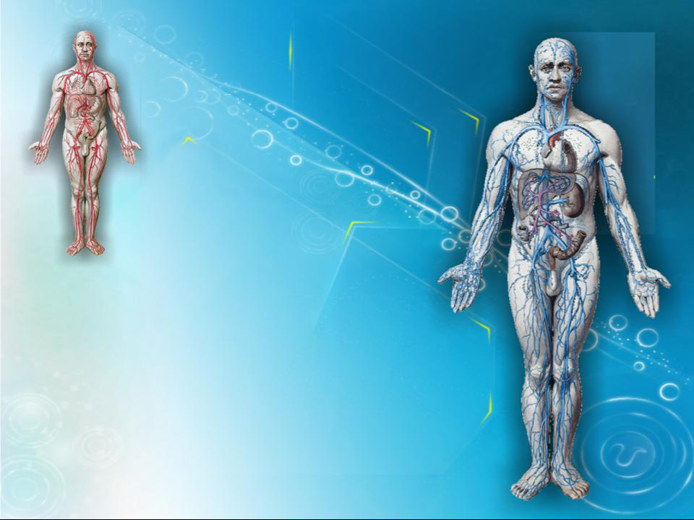
Current State Of Vascular Access In Chronic Hemodialysis Patients In Algeria
Lydia BENHOCINE
Ali BENZIANE
Mohamed BENABADJI
Nephrology Departement.
University Hospital of Beni Messous.Algiers
3rd International Conference on
« Nephrology & Therapeutics »
26-27 June 2014. Valencia. Spain

Slide 2
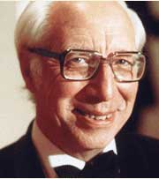
“ We believe that we can keep alive patients with uremia as long as the veins and arteries are in good condition. ”
Willem Kolff, 1944
Notes:
Pionneer of hemodialysis

Slide 3
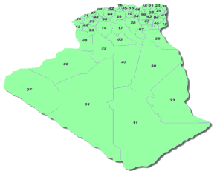
In ALGERIA..
Population of 37.100 000 inhabitants.
Prevalence of ESRD 350 PMP
Incidence of 94 PMP (3500 New cases/year)
17416 ESRD Patients
15.232 Patients on HD : 274 Hemodialysis center
- 154 Public Centers 8013 patients
- 120 Private Centers 7219 patients
430 patients on Peritoneal Dialysis (90 Infants)
100 Renal Transplantation / year ( 3% )
ESRD: end stage renal disease HD :hemodialysis

Slide 4
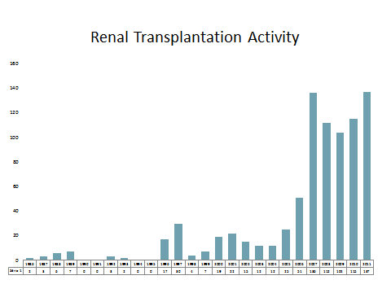

Slide 5
Despite all the progress made in the techniques of renal replacement therapy, survival on hemodialysis (HD) depends in a large part on the quality of vascular access.
Vascular access and its eventual complications remains the leading cause of morbidity in hemodialysis patients.

Slide 6
Objective of the study
1. identify what type of vascular access for Hemodialysis is made on first intention?
2. realize a clinical expertise on the vascular access for dialysis in patients after a certain period of HD.

Slide 7
Patients and Method :
Prospective study.
Multicenter
Datas collated on 60 days (data collection and statistical study)
1029 chronic Hemodialysis patients.
21 Hemodialysis centers (public and private center) located in the capital city of Algiers and neighboring towns.
(Tizi ouzou.Tipaza.Ain Defla.Medea.Msila.El-Eulma..)
Notes:
1029 chronic Hemodialysis patients treated and supported in 21 Hemodialysis centers (public and private center) located in the capital city of Algiers and neighboring towns.

Slide 8
Questionnaire sent to the treating Nephrologist
Sex | Age | Origin | InitialNeph | Diabete | HTA | otherPath. | Date of 1st HD | Numb Jug Cath | Numb Fem Cath | Numb Tunneled Cath | Num Gore-tex | Numb AVF | AVF life span | Proximal/distal AVF | Causeof no functioning AVF | Current state of vessels

Slide 9
RESULTS

Slide 10
Gender
Female 53%
Male
47%
Sex Ratio = 1.12

Slide 11
Age
Extremes ages : 13 -94 yearss

Slide 12
Distribution by age /gender
years

Slide 13
Initial Nephropathy
22%
Notes:
Uro 4% Heridit 6% Indet 30%

Slide 14
Life Span On HD
20%

Slide 15
Life span on HD

Slide 16
First access for HD was…

Slide 17
First AVF was…
45%

Slide 18
Total of AVF Vs Life span on HD
 | 0- 5 years | 6 - 10 years | 11 - 15 years | > 15 years
01 AVF | 557 patients | 223 Patients | 69 Patients | 19 Patients
2 AVF | 53 | 10 | 8 | 4
3 AVF | 16 | 8 | 2 | 3
4 AVF | 9 | 3 | 3 | 4
5 AVF | 5 | 4 | 3 | 6
Tunneled Cath | 2 | 8 | 5 | 5
TOTAL | 642 patients | 256 patients | 90 Patients | 41 Patients

Slide 19
Clinical evaluation of vascular access for HD (less than 10 years on HD )

Slide 20
Comments :
.Sex Ratio was identical
.Relatively young population (40-60 years)
.Percentage of undetrmined nephropathy remains
eleveted.
.Percentages of Diabetic and Hypertensive Nephropathies join International datas.

Slide 21
Comments :
.Central Catheter remains the leading access for HD.
(Despite 40% AVF on first intention → Follow-up of uremic patients before ESRD)
.1 Patient/2 : First AVF Proximal than Distal
.1patient /5 has « a Poor Vascular capital » within 10 years of dialysis.
Notes:
One in two patients has his first fistula proximal than distal and that reduced seriously his vascular capital and amputated his vascular access.
One in five patients has a poor ….

Slide 22
CONCLUSION
Vascular Capital of hemodialysis patients is VITAL.
Great interest to preserve it preciously :
→ Education of uremic patients and nursing staff.
→ Careful assessment of where anastomosis should be performed using radiological investigation if necessary.
(Distal>>Proximal)
→ Regular radiological monitoring of the vascular access.
Multidisciplinary planning seems essential to achieve this goal and thus improve the survival of patients on chronic hemodialysis.

Slide 23
Acknowledgment :
.Dr Bahamida,Dr Mazouni, Dr Rezzak.,Dr lechehab et Nadia.Beni Messous Hospital.
.Dr Labou,Dr Chachoua et aux medecins généralistes de l’EPH Kolea.
.Dr Tayar Clinique du rein .Cheraga
.Dr Bedja et Karim. Clinique Ibtissama. Dely Brahim
.Dr Chaimi.Dr Zeghlache Clinique Hydra
.Dr Moualek. Pr Rayane clinique Baraki
.Dr Bridja et Hocine.Clinique bonne santé. Belcourt
.Dr Hamiche Clinique hemodial Larbaa.
.Dr Oussalah. Dr Badaoui. Pr Seba.Tizi Ouzou university hospital
.Dr Slimani.EPH Sidi Aissa.
.Dr Tafoukt . EPH El-Eulma.
.Dr Belamri.CHU Thenia. Hemodialysis center of khemis khechna.
.Dr Belhaoua EPH Ain defla
.Dr Gouceme.Dr Hammadouche. Hemodialysis center of Hadjout.cherchell
.Dr Dif. EPH berouaghia
.Dr Mahmoudi.Private hemodialysis center of Tizi Ouzou
Notes:
A big thnks to all the nephrologists who participated in this work and have allowed the collection of datas

Slide 24
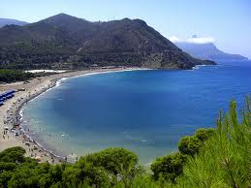
GRACIAS !

