Slide 1

www.wakeforest-personalized-hemonc.com
11635 Northpark Drive, Suite 250, Wake Forest, NC 27587
Gene expression profiling
for targeted cancer treatment
Luminita Castillos¹, PhD, MBA, Francisco Castillos¹, III, MD and Anton Yuryev², PhD
¹Personalized Hematology-Oncology of Wake Forest, PLLC, NC 27587, USA
²Elsevier, MD 20852, USA

Slide 2
Current landscape of cancer care
In the past 7 years, nearly 900 independent oncology practices in the United States have closed, been acquired by a hospital or merged with another entity, according to the Community Oncology Alliance. Several hundred more are struggling financially.
As expenses rise, reimbursements decline and regulatory burdens intensify, some experts suggest the trend will continue.
Others suggest independent providers who are willing to adapt to the evolving health care environment and embrace creative strategies can find ways to thrive.
HemOnc today, October 10, 2014

Slide 3
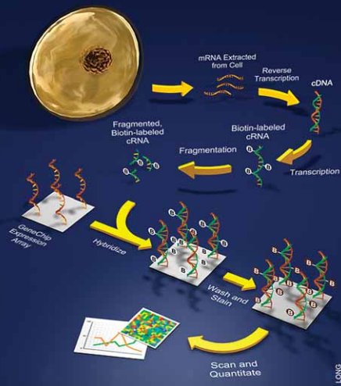
From the research bench to the physician’s tool for diagnosis and treatment :
Gene expression profiling –> experiment design
core biopsies from tumor and normal tissue preserved in RNA-later
RNA extraction and QC - clean, intact RNA will ensure the generation of high quality microarray data
synthesis of double stranded cDNA from the RNA sample using reverse transcriptase and an oligo-dT primer
in vitro transcription (IVT) reaction that produces amplified amounts of biotin-labeled antisense mRNA (cRNA)
cRNA fragmentation using heat and Mg+2 (this fragmentation reduces the cRNA to 25-200 bp fragments)
cRNA hybridization at 45 degrees Celsius for 18 hours
Staining the chip (U133 Plus 2.0) with a fluorescent molecule (streptavidin-phycoerythrin) that binds to biotin
series of washes and stains binds the biotin and provides an amplified flour that emits light when the chip
is then scanned and the images processed using Affymetrix software, GeneChip Operating Software (GCOS)
MAS file types are generated: Experiment File *.EXP, Image Data File *.DAT, Cell Intensity File *.CEL,
Probe Array Results File *.CHP, Report File *.RPT, and MAGE-ML *.XML
10. Importing CEL file into Elsevier Pathway Studio software.

Slide 4
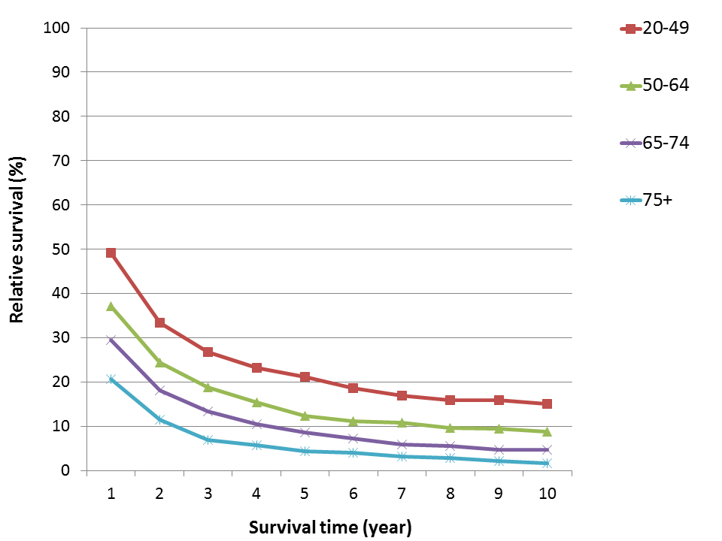
First patient
66 year old Caucasian female diagnosed with moderate to poorly differentiated hepatocellular carcinoma with associated necrosis
Pet/Ct scan shows 9.0x7.2x5.7 cm right hepatic lobe mass
Resection of hepatocellular carcinoma involving an ascending colon in the right lateral abdominal wall, segments 5 and 6 from the liver and 11 benign lymph nodes
Core biopsies of liver tumor as well as some of the normal liver parenchymal cells were sent for gene expression profile analysis.
Liver cancer survival in women by survival time and age
The figure shows survival rates for liver cancer by survival time and age for the US male and female between 1988 and 2007.

Slide 5
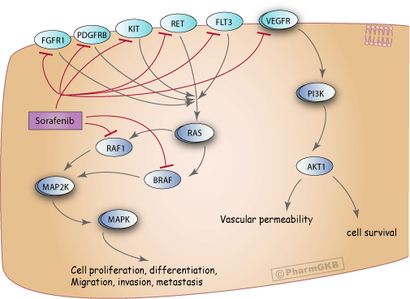
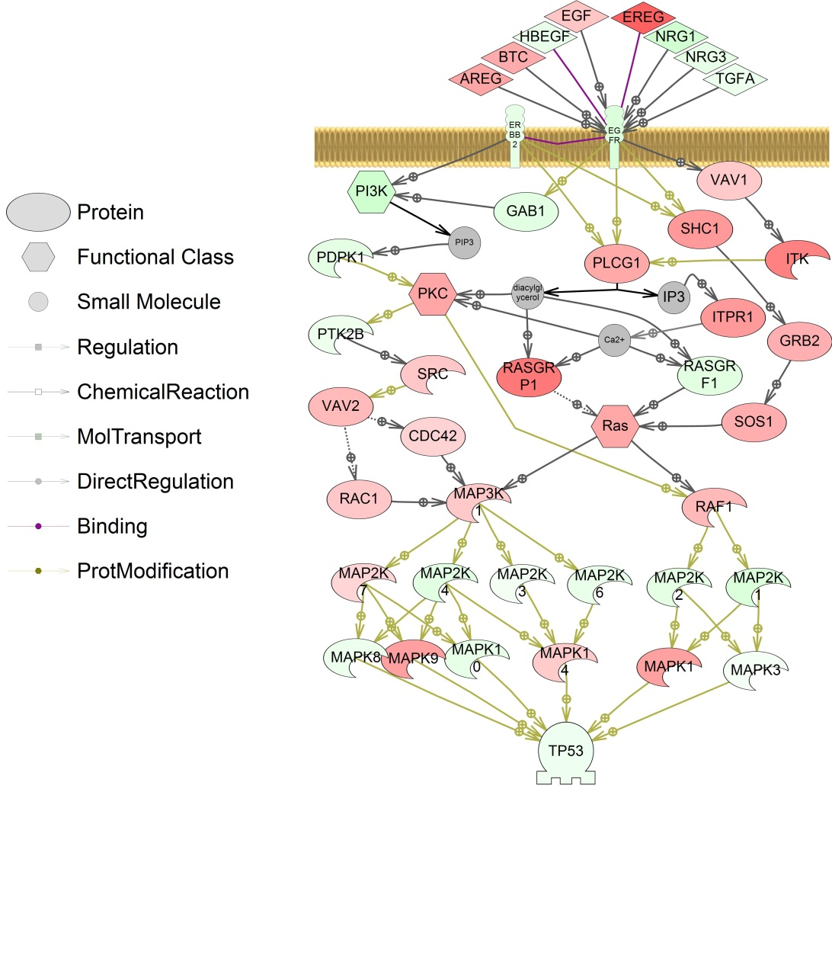
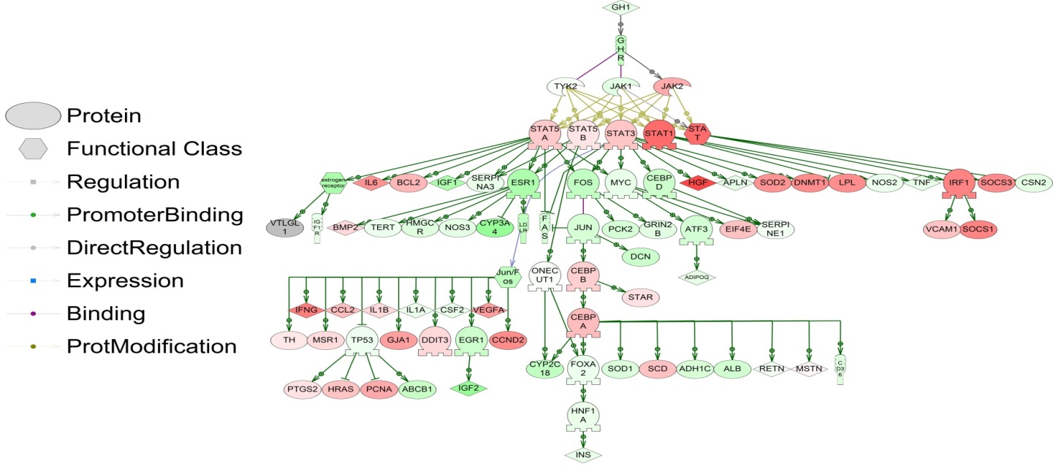
Dominant signal transduction pathways through which the hepatocellular carcinoma has proliferate is through the Raf- Ras-MEK-Map kinase pathway.
Other pathways within her hepatocellular carcinoma
  JAK-STAT
  SMAD – RUNX2
  AKT1-FOXO1-IGFBP1
  RUNT - VEGFA

Slide 6
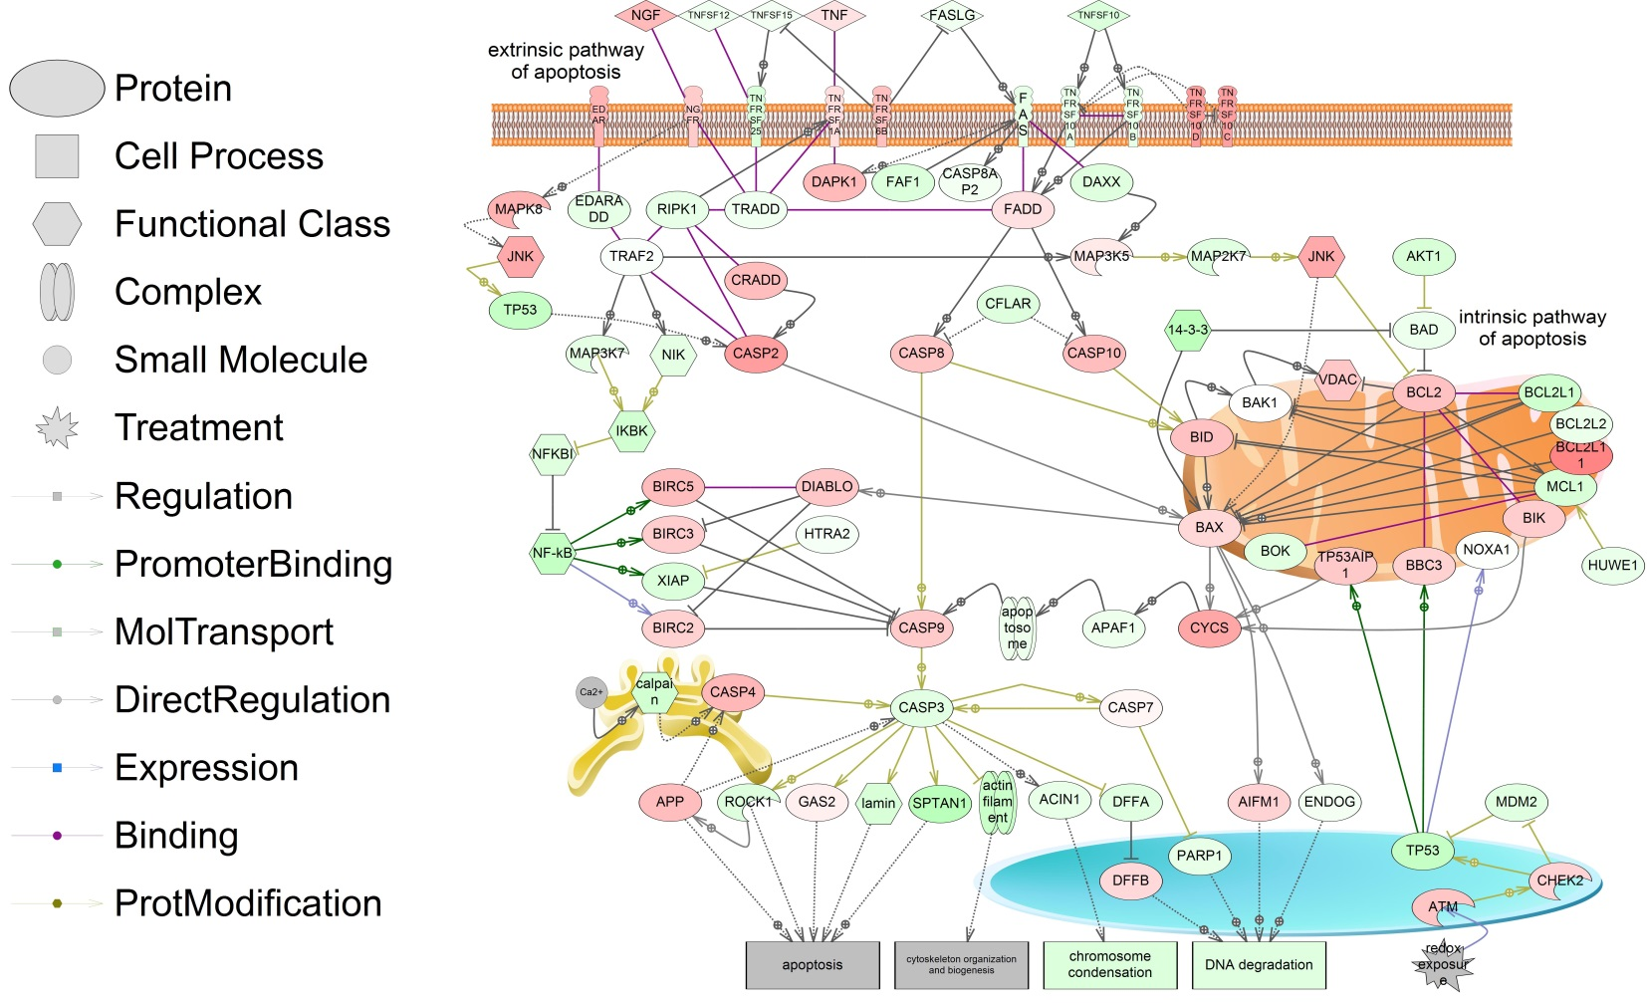
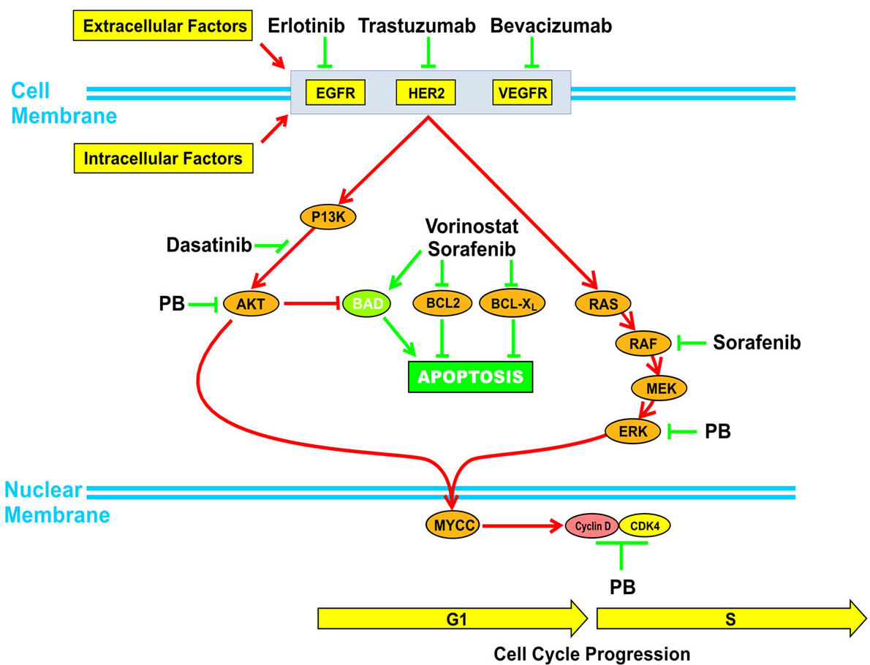
Patient arranged to receive Sorafenib 400 mg twice a day at least six months
Resection of residual disease with gene expression profile using mesenteric lymph node material from small bowel
Patient referred to Virginia, Massey Cancer Center to look at being randomized in the clinical trial (ClinicalTrials.gov Identifier: NCT01075113) looking at combinations of molecular targeted therapies inducing apoptosis (Vorinostat) in addition to the dominant pathway, which were blocked by Sorafenib: EGFR-Ras-Raf- MEK-Map kinase-ERK pathway.
Purpose: This phase I trial is studying the side effects and best dose of vorinostat when given together with sorafenib tosylate in treating patients with advanced liver cancer. Sorafenib tosylate and vorinostat may stop the growth of tumor cells by blocking some of the enzymes needed for cell growth or by blocking blood flow to the tumor. Giving sorafenib tosylate together with vorinostat may kill more tumor cells. - www.clinicaltrials.gov

Slide 7
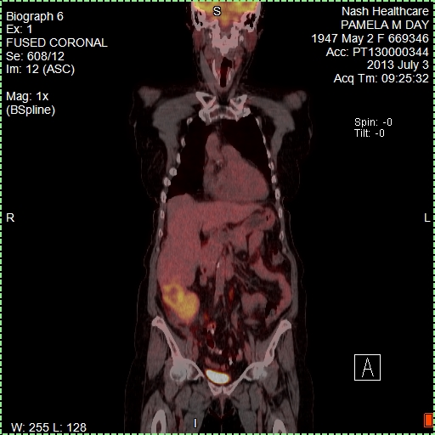
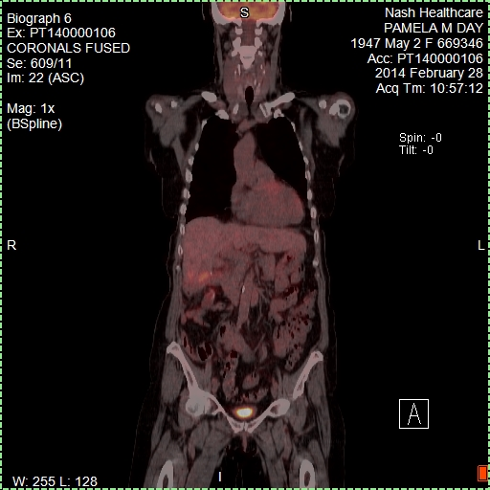
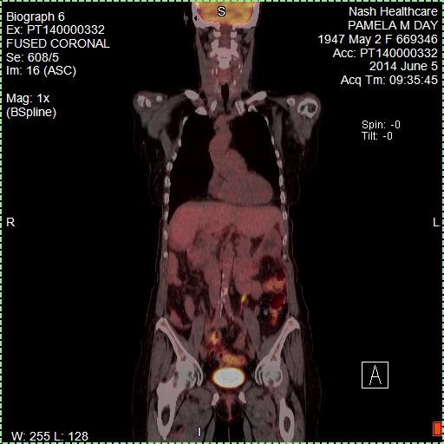
Before and after treatment
Before treatment
PET/Scan-July, 2013
After resection and Sorafenib 400 mg
twice a day (six months)-PET/Scan
After NCT01075113 clinical trial Sorafenib plus Vorinostat
Massey Cancer Center, Virginia, June 2014-PET/Scan

Slide 8
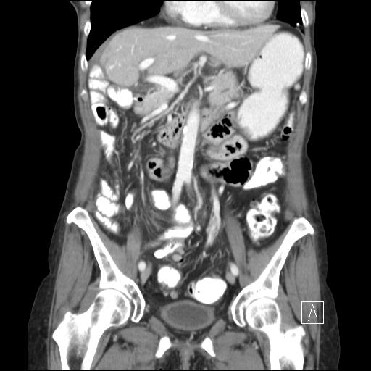
First patient summary
Continue the clinical trial
Patient has outlived Overall Survival estimates based on standard of care treatment and continues to have normal quality of life with intermittent grade I hand-foot syndrome from her Sorafinib + Voronistat treatments on Clinical trial and to this date in time appears to be in clinical remission.
CT/Scan from 10-October-2014

Slide 9
Second patient
66 year old Caucasian female diagnosed in 2011 in Florida with stage I breast cancer, miss-labeled as ER+/PR+, and treated with Docetaxel/Cyclophosphamine (4 cycles) followed by hormonal therapy
Cancer recurrence in 2013 and diagnosed with stage IV breast cancer with mets in the right lung and her brain (diagnose made in our practice for the first time after moving to North Carolina)
Re-diagnosed (initial tumor block from Florida) as ER-/PR- and treated with radiation for the brain met and 2 cycles of Adriamycin/Cyclophosphamide (dose dense standard of care therapy, based on ASCO and NCCN guidelines ) for the breast cancer lung mets
Brain met responded to the radiation treatment but the lung met did not respond to AC chemotherapy and core biopsies were performed from the lung met
Treatment was switched to Gemcitabine (standard of care) until the gene expression profiling data was processed
Gene expression profiling reveals:
  ER -, PR-, Her2Neu- confirming pathology findings as a triple negative breast cancer metastasis
  Cell invasion through: connective tissue growth factor (CTGF)->fibronectin 1 (FN1) ->integrin α-5 pathway
  Cell cycle is activated through transcription factor activator E2F and viral oncogene MYBL2
  Angiogenesis is up-regulated through VEGF
Based on the tumor pathways , bevacizumab (recombinant human monoclonal antibody that blocks angiogenesis by inhibiting VEGFA) was added to her treatment to decrease blood vessel ingrowth to her tumor from angiogenesis
Repeated scan showed considerable decreasing on the lung met to the size that allowed it to be resected follow up by 2 more doses of bevacizumab plus Gemcitabine
During the treatment, bone mets developed and she received 10 days of radiation as a palliative treatment
No sign of disease and next scan is scheduled for November 2014

Slide 10
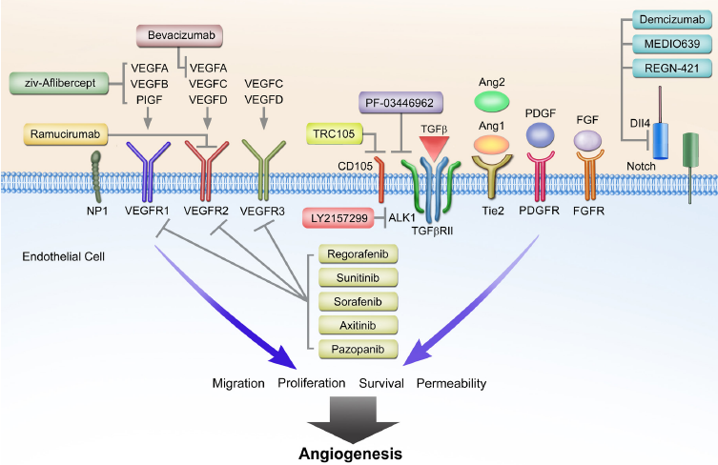


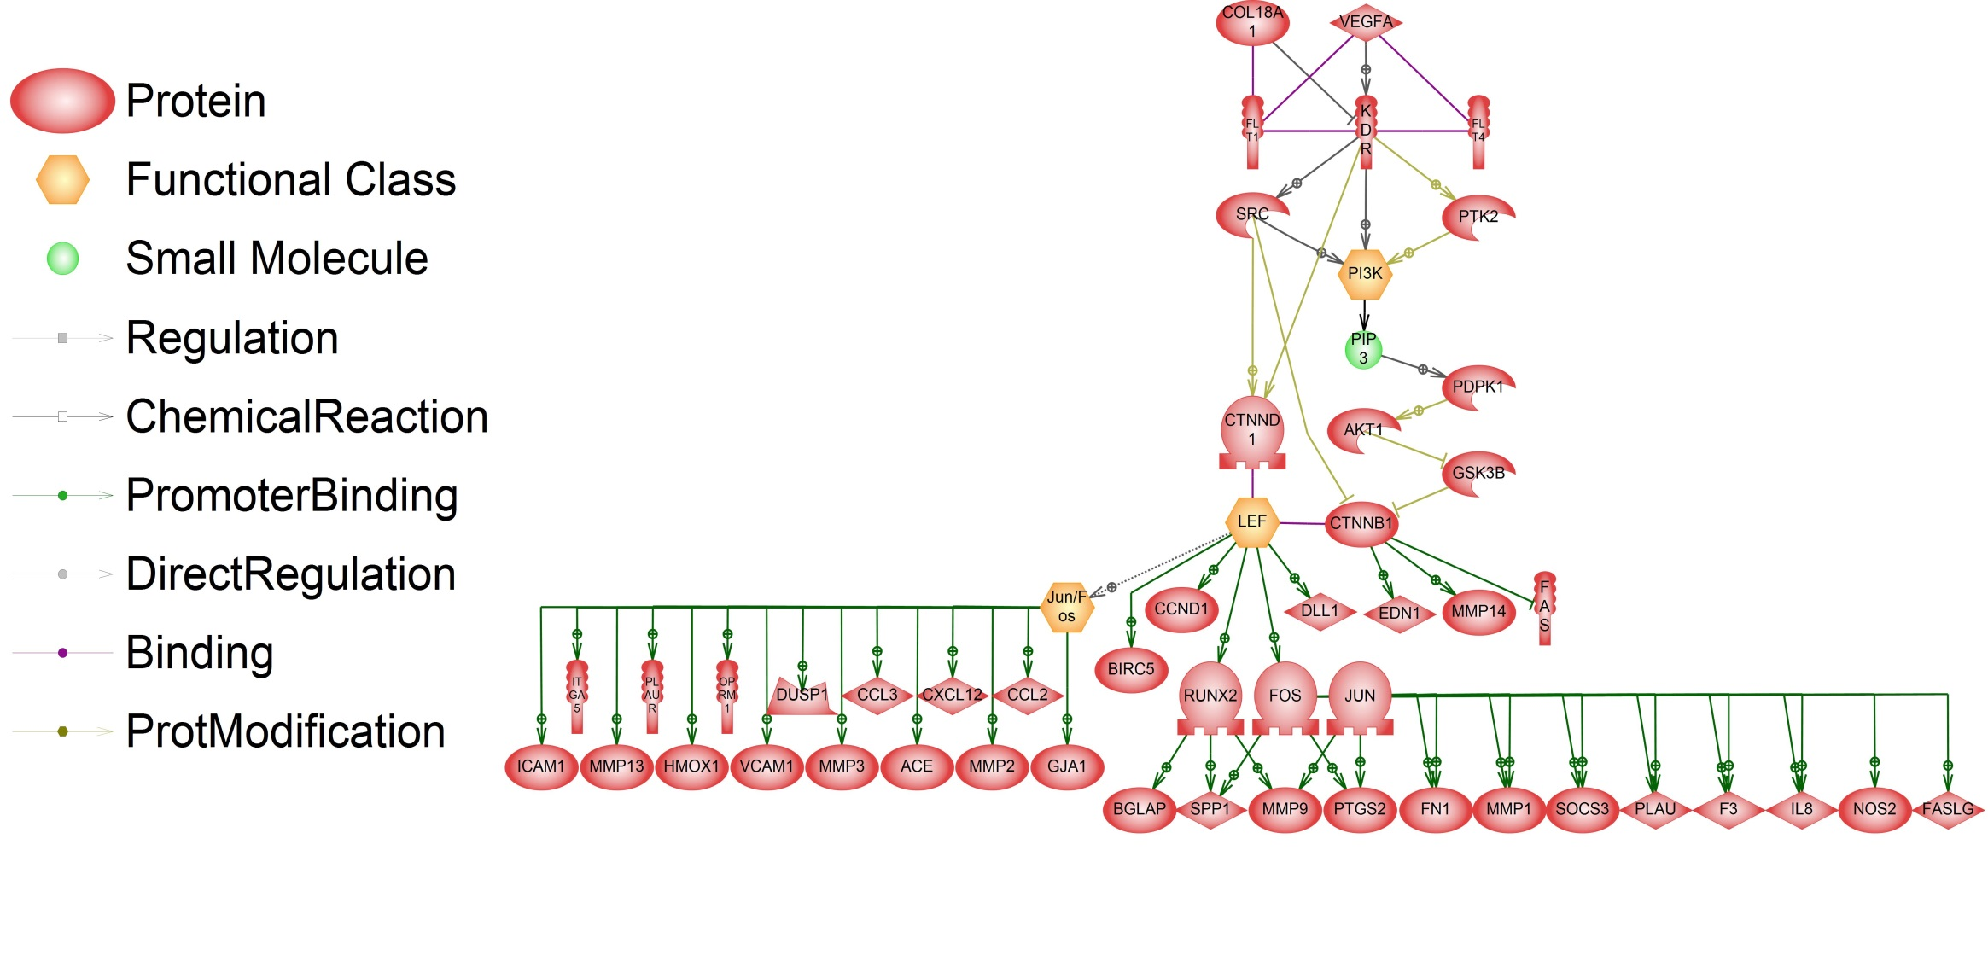
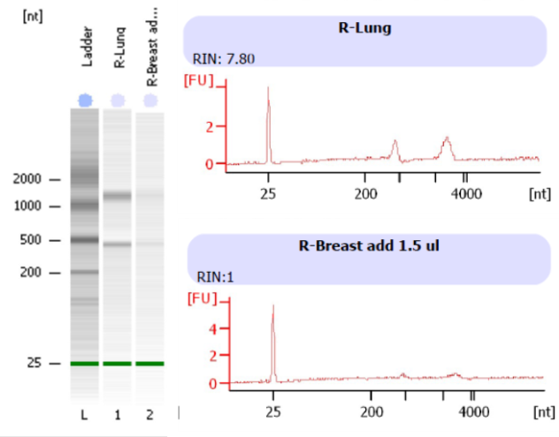
Second patient – tumor signaling pathway

Slide 11
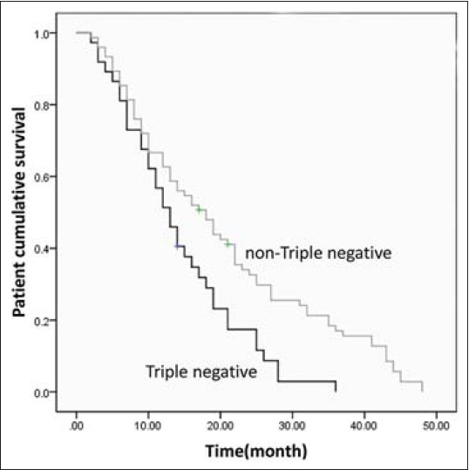
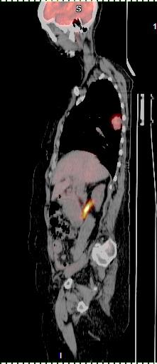
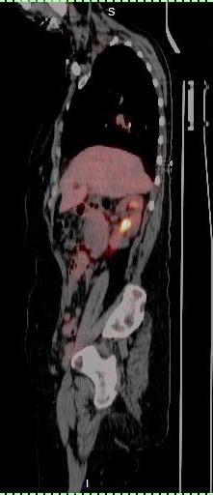
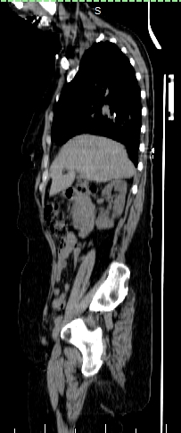
Lung met
before treatment
12 September 2013
PET/Scan
No lung met
after treatment
8 July 2014
PET/Scan
No lung met
after treatment
8 July 2014
CT/Scan

Slide 12
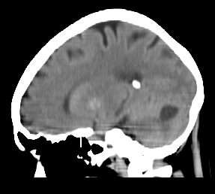
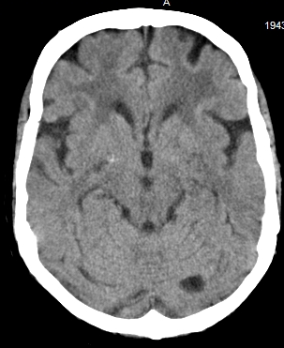
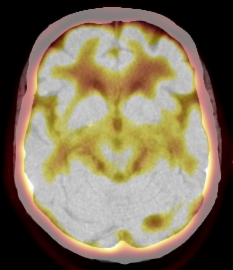
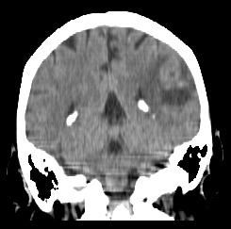
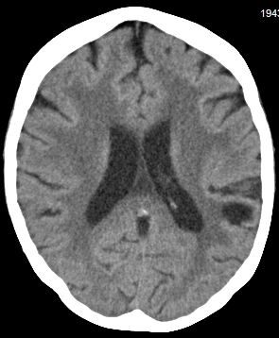
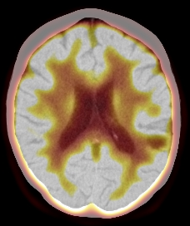
12-sept-2013: left cerebellum met
CT/Scan
8-july-2014: left cerebellum no change in size
CT/Scan
8-july-2014: left cerebellum no increased
hyper-metabolic activity PET/Scan
12-sept-2013: left parietal met
CT/Scan
8-july-2014: left parietal no change in size
CT/Scan
8-july-2014: left parietal no increased
hyper-metabolic activity PET/Scan

Slide 13
Second patient summary
No clinical signs or symptoms of disease and next PET/CT scan is scheduled for November 2014
Patient has outlived Overall Survival estimates based on standard of care treatments and continues to have normal quality of life

Slide 14
Third patient
74 year old Caucasian male diagnosed in 2009 with stage IV colon cancer
    Removal of sigmoid colon
    Radiofrequency ablation for two liver lesions
    Treated for surgical site infection
    Refused to have chemotherapy (adjuvant therapy) initially after the surgery
Cancer recurrence in 2013 with multiple mets in the liver and lung; core biopsies were performed from the liver met for gene expression profiling
In January 2014 started standard of care modified FOLFOX6 regimen every 2 weeks with 5-FU CADD pump
    FOLFOX6 = 5-FU + Oxaliplatin + Leucovorin
Gene expression profiling reveals:
  tumor grows due to mitotic activation
  FoxMP1 activation in the tumor ->FoxMP1 confers resistance to many drugs including chemo drugs
  drug metabolization pathways are active -> bad outcome because tumor adapts to liver and liver’s function is drug metabolism.
  angiogenesis is up-regulated through VEGF
Based on the tumor pathways
    Dexamethazone (blocks FoxMP1) was added to his original treatment (FOLFOX6) but without oxaliplatin to decrease resistance to chemo drugs; the other FoxMP1 inhibitors are not FDA approved for colon cancer
    Potential to use Ramucirumab – a VEGF Receptor 2 antagonist that specifically binds and blocks activation of VEGF Receptor 2 and blocks binding of VEGFA receptor which binds VEGF-A, VEGF-C, and VEGF-D ligands
    September 2014, a pharma company announced use of Ramucirumab in patients with metastatic colorectal cancer with benefit in overall survival
June and July 2013 the patient was on hold from the toxicity of chemo treatment due to: typhilitis, pneumotosis of the colon (air in the colonic wall) and pulmonary embolism; started back on treatment in August 2014 but after 3 cycles decided to not have any more chemotherapy at that time.

Slide 15
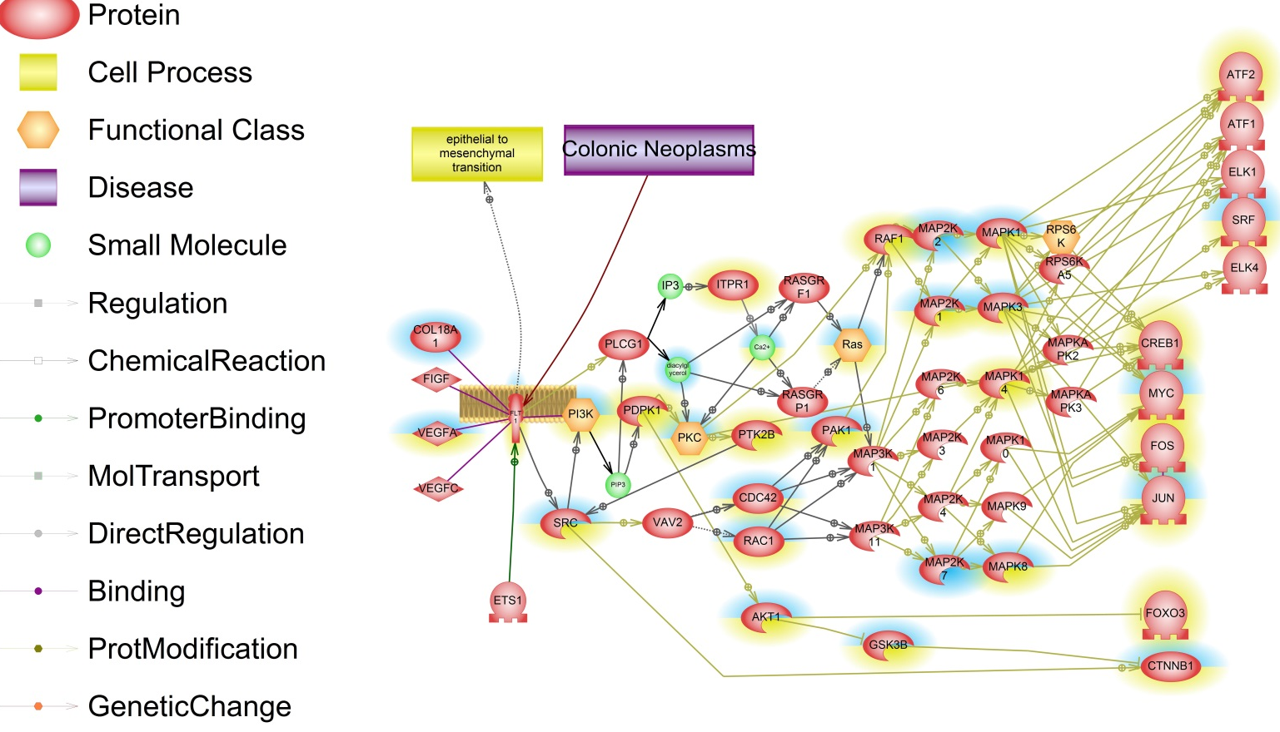
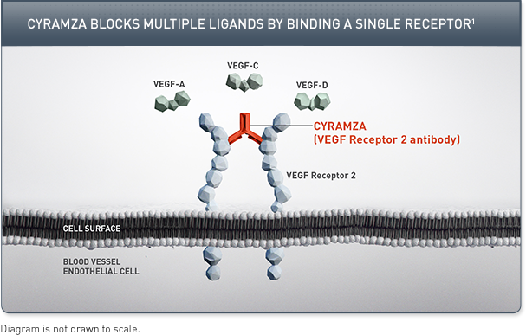
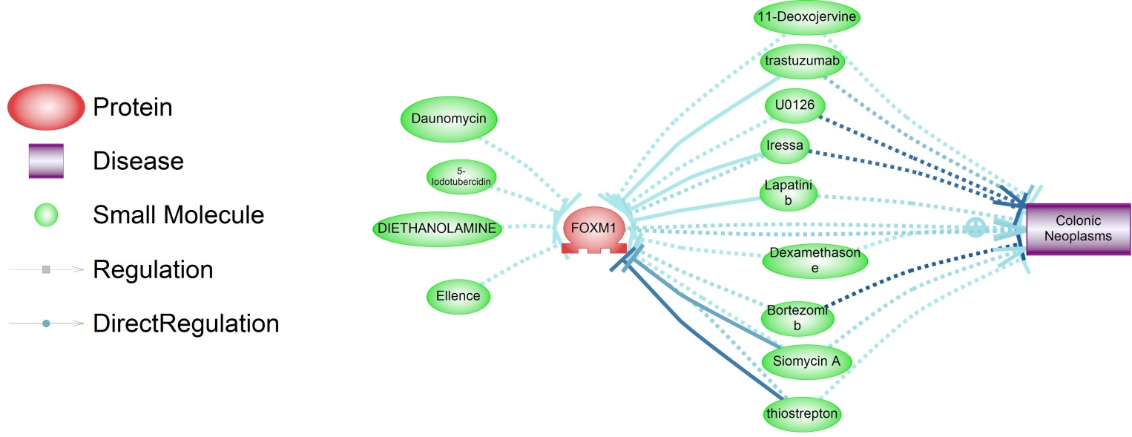
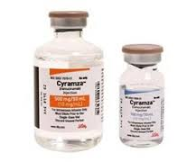
Third patient
tumor signaling pathway

Slide 16
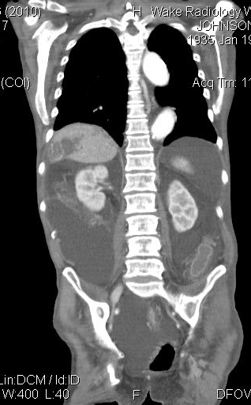
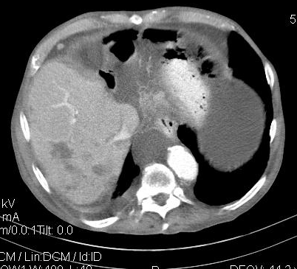
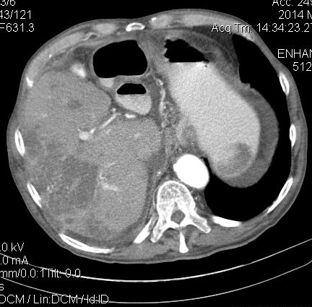
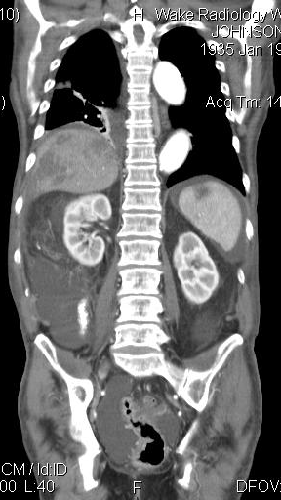
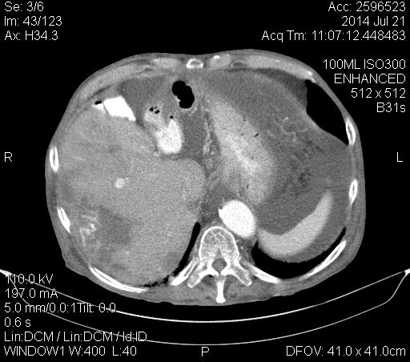
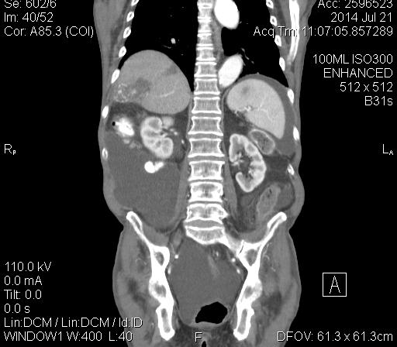
After adding dexamethasone
to his regimen, scan shows
decreasing number of mets
19-may-2014
Transverse CT/Scan
19-may-2014
Coronal CT/Scan
10-march-2014
Transverse CT/Scan
10-march-2014
Coronal CT/Scan
After 2 months off chemotherapy
Scan shows no increase in number
of mets but some increase in the
size of existing mets
Transverse 21-july-2014 Coronal CT/Scan
Coronal 21-july-2014 CT/Scan

Slide 17
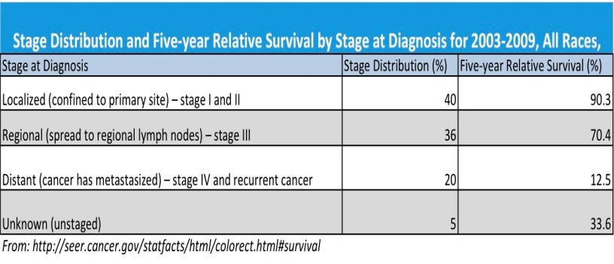
Third patient summary
Patient seen 2 weeks ago is able to walk with a walker, eat meals and enjoy time with family
Patient is still alive with better quality of life at the present time while on a treatment break. He may elect to restart therapy with Ramucirumab

Slide 18

Learning lesson and how a small independent oncology practice
will survive in the next 10 years and more
Every patient with metastatic cancer should have gene expression profiling performed on their tumor cells to allow the science to dictate which proliferation pathways to block with molecularly targeted drugs to force apoptosis of their cancer cells, to look at the blueprint of the tumor cells before selecting treatment - as opposed to using standard of care cytotoxic drugs based on treating a heterogeneous population of patients with the same cancer without having looked at the tumor blueprint, relying on physician preferences created by guideline committees (“blindfold and pin the tail on the donkey”)!
In patients with metastasis or who exhausted all the treatment options, gene expression profiling (GEP) changes the prognosis and management for the majority of patients.
Patients for whom the GEP test was performed had longer median survival than that historically reported for patients with the same diagnosis and stage of disease.
GEP is projected not only to increase overall survival, but also decrease toxicity of treatment, and improve quality of life.

