Slide 1

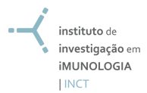
S. pyogenes candidate vaccine
Luiza Guilherme, PhD
Heart Institute (InCor)
University of São Paulo, São Paulo, Brazil
luizagui@usp.br
Notes:
1
1

Slide 2
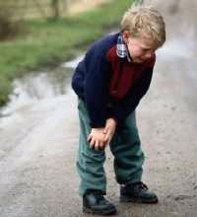
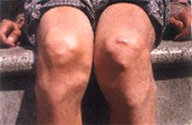
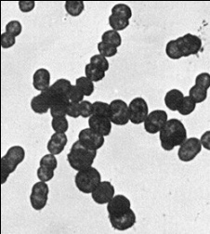

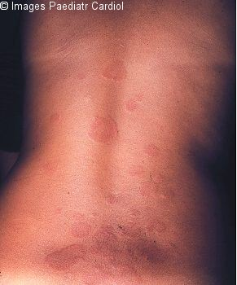
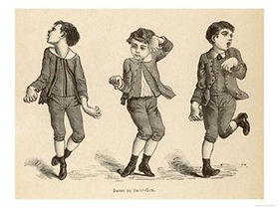
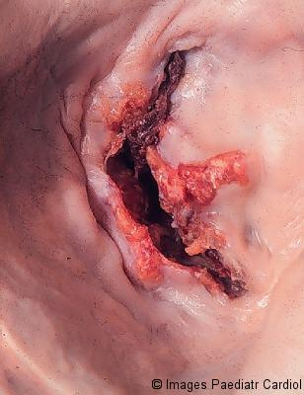
RF and RHD
Streptococcus pyogenes
Polyarthritis
(90%)
Subcutaneous
Nodulles
(3 a 4%)
Auto-immune Reations
Sydenham´s
Chorea
Eritema marginatum
(Decourt, 1972); (Kaplan, 1979)
Reviewed by Steer et al, 2007
RHD
Carditis
(30-45%)
1840: “ Rheumatic fever licks the articulations and bits the heart.” (Jean Baptiste Bouillot )
Notes:
A FR é uma sequela pós infecção estreptococica, pelo S. pyogenes, e manifesta-se clinicamente por episodios de poliartrite, coreia de sydenham , eritema marginatum, nodulos subcutaneos e cardite. Sendo a sequela mais severa a DRC, que pode levar o indivíduo a um quadro de insuficiencia cardiaca.

Slide 3
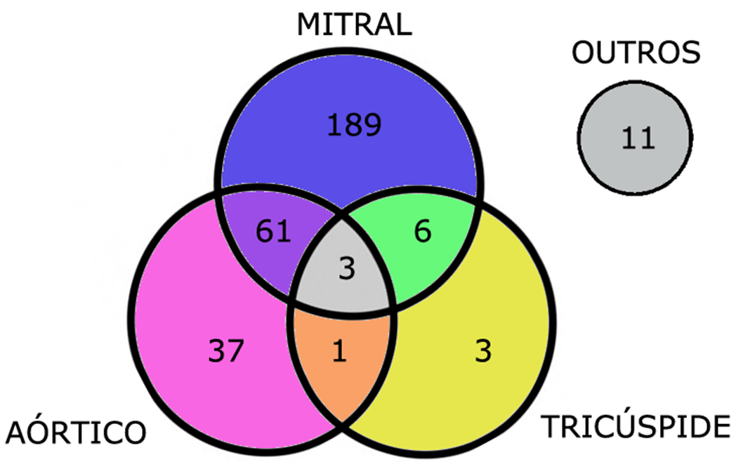
2013
Pattern of Valvular Lesions of Rheumatic Fever/ Rheumatic Heart Disease Patients
Based on Cardiology Auscultation
OTHER
311 out of 439 patients
63.6%
AORTIC
TRICUSPID
GROUP of PATIENTS OF RHEUMATIC FEVER
CLINICAL HOSPITAL, SCHOOL of MEDICINE, UNIVERSITY of SÃO PAULO
Spina G., 2013

Slide 4

VALVAR SURGERIES - InCor
1980 - 2004
Rheumatic Fever Surgeries
Number - Patients
Valvar Replacement
3873
Valvar Plastic
1131
Total
5004
49.5 % of cardiac surgeries performed
in 25 years
Pomerantzeff PMA, Brandao CM , et al.
Valve Reconstruction in the Heart Institute of São Paulo, Brazil.; Semin Thorac Cardiovasc Surg, 2002

Slide 5


Medical Care
Ambulatory
  2014
  Following-up: approximately 12000 patients;
  Average monthly attendance: 1600 patients;
  May/2015:
    New cases of VHD: 81patients
    Total: 1604 patients

Slide 6

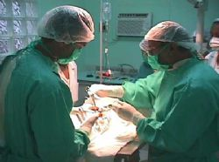
Medical Care -Teaching
28 bed ward for valvular heart disease;
In 2014: 615 surgeries (25% of all surgeries);
May 2015: 57 valvular heart surgeries (20% of all surgeries);
Monthly Activity Report, may 2015 – U.I.M.H.

Slide 7

Latin American / European / North American guidelines have a few diferences and a lot of similarities:
What is the Latin America (Brazilian) reality?
  Higher prevalence of rheumatic fever (up to 70% of all surgical cases of valvular disease).
  Incidence of rheumatic heart disease at school age is : 1 to 7/1000 children in Brazil versus 0.1 to 0.4/1000 in the USA.
  Higher incidence of valvular disease in young people.
What are the European and USA realities?
  Higher prevalence of degenerative valve disease (aortic stenosis and mitral regurgitation)

Slide 8

Rheumatic Fever – InCor
São Paulo - 2011
~ 600 outpatients / month
~ 2000 patients waiting for valvular surgery
38% of surgeries are in young patients

Slide 9
Adaptive IR
Genetic Susceptibility
HLA – Class II alleles
Serology, Mol Biol
Innate IR
SNP
Cytokines
TNF- alfa
TGF-beta
IL-1 Ra
IL-10
MBL-2- Alleles A / O
TLR-2
FCN-2
FcRII A

Slide 10
  RHD- Autoimmune Reactions: Peripheral T-cells and M protein Response
Streptococus pyogenes
Throat
A - Periphery
peptide
B Cell
Antibodies anti-streptococci
Macrophage
Citokines
HLA
DR/DQ
CD4⁺T Cell
Streptococci primed CD4⁺ T Cell
Responders to M5(81-96) peptide
80
100
70% of RHD patients recognized
Heart-tissue proteins
60
80
Reactivity ( %)
40
20
60
Severe RHD
% Responders
Mild RHD
0
DR7+
DR7-
DR53+
DR53-
40
controls
HLA class II
20
0
Myoc+ Ao v .
Myoc>150 KDa
Ao v 90-150 kDa
Ao v 65-90 kDa
Ao v 43-65 kDa
severe / mild RHD
Controls
Guilherme et al, Infect Immun, 2001
Notes:
10
10

Slide 11
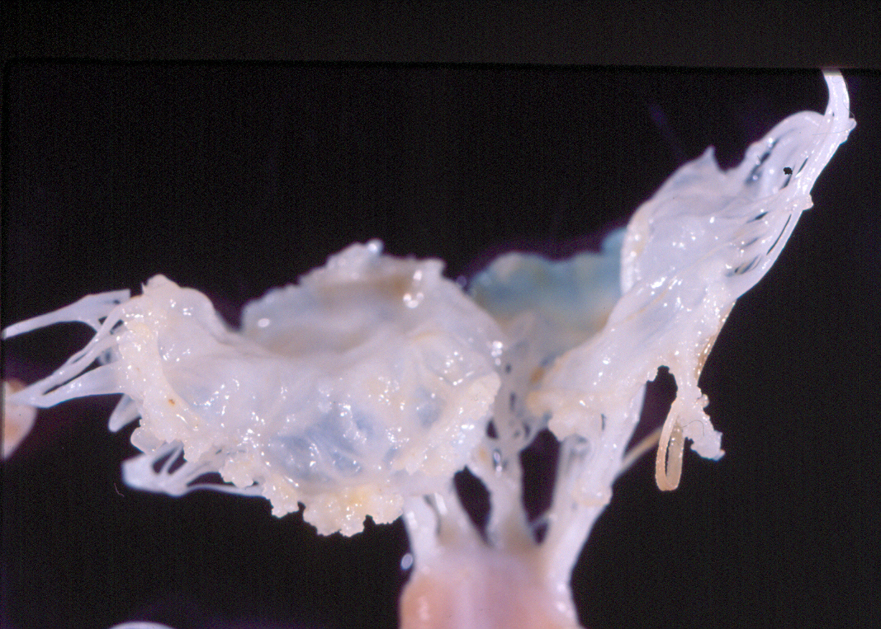
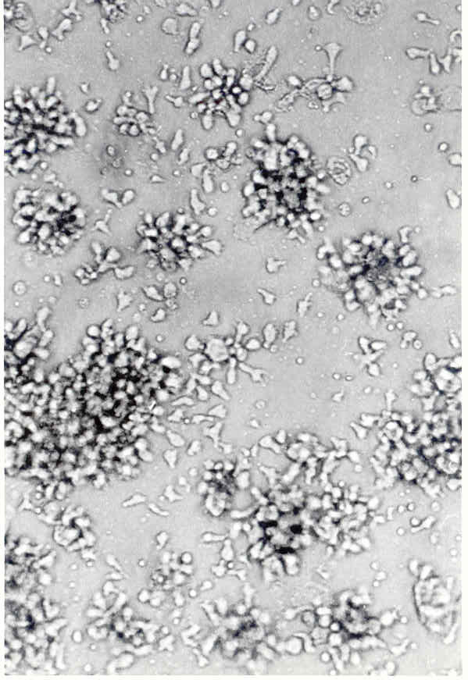
Rheumatic Valvulitis –Mitral v.
Vegetations
Valve Cross Reactive Proteins
Vimentin, Collagen VI,
Lumican
Intralesional Auto-reactive T cell clones
Acute Phase – 67%
Chronic Phase – 20 to 30%
20
SI
10
Guilherme,L et al,
Circulation 1995 J. Autoimmunity, 2001
I E
Martins C, Guilherme,L et al, 2014
0
PepM5 (81-96)
Ao.v. 90-150kDa

Slide 12
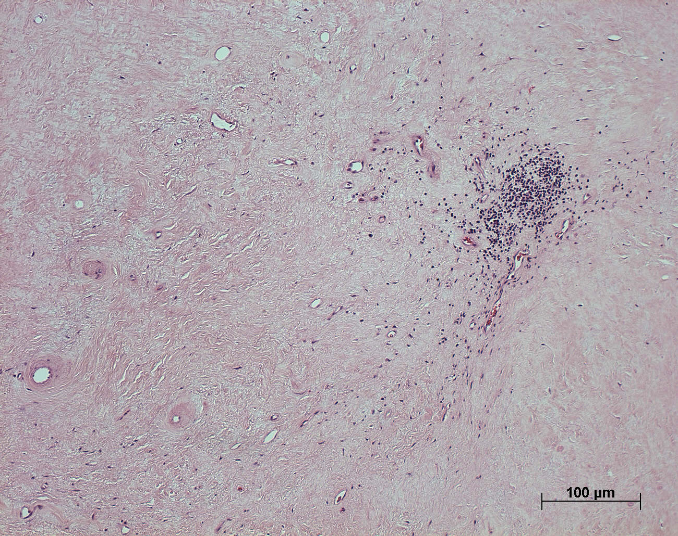
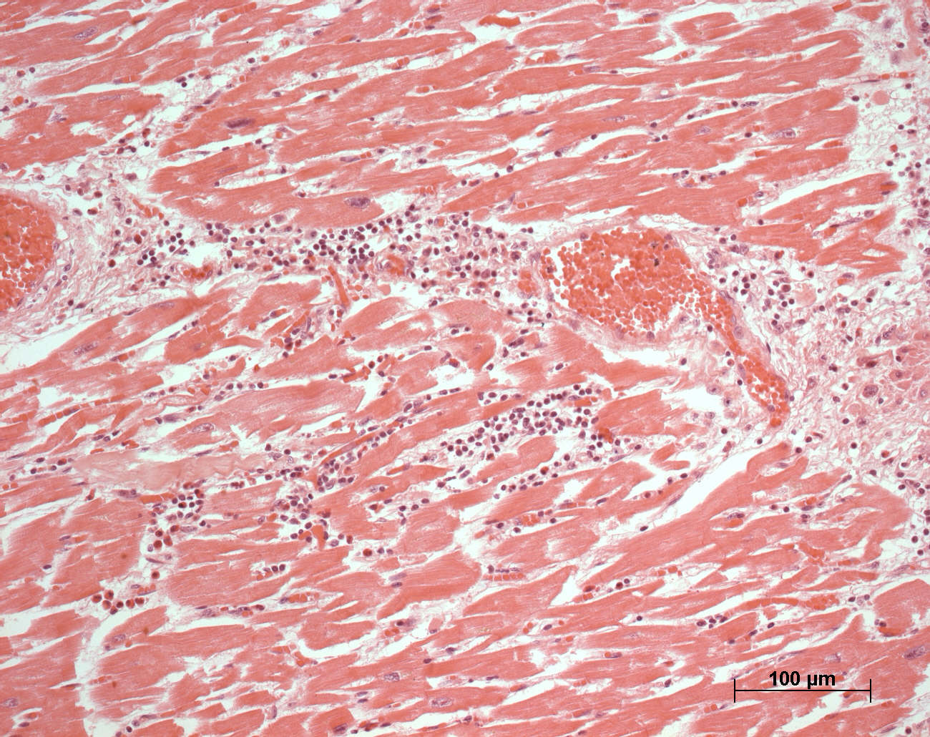
Cytokines in RHD
Th1
Inflammatory
TNFa , IFNg
IL-17, IL-23
Regulatory
IL-10
IL-4 –Low numbers
Progression of RHD lesions
Permanent valvular damage
* P < 0.02; O.R. = 15.8
Guilherme L, et al, Am J Pathol,165:1583-91, 2004

Slide 13
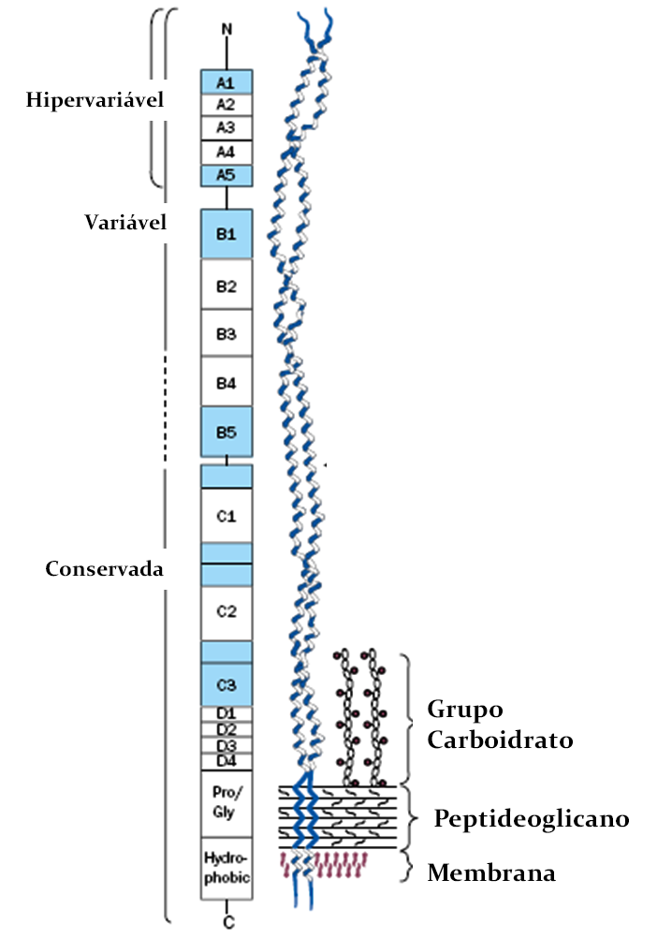
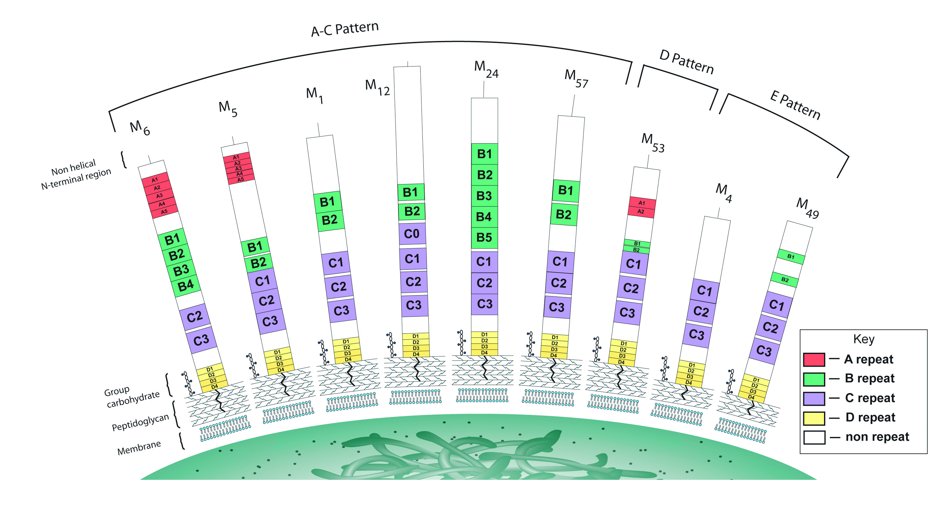
M protein
Streptococcus pyogenes
(Smeesters, et. al, 2010)
More than 200 strains
(Fischetti et. al, 1991)
Notes:
450 aa - 4 regiões, blocos de repetições:
N-terminal - A e B: sorotipos;
A1, 2 e 3 – mais variável;
B- peptídeos reação cruzada;
C-terminal - C e D: altamente conservada.
Diversidade de cepas no mundo

Slide 14
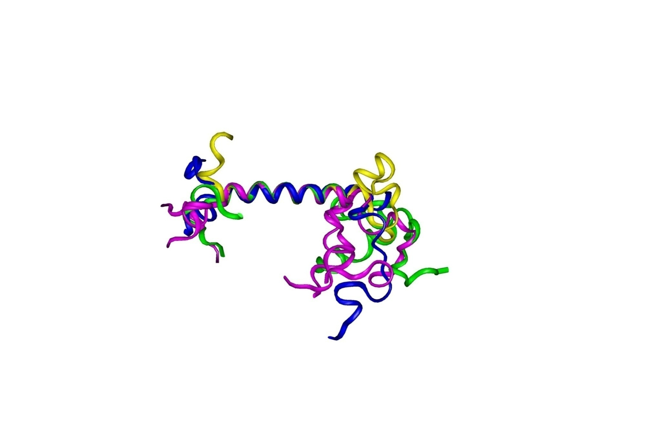
Vaccine Development
M protein- C-terminal Region: T and B Epitopes
Identical Region
²⁵³ KGLRRDLDASREAKKQLEAEQQ^{279 T epitope}
²⁸⁸ EASRKGLRRDLDASREAKKQVEKA ^{312 B epitope}
PepVac/Rec.Prot – StreptInCor 55 aa
²⁵³KGLRRDLDASREAKKQLEAEQQKLEEQNKISEASRKGLRRDLDASREAKKQVEKA³¹²
Sequence data bank
PDB ID 2KK9
RCSB 101224
NMR
B epitope
(31-55 aa)
Patents
INPI, BR – 0501290 / 0604997-4,
International: China, Korea, Japan, USA
Therapeutic Effect : USA
T epitope
(1-22 aa)
Guilherme L, Kalil, J, et al, Clin Dev Immunol, 2006, Methods, 2009,
J Biol Chem, 2011
Notes:
14
14

Slide 15
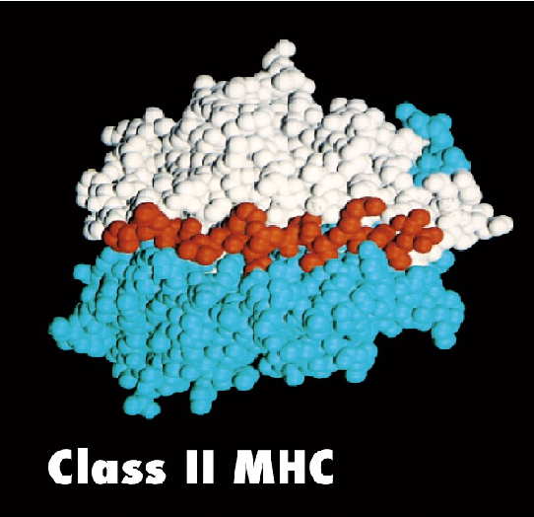
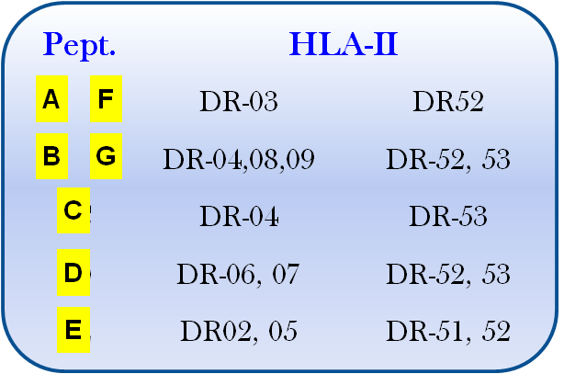
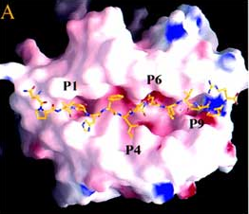
HLA Class II – Binding Prediction
²⁵³KGLRRDLDASREAKKQLEAEQQKLEEQNKISEASRKGLRRDLDASREAKKQVEKA³¹²
A
C
E
F
B
D
G
Afinity
P1 - L, I
P4 - D, S, E, A, Q, N
P6 - D, E, Q, R,
P9 - R, K, E, L,
Binding Prediction
Notes:
15

Slide 16
Human Humoral and Celular Reactivity
250 PBMC samples
Guilherme et al, J Biol Chem, 2011

Slide 17
Experimental Assays
Mice (Balb-C, C57BL6, Swiss, HLA- class II transgenic mice)
Mini pigs (25-30Kg)

Slide 18
StreptInCor induces high and specific IgG antibodies
No crossreativity against cardiac myosin was observed
Immunized mice
Control mice
Postol E, Guilherme L,
Plos One, 2013

Slide 19
Survival after emm1 S.pyogenes
challange
Immunized mice
87%
Controls
53%
Postol E, Guilherme L, Plos One, 2013/ 2014

Slide 20
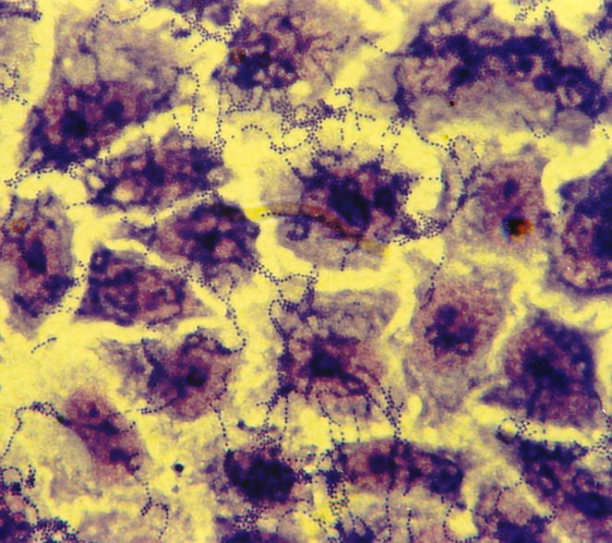
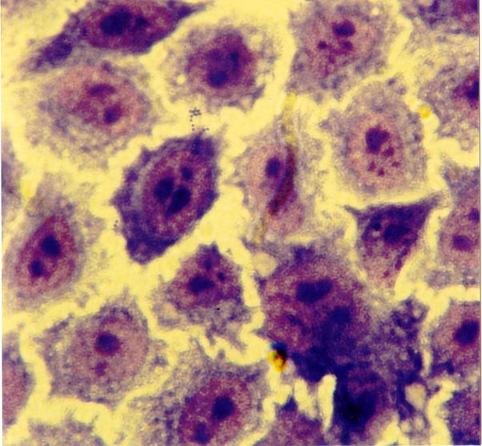
Adhesion/Invasion Inhibition – Hep-2 cells
Adhesion - S. pyogenes
Sera from StreptInCor immunized mice
S. pyogenes – M1 Adhesion/Invasion Inhibition
BALB/c (N=5) 95.0 %
C57BL6 (N=7) 92.0 %
Swiss (N=3) 98.5 %
UFC without sera > 200.000
Notes:
20
20

Slide 21
Anti-StreptInCor antibodies induce
Neutralization of several S. pyogenes strains
StreptInCor immunized BALB/c sera
Control sera
De Amicis MK, Guilherme L, Vaccine, 2013/2014

Slide 22
Anti-StreptInCor antibodies induce
opsonophagocytose and S. pyogenes death
StreptInCor immunized BALB/c sera
Control sera
Pool of pre-immune mice sera
De Amicis MK, Guilherme L, Vaccine, 2013/14

Slide 23
Opsonization, phagocytose/death of M1 induced by anti-StreptInCor antibodies
Pré-immune
sera
Hiperimmune
sera
S.pyogenes
De Amicis MK, Guilherme L,
Vaccine, 2013/14
Phagocytosis of S.pyogenes by APC

Slide 24
HLA Class II Tg Mice Model
DRB1 (DR2, DR4)
DQ6 and DQ8
Prof Chella David, Clinic Mayo, USA

Slide 25
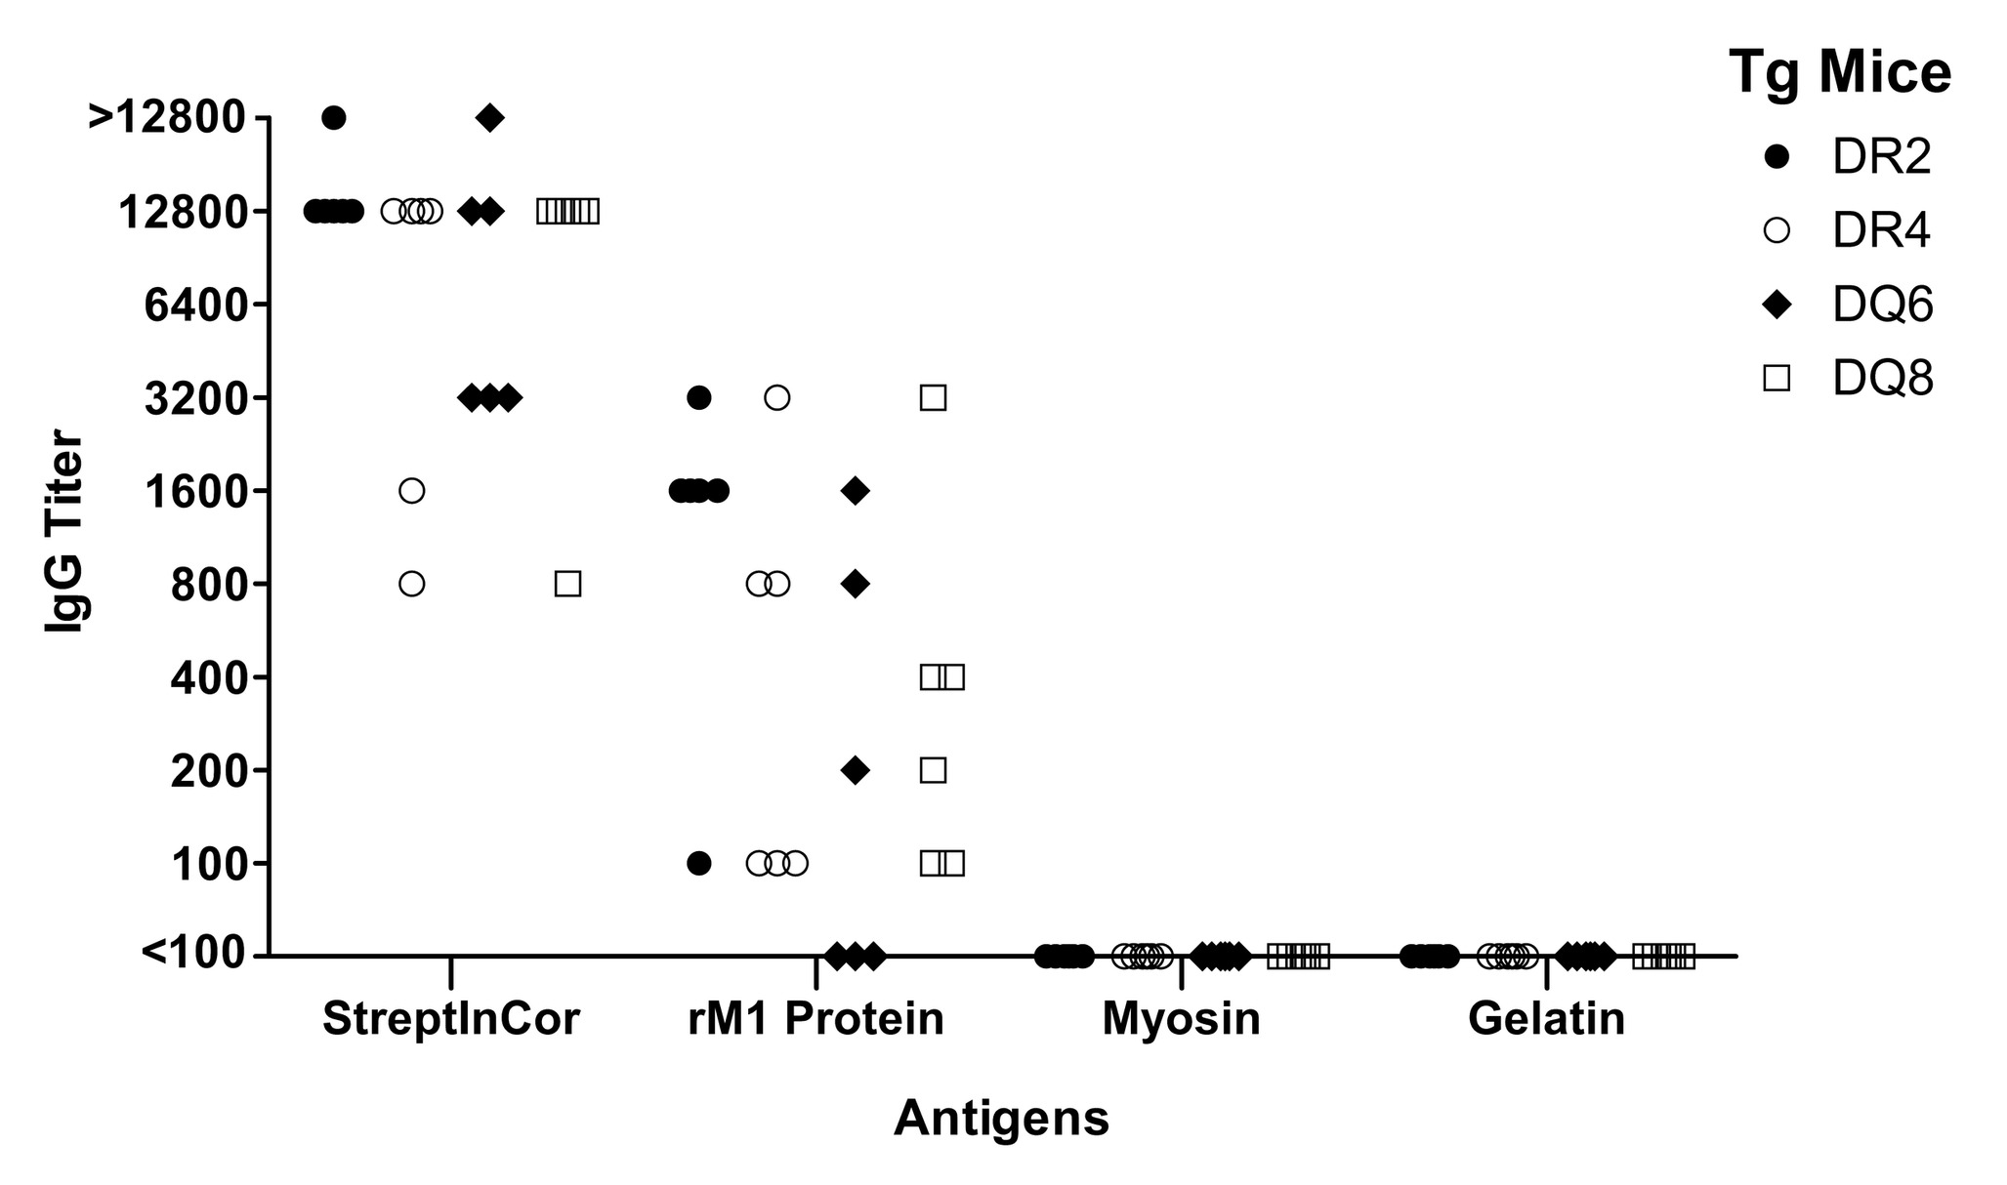
HLA class II Tg Mice
StreptInCor antibodies recognize heterologous protein without crossreactivity against cardiac myosin
Guerino, T; Guilherme L, Vaccine, 2011

Slide 26
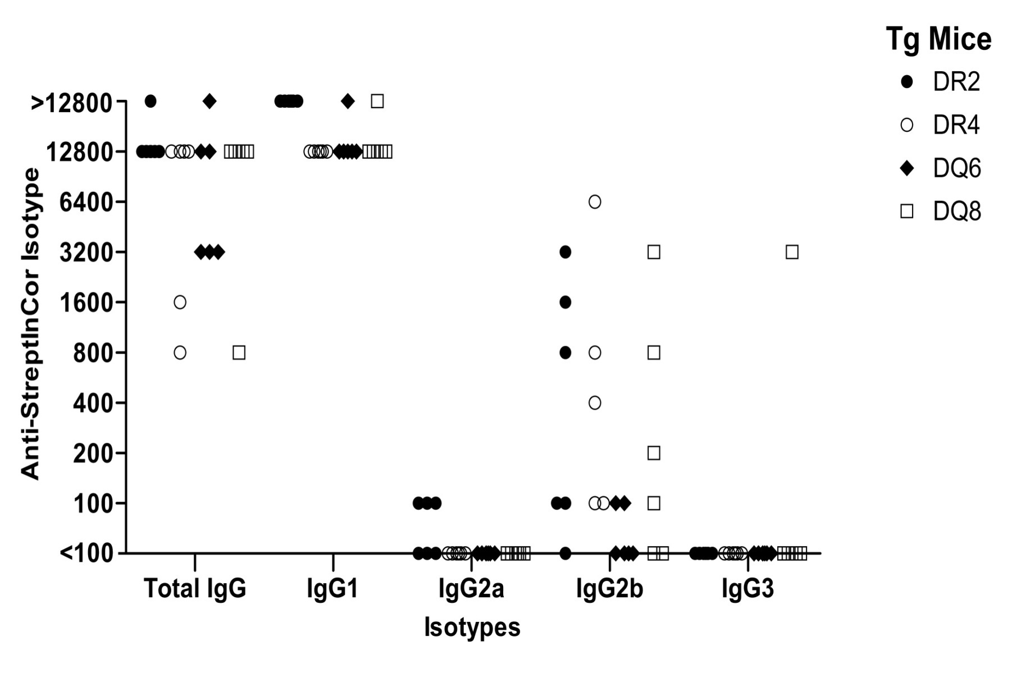
HLA-Class II -Transgenic mice: StreptInCor + ALUM
Guerino, T Guilherme et al, Vaccine, 2011

Slide 27
Immune Recognition of Overlapping M Protein C-terminal Peptides
Overlapping Peptides Sequences (20 aa residues) | Transgenic Mice Bearing HLA Class II Alleles Humoral Immune Response (IgG)
 | DR2 | DR4 | DQ6 | DQ8
KGLRRDLDASREAKKQLEAE | 6⁺/6 | 5⁺/6 | 2⁺/6 | 5⁺/6
KGLRRDLDASREAKKQVEKA | 5⁺/6 | 5⁺/6 | 3⁺/6 | 4⁺/6
GLRRDLDASREAKKQVEKAL | 5⁺/6 | 5⁺/6 | 2⁺/6 | 3⁺/6
LDASREAKKQLEAEQQKLEE | 4⁺/6 | 5⁺/6 | 3⁺/6 | 6⁺/6
KLEEQNKISEASRKGLRRDL | 5⁺/6 | 4⁺/6 | 3⁺/6 | 5⁺/6
KISEASRKGLRRDLDASREA | 5⁺/6 | 2⁺/6 | 2⁺/6 | 3⁺/6
SEASRKGLRRDLDASREAKK | 5⁺/6 | 4⁺/6 | 3⁺/6 | 5⁺/6
ASRKGLRRDLDASREAKKQV | 4⁺/6 | 4⁺/6 | 1⁺/6 | 2⁺/6
Guerino, T; Guilherme L, Vaccine, 2011,

Slide 28
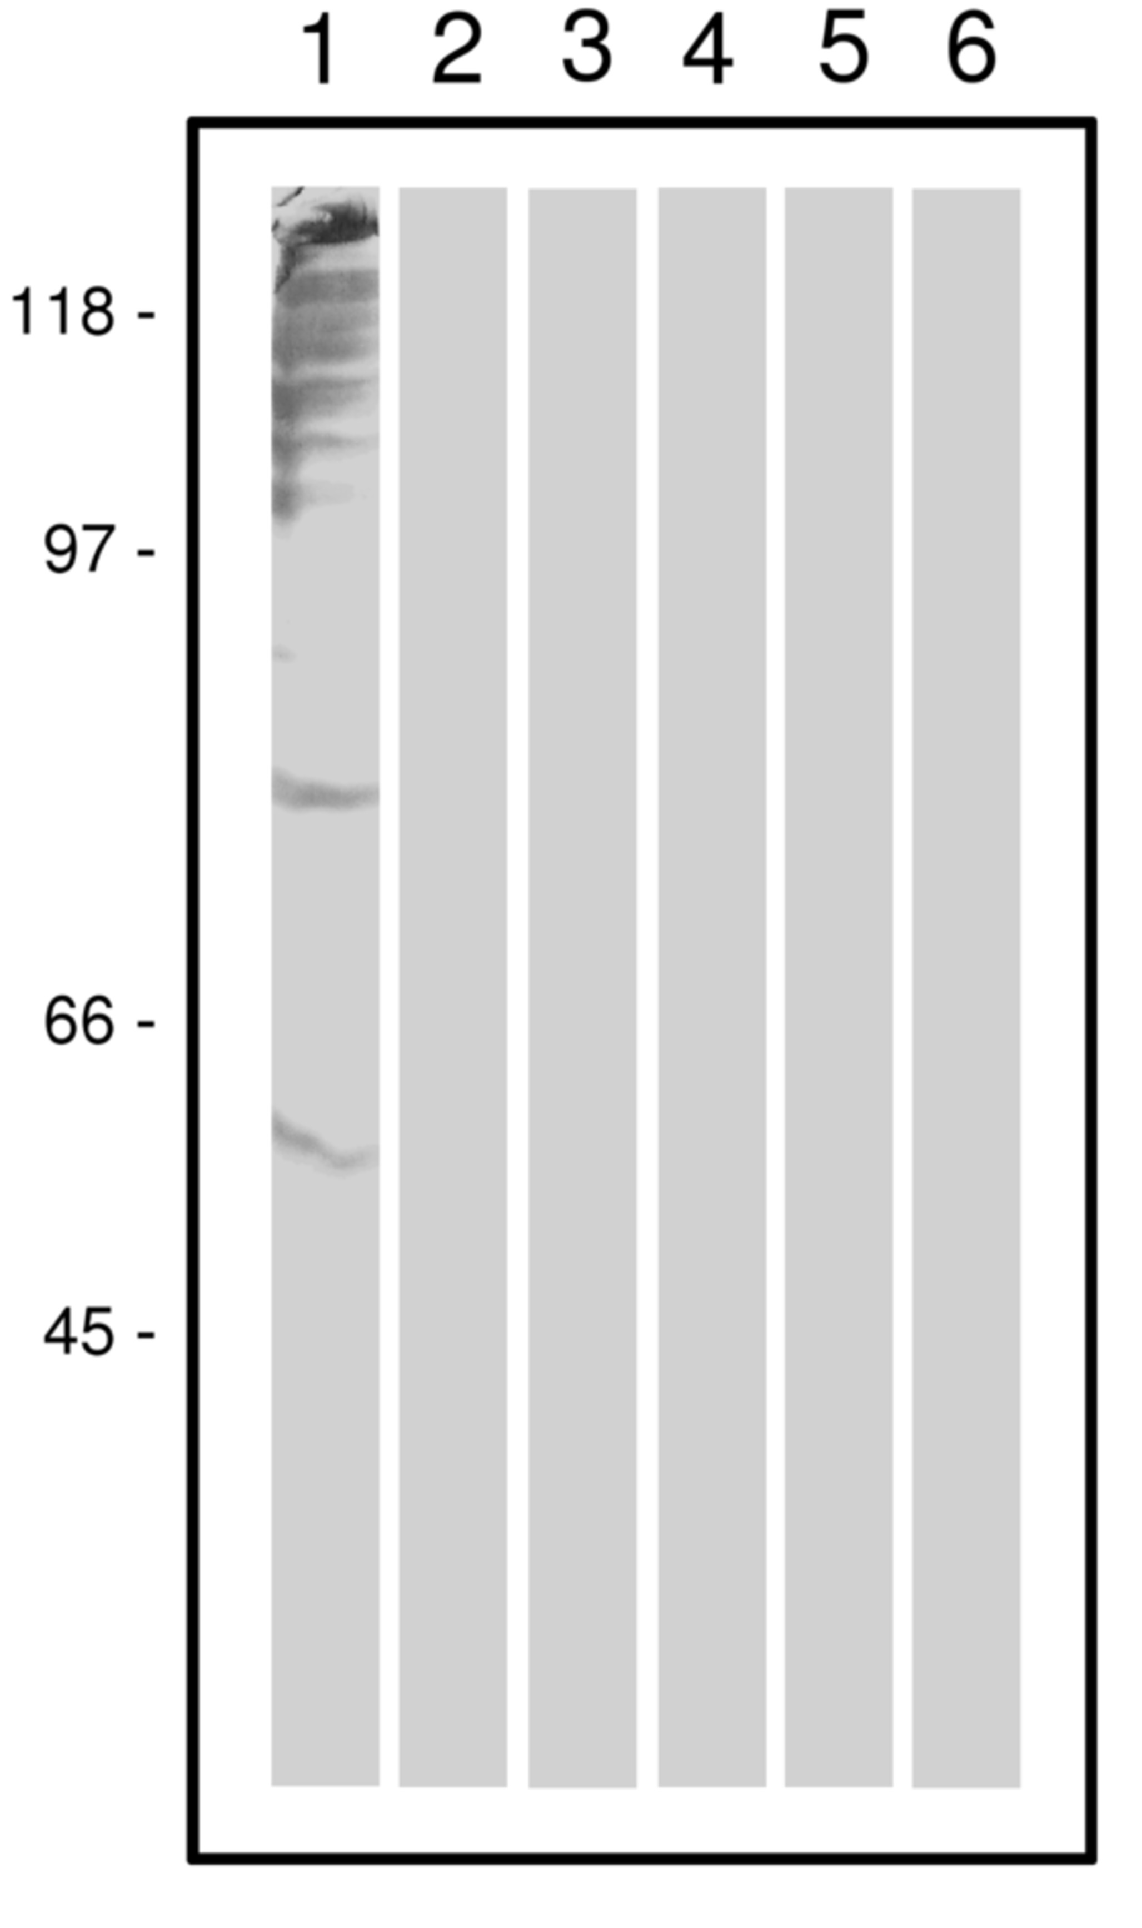
StreptInCor did not Induce Heart-tissue Proteins
Crossreactive Antibodies
(+) mouse anti-myosin sera
(-) non-immunized sera
DR2 tg mice sera
DR4 tg mice sera
DQ6 tg mice sera
DQ8 tg mice sera
Human myocardium tissue, Cadaveric donor
Guerino, T; Guilherme L, Vaccine, 2011

Slide 29
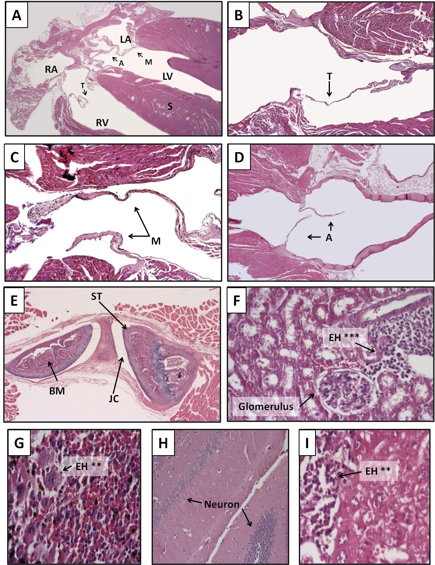
Animal model
HLA-class II Tg Mice
A- Heart
B, C, D –Tri, Mi, Ao valves
E- Articulations
F- Kidney
G - Spleen
H - Brain
I - Liver
StreptInCor
vaccine did not induces
autoimmune reactions
1 year
post- vaccination
Guerino, T; Guilherme L,
Vaccine, 2011

Slide 30
Autoimunnity Control
RHD - Heart tissue infiltrating cells
T cell clones
N=49
( 5 T cell Lines)
StreptInCor
Several peptides)
T cell lines T = 29 *
%
%
Negative | 23/29 | 79.3 | 42/49 | 85.7
Positive | 6/29 | 20.7 | 7/49 | 14.3
IL-10
* 14 valves and 15 myocardium
T-Reg Cells?
Guilherme L, et al, unpublish data
Notes:
30
30

Slide 31
T regulatory (Treg) Cells
Are defined by several cell markers and are important tools
as immunotherapy in organ transplantation and
autoimmune diseases.
C-terminal M protein epitope- StreptInCor has a potential to induce:
Protection against S. pyogenes (vaccine)
T reg cells that regulate autoimmune reactions (therapeutic effect)

Slide 32
StreptInCor : Potential Therapeutic Effect
T regulatory cells: Peripheral blood of RHD patients
Flow Cytometry
StreptInCor
(vaccine candidate epitope )
increases the numbers of Natural
T Reg cells
\
Köhler KF, Guilherme L, et al , In Preparation

Slide 33

Summary
The social-economic impact of RF/RHD in Brazil is still important
In the last 20 years - our studies lead to:
Better understanding of the autoimmune and inflammatory mechanisms leading to the rheumatic heart lesions
C-terminal M protein epitope - StreptInCor has a potential to induce:
Protection against S. pyogenes (vaccine)
Cells that regulate autoimmune reactions (therapeutic effect)
Both Properties of StreptInCor
Certainly will contribute to a better life of RF/RHD patients and to prevent new infections.

Slide 34
Clinical Phase I Assays / Design of the Study
Clinical Phase I : random, double-blind, controlled with placebo, sequential dosing of StreptInCor (50 µg, 100µg, 200 µg - 2 doses with 28d interval); 6 months boost .
Healthy Volunteer: individual without confirmed disease diagnosis or infection that would compromise the immune response, with ages between 18 and 45 years old.

Slide 35

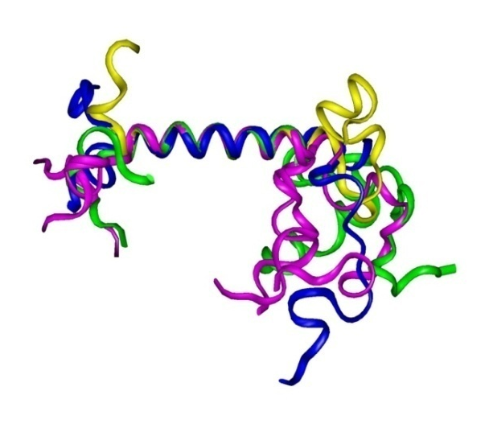
Next Steps
GMP production
Phase I/IIa Clinical Trials – 2015/2016
ANVISA and FDA registration
Financial Support
CNPq , FAPESP , BNDES
Brazil.
Notes:
35

Slide 36
Prof Jorge Kalil, MD,PhD Director of Immunology Lab – Heart Institute
Prof. Luiza Guilherme, Pharm, PhD, Rheumatic Fever Group´s Leader
RF/RHD Mechanism of Pathogenesis
Kellen Cristhina Faé, PhD
Rajendranath Ramasawy,PhD
Ana Flavia Vigna, PhD
Luciana Nogueira, PhD
Sandra Emiko Oshiro, MSc
Carlo Martins, PhD student
Nathalia Moreira Santos, MsC Student
Selma A Palácios
Simone Santos
Heart Institute, 1.Pediatric Cardiology, 2.Valvopathy, 3.Surgical and 4.Pathology Divisions
1. Ana C Tanaka, MD
2. Prof Max Grinberg, MD; Prof Flavio Tarasoutchi, MD; Guilherme Spina, MD; Roney Sampaio,MD
3. Prof Pablo Pommerantzeff, MD, Carlos Brandão, MD
4. Lea Demarchi, MD, Prof Vera D Aiello, MD: Paulo S Gutierrez
Pediatric Rheumatology Division, Clinical Hospital
Prof Maria H Kiss, MD, Clovis A Silva, MD
Vaccine Development
Claudio R Puschel, PhD – Peptide Synthesis
Washington R Silva
Samar F Barros, PhD – Molecular Biology, Microbiology
Raquel Alencar, MSc
Karine Marafigo De Amicis, MsC Student
Karen Kohler, PhD Cellular Immunology
Leticia Chaves, MSc – Humoral Response
Edilberto Postol, PhD – Experimental
Daniella Santoro, PhD
Fabio T Higa
Milton T.G. Silva, MsC Student
Luiz R Mundel
Frederico Moraes Ferreira, PhD- Structural analysis
Saint Louis Hospital, Paris, France –TCR, Treg Cells
Prof Dominique Charron, MD,PhD; Prof Antoine Toubert, MD,PhD
Oklahoma University, Oklahoma, USA – Cardiac Myosin Studies
Prof Madeleine W Cunningham, PhD
Finlay Institute, Havana, Cuba – Mucosal Adjuvant
Prof Oliver Perez Martin, MD; Miriam Lastre, MD; Caridad Zayas
Mayo Clinic Rochester, USA, HLA-class II Transgenic Mice
Prof Chella David, MD,PhD
Advisors – Lab of Immunology
Prof Edecio Cunha-Neto, MD,PhD
Veronica Coelho, MD,PhD
Notes:
36
36

Slide 37
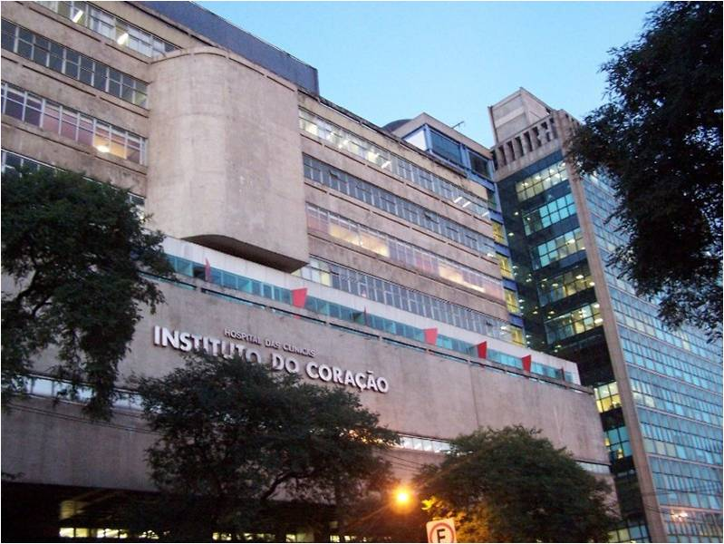
Thank you!

