Slide 1
www.veraodabahia.blogspot.com.br /
Paradoxical Variation of the Solar Day Related Kepler/Newton Sys. Prof. MSc.: Luiz Sampaio Athayde Júnior
Prof. MSc.:
Luiz Sampaio Athayde Junior
Professor at School of Accounting Sciences of Federal University of Bahia (FCC/UFBA) and also Professor of Astronomy Course of Physics Institute (IF/UFBA) and the University Jorge Amado (Unijorge), ex Professor at Visconde de Cairú University (FVC) of over graduation and has experience as a Tax Analyst. A Master in Business Administration and Extension in Higher Education Methodology by the School of Administration of Federal University of Bahia (EA/UFBA), Post Graduate MBA in Financial Management and Company, Post Graduate and Research Center at Visconde de Cairú (CEPPEV/FVC). Accountant and Degree Bachelor of Accounting Sciences by Estacio University Center of Bahia (Estacio/FIB) and is certified by IAFC First Degree in International Standards of Accounting-IFRS.
sampaioathayde@yahoo.com.br

Slide 2
www.veraodabahia.blogspot.com.br /
Paradoxical Variation of the Solar Day Related Kepler/Newton Sys. Prof. MSc.: Luiz Sampaio Athayde Júnior
Prof. MSc.: Luiz Sampaio Athayde Junior
His publications of Accounting area have appeared in many websites specializing in tax and international accounting standards-IFRS. He is author of the Blog www.contabeisufba.blogspot.com.br His research in the accounting area also made him the creator of New Accounting Policy, recently published in the Brazilian Journal of Accounting (RBC), the most important publication in Brazil in this area.
In the area of Astronomy he has made presentations in numerous symposia and conferences in Brazil on the main university and Venezuela and had his research also published in Spain. He is author of the Blog www.veraodabahia.blogspot.com.br read in over 70 countries and in more than 20 languages. He is also author of the book "The Solar Zenith Theory" (in portuguese "A Teoria do Zênite Solar") published by Editors of Federal University of Bahia (EDUFBA). His research in the Astronomy area helps to create a Tropical Astronomy and new seasons for tropical zone.
sampaioathayde@yahoo.com.br

Slide 3
www.veraodabahia.blogspot.com.br /
Paradoxical Variation of the Solar Day Related Kepler/Newton Sys. Prof. MSc.: Luiz Sampaio Athayde Júnior
• Paradoxical Variation of the Solar Day Related to Kepler / Newton System
(Found from The Solar Zenith Theory)
Prof. MSc.: Luiz Sampaio Athayde Junior

Slide 4

www.veraodabahia.blogspot.com.br /
Paradoxical Variation of the Solar Day Related Kepler/Newton Sys. Prof. MSc.: Luiz Sampaio Athayde Júnior
A Teoria do Zênite Solar Book
Author: Luiz Sampaio Athayde Junior Preface: Prof. Alberto Brum Novaes Editors from Ufba: EDUFBA
E-mail: sampaioathayde@yahoo.com.br

Slide 5

www.veraodabahia
Paradoxical Variati Prof. MSc.: Luiz S
.blogsp
on of t ampaio A
ot.com.br /
he Solar Day Related Kepler/Newton Sys. thayde Júnior

Slide 6
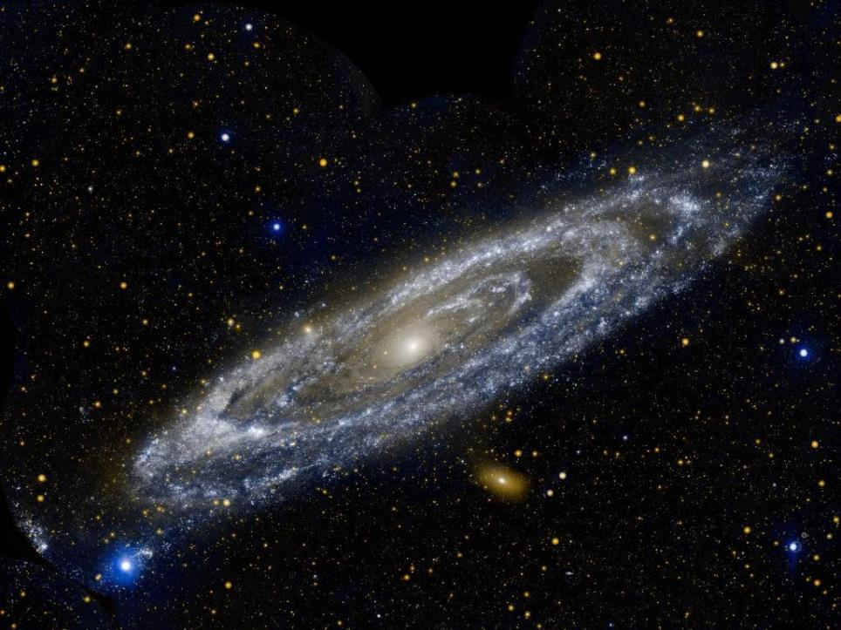








Paradoxical Variation of the Solar Day Related to Kepler / Newton System

Slide 7
Paradoxical Variation of the Solar Day Related to Kepler / Newton System

Slide 8
www.veraodabahia.blogspot.com.br /
Paradoxical Variation of the Solar Day Related Kepler/Newton Sys. Prof. MSc.: Luiz Sampaio Athayde Júnior
PVSDRKNS
Solar Day Concept:
According to Kepler de Oliveira (UFRGS) is the interval of time between two successive passages of the Sun by the meridian of the place - two consecutive upper culminations of the Sun.

Slide 9
www.veraodabahia.blogspot.com.br /
Paradoxical Variation of the Solar Day Related Kepler/Newton Sys. Prof. MSc.: Luiz Sampaio Athayde Júnior
PVSDRKNS
Solar Day Concept :
It’s 3^{m}56^{s} longer than the sidereal day because the sun is moving in the opposite direction to the diurnal motion, that is, from west to east. This difference is due to the Earth translation movement around the Sun, of approximately 1 degree (4 min / Day) - (360°/year=360°/ (365,25 days)=0,9856°/day).

Slide 10
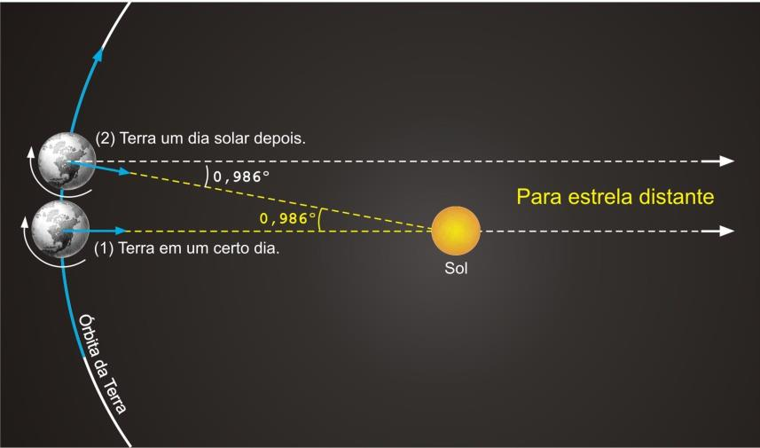
www.veraodabahia.blogspot.com.br /
Paradoxical Variation of the Solar Day Related Kepler/Newton Sys. Prof. MSc.: Luiz Sampaio Athayde Júnior
VPPDDSRSKN

Slide 11
www.veraodabahia.blogspot.com.br /
Paradoxical Variation of the Solar Day Related Kepler/Newton Sys. Prof. MSc.: Luiz Sampaio Athayde Júnior
PVSDRKNS
Simulators by University From Nebraska:
The First Kepler’s Law
The Second Kepler’s Law
(Johannes Kepler, German Astronomer – 1571/1630)

Slide 12
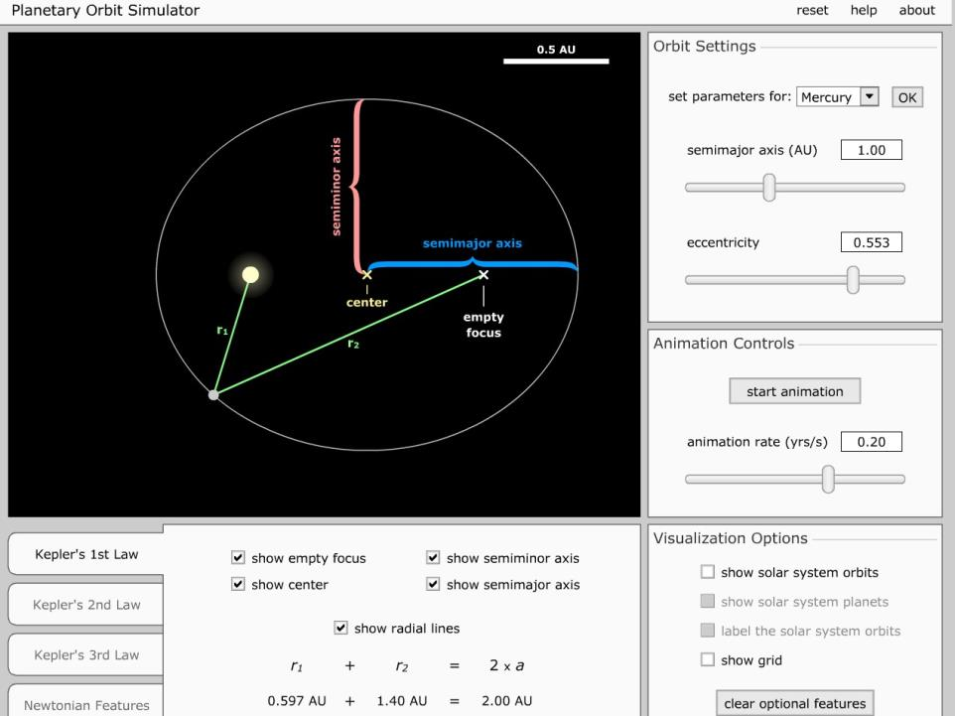
www.veraodabahia.blogspot.com.br /
VPPDDSRSKN
Paradoxical Variation of the Solar Day Related Kepler/Newton Sys.
Prof. MSc.: Luiz Sampaio Athayde Júnior
VPPDDSRSKN

Slide 13
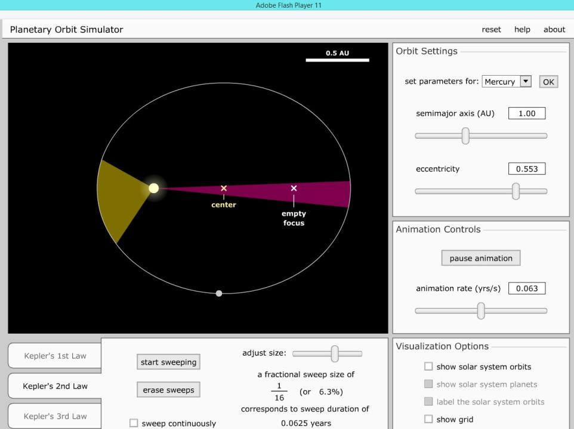
www.veraodabahia.blogspot.com.br /
VPPDDSRSKN
Paradoxical Variation of the Solar Day Related Kepler/Newton Sys.
Prof. MSc.: Luiz Sampaio Athayde Júnior
VPPDDSRSKN

Slide 14
www.veraodabahia.blogspot.com.br /
Paradoxical Variation of the Solar Day Related Kepler/Newton Sys. Prof. MSc.: Luiz Sampaio Athayde Júnior
PVSDRKNS
The Sun’s Analemma:
View from earth
View from space (The Solar Zenith Theory)
(Inverted Calendar)

Slide 15
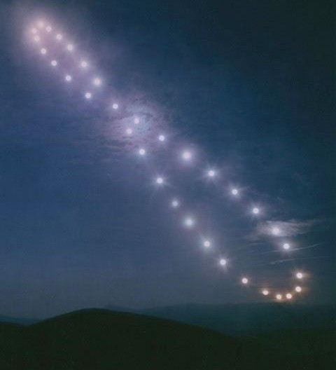
www.veraodabahia.blogspot.com.br /
VPPDDSRSKN
Paradoxical Variation of the Solar Day Related Kepler/Newton Sys.
Prof. MSc.: Luiz Sampaio Athayde Júnior
VPPDDSRSKN

Slide 16
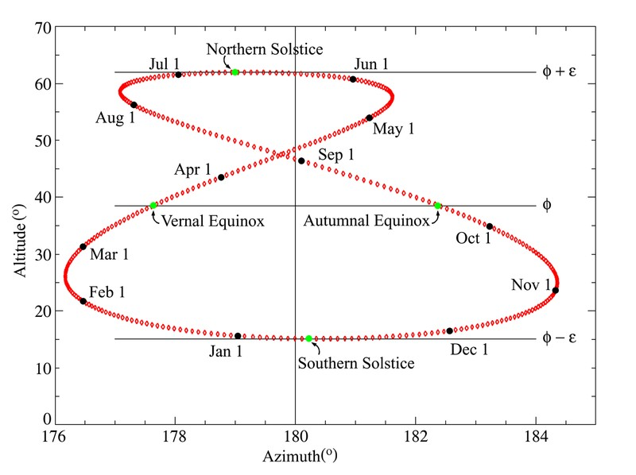
www.veraodabahia.blogspot.com.br /
VPPDDSRSKN
Paradoxical Variation of the Solar Day Related Kepler/Newton Sys.
Prof. MSc.: Luiz Sampaio Athayde Júnior
VPPDDSRSKN

Slide 17
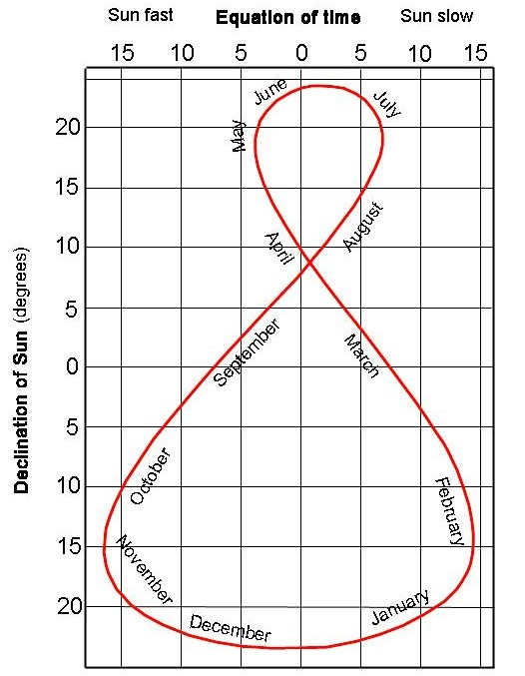
www.veraodabahia.blogspot.com.br /
VPPDDSRSKN
Paradoxical Variation of the Solar Day Related Kepler/Newton Sys.
Prof. MSc.: Luiz Sampaio Athayde Júnior
VPPDDSRSKN

Slide 18
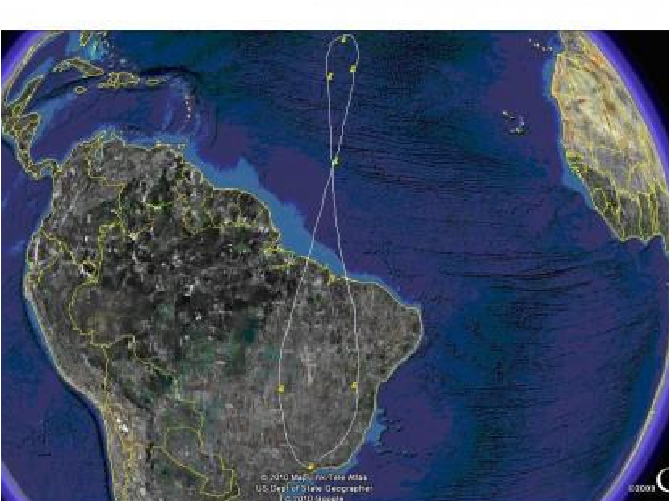
www.veraodabahia.blogspot.com.br /
VPPDDSRSKN
Paradoxical Variation of the Solar Day Related Kepler/Newton Sys.
Prof. MSc.: Luiz Sampaio Athayde Júnior
VPPDDSRSKN

Slide 19
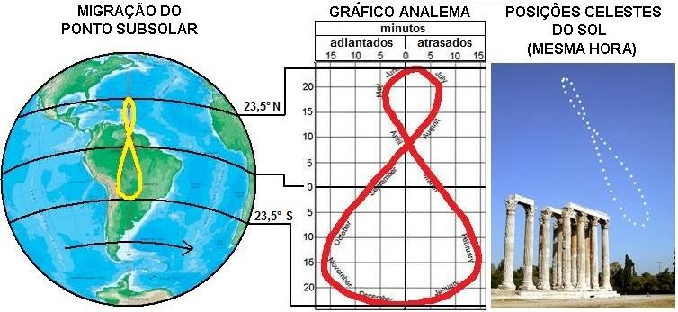
www.veraodabahia.blogspot.com.br /
VPPDDSRSKN
Paradoxical Variation of the Solar Day Related Kepler/Newton Sys.
Prof. MSc.: Luiz Sampaio Athayde Júnior
VPPDDSRSKN

Slide 20
www.veraodabahia.blogspot.com.br /
Paradoxical Variation of the Solar Day Related Kepler/Newton Sys. Prof. MSc.: Luiz Sampaio Athayde Júnior
PVSDRKNS
Simulators by University From Nebraska:
Motions of the Sun Simulator
(Original version in English and also available in Portuguese to download at: www.veraodabahia.blogspot.com.br)

Slide 21
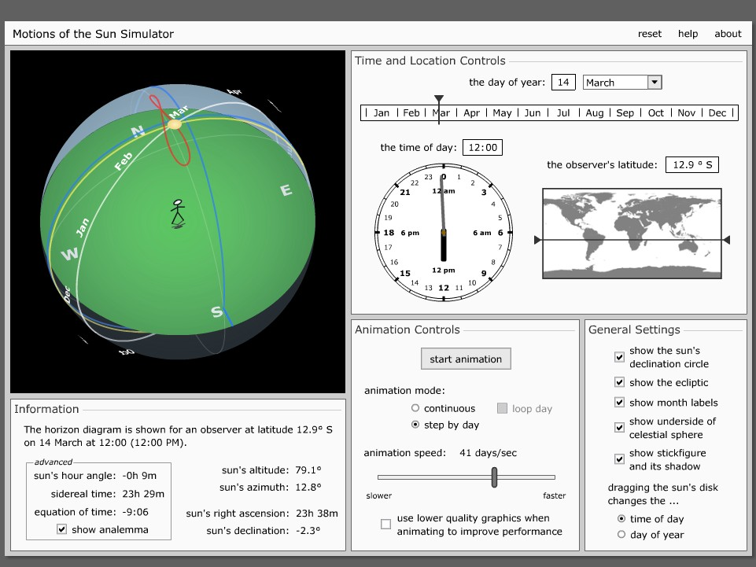
www.veraodabahia.blogspot.com.br /
VPPDDSRSKN
Paradoxical Variation of the Solar Day Related Kepler/Newton Sys.
Prof. MSc.: Luiz Sampaio Athayde Júnior
VPPDDSRSKN

Slide 22
www.veraodabahia.blogspot.com.br /
Paradoxical Variation of the Solar Day Related Kepler/Newton Sys. Prof. MSc.: Luiz Sampaio Athayde Júnior
PVSDRKNS
A translation with both Simulators by
University From Nebraska

Slide 23
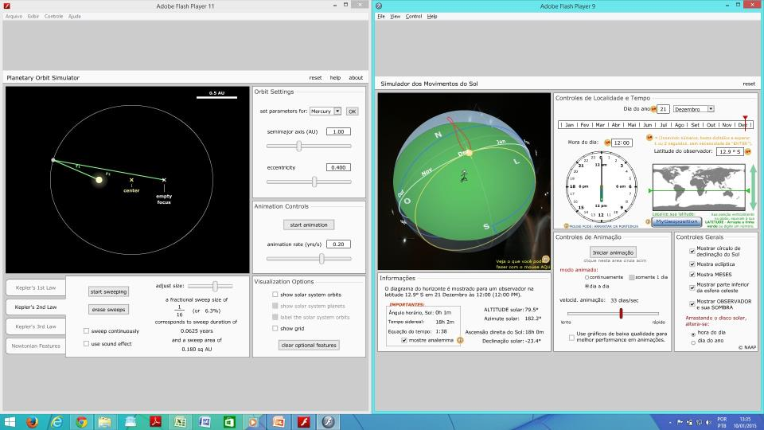
www.veraodabahia.blogspot.com.br /
VPPDDSRSKN
Paradoxical Variation of the Solar Day Related Kepler/Newton Sys.
Prof. MSc.: Luiz Sampaio Athayde Júnior
VPPDDSRSKN
Date: December 21st

Slide 24
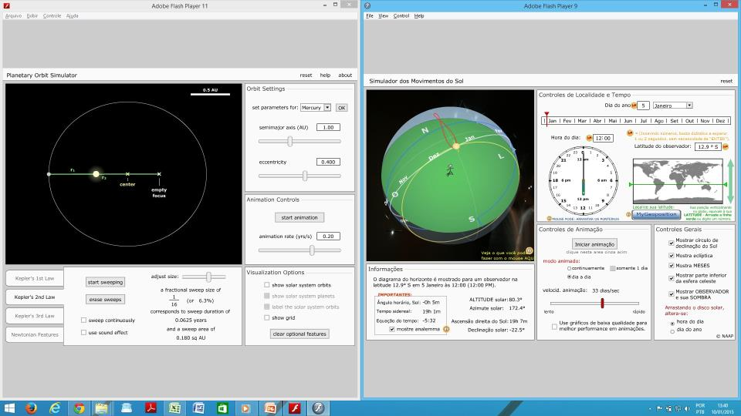
www.veraodabahia.blogspot.com.br /
VPPDDSRSKN
Paradoxical Variation of the Solar Day Related Kepler/Newton Sys.
Prof. MSc.: Luiz Sampaio Athayde Júnior
VPPDDSRSKN
Date: January 5th

Slide 25
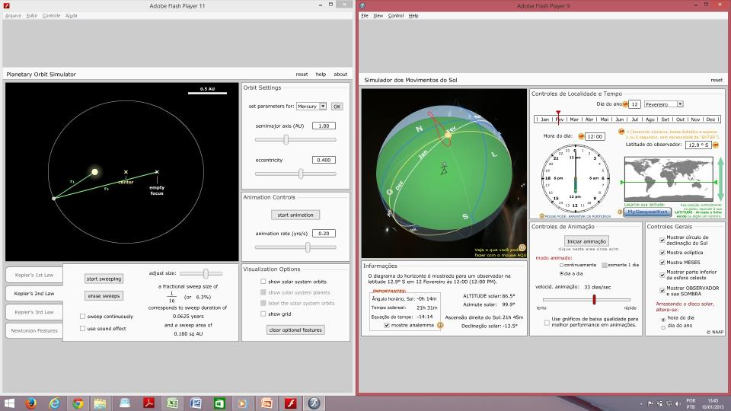
www.veraodabahia.blogspot.com.br /
VPPDDSRSKN
Paradoxical Variation of the Solar Day Related Kepler/Newton Sys.
Prof. MSc.: Luiz Sampaio Athayde Júnior
VPPDDSRSKN
Date: February 12th

Slide 26
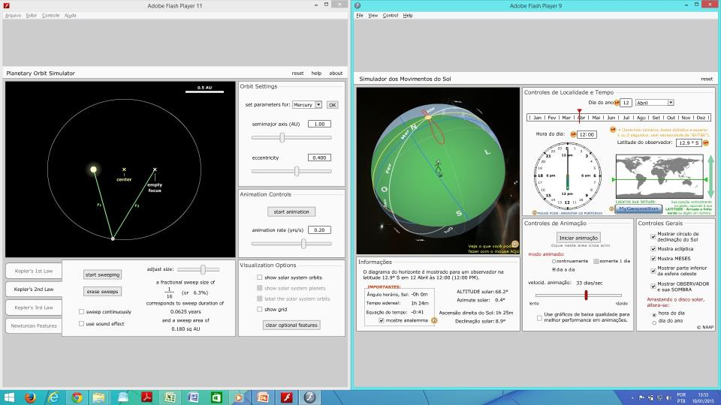
www.veraodabahia.blogspot.com.br /
VPPDDSRSKN
Paradoxical Variation of the Solar Day Related Kepler/Newton Sys.
Prof. MSc.: Luiz Sampaio Athayde Júnior
VPPDDSRSKN
Date: April 12th

Slide 27
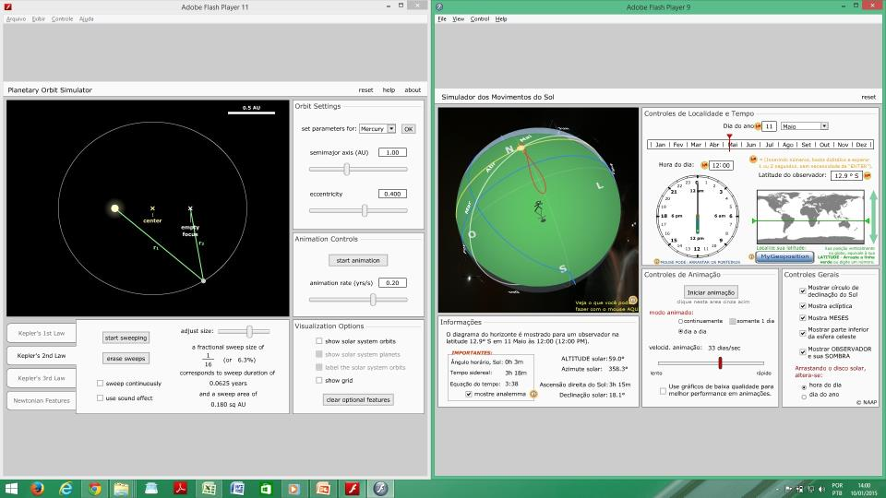
www.veraodabahia.blogspot.com.br /
VPPDDSRSKN
Paradoxical Variation of the Solar Day Related Kepler/Newton Sys.
Prof. MSc.: Luiz Sampaio Athayde Júnior
VPPDDSRSKN
Date: May 11th

Slide 28
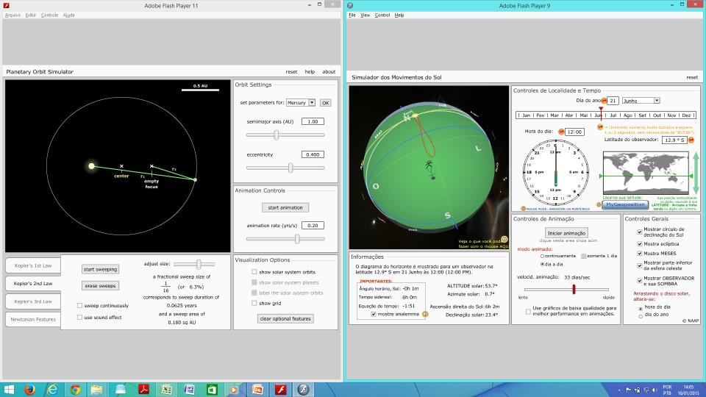
www.veraodabahia.blogspot.com.br /
VPPDDSRSKN
Paradoxical Variation of the Solar Day Related Kepler/Newton Sys.
Prof. MSc.: Luiz Sampaio Athayde Júnior
VPPDDSRSKN
Date: June 21st

Slide 29

www.veraodabahia.blogspot.com.br /
VPPDDSRSKN
Paradoxical Variation of the Solar Day Related Kepler/Newton Sys.
Prof. MSc.: Luiz Sampaio Athayde Júnior
VPPDDSRSKN
Date: July 5th

Slide 30
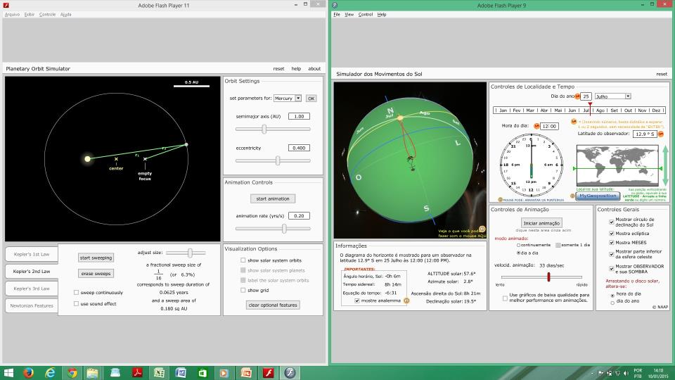
www.veraodabahia.blogspot.com.br /
VPPDDSRSKN
Paradoxical Variation of the Solar Day Related Kepler/Newton Sys.
Prof. MSc.: Luiz Sampaio Athayde Júnior
VPPDDSRSKN
Date: July 25th

Slide 31
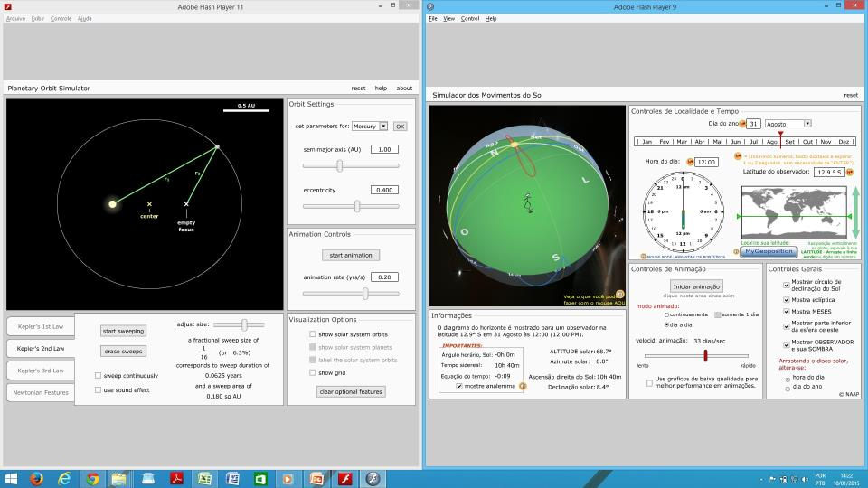
www.veraodabahia.blogspot.com.br /
VPPDDSRSKN
Paradoxical Variation of the Solar Day Related Kepler/Newton Sys.
Prof. MSc.: Luiz Sampaio Athayde Júnior
VPPDDSRSKN
Date: August 31st

Slide 32

www.veraodabahia.blogspot.com.br /
VPPDDSRSKN
Paradoxical Variation of the Solar Day Related Kepler/Newton Sys.
Prof. MSc.: Luiz Sampaio Athayde Júnior
VPPDDSRSKN
Date: November 3rd

Slide 33
www.veraodabahia.blogspot.com.br /
VPPDDSRSKN
Paradoxical Variation of the Solar Day Related Kepler/Newton Sys.
Prof. MSc.: Luiz Sampaio Athayde Júnior
VPPDDSRSKN
Date: December 21st / Back

Slide 34
www.veraodabahia.blogspot.com.br /
Paradoxical Variation of the Solar Day Related Kepler/Newton Sys. Prof. MSc.: Luiz Sampaio Athayde Júnior
PVSDRKNS
End of Translation
But... Where is the paradoxical variation?

Slide 35
www.veraodabahia.blogspot.com.br /
Paradoxical Variation of the Solar Day Related Kepler/Newton Sys. Prof. MSc.: Luiz Sampaio Athayde Júnior
PVSDRKNS
Earth:
Speed Decreasing
/ Speed Increasing
Jan | Fev | Mar | Abr | Mai | Jun | Jul | Ago | Set | Out | Nov | Dez
D 05 |  |  |  |  |  | D 05

Slide 36
www.veraodabahia.blogspot.com.br /
Paradoxical Variation of the Solar Day Related Kepler/Newton Sys. Prof. MSc.: Luiz Sampaio Athayde Júnior
PVSDRKNS
Before The Solar Day Approach:
We need a allowance of the Phycisist
Solar day has no speed
About solar day we must say “period”

Slide 37
www.veraodabahia.blogspot.com.br /
Paradoxical Variation of the Solar Day Related Kepler/Newton Sys. Prof. MSc.: Luiz Sampaio Athayde Júnior
PVSDRKNS
Before The Solar Day Approach:
When the solar day has increased its period, we will say its “speed” decreased
When the solar day has decreased its period, we will say its “speed” increased

Slide 38
www.veraodabahia.blogspot.com.br /
Paradoxical Variation of the Solar Day Related Kepler/Newton Sys. Prof. MSc.: Luiz Sampaio Athayde Júnior
PVSDRKNS
Solar Day “Speed” (Opposite of period):
Dec Inc Dec Inc Dec
Jan | Fev | Mar | Abr | Mai | Jun | Jul | Ago | Set | Out | Nov | Dez
 | D 12 |  |  | D 11 |  | D 25 |  |  |  | D 03

Slide 39
www.veraodabahia.blogspot.com.br /
Paradoxical Variation of the Solar Day Related Kepler/Newton Sys. Prof. MSc.: Luiz Sampaio Athayde Júnior
PVSDRKNS
Earth Speed:
Jan | Fev | Mar | Abr | Mai | Jun | Jul | Ago | Set | Out | Nov | Dez
D 05 |  |  |  |  |  | D 05
Solar Day “Speed”:
Jan | Fev | Mar | Abr | Mai | Jun | Jul | Ago | Set | Out | Nov | Dez
 | D 12 |  |  | D 11 |  | D 25 |  |  |  | D 03

Slide 40
www.veraodabahia.blogspot.com.br /
Paradoxical Variation of the Solar Day Related Kepler/Newton Sys. Prof. MSc.: Luiz Sampaio Athayde Júnior
PVSDRKNS
Special Points From Analemma:

Slide 41
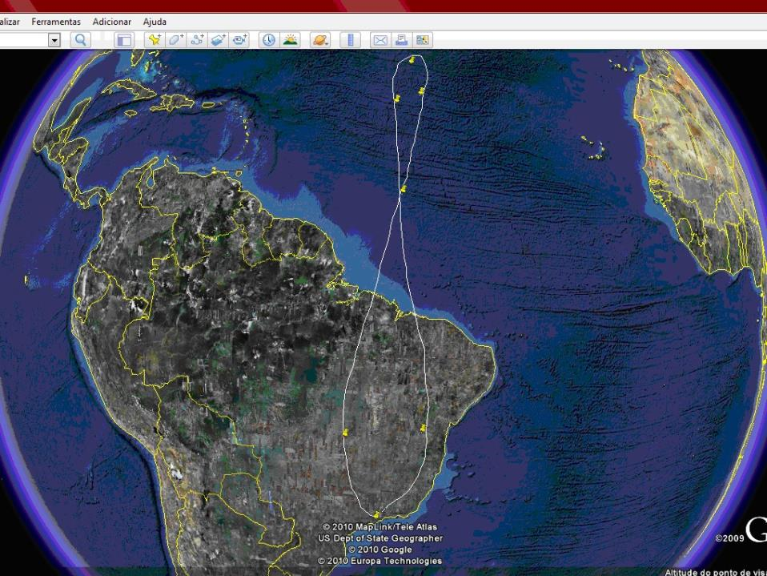
www.veraodabahia.blogspot.com.br /
VPPDDSRSKN
Paradoxical Variation of the Solar Day Related Kepler/Newton Sys.
Prof. MSc.: Luiz Sampaio Athayde Júnior
VPPDDSRSKN

Slide 42
www.veraodabahia.blogspot.com.br /
VPPDDSRSKN
Paradoxical Variation of the Solar Day Related Kepler/Newton Sys.
Prof. MSc.: Luiz Sampaio Athayde Júnior
VPPDDSRSKN

Slide 43
www.veraodabahia.blogspot.com.br /
VPPDDSRSKN
Paradoxical Variation of the Solar Day Related Kepler/Newton Sys.
Prof. MSc.: Luiz Sampaio Athayde Júnior
VPPDDSRSKN

Slide 44
www.veraodabahia.blogspot.com.br /
Paradoxical Variation of the Solar Day Related Kepler/Newton Sys. Prof. MSc.: Luiz Sampaio Athayde Júnior
PVSDRKNS
Measurements in video on You Tube:
https://www.youtube.com/user/luizsampaioa thayde
“Velocidade do Dia Solar” (In Portuguese)

Slide 45
www.veraodabahia.blogspot.com.br /
Paradoxical Variation of the Solar Day Related Kepler/Newton Sys. Prof. MSc.: Luiz Sampaio Athayde Júnior
PVSDRKNS
Measurements / Results:
July 12th and 13th/2012 – 1437 min
August 27th and 28th/2012 – 1440 min (Three videos)
October 08th and 09th/2012 – 1441 min
October 29th and 30th/2012 – 1442 min
December 03rd and 04th/2012 – 1441 min
January 07th and 08th/2013 – 1439 min

Slide 46
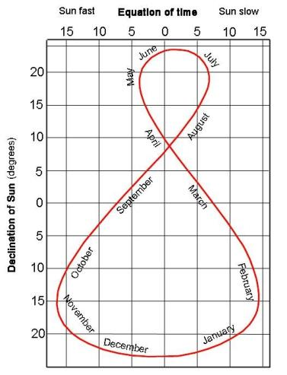
www.veraodabahia.blogspot.com.br /
Paradoxical Variation of the Solar Day Related Kepler/Newton Sys. Prof. MSc.: Luiz Sampaio Athayde Júnior
PVSDRKNS
Measurements / Results:
• Jul 12th and 13th/2012 – 1437 min
• Aug 27th and 28th/2012 – 1440 min
• Oct 08th and 09th/2012 – 1441 min
• Oct 29th and 30th/2012 – 1442 min
• Dec 03rd and 04th/2012 – 1441 min
• Jan 07th and 08th/2013 – 1439 min

Slide 47

www.veraodabahia.blogspot.com.br /
Paradoxical Variation of the Solar Day Related Kepler/Newton Sys. Prof. MSc.: Luiz Sampaio Athayde Júnior
PVSDRKNS
Lines: Period increases / Decreases “speed”
Curves: Period decreases / Increases “speed”
Analemma Elements:

Slide 48
www.veraodabahia.blogspot.com.br /
Paradoxical Variation of the Solar Day Related Kepler/Newton Sys. Prof. MSc.: Luiz Sampaio Athayde Júnior
PVSDRKNS
Conclusions:
Increasing or decreasing variations in the periods of the solar day length do not always occur at the same time the planet accelerates or decelerates. There are times when this occurs synchronously and at other times does not occur

Slide 49
www.veraodabahia.blogspot.com.br /
Paradoxical Variation of the Solar Day Related Kepler/Newton Sys. Prof. MSc.: Luiz Sampaio Athayde Júnior
PVSDRKNS
Conclusions:
The increasing or decreasing of the “speed variation” in the solar day duration periods are four each year, while the acceleration or deceleration of the planet occur only twice in the same time

Slide 50
www.veraodabahia.blogspot.com.br /
Paradoxical Variation of the Solar Day Related Kepler/Newton Sys. Prof. MSc.: Luiz Sampaio Athayde Júnior
PVSDRKNS
Conclusions:
The analemma is caused by the inclination of the imaginary axis of the planet and the eccentricity of orbit around the sun. Usually we study its causes. This study shows that it shows a different solar day variation of the planetary speed variation system

Slide 51
www.veraodabahia.blogspot.com.br /
Paradoxical Variation of the Solar Day Related Kepler/Newton Sys. Prof. MSc.: Luiz Sampaio Athayde Júnior
PVSDRKNS
Conclusions:
A curiosity is that if we score the dates aphelion and perihelion in analemma, we see that they occur almost perfectly about fourteen days after the two solstices.
North solstice ~june 21st / aphelion ~july 05th South solstice ~dec 21st / perihelion ~jan 05th

Slide 52
www.veraodabahia.blogspot.com.br /
Paradoxical Variation of the Solar Day Related Kepler/Newton Sys. Prof. MSc.: Luiz Sampaio Athayde Júnior
PVSDRKNS

Slide 53
www.veraodabahia.blogspot.com.br /
Paradoxical Variation of the Solar Day Related Kepler/Newton Sys. Prof. MSc.: Luiz Sampaio Athayde Júnior
References:
ATHAYDE JUNIOR, Luiz Sampaio. A Teoria do Zênite Solar: uma proposta para estações do ano nas localidades intertropicais. Edufba. Salvador: 2014
http://www.veraodabahia.blogspot.com (própria)
http://astro.if.ufrgs.br/tempo/tempo.htm
http://earth.google.com/intl/pt
http://www.usno.navy.mil/USNO/astronomical- applications/data-services/earthview

Slide 54
www.veraodabahia.blogspot.com.br /
Paradoxical Variation of the Solar Day Related Kepler/Newton Sys. Prof. MSc.: Luiz Sampaio Athayde Júnior
References:
http://astro.unl.edu/animationsLinks.html
http://astro.unl.edu/classaction/animations/coords
motion/sunmotions.html
http://astro.unl.edu/classaction/animations/renaissa nce/kepler.html
http://www.konstanta.lt/2012/09/analema/
http://timpanosgeograficos.blogspot.com.br/2011_0 2_01_archive.html

Slide 55
www.veraodabahia.blogspot.com.br /
Paradoxical Variation of the Solar Day Related Kepler/Newton Sys. Prof. MSc.: Luiz Sampaio Athayde Júnior
Thank You Very Much!

