Slide 1

HUMAN enterovirus AND VIRAL MENINGITIS IN SOUTHERN BRAZIL
Luine Rosele Renaud Vidal
Universidade Federal do Paraná
Financial Support: Secretaria de Ciência e Tecnologia do Estado do Paraná- SETI - PR

Slide 2
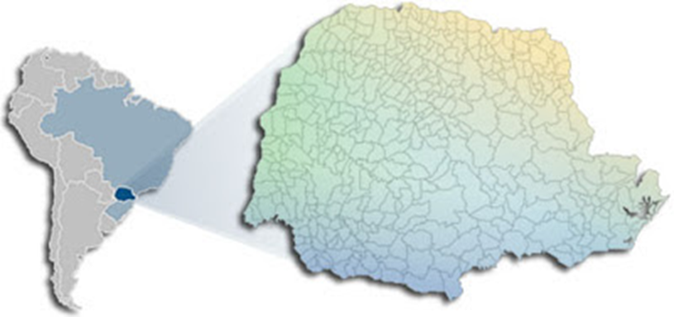
Research Background
Notifiable Disease in the National Health System
Around 1000 meningitis cases per year
All etiology
Estimated 60% - viral etiology

Slide 3
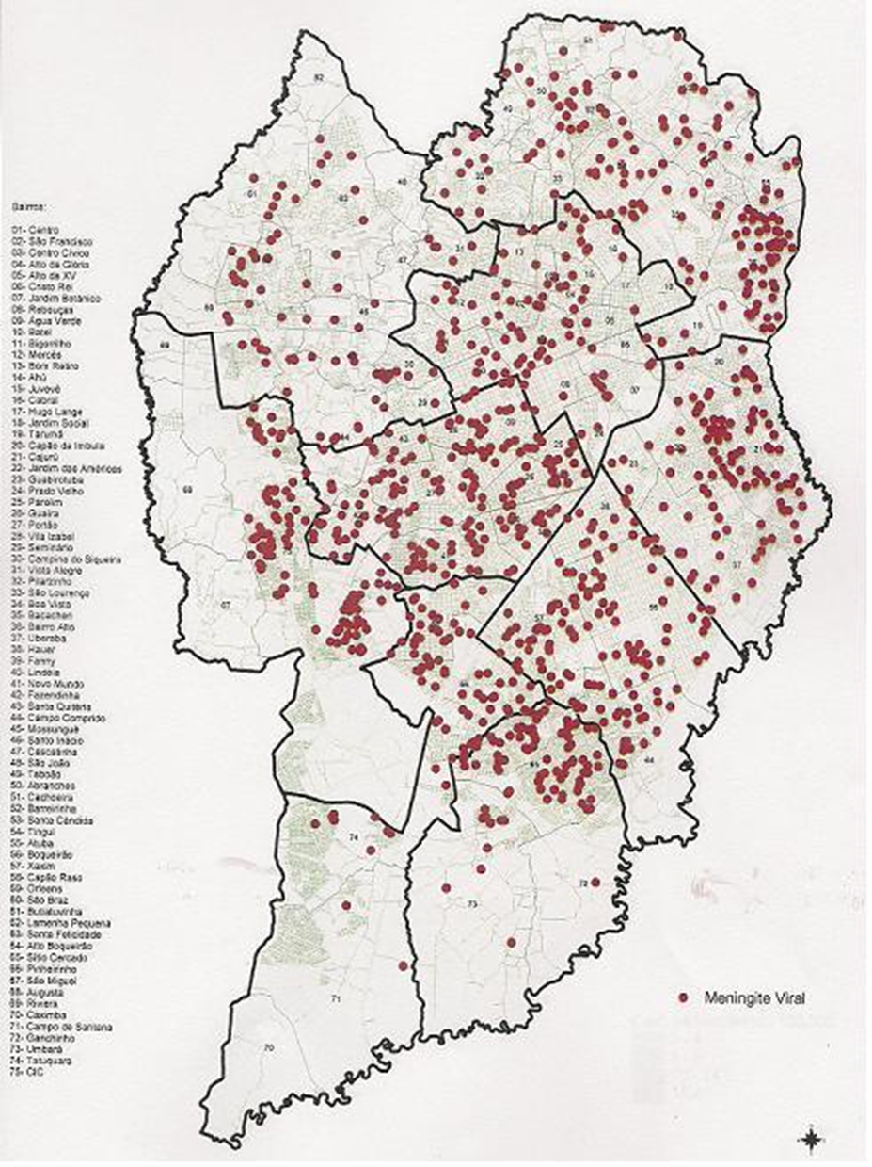
Research
Background
Distribution of Viral Meningitis in Curitiba City by Neighborhood

Slide 4
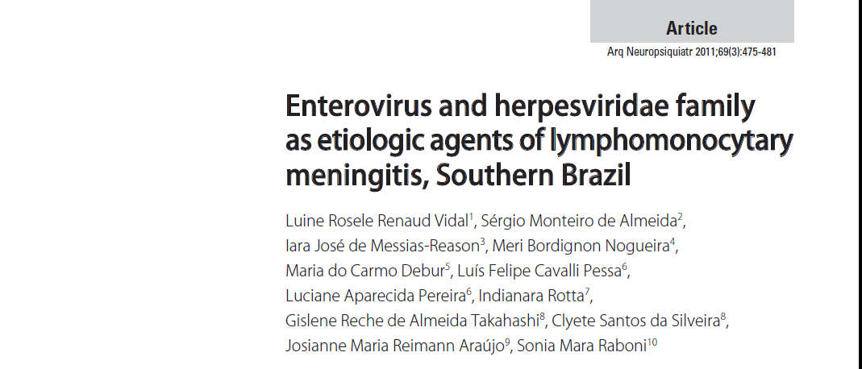
Research Background
460 CSF Samples
July 2005 – December 2006
13% Positive

Slide 5
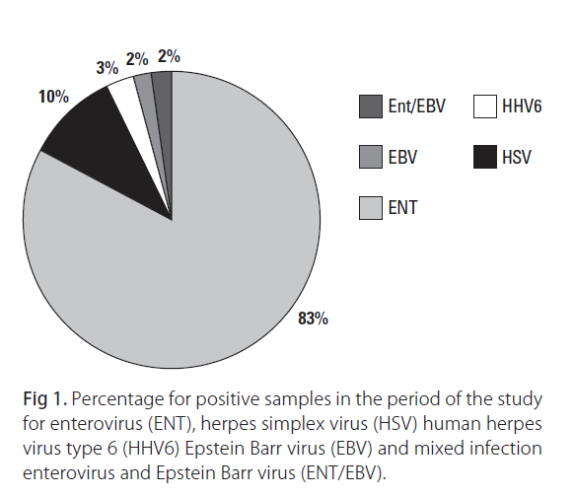
Research Background
Vidal et al, 2011

Slide 6
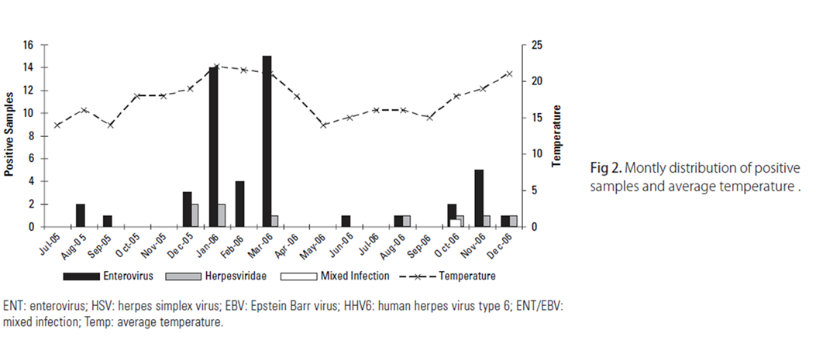

Research Background

Slide 7
Research Background

Slide 8
Research Background
July 2005 – September 2008
1010 CSF samples (immunocompromised / immunocompetent)
4.55% positive by nested PCR (nPCR)
50% encephalitis
40% meningoencephalitis
2.5% mielitis
Central Nervous System (CNS) Infections by Herpesviridae Family

Slide 9
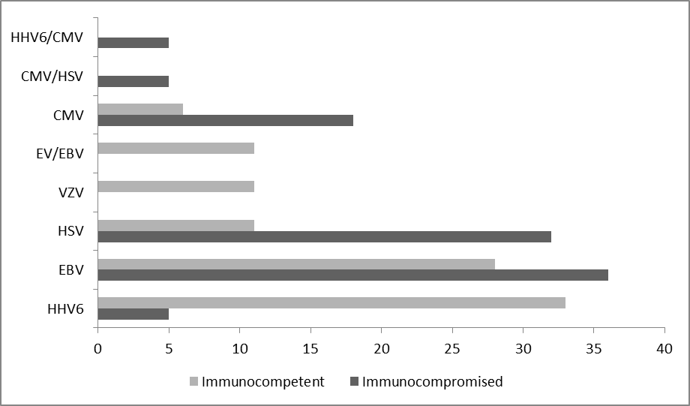
Research Background
Central Nervous System (CNS) Infections by Herpesviridae Family
%

Slide 10
Molecular characterization oF Human enterovirus
July 2005 – December 2006
440 CSF samples – meningitis patients
49 positive samples - 11%

Slide 11
Meningitis Patients
Inclusion Criteria
Exclusion Criteria
Acute onset: < 4 weeks
Fever: > 38 °C
WBC: > 4 cell/mm³
Lymphocytes Predominance
Normal Glucose (≥ 45 mG/dL)
Lactate: < 3.5 mmol/L
Encephalitis Parenquima Envolvement
Bacterial Meningitis
Inadequate sample: collection / transport / storage

Slide 12
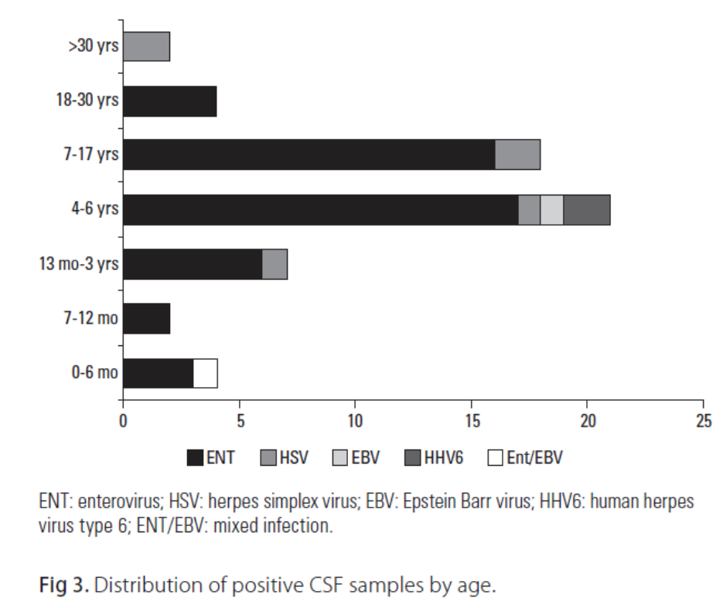

Meningitis Patients

Slide 13
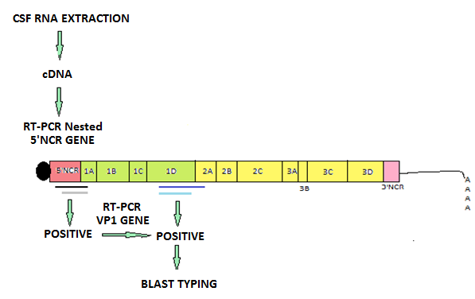
METHODS
Casas et al, Journal of Medical Virology,1999
Oberste et al, Virus Research, 1999

Slide 14
Seasonality

Slide 15
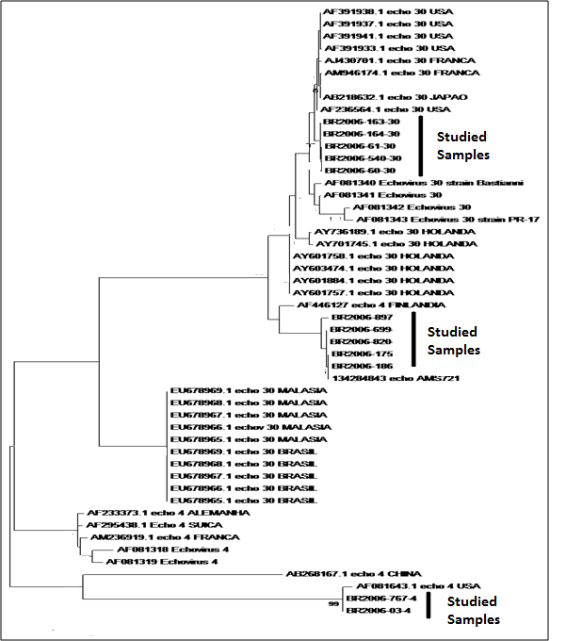


Nucleotide sequencing
EV Typing
12 samples

Slide 16
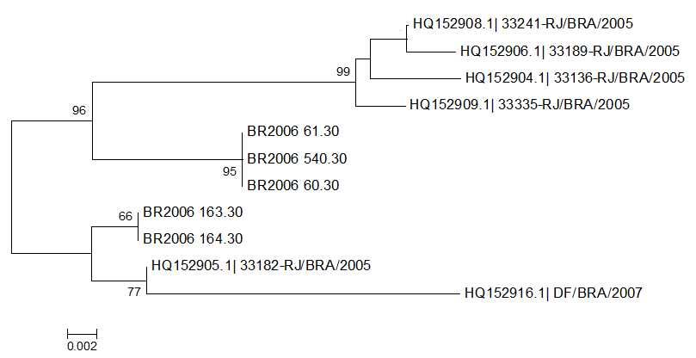
Nucleotide sequencing
Human Echovirus 30

Slide 17
Nucleotide sequencing
ECHOVIRUS 4

Slide 18
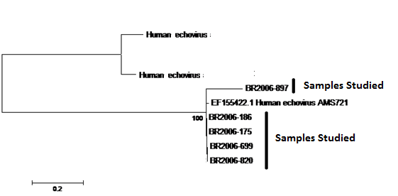
Nucleotide sequencing
HUMAN ECHOVIRUS

Slide 19
Conclusions
The molecular methodology was efective and fast to define the etiology of meningitis.
CNS infection for EV was observed in the summer (higher temperatures).
The EV types found were Human Echovirus
It was observed a predominance of EV infection in the ages of 4 to 17 years old.
It was not possible to identify the etiologic agent in the majority of the samples.

Slide 20
Currently
Establishing a flowchart for CSF collecting
Introduction of lactate quantification
DNA/RNA Extraction – commercial reagentes
Real Time PCR
Changes and
Benefits

Slide 21
Investigation and Molecular Epidemiology:
  Adenoviruses
    Flavivirus
    Arenavirus
Patients with signs and symptoms of encephalitis and meningoencephalitis
Future Researches

Slide 22
Future Researches
Human Parechovirus - HPeV Project
CSF samples stored from 2007-2014
Objective to establish the impact of the virus

Slide 23
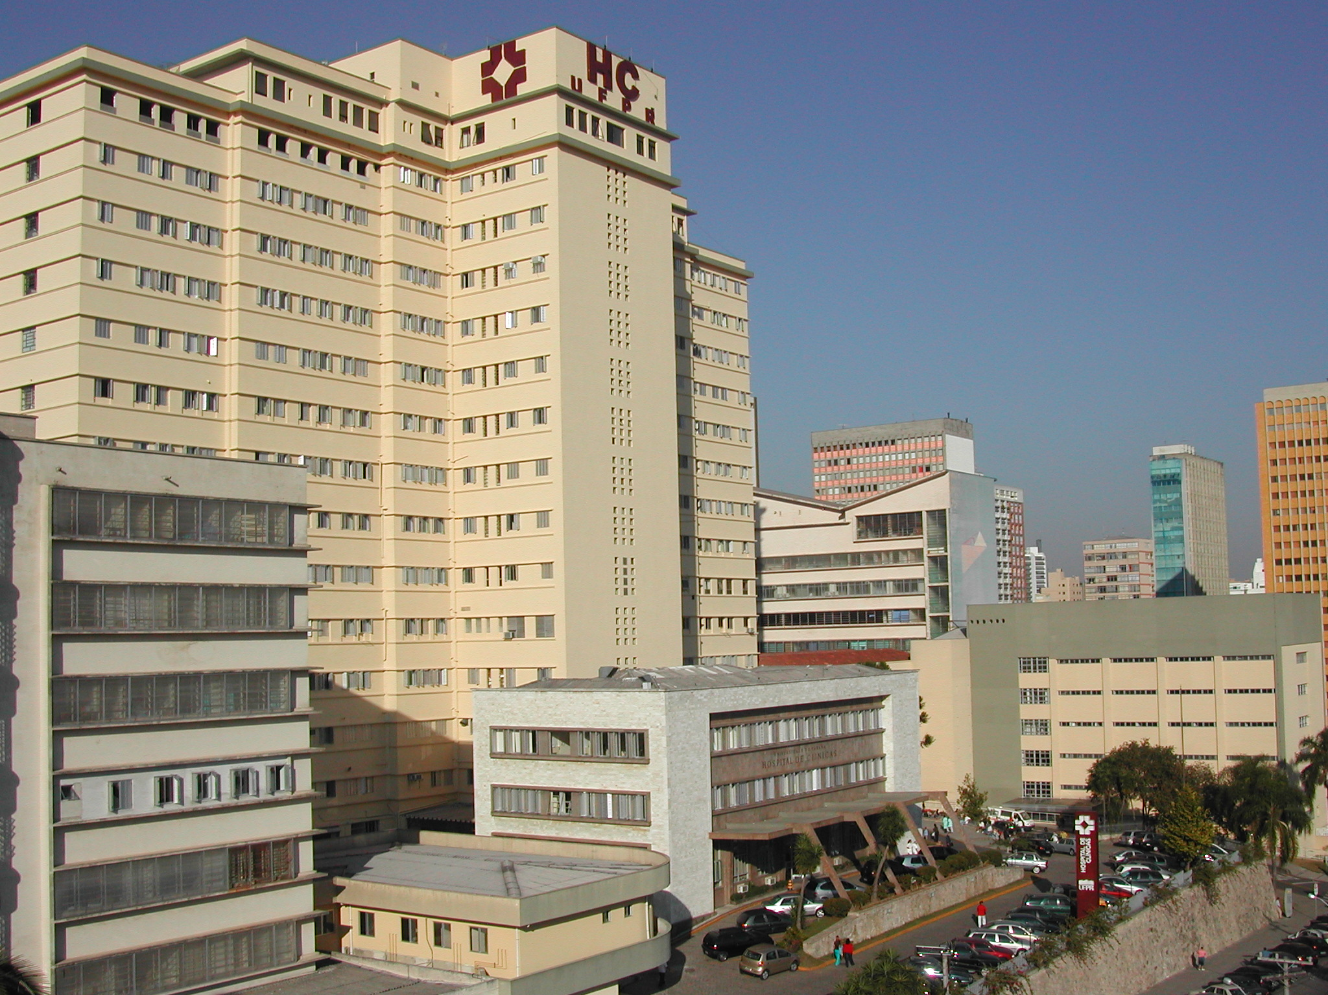
General Hospital
Universidade Federal do Paraná

Slide 24
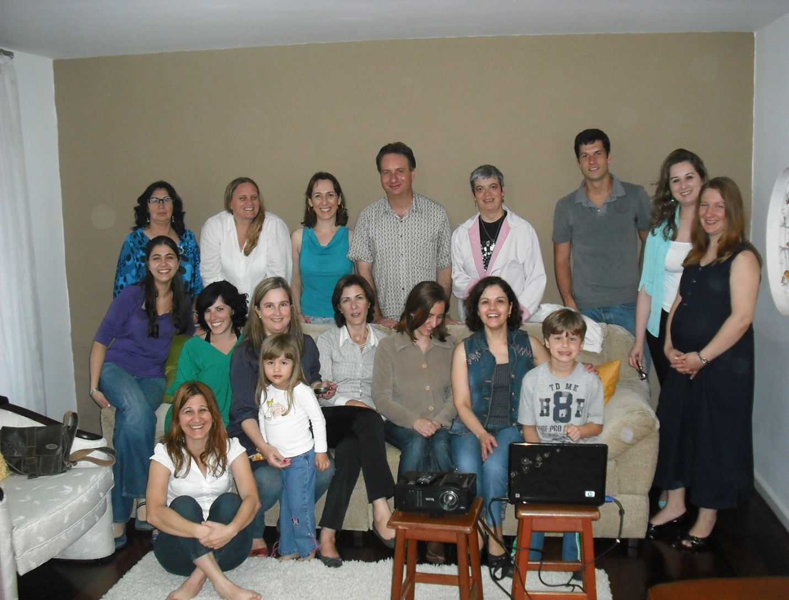
Team
Virology Laboratory

Slide 25

Curitiba City
Bothanic Garden

