Slide 1
Ecotoxicological evaluation and occurrence of losartan potassium and valsartan in a Brazilian coastal zone
Dr. Luciana Lopes Guimarães
Santa Cecília University, Santos, Brazil

Slide 2
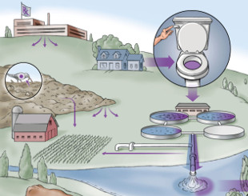
Introduction
Special attention has been given to environmental contamination related to pharmaceuticals because these compounds may represent a biological-ecological risk, especially in aquatic ecosystems.

Slide 3
PHARMACEUTICALS in aquatic ecosystems
Environmental persistence
Biological effects on non-target organisms
Interactions resulting in multiple modes of action
Absence of a Brazilian policy for the monitoring of these compounds in the environment
Notes:
among the problems related to pharmaceuticals in the enviroment

Slide 4
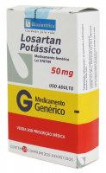
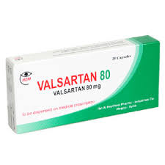
Introduction
Antihypertensive drugs are used worldwide with evidence of their occurrence in environmental matrices and domestic effluents
Angiotensin II receptor blockers (ARBs)

Slide 5
Objective
This study aimed to investigate the occurrence of Losartan and Valsartan in a Brazilian coastal zone and also evaluated their adverse biological effects on sea urchin Lytechinus variegatus.

Slide 6
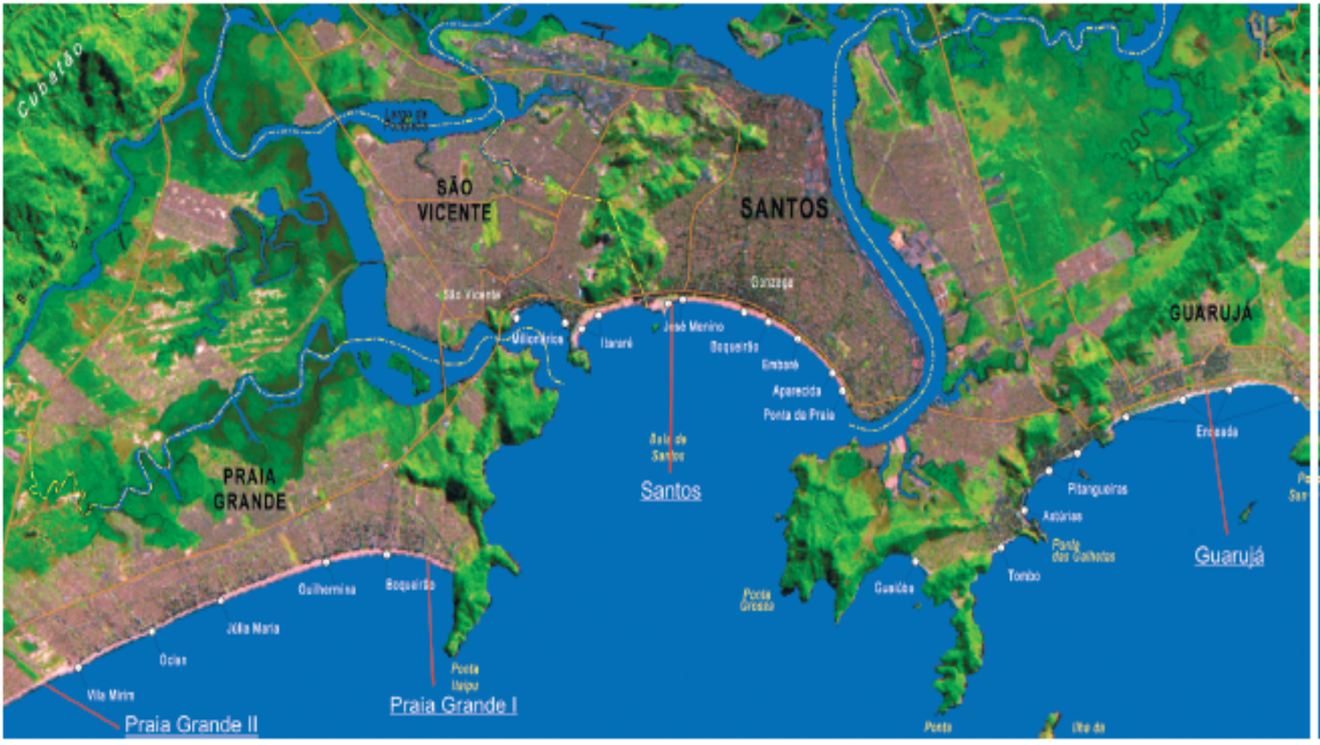
Santos submarine outfall
The sampling area selected in this study was Santos Bay (São Paulo, Brazil), which receives over 7,000 m³ of sewage per day.
The main pollution sources of this coastal zone include wastewater discharges without appropriate treatment
The local wastewater treatment plant performs only a mechanical treatment followed by chlorination.
Sewage is sent through pipes into the Santos Bay, in a 10 meter-deep area located 4.5 km away from the beach.
Notes:
(railing and screening for the removal of solids)
7367 meters cubic sewage

Slide 7
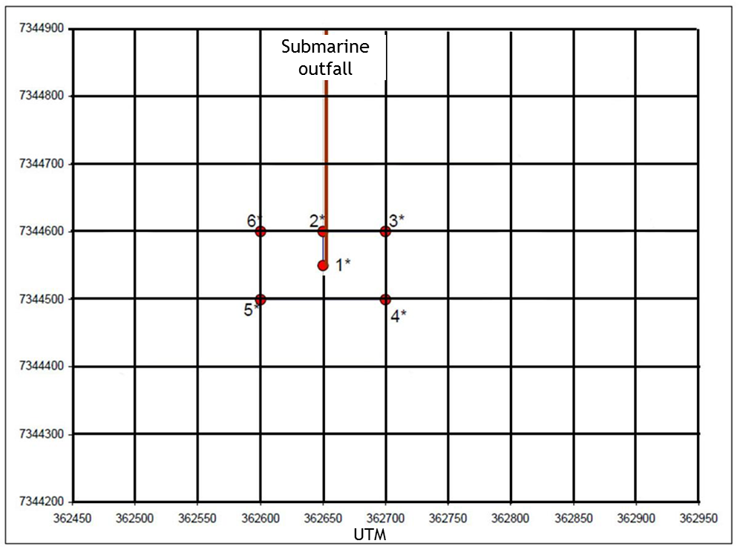
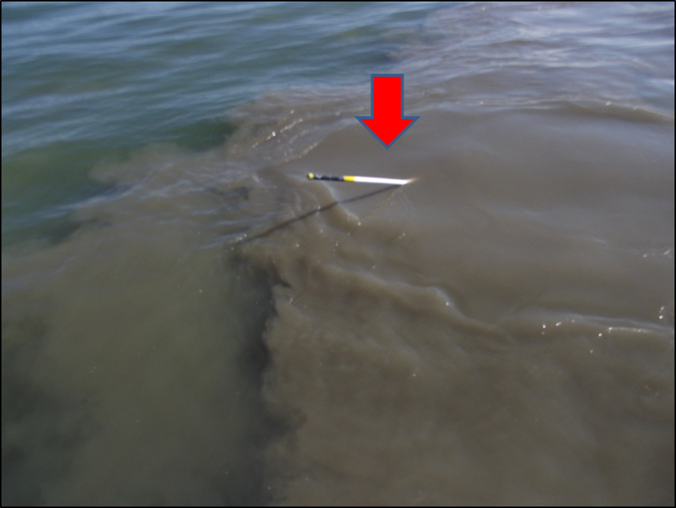
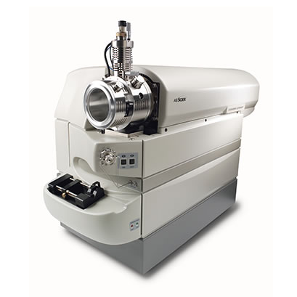
Methodology
Seawater samples were collected from six points surrounding the submarine outfall of Santos, in two depths (1 and 8 meters)
Water samples were filtered (0.45µm filter) submited to partition with ether-chloroform (1:2;v/v)
The red arrows indicate the exit point of the outfall (point 1)
Organic layer was analysed by Liquid Chromatography coupled with Mass Spectrometry (LC-MS/MS)
HPLC Agilent 1260 (Agilent Technologies, CA, USA) combined with a 3200 QTRAP hybrid triple quadrupole/LIT (linear ion trap)
mass spectrometer ABSciex,
Ontario (Canada).
Notes:
. Seawater samples were collected from six points surrounding the submarine outfall of Santos (São Paulo, Brazil) and the samples were analyzed by LC/MS/MS.

Slide 8
LC-MS/MS
Gradient elution
Time | 0.1% formic acid (in water) | acetonitrile
0 | 95 | 5
0.5 | 95 | 5
5 | 5 | 95
6 | 5 | 95
6.1 | 95 | 5
8 | 95 | 5
10 μL of each sample was injected in an Agilent Eclipse XDB-C18 4.6 × 50 mm, 1.8 μm column at 25 °C.
The eluent flow rate was 0.7mL.min⁻¹.
Parameters of Multiple Reaction Monitoring
Compounds | R.T. (min) | Q1 | Q3 | LOD (ng·L⁻¹) | LOQ (ng·L⁻¹)
Losartan | 4.84 | 432.2 | 207.2 | 0.2 | 0.8
 |  |  | 405.2
Valsartan | 5.30 | 436.3 | 235.1 | 0.46 | 2.0
 |  |  | 207.1
Analytes were detected and quantified using ESI ionization (positive ion mode) in Multiple Reaction Monitoring (MRM) mode,
with the selection of a precursor ion
and two ion products to quantify and qualify each compound.
Notes:
Q1 (first quadrupole);Q3 (last quadrupole); DP (Declustering potential); CE (Collision Energy); CXP (Collision Exit Potential); LOD(Limits of detection); LOQ (Limits of quantification); RT
(Retention Time); MIM (Multiple ion monitoring). In Q3, in the upper cell is the quantifier ion and in the lower cell is the qualifier ion
analyzed by electrospray ionization mass spectrometry (ESI-MS).

Slide 9
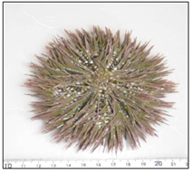
Ecotoxicological evaluation
Test Solutions:
Losartan
100; 200; 400; 800; 1600 mg.L⁻¹;
Seawater control.
Valsartan
6,25; 12,5; 25; 50; 100 mg.L⁻¹;
Seawater control with the highest DMSO concentration used in each experiment
4 replicates and the assay was repeated four times
Test organism: Lytechinus variegatus
(Echinodermata, Echinoidea).
Environmental Bioindicator (seawater)
Notes:
Sixteen hundred mg per liter (1600mg/L)
Due to its low solubility in water, Triclosan (Merck) was firstly dissolved in
dimethyl sulfoxide (Merck) 1 g L1, before being diluted in seawater to prepare
a stock solution with a final concentration of 5 mg L1. From this stock solution all
test solutions was prepared. In order to assess possible effects of the solvent on the
test organisms, the highest DMSO concentration used in each experiment was
simultaneously tested as the solvent control.
Highly saline water
Esta espécie é encontrada desde a Carolina do Norte (Estados Unidos) até a costa sudeste do Brasil.
São considerados bons bioindicadores ambientais por terem alta sensibilidade às mudanças que ocorrem no ambiente. São animais com forma de vida sedentária, o que permite investigar a contaminação de um determinado local ao longo do tempo (VENTURA et al. 2007).

Slide 10
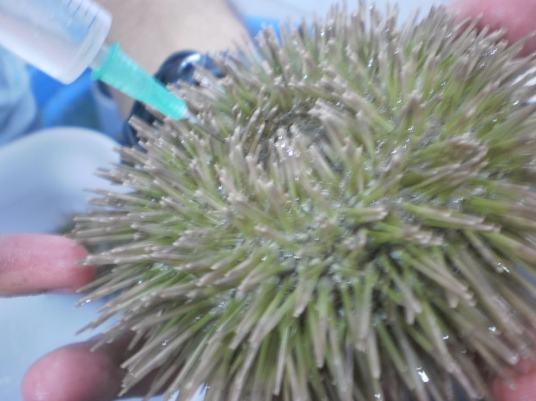
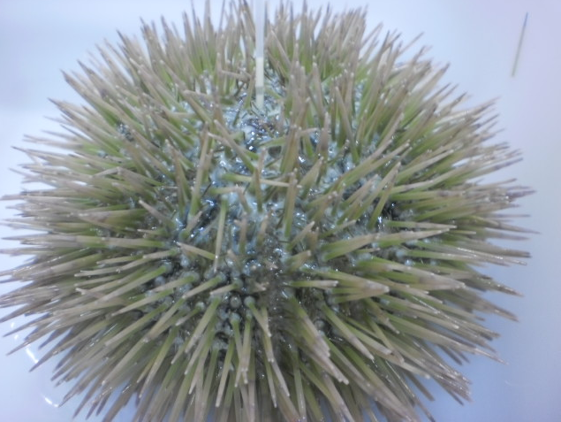
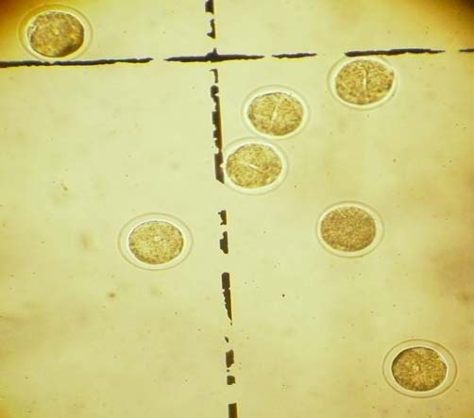
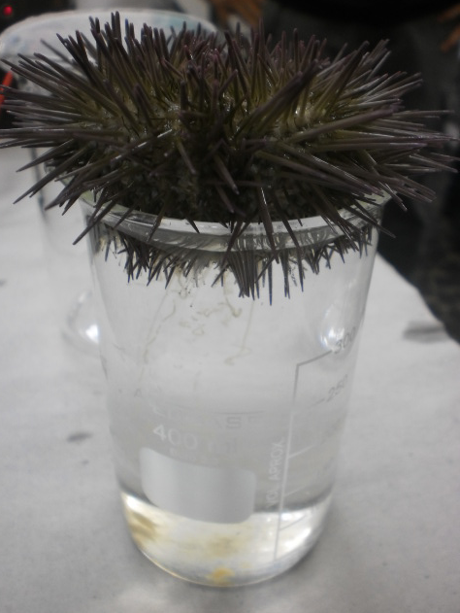
Acute toxicity assay (Fertilization assay)
USEPA protocol (2002)
Sea urchin were stimulated with 0.5 M KCl
Gametes from males and females were collected separately and transferred to glass beakers
The sperm (5 x 10⁷ cels.) was exposed to different concentrations of pharmaceuticals for 60 min.
After this period, a suspension containing approximately 2.000 ovules were added to the
test tubes
40 minutes later the test was finished by adding 0.5mL of formaldehyde in each replicate
First 100 eggs from each replicate were analyzed and fertilization was identified by observation of the occurrence of the membrane of fertilization or first cellular divisions.
The assays were validated with 70% or more eggs in
the control.
Notes:
The assays were validated with 70% or more eggs in the control.
potassium chloride / 3 machos e 3 femeas
Acute toxicity assays were conducted according to U.S. Environmental Protection Agency protocol.

Slide 11
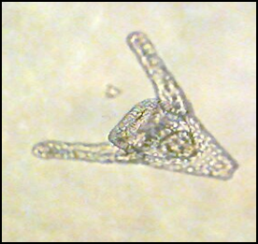
Chronic toxicity assays (Embryo-larval development assay)
ABNT protocol (2012)
Sea urchin were stimulated with 0.5 M KCl
Gametes from males and females were collected separately and transferred to glass beakers
The fertilization was attained by adding 2 mL of sperm (5 x 10⁷ cels.) solution to the 200 mL of ovules solution
After 10 min the density of fertilized eggs was estimated and ≈300 embryos were transferred to glass tubes containing different concentrations of pharmaceuticals
After 24 h, the assay was finished and the first 100 larvae from each replicate
were analyzed.
Larvae developed to pluteus stage were considered normal, whereas those presenting delay and/or morphological anomalies in their development were considered abnormal.
The assays were validated with 80% or more larvae in pluteus stage in
the control.
Notes:
The assays were validated with 70% or more eggs in the control.
potassium chloride / 3 machos e 3 femeas
Acute toxicity assays were conducted according to U.S. Environmental Protection Agency protocol.

Slide 12
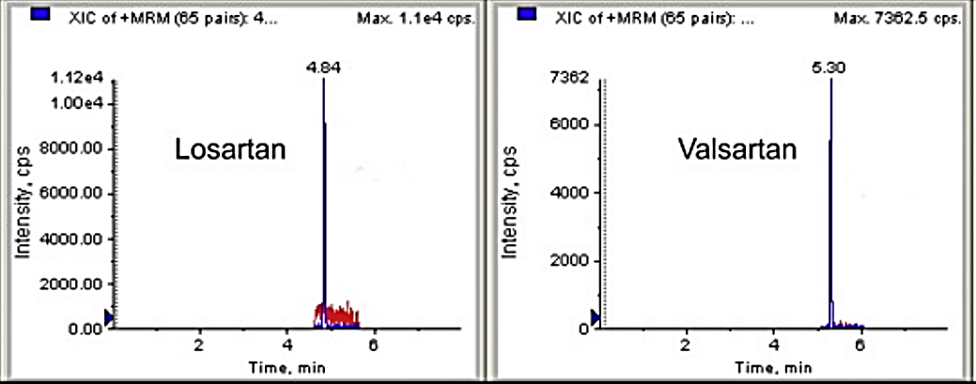
Results
<LOD: below detection limit; <LOQ: below quantification limit.
surface (1S–6S) and bottom (1B–6B)

Slide 13
Acute toxicity assay (Fertilization assay)
 | EC₅₀
Losartan | 292,93 mg.L⁻¹
Valsartan | >100mg.L⁻¹
Classification of the acute ecotoxicity assay results based on the European Union Directive 93/67/EEC.
Losartan Valsartan

Slide 14
Chronic toxicity assays (Embryo-larval development assay)
 | LOEC (mg.L⁻¹) | NOEC (mg.L⁻¹) | EC₅₀ (mg.L⁻¹)
Losartan | 70 | 50 | 98.94
Valsartan | 18.75 | 9.37 | 18.22
LOEC (Lowest observed effect concentration); NOEC (No observed effect concentration)
Classification of the chronic ecotoxicity assay results based on the European Union Directive 93/67/EEC.
Losartan
Valsartan
Notes:
NOEC (No observed effect concentration) and LOEC (Lowest observed effect concentration)

Slide 15
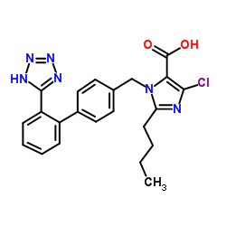
Discussion
Diferences in NOEC e LOEC and EC₅₀ values for chronic assays:
Log Kow for Losartan = 3,01
Log Kow for Valsartan = 3,65
Main human metabolite for Losartan: Carboxylosartan
Log Kow for Carboxylosartan = 4,81
Carboxylosartan is 10 to 20 times more potent than Losartan
Absorption and
Bioaccumulative effect
Notes:
No ouriço-do-mar Strongylocentrotus purpuratus já foi descrito um gene que codifica uma enzima (like) conversora de angiotensina (NCBI, 2014; Tu et al., 2012), embora a função fisiológica da angiotensina e o seu(s) respectivo(s) receptor(es) neste organismo, constituindo então prováveis alvos moleculares para os fármacos Losartan e Valsartan, ainda seja desconhecida

Slide 16
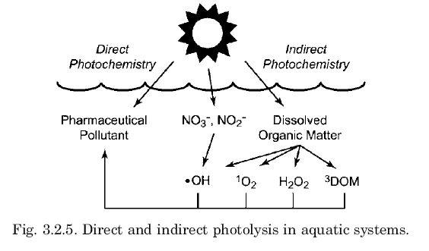
Reactions in aquatic systems!

Slide 17
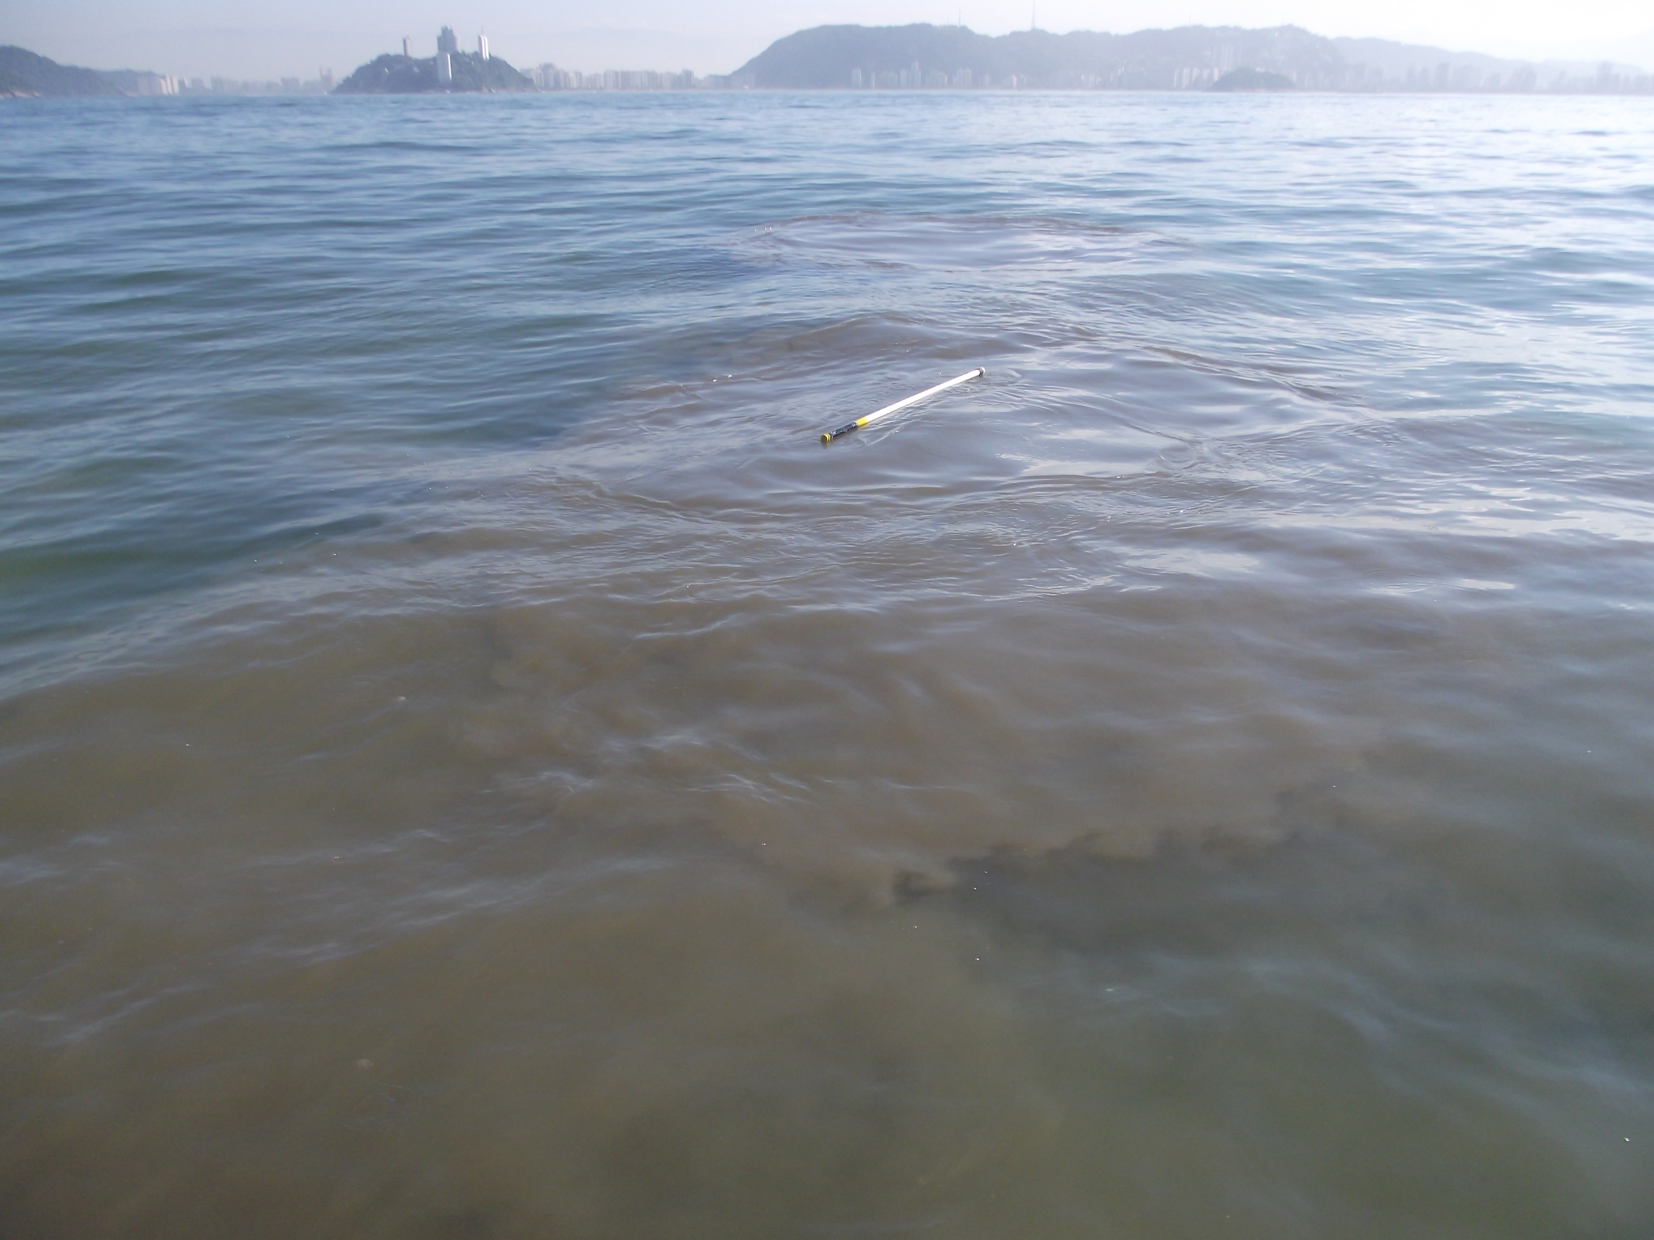
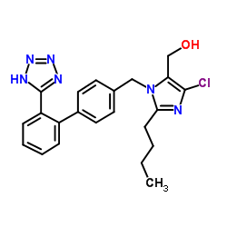
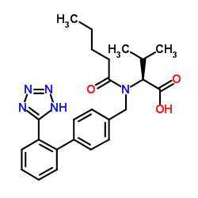
Discussion
Occurrence of pharmaceuticals in coastal ecosystems serves as a reminder that all these compounds are strongly associated with the discharge of insufficiently treated wastewater

Slide 18
Conclusion
Despite the occurrence of Losartan and Valsartan in seawater samples, it’s unlikely the occurrence of ecotoxicological effects, considering the environmental concentrations detected for these pharmaceuticals.

Slide 19
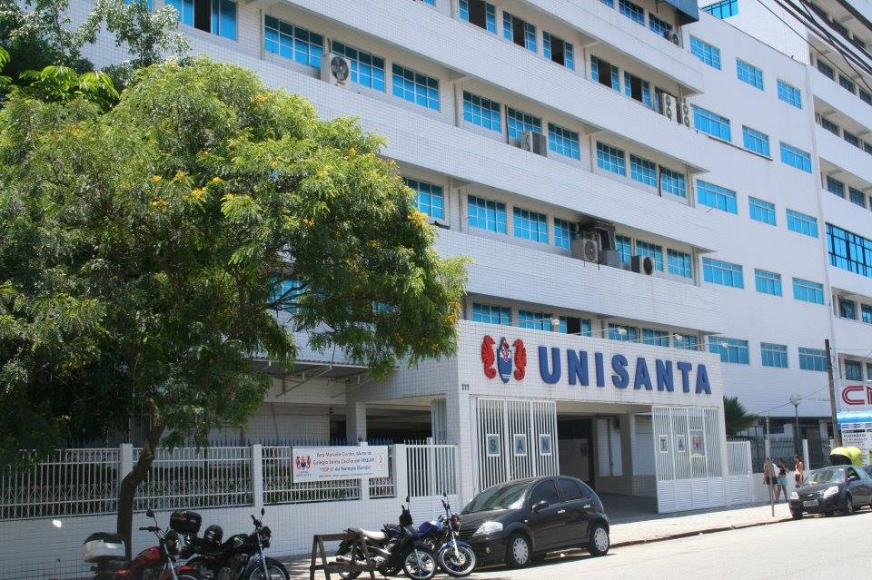
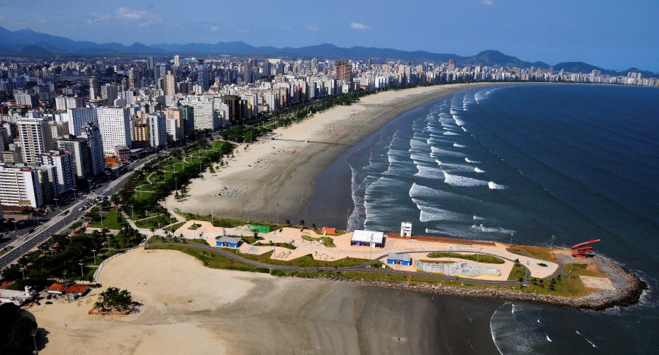
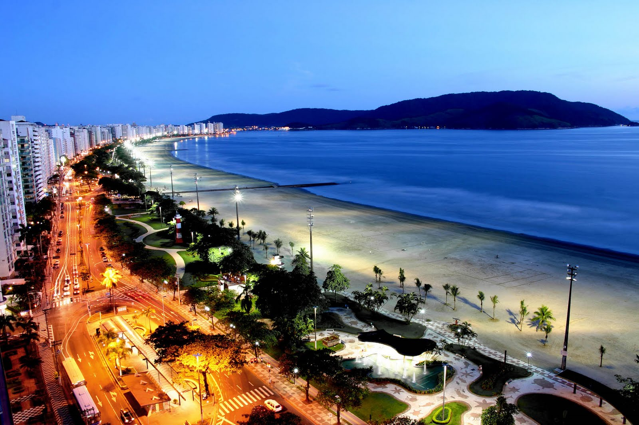
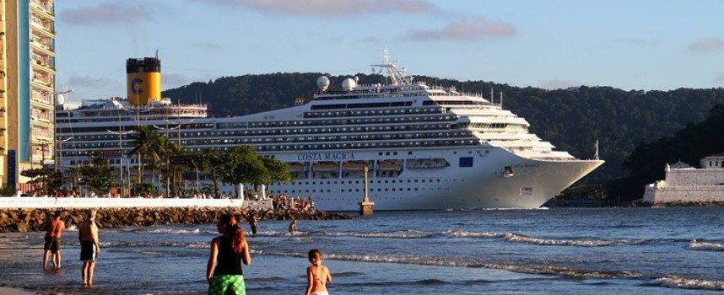
Thank you!

