Slide 1
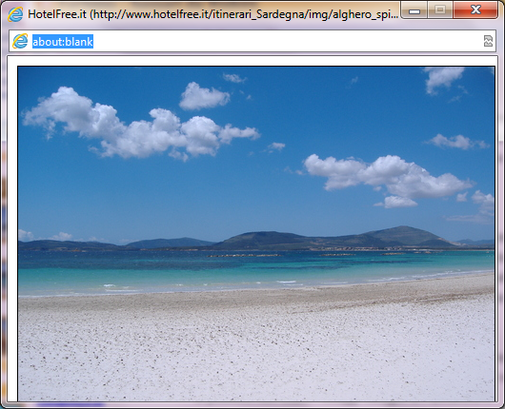

Functionalized carbon nanotubes as immunomodulator systems
and ultrasound contrast agents
3rd International Conference and Exhibition on
Clinical & Cellular Immunology
September 29 - October 01, 2014 Baltimore, USA
Lucia Gemma Delogu Ph.D.
University of Sassari, Italy

Slide 2
1. What they are?
Carbon Nanotubes
2. What they can do for clinical applications?
3. Interaction with the immune system
4. As ultrasound contrast agents

Slide 3
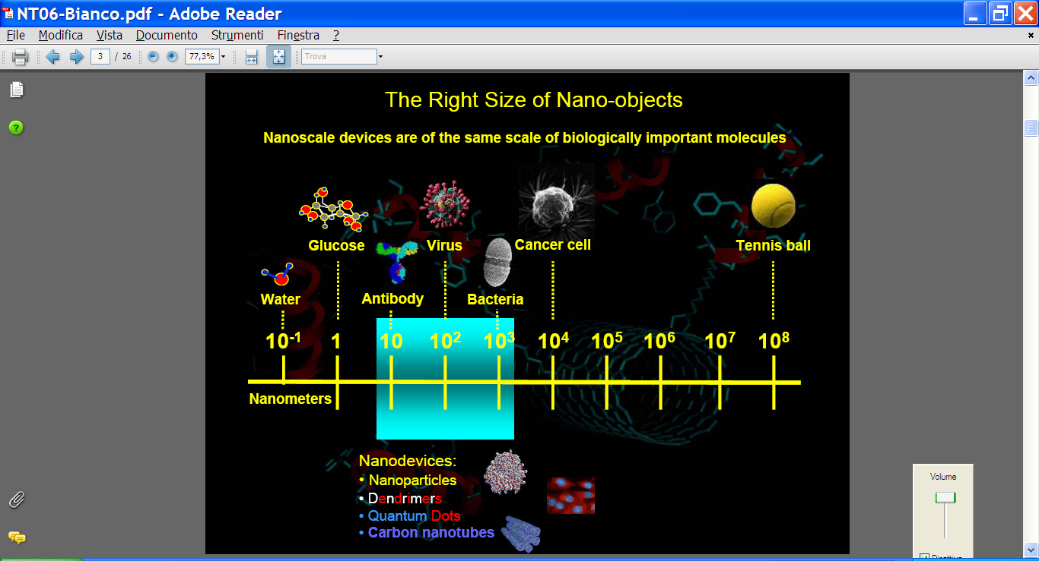
Carbon Nanotubes
1. What they are?
Nanomaterials dimensions

Slide 4
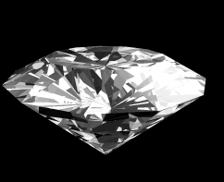
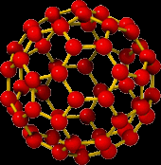
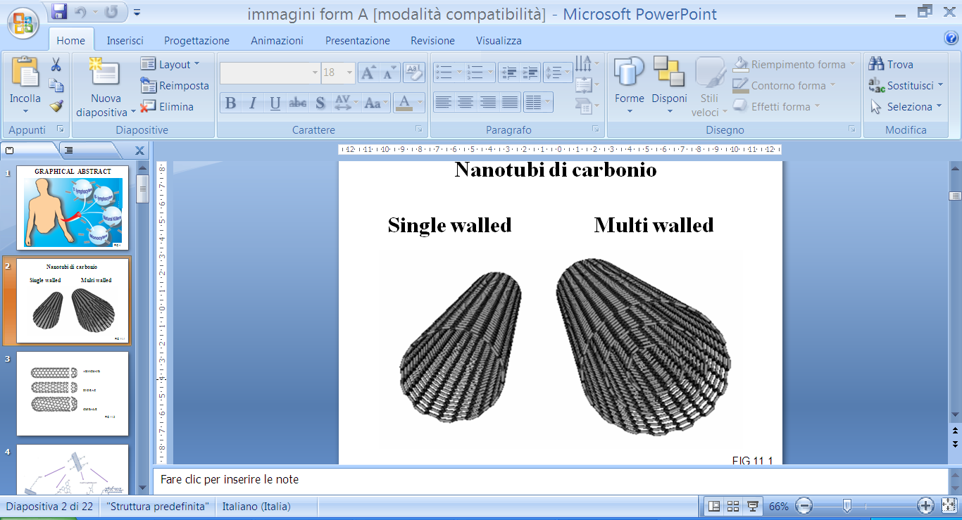
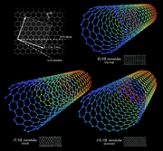
- Carbon Nanotubes
1. What they are?
Carbon Atoms
1991
Sumio Iijima
SWCNTs
Single-Walled Carbon Nanotubes
MWCNTs
Multi-Walled Carbon Nanotubes

Slide 5
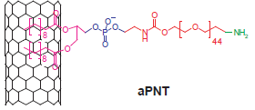
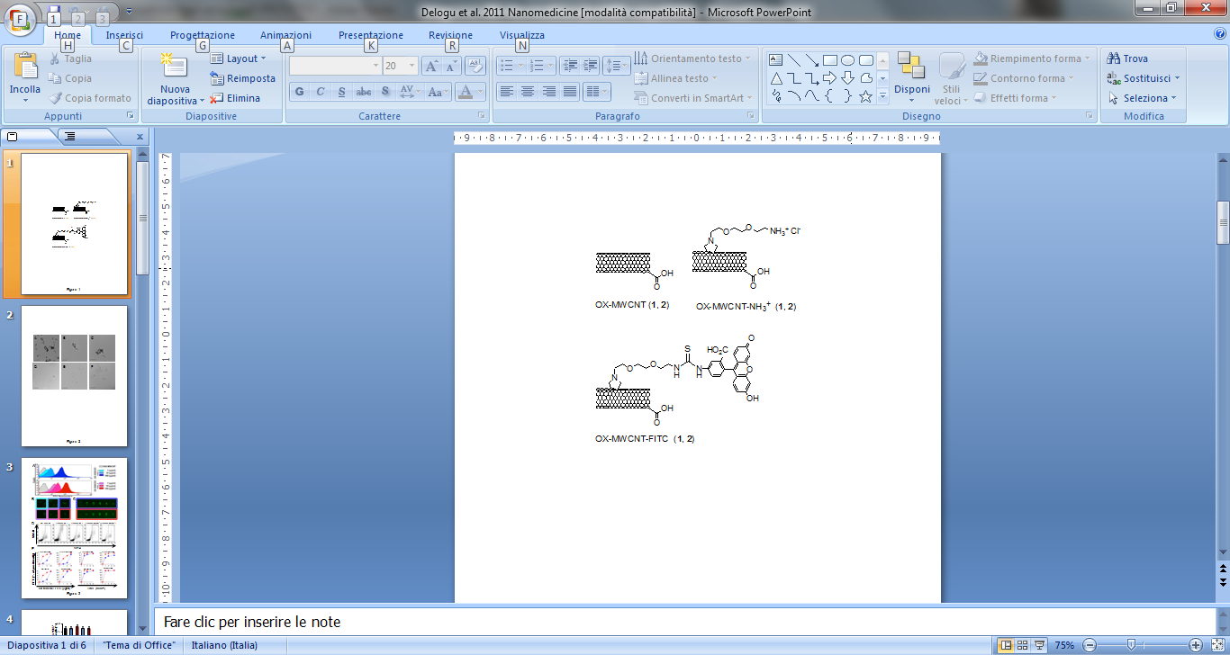
- Carbon Nanotubes
1. What they are?
Biocompatible
Biodegradable
…only when WELL FUNCTIONALIZED...
Kam NWS et al. J Am Chem Soc 2004
Cherukuri P et al. J Am Chem Soc 2004
Chen X et al. Angew Chem Int Ed 2004
Kam NWS et al. PNAS 2005
Wu W et al. Angew Chem Int Ed 2005
Dumortier H et al. Nano Lett 2006
Singh R et al PNAS 2006
Cherukuri P et al PNAS 2006
Chen X et al. J Am Chem Soc 2006
Liu Z et al. ACS NANO 2007
Liu Z et al. Angew Chem Int Ed 2007
Chin SF et al Exper Biol Med 2007
Yehia HN et al J Nanobiotech 2007
Schipper ML et al. Nature Nanotech 2008
Wu P et al. Angew Chem Int Ed 2008
Ali-Boucetta H et al. Angew Chem Int Ed Engl. 2013
Kagan VE et al. Nature Nanotech 2010
Zhao Y et al. J Phis Chem Soc 2011
Bianco A et al. Chem Comm 2011
Kotchey GP et al. ACC chem Res 2012
Nunes A et al. Nanomedicine lond 2012
i.e. Phospholipids absorption
i.e. 1,3 dipolar cycloaddition

Slide 6
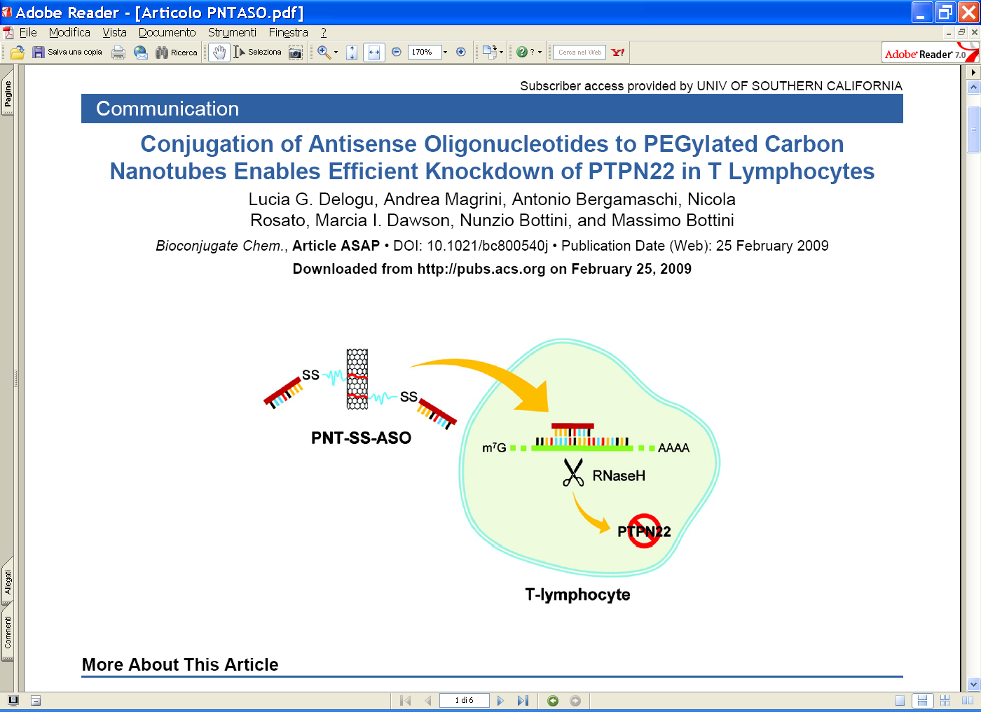
Carbon Nanotubes
2. What they can do for clinical application?
Drug Delivery
Gene delivery
In therapy
i.e. Delogu LG et al Bioconjugate chemistry 2009
Delogu LG et al JNN 2010
Carbon Nanotubes
(CNTs)

Slide 7
Carbon Nanotubes
2. What they can do for clinical application?
Drug Delivery
Gene delivery
Hyperthermia
Tissue regeneration
To increase
the neuronal perfomance
In therapy
Carbon Nanotubes
(CNTs)
In diagnosis
Biosensors
In imaging
For enantioseparation of chiral drugs

Slide 8
- Carbon Nanotubes
3. Interaction with the immune system
...on human immune cells
Do differently functionalized carbon nanotubes with different diameters act differently with the immune cells?
Do they interact with the immune system?.....
…..if yes, how?
Is the possible impact dependent on the cell type?
Delogu LG et al. Nanomedicine (London) 2012

Slide 9
AAAAAA

Slide 10
- Carbon Nanotubes
3. Interaction with the immune system
~ 400 nm
20-30 nm
ox-MWCNT-1
ox-MWCNT-NH₃⁺-1
ox-MWCNT-FITC-1
~ 400 nm
9.5 nm
ox-MWCNT-2
ox-MWCNT-NH₃⁺-2
ox-MWCNT-FITC-2
Delogu LG et al. Nanomedicine (London) 2012

Slide 11
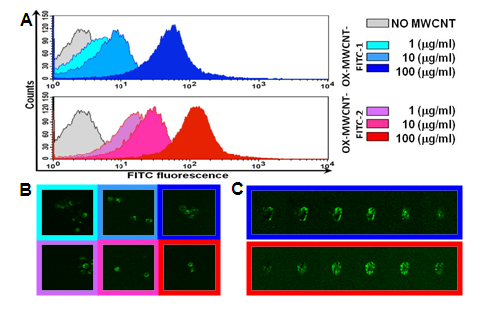
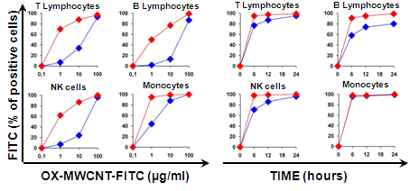
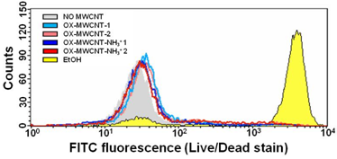
3. Interaction with the immune system
Diameter
- Carbon Nanotubes
ox-MWCNT-FITC-1
20-30 nm
ox-MWCNT-FITC-2
9.5 nm
Uptake
Viability
Delogu LG et al. Nanomedicine (London) 2012

Slide 12
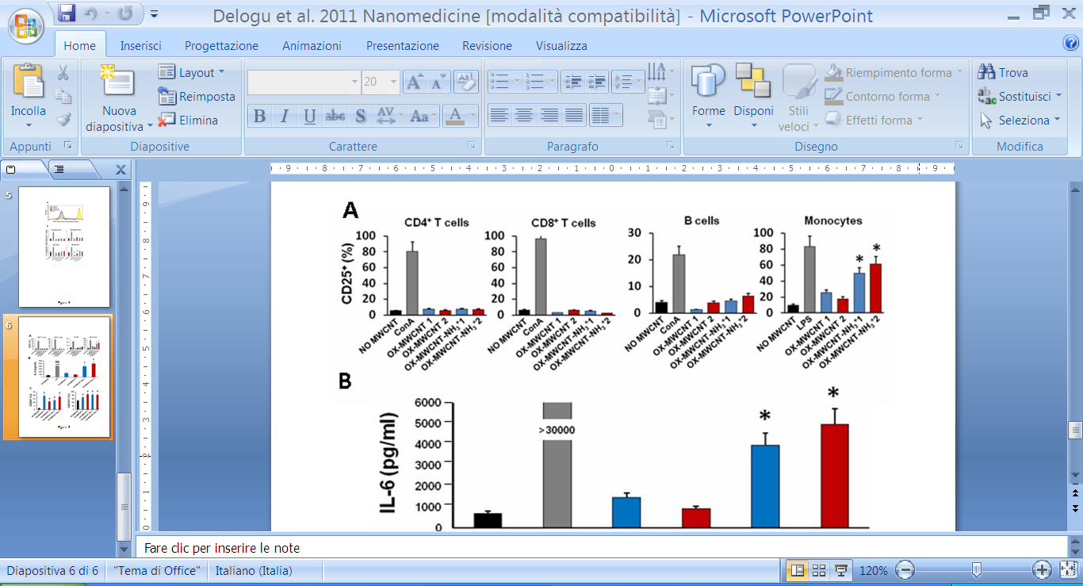
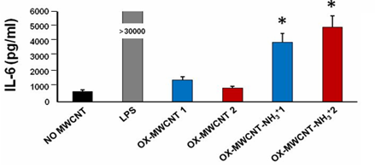
- Carbon Nanotubes
3. Interaction with the immune system
Functional assay CD25
Monocytes
Delogu LG et al.
Nanomedicine (London) 2012

Slide 13
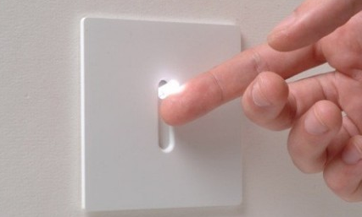
- Carbon Nanotubes
3. Interaction with the immune system
“The immune system is always a balance of switching several genes on and off”

Slide 14
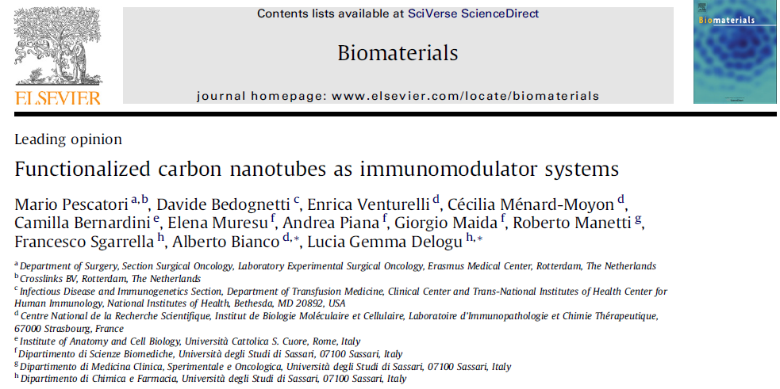
- Carbon Nanotubes
3. Interaction with the immune system

Slide 15
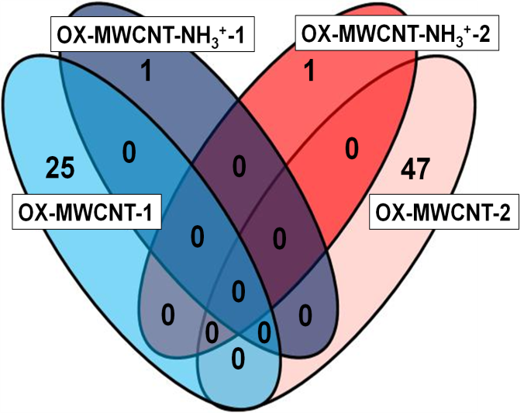
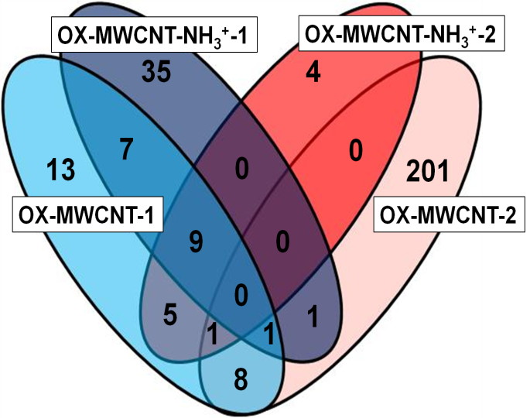
- Carbon Nanotubes
3. Interaction with the immune system
Pescatori M et al. Biomaterials 2013
Affymetrix technology to analyze
the expression of 32 020 transcripts
Diameter
 | T cells | Monocytes
OX-MWCNTs-1 | 25 | 44
OX-MWCNTs-2 | 47 | 212
OX-MWCNTNH₃⁺-1 | 1 | 53
OX-MWCNTNH₃⁺-2 | 1 | 19
20-30 nm
P< 0.001
9.5 nm
T cells
Monocytes

Slide 16
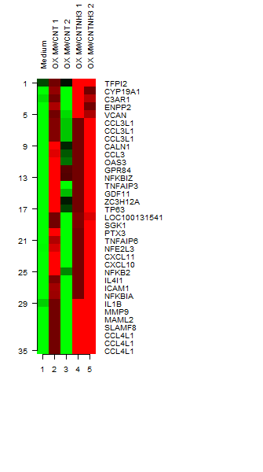
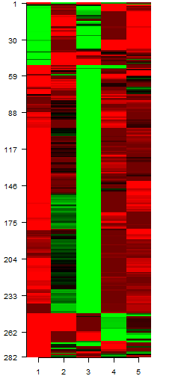
- Carbon Nanotubes
Monocytes activators MA-CNTs
3. Interaction with the immune system
CCR5 Ligands
CXCR3 Ligands
Pescatori M et al.
Biomaterials 2013
CCR5 Ligands

Slide 17
- Carbon Nanotubes
3. Interaction with the immune system
Pescatori M et al. Biomaterials 2013
Multiplex ELISA
Real Time PCR
IL6
*
Medium
*
OX-MWCNTs-1
OX-MWCNTs-2
Monocytes activators MA-CNTs
*
*
OX-MWCNTsNH₃⁺-1
*
OX-MWCNTsNH₃⁺-2
Gene expression
*
IL1 β
*
IL1 β
*
*
*
*
*
*
*
*
*
TNFα
TNFα
*
*
*
*
*
*
Medium
OX-MWCNTs-2
MONOCYTES
(THP1 Cell line)
HUMAN PRIMARY
MONOCYTES
OX-MWCNTs-1
OX-MWCNTsNH₃⁺-1
OX-MWCNTsNH₃⁺-2

Slide 18
- Carbon Nanotubes
3. Interaction with the immune system
- A cell specific action on monocytes from 3 types of nanotubes (MA-CNTs) with the selective induction of innate activation pathways.
We have the opportunity to choose the activators CNTs…
Future perspectives:
A carrier of a vaccine able also to act as a adjuvant

Slide 19
- Carbon Nanotubes
3. Interaction with the immune system
We have the opportunity to choose the activators CNTs…
Future perspectives:
CCL3L1; CCL4L1
(CCR5 Ligands)
Expression
CXCL11
(CXCR3 Ligands)
Monocytes activators
Carbon nanotubes

Slide 20

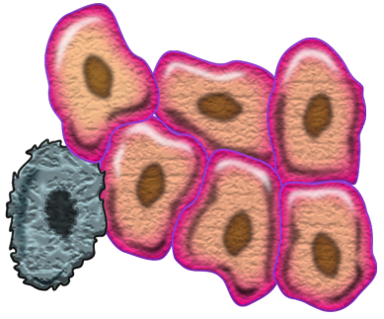
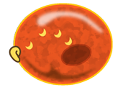
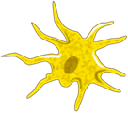

IL-2
TUMOR
Monocytes
Tumor cells
Tumor
cells
Dendritc cells
CXCL9/10/11 (CXCR3 ligands)
CCL3/4/5 (CCR5 ligands)
Lymphocytes migration
CTL Th1
NK
CXCR3
CCR5

Slide 21
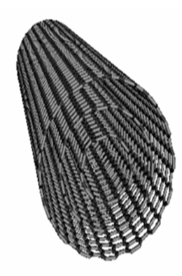
TUMOR
Monocytes
Tumor cells
Tumor
cells
Dendritc cells
CXCL9/10/11 (CXCR3 ligands)
CCL3/4/5 (CCR5 ligands)
Lymphocytes migration
CTL Th1
NK
CXCR3
CCR5

Slide 22
- Carbon Nanotubes
3. Interaction with the immune system

Slide 23
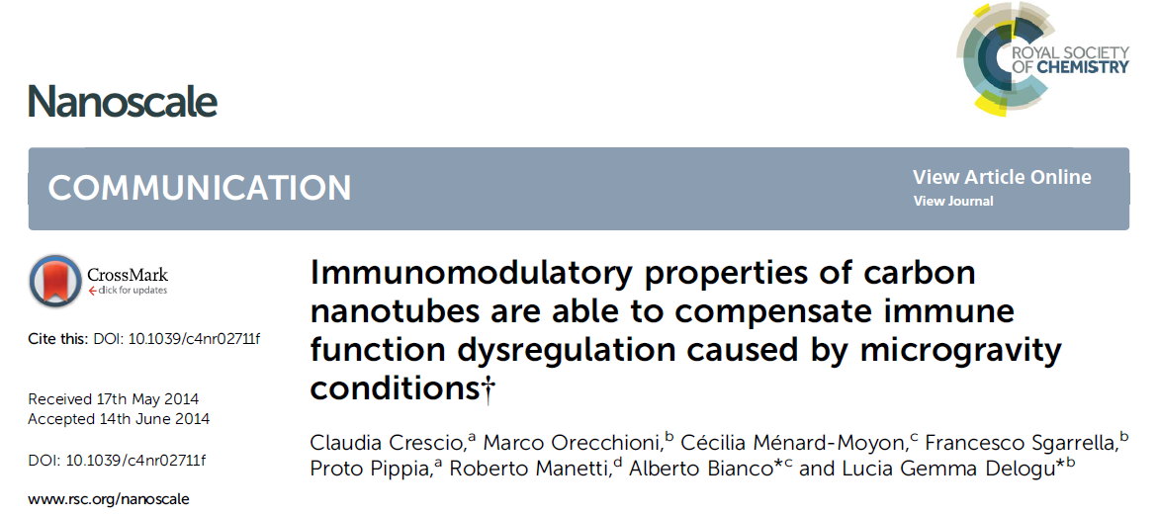
- Carbon Nanotubes
3. Interaction with the immune system

Slide 24
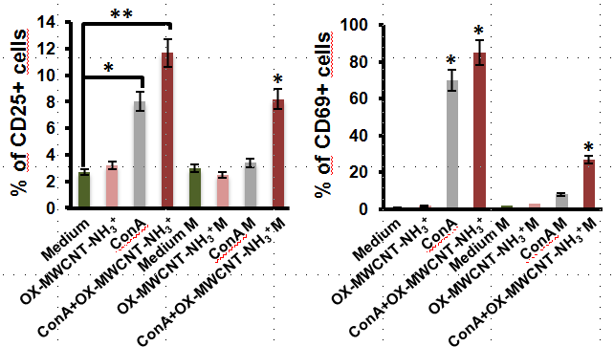
- Carbon Nanotubes
3. Interaction with the immune system
Space flight
conditions
Space flight
conditions

Slide 25
- Carbon Nanotubes
3. Interaction with the immune system
Possible future applications:
in immunotherapy
as vaccine adjuvants
as possible fighters to contrast spaceflight immune cell dysregulation.

Slide 26
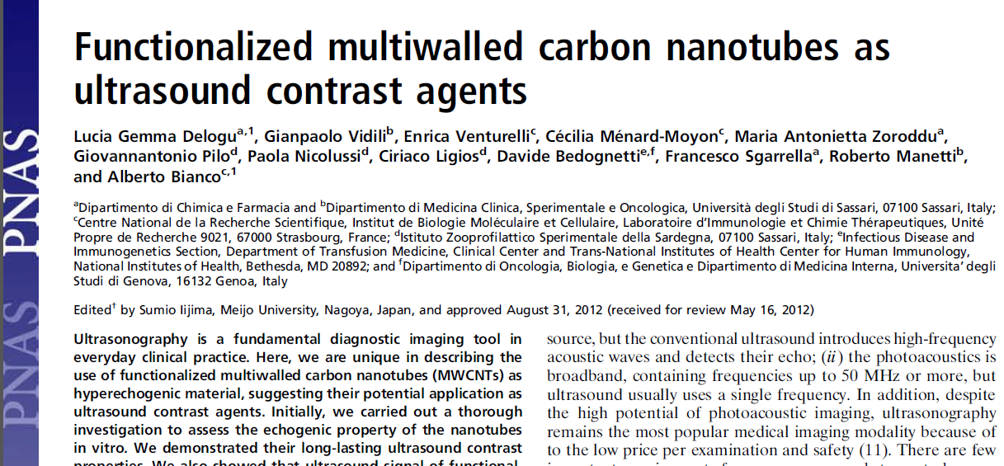
4. As ultrasound contrast agents
- Carbon Nanotubes

Slide 27
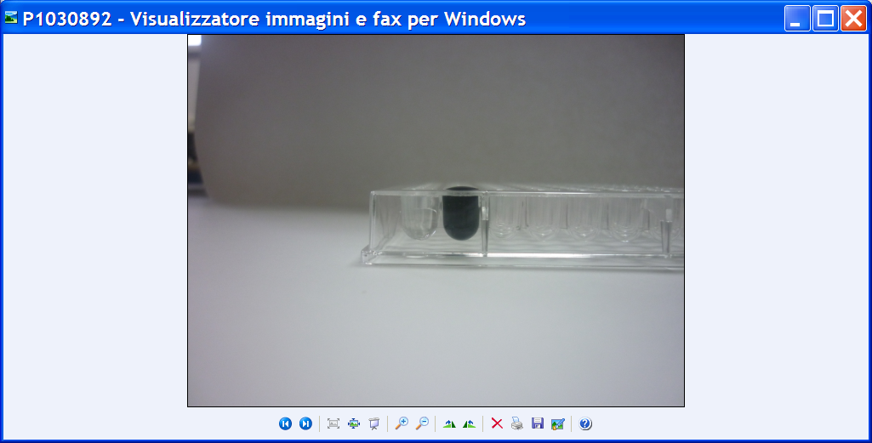
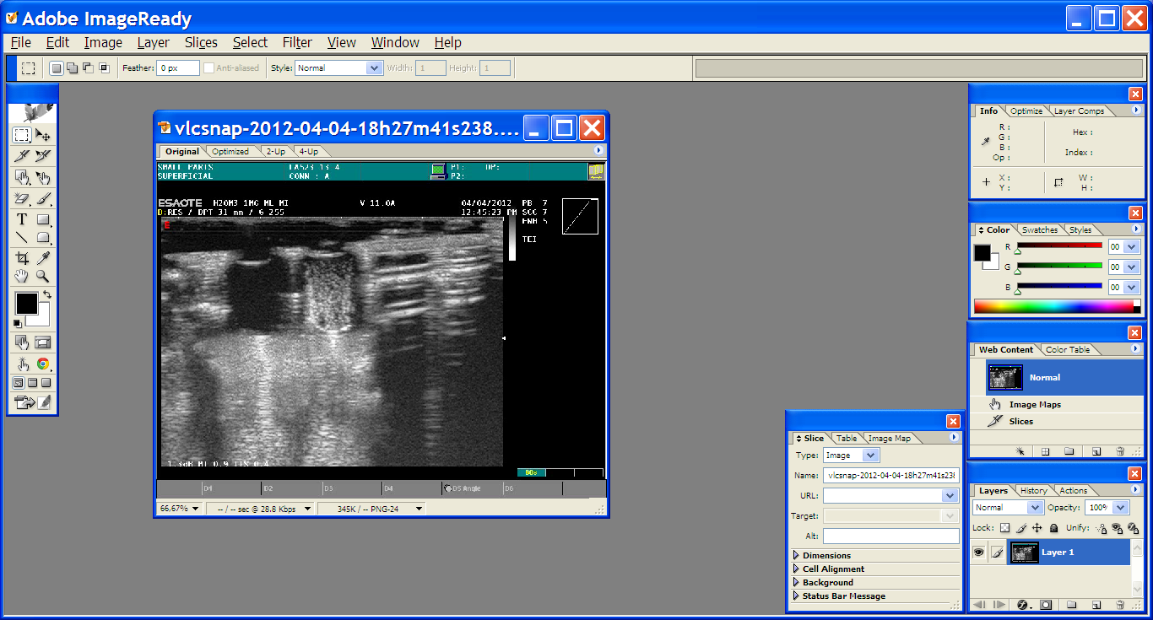
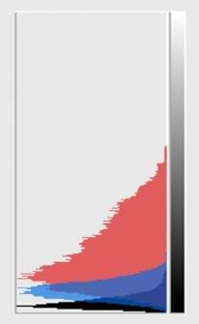
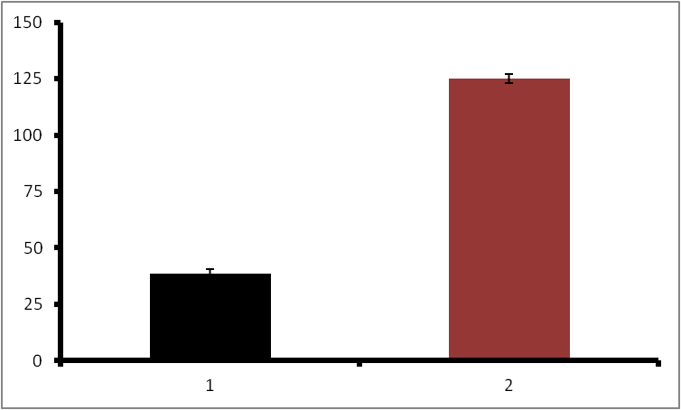
4. As ultrasound contrast agents
- Carbon Nanotubes
Nanotubes
1000
µg/ml
Nanotubes
1000
µg/ml
water
water
150
*
125
100
Ultrasound
signal
75
50
25
0
water
1000
µg/ml
Delogu LG et al. PNAS 2012
* Pvalue < 0.05

Slide 28
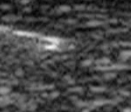
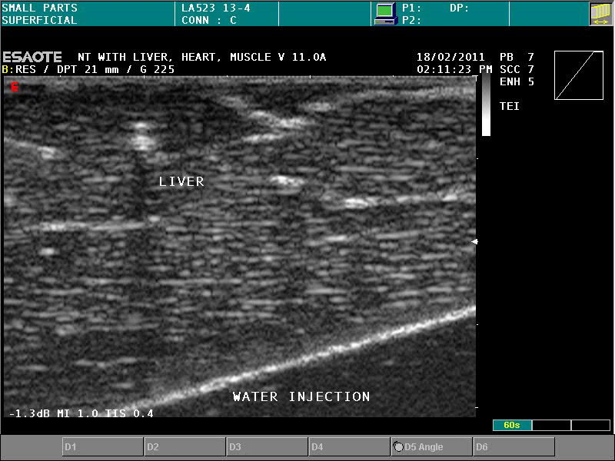

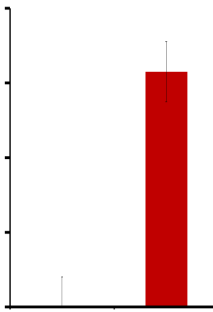
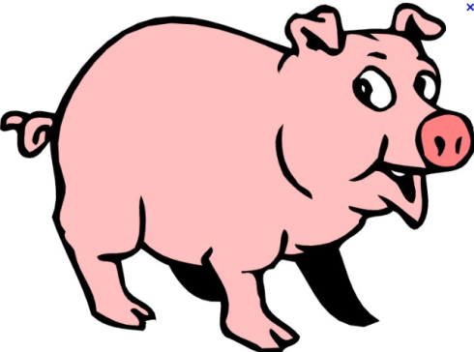
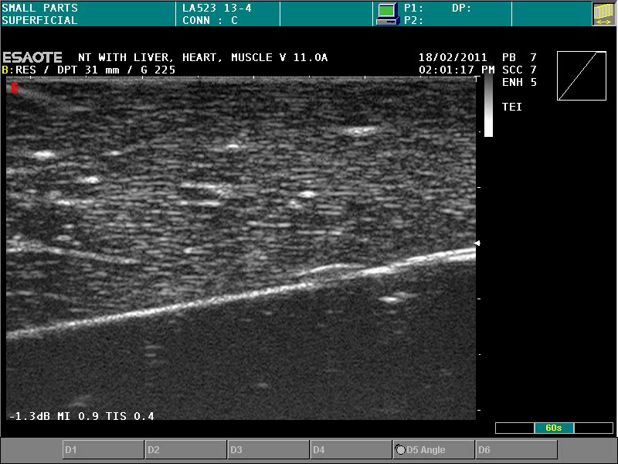
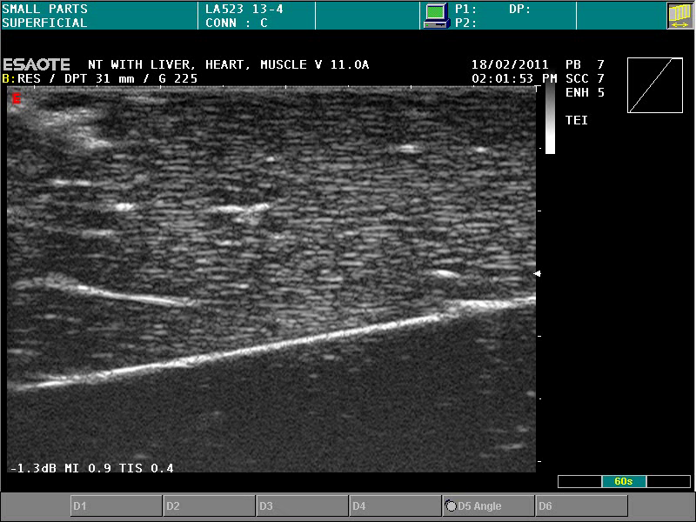
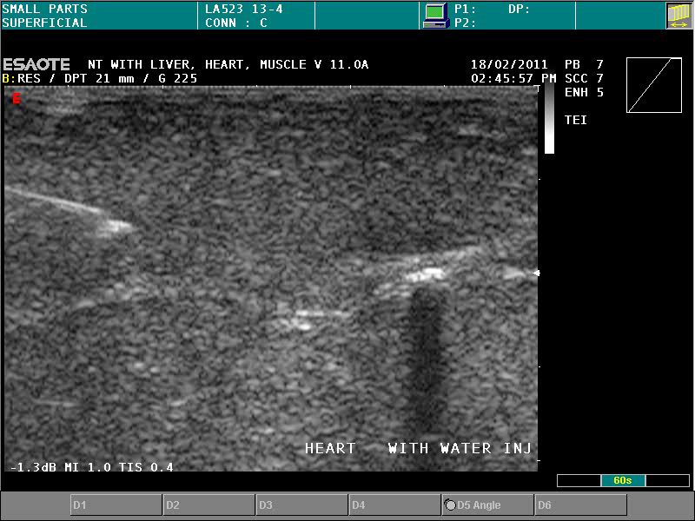
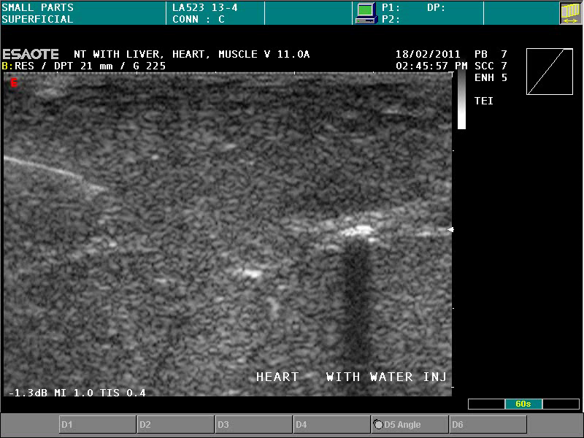
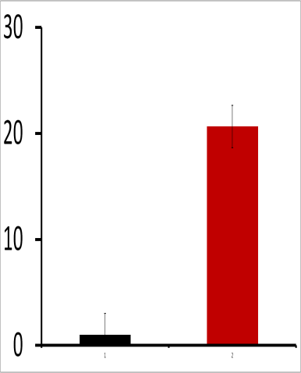
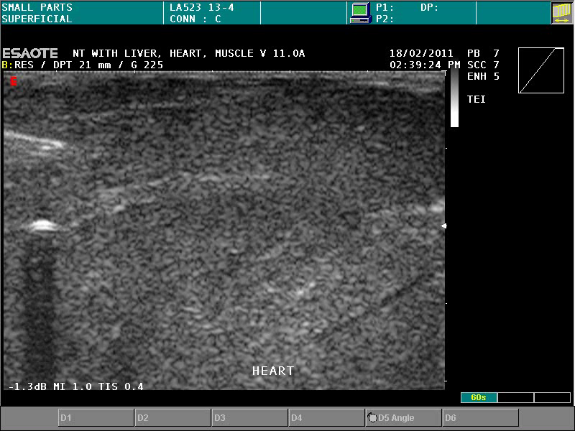
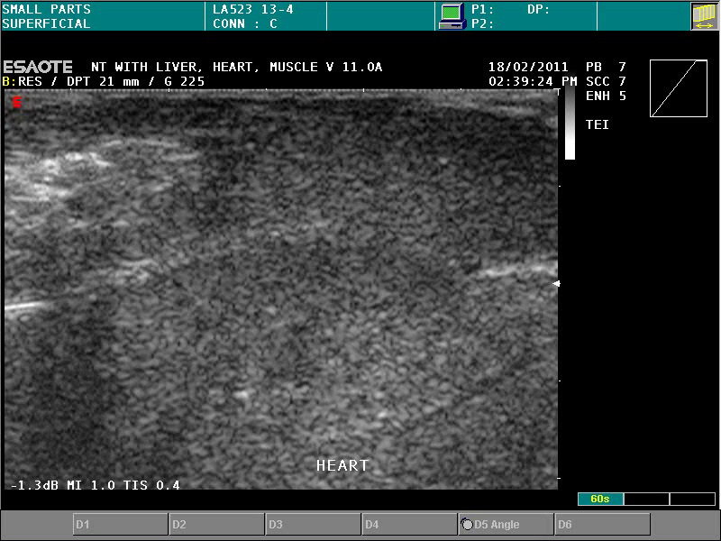
4. As ultrasound contrast agents
- Carbon Nanotubes
Before Injection
After
Injection
nanotubes
Water
20
*
Water
15
Liver
Ultrasound signal
10
nanotubes
5
0
Before Injection
After
Injection
nanotubes
30
Water
Water
*
20
Heart
Ultrasound signal
nanotubes
10
0

Slide 29
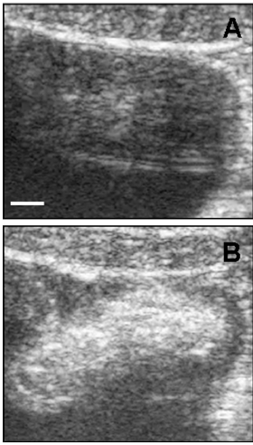
4. As ultrasound contrast agents
- Carbon Nanotubes
IN VIVO PIG BLADDER
Pre injection
Post injection

Slide 30
4. As ultrasound contrast agents
- Carbon Nanotubes
MICROBUBBLES
CARBON NANOTUBES
Big size 1-8 µm; purely intravascular flow tracers
Are classified as long half-life agents when the signal persists for more than 5 min after injection
Research as drug delivery system is still at an early stage
Small enough to reach a tumor region (vascular pore up to 780 nm)
Long lasting signal (are eliminated in 24-48 hours by renal clearance)
Can be functionalized with therapeutic molecules

Slide 31
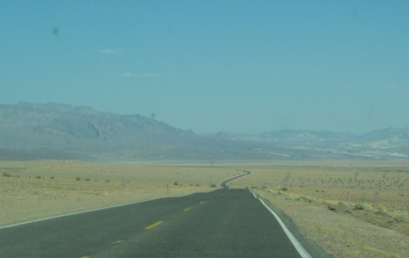
Working on carbon nanotubes
In diagnosis
In therapy

Slide 32
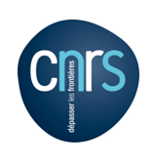
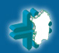
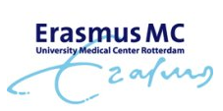
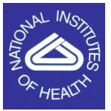
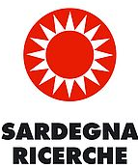
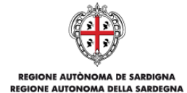

University of Sassari
Francesco Sgarrella
Roberto Manetti
Proto Pippia
Giampaolo Vidili
Claudia Crescio
Marco Orecchioni
CNRS, Strasbourg
Alberto Bianco
Istituto Zooprofilattico
Sperimentale della Sardegna
Paola Nicolussi
Ciriaco Ligios
Giovannantonio Pilo
Rotterdam, Netherlands
Mario Pescatori
NIH Bethesda USA
Davide Bedognetti
Francesco Marincola
Patent office
Sandra Ennas
Alessandra Carta

Slide 33






www.uniss.it

Slide 34








Sardinia
Cagliari
Thanks for the attention
Lucia Gemma Delogu
lgdelogu@uniss.it
luciagemmadelogu@yahoo.it

