Slide 1
Reconstruction of the dynamics of a huge fire in a steel-rolling plant. Methods of investigation
Luca Marmo^{a,c}, Norberto Piccinini^{a, c}, Luca Fiorentini^{b,c}
ª Politecnico di Torino Dipartimento di Scienza Applicata e Tecnologia
^{b} Tecsa S.p.A., Pero (MI) Italy
^{c}Technical Consultants of ‘Procura della Repubblica di Torino’
(Public Prosecutor’s Office), Procedimento N° 31095/07 R.G.N.R.

Slide 2
Outline
Accident intro
Plant/process description
Investigation
Findings
Conclusions

Slide 3
The Thyssen Krupp fire
Location:
Thyssen Krupp plant, Turin, 12/06/2007
Plant Involved:
Pickling and Annealing line N° 5, inlet (unrolling) section.
Main features
Small oil and paper fire which suddenly evolved into a jet fire
Personnel directly involved:
8
Fatalities:
7

Slide 4
Technical investigation activities
Site survey:
Process and field variables,
Heat and flame damage extension,
State of the coils, position, scratching of a coil border against the carpentry,
Paper spread along the line. Residue of carbonized paper in the area of the fire.
Witnesses:
Description of the event.
Electronic data
PLC communications, time scale of the event.
Fire scenario modeling
Temperature field, radiation intensity.

Slide 5
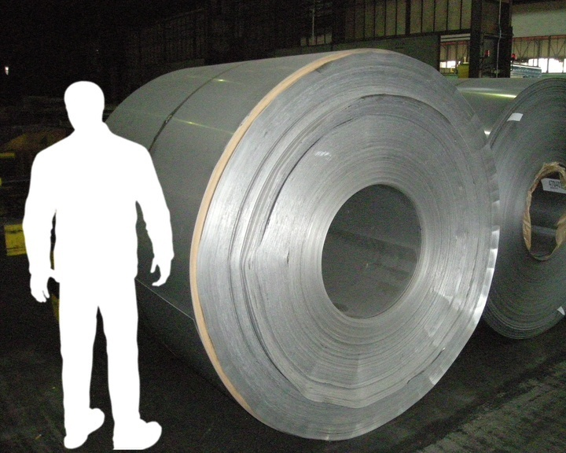
The plant and the process
Pickling and annealing of stainless steel coils
Unrolling
Welding consecutive coils
Annealing
Pickling
Cut
Rolling up
Light green: discontinuous
Orange: contnuous

Slide 6
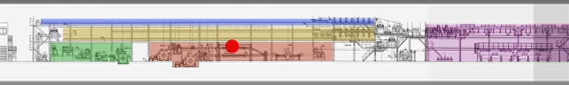
The plant and the process
≅ 200 m
Red: inlet section
Yellow: inlet storage section
Violet: treatment section
Light blue: outlet storage section
Green: outlet section
Red dot: fire location

Slide 7
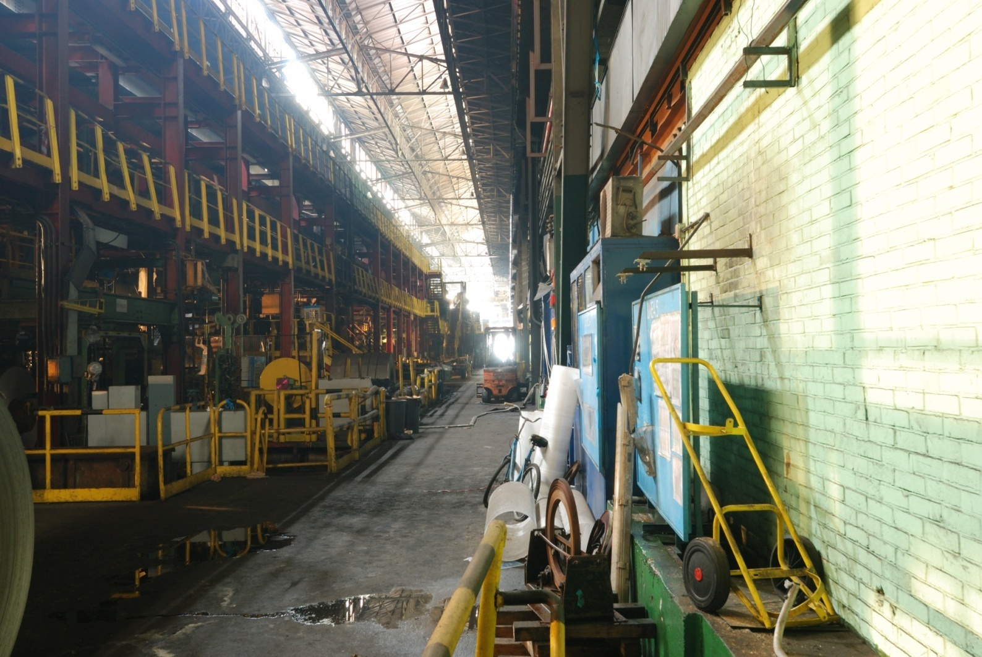
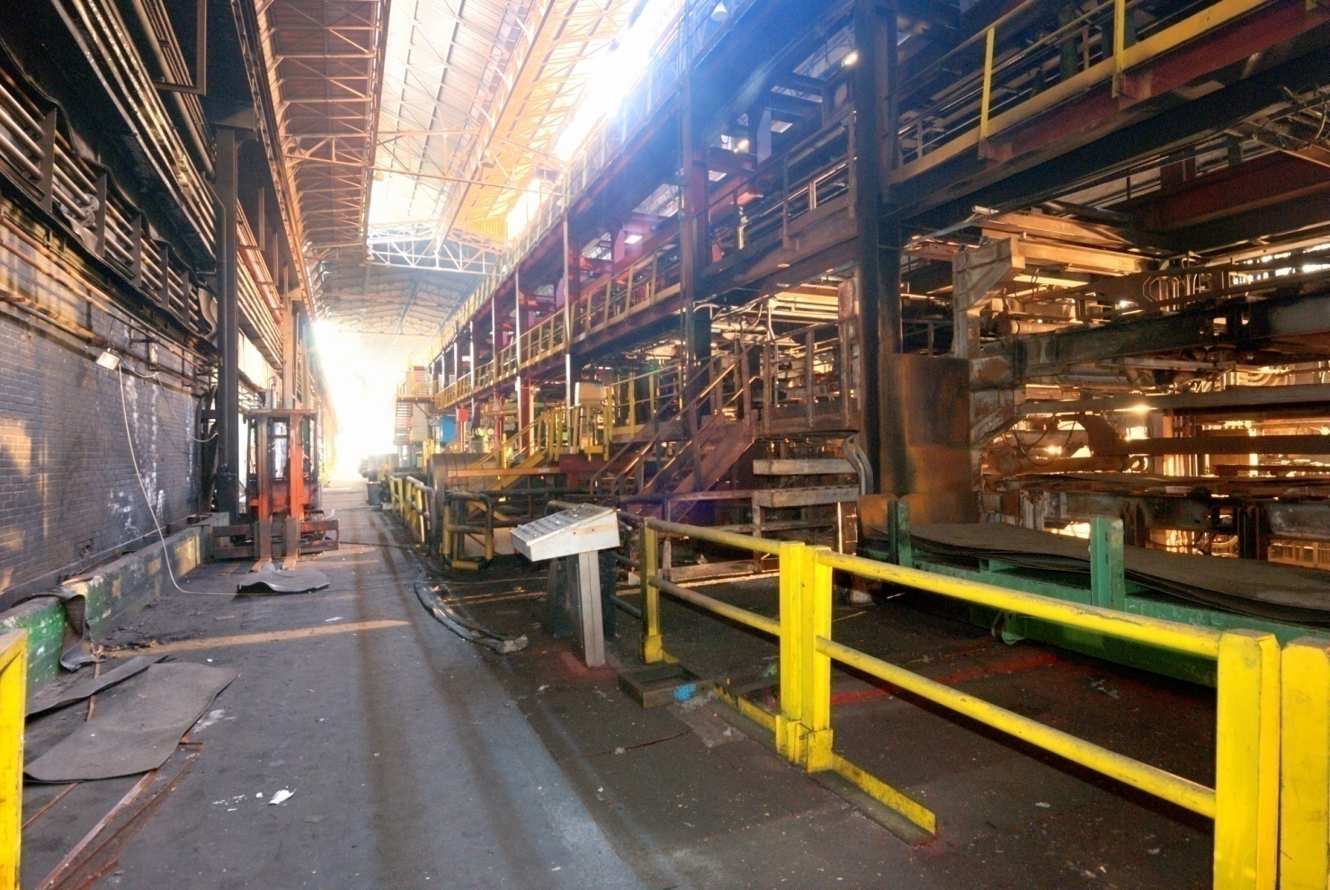
The plant and the process

Slide 8
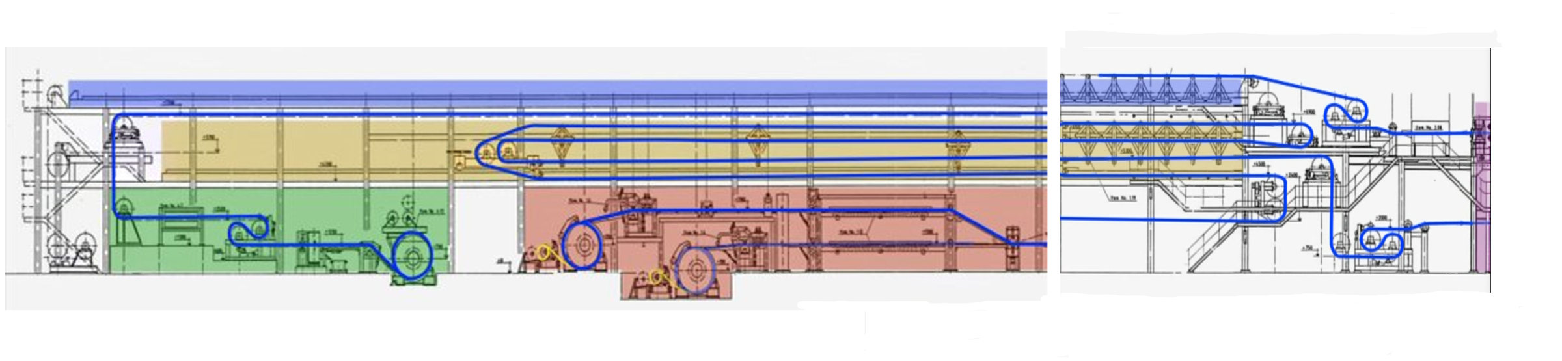
The plant and the process

Slide 9
The plant and the process

Slide 10
The plant and the process
Process and field variables.
Mandrel 1: Coil to process. 350 m of coils have been worked, (from welding position at the end of the chemical section),
Coil width 1500 mm
Mandrel 2: Coil tip close to the welder
Process speed: 21 m/min until decreased to 18 m/min,
Unwind section velocity: +20 m/min

Slide 11
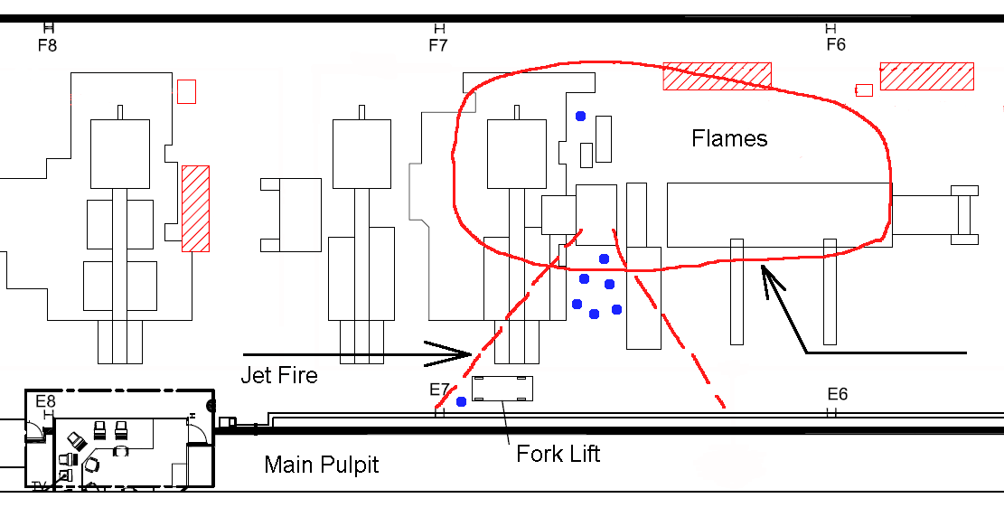
Heat and flame damages

Slide 12
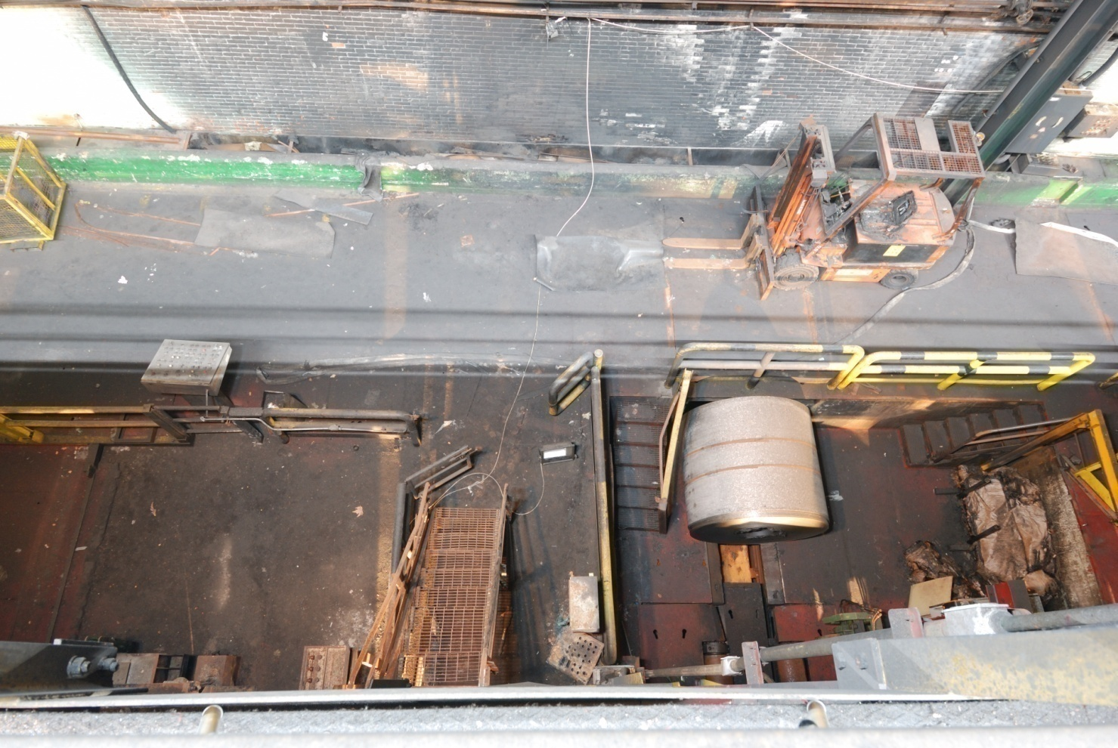
Heat and flame damages

Slide 13
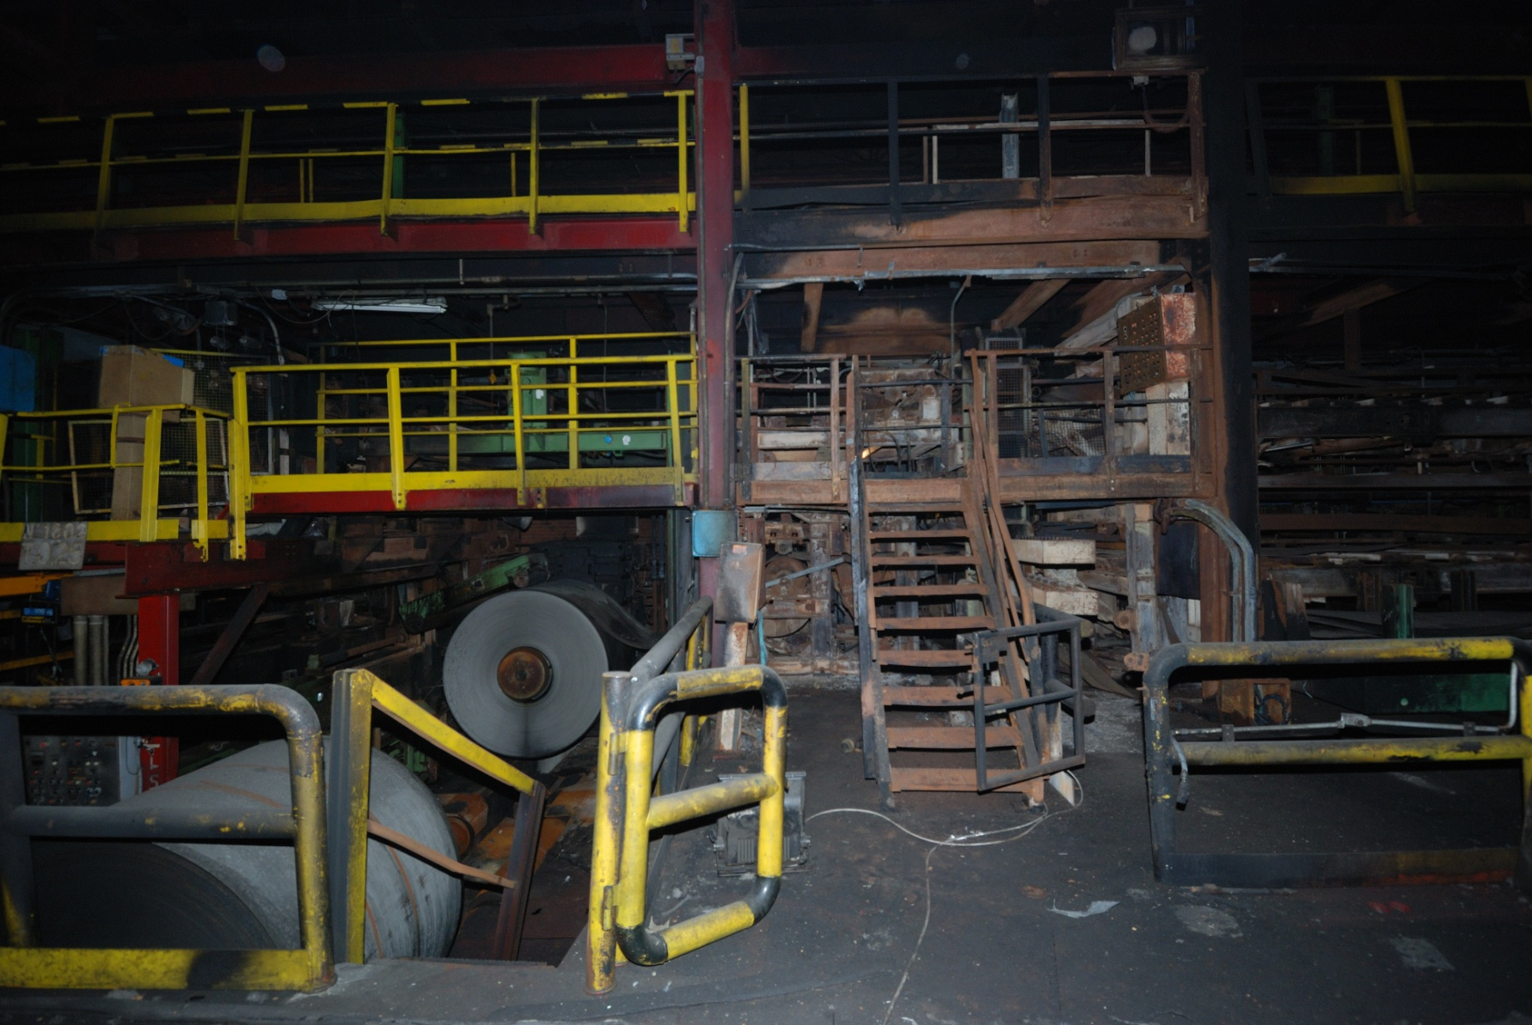
Heat and flame damages

Slide 14
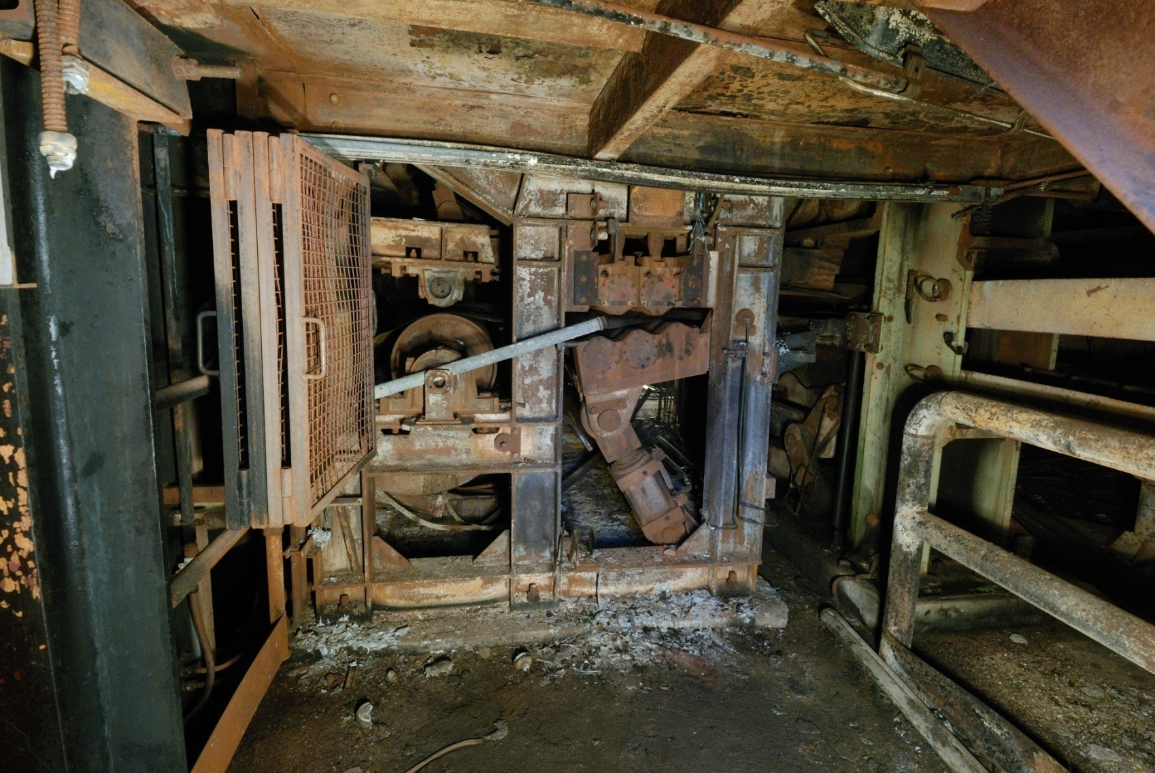
Heat and flame damages

Slide 15
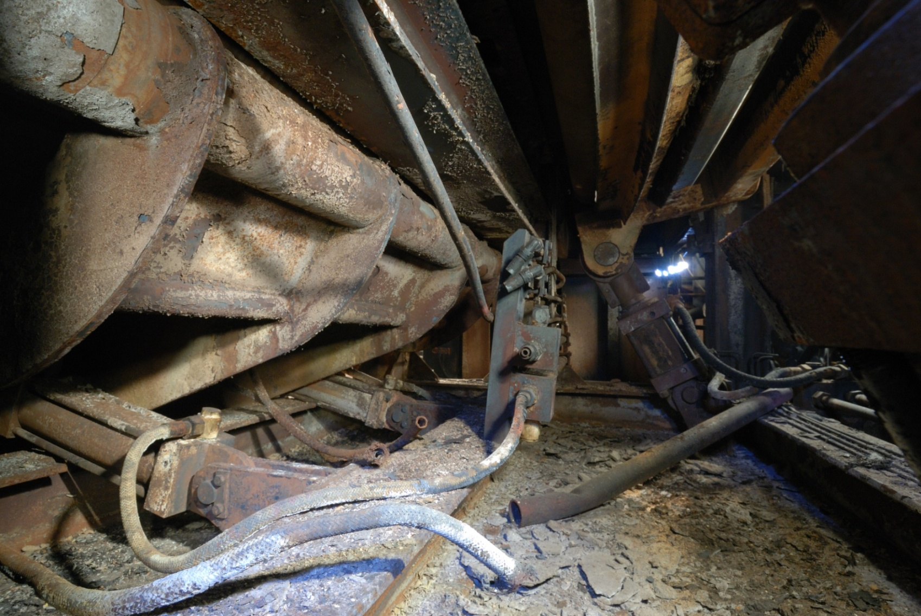
Heat and flame damages

Slide 16
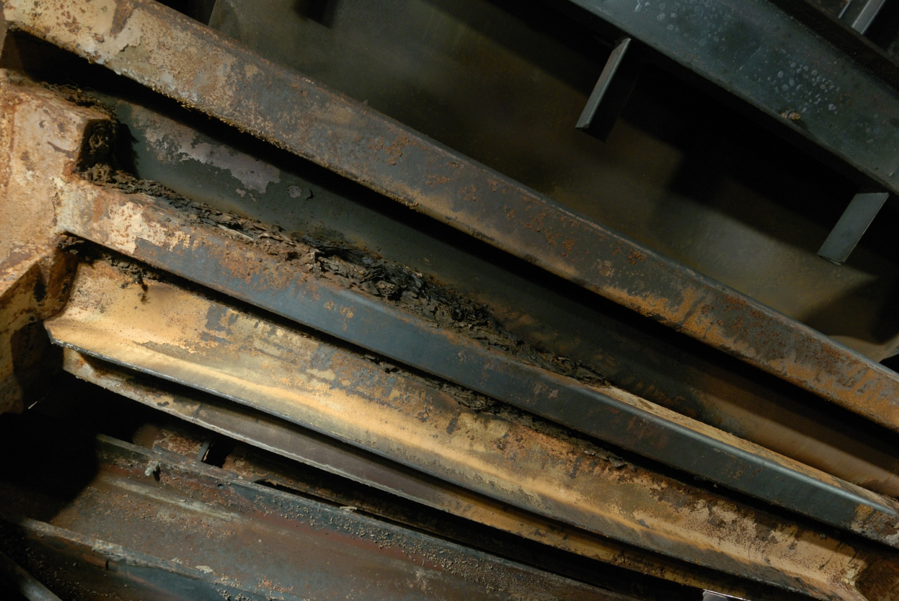
Heat and flame damages

Slide 17
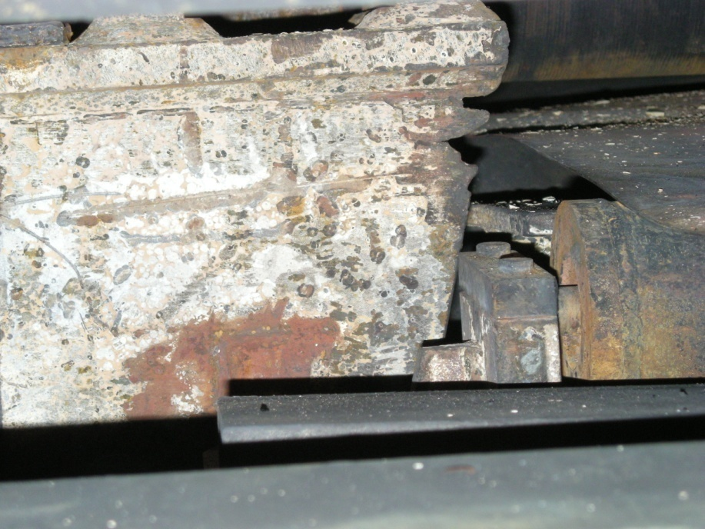
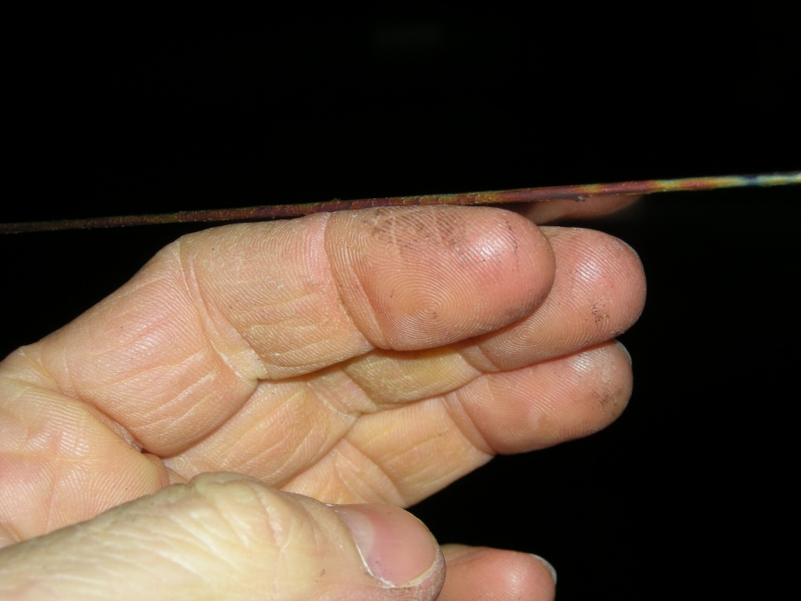
Heat and flame damages
Coil

Slide 18
Witnesses
1 Worker on duty survived (A. Boccuzzi).
Workers started the line at 00.35’,
7 were in the main control room, 1 was at the quality check point,
A worker (coming from check point?) saw a small fire close to flattener N° 2,
All the workers went out from the control room to extinguish the fire with CO₂ fire extinguishers without any success. Flame spread,
Boccuzzi went to the closest fire hydrant,
While he was there, he heard dumb blast and view a “fire wave” of a tenth of meters height coming towards his coworkers and him.

Slide 19
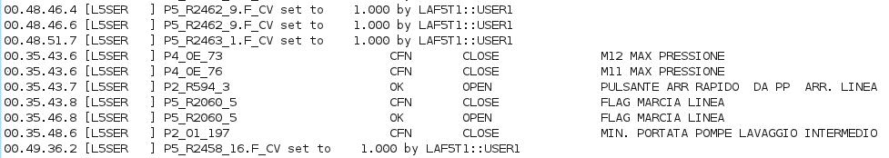
Electronic data collection and analysis
Forensic copies of the HD of the computer hosting the alarm database.
Raw data analysis and synchronization
Definition of coherent groups of events and of the time scale of the event

Slide 20
The time scale of the event
Last note taken by the tester
00.44’09”
Last action from control room 00.45’49”
Field communication failure 00.48’24”
F.1
F.2
Inlet section stop, 00.44’18”
Speed reduction to 18 m/min
00.45’45”
Line start
00.35’46”
Line stop
00.53’10”

Slide 21
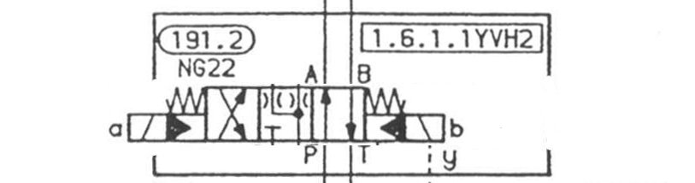
Jet fire causes
From pumps, high P
To pumps, low P

Slide 22

Jet fire causes
Sudden collapse of an hydraulic pipe which was fed by pump station (140 bar).
Ignition by the local fire
Hydraulic oil: Agip LH 46 (FP 220 °C), Fuchs Renolin HTF 46 (FP 202 °C)

Slide 23
CFD for forensic fire scene reconstruction
A specific analysis has been conducted in order to understand the consequences of the accident and the level of risk for the operators. The fire scenario was modeled by means of a specific CFD calculation tool (Fire Dynamics Simulator, generally known as ‘FDS’, which was developed by the Building and Fire Research Laboratory e BFRL e of the U.S. National Institute for Standards and Technology).
CFD is a recognized methodology to estimate the consequences of accidental releases of hazardous chemicals in industrial premises (thermal radiation, temperature rise, presence and extension of flames, smoke production, the dispersion of combustion products, and the movement of those species in the compartment/s under examination.
The well-known NFPA n. 921 standard (2008) recognizes that fire behavior numeric codes play a fundamental role for in-depth analysis in the forensic framework: both simplified routines and zone and field models are explicitly quoted.

Slide 24
Fire scenario reconstruction
NIST, on behalf of the FEMA (Federal Emergency Management Agency) investigated (2002) the danger of the release of flammable liquids in the form of sprays and this danger was also assessed by conducting a number of real tests. Those tests were in fact similar to the activity that was later conducted by the U.S. Navy to test the consequences of the accidental release of hydraulic flammable oil at high pressure at a real
U.S. Navy: danger of hydraulic oil, even for releases of limited quantities of fuel, is described clearly.
The real, full-scale experiments conducted by the U.S. Navy are comparable with the data used by the authors for the simulation of the ThyssenKrupp accident, e.g. a pressure range from 69 bar to 103.4 bar, a released fluid with a combustion heat of 42.7 MJ/kg, and a similar viscosity.
First the authors validated FDS against the experimental results by the U.S. Navy. On this basis, FDS has been employed to reconstruct the accidental release and fire that actually occurred at the ThyssenKrupp plant in Turin.

Slide 25
Fire scenario reconstruction
The simulation activities helped the Authors to describe the consequences of the accident in order to define the real risk for the operators and, subsequently, to:
verify whether the calculated risk level corresponded to the level formally declared by the Owner (in the risk assessments required by law) to the AHJ;
verify whether different scenarios could have exposed the operators to similar risks (e.g. with limited releases, with retarded ignition, etc.).

Slide 26
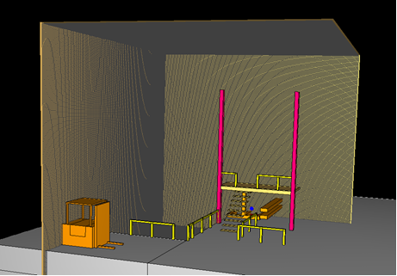

Slide 30
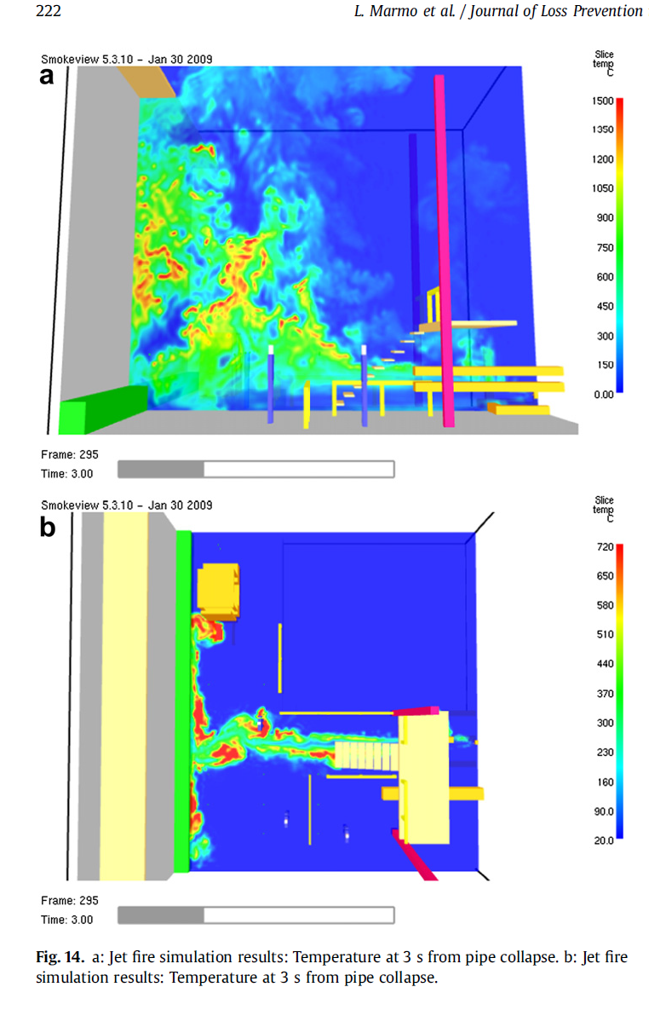
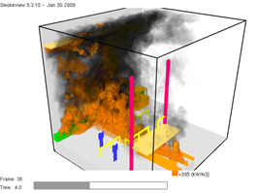
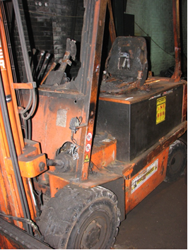
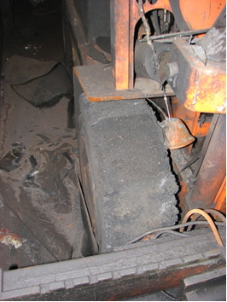

Slide 31
Summary of investigation
Activity | Evidences | Deductions
Site survey | Heat and fire damage, State of the coils, position, Scratching of coil against the carpentry (290 m), Paper spread along the line. Residue of carbonised paper in the area of the flattener. | Area reached by the jet fire, Area reached by the fire, Axial coil position not correct. Shift of coil N° 1 toward the side carpentry, Scratching lasted several minutes Scratching occurred above the flattener, Combustible material in the area.
Documents on Risk analysis | Fire risk evaluation. The area was considered at medium risk according to Italian regulation | No fire detection systems were provided.
Documents examination pertaining to technical description of plants | The complete inventory of the hydraulic circuits involved in the fire. Pipe state at the moment, Circuits working pressure were identified. | The pipe that collapse first one was identified, on the basis of position, direction, and because it was under pressure at normal conditions

Slide 32
Summary of investigation
Activity | Evidences | Deductions
Witnesses | The size and position of the initial fire. The size and shape of the jet fire Fire growth rate (roughly) | Small fire on the flattener at the beginning Fire grew in size after the first attempt to extinguish, Fire extinguishers unfit to control the fire, Sudden jet fire spreading “like a wave”
Electronic data | The time scale of the events | Line start at 00.35’46” Speed reduction by workers at 00.45’45” The PLC lost the sensors located close to the flattener at 00.48’24” Line emergency stop (automatic) at 00.53’10” due to low oil level

Slide 33
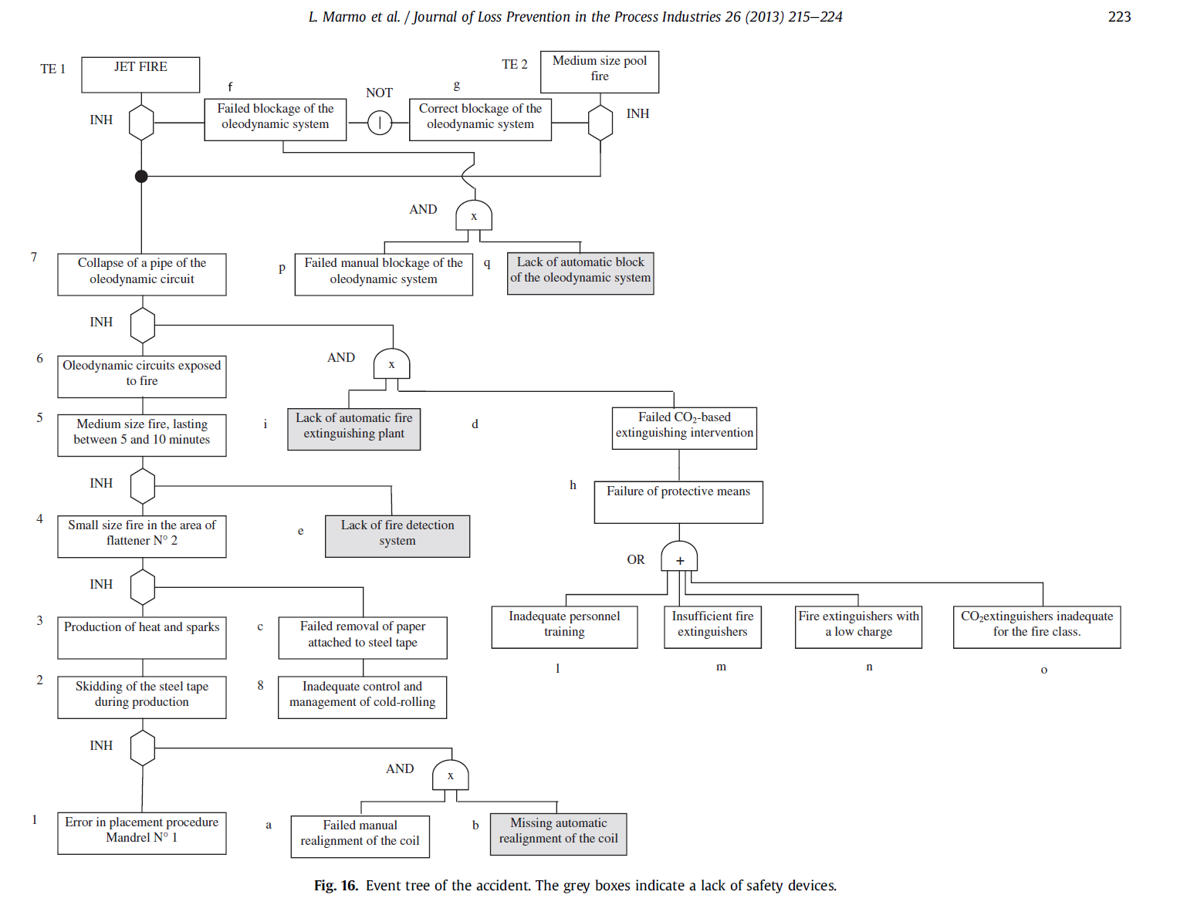
Risk Assessment

Slide 34
Conclusions
Industrial accidents are the result of several causes
In general the responsibilities are shared by different actors
Only when all the root causes have been individuated proper lessons could be learned
CFD simulations as a tool to discern between possible dynamics
Material testing is a necessary tool but…

Slide 35
Considerations from CFD
The jet fire involved the entire area opposite the release point in a direct manner and immediately created a serious risk for the workers that were in the area of interest;
in fact conditions that could have lead to fatalities were recorded almost immediately;
all the reference thresholds for fire thermal radiation were reached in the area (e.g. incident radiant heat, with a value of 200 kW/m², on the wall in front of the release point);
a risk arose from both the direct and non-direct effects of the jet fire and it was also related to the flame extension, thermal radiation and temperature rise in the compartment area;
the combustion of the hydraulic oil was characterized by a huge amount of smoke and soot which worsen the conditions in the area;
the jet was vertically and horizontally fragmented as a result of the impact with the wall (and as a result of the impact with the main plant structures in the area). This fragmentation allowed a flame wall to build up that divided the compartments into two parts (thus creating problems for the emergency procedures) and it determined more serious conditions in the area than a similar jet without the presence of fixed obstacles. The amplitude and the dispersion of the jet was in line with the status of the compartment after the real fire;

Slide 36
the fork-lift shielded a worker located behind it from the effects of the jet fire: this has been confirmed through an evaluation of the damage to the fork-lift itself, which presented different levels of damage on the two sides (the damage is coherent with the shape and effects of the simulated flames);
HYPHOTESIS: the release of hypothetically smaller quantities of hydraulic oil could have exposed the workers who were possibly located at a distance of 15 m to a serious risk (with limited effects compared to the real jet-fire that occurred but which could have significant consequences on people);
HYPHOTESIS: the same considerations were made for a hypothetical flash-fire considering that the reference thresholds were reached in the same area (a distance of 15 m for 0.5LFL from the release point in the case of the release of down to 500 cc of hydraulic oil);
the real conditions could have been judged worse than then the simulated ones because the simulations only considered one single accidental release; it is very probable that the real evolution of the fire involved several subsequent collapses: the simulation of contemporary or slightly delayed releases from different sources would have led to a more significant impact, in terms of consequences for both accidental events (jet fire and flash-fire).

Slide 37
Lessons learned
Coil position control.
The first automatic position control was located some tenths of meters downstream of the payoff mandrel.
Automatic position control is necessary.
Housekeeping.
It was insufficient at the moment of the accident. The fire spread in the early phase is a direct consequence of the presence of paper and oil on site.
Fire load and fire detectors.
No fire detectors in the area.
The reason was that the fire load, according to a “traditional” calculation approach, was negligible. This accident do demonstrate all the limits of such assumption.

Slide 38
Lessons learned
Automatic fire extinguishing systems.
No automatic extinguishing system, which would have limited the worker exposure to the jet fire, was in place.
The presence of workers in the areas where hydraulic circuits are located should be limited as far as possible in the presence of fire.
Emergency stop.
The emergency shutdown of the hydraulic units can lead to the loss of control of the actuators.
Despite this aspect, this episode demonstrate that hydraulic units should be properly shut down when involved in fires.

Slide 39
Lessons learned
Emergency procedure
In the present case the procedure failed to prevent the accident because the fire was not evaluated as of “evident gravity” by the present personnel.
Procedures not involving or at least limiting as far as possible the personnel judgment should be set when huge hazard is detected.
CFD simulation
Precise description of the magnitude of the consequences
Level of hazard posed by different accident scenarios

Slide 40
Thank You
Questions?

