Slide 1
About OMICS Group
OMICS Group International is an amalgamation of Open Access publications and worldwide international science conferences and events. Established in the year 2007 with the sole aim of making the information on Sciences and technology ‘Open Access’, OMICS Group publishes 400 online open access scholarly journals in all aspects of Science, Engineering, Management and Technology journals. OMICS Group has been instrumental in taking the knowledge on Science & technology to the doorsteps of ordinary men and women. Research Scholars, Students, Libraries, Educational Institutions, Research centers and the industry are main stakeholders that benefitted greatly from this knowledge dissemination. OMICS Group also organizes 300 International conferences annually across the globe, where knowledge transfer takes place through debates, round table discussions, poster presentations, workshops, symposia and exhibitions.

Slide 2
About OMICS Group Conferences
OMICS Group International is a pioneer and leading science event organizer, which publishes around 400 open access journals and conducts over 300 Medical, Clinical, Engineering, Life Sciences, Pharma scientific conferences all over the globe annually with the support of more than 1000 scientific associations and 30,000 editorial board members and 3.5 million followers to its credit.
OMICS Group has organized 500 conferences, workshops and national symposiums across the major cities including San Francisco, Las Vegas, San Antonio, Omaha, Orlando, Raleigh, Santa Clara, Chicago, Philadelphia, Baltimore, United Kingdom, Valencia, Dubai, Beijing, Hyderabad, Bengaluru and Mumbai.

Slide 3
The Research on Technological Parameters of Short Forming Process of Ring Parts
LU JIA
School of Materials Science and Engineering
Taiyuan University of Science and Technology,
030024 Tai Yuan, ShanXi, China
jialu19890812@126.com

Slide 4
Contents
1
Introduction
2
Theory & Method
3
Results & Discussion
4
Conclusion
5
Achnowledgements
6
References

Slide 5
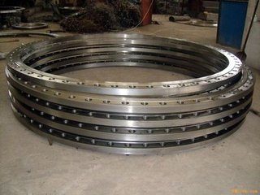
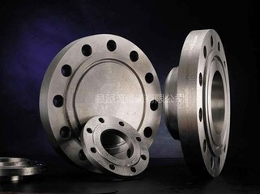
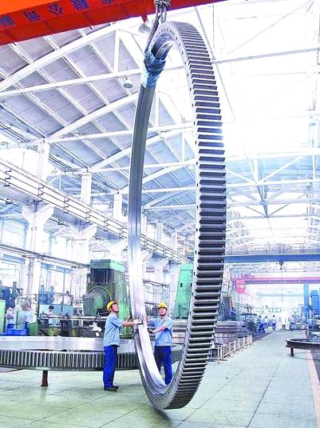
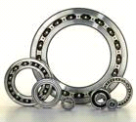
Introduction
Fig.1 Different Size of Flanges

Slide 6
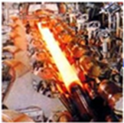
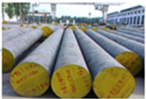
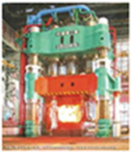
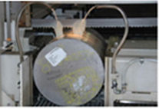
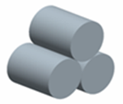
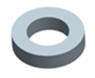
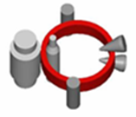
Introduction
Heating
Smelting &Casting
Steel ingot
Cogging
Round bar stock
Heating
Workpiece
Upsetting
Short bar stock
Cutting
Heating
Punching
Punching piece
Hot rolling
Formed part
Fig.2 The Traditional Forming Process

Slide 7
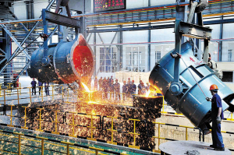
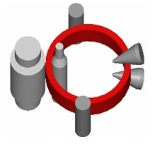
Introduction
Heating
Smelting &Casting
Casting ring blank
Hot rolling
Formed part
Fig.3 Process of Casting-Rolling Continuous Forming
The purpose of research：to obtain main technological parameters of Casting-rolling continuous forming
Notes:
Get main technological parameters of Casting-rolling continuously forming：Casting & heating and hot rolling

Slide 8
Theory & Method
Filling and Solidification
The characteristics of liquid metal
Metal thermal physical properties
Theory
latent heat
Temperature parameters
Stress field
heat transfer
Casting

Slide 9
Theory & Method
Method
Theoretical analysis
JMatPro software
Experiment research
THMS600 heating stage
Numerical modeling
ProCAST software/ ABAQUAS software

Slide 10
Theory & Method
Numerical modeling-ProCAST
Casting temperatures
1520℃、1530 ℃
1540℃、1550℃
Depanning temperature
950 ℃
1050 ℃
1150 ℃
Filling process
Temperature
Stress
Casting
temperature
Depanning
temperature
Parameters in centrifugal casting process

Slide 11
Theory & Method
Micro-organizational change under different heating temperature
Experiment research
THMS600 heating stage
Micro-organizational change under different holding time
Heating temperature
&holding time

Slide 12
Theory & Method
Numerical modeling-ABAQUS
Innitial rolling T
Rolling than
Rotate speed
Hot rolling parameters

Slide 13
Results & Discussion Ⅰ
Ⅰ. The research on smelting & casting
ⅰ.The smelting temperature
Table1 Chemical Composition of 42CrMo Steel（wt，%）
Element | C | Si | Mn | S | Cr | Mo | P
42CrMo | 0.46 | 0.28 | 0.72 | 0.007 | 1.13 | 0.22 | 0.012

Slide 14
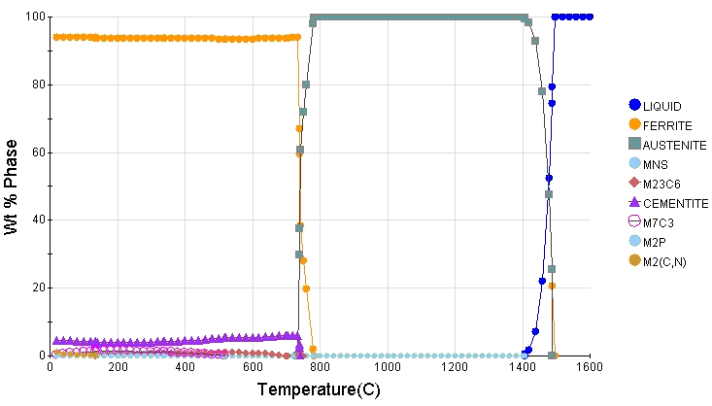
Results & Discussion Ⅰ
Liquid phase temperature： 1488℃
Solidus temperature:
1413℃
Fig.4 Phase Diagram of 42CrMo As-cast Steel Alloy
The smelting temperature is 1700℃

Slide 15
Results & Discussion Ⅰ
ⅱ.The casting temperature
a
浇注温度确定
b
Fig.5 Filling Condition on 7 seconds(a) and 30 seconds(b)
Combined with the practical capacity and the filling condition, the best casting temperature is 1520℃.

Slide 16
Results & Discussion Ⅰ
(1)
ⅲ.The rotational speed of casting mold
（1）
n—— rotational speed of casting mold (r/min)
R——inside radius of mold(m)
G——gravity coefficient
For Φ864mm×Φ530mm×234mm n =480r/min

Slide 17
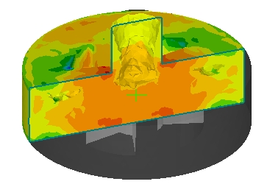
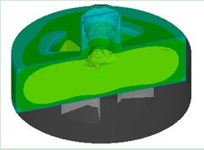
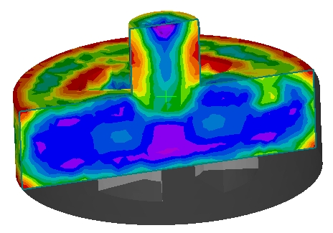
Results & Discussion Ⅰ
ⅳ.The molding temperature
Fig.7 The stress cloud charts before molding at 1050℃
The stress cloud charts after molding at 1050℃
Fig.6 The casting temperature under the mold temperature of 1050℃

Slide 18
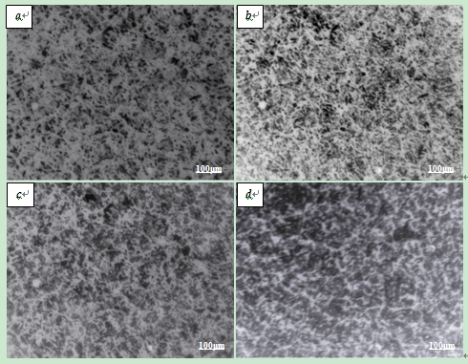
Results & Discussion Ⅱ
Ⅱ. The parameters on heat preservation process
ⅰ.The heating temperature
The microstructure under 1050℃ shows small and homogeneous structure in grains .The casting with this structure will have high strength and excellent comprehensive mechanics performance.
Fig.8 Micro-organizational change under different heating temperature (hold10min)(×500)a）850℃、b）950℃、c）1050℃、d）1200℃

Slide 19
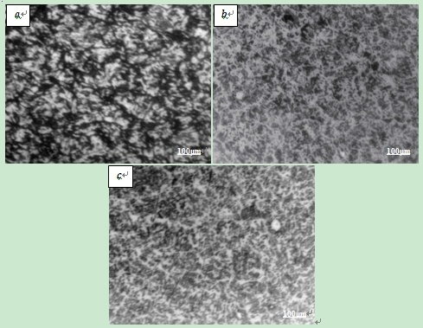
Results & Discussion Ⅱ
ⅱ.The holding time
The microstructure under10min (b) shows the most uniformed grain size in evidence. When keeping for 15min, the size of grains has grown large and the edge of the grains has changed fuzzy.
As a result, the best holding time is 10min, the grain size meets the requirements of hot-rolling.
Fig.9 Micro-organizational change under different holding time(×500)
a）5min、b）10min 、c）15min）

Slide 20
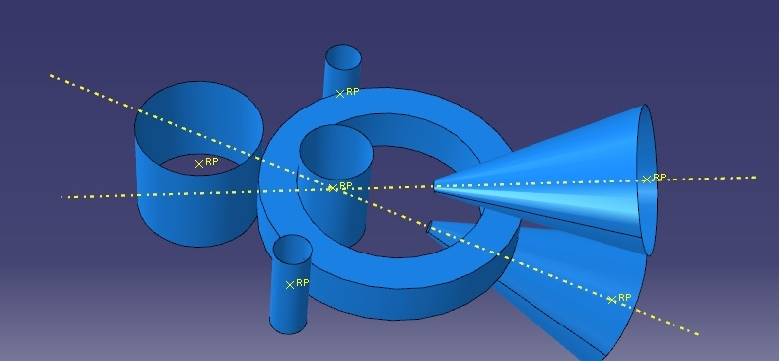
Results & Discussion Ⅲ
Ⅲ. The parameters on hot rolling process
Driving roller
Guide roller
Cone roller
Core roller
Fig.10 Principle diagram of radial-axial ring rolling

Slide 21
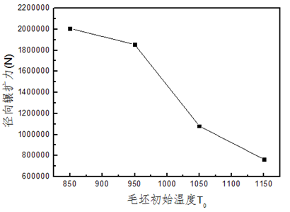
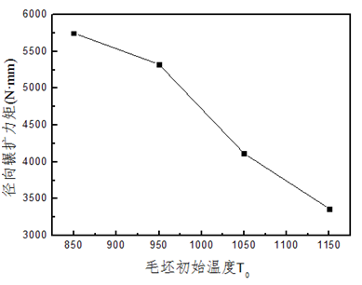
Results & Discussion Ⅲ
ⅰ.The initial rolling temperature
Radial rolling force/N•mm
Radial rolling force/N•mm
Billet initial temperature/℃
Billet initial temperature/℃
（a）The law about rolling force variation （b）The law about rolling torque
Fig.11 The effect of initial temperature on mechanics performance

Slide 22
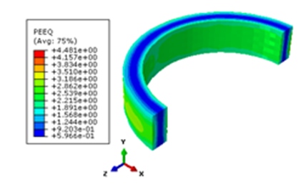
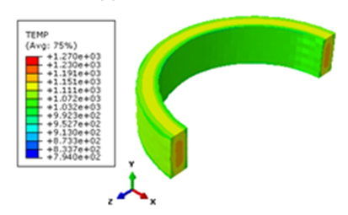
Results & Discussion Ⅲ
ⅰ.The initial rolling temperature
(a)The distribution of equivalent strain (b) The distribution of temperature
Fig 12 The distribution of equivalent strain and temperature under 1150℃
The initial rolling temperature is 1150℃

Slide 23
Results & Discussion Ⅲ
ⅱ.The rolling than
（2）
K —— rolling than
d ——inner diameter of the ring.
Substituting d=1045mm and K is 2.0.

Slide 24
Results & Discussion Ⅲ
ⅲ.The rotate speed of core roller
（3）
（4）
（5）
DK-3500 radial-axial ring rolling machine, set the rotate speed of driving roll 29.2r/min
The rotate speed of core roller is 0.35mm/s~2.57mm/s

Slide 25
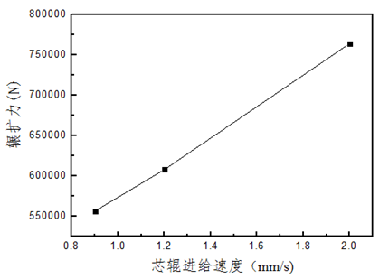
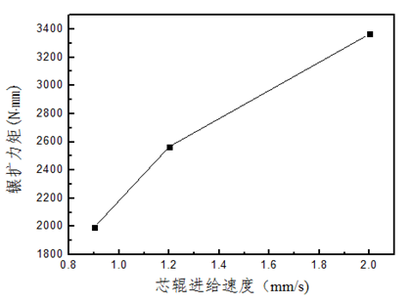
Results & Discussion Ⅲ
ⅲ.The rotate speed of core roller
Rolling force/ N·mm
Rolling force/ N·mm
Feed rate of core roller/ mm/s
Feed rate of core roller/ mm/s
(a)The law about rolling force variation (b)The law about rolling torque
Fig.13 The effect of core roller feeding speed on mechanics performance

Slide 26
Conclusion
The main technological parameters of Casting-rolling continuously forming are as follows:
1. The smelting temperature, casting temperature and molding temperature of 42CrMo alloy are 1700℃, 1520℃ and 1050℃, respectively. The rotate speed of mold cast is 480r/min.
2. The heating temperature is 1050℃ in heat preservation process and preservation time is 30min. The ring cast is heated to rolling temperature of 1150℃at heating rate of 5℃/min and held for 5min.
3. The rolling than is 2 and the range of rotate speed of core roller is 0.35mm/s~2.57mm/s.

Slide 27
Achnoledgements
Key of National Natural Science Foundation of China (51135007)
National Natural Science Foundation of China (51174140, 51075290)
National Natural Science Foundation for the Youth of China (51205270)
Doctoral Program of Higher Education of China (20111415130001)
Shanxi Scholarship Council of China (2011-084)

Slide 28
References
[1] Ma YW. Wang ZH. Liu D. et al. Acta Aeronautica et Astronautica Sinica, 2011, Vol 8, pp. 1555-1562.
[2] Qi HP. Li YT. Hua L. et al. Journal of mechanical engineering, 2014, Vol.50, No.14, pp. 75-80.
[3] Jia L. LI YT. Ju L. Applied Mechanics and Materials, 2014, pp.522-525.
[4] Hou WZ. Cao XG. Xu H. Foundry, 2006, Vol.55, No.10, pp.1047-1051.
[5] Yue WJ. Yang GM. Su C. et al. Foundry,2013, Vol.162, No.7, pp.691-693.
[6] Wang ML. Bearing,2013, Vol.12, pp.19-20.
[7] Hua L. Pan LB. Journal of Plasticity Engineering, 2007, Vol.14, No.5, pp.102-105.
[8] Zhou G. Hua L. International Journal of Mechanical Sciences,2012, Vol.59, pp.1-7.
[9] Han XH. Hua L. Materials and Design, 2014, Vol.58, pp.508-517.
[10] Qian DS. Zhang ZQ. Hua L. Journal of Materials Processing
Technology, 2013, Vol.213, pp.1258-1267.
[11] Jia ZH. The forming principle of liquid metal. BeiJing, Peking
University Press,2011, p25.

Slide 29
References
[12] Guo YN. Li YT. et al Journal of mechanical engineering, 2014,
Vol.50, No.12, pp. 30-35.
[13] WangYJ. Fu JH. et al Casting Forging Welding, 2014, Vol.41,
No.19, pp.50-52.
[14] Jia L. The New Casting-Rolling Continuously Forming of
Large Rings and Process Control Research. [thesis]. Taiyuan:
TaiYuan University of Science and Technology,
July 2014. pp.30-40.
[15] Bao E. Tian SJ. Wang HQ. Heat Treatment Technology and
Equipment, 2008, Vol.29, Vo.2. pp.53-55.
[16] Jia F. Research on Hot Deformation Behavior and
Microstructure-Properties of As-cast Ring Pieces during
Casting-Rolling Forming Process. [thesis]. Taiyuan: TaiYuan
University of Science and Technology, July 2011.pp.25-40
[17] Li YT. Qin FC. Qi HP. Method for determining dimension of
ring casting-rolling combined formed blank.Chinese patent:
CN102886473B.

Slide 30
Thank You !
LU JIA
jialu19890812@126.com

