Slide 1
Cancer Stem Cell Markers in Lung Cancers: Proofs of Concepts and Some Reservations
Lourdes Cortes-Dericks, PhD
University of Hamburg
Hamburg, Germany
Notes:
Before I start with my presentation, I would like to thank the organizers for giving me the opportunity to present this morning. Today, I would like to share with you the success of utility of cancer stem cell markers and some precautions in its application based on our studies.

Slide 2
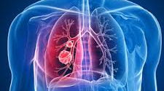
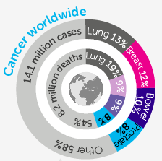
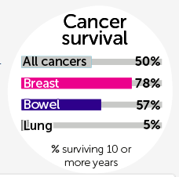

Lung cancer: highest death rate and poorest patient survival
2012
2012
Prepared by:
Notes:
I would like to start by showing some statistics on lung cancers which are not very amusing but rather will reveal the importance of lung cancer research. Based on the statistics of 2012 and even at present, lung cancers have the highest no of after diagnosis and even after an appropriate therapy. This is not a good prognosis, considering that breast and bowel cancers have already achieved a survival rate of more than 50%.
Lung cancer is still the leading cause of death worldwide, accounting for 8.2 million deaths in 2012 (1). Cancer of the lung is the most common form , claiming the lives of 1.59 M people and a reported 1.8 M new cases in 2012. Looking at this data, there`s still a lot of room to look for new therapeutic approaches to reduce the mortality in lung cancer. death rate of 0.532 M in 2012.

Slide 3

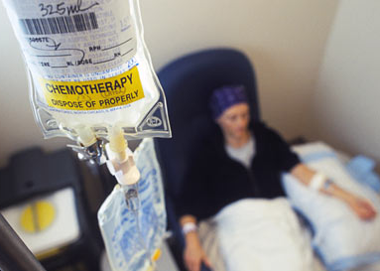
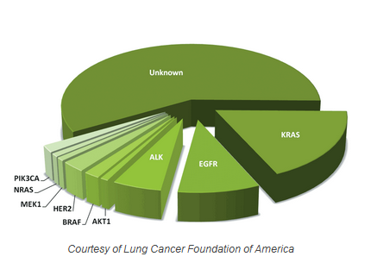
Current Treatment Modalities in Lung Cancers
Surgery &chemotherapy
Chemotherapy alone,
or combined with radiotherapy
Standard therapy
Non- small-cell lung cancer
Targeted therapy
ALK- Anaplastic lymphoma kinase
EGFR- Epidermal growth factor receptor
KRAS - Kirsten rat sarcoma viral oncogene
Lung Foundation of America
Notes:
The combination of surgery and chemotherapy or chemotherapy alone or in combination with radiotherapy are the standard methods in the treatment of lung cancers. Some improvement in lung cancer treatment has been accounted for the application of the so-called targeted treatment (patient specific treatment) in which specific molecules are eliminated by pharmacological inhibition. Which has been combined with the standard treatment modalities. Inspite of this, effective targeted therapy has still to be developed and more mutated molecules have to be identified.
In presence of EGFR mutation negative or unknown status, patients with advanced squamous NSCLC, with good performance status (PS) and without major co-morbidities, chemotherapy with third-generation regimens containing cisplatin is the recommended treatment. In non-squamous NSCLC patients, also cisplatin plus pemetrexed and platinum-based chemotherapy plus bevacizumab should be considered. Carboplatin is a valid option for patients unsuitable for cisplatin. Maintenance therapy with pemetrexed or erlotinib is a reasonable choice if allowed by reimbursement procedures and discussed with patients. Elderly patients, defined as ≥ 70 years old, should receive third-generation
For example, patients with epidermal growth factor receptor (EGFR) mutation, EGFR inhibitor is recommended as first-line treatment. For second-line treatment, two cytotoxic the standard drugs, (docetaxel and pemetrexed), the latter only in non-squamous tumours), EGFR inhibitor, erlotinib and gefitinib, are available. While a number of mutated molecules have been identified in lung cancers, effective targeted therapies is still to be developed and more mutated molecules have to be identified.
In presence of EGFR mutation negative or unknown status, patients with advanced squamous NSCLC, with good performance status (PS) and without major co-morbidities, chemotherapy with third-generation regimens containing cisplatin is the recommended treatment. In non-squamous NSCLC patients, also cisplatin plus pemetrexed and platinum-based chemotherapy plus bevacizumab should be considered. Carboplatin is a valid option for patients unsuitable for cisplatin. Maintenance therapy with pemetrexed or erlotinib is a reasonable choice if allowed by reimbursement procedures and discussed with patients. Elderly patients, defined as ≥ 70 years old, should receive third-generation single-agent chemotherapy, but in elderly patients with good PS, without major co-morbidities and with adequate organ function, platinum-based doublets with attenuated doses can be a valid option. In PS 2 patients, single-agent third-generation drug is a reasonable choice. Combination chemotherapy with carboplatin or low doses of cisplatin is a suitable alternative. For second-line treatment, two cytotoxic drugs (docetaxel and pemetrexed, the latter only in non-squamous tumours), and erlotinib, an EGFR inhibitor, are available. There are no strong data to help the choice between chemotherapy and erlotinib.

Slide 4
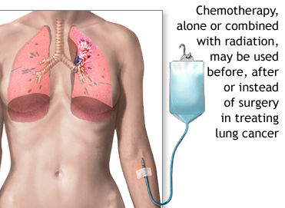
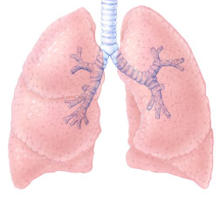
Cancer stem cells within lung tumour are crucial players in cancer therapy
Chemotherapy
Induces cell death and reduction of tumour bulk
Drug resistance leads to recurrence or
death
Cancer stem cells (CSCs)
Self-renewal
Generate phenotypic heterogeneity
Tumorigenicity in immunocompromised mice
Chemoresistance
Drugs that kill tumour stem
cells
CSC
Tumour looses ist ability to
generate new cells
Drugs that kill tumour cells but not cancer stemcells
CSC
CSC
Tumour regeneration
CSC
Tumour degeneration
Reya T, et. al.,Nature 414, 105-111(2001)
Notes:
While chemotherapy is often capable of inducing cell death in tumors and reducing the tumor bulk, many cancer patients experience recurrence and ultimately death because of treatment failure. There is a strong concensus that cancer stem cells (CSCs) are supposedly responsible for the failure of current chemotherapy of lung cancer. Because of their property of being chemoresistant.
What make these cells notorious is that the fact that they can escape the standard therapy and regenerate the bulk of the tumor if not specifically targeted the reason why they are also known as tumour-initiating cells. Ideally, there should be more biomarkers which can identify specific features of these cells so that they can be targeted which may lead to a complete eradication of tumour.
Anumber of mechanisms of chemoresistance have been identified in CSCs.

Slide 5
Our goal…
To identify cancer stem cell markers that are involved in the initiation, progress and drug resistance in lung cancers.
Notes:
Our goal is to identify cancer stem cell markers that are involved…..

Slide 6
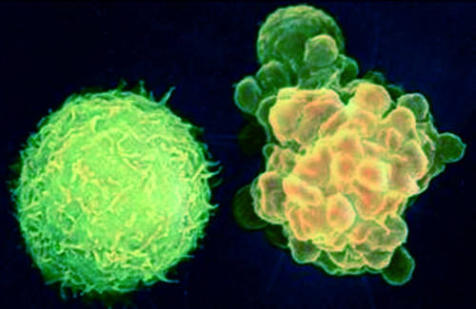
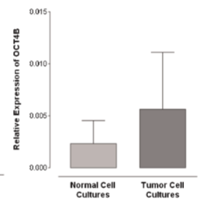
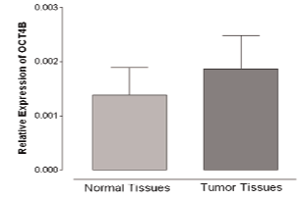
Increased OCT4B levels in lung tumor tissues
OCT4B
Normal cell
Apoptotic cell
Relative expression of OCT4B
Relative expression of OCT4B
Normal
cell cultures
Lung
adenocarcinoma-derived cell cultures
Normal
tissues
Lung
adenocarcinoma tissues
OCT4B – octamer-binding transcription factor 4B
Karoubi G, Cortes-Dericks L et al. Journal of Surgical Oncology. 11/2010; 102(6):689 - 698.

Slide 7
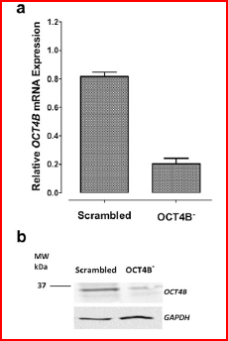
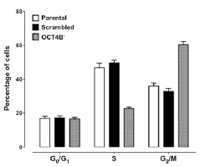
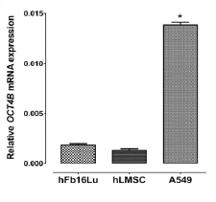
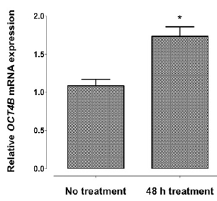
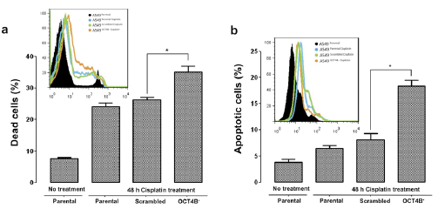
Suppression of OCT4B sensitizes lung adenocarcinoma cells to cisplatin treatment
Silencing of OCT4B
Cell cycle analysis
*
*
*
*
*
No treatment
48 h cisplatin
A549
No treatment
48 h cisplatin treatment
No treatment
48 h cisplatin treatment
OCT4B – octamer-binding transcription factor 4B
A549 – lung adenocarcinoma cell line;
hFb16lu – normal lung fibroblasts;
hLMSC – human lung mesenchymal stem cells
Parental
Parental
Scrambled
OCT4B⁻
Parental
Parental
Scrambled
OCT4B⁻
Cortes-Dericks L et al.
Anticancer Res. 2013 Dec;33(12)
Notes:
I`m going to start with OCT4B - OCT4B is a splice variant of OCT4 whose primary function is to maintain pluripotency and self-renewal in embryonic stem cells. Going back to OCT4B, So far, the only function associated with this OCT4B is that an overexpression results to increased resistance to apoptosis .In one of our studies we detected hihg expression levels of OCT4B in lung tumour tissues. So here, we investigated the expression level of OCT4B in a LAC cell line 2 normal cell lines, and after cisplatin treatment, a standard component in LAC treatment. OCT4B is not only significantly increased in the LAC cell line but also increased after cisplatin treatment, indicating a particular role in drug resistance. We though that if we silence OCT4B, we might be able to reveal some essential functions of this molecule in protecting the cells against the cisplatin treatment. The suppression of OCt4B resulted in a marked transition of cells from dormant Go/G1 phase to G2/M; the 48-h cisplatin treatment in the OCT4B- cells also resulted to a high frequencies of dead and apoptotic cells. From these data, we could show that 1) OCT4B protects LAC cells from apoptosis; 1) silencing of OCt4B confers sensitivity to cisplatin treatment via cell cycle regulation – resulting to increased cell proliferation, which make the cells more suceptible to the cisplatin-induced apoptosis.

Slide 8
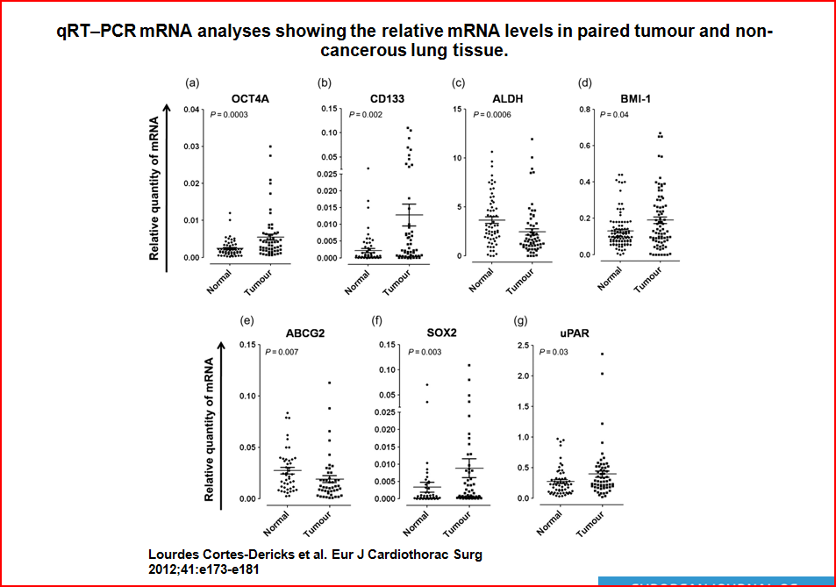
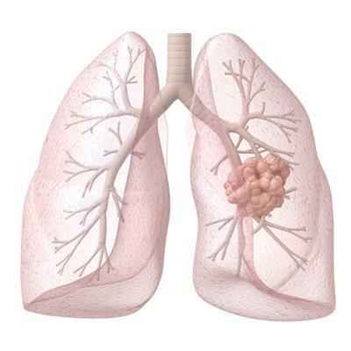
mRNA levels of CSC-associated genes in paired normal and lung adenocarconoma biopsies
Tumor tissue
Normal tissue
n – 64
male - 34
female - 30
median age – 62
Cortes-Dericks L et al. Eur J Cardiothorac Surg (2012) 41 (6)
Notes:
This is an interesting study where we investigated the pattern and expression levels of 7 CSC-associated genes in paired tumour and nontumour biopsies meaning that the normal tissue counterpart was taken 10 cm away from the tumor. The biopsies were obtained from the biggest cancer lung centre in Italy with whom our group has been collaborating. Immediately after lung resection, the tissues were preserved in RNA later and were then transported to Switzerland where the samples were analysed by RT PCR analysis in which the expression levels of selected CSC-associated genes were compared between tumor and nontumor tissues. The tumor tissues contain significantly higher frequencies in all of the tested CSC genes compared to the corresponding normal tissues.
European Institute of Oncology, Milan Italy

Slide 9
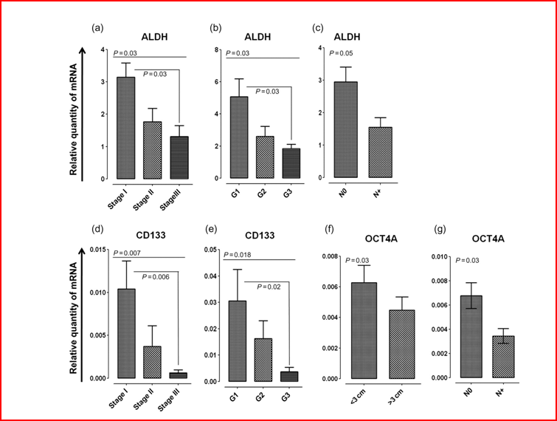
mRNA levels of ALDH, CD133 and OCT4A decreases with increasing tumor stage
Stage 1-3, tumor stage
G1 -3, tumor grade
< / > 3 cm, tumor size
NO/N+, lymph node metastasis
Cortes-Dericks et al. Eur J Cardiothorac Surg (2012) 41 (6)
Notes:
Within this study, we obtained data which showed that mrna levels of aldh, cd 133 and oct4a significantly decreases with increasing tumor stage, indicating a critical role in the initiation of lung adenocarcinoma rather than in the progress of the disease.

Slide 10
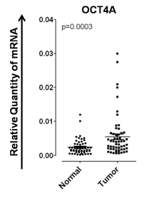
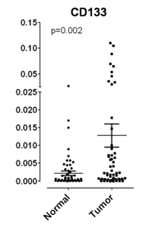
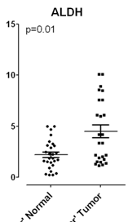
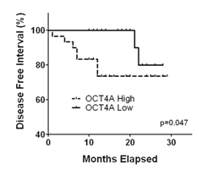
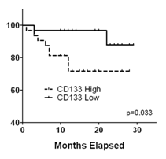
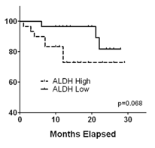
Increased CSC-associated gene profiles correlate with reduced disease-free intervals in lung adenocarcinoma
*
*
Notes:
One of the significant observations we obtained from this study is the correlation of increased levels of levels of Oct4a, CD133 and ALDH with a reduced disease-free interval for these patients compared to those patients with low frequencies of the 3 markers. The median survival was 13 months. Therefore these genes may be used as a prognostic markers in LAC. We evaluated the patient within a period 29 months after chemotherapy. These 2 projects motivated us to set up a study to enriched a subpopulation of drug resistant cells using cancer stem cell markers.

Slide 11
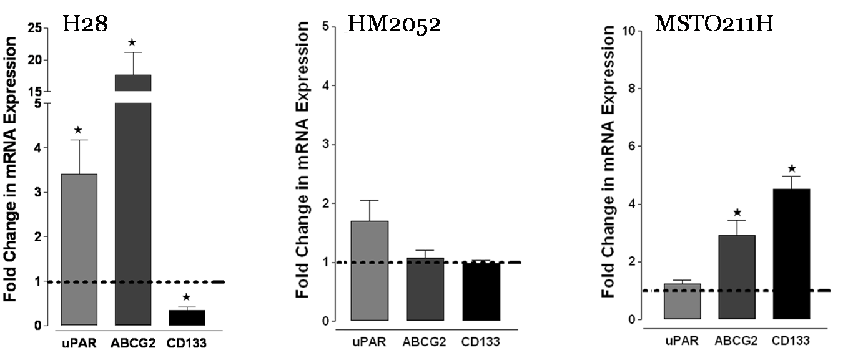
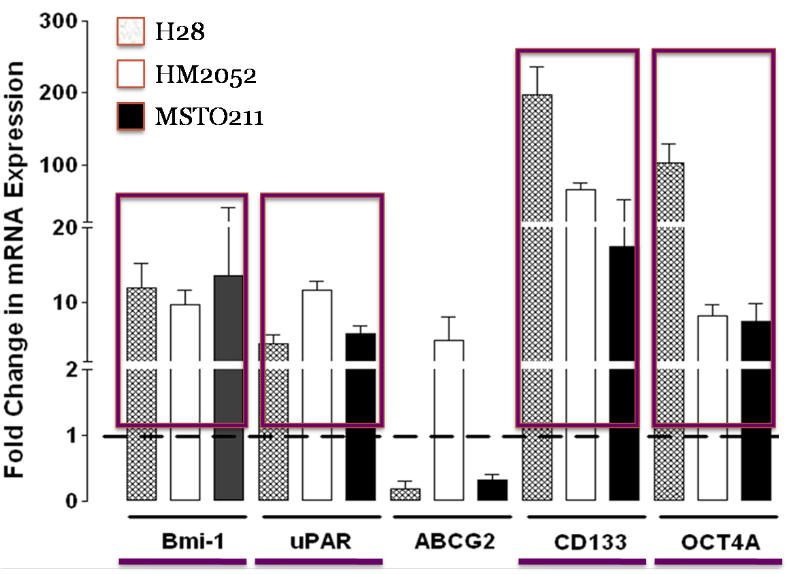
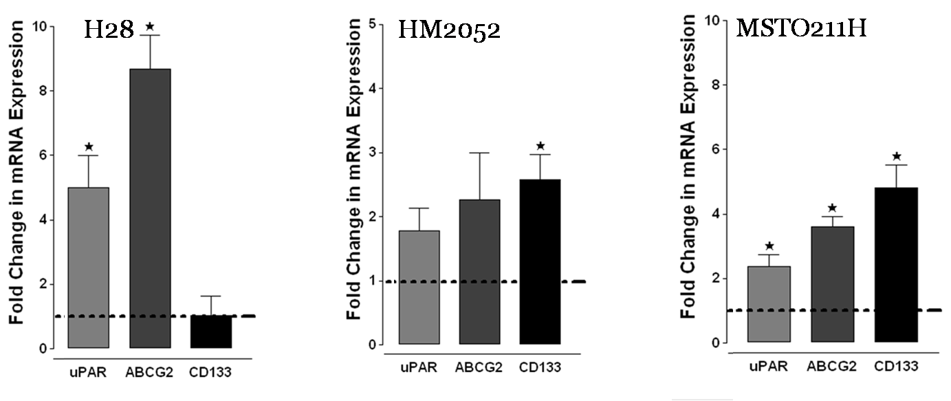
mRNA levels of CSC-associated genes are increased in drug-resistant cells in malignant pleural mesothelioma
Increased levels of uPAR, ABCG2 and CD133 in cisplatin –resistant cells
Enhanced expression of CSC markers in MPM cell lines compared to non-malignant mesothelial Cells
Pemetrexed-resistant cells
H28, H2052, MSTO211H – malignant pleural mesothelioma cell lines
MPM- malignant pleural mesothelioma
Cortes-Dericks L, et al.
Int J Oncol. 2010 Aug;37(2)
Notes:
In a separate project, we observed that malignant pleural mesothelioma cell lines basically express high levels of cancer stem cell-associated markers such as uPAR, ABCG2, CD133 and OCT4A. compared to normal mesothelial cells which is represented by the broken lines.
What I would like to highlight in this study, is that the cells which escaped cisplatin and pemetrexed treatments showed moderate to significantly increased mrna levels of the cancer stem stem cell-associated genes highly indicating the presence of a drug-resistant CSC subpop. Another interesting point is that the expression profiles of the CSC-associated genes varies with the type of the cancer type and the drug used in this study.

Slide 12
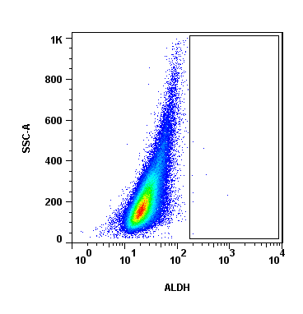
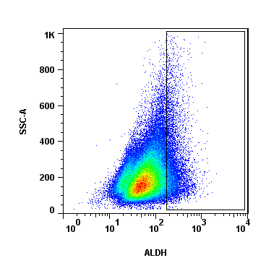
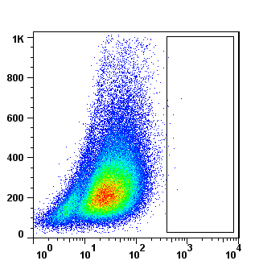
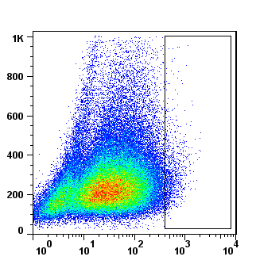
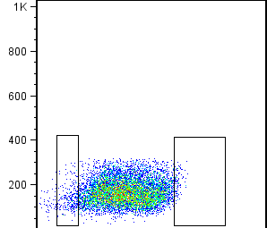
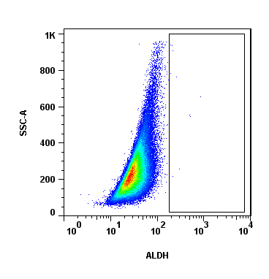
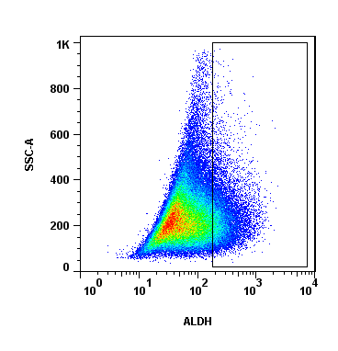
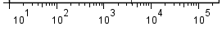
Reliability of ALDH to demarcate a CSC from non-CSC subpopulation in malignant pleural mesothelioma cells
ALDH activity
H28
+DEAB
0.02%
- DEAB
4.15%
FACS-based ALDH cell sorting
H2052
H2052
0.01%
1.0%
ALDH^{low}
ALDH^{high}
2.5 %
1.1 %
Meso4
Side scatter (SSC-A)
0.01%
12.5%
ALDH
FACS – fluorescence activated cell sorting
H28, H2052, Meso4 – mesothelioma cell lines
ALDH – Aldehyde dehydrogenase
Notes:
In another project, we tested the reliability of ALDH another established CSC marker to demarcate a CSC from a CSC subpop. Because these MPM cell lines express contain ALDH activity, we thoûght that sorting for ALDH + cells will allow the demarcation between CSC and nonCSC subpopulations in MPM cell lines. Separating the two populations will therefore allow us to study the chemoresistance properties of the enriched CSC subpopulations.

Slide 13
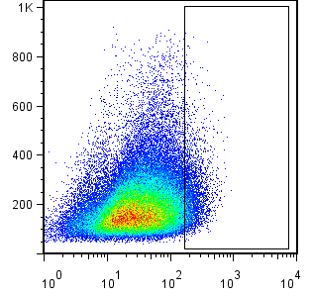
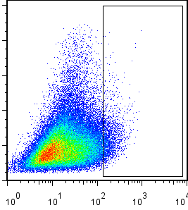
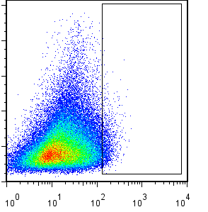
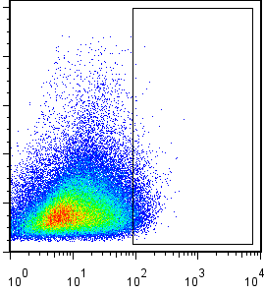
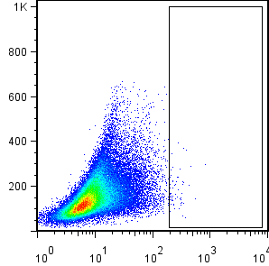
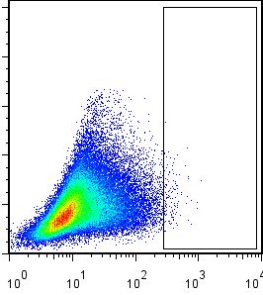
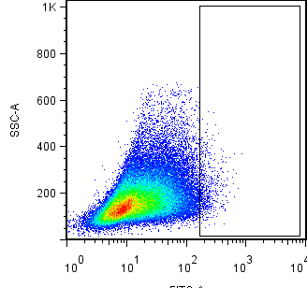
Phenotypic generation of ALDH-sorted cells
FACS-based sorted H2052
ALDH^{low}
ALDH^{high}
2.5 %
1.1 %
ALDH^{high} cells
P1
P2
P3
P4
3.5 %
3.7 %
2.9 %
3.1 %
ALDH^{low} cells
Side scatter (SSC-A)
0.14 %
0.92 %
1.2 %
1.2 %
ALDH
P1 to P4– cell passages
H2052- mesothelioma cell line
Cortes-Dericks L et al.
BMC Cancer. 2014, 14:304
Notes:
We were surprised to see that when we cultured the ALDH-sorted cells over 4 passages, to test the maintenance or expression of ALDH activity, we observed that the ALDH^{low} cells were also able to repopulate ALDH+ cells although at a lesser efficiency compared to the ALDH^{high}-sorted cells – demonstrating that the ALDH^{low} cells are also capable of generating ALDH+ cells. The ALDH^{low} cells and a much lower capacity of the ALDH^{low}-sorted cells showed multilineage differentiation, and an ability to preserve ALDH activity up to the fourth passage.
we found significant 4.4, 4.0 and 1.9 - fold increases in the ALDH^{high}-sorted H28, H2052 and Meso4 cell lines respectively.

Slide 14
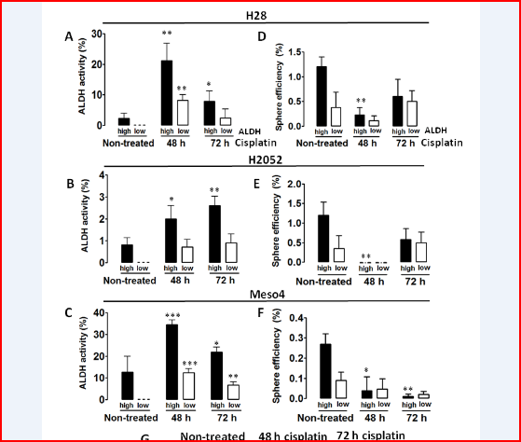
Both ALDH^{high} and ALDH^{low} subpopulations contain cisplatin-resistant tumor spheres
H28
Non-treated
48 h cisplatin
72 h cisplatin
H2052
H2052^{high}cells
H2052^{low}cells
Meso4
Cisplatin - cisdiamminedichloroplatinum(II)
Sphere-formation – basic property of putative cancer stem cell population
Notes:
We also investigated the effect of cisplatin on the sphere-forming cells of the ALDH-sorted fractions as the generation of spheres after drug treatment would reflect the presence of drug-tolerant CSCs. After 48- and 72-h treatments with cisplatin, surviving cells were collected and incubated in a sphere-permissive medium. The 48-h drug treatment reduced or eliminated the sphere-forming cells, but surprisingly, we observed a re-growth of spheres after the 72-h of cisplatin treatment in both ALDH-sorted fractions. Thesellse are representative pictures of the sphere formation of H2052 cell line before and after treatments with cisplatin.
One of the properties of cancer stem cells is the state

Slide 15
Conclusions
Cancer stem cell marker is not universal to any type of cancer.
Personalized therapy – identification of CSC markers in patient`s clinical specimens before and after therapy may lead to specific targeting of drug-resistant subpopulation.
Notes:
Although we could show that cancer stem cell markers can predict some oncogenic roles and conveying drug resistance in lung cancers, we also found that stem cell markers are not universal to any type of cancer. Some markers may not function as an indicator to identify CSC subpopulation; which has been proven to be a reliable marker in other types of cancer. Even within the same type of cancer, patients response differently to these markers.
For a successful PT, specific CSC markers should be detected in clinical specimens before and after therapy to be able to evaluate the reliability of the markers in the context of cancer therapy.
We have to identified phenotypically defined targets in clinical specimen which may be specifically targeted to eliminated a drug-resistant population. Before I finally wind up, I would like to thank you for your attention and also to my former colleagues and the swiss cancer foundation for supporting the presented projects.

Slide 16
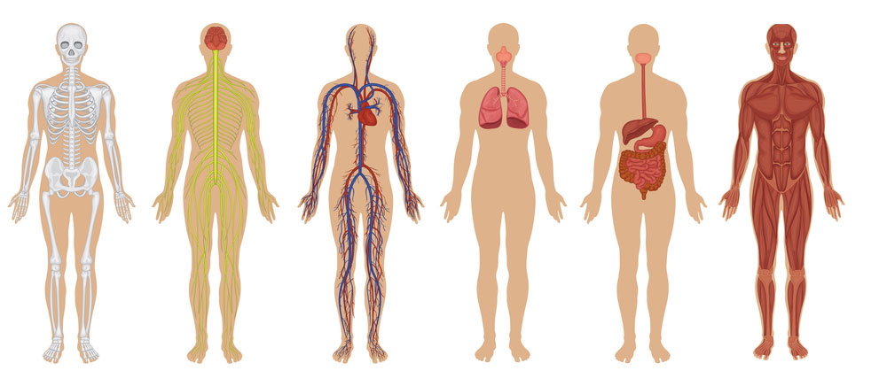
Tracking patient-specific cancer stem cells
Before chemotherapy
Blood/Biopsy /Pleural effusion
  Cancer markers i.e. mesothelin in mesothelioma
  Molecular features of CSCs
Chemotherapy
Tumor /molecular imaging of cancer cells
  Micro-PET
  MRI
  CT
CSC
Micro-PET – micro positron emission tomography
MRI – magnetic resonance imaging
CT – computed tomography
Notes:
Tracking of specific CSCs using CSC markers in lung cancer is already a reality. In mesothelioma, levels of mesothelin in pleural effusions and serum serves as one of the standard methods in the diagnosis of mesothelioma just like PSA in prostrate cancer, BRR-ABL in AML etc- Non-invasive molecular imaging is an effective and novel approach to visualize living cells in vivo.This includes micro-PET ( micro-positron emission tomography), cell tracking with magnetic resonance imaging , MRI; quantitativee fluoresence-based optical imaging of mouse xenografts. Bioluminiscence imaging as few as 10 CD44+ cells of stably labelled breast cancer cells could be tracked. KRAS, EGFR, mutations (tissue) , Cytokeratin fragments 21-1, mutation, Alk gene rearangements
Molecular imaging will allow clinicians to not only see where a tumor is located in the body, but also to visualize the expression and activity of specific molecules (e.g., proteases and protein kinases) and biological processes (e.g., apoptosis, angiogenesis, and metastasis) that influence tumor behavior and/or response to therapy. This information is expected to have a major impact on cancer detection, individualized treatment, and drug development, Imaging (especially computed tomography [CT], magnetic resonance imaging [MRI], and positron emission tomography [PET]) plays an important role in determining the pretreatment clinical staging (TNM or cTNM). This clinical classification is a critical step in selecting and evaluating treatment. The pathological (postsurgical histopathological) classification (pTNM) is more precise in defining prognosis.

Slide 17


Thank you for your attention
Department of Clinical Research
Division of General Thoracic Surgery
University Hospital Bern
Division of General Thoracic Surgery
European Institute of Oncology, Milan Italy
Department of Molecular Genetics, Faculty of Biological Sciences, Tabiat Modares University, Teheran Iran
Golnaz Karoubi, Ralph Alexander Schmid, Giovanni L. Carboni, Domenico Galetta, Lorenzo Spaggiari, Ehsan Farashahi Yazd, Seyed J. Mowla, Laurene Froment, Ruben Boesch

