Slide 1
About OMICS Group
OMICS Group International is an amalgamation of Open Access publications and worldwide international science conferences and events. Established in the year 2007 with the sole aim of making the information on Sciences and technology ‘Open Access’, OMICS Group publishes 400 online open access scholarly journals in all aspects of Science, Engineering, Management and Technology journals. OMICS Group has been instrumental in taking the knowledge on Science & technology to the doorsteps of ordinary men and women. Research Scholars, Students, Libraries, Educational Institutions, Research centers and the industry are main stakeholders that benefitted greatly from this knowledge dissemination. OMICS Group also organizes 300 International conferences annually across the globe, where knowledge transfer takes place through debates, round table discussions, poster presentations, workshops, symposia and exhibitions.

Slide 2
About OMICS Group Conferences
OMICS Group International is a pioneer and leading science event organizer, which publishes around 400 open access journals and conducts over 300 Medical, Clinical, Engineering, Life Sciences, Phrama scientific conferences all over the globe annually with the support of more than 1000 scientific associations and 30,000 editorial board members and 3.5 million followers to its credit.
OMICS Group has organized 500 conferences, workshops and national symposiums across the major cities including San Francisco, Las Vegas, San Antonio, Omaha, Orlando, Raleigh, Santa Clara, Chicago, Philadelphia, Baltimore, United Kingdom, Valencia, Dubai, Beijing, Hyderabad, Bengaluru and Mumbai.

Slide 3
In situ NMR and STD NMR to Study Mechanisms of Enzyme Catalyzed Reactions to Optimize Use of Enzymes in Organic Synthesis
Lothar Brecker
International Summit on Past and Present
Research Systems of Green Chemistry
Philadelphia (Pennsylvania, USA), August 25th – 27th 2014

Slide 4
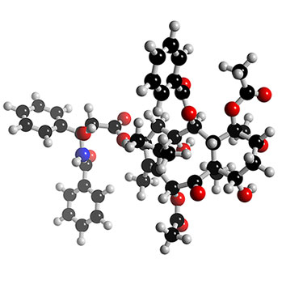
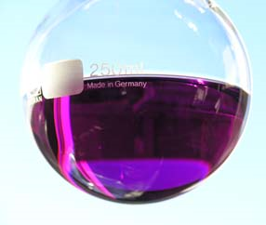
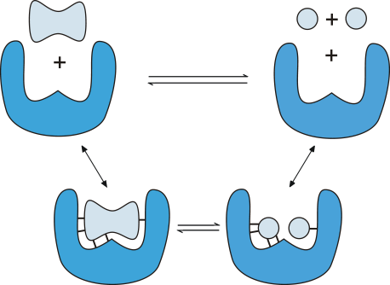
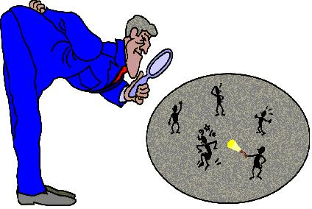
Modern Synthesis in Green Chemistry
...
is used to synthesize complex molecules.
The syntheses often include - new chemical reactions - biocatalyzed transformations
An effective application requires knowledge about details of the reactions, in particular in the field of biocatalysis.
02/27

Slide 5
Details of Biocatalyzed Reactions
- Solutions structure of starting materials
- Progress of the reaction and reaction rate
- Kinetic data
- Parallel and consecutive reactions as well as metabolisms
- Identification of intermediates
- Substrate and product binding to enzymes
- Reaction mechanisms
- Structure of products
- Solutions structure of starting materials
- Progress of the reaction and reaction rate
- Kinetic data
- Parallel and consecutive reactions as well as metabolisms
- Identification of intermediates
- Substrate and product binding to enzymes
- Reaction mechanisms
- Structure of products
03/27

Slide 6
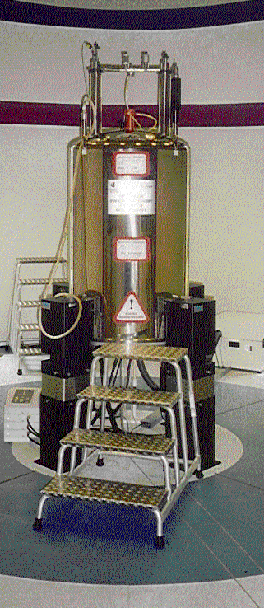
NMR as Analytical Method
“NMR Spectroscopy is a window to the world of biocatalysed reactions!”
D. W. Ribbons, 1997
Which details of reactions can be investigated by NMR?
Which concepts und methods have to be applied?
04/27

Slide 7
Time-Dependence of NMR-Measuring Methods
accumulated products and intermediates
isomerization
enyzme-substrate binding
correlation time
¹H-NMR
¹³C-NMR
T₁/T₂-relaxation
couplings
chemical shift
direct with in situ NMR
indirect with STD NMR
05/27

Slide 8
In situ ¹H-NMR Monitoring
- No sampling necessary
- Reaction is not influenced
- Direct substrate and product analysis possible
- ‘Separation’ can be made in the spectrum
- (Almost) all organic compounds contain protons
- Expensive isotope labeling is not necessary
Concentrations down to ca. 100 µM are well detectable
Water-suppression
D₂O must be added for a Lock-signal
Small spectral width
Brecker, Ribbons. Trends Biotechnol. 2000, 18, 197.
Weber, Brecker. Curr. Opinions Biotechnol. 2000, 11, 572.
06/27

Slide 9
β-Ketolase – Reaction
Isolated from Pseudomonas putida ORC
07/27

Slide 10
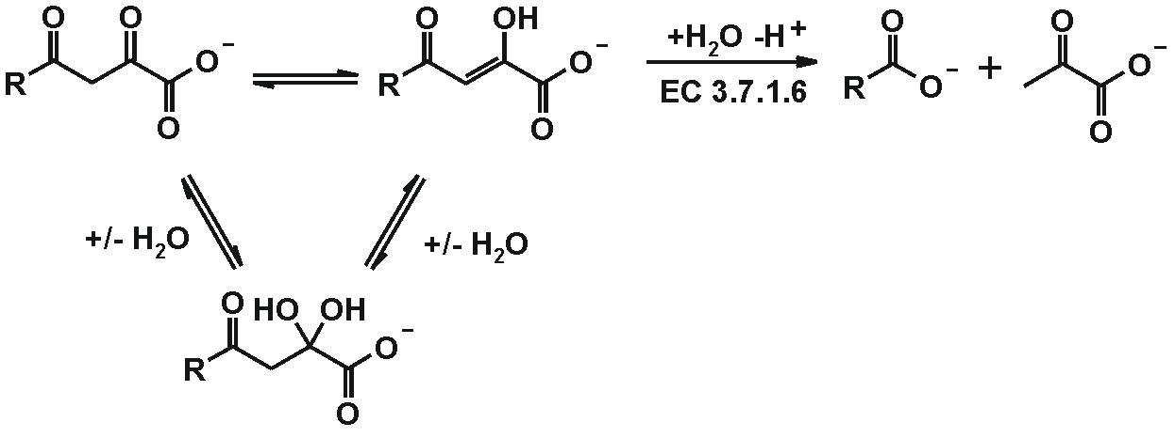
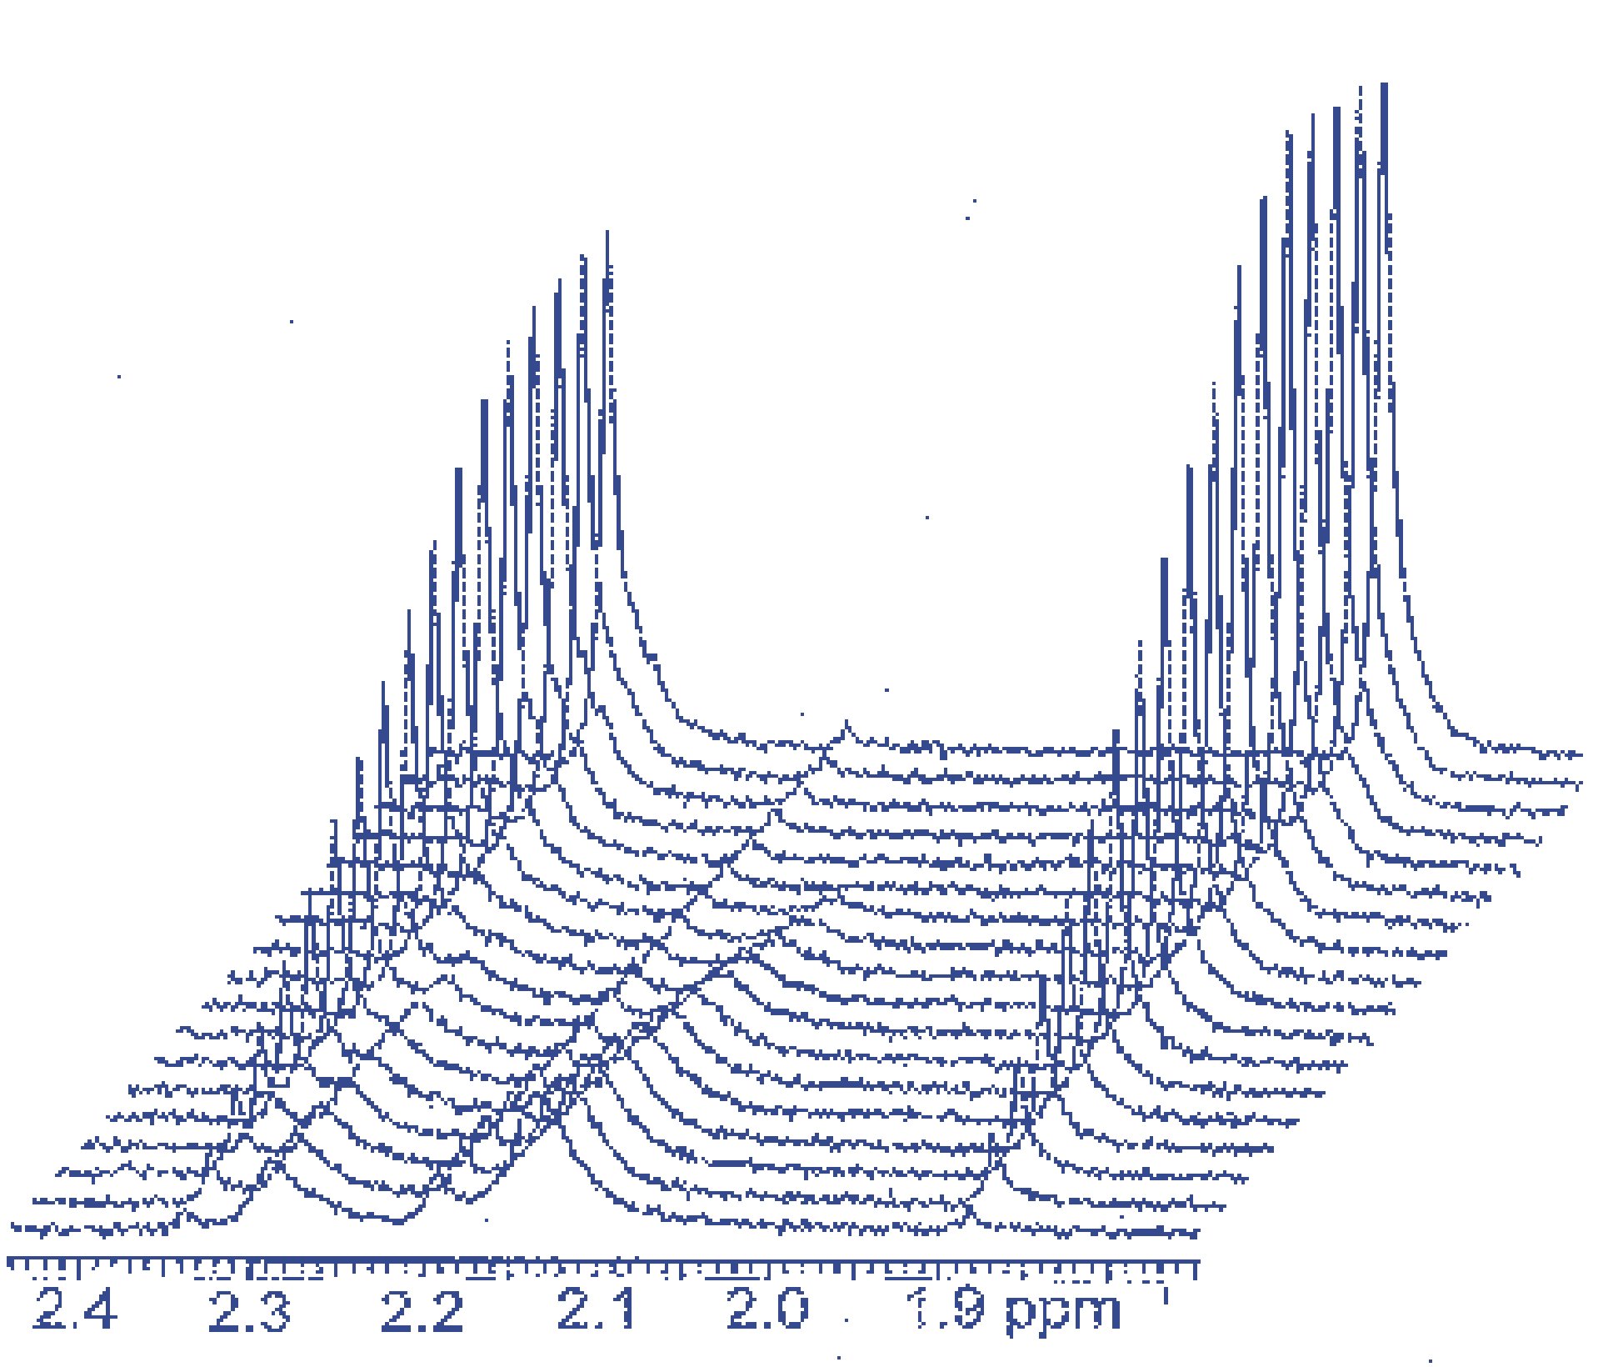
β-Ketolase – Enzyme Catalysed Hydrolysis
R = CH₃
08/27

Slide 11
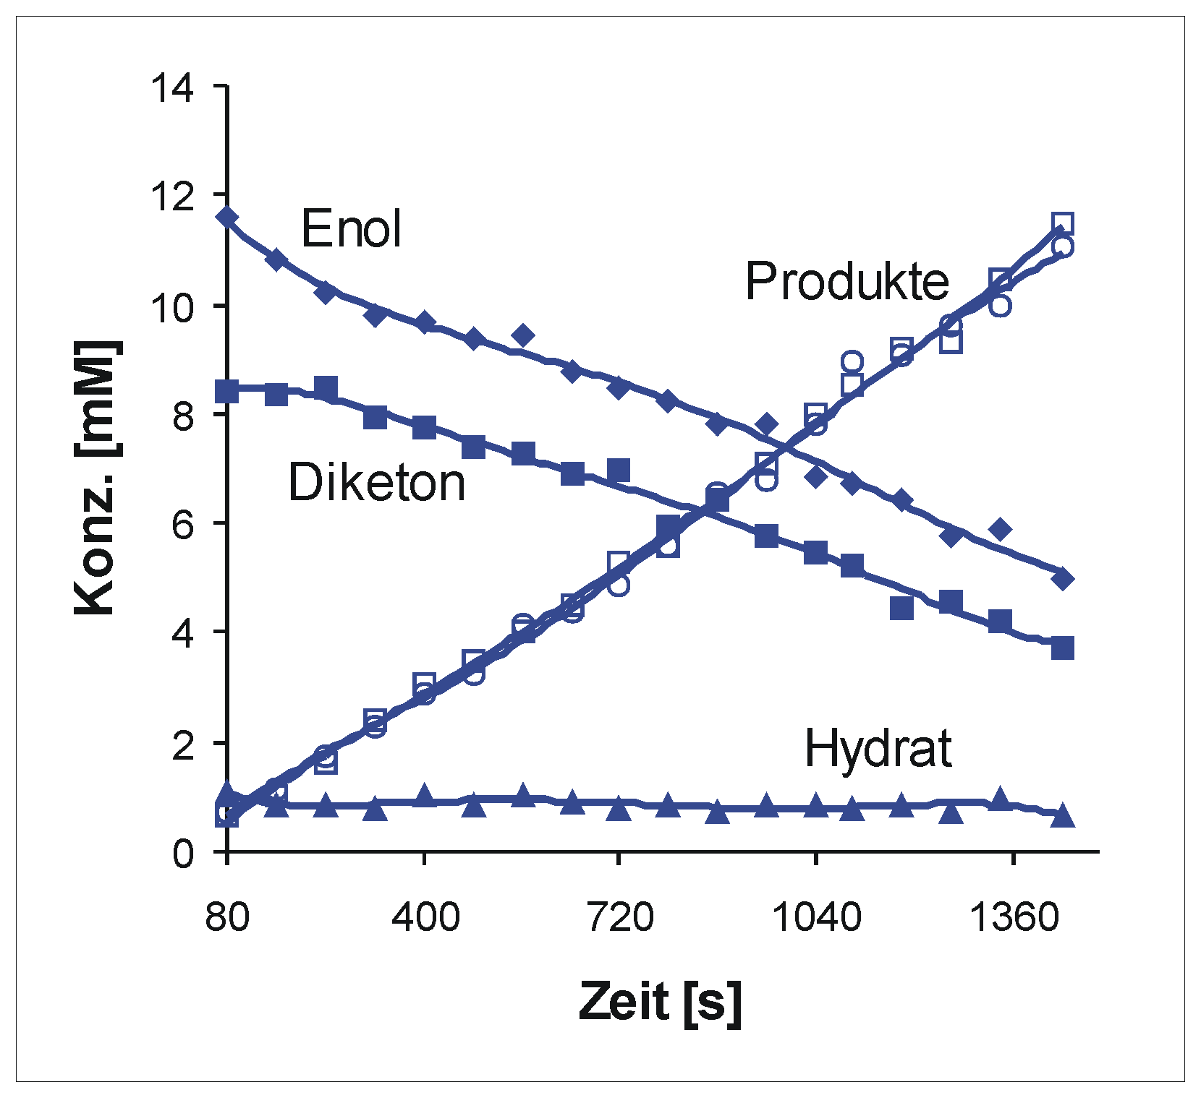
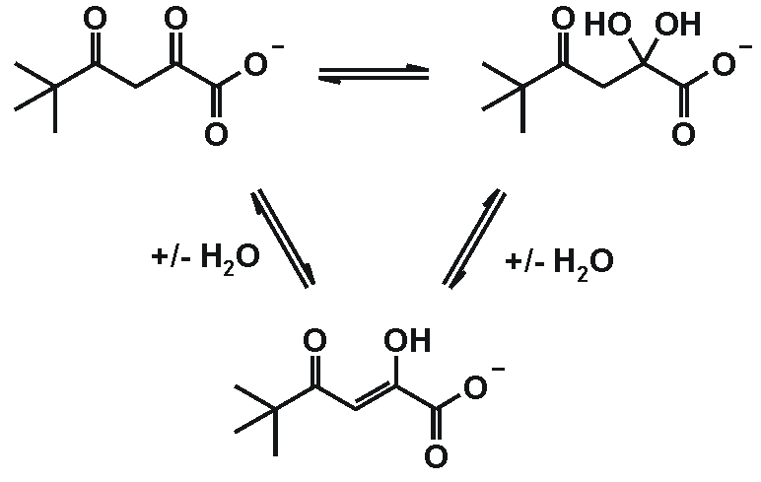
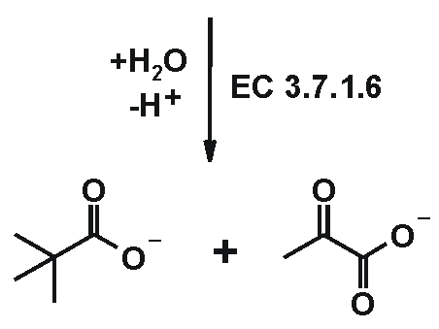
β-Ketolase – Hydrolysis of the Enol-Form
Conc.
[mM]
Time[s]
Brecker et al. New J. Chem. 1999, 23, 437.
Pokorny et al. J. Bacteriol. 1999, 181, 5051.
09/27

Slide 12
Saturation Transfer Difference (STD) NMR
Principle
1. Experiment: Selective irradiation of a protein frequency
2. Experiment: Irradiation at ~40 ppm
10/27

Slide 13
Saturation Transfer Difference (STD) NMR
Premises
- Small amounts of the protein [µg scale]
- Isotopic labeling is not necessary
- Independent of knowledge about the protein structure
Results
- Spatial closeness of ligand-protons to the protein
- Binding epitope of the ligands
Information about protein-ligand interactions
11/27

Slide 14
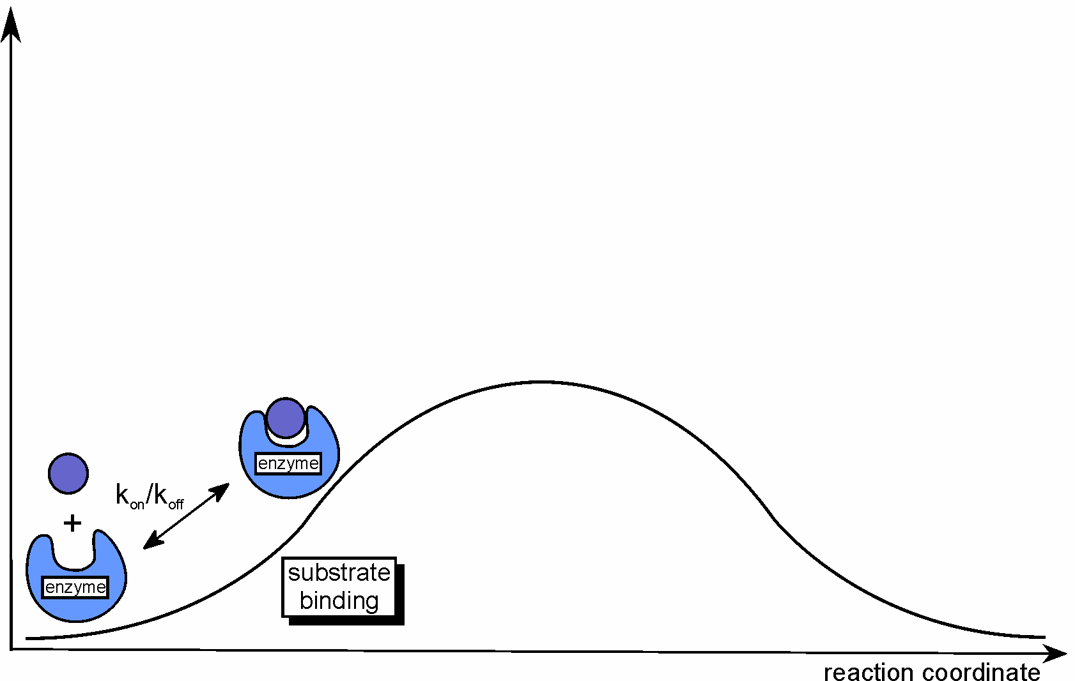
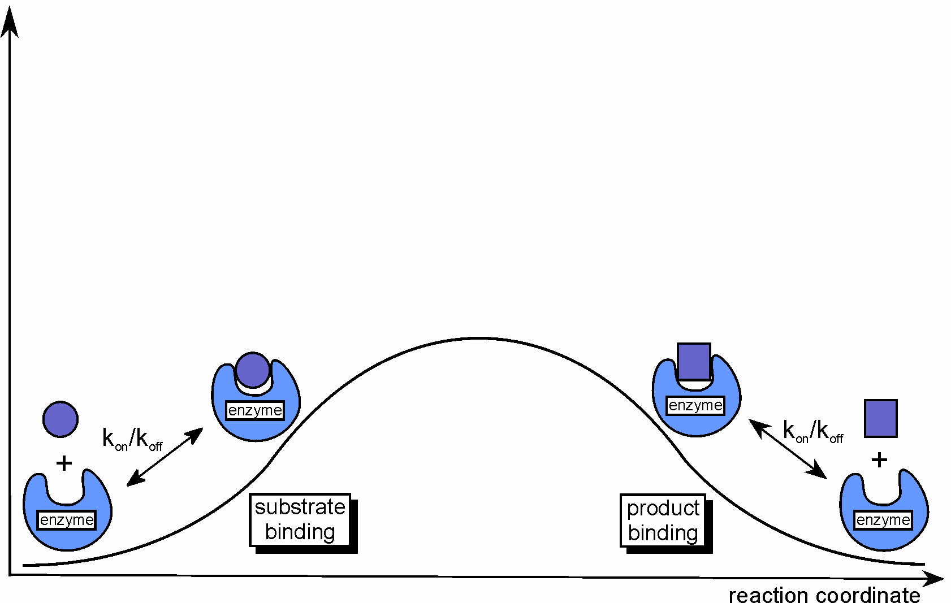
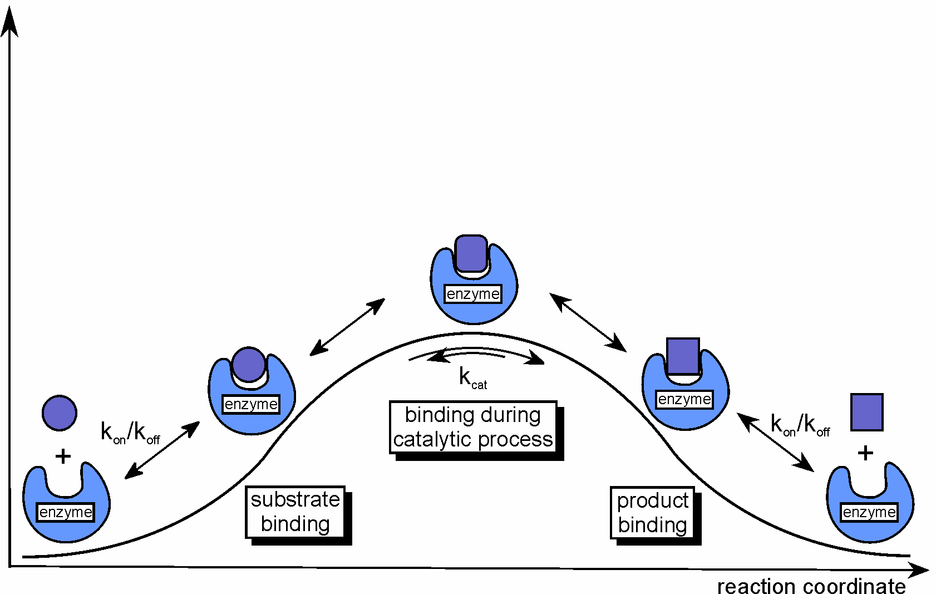
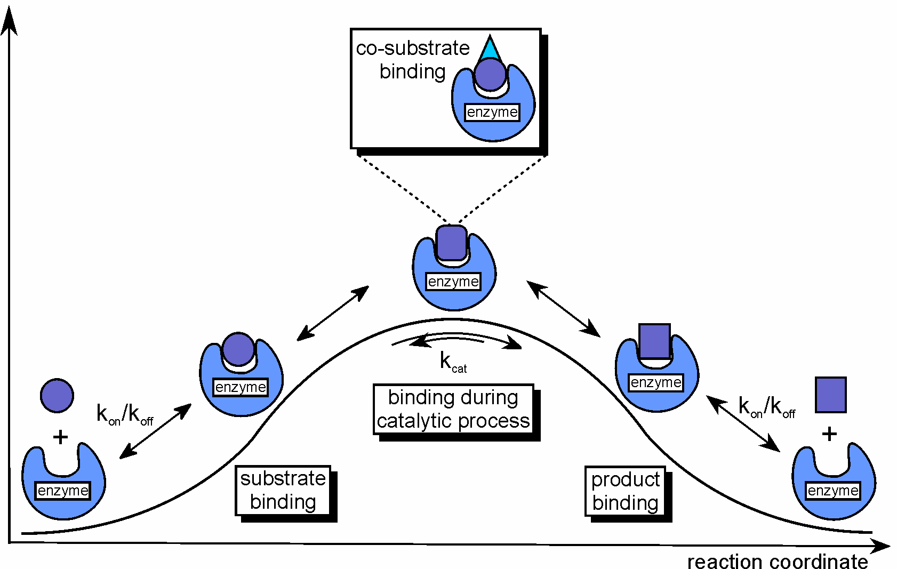
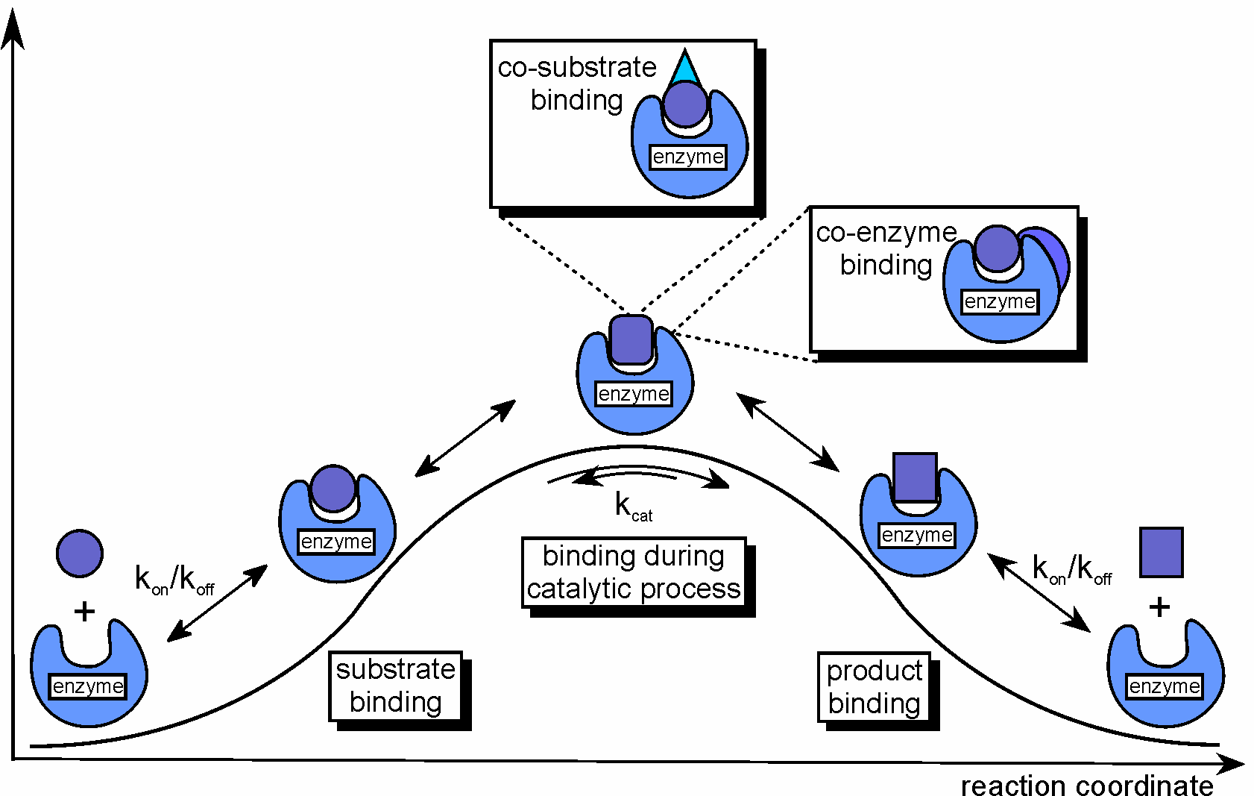
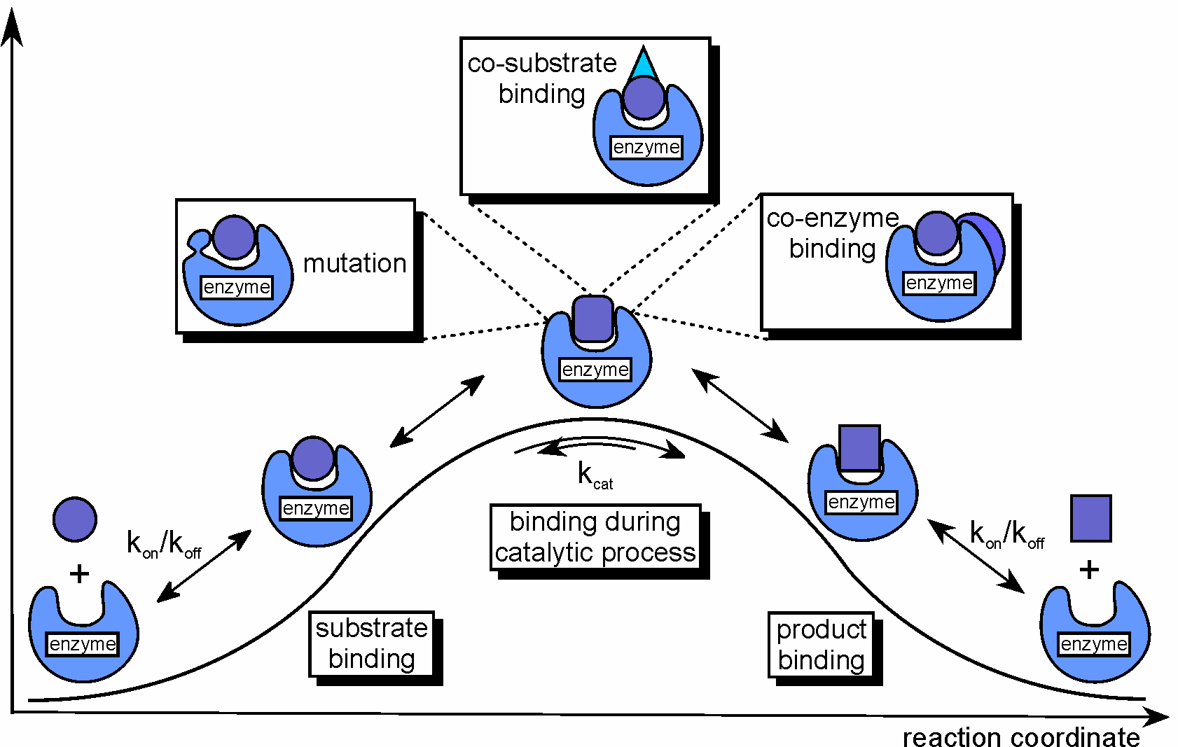
STD NMR in Biocatalysis
ΔE
Brecker et al. Carbohydr. Res. 2008, 343, 2153.
12/27

Slide 15
Binding of Intermediates during Reaction
Candida tenuis Xylose Reductase (CtXR)
Acceptance of a very broad variety of unnatural substrates
- α-keto-ester
- β-keto-ester
- ortho-halo-acetophenone
13/27

Slide 16
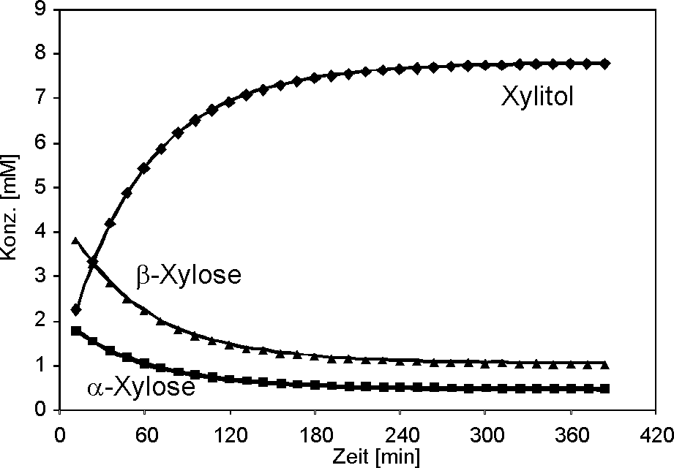
Binding of Intermediates during Reaction
Candida tenuis Xylose Reductase (CtXR)
Very high catalytic efficiency: 680,000 M⁻¹ s⁻¹
In situ NMR of CtXR catalysed xylose reduction at 303 K
14/27

Slide 17
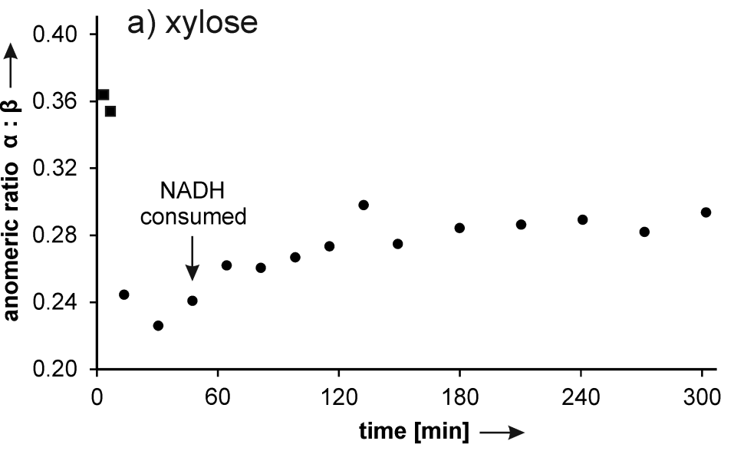
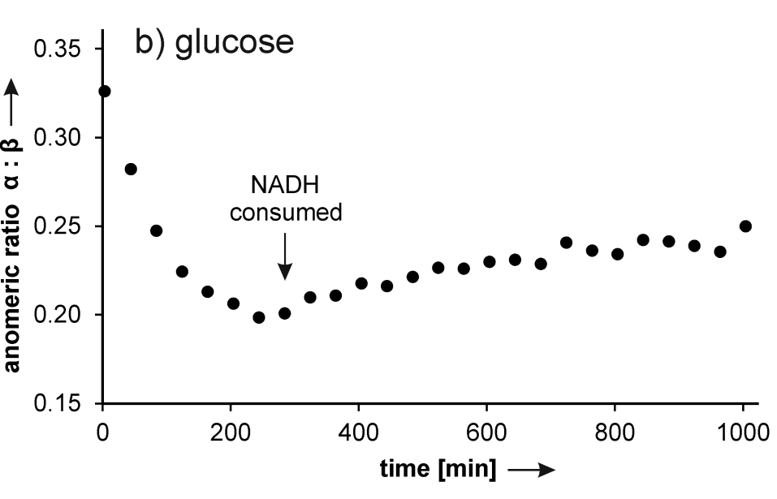
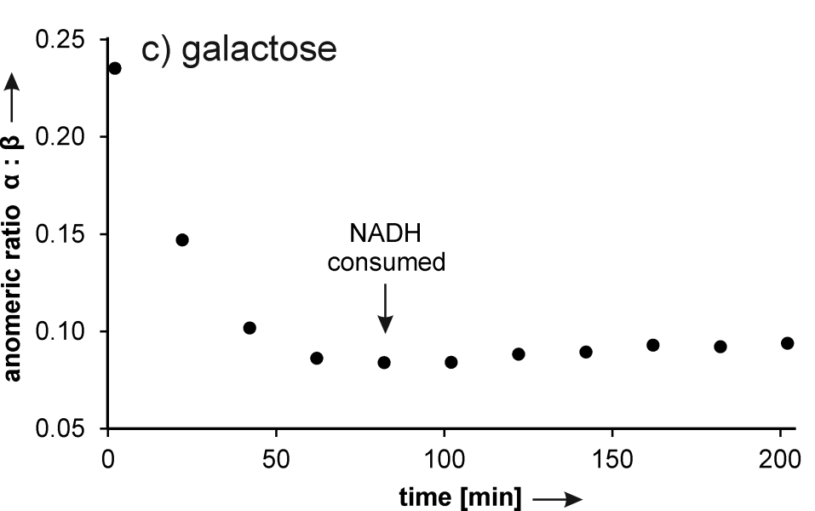
In situ NMR of CtXR catalysed reductions
Anomeric ratio
during the reaction at 283 K
15/27

Slide 18
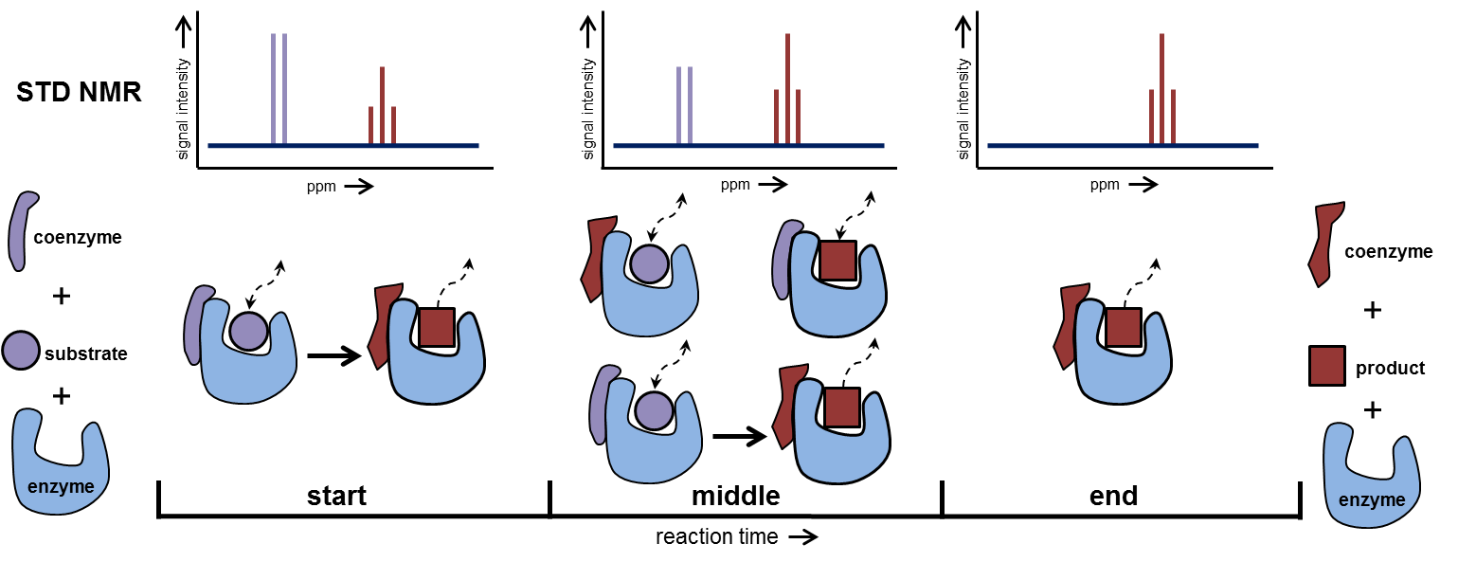
STD NMR of Ternary Complexes
16/27

Slide 19
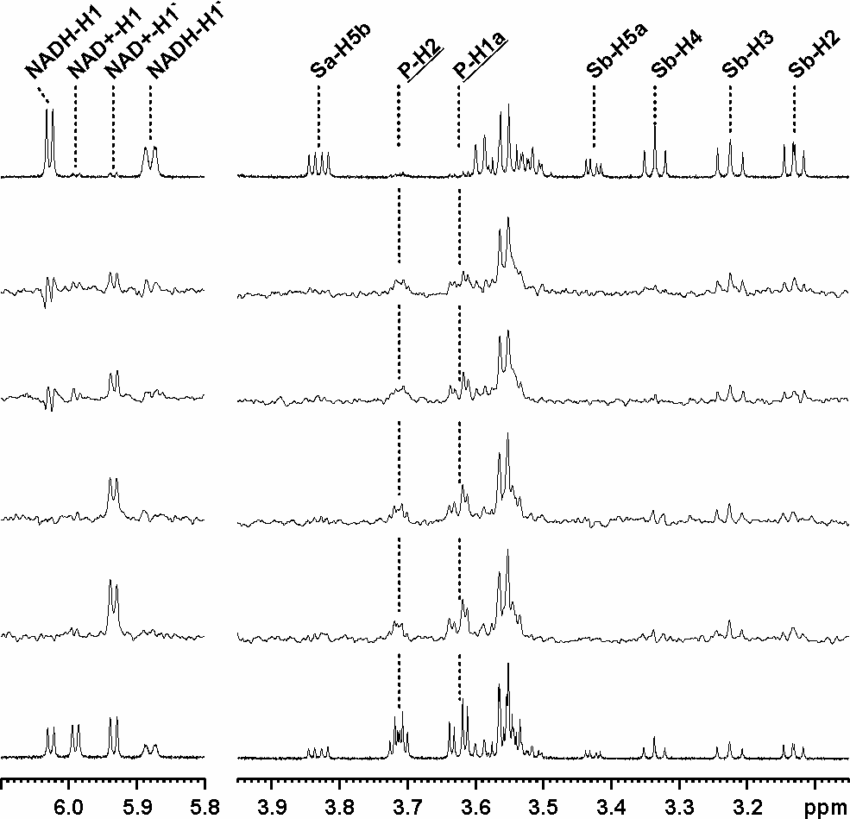
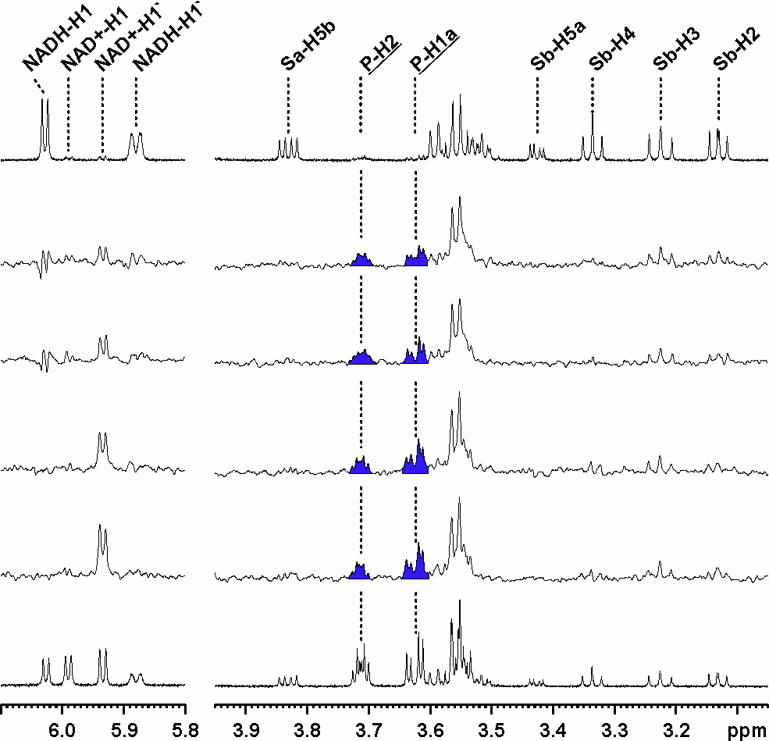
Binding of Intermediates during Reaction
¹H-NMR 0 min
STD-NMR 1-15 min
STD-NMR 16-30 min
STD-NMR 31-45 min
STD-NMR 46-60 min
¹H-NMR 61 min
Brecker et al. Carbohydr. Res. 2008, 343, 2153.
17/27

Slide 20
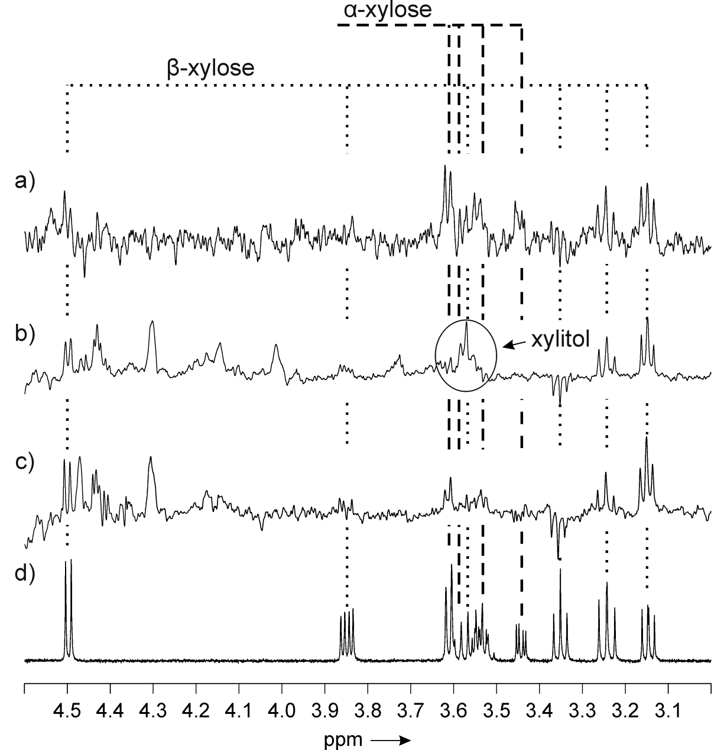
STD NMR of Xyl/Coenzym/CtXR-Complexes
STD NMR Xyl/CtXR
STD NMR Xyl/NADH/CtXR
STD NMR Xyl/NAD⁺/CtXR
¹H NMR Xyl
18/27

Slide 21
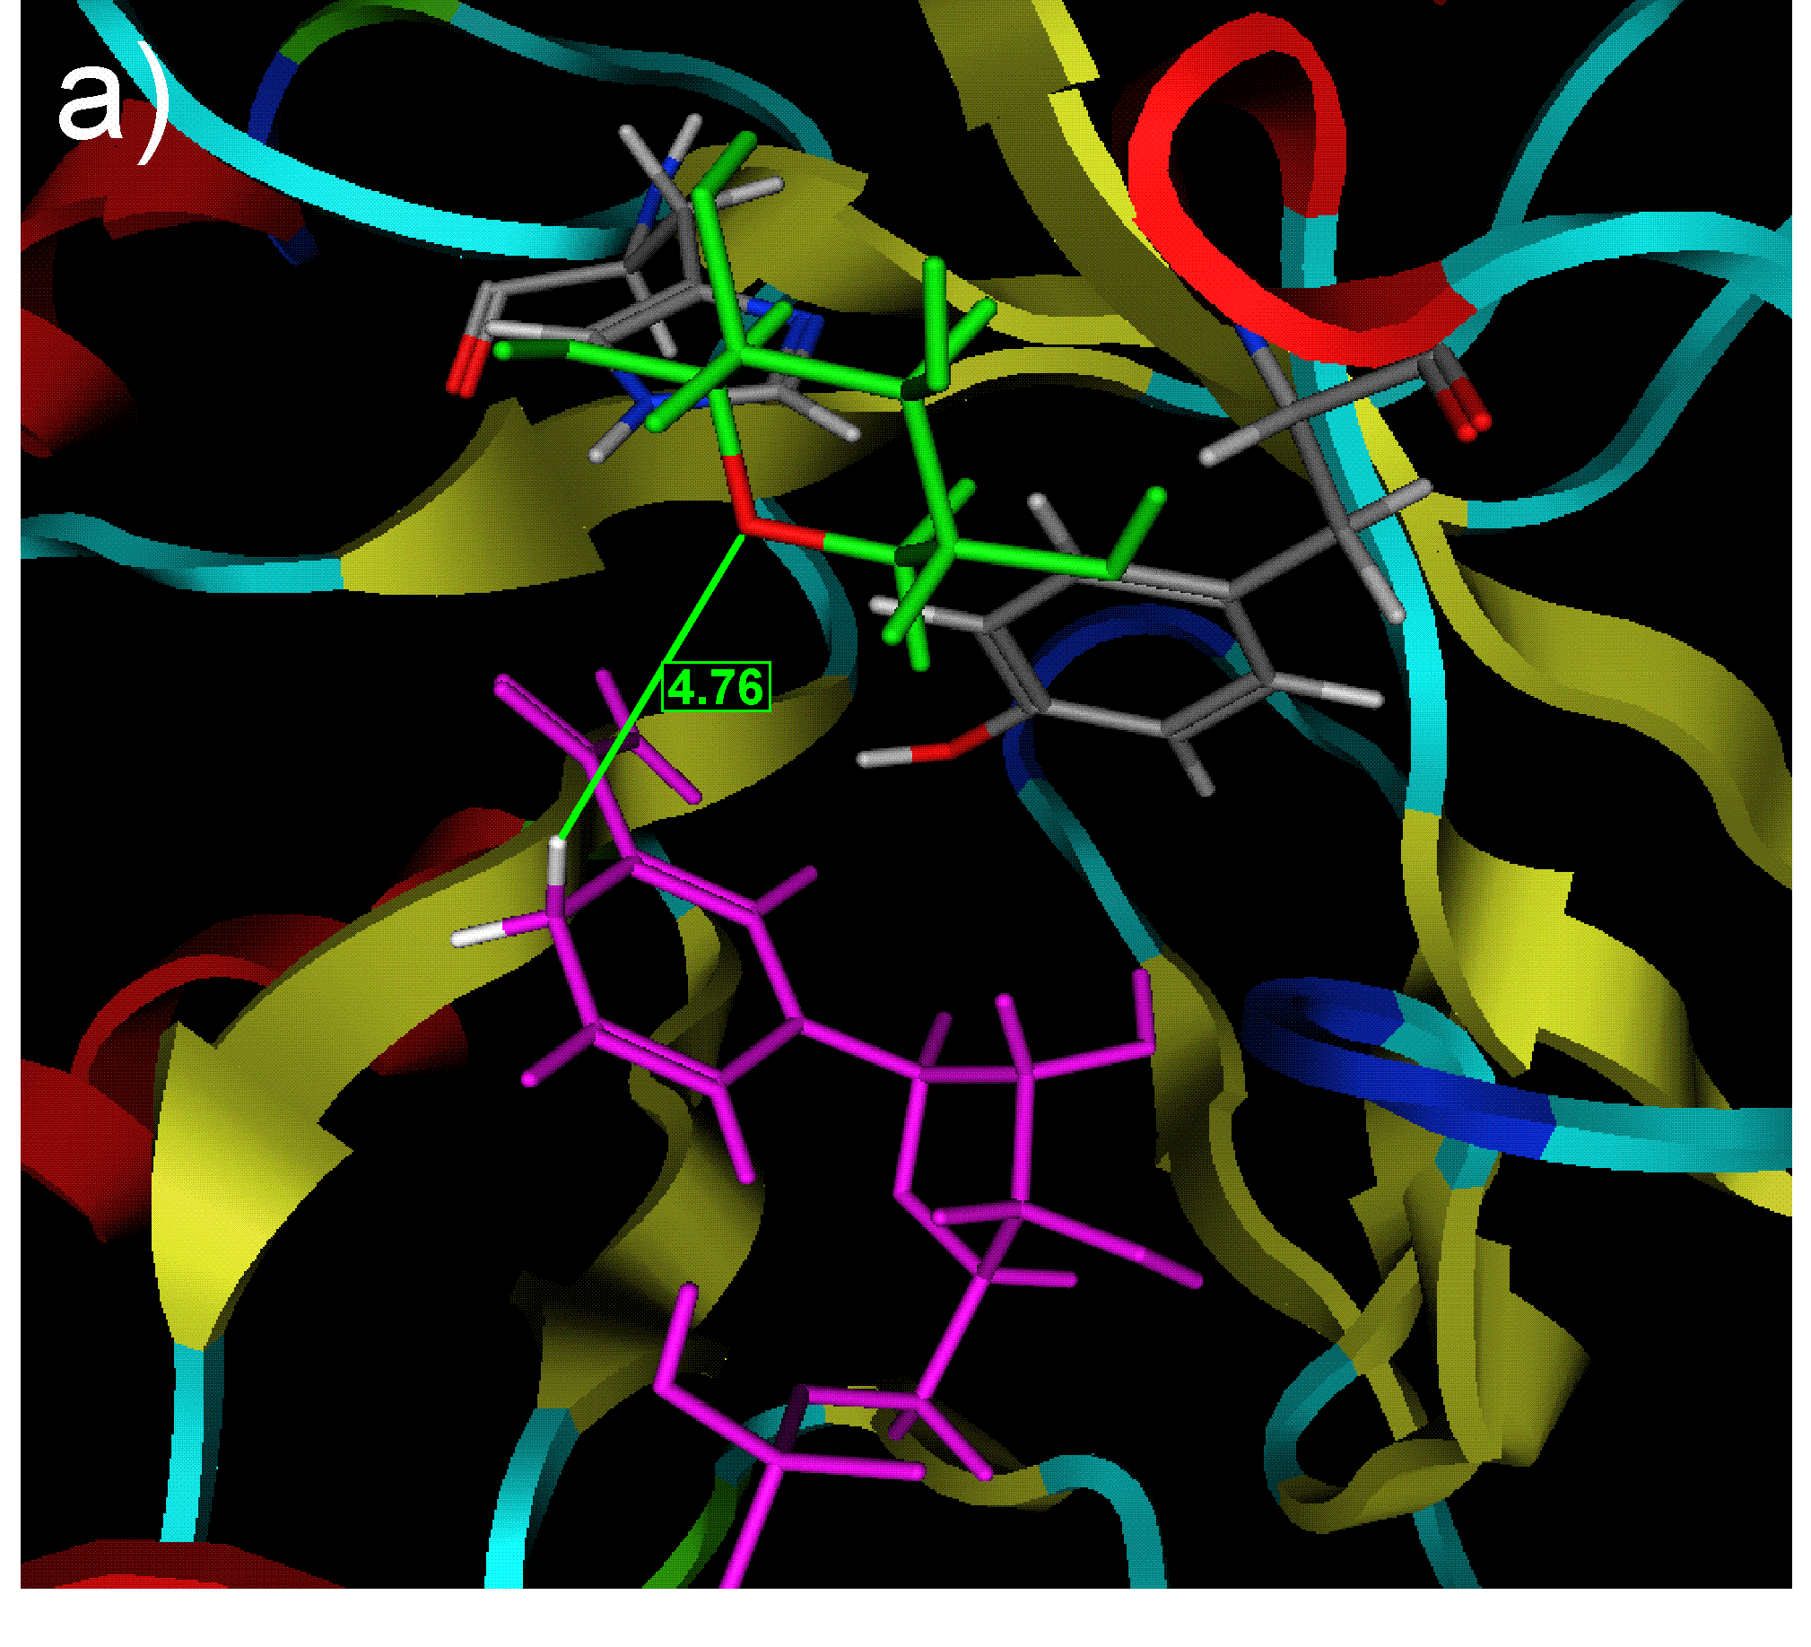
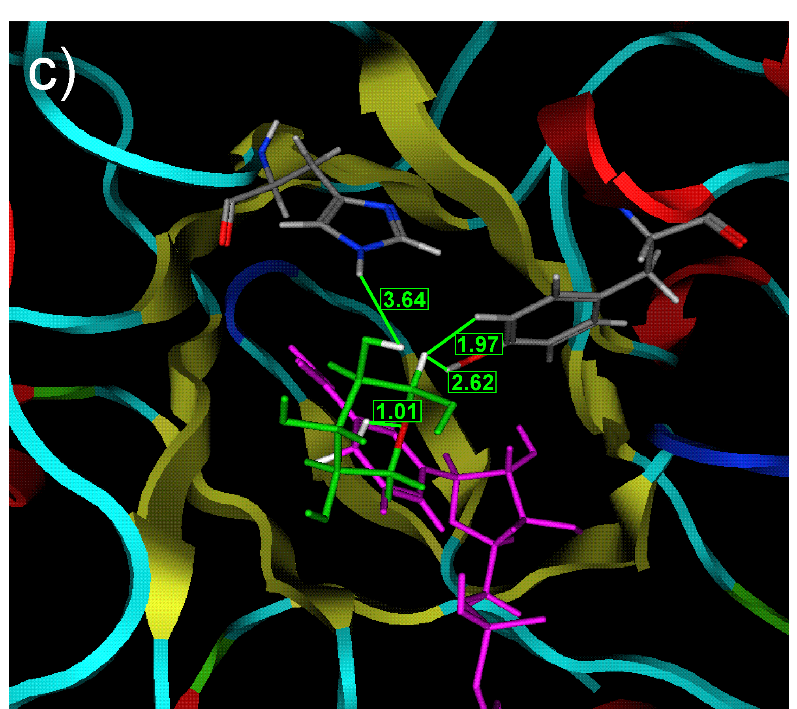
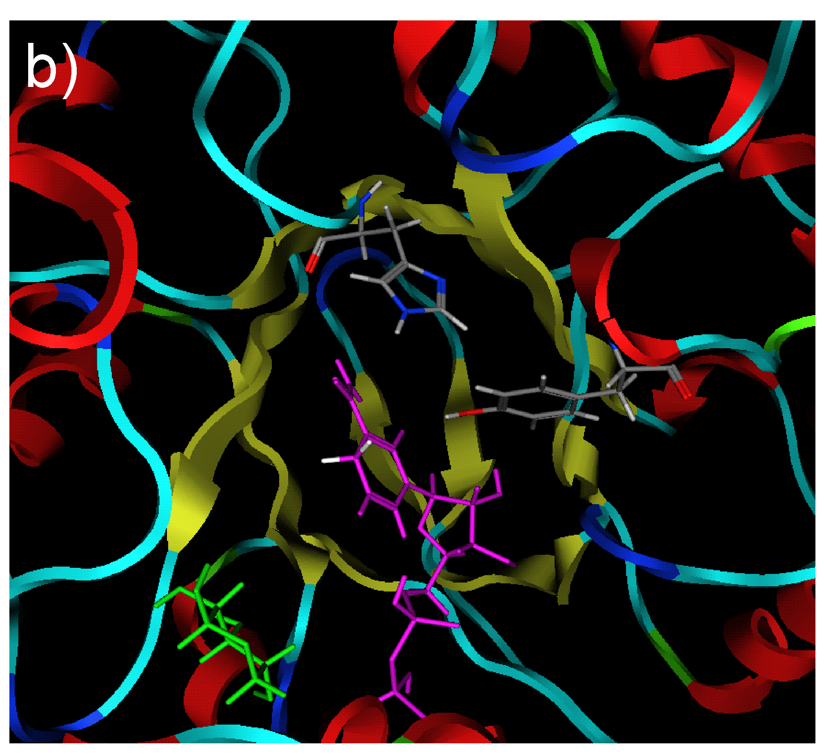
Molecular Docking in the Active Site
Vogl, Brecker. RSC Adv. 2013, 3, 25997.
19/27

Slide 22
Candida tenuis Xylose Reductase (CtXR)
Acceptance of a very broad variety of unnatural substrates
- α-keto-ester
- β-keto-ester
- ortho-halo-acetophenone
20/27

Slide 23
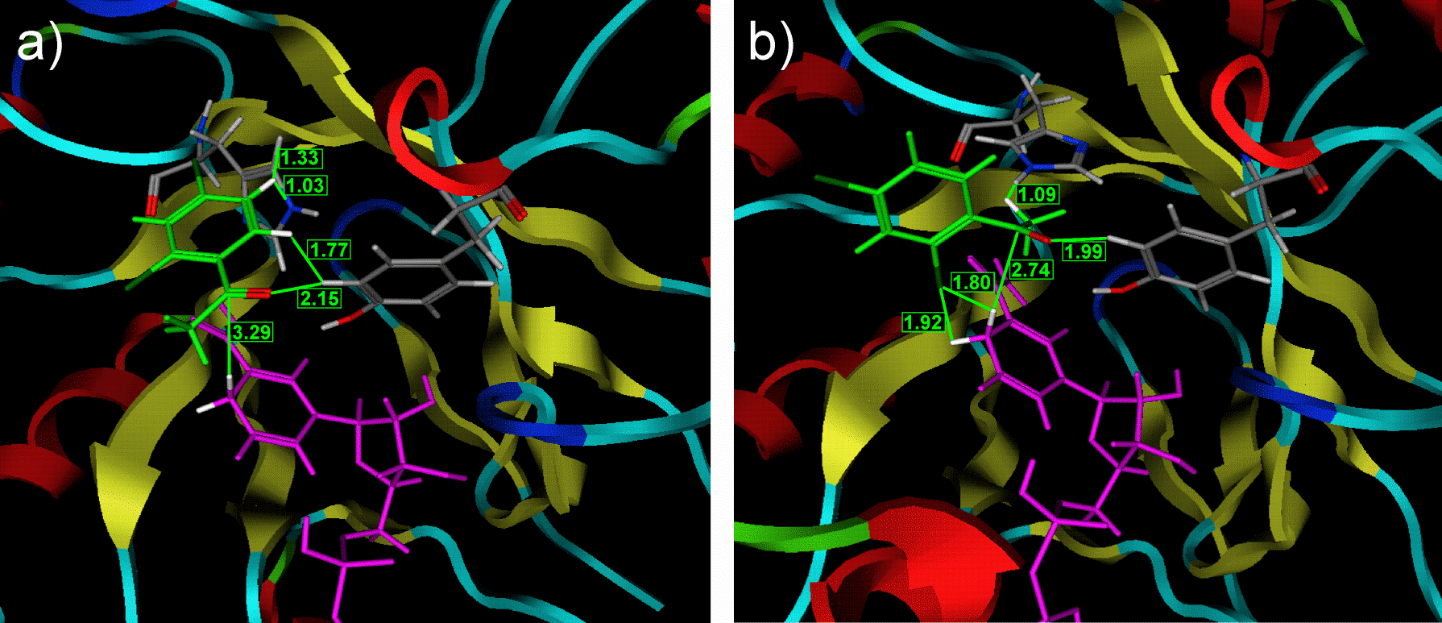
Molekular Docking of an Acetophenone
?
Vogl, Brecker. RSC Adv. 2013, 3, 25997.
21/27

Slide 24
Applications in Synthesis of Drugs
2-Chlor-acetophenone as substrate for PLK-1 inhibitor (cancer therapy)
Propiophenone as substrate for oxetines (antidepressent drug)
Kratzer et al. Biotechnol. Bioeng. 2011, 108, 797.
Vogl et al. Org. Biomol. Chem. 2011, 9, 5863.
PLK-1 Hemmer: Sato et al. Bioorg. Med. Chem. Lett. 2009, 19, 4673.
22/27

Slide 25
Oxetines (Antidepressent Drugs)
Fluoxetin Nisoxetin Tomoxetin
„Prozac“
- Worldwide use as antidepressent drug
- Sales volume in the billion-dollar region
- Application as racemic mixtures
- Side effects lead to intensive critique
→ Enantiomerical pure synthesis using CtXR
23/27

Slide 26
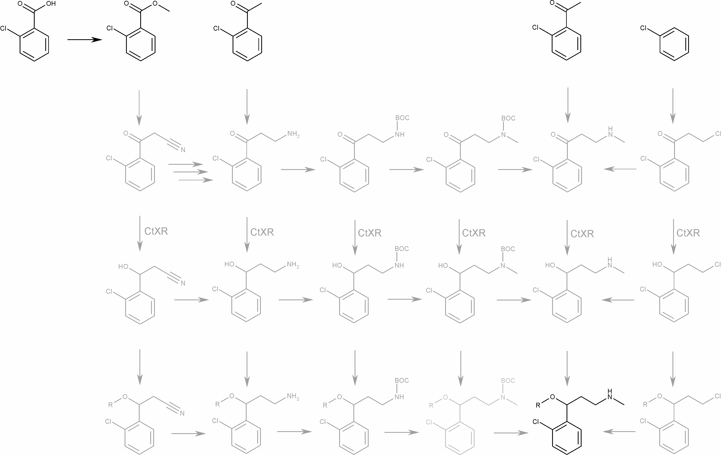
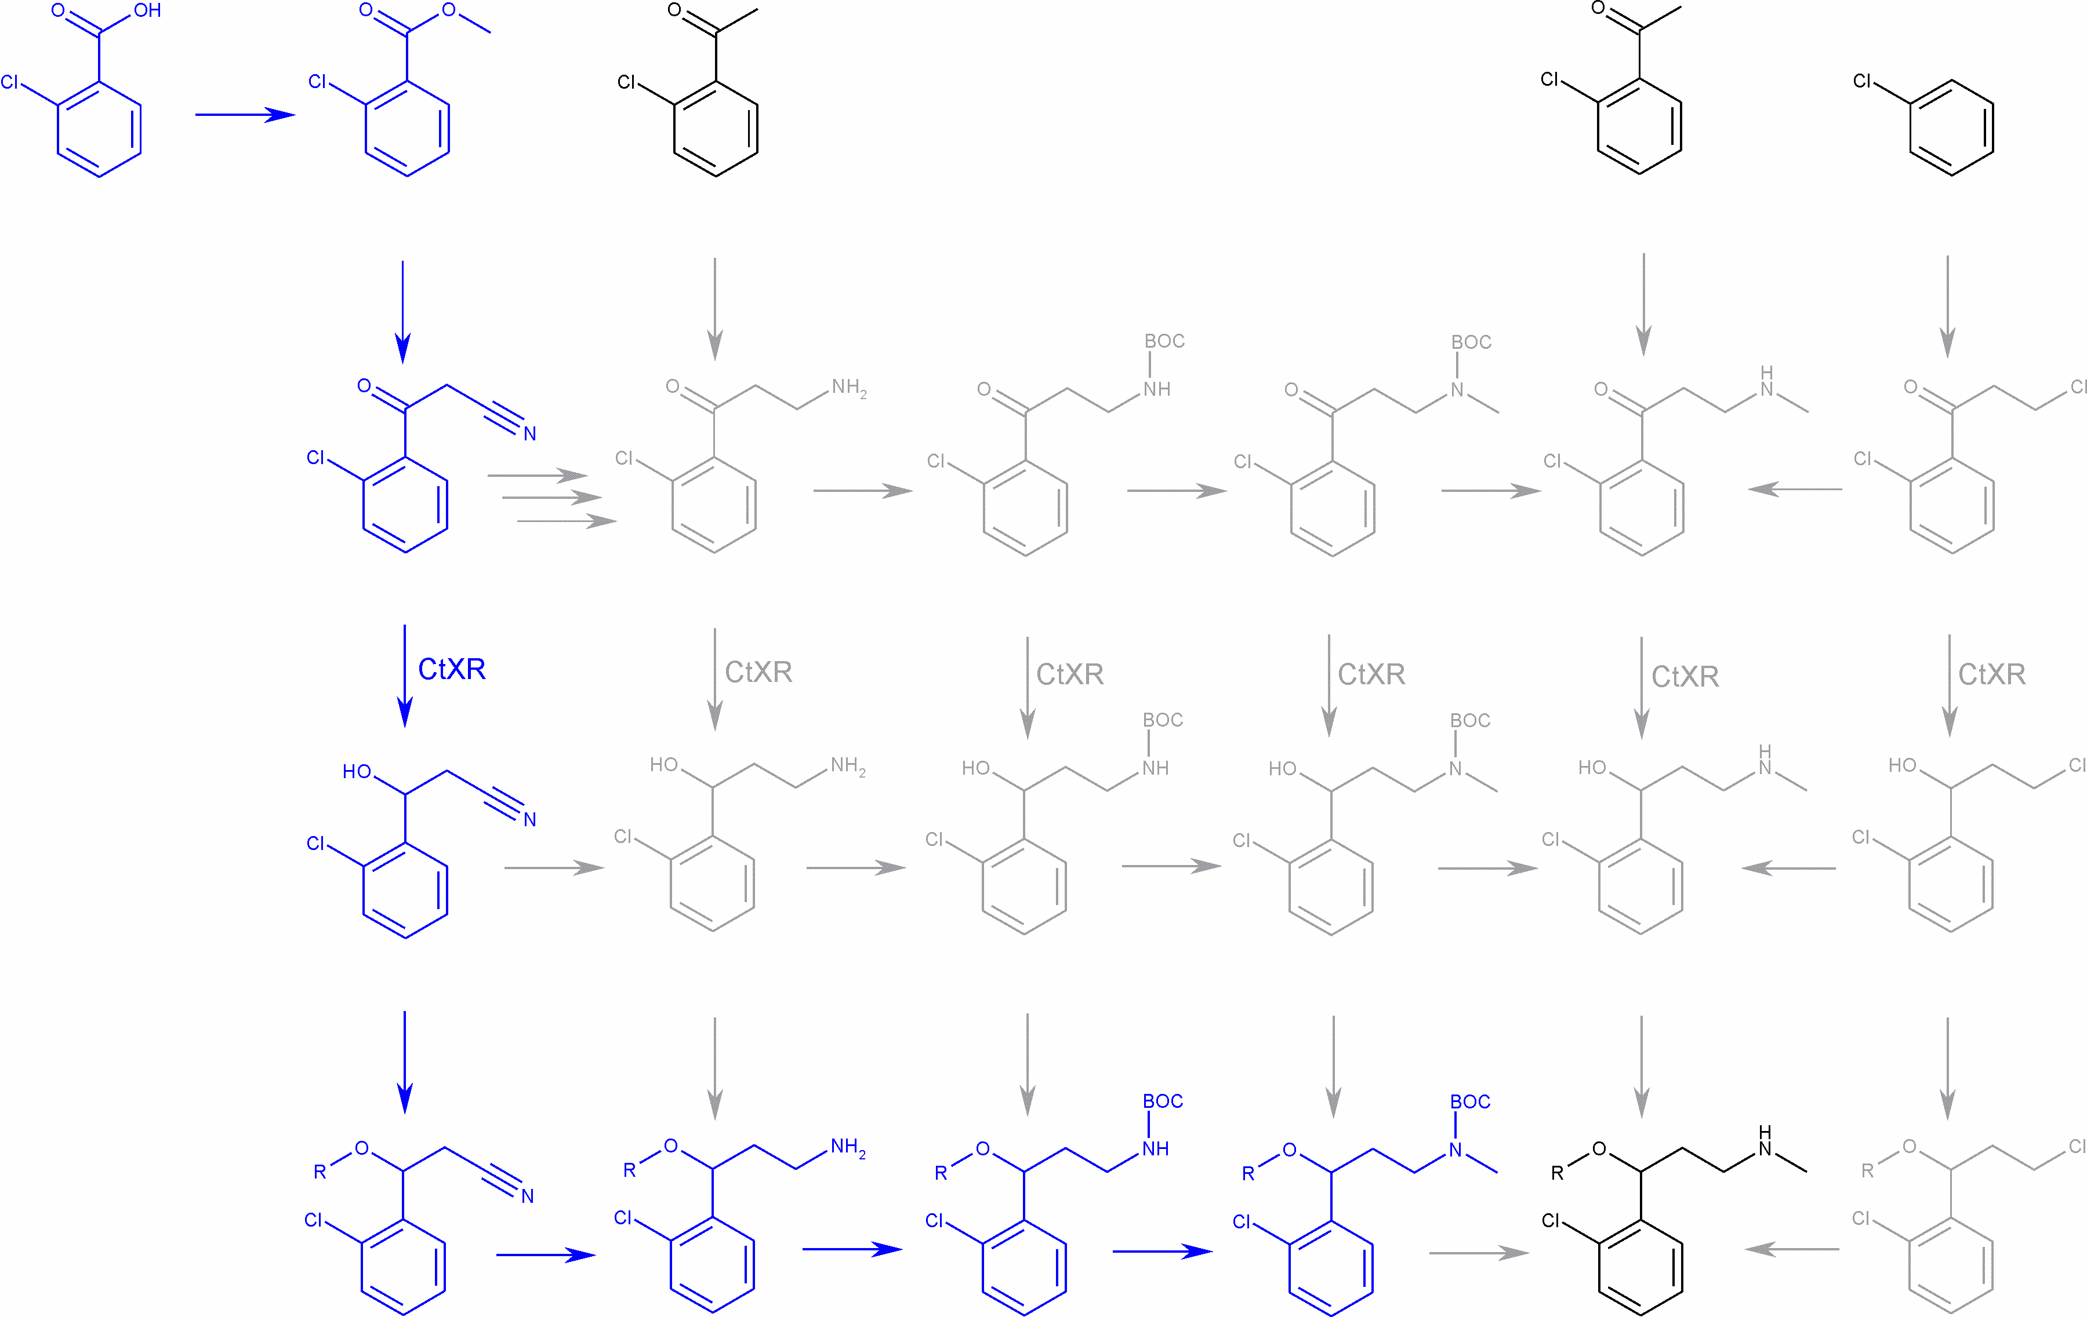
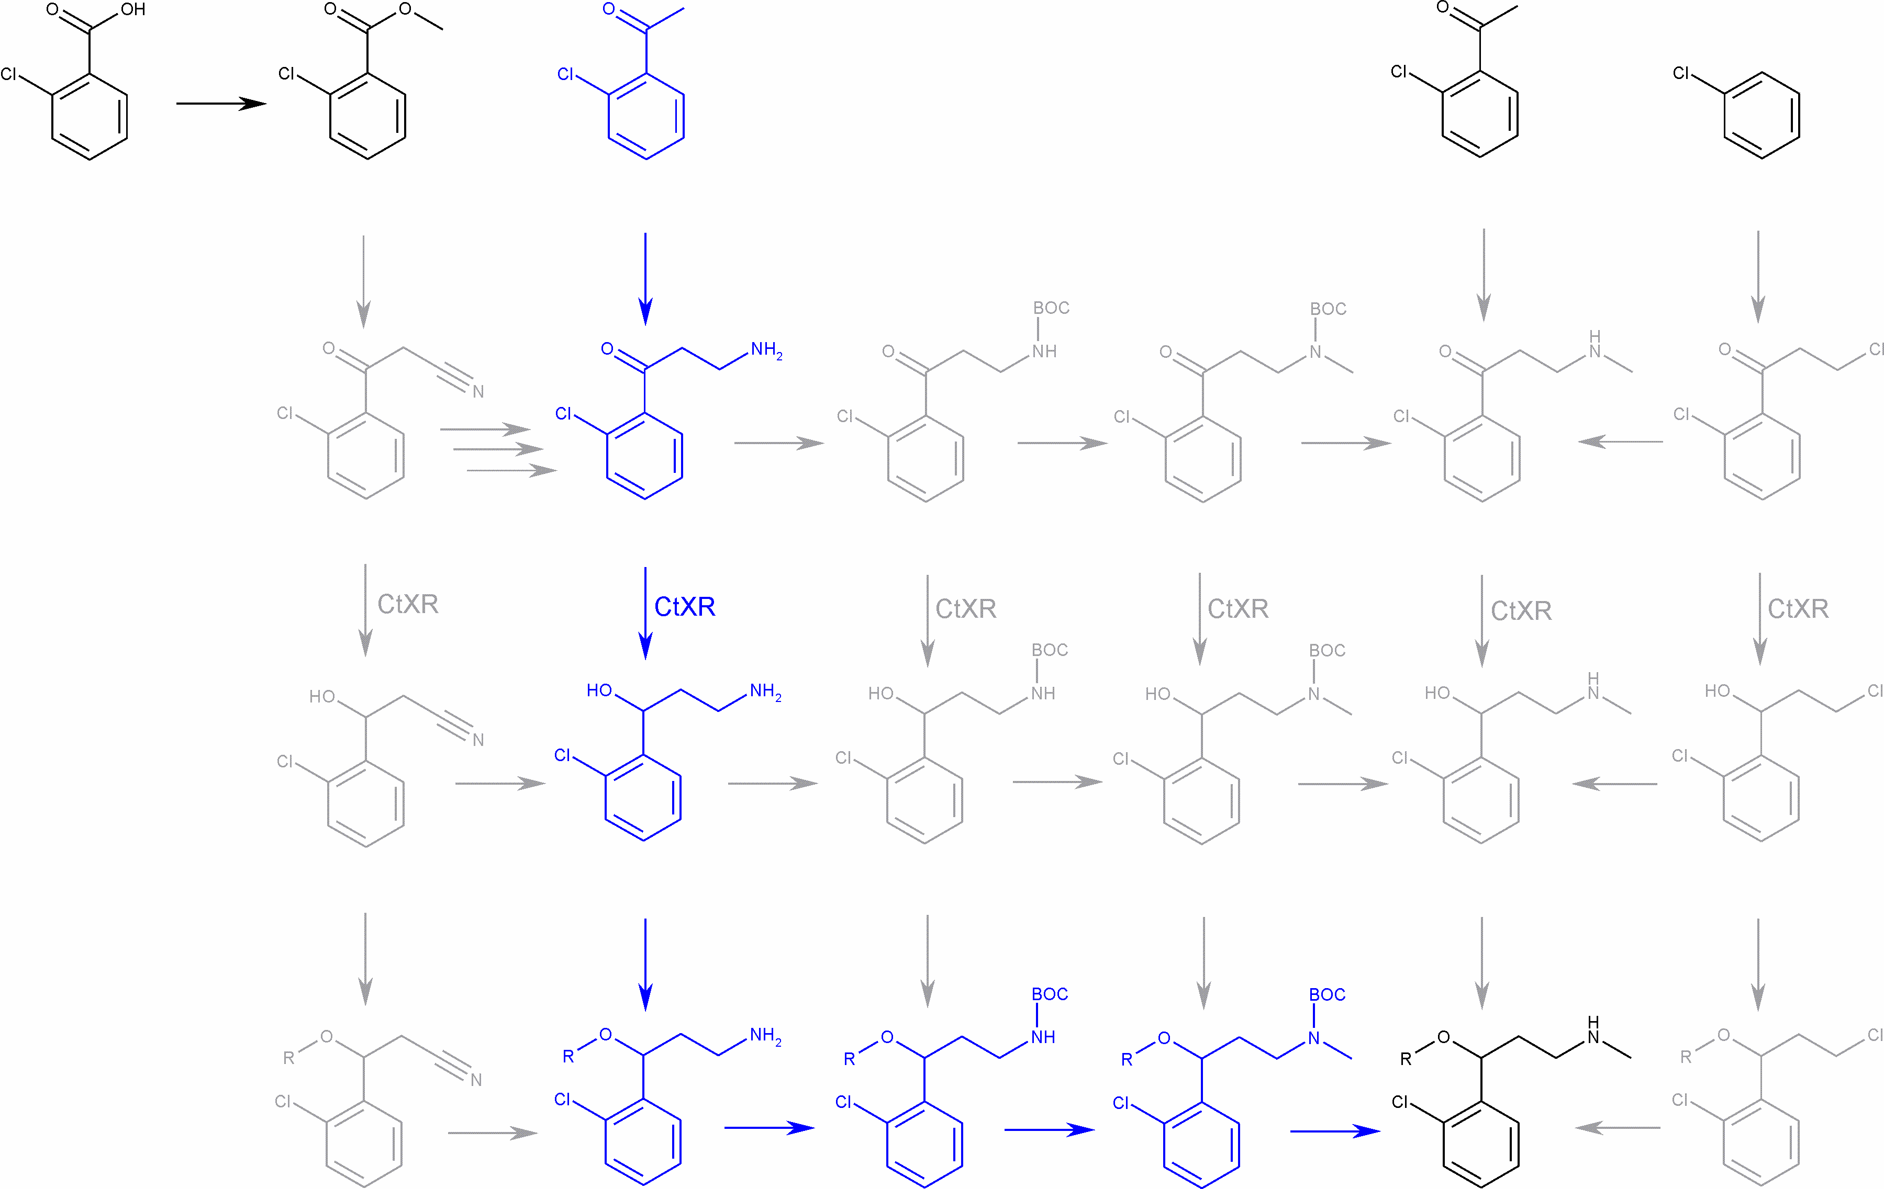
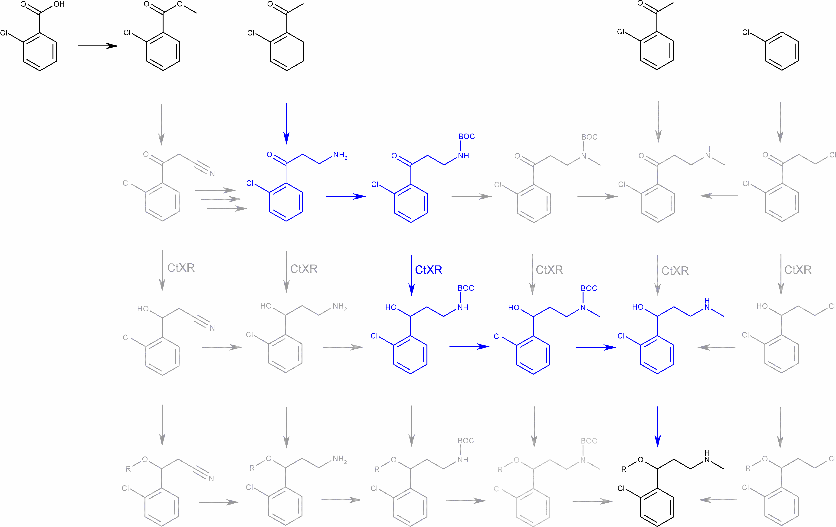
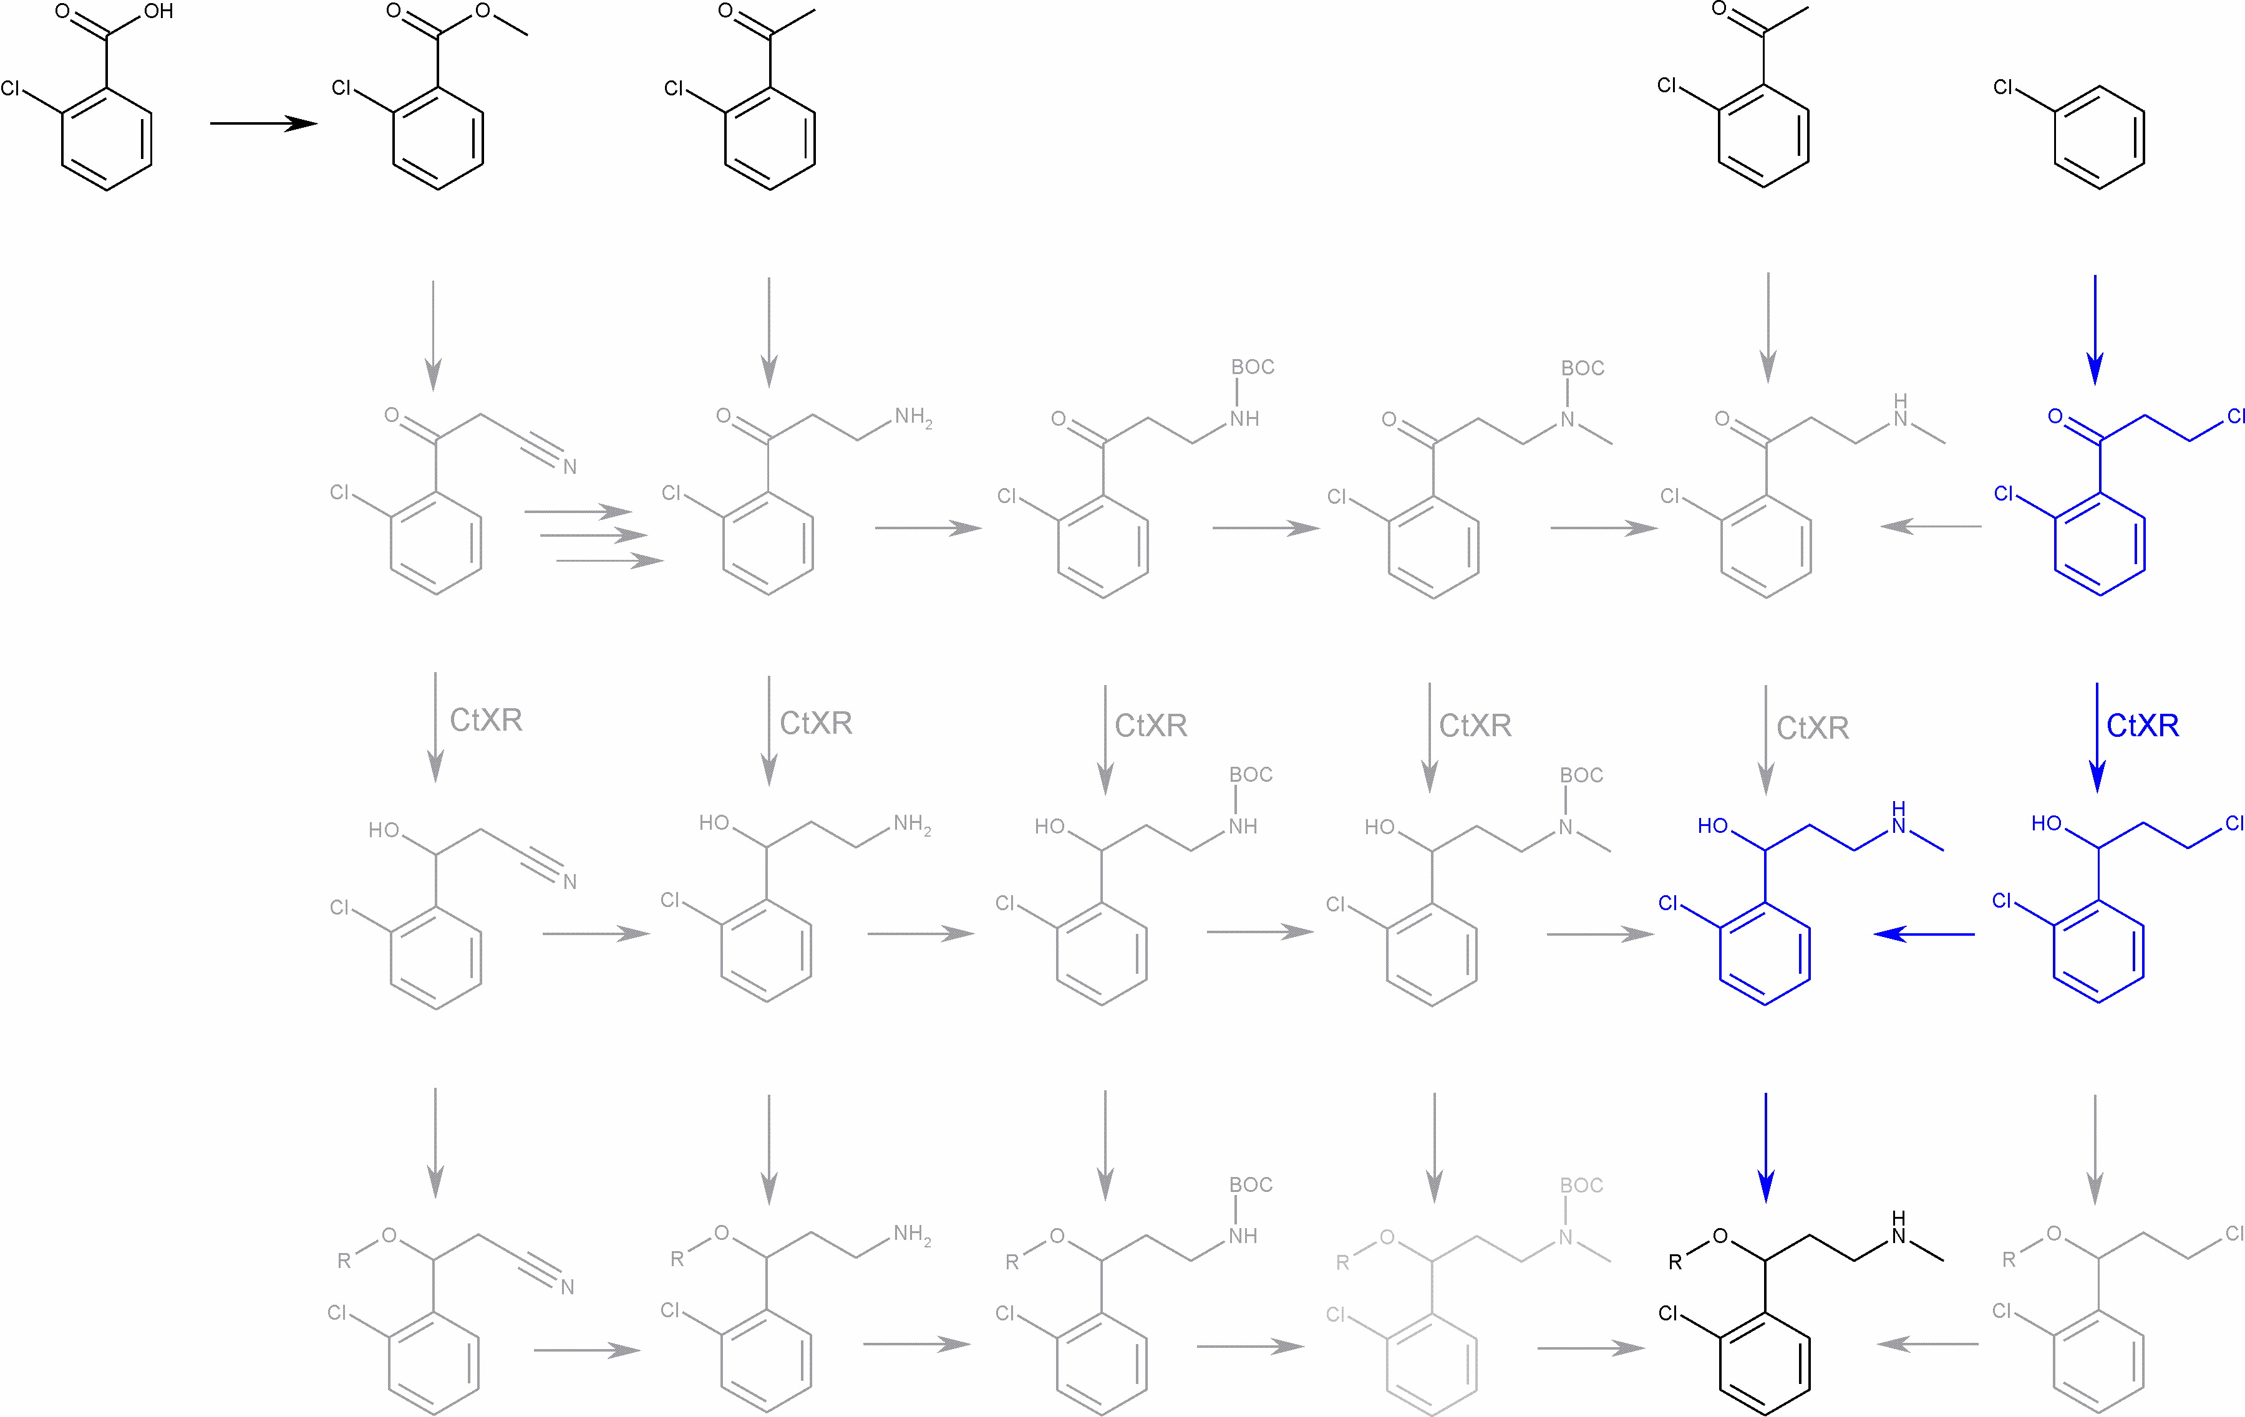
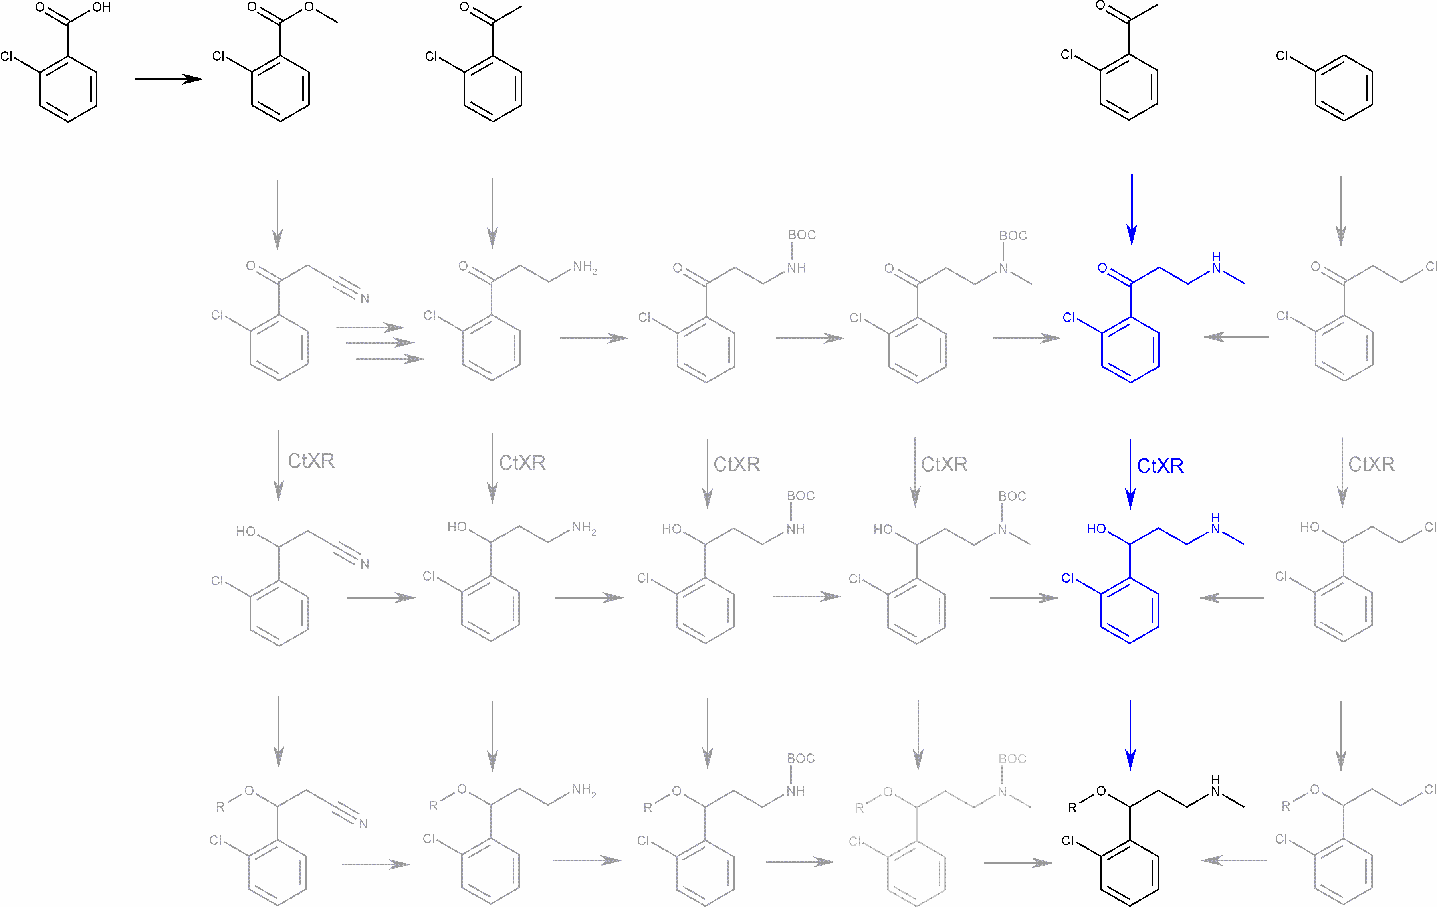
Enantiomerical pure synthesis using CtXR
24/27

Slide 27
Patent application
Patent application and marketing since 2010
Vogl et al. Chirality 2012, 24, 847; Brecker et al. EP 2348120 B1, 2014, 28 pp.
25/27

Slide 28
Acknowledegent
University of Vienna
Graz Technical University
M. Vogl
C. Puchner
C. Tyl
H. Fasshuber
S. Felsinger
H. Kählig
K. P. Wolschann
B. Nidetzky
R. Kratzer
C. Luley-Gödl
T. Eixelsberger
S. Schwarz
H. Griengl
D. W. Ribbons
26/27

Slide 29
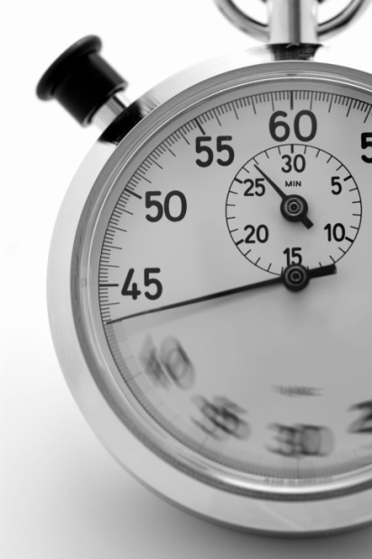
Thank you
for your kind attention !

Slide 30
Let Us Meet Again
We welcome you all to our future conferences of OMICS Group International
Please Visit: www.omicsgroup.com
www.conferenceseries.com
www.pharmaceuticalconferences.com

