Slide 1
Salutogeneses - perception of life quality
L Jakobsson
Dr med sci, RNT
Kristianstad University
Sweden

Slide 2
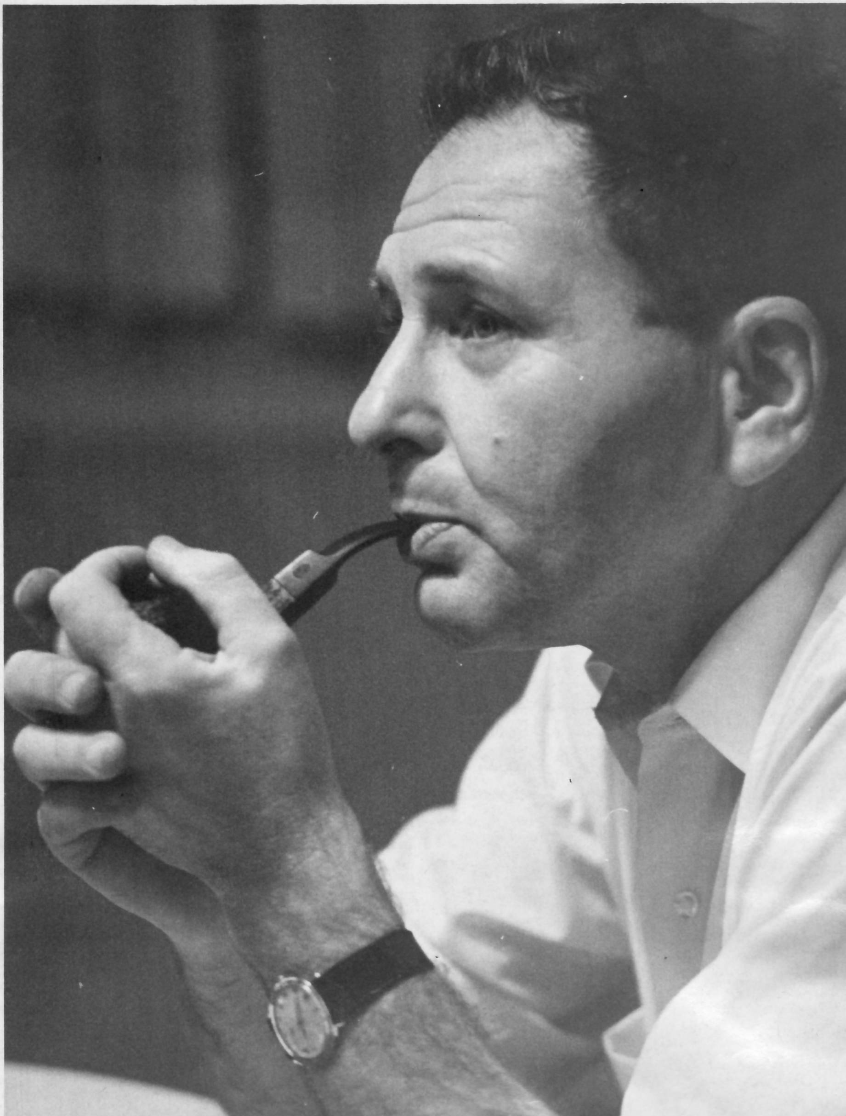

Slide 3
Salutogenesis
The mystery of health
The sense of coherence
General resistance resourses

Slide 4
Sense of coherence
.. ’a global orientation that expresses the extent to which one has a pervasiev, enduring though dynamic feeling of confidence ..
(Antonovsky, 1987)

Slide 5
Comprehensibility
Manageability
Meaningfulness

Slide 6
General Resistant Resources
… ’a property of a person, a collective or a situation, which, as evidence or logic has indicated, facilitates successful coping with inherent stressors of human existence’ (Antonovsky 1996)

Slide 7
Personality traits
Financial position
Social support
Research has shown …..

Slide 8
Aim
..weather sense of coherence increases the perception of health related quality of life and sexual functioning in a 5-year perspective following prostatectomy

Slide 9
Design
A longitudinal survey –
mail out–mail in
Data collection at base line, 3 months and at 1, 2, 3 and 5 years following treatment

Slide 10
Sample
Verbal approach by a urological specialized nurse at the first visit
Written study information
Oral and written consent before given a set of questionnaires
Questionnaires sent by mail

Slide 11
Participation
Baseline
222 men accepted participation
Year 5
167 remained (75.2%)

Slide 12
Demographics (n=222)
Age, m (md), range 62 (65), 36-75 ys
Living with partner
Yes/No 181/19
Education
Compulsory level 93
Post compulsory 48
University 25
Employment/
Retired 56/86

Slide 13
Tumor stage (TNM-system)
T1 46 (66%)
T2 73 (33%)
T3 3 (1%)
Prostetectomy

Slide 14
Data collection
Orientation to life questionnaire, SOC
(13 items)
EORTC, Health related Quality of Life, QLQ C-30 (30 items)
PR-25, Prostate cancer specific (25 items)
Applied at base line, at 3 months after surgery and after 1 to 5 years

Slide 15
Analysis / Statistical Tests
Nominal/ordinal data – Chi₂
Linear relation – Spearman’s rank correlation
Likelihood – Logistic regression

Slide 16
Preliminary results

Slide 17
Table.1 Sense of coherence over 5 years of investigationm, m (min-max scores, 13-91)
_____________________________________________________
p=<0.05 _____________________________________________________
Baseline | 78 | n=159
3 months | 77 | 183
1 year | 76 | 174
2 years | 77 | 163
3 years | 77 | 147
5 years | 78 | 145 ns
_____________________________________________________

Slide 18
Table 2. Correlation between SOC and Quality of Life from EORTC QLQ C-30 over 5 years of investigation
_____________________________________________________
p=<0.05 _____________________________________________________
SOC | Quality of Life | 0.000
_____________________________________________________

Slide 19
The logistic regression assessed the impact of QoL- and PR-25-variables
on the likelihood that respondents would report a low SOC-value
(dichotomized at mean value)

Slide 20
Different independent variables, through the years, made a unique statistically significant contribution to the model
When respondents scored low functioning or high grade of problems the QLQ C-30 and PR- 25 there was a risk of scoring a low SOC

Slide 21
Baseline Emotional functioning
3 mhs Quality of life
Diarrhoea
1 year Emotional functioning
Quality of life
Sleeping problems
Constipation
Financial issues

Slide 22
2 years Physical functioning
Emotional functioning
Quality of life
Sleeping problems
3 years Emotional functioning

Slide 23
5 years Emotionell functioning
Cognitive functioning
Pain
Hormone related problems

Slide 24
A common result through the years was that scoring problems in the Emotional variable was associated with low SOC, not surprisingly
Surprisingly though, that no sexual life variables were associated with low SOC

Slide 25
Conclusion
SOC was rated at the same level over 5 years – contradicting other research results
SOC level was rather low

Slide 26
Few physical problems were associated with low SOC
Whereas emotional state and quality of life were

Slide 27
Implications for nursing care
Somatic in-hospital care and primary care collaboration
Continues follow-up
Over the years emphases on cancer diagnosis surveillance
Focus on holism and not on the illness

Slide 28
Thank you for listening!

